Slide 1
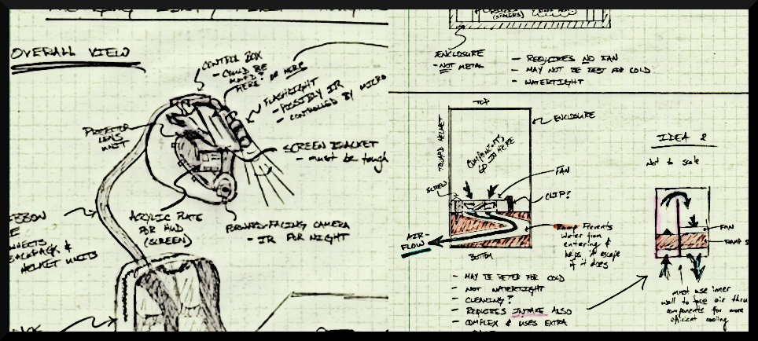
THE INCREDIBLE HUD
ADITYA B. BRANDON G. MARCELO L. NIKHIL S.

Slide 2
PSSCs
An ability to display critical system information via a heads-up-display (HUD)
An ability to measure telemetry information (speed, acceleration, temperature, and GPS) and store it to flash memory.
An ability to maintain portability through the use of a rechargeable battery system .
An ability to enable/disable important features within the display (full information, minimal, on/off).
An ability to plot recorded GPS data on a map while overlaying telemetry information on a computer.
ADITYA B. BRANDON G. MARCELO L. NIKHIL S.

Slide 3
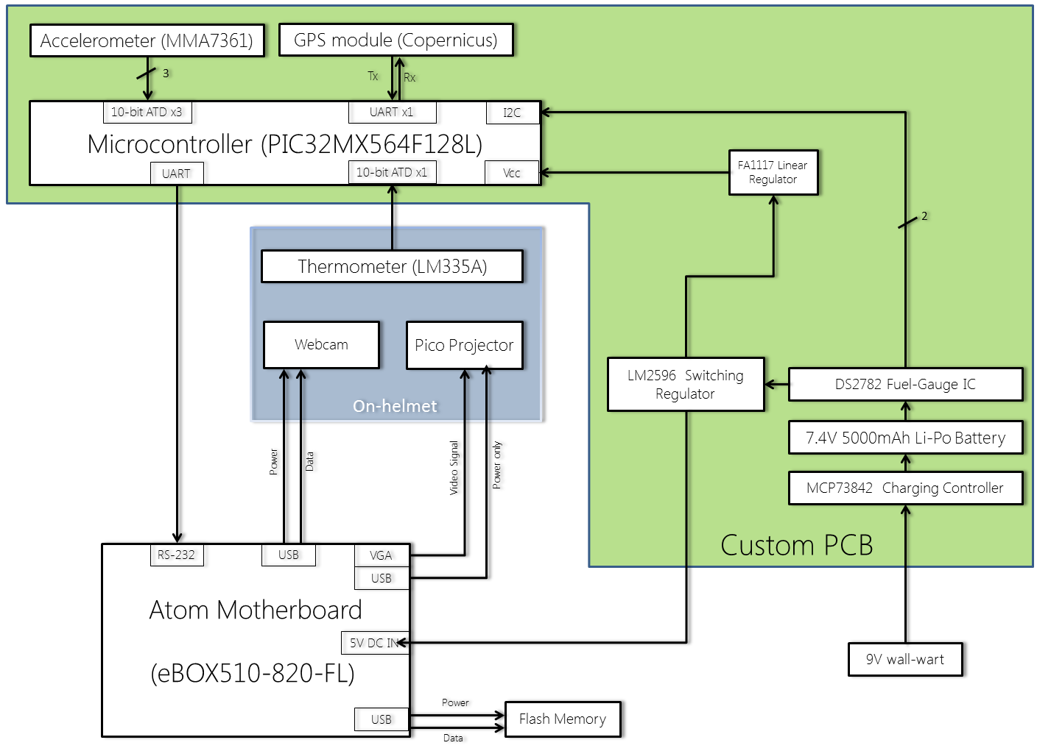
bq24005 Charging Controller
Block Diagram

Slide 4
Changes to Schematic
Everything on one PCB board
Reduces possible communication issues
More compact, stable design
Included charging circuit and charge monitoring (fuel gauge) circuit
TI bq24005 & Maxim DS2782
ADITYA B. BRANDON G. MARCELO L. NIKHIL S.

Slide 5
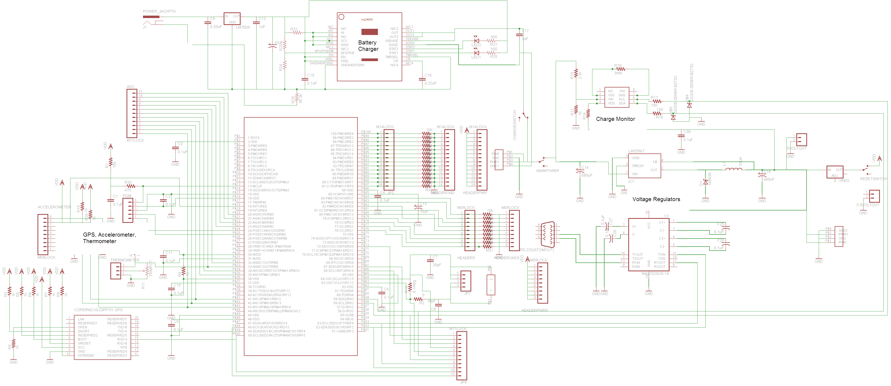

Slide 9
General PCB considerations
Size – must fit with motherboard and battery pack in backpack enclosure
130mm x 90mm
Focus on internal noise reduction
Terminals need to be placed at edges
Separation of components by current draw
ADITYA B. BRANDON G. MARCELO L. NIKHIL S.

Slide 10
Microcontroller PCB considerations
Headers for I/O pins to aid debugging
External crystal oscillator
ADC pins away from digital I/O
Microcontroller near I2C and RS232 jack
ADITYA B. BRANDON G. MARCELO L. NIKHIL S.

Slide 11
Power Supply PCB considerations
5 Volt line, 3.3 Volt line, 9 volt wall wart
Off board terminal connections for motherboard and cooling fans
Single point ground
ADITYA B. BRANDON G. MARCELO L. NIKHIL S.

Slide 12
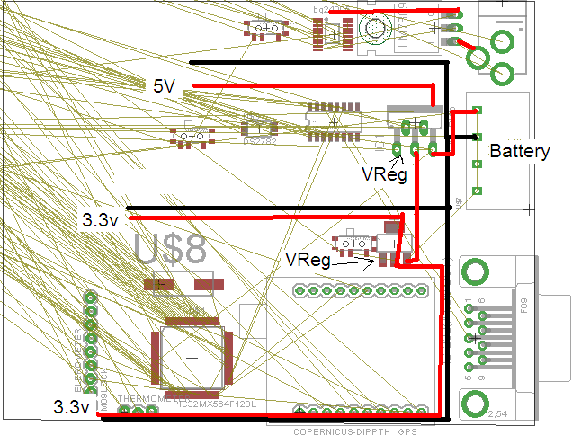

Slide 13
Questions?
???
ADITYA B. BRANDON G. MARCELO L. NIKHIL S.

