Slide 1
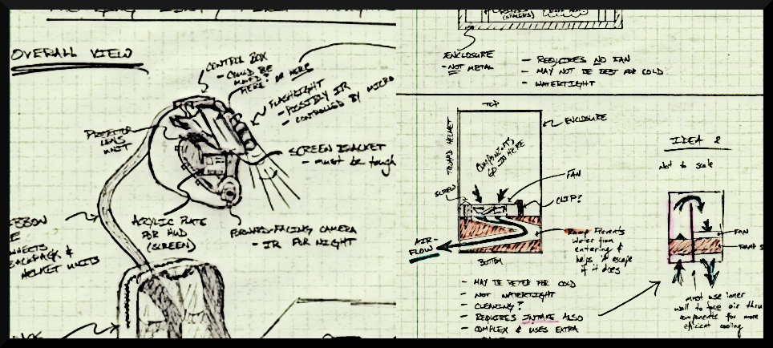
THE INCREDIBLE HUD
ADITYA B. BRANDON G. MARCELO L. NIKHIL S.

Slide 2
PSSCs
An ability to display critical system information via a heads-up-display (HUD)
An ability to measure telemetry information (speed, acceleration, temperature, and GPS) and store it to flash memory.
An ability to maintain portability through the use of a rechargeable battery system
An ability to enable/disable important features within the display (full information, minimal, on/off).
An ability to plot recorded GPS data on a map while overlaying telemetry information on a computer.
ADITYA B. BRANDON G. MARCELO L. NIKHIL S.

Slide 3
Custom PCB
Accelerometer (MMA7361)
Thermometer (LM335A)
GPS module (Copernicus)
Tx
Rx
10-bit ATD x1
Microcontroller (PIC32MX564F128L)
10-bit ATD x3
UART x1
UART
Vcc
FA1117 Linear Regulator
RS-232
USB
USB
Power only
Pico Projector
Block Diagram
Atom Motherboard
(eBOX510-820-FL)
VGA
Video Signal
USB
Power
Flash Memory
Data
USB
Power
Webcam
Data
5V DC IN
Custom PCB
LM2596 Switching Regulator
7.4V 5000mAh Li-Po Battery

Slide 4
PSSCs
An ability to display critical system information via a heads-up-display (HUD)
An ability to measure telemetry information (speed, acceleration, temperature, and GPS) and store it to flash memory.
An ability to maintain portability through the use of a rechargeable battery system
An ability to enable/disable important features within the display (full information, minimal, on/off).
An ability to plot recorded GPS data on a map while overlaying telemetry information on a computer.
ADITYA B. BRANDON G. MARCELO L. NIKHIL S.

Slide 5
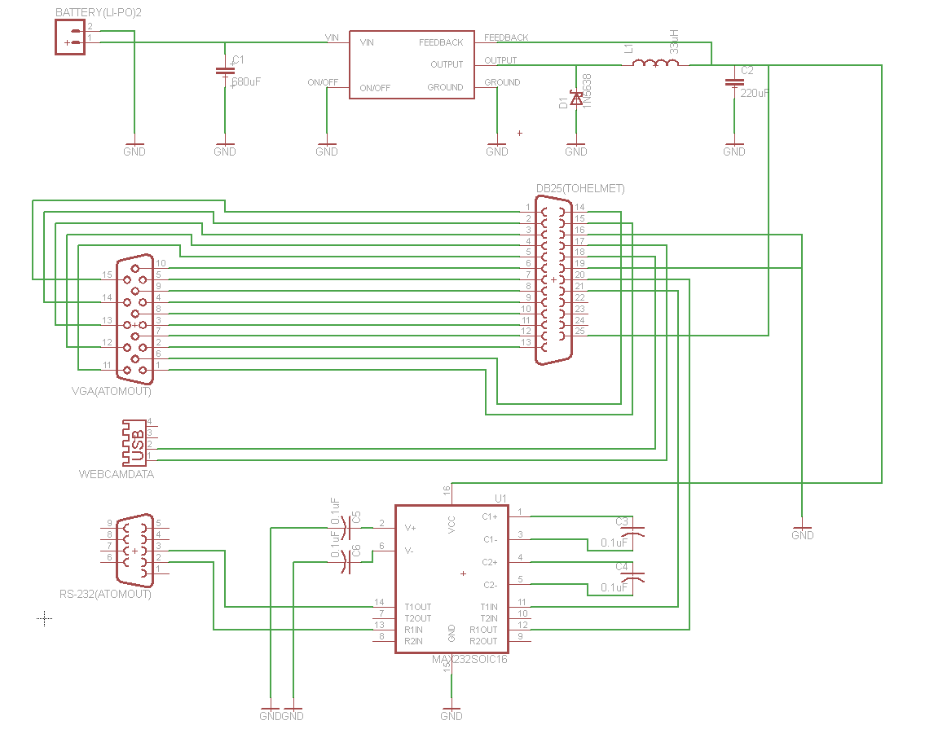
Backpack Unit PCB

Slide 6
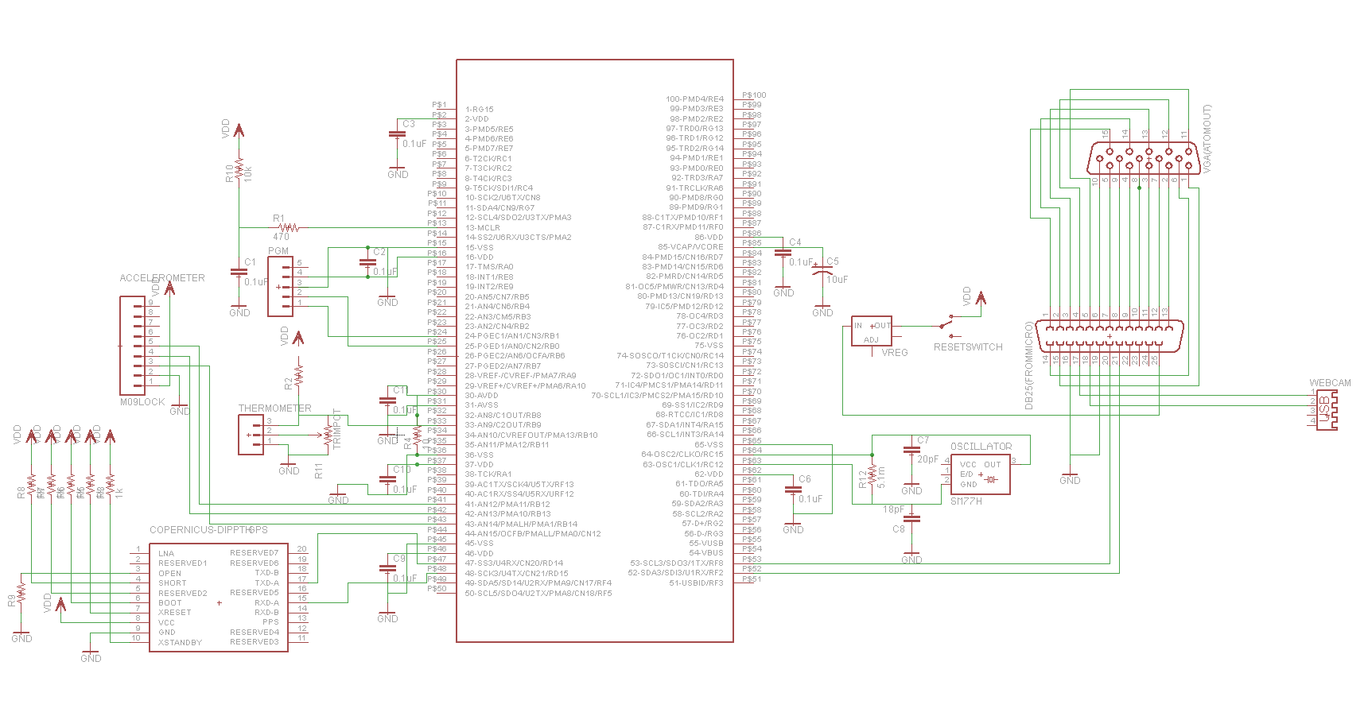
Microcontroller PCB (On-helmet)

Slide 7
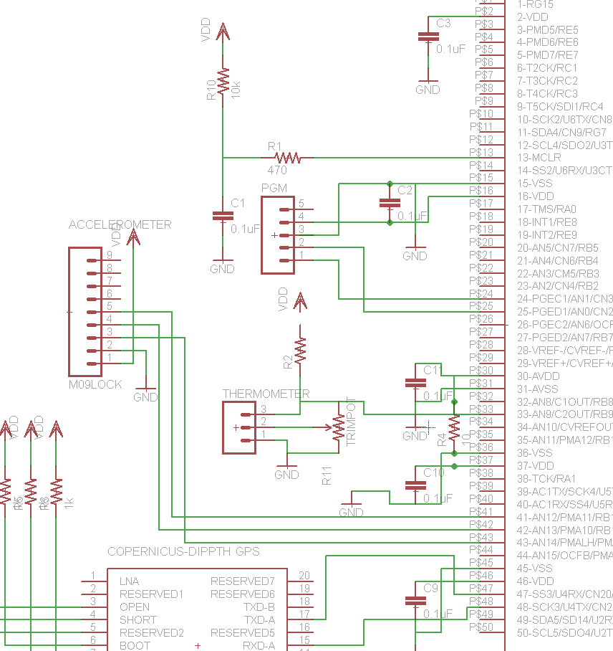
Microcontroller PCB (Zoom-in)

Slide 8
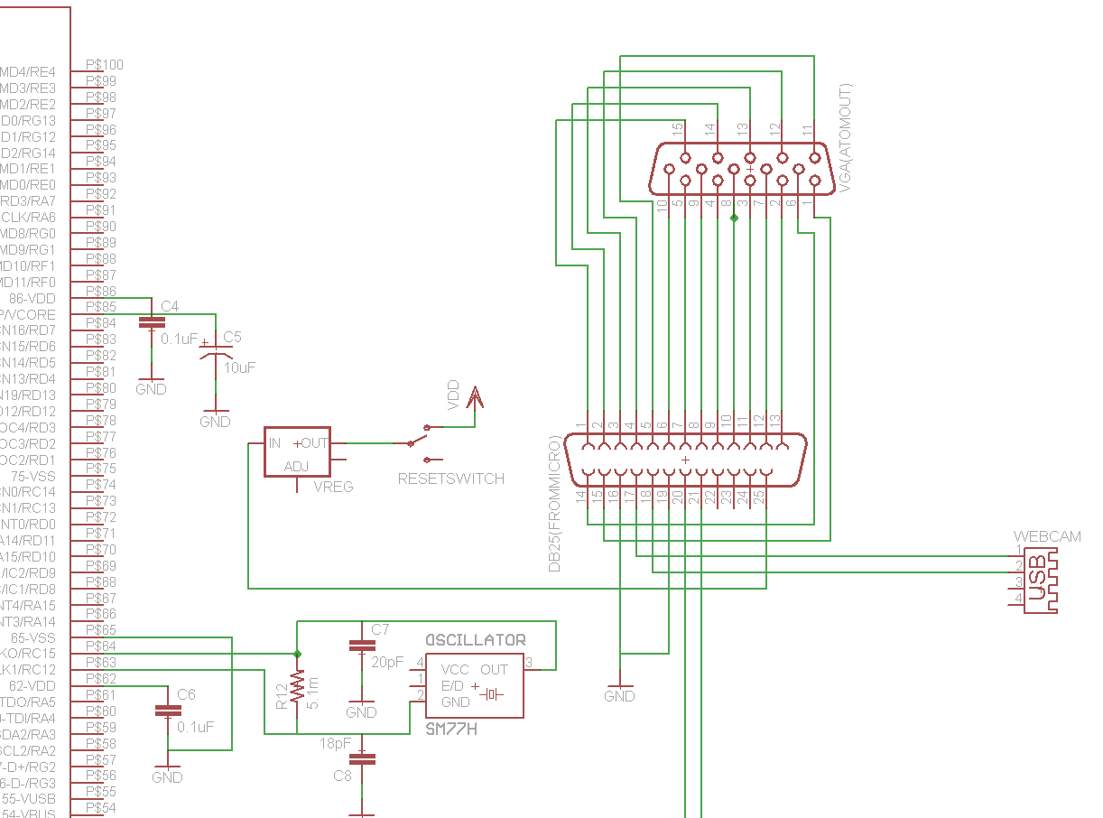
Microcontroller PCB (Zoom-in)

