Slide 1
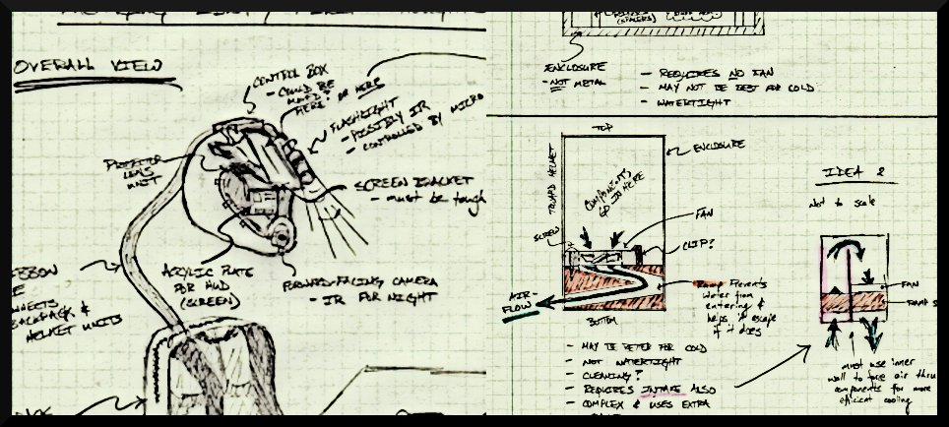
The Incredible HUD
ADITYA B. BRANDON G. MARCELO L. NIKHIL S.

Slide 2
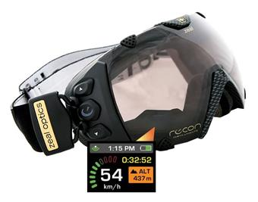
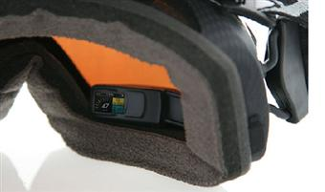
Commercial Product Packaging : Product #1
Android Ski Goggles by Recon Instruments
Control Buttons
Display
USB

Slide 3
Commercial Product Packaging : Product #1
Android Ski Goggles by Recon Instruments
What we plan to mimic (positives) :
Big, user-friendly control buttons on side of device
Rechargeable power source
Portable design concept (device & data)
Why Incredible HUD is unique (negatives) :
Projection display technology

Slide 4
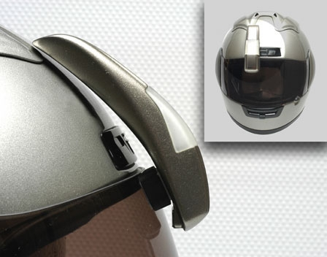
Commercial Product Packaging : Product #2
SportVue by Motion Research Corporation
Helmet Attachment
Display

Slide 5
Commercial Product Packaging : Product #2
SportVue by Motion Research Corporation
What we plan to mimic (positives) :
Transparent display, in direct sight
External design concept
Why Incredible HUD is unique (negatives) :
Rugged design
More complex information display

Slide 6
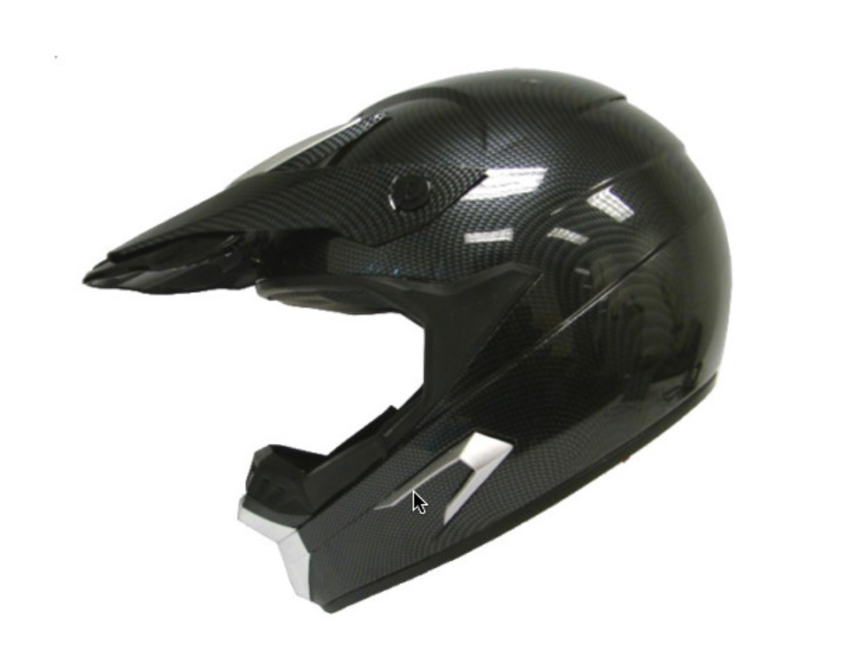
Project Packaging Specifications
Component Placement Mock-up
Contain hardware on the helmet itself to allow for “portability”
Implement cooling system (vents) to dissipate heat for projector, Atom processor, and GPS module
Package for reasonable weather and impact resistance
Battery may be relocated off-helmet if unwieldy in size (integrated into a backpack)
Optical Glass/Mirror
Atom Box
projector
Sensors
Fiberglass

Slide 7
Project Packaging Specifications
Materials list : helmet, fiberglass, tint, adhesives, plastic liner, screws, washers, aluminum mount/cover
Tooling requirements : razor blade, drill, metal cutters
Estimated weight : 4 lbs
Estimated Cost : $100

Slide 8
Printed Circuit Board
Components going on PCB : Microcontroller, GPS, power converter, accelerometer (breakout), thermometer
We need to split it up into three parts -
Thermometer placed on outside of helmet
Two pieces to easily fit inside beak of helmet

