Slide 1
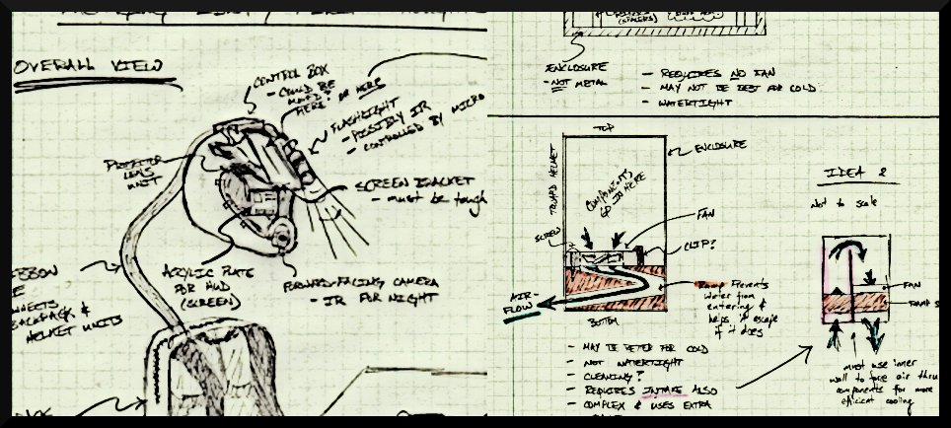
THE INCREDIBLE HUD
ADITYA B. BRANDON G. MARCELO L. NIKHIL S.

Slide 2
UPDATED PSSCs
An ability to display critical system information via a heads-up-display (HUD)
An ability to measure telemetry information (speed, acceleration, temperature, humidity and GPS) and store it to flash memory.
An ability to maintain portability through the use of a rechargeable battery system
An ability to enable/disable important features within the display (full information, minimal, on/off).
An ability to plot recorded GPS data on a map while overlaying telemetry information on a computer.
ADITYA B. BRANDON G. MARCELO L. NIKHIL S.

Slide 3
MAJOR DESIGN CONSTRAINTS
Electrical specifications:
Microcontroller responsible for fusing sensor and GPS data into meaningful packets to be delivered to Intel Atom motherboard
Intel Atom board responsible for processing rear-view camera feed, generating GUI elements and outputting VGA signal to HUD
Optical performance:
Collimated light & combiner glass
Packaging:
Majority of components must fit onto helmet
Design must be robust enough to be water/dust/impact resistant
ECE 477 – The Incredible HUD

Slide 4
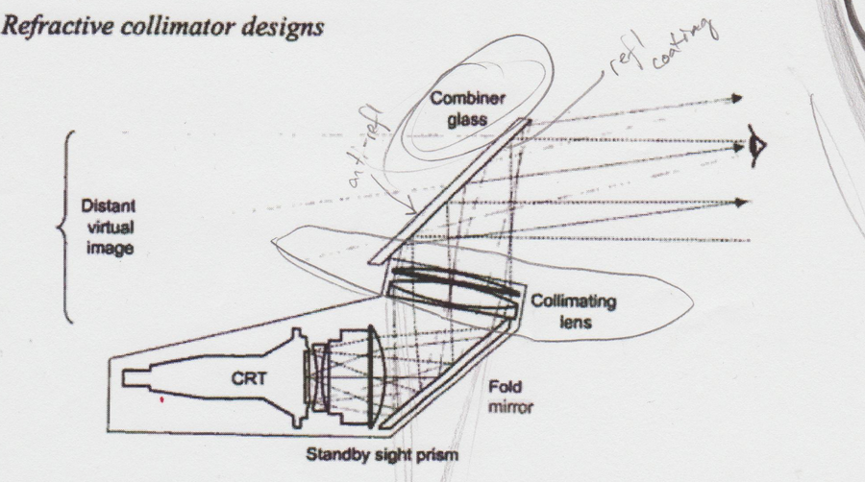
MAJOR DESIGN CONSTRAINTS
Electrical specifications:
Microcontroller responsible for fusing sensor and GPS data into meaningful packets to be delivered to Atom motherboard
Atom board responsible for processing rear-view camera feed, generating GUI elements and outputting VGA signal to HUD
Optical performance:
Collimated light & combiner glass
Packaging:
Majority of components must fit onto helmet
Design must be robust enough to be water/dust/impact resistant
ECE 477 – The Incredible HUD

Slide 5
MAJOR DESIGN CONSTRAINTS
Electrical specifications:
Microcontroller responsible for fusing sensor and GPS data into meaningful packets to be delivered to Atom motherboard
Atom board responsible for processing rear-view camera feed, generating GUI elements and outputting VGA signal to HUD
Optical performance:
Collimated light & combiner glass
Packaging:
Majority of components must fit onto helmet
Design must be robust enough to be water/dust/impact resistant
ECE 477 – The Incredible HUD

Slide 6
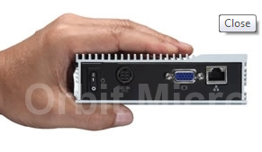
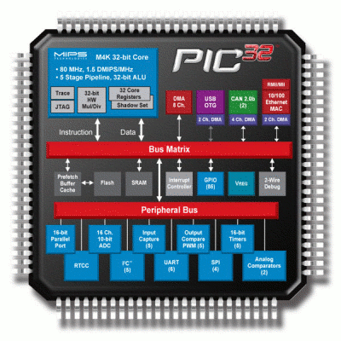
COMPUTATIONAL REQUIREMENTS
Intel Atom motherboard:
Handles all video processing – rear-view camera feed control, generate VGA signal for output to projector
Will render GUI elements with telemetry information
PIC32 microcontroller:
Sampling information from GPS module, temperature sensor & accelerometer @10Hz
Process raw accelerometer data into meaningful “G-force” value, GPS data into meaningful location and heading data
Perform signal conditioning on raw GPS data
Parse and transmit aggregated sensor data to Intel Atom board in a custom packet format via RS-232 connection
Sample and process control device inputs
eBox510-820-FL
ECE 477 – The Incredible HUD

Slide 7
ON-CHIP PERIPHERAL REQUIREMENTS
Peripheral(s) | Type | Number of channels
Thermometer (TI TMP102 Breakout) | ATD | 1
Accelerometer (Freescale MMA7361 Breakout) | ATD | 3
GPS Module (Trimble Copernicus 12-Channel Module) | SCI | 1
Microcontroller→ Atom board connection | RS-232 or USB | 1/1
Rotary encoder | GPIO | 2
Select/Back buttons | GPIO | 2
Rear-view insta-select/Kill-switch buttons | GPIO | 2
Data collection algorithms & rotary encoder input decoding | TIM | 2
Audio feedback to helmet (tentative) | PWM/ Atom | 1/1
ECE 477 – The Incredible HUD

Slide 8
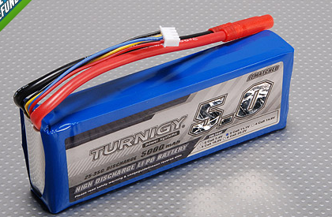
POWER CONSTRAINTS
Intel Atom motherboard (Board = 5V, Die = 1.1V)
Supports advance power saving features such as SpeedStep
Consumes approximately 2W, current draw of processor expected to be ~1.8A
PIC32 microcontroller & sensors
All components function in the 2.7~3.3V range
Collectively expected to draw <50mA
GPS module is comparatively power hungry, with 35mA continuous current draw when tracking
Total current consumption ≈1.9A
Desired runtime ≥ 2.5hrs
Battery capacity requirement ≥ 4800mAh
ECE 477 – The Incredible HUD

Slide 9
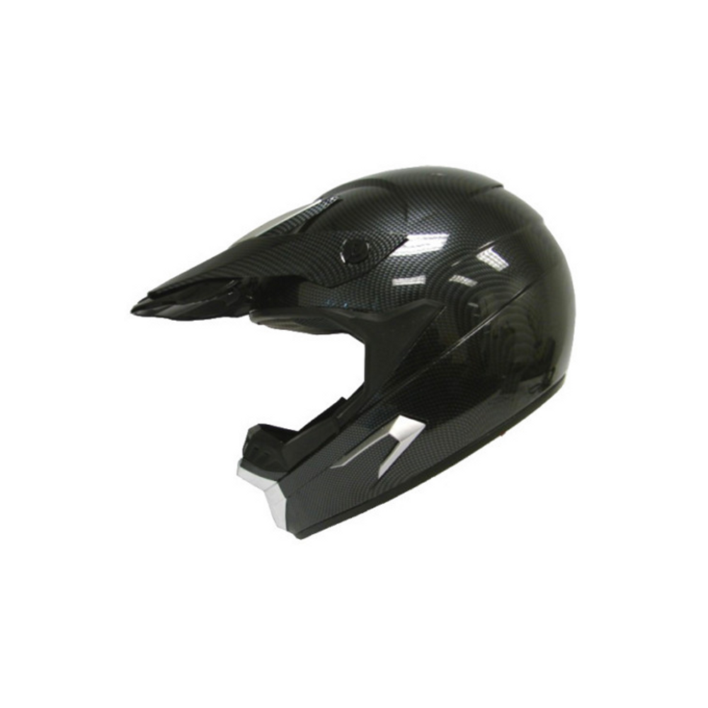
PACKAGING CONSTRAINTS
Contain as much of the hardware as possible on the helmet itself
Allow for sufficient heat dissipation by the projector, Atom processor, and GPS mod.
Optimize device for hostile and extreme environments by ‘ruggedizing’ it.
Water, dust and impact-resistant
Battery may have to be relocated off-helmet due to size required – possibly integrated into a neck-brace or backpack
Embedded sensors
Optics
Atom box
projector
Visor + Combiner glass
ECE 477 – The Incredible HUD

Slide 10
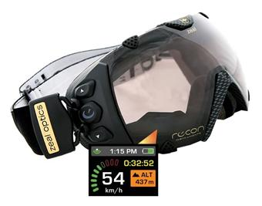
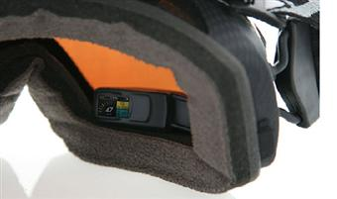
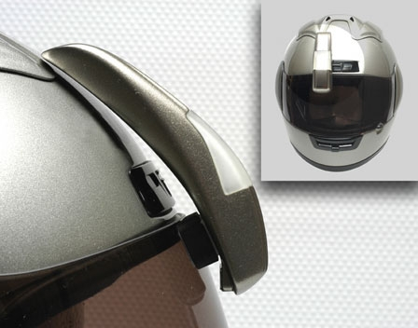
COST CONSTRAINTS
Closest competitors are diopter based:
‘Smart’ ski-goggles ($631)
Retro-fit helmet HUD ($N/A)
The Incredible HUD is a novel device in both feature-set and display technology
Target cost is ≤ $1000
Display alone = $300
Costs could be significantly reduced in mass production - heavy prototyping costs%
ECE 477 – The Incredible HUD

Slide 11
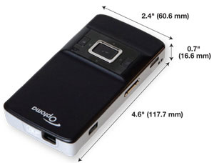
COMPONENT SELECTION: Projector
Optoma PK201 Pico Pocket Projector | SHOWWX+TM laser pico projector.
20 lumens, WVGA resolution, LED projection technology | 15 lumens, WVGA resolution, Laser projection technology
159g, 17x61x118mm | 122g, 14x60x90mm
$250 | $249
Virtually non-existent documentation | Excellent documentation, tear-down information available
Mechanical optics | Solid-state optics – more rugged
Unnecessary media oriented features | Limited but well-developed feature set
ECE 477 – The Incredible HUD

Slide 12
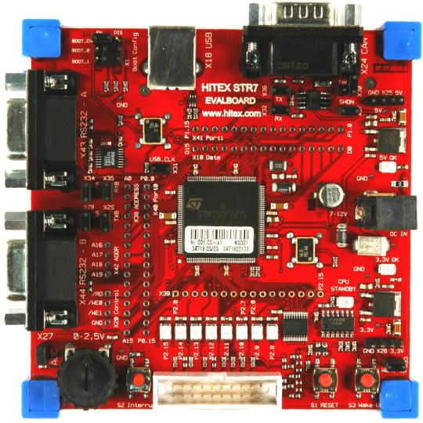
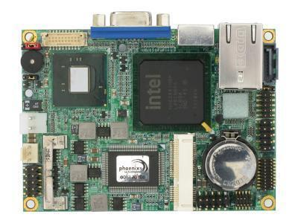
COMPONENT SELECTION: Motherboard
ARMv7 based motherboard | Intel Atom based motherboard
Only UNIX OSes supported | UNIX and Windows Embedded 7 support
No packaging solutions readily available – would have to be custom fabricated | Rugged case available
Sponsorship not available ~ $150-$200 | Free!
ECE 477 – The Incredible HUD

Slide 13
COMPONENT SELECTION: Microcontroller
PIC32 Microcontroller
Low power consumption
Abundance of on-chip-peripherals
Native USB support
Previous experience with PIC32s
Easily and quickly sampled from Microchip
ECE 477 – The Incredible HUD

Slide 14
Block Diagram: Microcontroller
Accelerometer (MMA7361)
Thermometer
(TMP102)
GPS
(Copernicus)
4
3
4
Note:
GPS module has both Tx and Rx RS232 lines
Microcontroller PIC32MX564F128L
ATD x3
ATD x1
RS232 x2
RS232 x1
4
To Atom Motherboard
ECE 477 – The Incredible HUD

Slide 15
Block Diagram: Microcontroller
Flash Memory
Microcontroller Board (PIC32)
Power + Data
Power only
Atom Motherboard
(eBOX510-820-FL)
USB
USB
Data only
RS232
USB Webcam
Power + Data
USB
Pico Projector
Power only
USB
Video Data
VGA
5V DC IN
Main Power
5000mAh Li⁺ Battery
ECE 477 – The Incredible HUD

Slide 16
Questions or Comments?
? + //
ECE 477 – The Incredible HUD

