Slide 1
TCSP #1 – PSSC Presentations
The Incredible HUD
Purdue University
Team #3 – Aditya Balasubramanian, Brandon Blaine Gardner, Marcelo Leone, Nikhil Naciketas Sureshkumar

Slide 2
Project Abstract
Device will display a spread of data onto the visor of a motor-vehicle helmet.
Includes speed, direction (GPS), temperature, rear view camera, and G-force.
Display system will be completely helmet based; all functioning sensors and parts will be packaged on the outside surface.
User will have the ability to control the information displayed. Additionally the telemetry information will be logged in memory enabling the user to view it at a later time on another computer.
https://engineering.purdue.edu/477grp3/

Slide 3
PROJECT SPECIFIC SUCCESS CRITERIA (PSSC)
PSSC #1 - An ability to display critical system information via heads-up-display.
PSSC #2 - An ability to contain and manage and independent power supply (rechargeable battery pack with power management).
PSSC #3 - An ability to receive and store telemetry information (speed, acceleration, temperature, humidity and GPS).
PSSC #4 - An ability to enable/disable important features within the display (rear view, on/off).
PSSC #5 - An ability to display GPS data on a computer, with corresponding telemetry data overlaid on an interactive map.

Slide 4
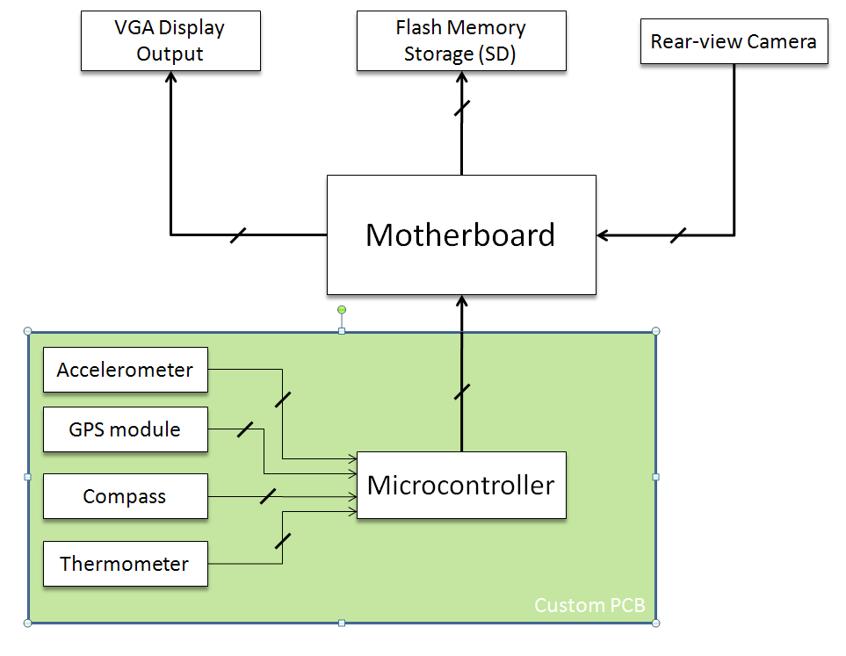
Block Diagram

