Slide 1
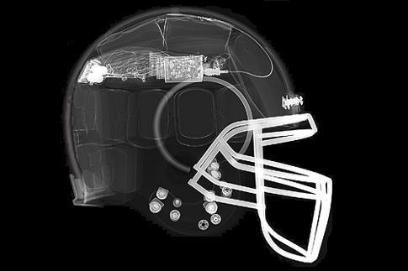
Instrumented Football Helmet
Packaging Specifications and Design

Slide 2
Introduction: An update
More accelerometers… it takes 3 points to form a plane, so we should use (at least) three accelerometers to accurately measure acceleration and rotation.
New microcontroller… PIC18F45K20 gives us more program memory, 14 ATD channels, and great power management features while only consuming around 20 µA of current.
Just a few changes …

Slide 3
Introduction…
MUST BE….
Lightweight
Small (flexible?)
Thermal Restrictions
Hidden
Sturdy
Will need to fit a microcontroller, 3 accelerometers, wireless adapter, antenna, memory card reader, batteries, charge management, and wires into a small, enclosed space that must be durable enough to survive 35 mph car wrecks…repeatedly.

Slide 4
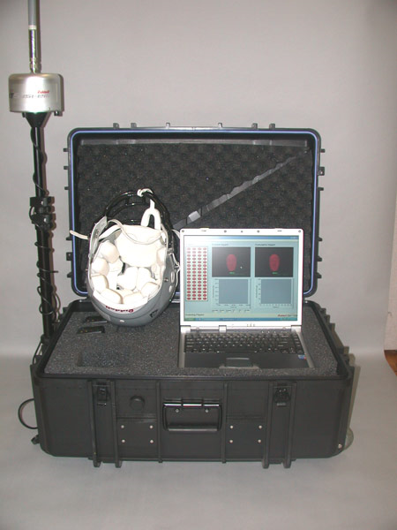
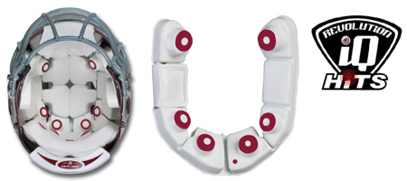
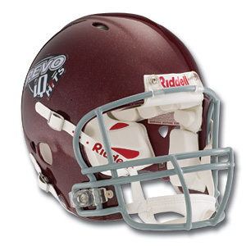
Product #1: Riddell Revolution IQ HITS™
Positive Aspects:
No visible antenna
No exposed circuitry
Adds negligible weight
Negative Aspects:
None (it shouldn’t look or feel different from a normal football helmet)

Slide 5
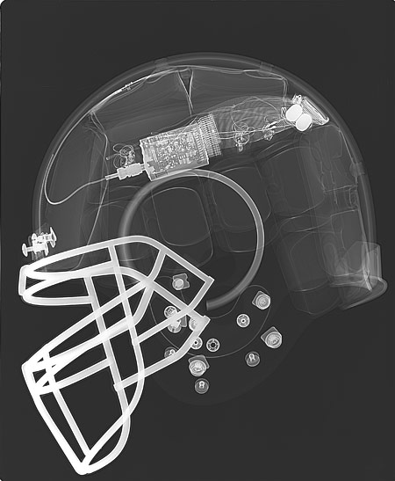
Product #1: Riddell Revolution IQ HITS™
Ideas Gained:
Multiple PCBs
Placement of antenna
Unique to Us:
Memory Card Reader
Ideas gained from this product

Slide 6
Product #2: BMW M5
Accelerometers and sensors measure tilt, acceleration, and vibrations. They influence traction control, airbag deployment, and navigation systems.
Positive Aspects:
Seamlessly integrated
Negative Aspects:
Affects/Hinders Performance

Slide 7
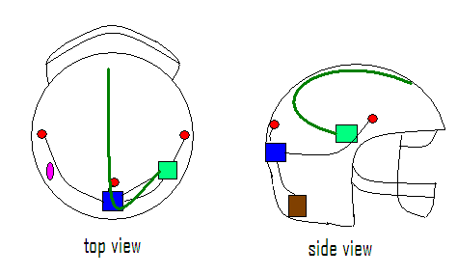
Packaging layout
Blue – Micro Controller Red – Accelerometer Cluster
Pink – Batteries and Power Brown – Memory Card
Green – Wi-Fi and antenna

