Slide 1
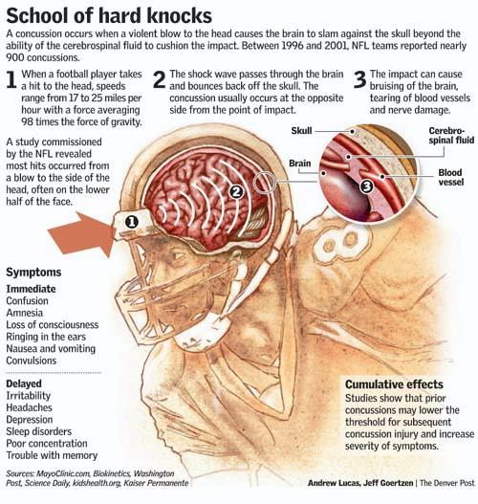
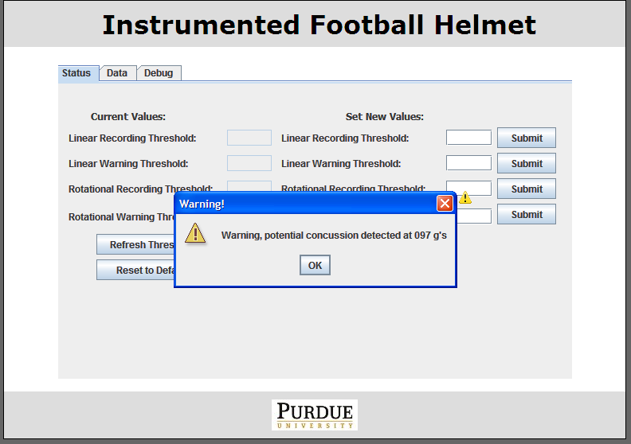
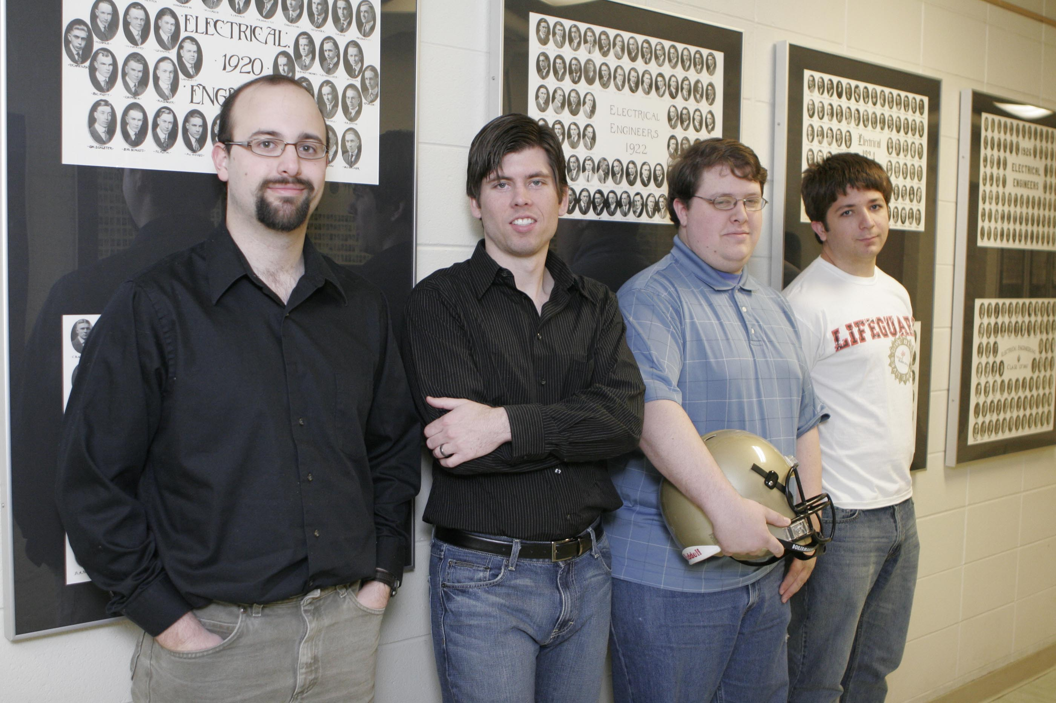
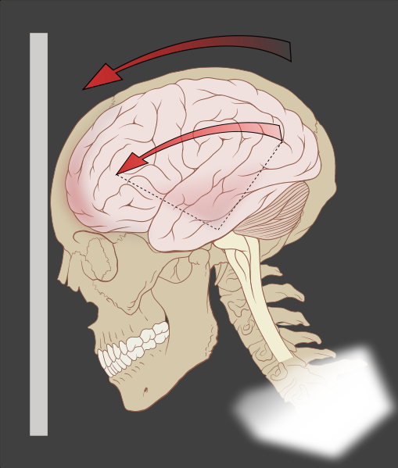
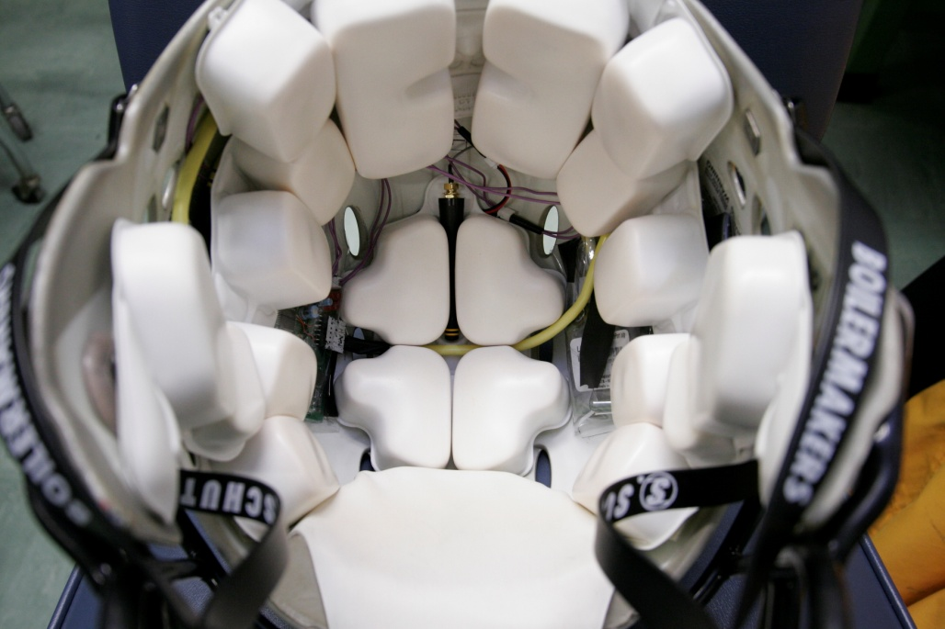
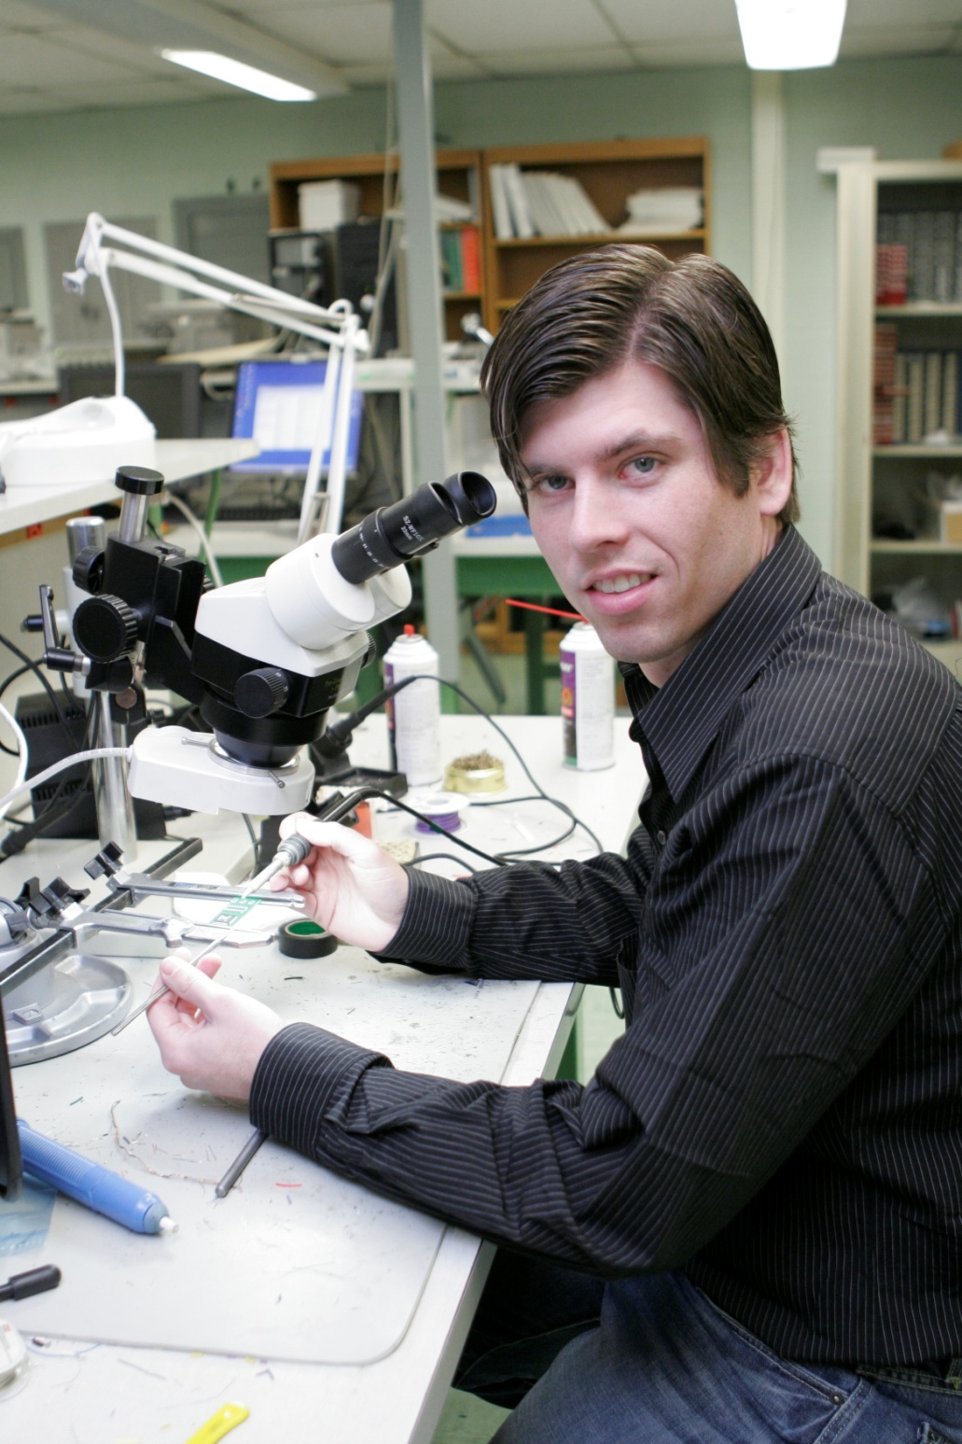
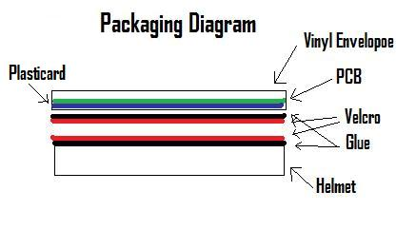
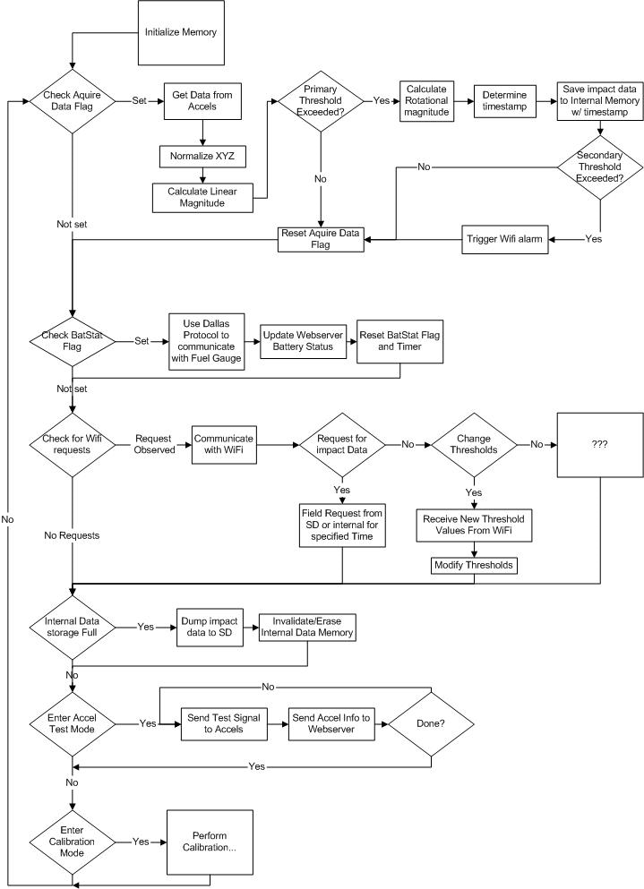
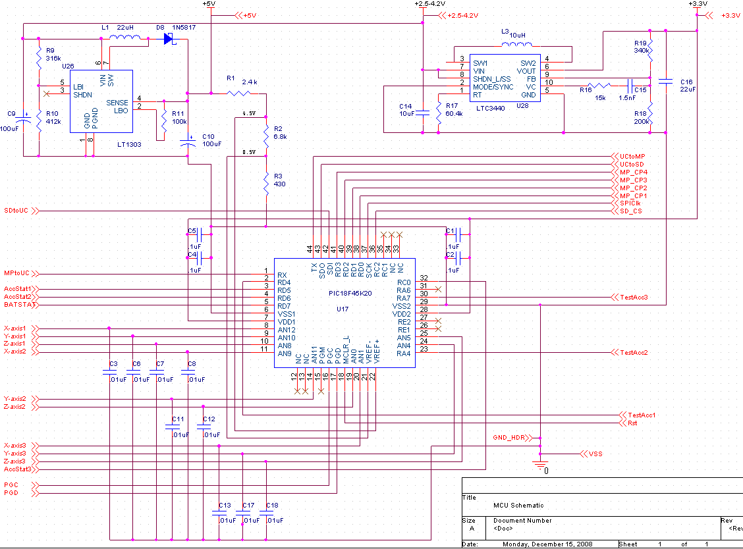
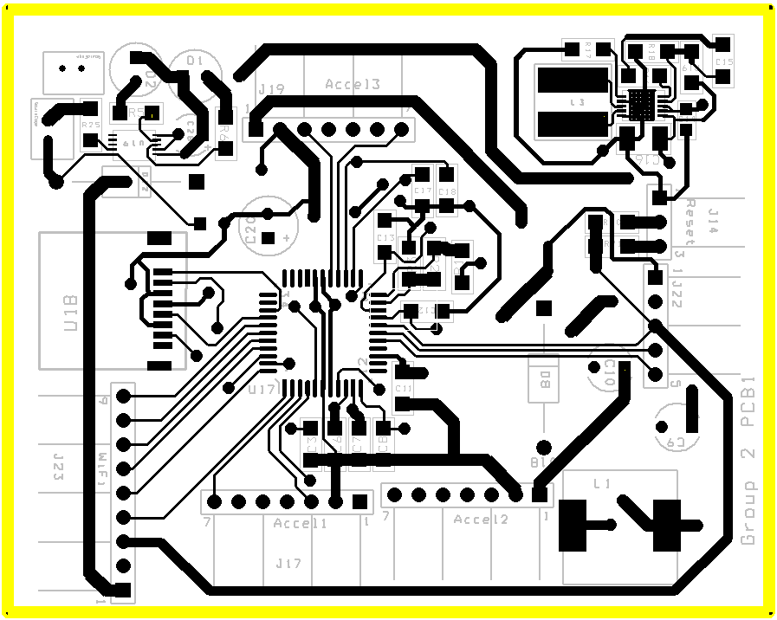
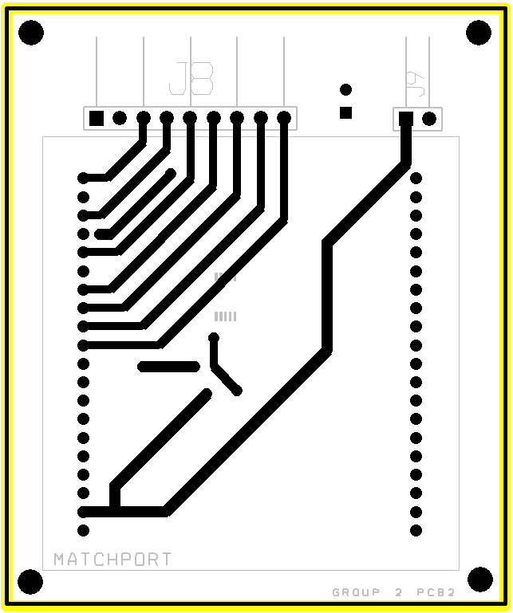
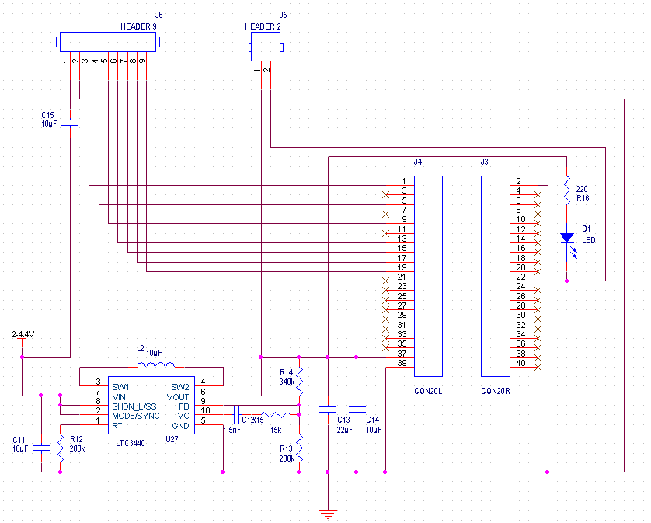
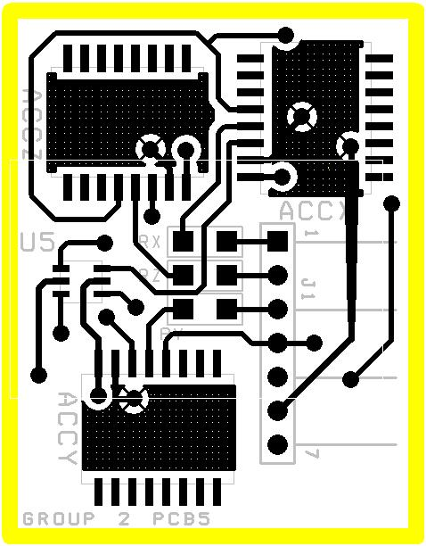
ECE 477 Digital Systems Senior Design Project − Fall 2008
Purdue’s - Instrumented Football Helmet
Research:
Testing:
Andrew Camp
Kevin Hughes
Construction:
Criteria:
An ability to recharge and monitor an integrated (lithium ion) battery.
An ability to sense impact data using 3-D accelerometers.
An ability to alert sideline personnel when a dangerous hit is received.
An ability to log/timestamp impact data on a removable memory device (SD card).
An ability to remotely monitor real-time impact data and tune impact detection thresholds via an embedded web server.
Adam Boeckmann
Michael Olson
Design:
Abstract:
The Instrumented Football Helmet is a standard football helmet that is able to measure, record and report on impacts to the head. It is equipped with a series of accelerometers that are able to measure the sudden deceleration of the head during an impact. It records impacts on a removable memory card and will alert sideline personnel if any hit is received above a threshold. An integrated web server will allow sideline personnel to adjust recording and notification thresholds at any time.
Layout:
Digijock(ette)-Strength Digital System DesignTM

