Slide 1
Variation
Reference: Chapter 8 (3rd Ed.) of Sound Systems: Design and Optimization, by Bob McCarthy (Elsevier, 2017)

Slide 2
Outline
Minimum variance principles
Level variance
Range ratio
Spectral variance and tilt
Pink shift
Ripple variance
Forward aspect ratio
Proximity ratio
Minimum level variance
Shapes of minimum level variance

Slide 3
Minimum Variance Principles
Level variance – differences in overall level (SPL) over the space (e.g., “6 dB down under balcony relative to 10th row”)
Spectral variance – difference in relative level over frequency among different locations (e.g., “6 dB down @ 8 KHz under the balcony relative to mix position”)
Ripple variance – differences in the extent of the summation-related peaks and dips in the response (e.g., “there is ±12 dB of ripple in the mid-range under the balcony, compared to ±3 dB in the 10th row”)

Slide 4
Level Variance – Single Speaker
Function of proximity and axial orientation
Off-axis response will be a combination of level and spectral variance
Loss rate off-axis will not be uniform over frequency
Primary option for management of level variance is tilt
Aiming speaker at the most distant coverage point offsets the two level variance factors (distance and axial):
distant seats will have more propagation loss
closer seats will experience more axial loss

Slide 5
Level Variance Spatial Progression

Slide 6
Range Ratio

Slide 7
Range Ratio

Slide 8
Level Variance – Multiple Speakers
Three directions for extending minimum level variance in multiple speaker configurations
forward extension – accomplished by adding (delayed) speakers in the on-axis plane of the original source
radial extension – additional sources are aimed to intersect at the coverage edges and “fused” together to create a wider angle
lateral extension – uncoupled secondary sources added to the side of the original, creating a line of equal level (at the unity class crossover point)
Can be employed separately or in combination

Slide 9
Level Variance Progressions
Forward Extension
Uncoupled Pt Dest.
Summation
X
Minimum Variance Line

Slide 10
Level Variance Progressions
Radial Extension
Coupled Point Source
Summation
X
Axial loss
Axial loss
Minimum Variance Line

Slide 11
Level Variance Progressions
Lateral Extension
Uncoupled Line Source
X
Minimum Variance Line
X
Axial loss
Summation

Slide 12
Spectral Variance
Can look at this two ways:
Changes in coverage pattern shape over frequency (“spatial over spectrum”)
Changes in frequency response over coverage area (“spectral over space”)
For single loudspeaker, spectral variance is directly related to speaker order
High-order speakers have the highest spectral variance, and therefore are least well-suited for single-speaker applications
Low-order speakers have the lowest spectral variance, and therefore are best suited for single-speaker applications

Slide 13
Radial/Lateral Spectral Tilt

Slide 14
Beamwidth Shapes

Slide 15
Spectral Variance
Note that arrays can be constructed with combined coverage shapes that differ from the individual components
Coupled point source array comprised of high-order speakers
high frequencies spread (due to isolation)
low frequencies narrowed (due to coupling)
Example: pair of 2nd order speakers arrayed at unity splay angle of 40º
High frequency coverage is spread to 80º
Low frequency overlap couples at center and narrows low-frequency coverage
Combined spectral shape of array has lower spectral variance than the individual elements

Slide 16
Spectral Tilt and Spectral Variance

Slide 17
Spectral Variance Progressions
Standard
Single Speaker
Reflections
Air loss
Axial loss
Minimum Spectral Variance Line
Pink shift increases
Pink shift constant
X – spatial crossover

Slide 18
Spectral Variance Progressions
Radial Extension
Coupled Point Source
Axial loss
X
Air Loss
Axial loss
Minimum Spectral Variance Lines
Pink shift increases
Pink shift constant
X – spatial crossover

Slide 19
Spectral Variance Progressions
Forward Extension
Coupled Line Source
Axial loss
Air Loss
X
Minimum Spectral Variance Lines
Axial loss
Pink shift increases
Pink shift constant
X – spatial crossover

Slide 20
Spectral Tilt
Previous example illustrates spectral tilt – summation addition at low frequencies not matched by a comparable addition at high frequencies
Affects overall shape of frequency response
Difference between on- and off-axis response of a single speaker is not just level: only the higher frequencies have been significantly reduced by the axial loss (also a source of spectral tilt)
The difference in spectral tilt among listening locations is the spectral variance

Slide 21
Spectral Tilt vs. Spectral Variance
Points with matched flat responses: no spectral tilt or spectral variance
Points with matched HF/LF rolloffs/boosts: spectral tilt but no spectral variance
One point has HF/LF rolloff/boost (spectral tilt) and another has flat response (no tilt): spectral variance
Spectral variance is therefore a measure of the change in spectral tilt across a listening area
Goal is to minimize spectral variance, but not necessarily spectral tilt (many clients actually prefer large amounts of spectral tilt –“you can never have too much bass” …oops, yes you can! “Doppler is bad”)
Want to ensure that same amount of tilt is found in all areas of listening space

Slide 22
Spectral Tilt Causes
Two transmission-related effects:
axial loss (as move off-axis, higher frequencies attenuate faster than lower frequencies)
air loss (even on-axis, have high-frequency loss due to absorption effects of air)
spectral tilt caused by transmission-related effects favors lower frequencies (called “pink shift”)
Two summation-related effects:
reflections (room reflections tend to reduce loss rate at lower frequencies)
combinations with other speakers (typically have more power coupling at lower frequencies than higher ones)
spectral tilt caused by summation-related effects also favors lower frequencies

Slide 23
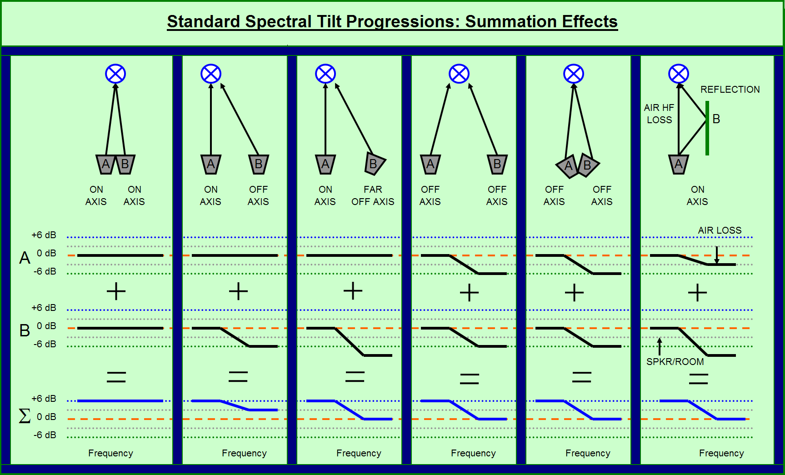
Variation: Spectral Tilt Progressions

Slide 24
Spectral Tilt Progression Summary
Since all the progressions lead to tilting, the spectral variance can be reduced by matching the tilts rather than trying to stop the progression
Tilt can be “leveled” by equalization to the extent desired
Note that a frequency response need not be flat to be considered to possess minimum spectral variance

Slide 25
Pink Shift
Based on perceptions of distance to the sound source
Analogous to pink noise: filtered white noise (equal energy per frequency band) with steady 3 dB reduction per octave, which creates equal energy per octave balanced for our logarithmic hearing
Frequency response progressions previously described can be viewed as pink shift added to response
In natural acoustic transmission, pink shift is directly related to sonic source distance: the farther away we are from a source, the greater the degree of tilting due to air absorption effects (HF loss) and room summation effects (LF boost)
Our internal ear-brain processing estimates source distance by factoring in expectations of pink shift

Slide 26
Pink Shift Progressions

Slide 27
Range Ratio Effects on Pink Shift

Slide 28
Range Ratio Effects on Pink Shift

Slide 29
Vertical Location Variance

Slide 30
Ripple Variance
Defined as differences in the extent of the summation-related peaks and dips in the response
Center point is phase-aligned spatial crossover (point of lowest variance)…but center of area where highest rate of change in ripple variance occurs (like “eye of hurricane”)
Can be found in all forms of speaker arrays
Focus will be on full-range spatial crossover transitions
Primary factors are source displacement and pattern overlap
least variance occurs when both are low
highest variance occurs when both are high

Slide 31
Ripple Variance Progression
Frequency response ripple: as the spatial crossover is approached, the ripple variance increases; as overlap increases, the ripple variance increases
From the spatial crossover point: coupling zone → combing zone → combining zone → isolation zone
From the isolation zone: to coverage pattern edge, or to combining zone → combing zone → coupling zone → next crossover point
Cycle repeats for each speaker transition until coverage edge is reached
All spatial crossovers must be phase-aligned (phase- aligned crossovers cannot eliminate ripple variance over the space, but are the best means to control it)

Slide 32
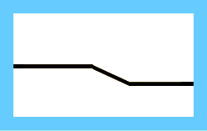
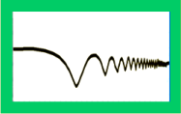
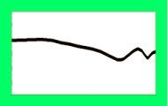
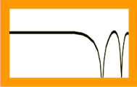
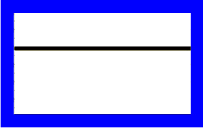

Ripple Variance Progression
Speaker to Edge
Speaker to Speaker
Ripple
>18 dB
X
X
<12 dB
<6 dB
A
B
Phase Aligned Spatial Crossover
Phase Aligned Crossover
Off Axis
Isolation
Combining
Combing
Coupling
Combing
Combining
Isolation
Combining
Combing
Coupling

Slide 33
Ripple Variance Geometry
Four triangle types give strong indication of ripple variance spatial behavior
isosceles – zero variance on-axis
acute – highest rate of change (over angle and distance)
right – variance over distance
obtuse – lowest rate of change
Compromise between minimum variance and maximum SPL capability
maximum overlap (100%) will yield maximum power (+6 dB) but with maximum risk of ripple variance
minimum overlap reduces risk of ripple variance, but significantly limits the amount of power addition possible

Slide 34
Ripple Variance: Spatial Reference
Isosceles:
Zero Variance
Obtuse:
Minimum Variance
Right:
Variance over distance
Highest rate of change is in the isosceles and acute triangle zones
Lowest rate of change is in the obtuse triangle zone
Acute:
Variance over angle & distance
Obtuse:
Minimum Variance
Maximum Variance

Slide 35
Forward Aspect Ratio
Defined as a single level contour’s length from the speaker (forward) compared to its width (street term: “throw” or D_{I})
Determined by creating a rectangle that encloses the following:
the speaker
the on-axis point at distance X
the off-axis points at distance X/2
Example: 180º coverage has FAR of 1
Example: 10º coverage has FAR of approx 12

Slide 36
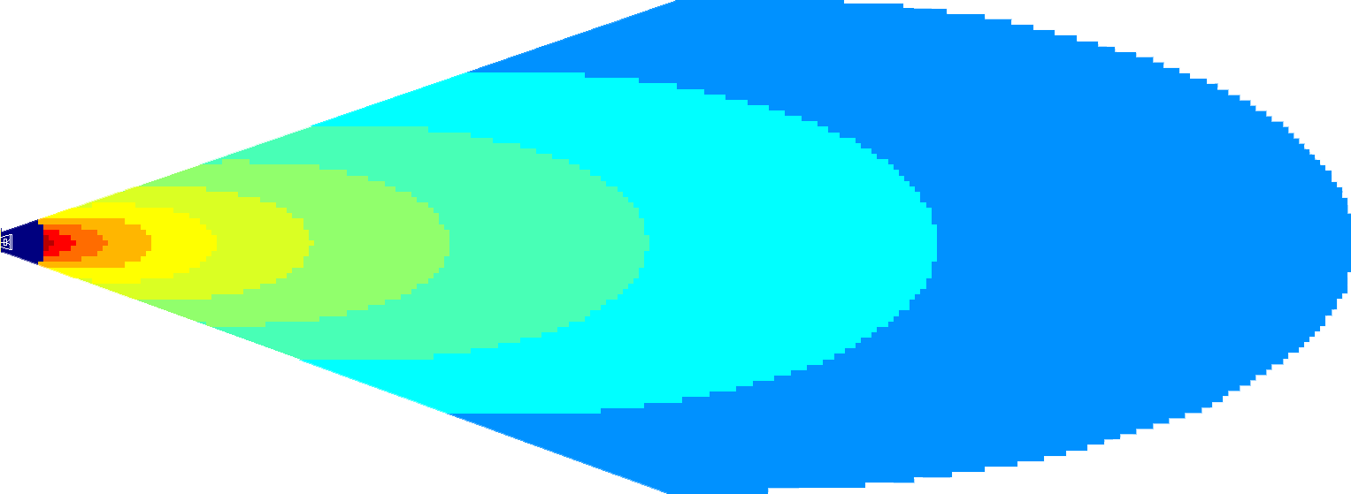
Shapes of Minimum Level Variance
Single speakers: Symmetric Orientation
FAR=5.8 (20 deg)
FAR=11.5 (10 deg)

Slide 37
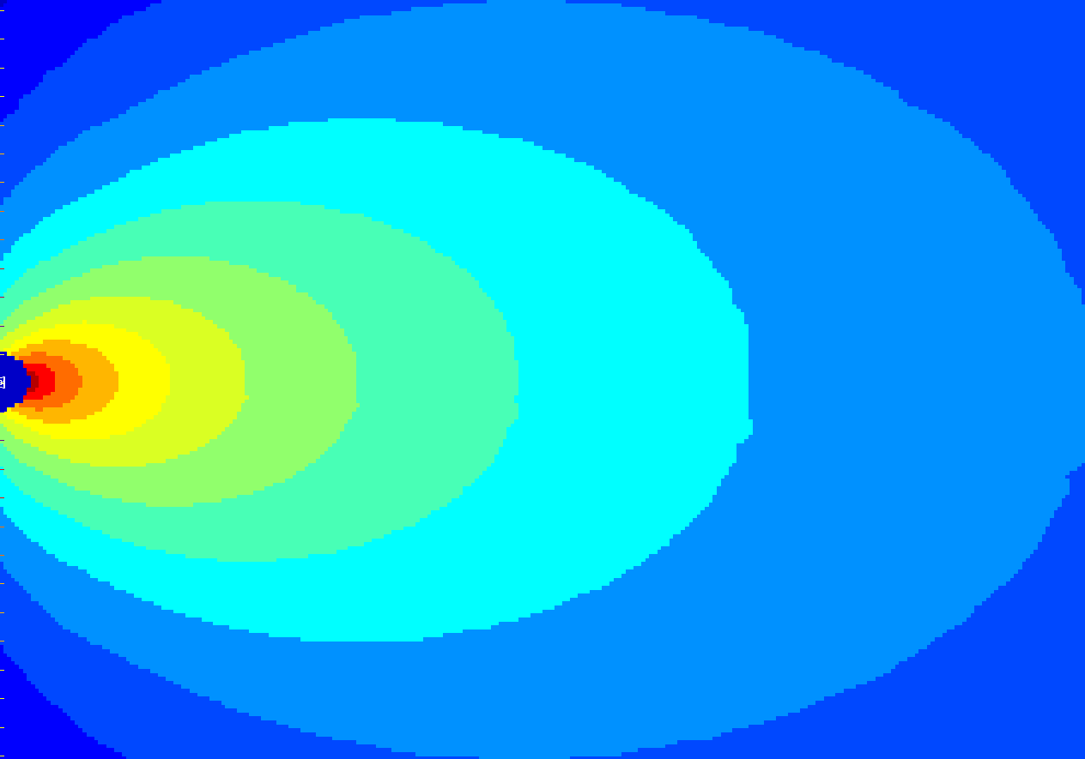
Minimum Level Variance: Coverage Pattern
-6 dB
FAR= 1.4
0 dB
Θ= 90
-6 dB
+6 dB
0 dB
0 dB
Minimum
Variance Line
-6 dB
Protractor angle with coverage bow:
90 degree speaker

Slide 38
Minimum Level Variance: Coverage Pattern
FAR= 2.6
-6 dB
0 dB
Θ= 45
-6 dB
+6 dB
0 dB
0 dB
-6 dB
Minimum
Variance Line
Protractor angle with coverage bow:
45 degree speaker

Slide 39
Minimum Level Variance: Coverage Pattern
-6 dB
FAR= 1.4
0 dB
Θ= 90
-6 dB
+6 dB
0 dB
0 dB
Minimum
Variance Line
-6 dB
Protractor angle with coverage bow:
90 degree speaker

Slide 40
Minimum Level Variance: Coverage Pattern
FAR= 2.6
-6 dB
0 dB
+6 dB
Θ= 45
0 dB
0 dB
-6 dB
Minimum
Variance Line
-6 dB
Protractor angle with coverage bow:
45 degree speaker

Slide 41
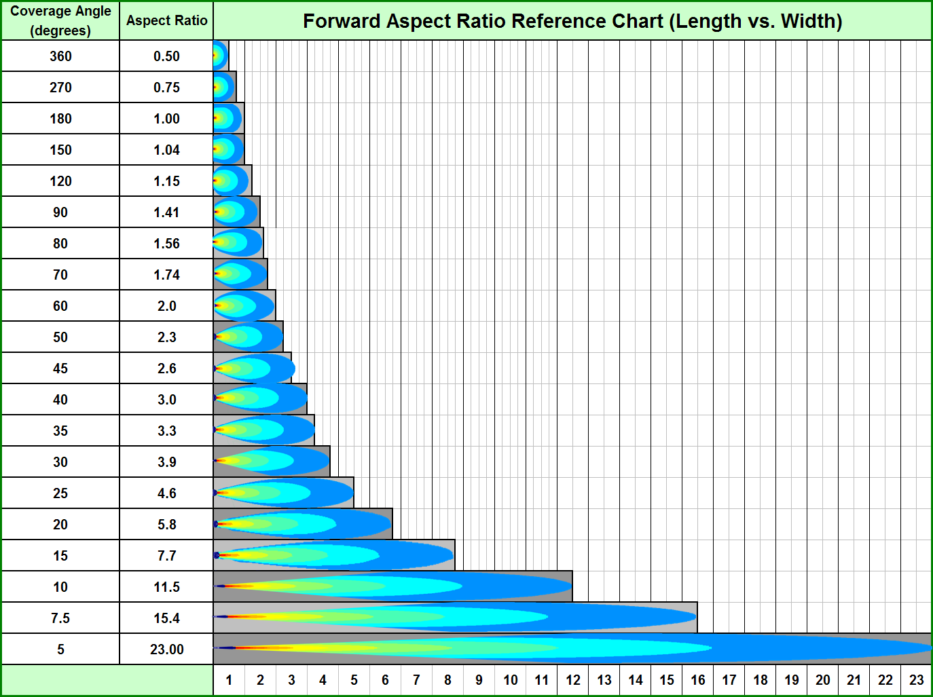
Variation

Slide 42
Proximity Ratio
Defined as the difference between the closest and farthest seats in the coverage area of the speaker(s) – a measure of the asymmetry of the coverage shape
Can be expressed as a number or in dB (20 x log₁₀ of ratio)
Example: If all seats are equidistant in a plane, the proximity ratio is 1 (0 dB)
Example: A proximity ratio of 2 signifies that there is 6 dB of asymmetry

Slide 43
Proximity Ratio
Creates an asymmetry level requirement for which the source (speaker) must compensate
Compensation can be achieved by:
orienting the speaker coverage pattern to compensate for the asymmetry
using multiple loudspeakers to create an asymmetric shape in proportion to the listeners
Has implications for control of spectral variance (excessive pink shift) – coverage areas with proximity ratios ≥ 2 can benefit from the addition of a “fill” subsystem

Slide 44
Minimum Level Variance
Aspect ratio rectangle is most basic shape of minimum level variance
As coverage angle narrows, rectangle elongates
Minimum variance area can be found as a solid shape and a line
solid shape standard for symmetric applications often found in horizontal plane – front half of rectangle highly variable, back half experiences nominal variation
line of minimum variance is most representative for asymmetrical applications, such as vertical coverage – extends from on-axis rear to off-axis mid-point

Slide 45
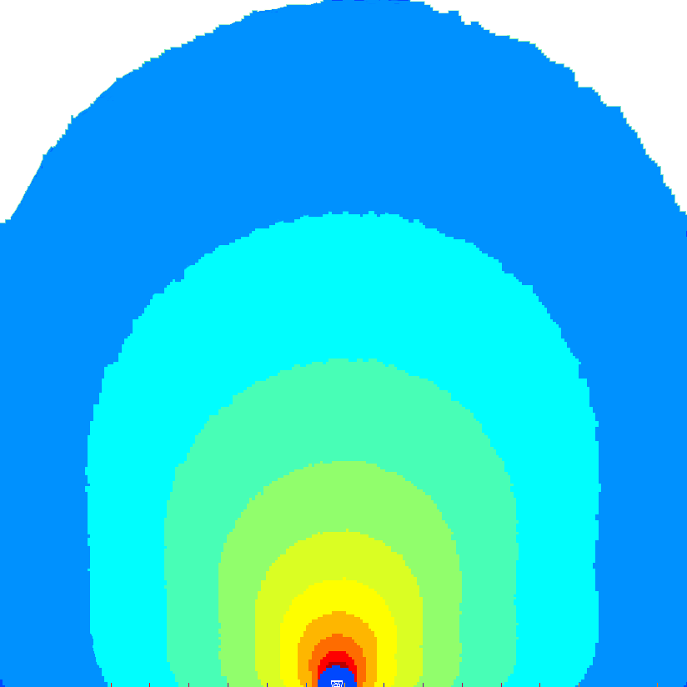
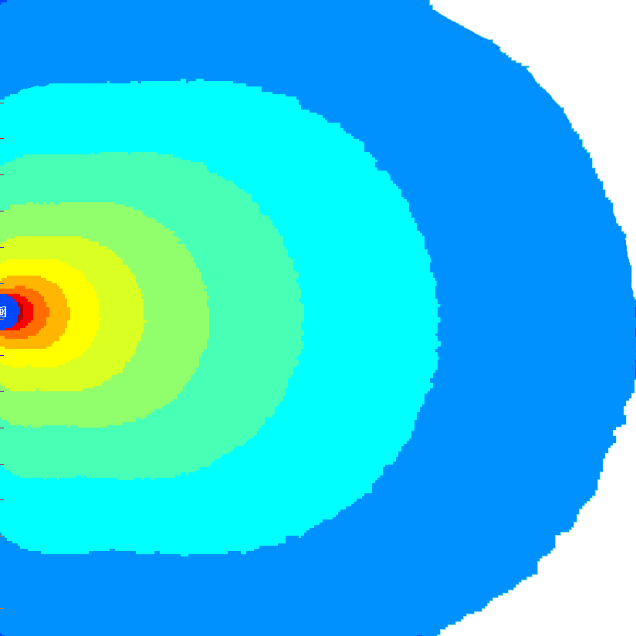
Shapes of Minimum Level Variance
Single speakers: Symmetric Orientation
FAR=1 (180 deg)

Slide 46
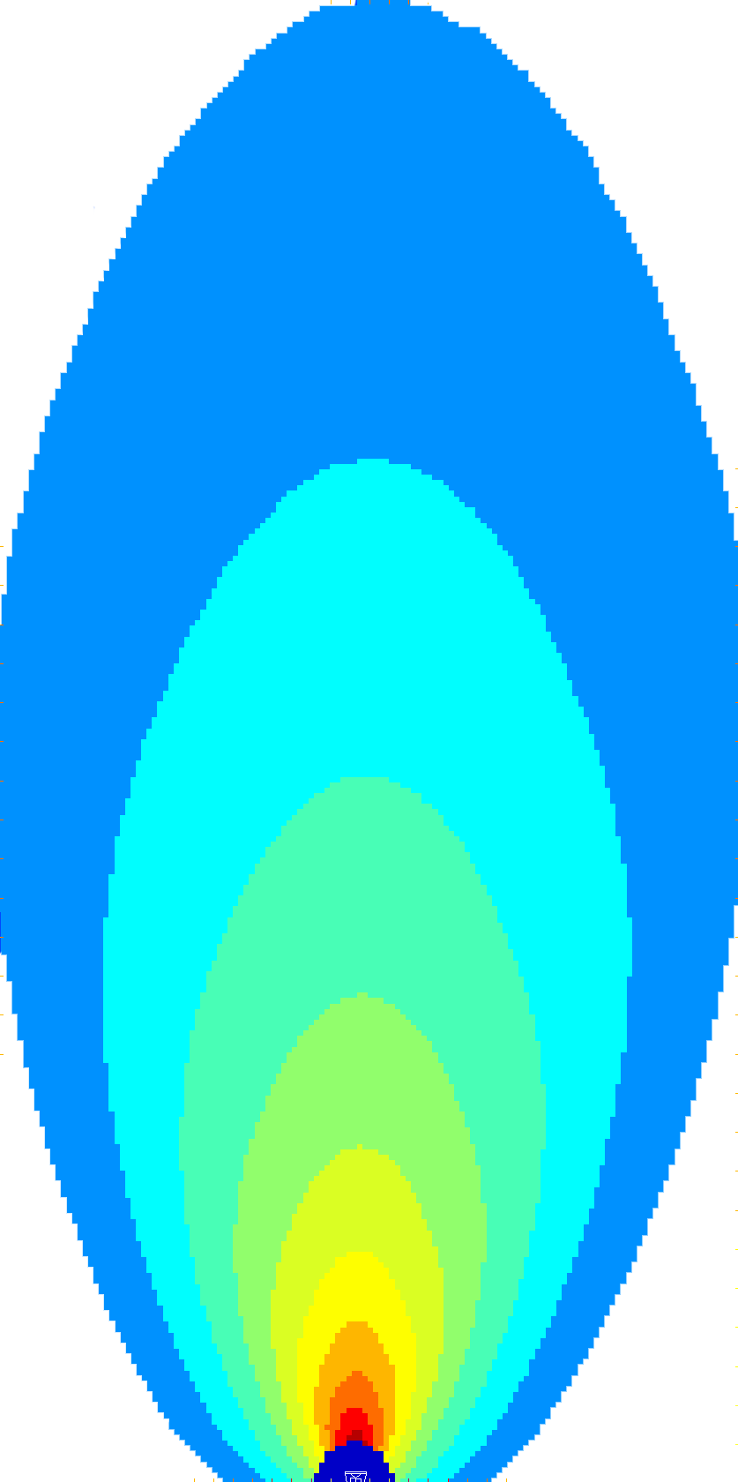
Shapes of Minimum Level Variance
Single speakers: Symmetric Orientation
Rectangle
Diamond
Hexagon
Circle/Oval
Octagon
Cross
FAR = 1 (180 degrees)
FAR = 2 (60 degrees)

Slide 47

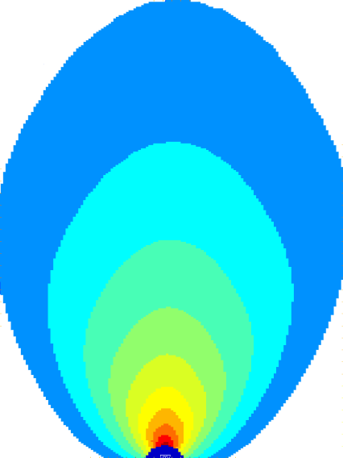
Shapes of Minimum Level Variance
Single speakers: Symmetric Orientation
Trapezoid
FAR = 1.3 (100 degrees)
FAR = 2.6 (45 degrees)

Slide 48
Shapes of Minimum Level Variance
Single speakers: Symmetric Orientation
Pentagon
FAR = 1.15 (120 degrees)
FAR = 2.3 (50 degrees)

Slide 49


Shapes of Minimum Level Variance
Single speakers: Symmetric Orientation
Triangle
FAR = 2 (60 degrees)
FAR = 4 (30 degrees)

Slide 50
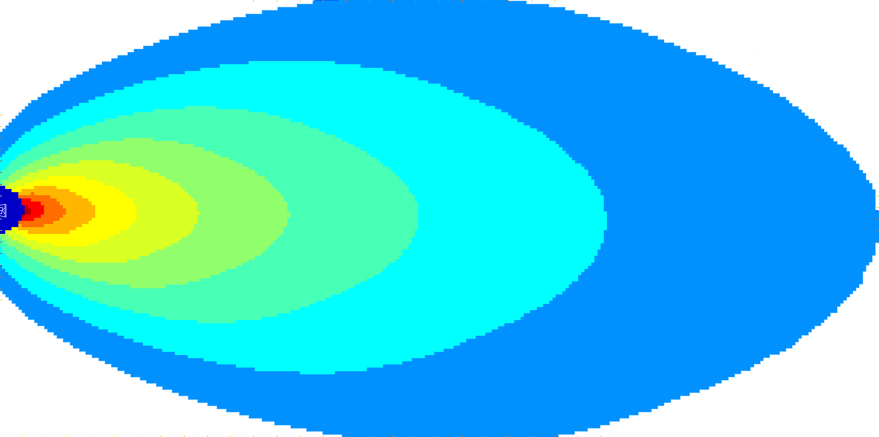
Shapes of Minimum Level Variance
Single speakers: Asymmetric Orientation
Rectangle from side (Symmetric/Symmetric)
FAR = 3 (40 degrees)
Symmetric and asymmetric shapes with
symmetric and asymmetric orientation

Slide 51
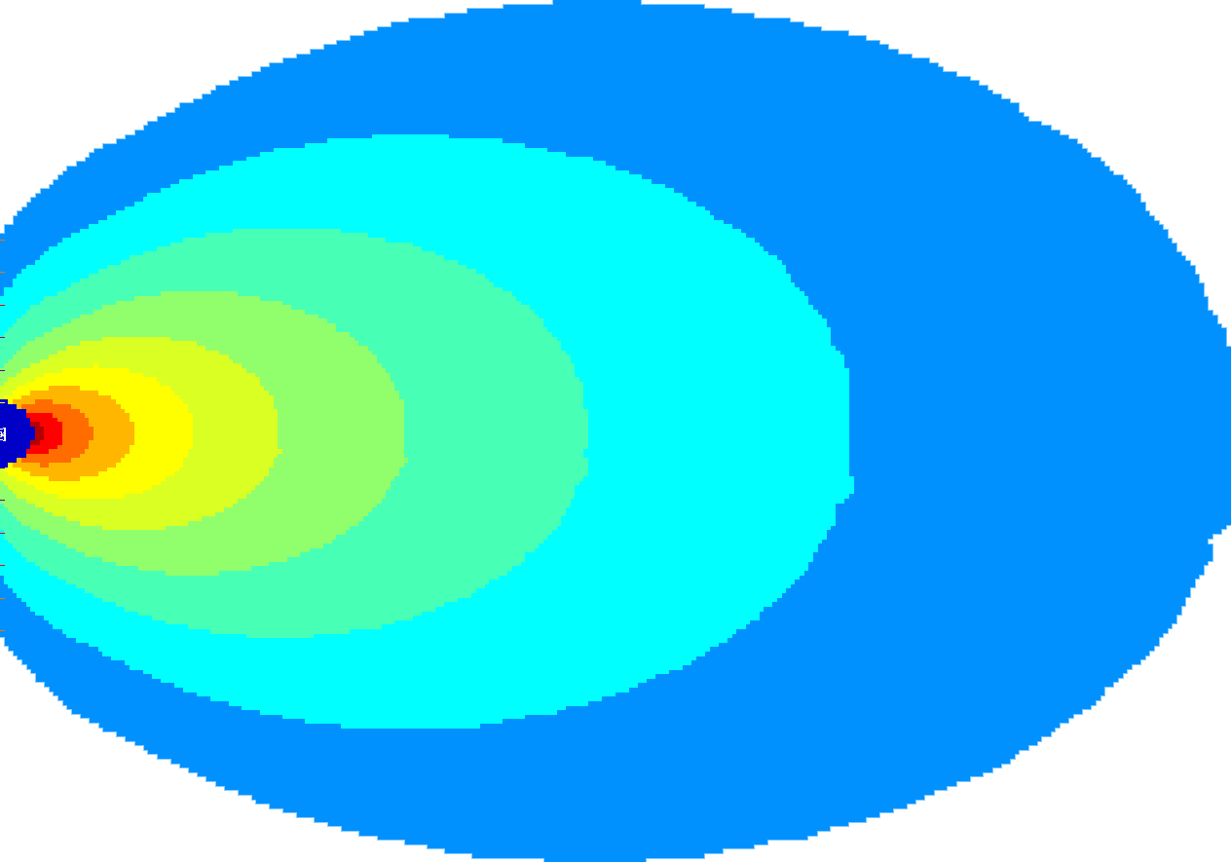
Shapes of Minimum Level Variance
Single speakers: Asymmetric Orientation
Rectangle from corner (Symmetric/Asymmetric)
FAR = 3 (40 degrees)
Symmetric and asymmetric shapes with
symmetric and asymmetric orientation

Slide 52
Shapes of Minimum Level Variance
Single speakers: Asymmetric Orientation
Rhombus from side (Asymmetric/Symmetric)
FAR = 2.5 (45 degrees)
Symmetric and asymmetric shapes with
symmetric and asymmetric orientation

Slide 53
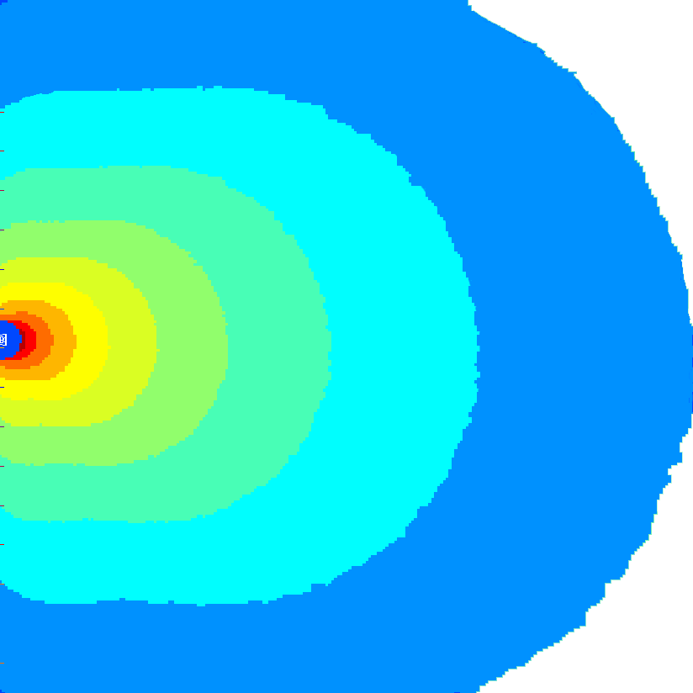
Shapes of Minimum Level Variance
Different coverage target shape, matched orientation, matched distance from start of shape
FAR=1 (180 deg)

Slide 54
Shapes of Minimum Level Variance
Different coverage target shape, matched orientation, matched distance from start of shape
FAR=2 (60 deg)

Slide 55
Shapes of Minimum Level Variance
Different coverage target shape, matched orientation, matched distance from start of shape
FAR=3 (40 deg)

Slide 56
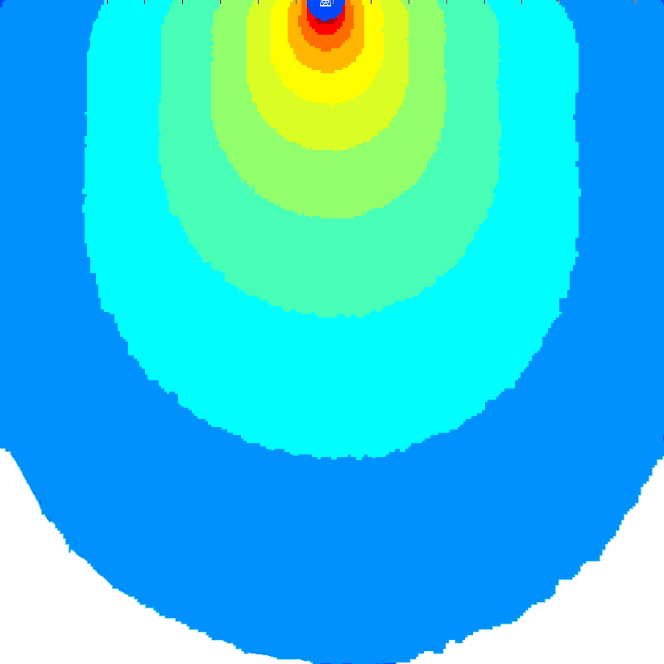
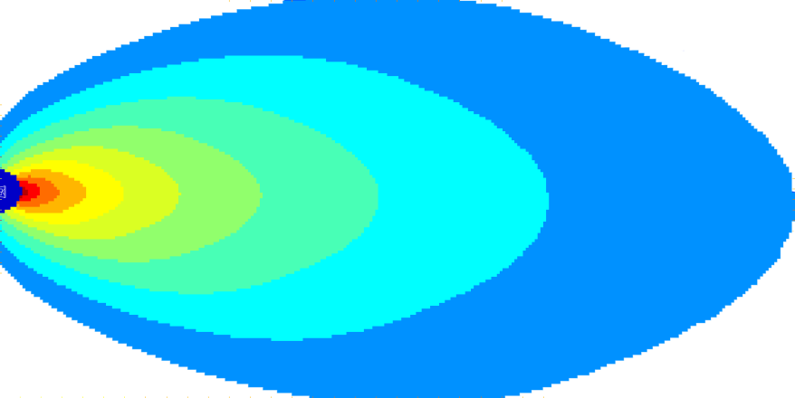


Shapes of Minimum Level Variance
Effect of orientation to coverage target shape on aspect ratio
FAR=2 (60 deg) Aim = 0 deg
FAR=1 (180 deg) Aim = -90 deg
FAR=2 (60 deg) Aim = -64 deg
FAR=3.6 (32 deg) Aim = -40 deg
FAR=3.6 (32 deg) Aim = +10 deg
FAR=2.6 (45 deg) Aim = -10 deg
FAR=1.15 (120 deg) Aim = -23 deg

