Slide 1
System Components for the EASE Focus 3 Design Project
Signal Processors
Reference: Chapters 2 & 3 (3rd Ed.) of Sound Systems: Design and Optimization, by Bob McCarthy (Elsevier, 2017)

Slide 2
Outline
Analog-to-Digital Conversion Basics
Digital Audio Transmission
Filters
Signal Delay
Amplitude Equalization
Commercial Signal Processors

Slide 3
Analog Conversion Basics
Introduction
  Process of converting continuous time signals into discrete representations is called analog-to-digital conversion
  A-to-D (ADC) conversion process involves three distinct steps
    sampling
    quantizing
    encoding
  Pulse Code Modulation (PCM) is a name often used for uniform sampling (periodic samples are uniformly spaced)

Slide 4
Analog Conversion Basics
System design issues
  Sampling rate required for sufficient bandwidth
  Number of bits required for sufficient dynamic range
  Type of converter most appropriate for a given application

Slide 5
Analog Conversion Basics
Sampling
  Ideally would like to determine the digital equivalent of an analog signal at a precise instant of time (“snapshot”)
  Because ADC process takes a finite amount of time, a rapidly changing analog input signal can present an ADC converter with an ambiguous input (“blurred image”)
  One solution is to incorporate an “analog memory” that can hold a snapshot of the analog input for the converter
  Called a “sample-and-hold” (S/H) circuit or a “zero-order-hold” (ZOH)

Slide 6
Analog Conversion Basics
Sampling rate
  Major design issue in data acquisition systems is the sampling rate Ts
  Need to know spectral characteristics of incoming signal (can be determined using a spectrum analyzer)
  Sampling frequency Fs must be at least twice that of the highest frequency component present in input signal (called the Nyquist rate)
  Use low-pass “brick wall” filter (LPF) to ensure no frequency components in excess of Fs / 2 are applied to ADC input

Slide 7
Analog Conversion Basics
Sampling rate, continued
  Input LPF referred to as an “anti-aliasing” filter
  Frequency components in excess of Fs / 2 are “folded back” into the baseband at an “alias” frequency
  In audio, aliases show up mostly as (non-linear) intermodulation distortion products
Aliasing Example:
If Fs = 20 KHz → maximum input frequency component is 10 KHz
If have an input frequency component of 11 KHz, will be encoded as a 9 KHz component

Slide 8
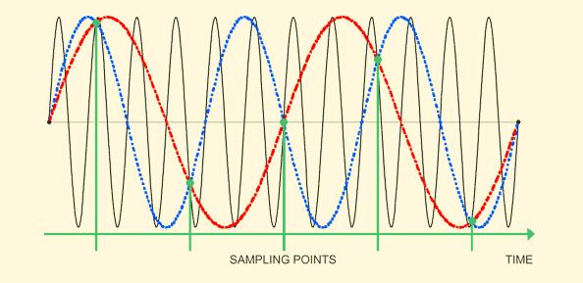
Illustration of Aliasing Frequencies

Slide 9
Analog Conversion Basics
Quantization
  Another important design consideration is the number of bits required to obtain adequate resolution and/or sufficient dynamic range
  Quantization is the assignment of a fixed amplitude level (corresponding to an available binary code) to the incoming analog signal
  Note that the converted code is relative to the reference voltage(s) applied to the converter (V_{RH} = voltage reference high, V_{RL} = voltage reference low)

Slide 10
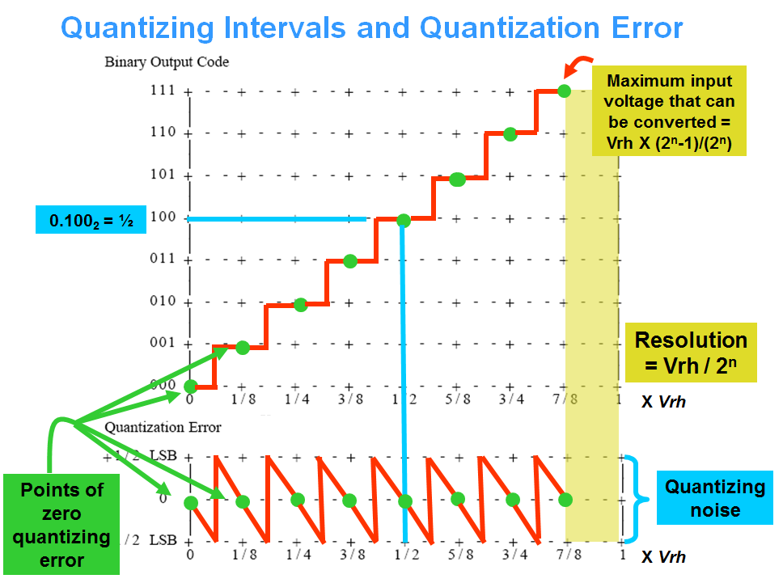

Slide 11
Analog Conversion Basics
Quantization, continued
  The quantization error imposes “noise” on the converted value (“quantization noise”)
  The dynamic range of a converter is its signal to quantizing noise ratio (SQNR), measured in dB: SQNR = 20 log₁₀ (2^{n} / 1)
Example: For n = 8,
SQNR = 20 log₁₀ (256 / 1) ≅ 48 dB
Solving for other values of n shows that the dynamic range is approximately 6 dB/bit

Slide 12
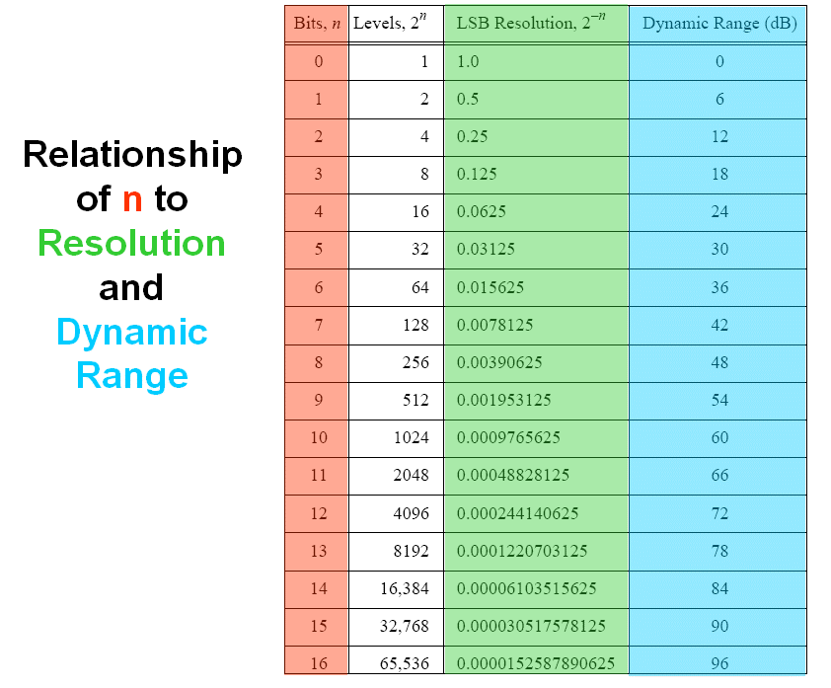

Slide 13
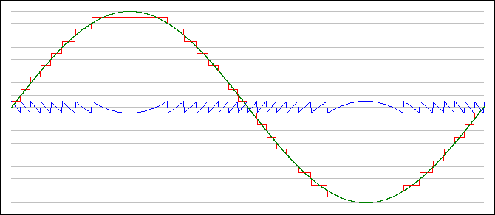
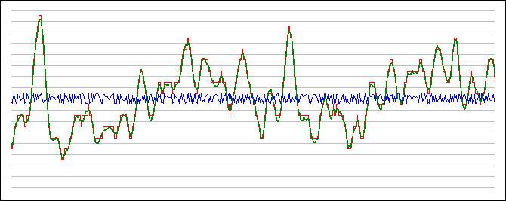
Quantization Noise in PCM Systems
Sine Wave
Audio Signal

Slide 14
Analog-to-Digital Conversion
PCM Converter type
  Wide variety of types, but two basic categories
    Those requiring a DAC (digital-to-analog converter as an integral component)
    Those not requiring a DAC
  Successive approximation is one of the most common types of PCM ADC converters integrated into microcontrollers
    High resolution
    Conversion time is a linear function of n
    Based on “binary guess a number” game

Slide 15
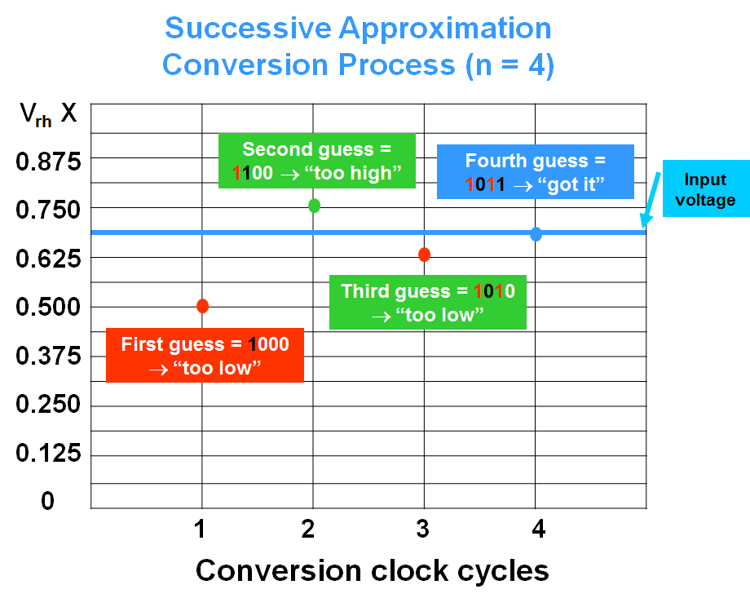

Slide 16
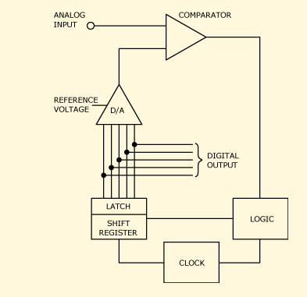
Successive Approximation Converter Block Diagram

Slide 17
Pulse Width Modulation (PWM)
Pulse-width modulation (PWM) is the ability to modify the duty cycle of a square wave
  0% duty cycle → always off
  50% duty cycle → symmetric square wave
  100% duty cycle → always on
A continuous time analog input can be encoded as a PWM signal using an analog modulator
  analog comparator
  triangle waveform (sampling frequency)
This is referred to as “natural sampling” (in contrast to the “uniform sampling” associated with PCM)

Slide 18
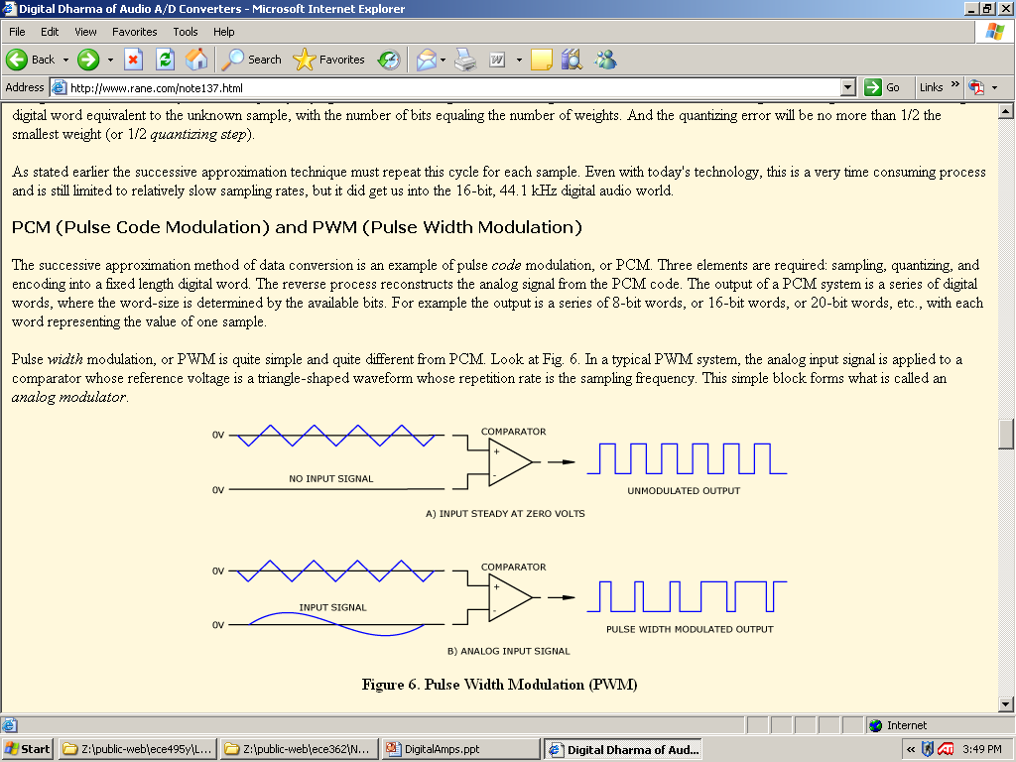
PWM Encoding (Delta Modulation)
Can be thought of as a one-bit A/D encoding system (“delta modulation”). The sampling frequency must be at least an order of magnitude higher than the highest frequency component of the input signal. The PWM output can be low-pass filtered to re-construct the analog signal.

Slide 19
Delta-Sigma ADC
Essentially a delta-sigma converter digitizes the audio signal with a very low resolution (1-bit) A/D converter at a very high sampling rate
Also referred to as pulse-density modulation (PDM), because it is the density of the pulses (not the amplitude, as in PCM) that is encoded
The oversampling rate and subsequent digital processing separates this from plain delta modulation (with no “sigma”)
The simplicity of 1-bit technology makes the conversion process very fast, and very fast conversions allows use of extremely high oversampling rates

Slide 20
Delta-Sigma ADC
A delta-sigma modulator consists of three parts:
  an analog modulator (the integral of the analog signal is encoded rather than the change in the analog signal, as is the case for traditional delta modulation)
  a digital filter (suppresses aliasing and quantization noise)
  decimation circuit (generates the correct output word length of 16-, 20-, or 24-bits, and restores the desired output sample frequency)

Slide 21
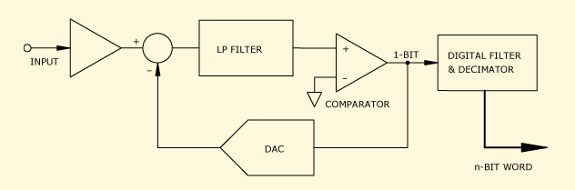
Delta-Sigma ADC Block Diagram
The “negative feedback” successively influences every other quantization measurement and its error, which has the effect of averaging out the quantization error.

Slide 22
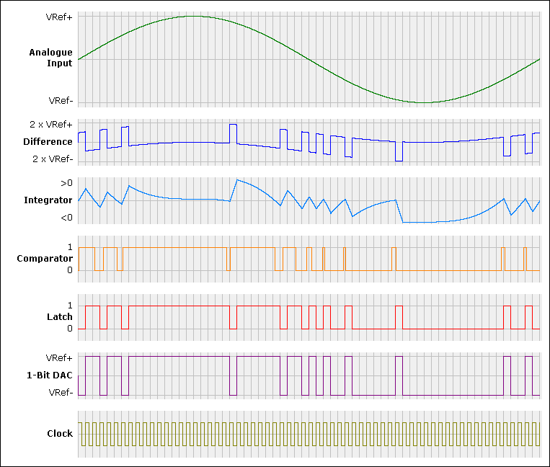
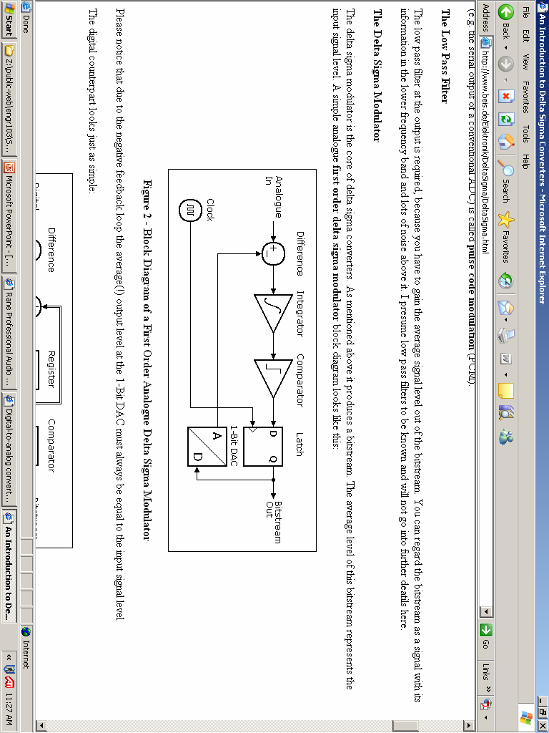

Slide 23
Delta-Sigma ADC
Use of extreme oversampling pushes the quantizing noise and aliasing artifacts well beyond audible range, where it is easily dealt with by digital filters
With oversampling, the quantization noise power is spread over a band that is as many times larger (e.g., for 64X oversampling, the noise power is spread over a band that is 64 times larger, reducing its power density in the audio band proportionally)

Slide 24
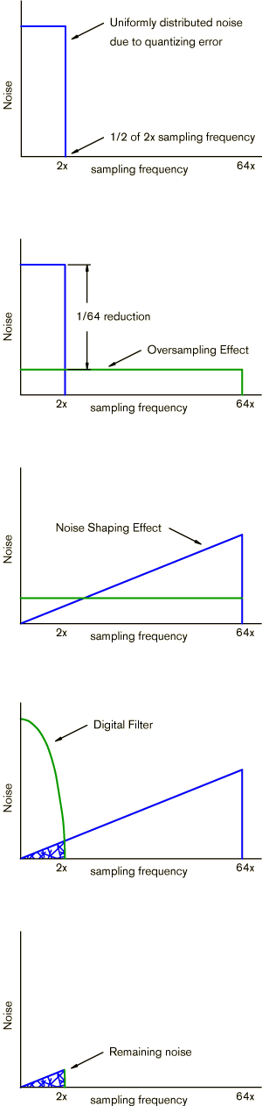
Delta-Sigma ADC Oversampling and Noise Shaping

Slide 25
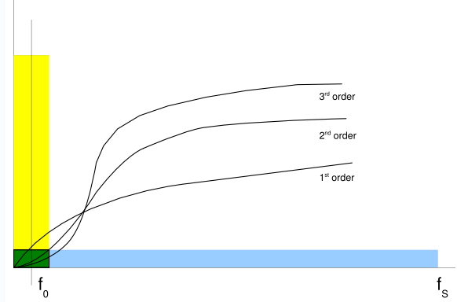
Delta-Sigma ADC Noise Shaping Order
Higher order delta-sigma modulators (based on number of stages) push the conversion noise out of the audible band.

Slide 26
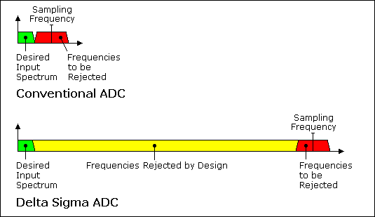
Comparison Between Conventional (PCM) and Delta-Sigma ADC Converter Spectra

Slide 27
Delta-Sigma ADC
Noise shaping helps reduce in-band noise even more, by contouring the noise so that it is reduced in the audible regions and increased in the inaudible regions
The net result is much greater resolution and dynamic range, with increased S/N and far less distortion compared to successive approximation techniques − all at lower costs

Slide 28
Delta-Sigma ADC
High quality ADC converters for audio applications provide 24 output bits (they use 5th order modulators so that the conversion noise could be theoretically at -160 dB)
The quantization noise of a 24 bit converter could become better than -147 dB
Practical (good) ADC converters achieve "just" 120 dB SQNR (19.6 effective bits) due to the non-ideal operation of the modulator

Slide 29
Digital-to-Analog (DAC) Conversion
DAC converters are used to reconstruct analog (output) signals from digital (input) samples
For PCM signal reconstruction, an anti-image low-pass output filter is needed to remove replicas of the reconstructed signal appearing at integer multiples of Fs
Common types of DAC converters used for audio applications include:
  R-2R ladder (PCM)
  Oversampling (Delta-Sigma)
  PWM (“Class D” power amplifiers)

Slide 30
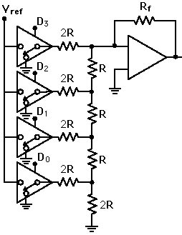
R-2R Ladder DAC (4-bit Example)
data bits
analog output
R-2R resistor ladder network produces a binary weighted sum of currents, which is transformed into a proportional voltage by the OP AMP

Slide 31
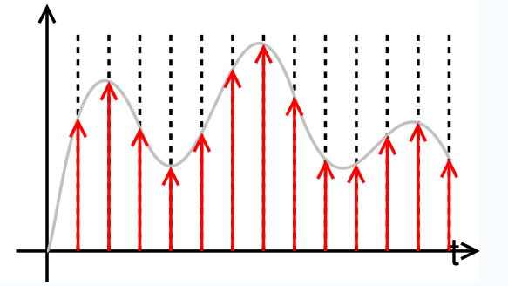
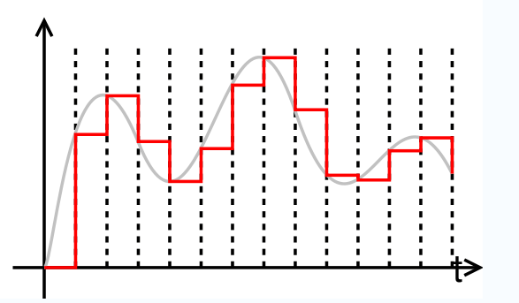
PCM DAC Output
Ideally sampled signal (PCM)
“Staircase” output produced by PCM DAC converter (must be low-pass filtered to “smooth out”)

Slide 32
Delta-Sigma DAC Converters
The process of decoding a pulse-density modulated (PDM) signal into an analog one is amazingly simple: pass the signal through a low-pass filter (this works because the function of a low-pass filter is essentially to average the signal)
The density of pulses is measured by the average amplitude of those pulses over time, thus a low pass filter is the only step required in the decoding process

Slide 33
PWM DAC Converters
PWM is just a special form of PDM where all the pulses corresponding to one sample are contiguous in the digital signal
Like PDM, reconstruction of the analog output signal can be accomplished by low-pass filtering the PWM output
Highly efficient audio power amplifiers (“Class D”) are based on PWM

Slide 34
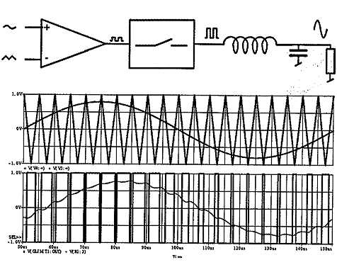
PWM Encoding (Delta Modulator) and Signal Reconstruction
PWM Output
IN

Slide 35
DAC Selection Criteria for Audio Apps
Resolution (number of bits)
Maximum sampling frequency (measurement of the maximum speed at which the DAC circuitry can operate and still produce the correct output)
Monotonicity (the ability of the DAC analog output to increase with an increase in digital code, or the converse)
THD+N (measurement of the distortion and noise introduced to the signal by the DAC, expressed as a percentage of the total power of unwanted harmonic distortion and noise that accompany the desired signal)
Dynamic range (measurement of the difference between the largest and smallest signals the DAC can reproduce, in dB)

Slide 36
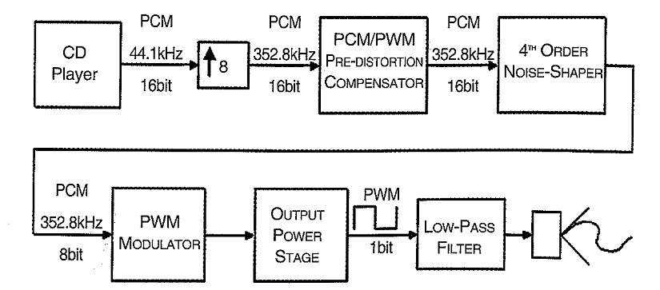
PCM Input → PWM Output
The PWM sampling rate must be significantly higher than the PCM sampling rate in order to minimize distortion

Slide 37
Digital Audio Transmission
AES/EBU digital audio pipeline
  AES3 is 2-ch configuration that uses XLR connectors (max length 100 m)
  Compatible formats
    TOSLINK (Toshiba Link) – short distance fiber optic version
    S/PDIF (Sony/Phillips Digital Interface) – short distance unbalanced consumer implementation of AES3, with RCA (phono) connectors
    ADAT Lightpipe – multichannel optical format initially implemented by Alesis for its ADAT recorders
    MADI (AES10) – multichannel audio digital interface, can transmit multiple channels of uncompressed AES-compatible audio, uses same connectors as 2-channel AES3, cable lengths up to 3000 m

Slide 38
Digital Audio Transmission
Sound networking challenges for live sound applications
  Low latency
  Clock timing and synchronization
  On-time delivery of audio packets
  Error-free streaming

Slide 39
Digital Audio Transmission
OSI layer model
  Application
  Presentation
  Session
  Transport
  Network
  Datalink
  Physical

Slide 40
Digital Audio Transmission
Digital audio network flow chart

Slide 41
Digital Audio Transmission
Network devices
  Network adapter and interface (port)
  Router / switch / hub / repeater
Protocols
  Cobranet – widely used first-generation multichannel Audio over Ethernet (AoE), uses Ethernet packets
  Dante – second generation AoE that is an IP-based protocol (proprietary)
  AES67 – Layer 3 open interoperability standard to facilitate connections between competing systems (RAVENNA, Livewire, Q-LAN, Dante, AVB, others) using a standard transport protocol
  Q-LAN – QSC’s second generation system, gigabit IP-based
  AVB* – collection of IEEE standards that provide a way of using Ethernet to transport high-fidelity audio and video signals with guaranteed minimum latency, guaranteed bandwidth, and with sample synchronous output at all interfaces
________
* Audio Video Bridging aka Time-Sensitive Networking (TSN)

Slide 42
Filters
Many different types and realizations – can be combined to create equalizers, frequency dividers, effects generators, beamformers, etc.
Classifications
  Spectral crossover (high pass / low pass)
  Shelving
  Band pass / band reject (notch)
  All pass
Parameters
  Cutoff (or “corner”) frequency, for shelving and high / low pass filters
  Order (steepness of cutoff slope): 6 dB per “order number”
  Center frequency, for band pass / reject filters
  Bandwidth (“Q”), for band pass / reject filters: frequency range between the -3 dB points compared with the center frequency
  Ripple, for stopband and passband
  Topology (e.g. Chebyshev, Butterworth, Bessel, Linkwitz-Riley, etc.)
DSP realizations: IIR vs FIR

Slide 43
Filter Classifications
Spectral crossovers (“crossover networks”)
  Combination of low pass and high pass filter
  Order is steepness of cutoff slope (6 dB per “order number”)
  Both stopband and passband can exhibit ripple
  Variety of filter topologies can be utilized

Slide 44
Filter Classifications
Shelving filters
  Low shelf
  High shelf
BOOST
ATTENUATION
BOOST
ATTENUATION

Slide 45
Filter Classifications
Band-pass and state-variable filters
  Standard building blocks for graphic and parametric equalizers
BOOST
ATTENUATION
BOOST
ATTENUATION

Slide 46
Filter Classifications
All-pass filters
  Also called delay equalizers or phase correctors
  Provide tunable signal delay that can be set to a particular range of frequencies (i.e. displace signals in time as a function of frequency)
  Exhibit flat frequency response: changes relative delay without affecting amplitude, with selectable bandwidth and center frequency
  Applications include digital reverberators, loudspeaker phase alignment (“correction”) and frequency-invariant beamforming / steering

Slide 47
Filter Topologies
Butterworth: commonly used for audio applications, exhibits increased sharpness in the transition region with minimal artifacts in the passband or stopband
Bessel: exhibits more gradual level transition and minimal phase delay
Chebyshev: exhibits extremely steep transition but substantial ripple near the cutoff frequency
Elliptical: even steeper transition than Chebyshev and substantial ripple near the cutoff frequency in both the passband and stopband
Linkwitz-Riley: most popular choice for frequency dividers, created by cascaded pairs of Butterworth filters (4th order L-R filters very commonly used in pro audio)
In general, phase shift at cutoff frequency increases with filter order

Slide 48
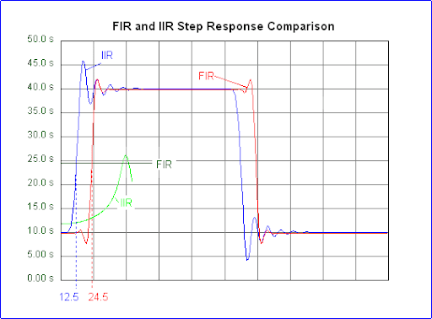
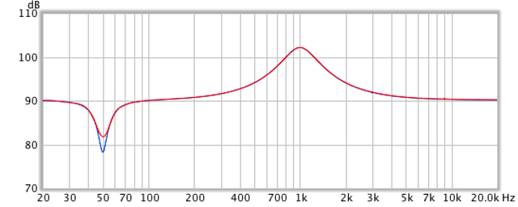
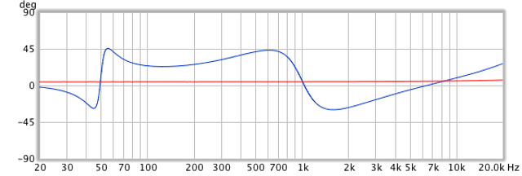
DSP Filter Realizations
IIR (infinite impulse response) filters
  Most efficient type of filter to implement in DSP
  Usually provided as “biquads” (each filter is a single biquad)
  Signal delay varies with frequency (greatest at cutoff frequency)
FIR (finite impulse response) filters
  Equal signal delay at all frequencies, so can implement linear-phase filtering (i.e. exhibits no phase shift across filter band)
  Phase can be corrected independently of amplitude, so can be used for beamforming
  Can be used to correct frequency response anomalies in loudspeakers to a finer degree of precision than IIR filters (but can be limited in resolution at lower frequencies)
  Significantly more computationally complex than IIR filters
Parametric filter amplitude response: IIR vs FIR
Parametric filter phase response: IIR vs FIR

Slide 49
Signal Delay
Human sense of hearing can detect the results (side effects) of as little as 15-20 μs in path length differences
Delays ranging from 100 μs to 50 ms + can interfere with speech intelligibility
Signal delay devices can be used to correct “time alignment” problems among multiple loudspeakers and preserve locality of reference in distributed systems
Haas Effect: If one loudspeaker of a pair equidistant from a listener has the signal delayed by (20 ms), then all of the sound appears to come from the loudspeaker with no delay
Kuttruff Effect: If a series of delayed signals of the proper intervals and levels is developed, it is possible to extend the Haas zone

Slide 50
Signal Delay Calculation
Signal Delay (ms) = 0.885 ∗ ΔD_{feet} + 20* where
  0.885 = 1000/(1130 feet/sec),
  ΔD_{feet} is the difference in path length, and
  20 ms is the additional signal delay providing directional reorientation
Caution: Temperature gradient in room can affect path length, and therefore the amount of signal delay required (some commercial delay units measure the room temperature and automatically compensate for this)
________
* There is not universal agreement on the use of this “fudge factor”
Classic distributed, delayed system

Slide 51
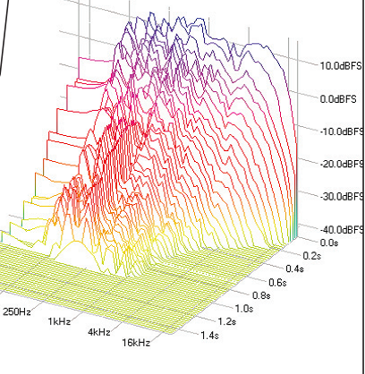
Signal Alignment
Signal (“time”) alignment is typically accomplished using a digital delay device (DSP + memory)
Most current signal processing devices are “multi-function” units (equalization, delay, feedback suppression, limiting, compression, etc.)
A time-energy-frequency (TEF) analyzer is needed to perform accurate signal alignment

Slide 52
Signal and Loudspeaker Alignment
Coarse (millisecond-resolution) delay is usually sufficient to implement a distributed loudspeaker system that preserves locality of reference
Fine (microsecond resolution) delay is required to align multiple loudspeakers offset in time
Seemingly minor misalignments among multiple loudspeakers can cause major problems in coverage overlap regions
  comb filtering effects (severe dips in frequency response curve)
  excess energy reflected off walls/ceilings due to “lobing” in polar response
  insufficient direct sound field (at null) for Haas effect (resulting in loss of locality of reference)

Slide 53
Signal and Loudspeaker Alignment

Slide 54
Amplitude Equalization
Amplitude equalization (with 1/3-octave or greater resolution) can:
  increase acoustic gain
  enhance acoustic quality
While some “analog” equalizers are still manufactured, most “signal processing” devices are now all-digital, multi-purpose units (but, be wary of signal processing latency, which can be several milliseconds)

Slide 55
Amplitude Equalization
One method of performing amplitude equalization is to check for feedback instabilities and successively “tune them out” (“feedback tuning”) – here, the goal is to maximize system gain before feedback
Another method is to use “pink noise” (spectrally shaped noise) and use that signal to “flatten” the system response
Pink noise (or 1/f noise) is a signal with a frequency spectrum such that the power spectral density is proportional to the reciprocal of the frequency
Both band-reject and band-pass filters can be used to equalize sound systems (band-reject are typically preferred)
Trend is for these filters to be parametric (programmable center frequency and bandwidth or Q)
A real-time analyzer (RTA) is necessary to perform system amplitude equalization

Slide 56
Potential Gain Improvement

Slide 57
Equalizer Misuse
Correcting response anomalies caused by phase reversals
Correcting instabilities caused by comb filters rather than addressing the cause of the comb filter
Controlling a problem caused by mechanical feedback (microphone without a “shock mount”)
Controlling feedback caused by electrical crosstalk (e.g., in a cable, like a multi-purpose “snake”)
Adjusting steady-state response of devices that have an un-damped resonance in their transient response

Slide 58
Commercial Signal Processors
What to look for…
  fixed/parametric filters
  delay settings range/resolution
  compression/limiting
  auto feedback suppression
  input channels/output channels
  matrix capability
  remote control/network capability
  “drag and drop” processing chain configuration
  auto calibration capability

Slide 59
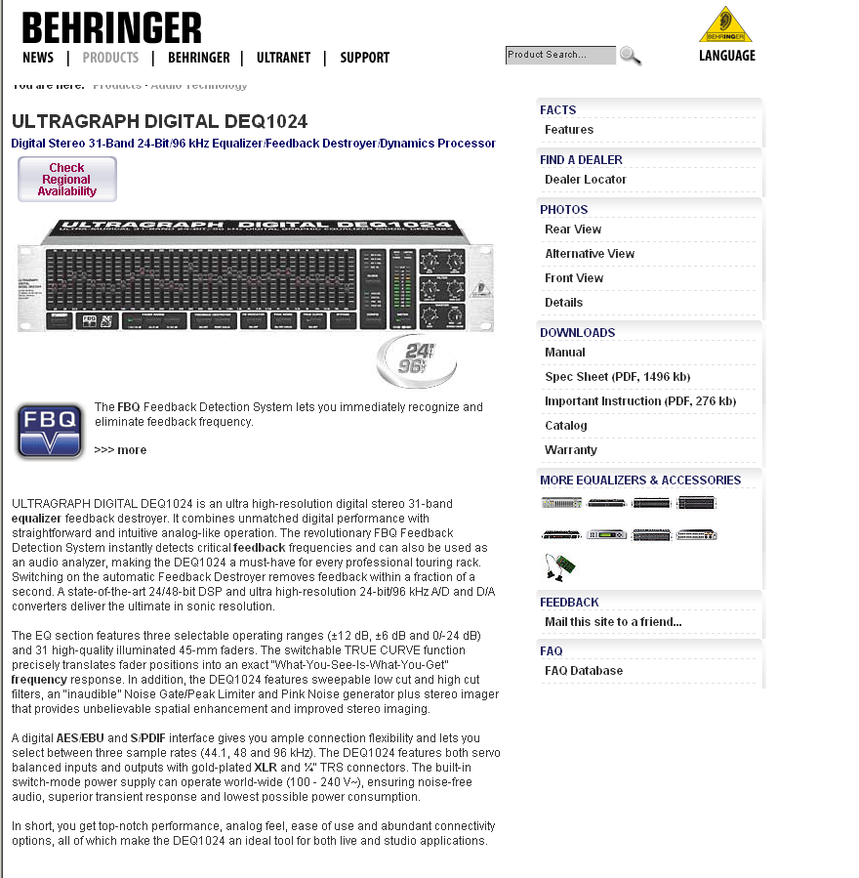

Slide 60
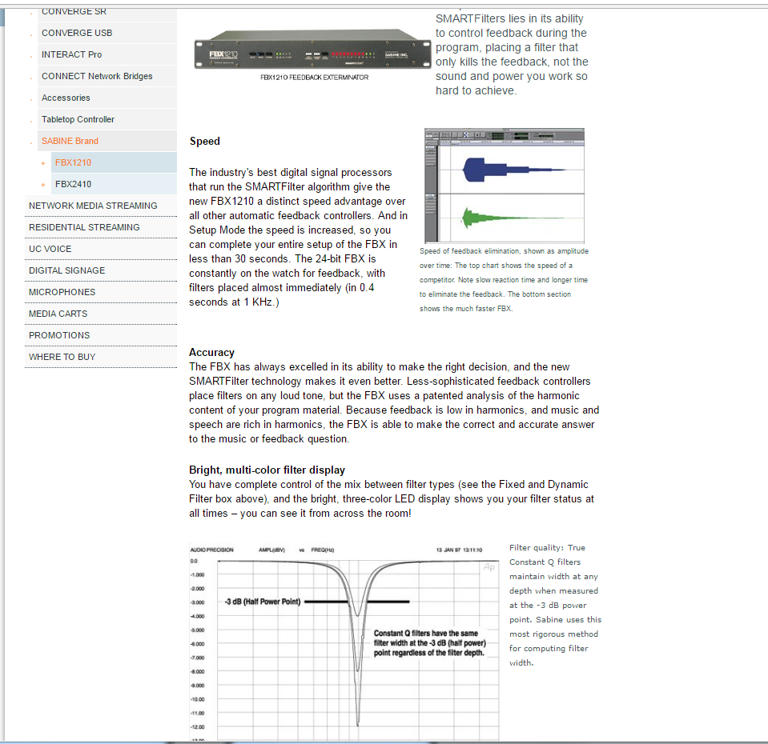
Sabine Feedback Exterminators

Slide 61

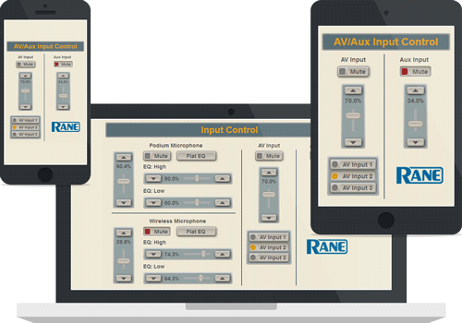
RANE Multiprocessors

Slide 62
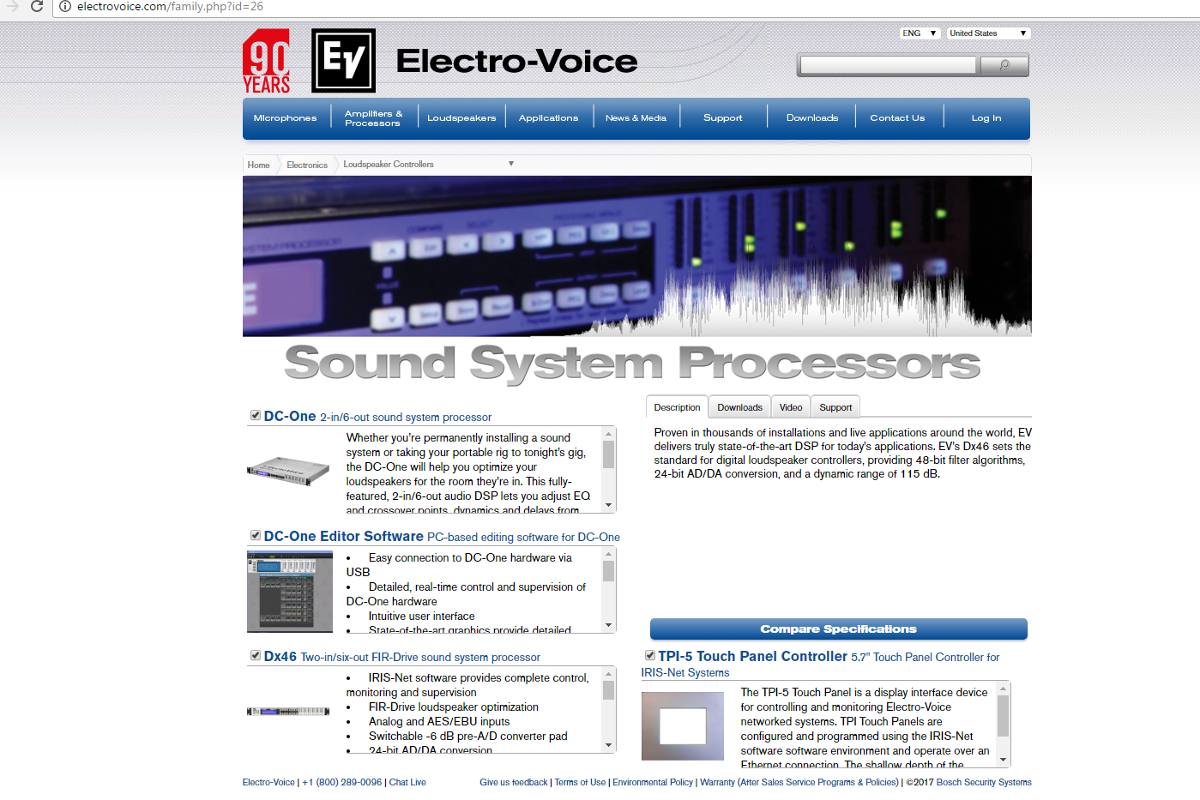

Slide 63
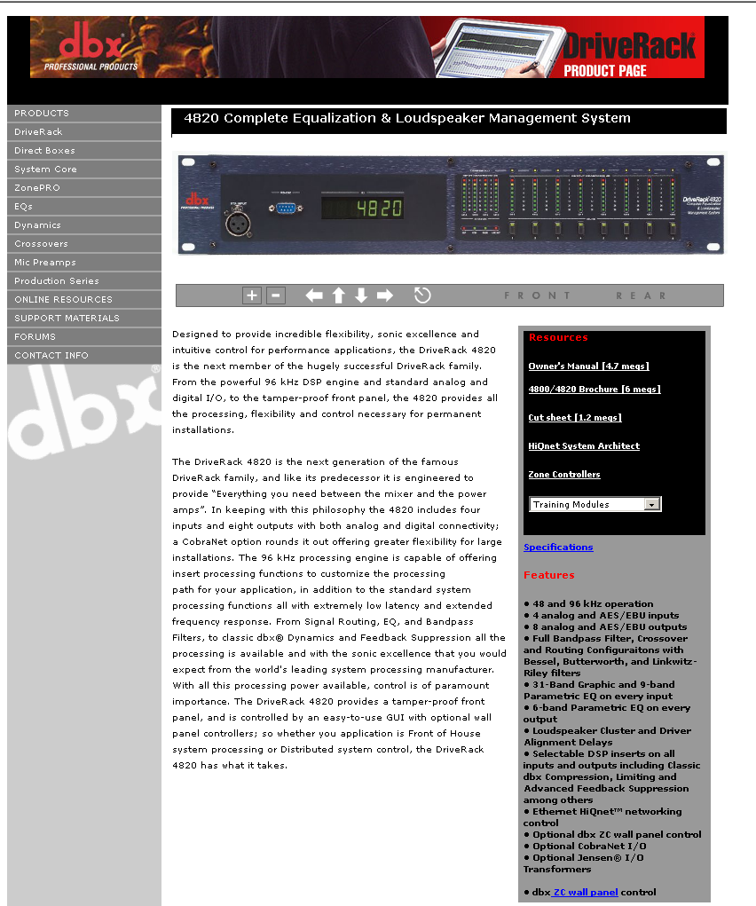

Slide 64
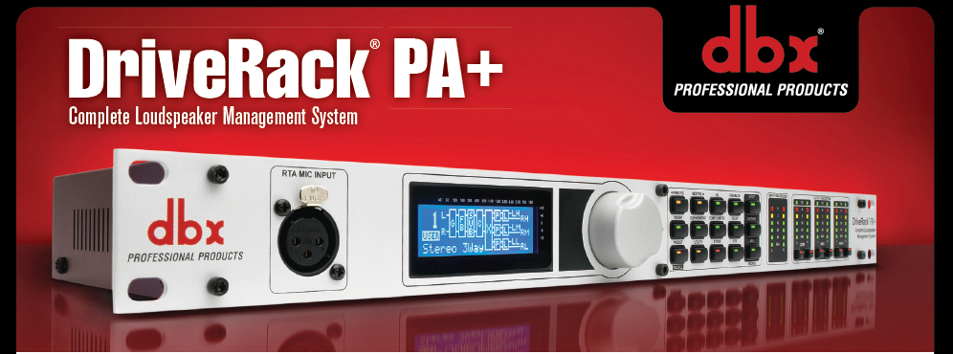
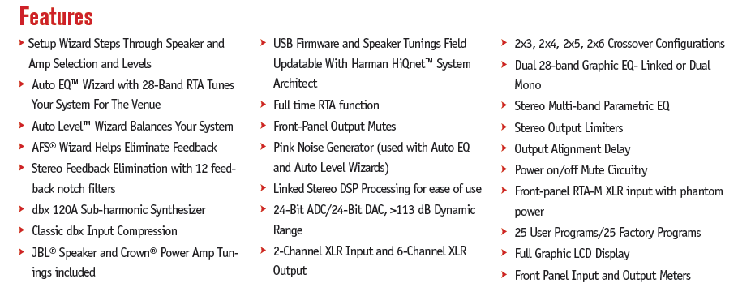

Slide 65
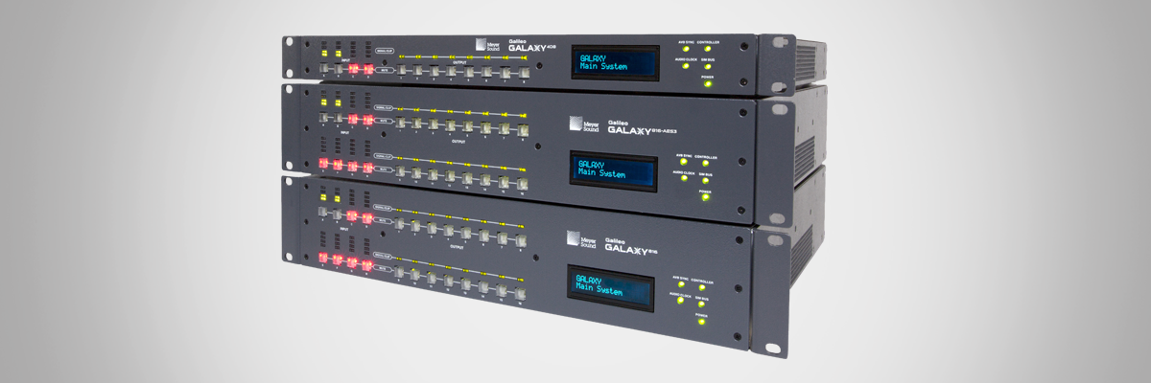
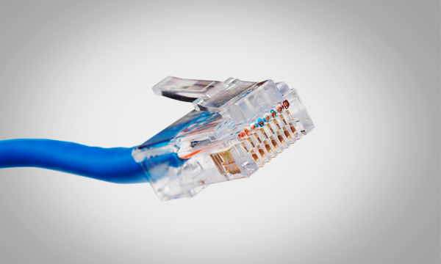
AVB-capable network interface
Fully Networkable Loudspeaker Processor – Meyer Sound Galileo

