Slide 1
System Components for the EASE Focus 3 Design Project Racks and Wiring

Slide 2
Outline
Equipment Racks
Rack Issues
Rack Design Software
Sample Rack Layout and Equipment List
Wiring Issues

Slide 3
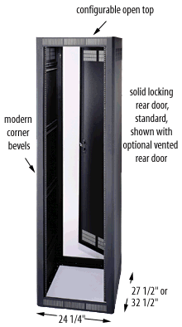
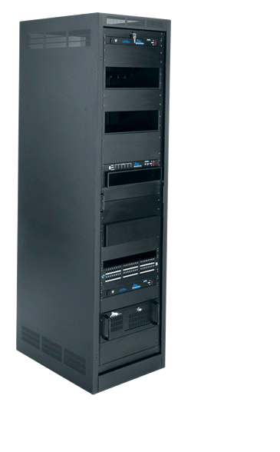
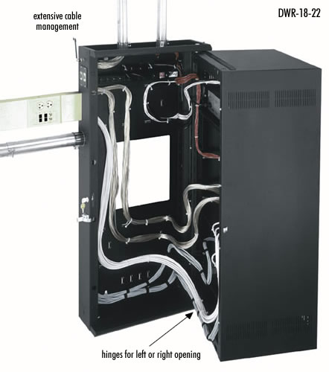
Equipment Racks
http://www.middleatlantic.com/
http://www.racktools.com/

Slide 4
Rack Issues
Access (installation and maintenance)
Mechanical support and stability
Ventilation
Cable routing and dressing

Slide 5
http://www.racktools.com/

Slide 6
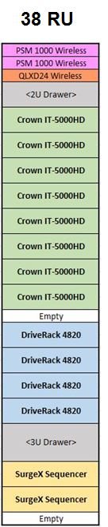
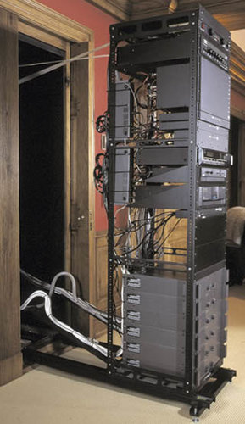
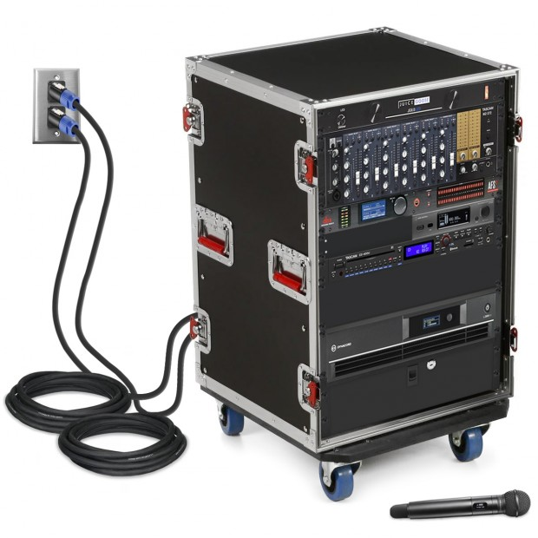
Sample Rack Layout
Middle Atlantic AXS-43
43SP AXS Rack For In-Wall Applications
Note: “1U” is referred to as a “single rack space”, which is a panel 1.75” tall and 19” wide. All rack panel heights are expressed in integer multiples of “U” (i.e., “2U” is 3.5” tall, “3U” is 5.25” tall, etc.
Also: Rack cabinet depth can vary (26-27” is typical). Rack cabinets can be free-standing or designed for wall installation (as shown).

Slide 7
Wiring Issues
Power conditioning, distribution, and sequencing
Balanced vs. unbalanced audio cables
XLR vs TRS connectors
Avoiding ground loops, hum, and buzz

Slide 8
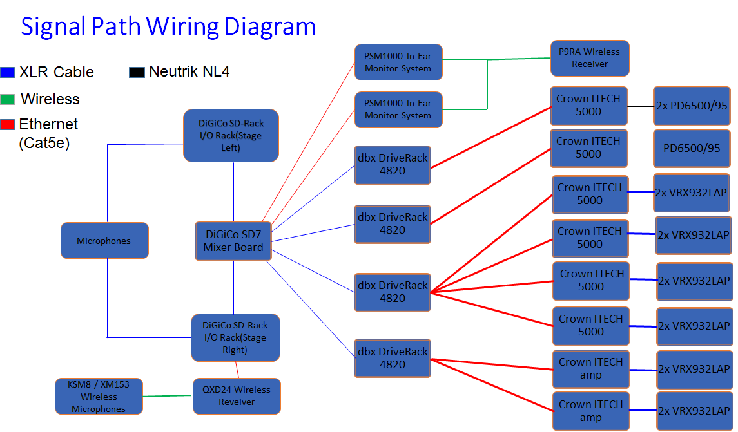

Slide 10
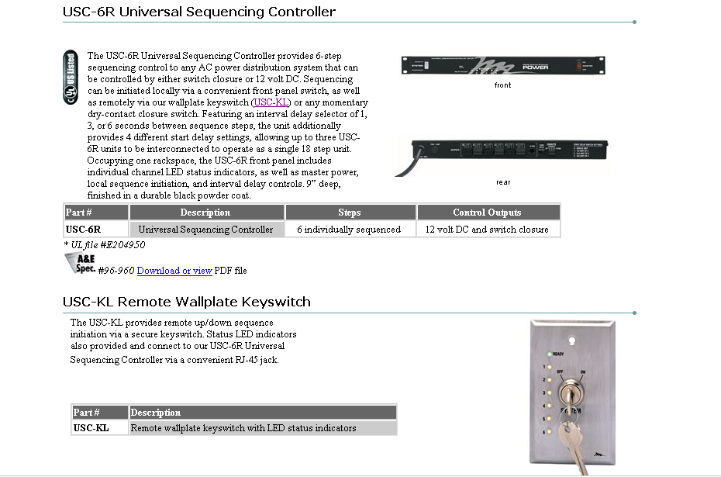
Power Sequence Control

Slide 11
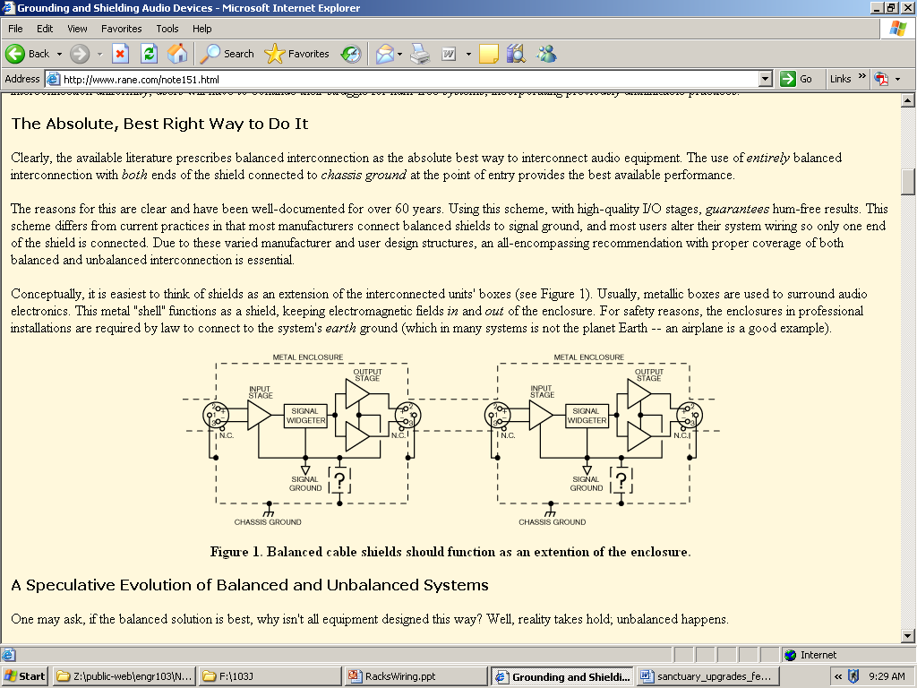
Grounding Strategies
Grounding and Shielding Notes (Rane)

Slide 12
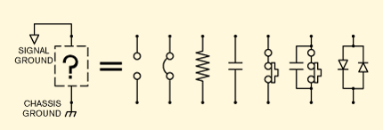
What’s in the “?” Passive Schemes for Connecting Signal Ground to Chassis
Grounding and Shielding Notes (Rane)

Slide 13
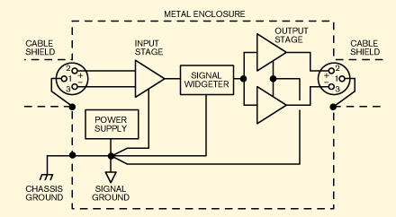
Star Ground Scheme for Connecting Signal Ground to Chassis
Grounding and Shielding Notes (Rane)

Slide 14
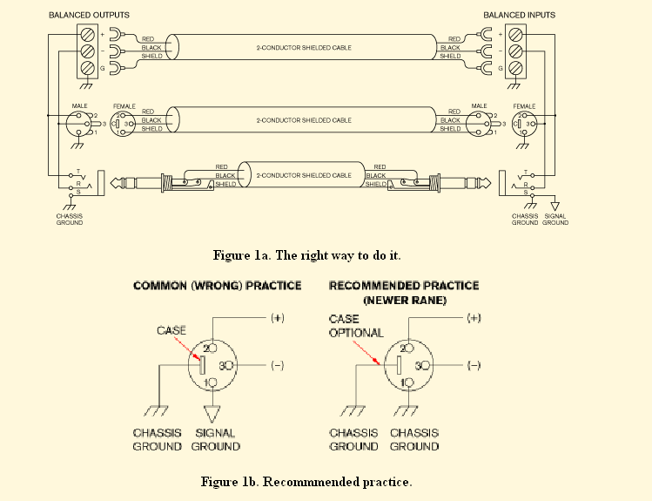
Recommended Practice
Sound System Interconnection (Rane)

Slide 15
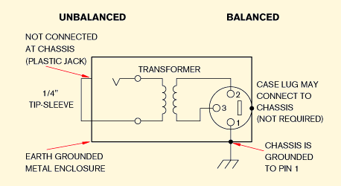
Recommended Practice Unbalanced to Balanced Using Transformer Isolation
Sound System Interconnection (Rane)

Slide 16
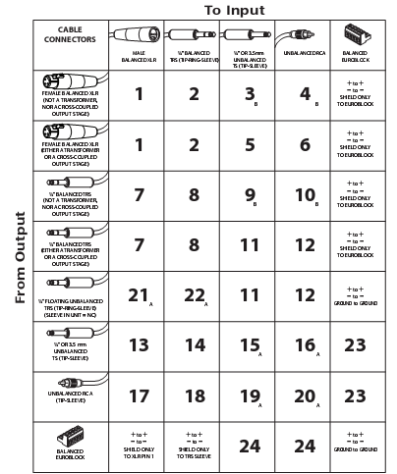
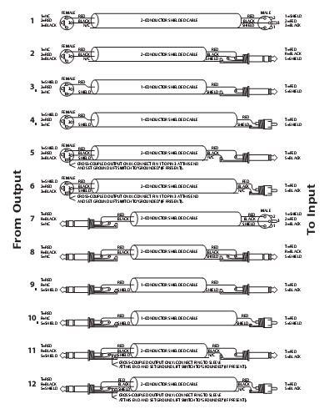
Lots of Other Possibilities…
Sound System Interconnection (Rane)

