Slide 1
System Components for the EASE Focus 3 Design Project Mixers and Microphones

Slide 2
Outline
Mixing Consoles
FOH Console Criteria
Representative FOH Console
Choosing Analog or Digital
Microphones
Characteristics
Pickup Patterns and Directional Characteristics
Balanced Lines
Musical Instruments
Effects and Rules
Wireless Systems
Frequency Bands and Intermodulation Effects
Diversity Principle and Antenna Types

Slide 3
FOH Console Criteria
Inputs (number/type/phantom power)
Channel inserts
Number of mix buses and groups
Number of masters (L/C/R)
Number of aux sends/aux returns
Meter bridge
Channel input gain/attenuation
Channel EQ (parametric/shelving)
Monitoring (PFL/AFL)
Matrix output mixer
Automation (programmable scenes)

Slide 4
Representative FOH Console
Allen&Heath GL2800

Slide 5
Representative FOH Console
Allen&Heath GL2800

Slide 7
MONO CHANNEL STRIP
Polarity
Line (src)
Gain
HPF (anti-pop/rumble)
EQ (x4)
Aux sends (mon mix)
PRE/POST
PRE-EQ
PAN
MUTE
PFL
Meter (4 LED)
ROUTING (group assign)
Fader
Mute Groups

Slide 9
Choosing Analog or Digital
Analog consoles
generally more “intuitive”
generally less expensive
limited “scene setting” capability
with VCA, increased automation capability
physically large for large number of channels
Digital consoles
generally less intuitive (but more “foolproof”)
generally more expensive
extensive “scene setting” capability
generally more compact (multi-function faders)
Allen&Heath
Mackie
Midas
Soundcraft
Yamaha

Slide 10
Microphone Selection Reference

Slide 11
Microphone Characteristics
Dynamic
employs diaphragm/voice coil/magnet assembly
rugged, relatively inexpensive
can handle large SPL
generally unaffected by heat/humidity

Slide 12
Microphone Characteristics
Condenser
based on an electrically-charged diaphragm/backplate assembly that forms a “sound-sensitive capacitor”
electric field between diaphragm and backplate is proportional to spacing between them
Maintaining charge
electret: permanent charge (special material)
non-electret: need polarizing voltage

Slide 13
Microphone Characteristics
Condenser
all types require additional active circuitry to create an electrical signal compatible with standard microphone inputs
requires batteries or phantom power (48 v)

Slide 14
Microphone Characteristics
Transient response
ability to respond to rapidly changing sound wave (“it’s all about physics”)
diaphragm assembly of a dynamic microphone may weigh up to 1000x that of a condenser microphone
condenser mic transient response
dynamic mic transient response

Slide 15
Microphone Characteristics
Frequency response
smoothness of frequency response curve
may be “flat” (“extended”) or “shaped”

Slide 16
Pickup Patterns
Omnidirectional (also called “non-directional”)

Slide 17
Pickup Patterns
Cardioid (“heart shaped”)

Slide 18
Pickup Patterns
Supercardioid
NOTE: “Super” cardioid is not necessarily a “better” cardioid – the nulls are just in a different place off-axis
Hypercardioid microphones have a front lobe that is more narrow than a supercardioid, but has a larger rear lobe.

Slide 19
Pickup Pattern Comparison

Slide 20
Monitor Speaker Placement

Slide 21
Directional Characteristics
ambient sound rejection (better with directional microphones than non-directional)
distance factor (directional microphones have greater “reach”)
off-axis coloration (less with non-directional microphones)
proximity effect (bass boost on directional microphones with decreasing distance)
susceptibility to “popping” (inherent in all directional microphones)
directional microphone proximity effect

Slide 22
Balanced Lines
electrical output of microphones is only a few millivolts
to reduce noise susceptibility, use shielded, balanced lines ONLY
balanced lines provide common-mode noise rejection
braided shield is generally better at EMI rejection than foil shield

Slide 23
Musical Instruments
need to be aware of frequency range (including harmonics*) and directional output of musical instruments
_____
* also called “overtones”

Slide 24
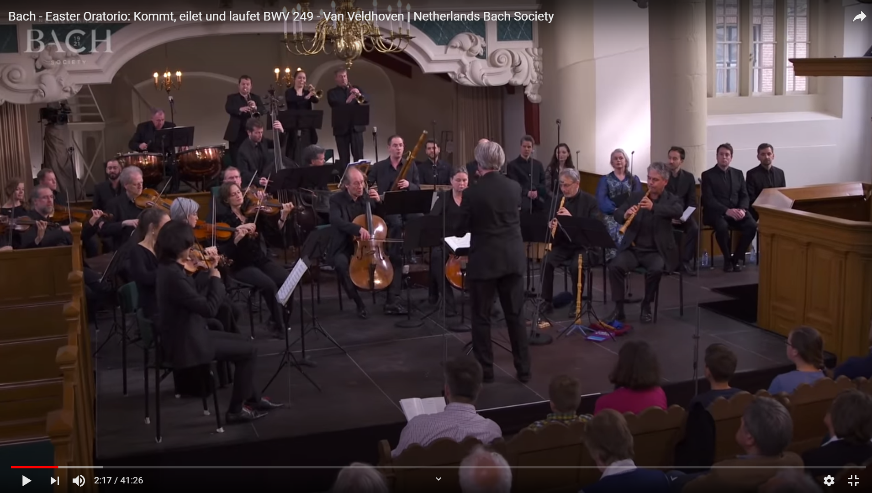
Example
Ensemble: https://www.youtube.com/watch?v=62fawgUUpg8

Slide 25
Effects and Rules
multi-mic comb filtering

Slide 26
Effects and Rules
reflection comb filtering

Slide 27
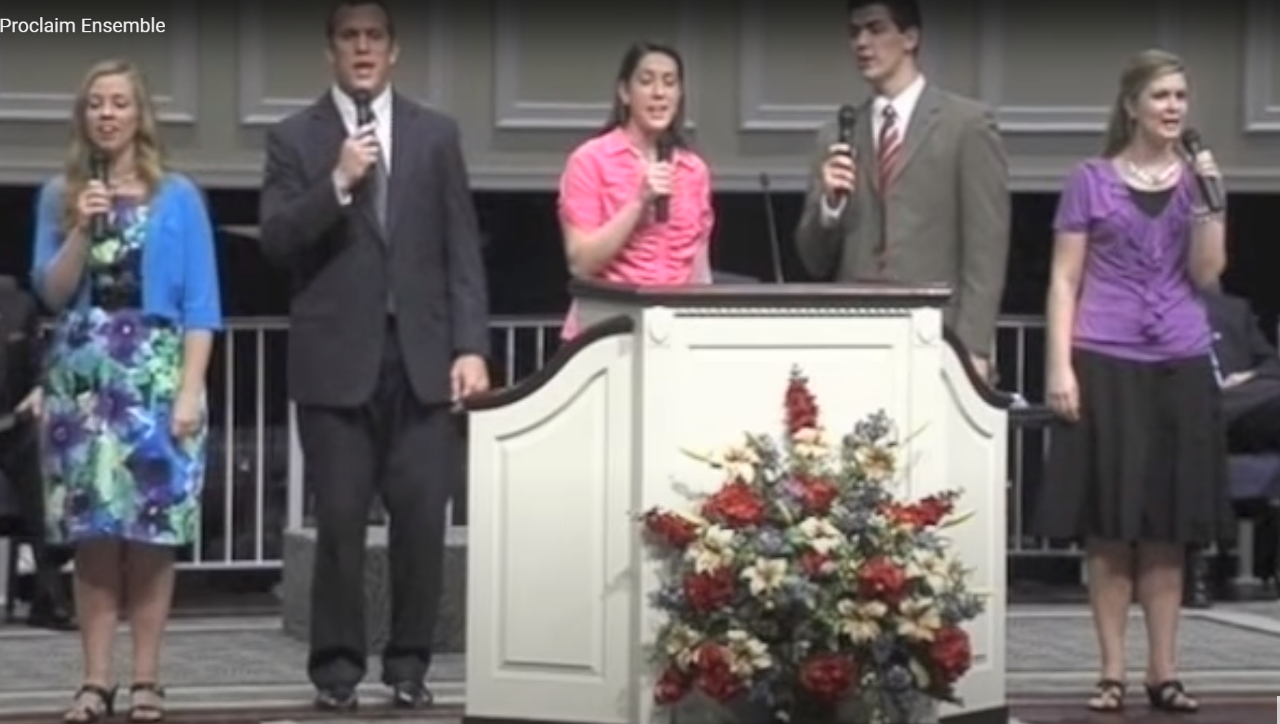
Effects and Rules
3-to-1 rule (“the distance between microphones should be at least 3x the distance from each microphone to its intended sound source”)

Slide 28
Effects and Rules
General
microphone technique boils down to personal taste (“whatever sounds right is right”)
there is no one ideal microphone to use on any particular instrument (but there are “good choices” and “bad choices”)
use as few microphones as are necessary to get a good sound – remember that every time the number of open microphones doubles, the potential acoustic gain (before feedback) decreases by 3 dB

Slide 29
Live Microphone Techniques

Slide 30
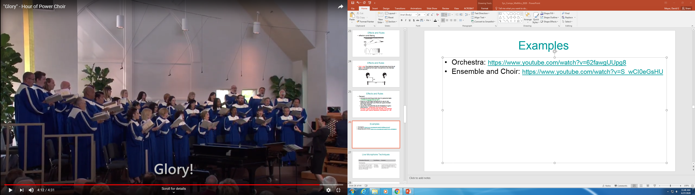
Examples
Choir: https://www.youtube.com/watch?v=S_wCI0eGsHU

Slide 31
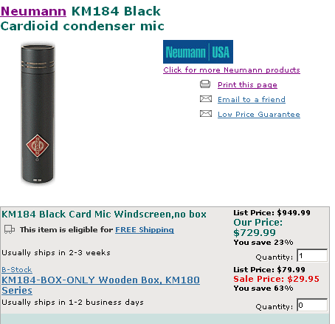
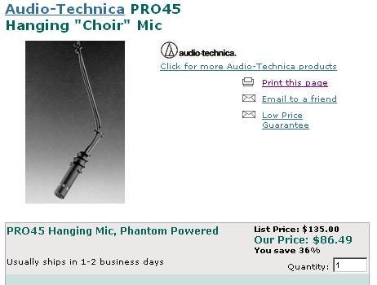
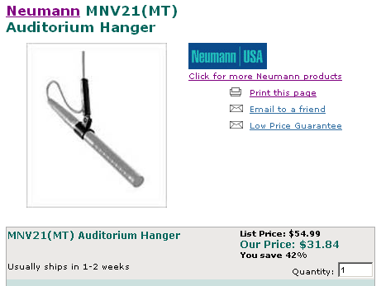
Let’s Play…What’s the Difference?

Slide 32
Live Microphone Techniques

Slide 33
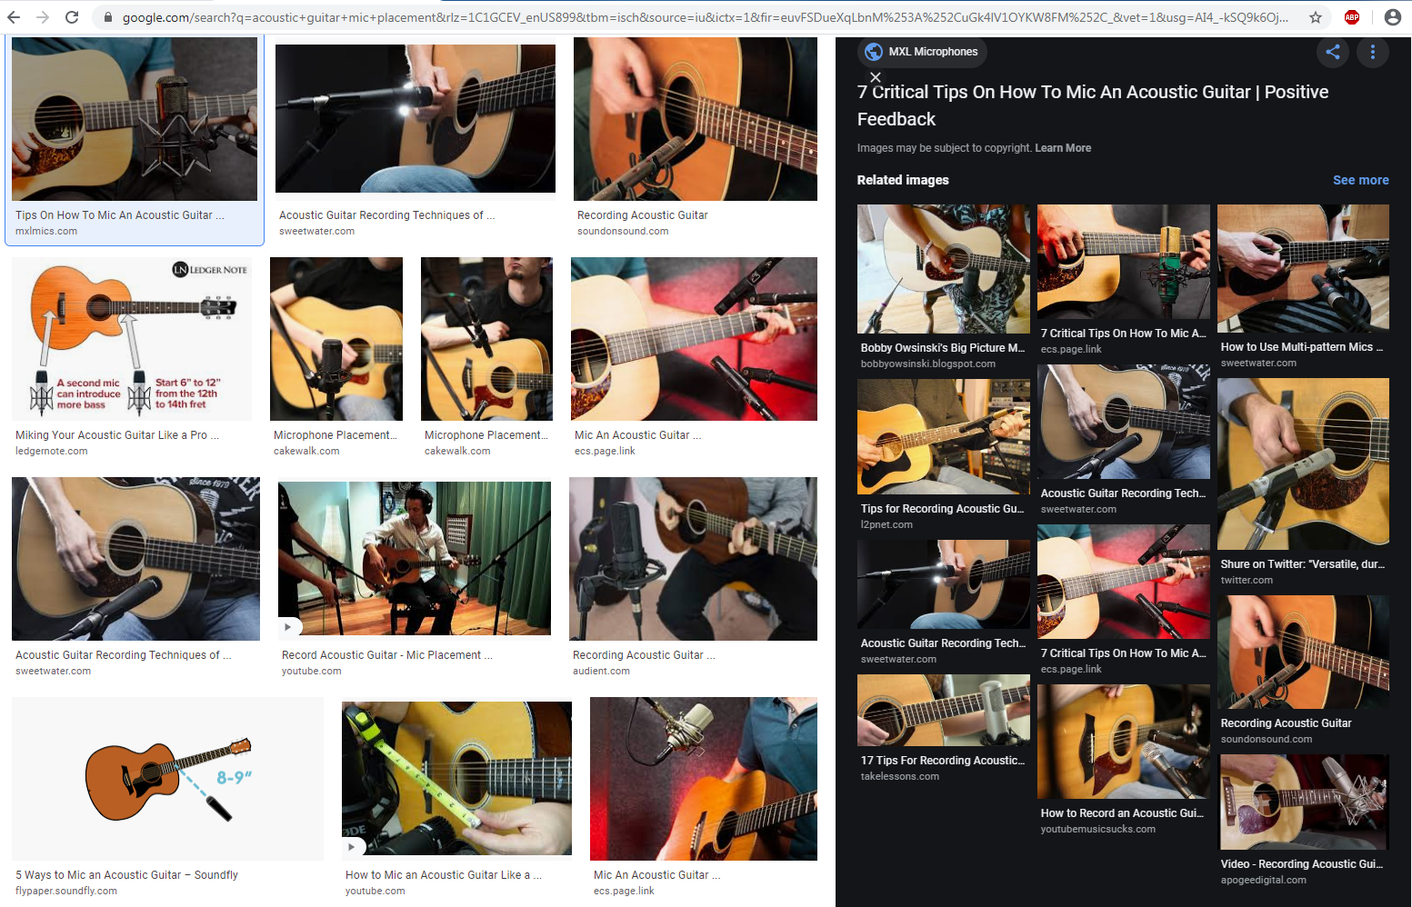
Examples

Slide 34
Live Microphone Techniques

Slide 35
Live Microphone Techniques

Slide 36
Live Microphone Techniques

Slide 37
Live Microphone Techniques

Slide 38
Live Microphone Techniques

Slide 39
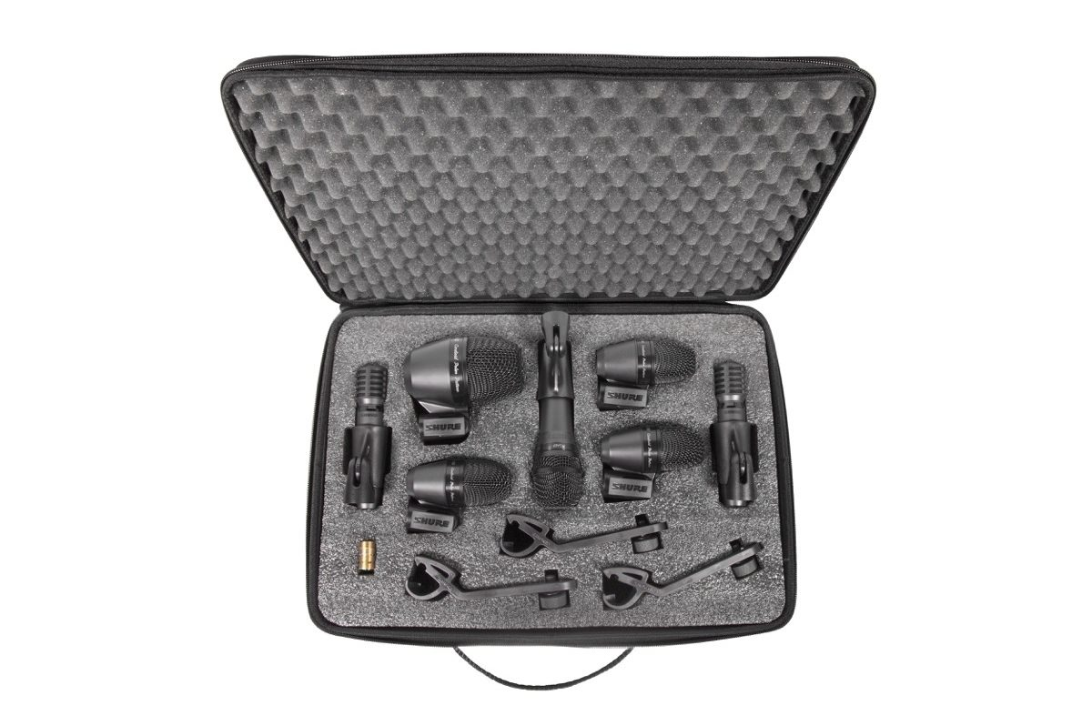
Live Microphone Techniques

Slide 40
Live Microphone Techniques

Slide 41
Live Microphone Techniques

Slide 42
Wireless Microphone Systems

Slide 43
FM Wireless Systems
Basically a low-power transmitter and radio receiver combination
Can be frequency agile (tunable) UHF or spread spectrum (2.4 GHz)

Slide 44
FM Antenna Types
Transmitter
Receiver

Slide 45
Wireless Microphone Frequency Bands

Slide 46
Range (Signal Loss vs RF Frequency)

Slide 47
FM Intermodulation Effects
Two Transmitters Three Transmitters

Slide 48
FM Diversity Principle

Slide 49
Noise Squelch

Slide 50
Companding

Slide 51
FM Wireless Systems
Desirable characteristics
frequency synthesis provides tuning flexibility
compatibility groups provide interference-free operation of multiple transmitters/receivers in same venue
diversity (dual antenna) receivers less prone to signal dropout due to interference effects
squelch provides protection against noise bursts if signal drops out – “tone-key” preferable
companding increases dynamic range of radio link

Slide 52
Digital (Spread Spectrum) Wireless Systems
Potential benefits
improved audio quality
improved radio transmission
possibility of encryption
Technical requirements are non-trivial
bandwidth needed (for high quality audio) is limited by physical and regulatory requirements
data compression techniques are needed to fit available bandwidth (typically a “lossy” scheme)
any digital processing introduces latency, which must be kept less than 5 ms for live sound applications
audio bandwidth divided into sub-bands that are processed separately to deliver the desired amount of data compression
modulation is usually FSK (frequency shift keying) or PSK (phase shift keying)
control and timing information has to be added to digital bit stream to achieve synchronization between transmitter and receiver processes
error correction codes need to be transmitted as well

Slide 53
Digital (Spread Spectrum) Wireless Systems
Digital transmitter Digital receiver

Slide 54
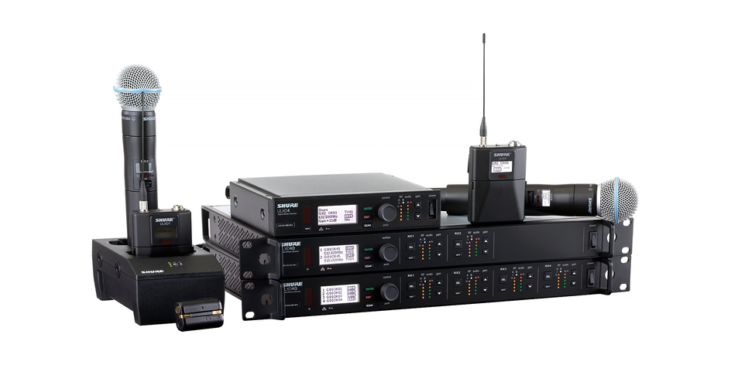
Digital (Spread Spectrum) Wireless Systems

Slide 55
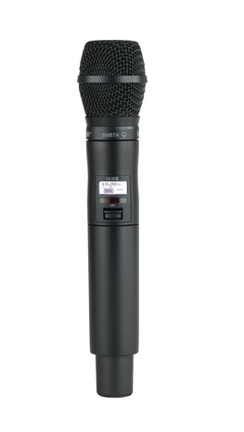
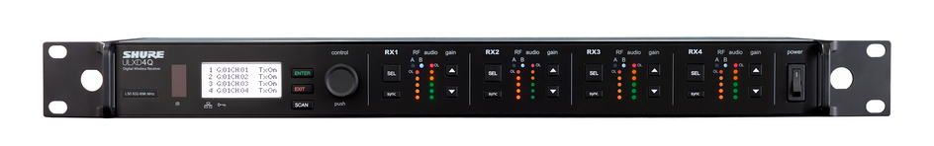
Digital (Spread Spectrum) Wireless Systems
ULXD2/SM87 Handheld Wireless Microphone Transmitter
With an interchangeable SM87A microphone cartridge, the ULXD2/SM87 delivers uncompromising audio quality and RF performance, and AES 256-bit encryption for secure transmission.
Works with ULX-D® Wireless Systems
Offers over 12 hours of continuous battery life with Shure rechargeable battery or 11 hours with alkaline battery
Includes ULXD2/SM87, 2 AA batteries, microphone clip, zipper bag, and user guide
Quad Channel Digital Wireless Receiver Four channels of uncompromising audio quality, RF signal stability, and advanced setup features in a space-efficient single rack unit.

Slide 56
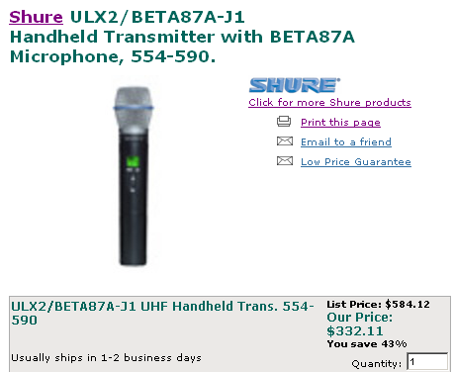
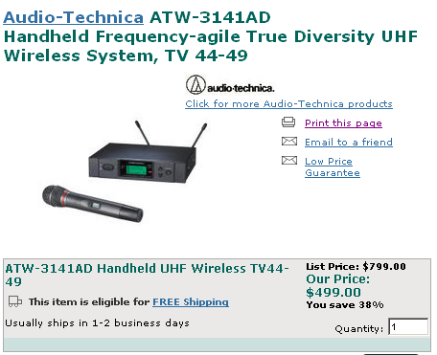
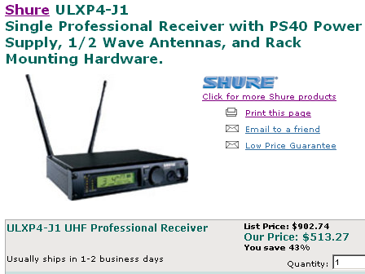
Let’s Play…What’s the Difference?

