Slide 1
System Components for the EASE Focus 3 Design Project Loudspeakers
Reference: Chapter 11 (3rd Ed.) of Sound Systems: Design and Optimization, by Bob McCarthy (Elsevier, 2017)

Slide 2
Outline
Specific questions and answers
Reception goals and challenges
Channel/system types
mono
stereo
surround
fills
monitor
Balcony battles
EASE Focus 3 project loudspeaker component selection
main arrays
fills / distributed delay
subwoofer arrays
Summary / conclusions

Slide 3
Specific Questions
How many channels?
Location of each channel’s desired sound image?
What are the specific practical limitations?
landmark status concerns (no drilling in plaster fascia)
invisibility (all speakers must be hidden)
sight lines (no speakers allowed below proscenium)
scenic elements (speaker locations must dodge set pieces and structural members)
must use “Brand X” speakers
must be portable
must fit in a truck (touring companies)
must be easily rigged
must be dummy-proof
must be a line array (even if a line array isn’t the best choice)

Slide 4
Specific Questions
Where are open microphones in a given channel’s coverage area?
What is the channel’s program material? (must be evaluated on a channel-by-channel basis)
What is the desired power scale? (loud, stupid loud, insanely loud)
What is the channel’s range of coverage? (“reach”)
What is the channel’s coverage area shape?
What areas need to be covered by fills?
What are the acoustic properties of the channel’s coverage area (absorption coefficients)?
What are the restrictions on choice of mix position? (prime house seats consumed by tech crew vs. “cheap seats”)
What is the budget?

Slide 5
Specific Answers
Speaker locations
Speaker array types
long and narrow space – coupled arrays
wide and shallow space – uncoupled arrays
Speaker models (required power and coverage angle)
Speaker quantities (power needs and coverage)
Speaker angles/orientation
Acoustic treatment (esp. on-axis surfaces)
Signal-processing channels
Cost

Slide 6
Reception Goals
Spatial separation as desired by artist (stereo, surround, multi-channel)
Credible tonal and spatial relationship to the source
Appropriate frequency bandwidth
Sufficient loudness
Desirable acoustics – tonal balance (appropriately scaled diffuse reverberation field, freedom from discrete echoes/resonances)
Clarity (sufficient direct-to-reverberant level ratio)

Slide 7
Challenges
Unfavorable architectural acoustics for amplified sound
Acoustic path obstructions (set pieces, lighting)
Poor speaker positions and focus angles
Insufficient coverage (gaps due to lack of resources, poor positions/focus angles)
Excessive coverage (too many loudspeakers, overlap due to poor positions/focus angles → combing)
Insufficient system subdivision (signal processing and power amplifiers) – independent channels needed to minimize spectral variance (EQ) and ripple variance (level + delay)

Slide 8
Channel/System Types - Mono
Central cluster (coupled point source) is the standard; alternative is “dual mono” system on left and right of the stage (uncoupled point destination array – note: lots of opportunity for combing!)
Related subsystems should preserve forward locality of reference, and be scaled as appropriate for their relative throw distances (fills, under balcony)
Subdivide when appropriate in order to level compensate for different distances, to minimize reflections, improve sonic image, or deal with obstructions

Slide 9
Loudspeaker Choice and Placement Options
central cluster (typically single-channel)
excellent coverage
high intelligibility
high gain before feedback
smooth frequency response
good locality of reference
cluster needs to be large for long, narrow room
potential for interference in driver overlap regions
hard to hide architecturally
“ugly hanging mess”

Slide 10
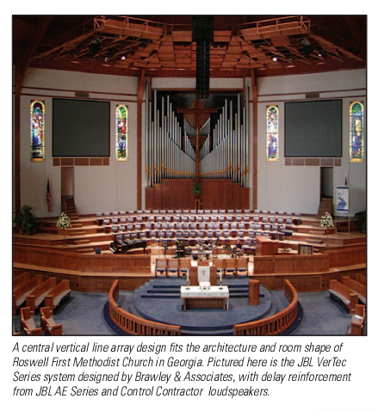
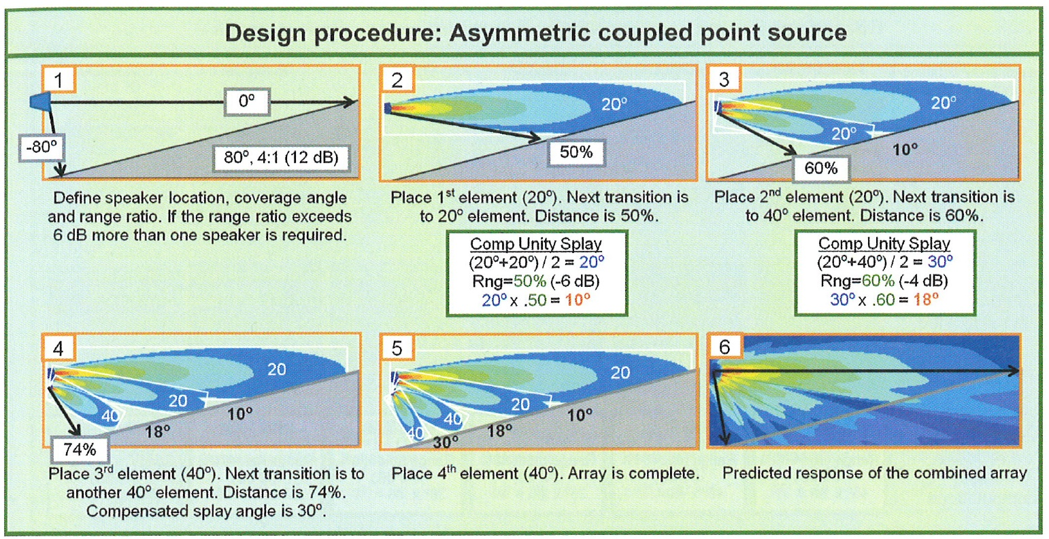
Central Vertical Line Array Example

Slide 11
Loudspeaker Choice and Placement Options
split (uncoupled point) source
best if multi-channel
high intelligibility
potential solution for challenging room geometries
generally more aesthetically pleasing (but not always)
potential for creating large interference (combining) zone
potential for loss of locality of reference
potential for limited frequency range over which directional control is possible

Slide 12

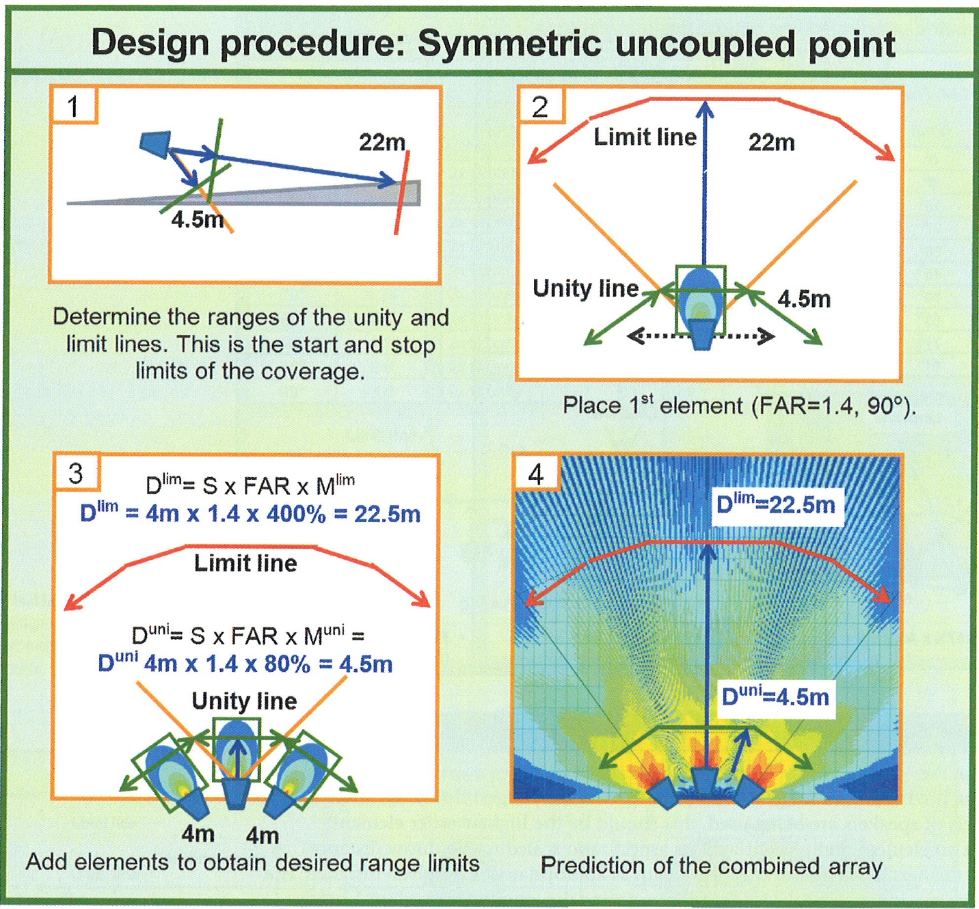
Split (Uncoupled Point) Source

Slide 13
Channel/System Types - Stereo
Horizontal overlap required in center seating area
Be mindful of non-scalable time offset considerations regarding stereo imagining (keep offset within 10 ms)
Stereo “aux” systems rarely worth effort/expense (e.g., stereo under-balcony delays)
If the stereo spacing is too narrow, it is not worth the trouble (e.g., central cluster split into stereo)

Slide 14
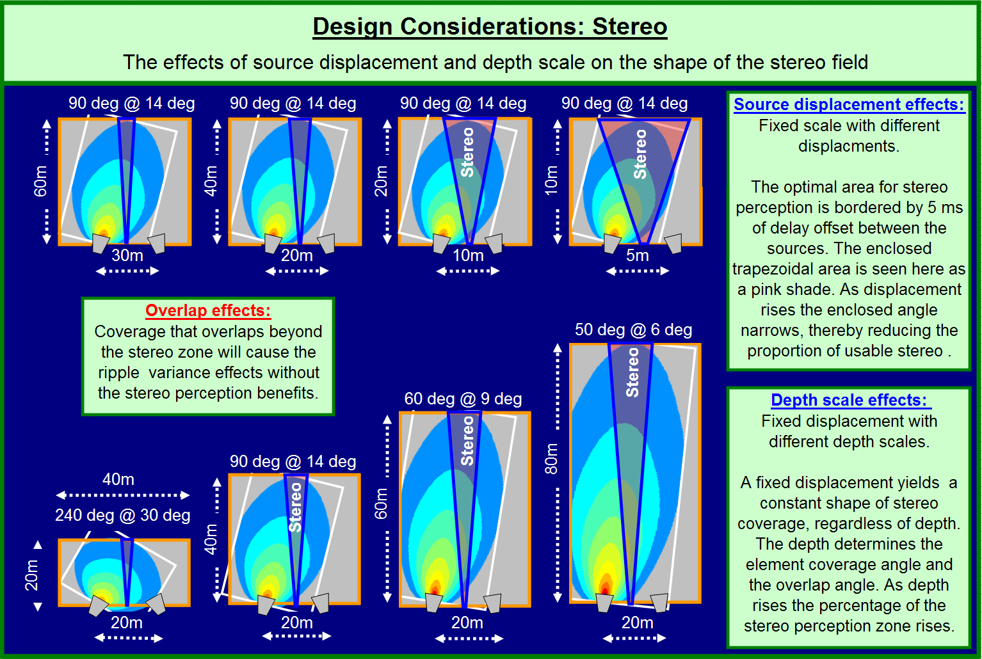
Channel/System Types - Stereo

Slide 15
Channel/System Types - Surround
Surround speakers typically spaced along side and rear walls as an uncoupled line source array in the horizontal plane (1st order standard) – use aspect ratio method to space them
Want to mount these as high as they practically can in order to reduce proximity effect (distortion of horizontal localization)
Surround speakers will provide the most uniform experience if they are aimed far across the space (left aimed at right, rear aimed at front)
Subdivide coverage for different seating levels (first floor, second floor)
Delay generally not required except in special cases

Slide 16
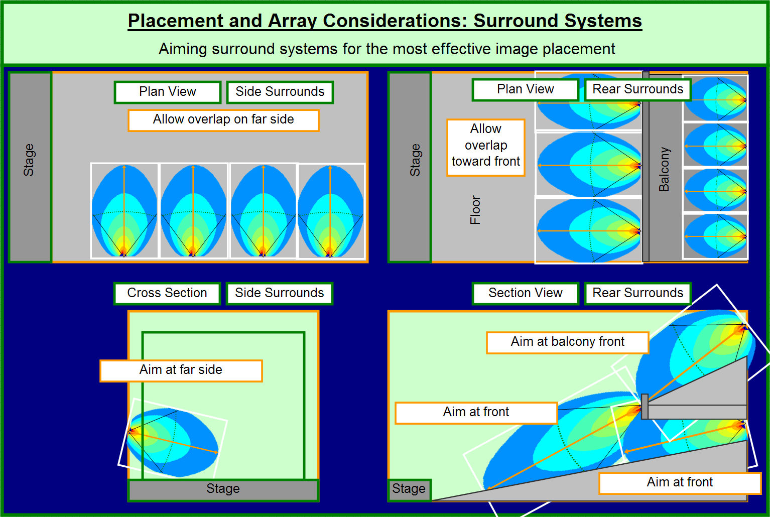
Channel/System Types - Surround

Slide 17
Channel/System Types - Fills
Sidefill – provides horizontal radial extension to main system (semi-isolated from mains)
Infill – also provides horizontal radial extension to main system (differ from sidefills in that they are oriented toward the center rather than the outside)
Downfill – provides a vertical radial extension of main array (typically an asymmetric component of the coupled point source)
Frontfill – coverage of seats very near to stage (usually located on stage lip, very limited in forward coverage depth)
Delays – forward extensions of mains, inherently uncoupled

Slide 18
Channel/System Types - Fills

Slide 19
Loudspeaker Choice and Placement Options
distributed / delayed (uncoupled point destination)
good solution for large, absorptive rooms with low ceilings
potential solution for challenging room geometries
potential solution for reinforcing “distant” zones
requires digital delays / multiple amplifiers (expensive)
potential for loss of locality of reference
generally not well suited for rooms with high ceilings (or that are highly reverberant)

Slide 20
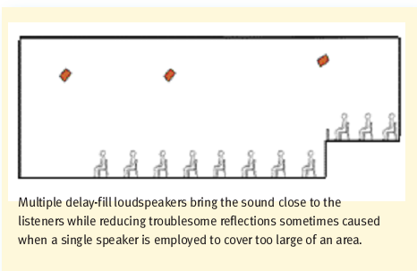
Distributed / Delayed

Slide 21
Balcony Battles
Shape is “W” turned on its side – suggests need for uncoupled pair of asymmetric point source arrays
Problem is midrange and below (can do the HF steering)
Tradeoffs
single main: best for minimum ripple variance, worst for level and spectral variance
multiple main: worst for ripple variance, best for minimum level and spectral variance
Return ratio – number of dB closer we find the front of the balcony to the farthest area angularly adjacent to it (where sound goes when skims just above or below the balcony front); affects decision whether or not to split mains

Slide 22
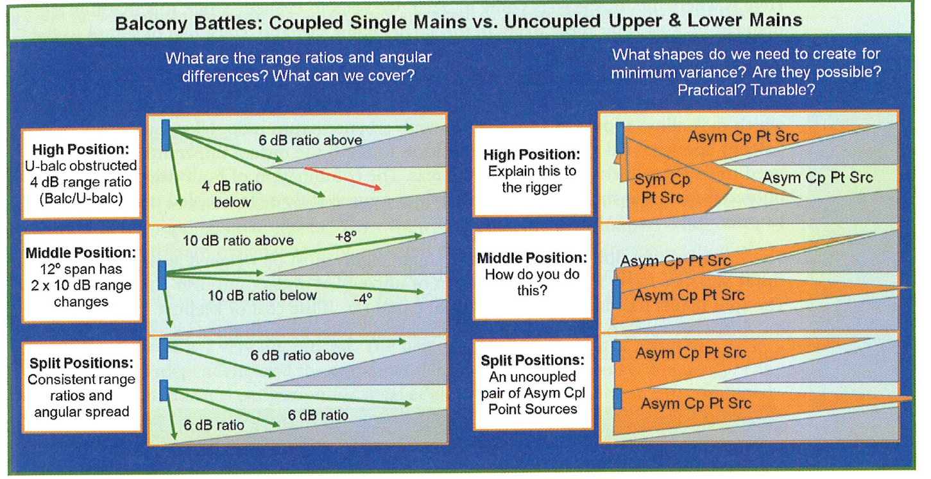
Balcony Battles

Slide 23
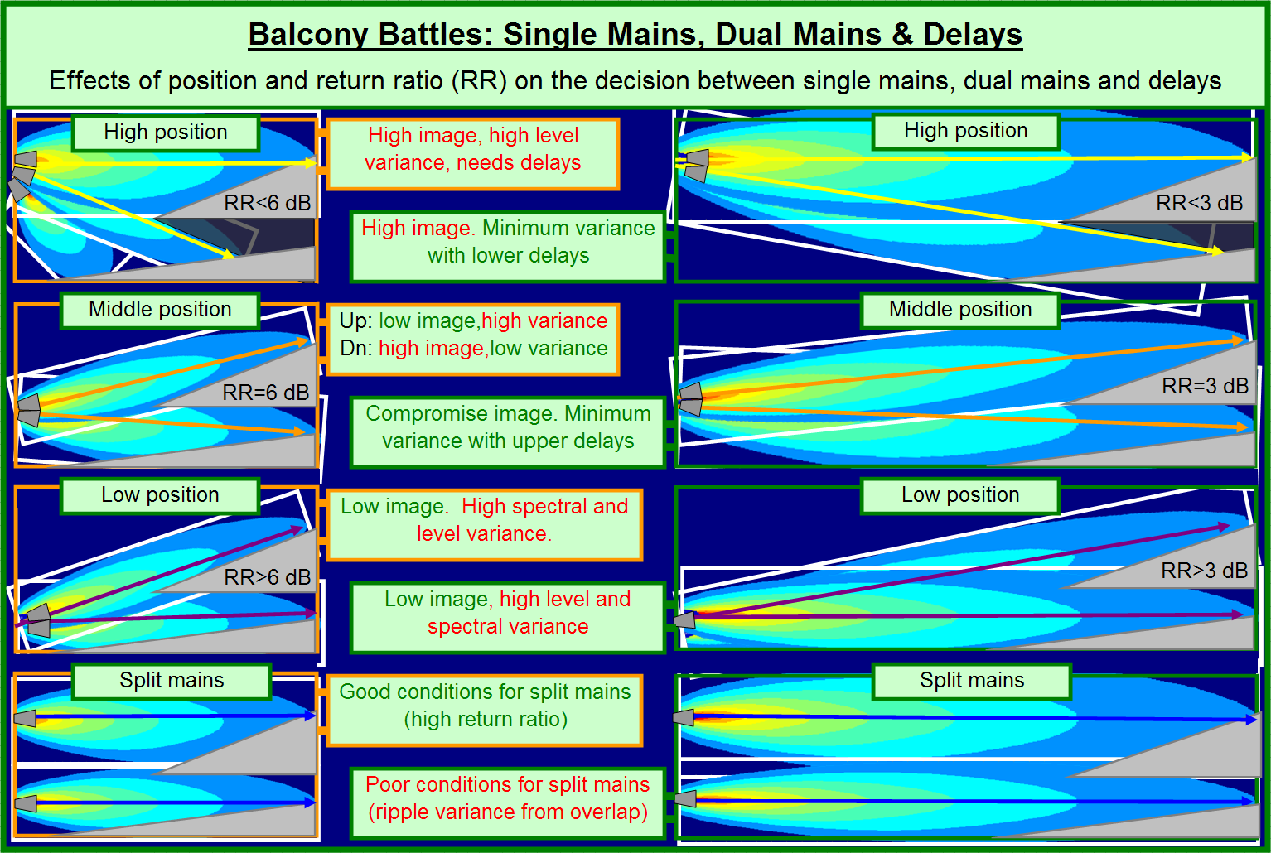
Balcony Battles

Slide 24
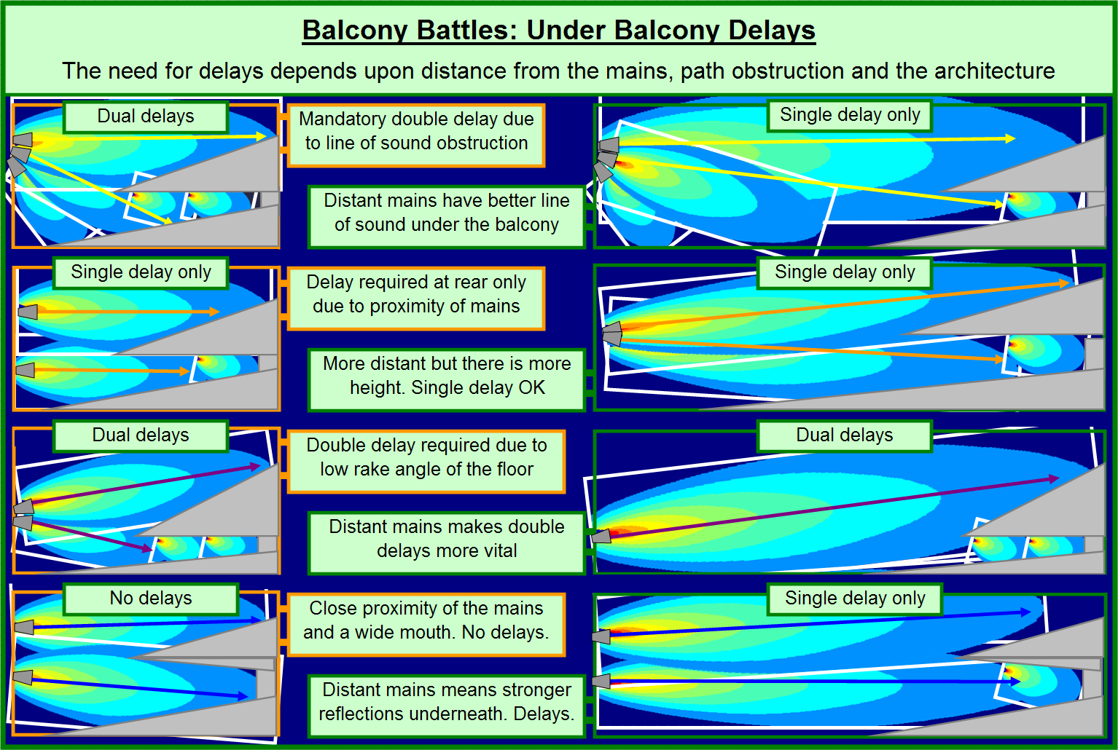
Balcony Battles

Slide 25
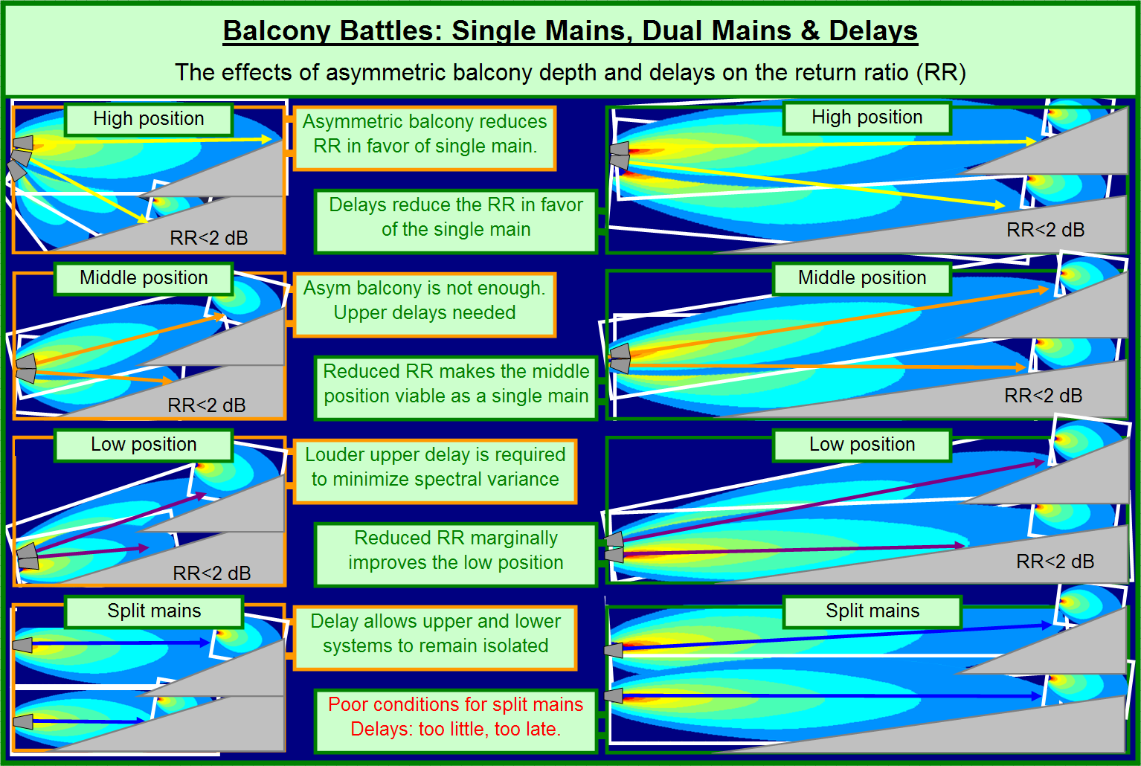
Balcony Battles

Slide 26
Balcony Battles
Introducing “shock” into splay angle increment to induce “separation” of main beam

Slide 27
Monitor Systems
Two choices
stage monitor loudspeakers
powered
unpowered
personal (earbud) monitors
wired
wireless
Monitor mixes
main (FOH) mixing console
personal monitor mixers

Slide 28
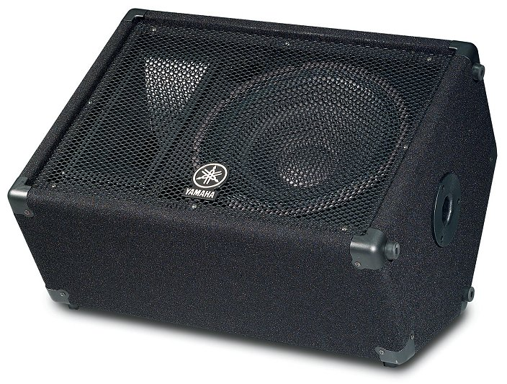
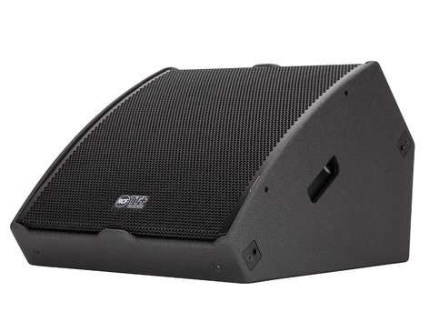
Stage Monitors
Can be PASSIVE or ACTIVE

Slide 29
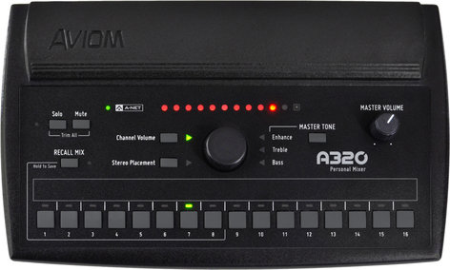
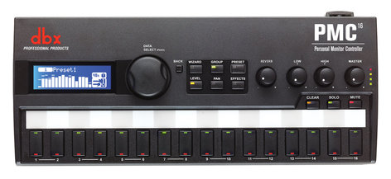
Personal Monitor Mixers

Slide 30
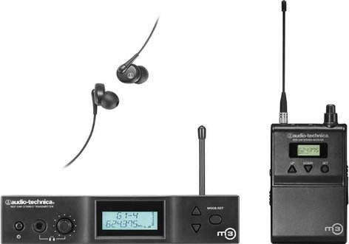
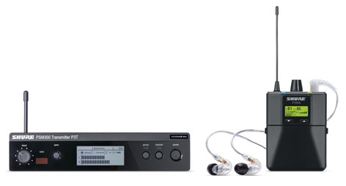
Wireless Earbud Monitors

Slide 31
Main Loudspeaker Arrays for the EASE Focus 3 Design Project

Slide 32
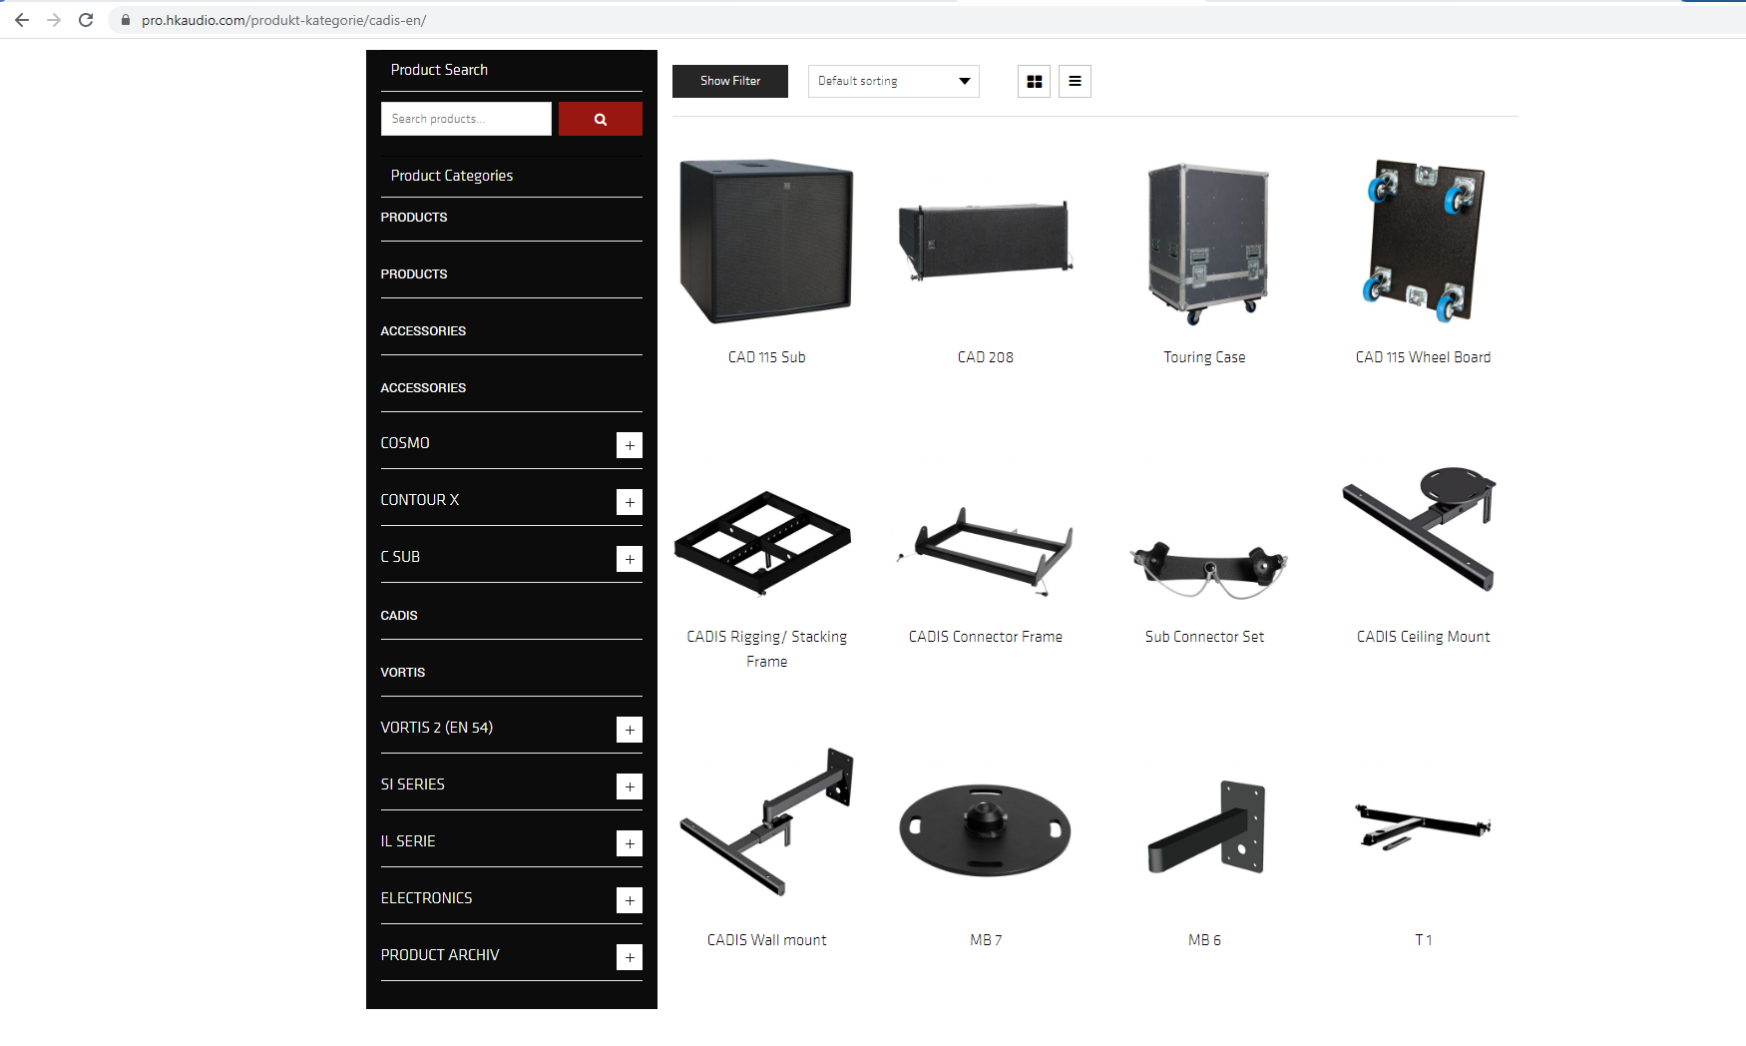

Slide 33
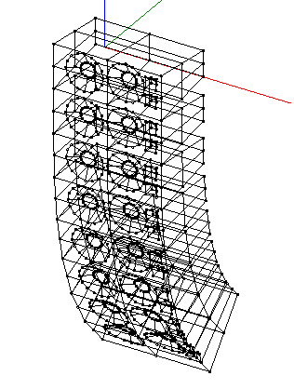
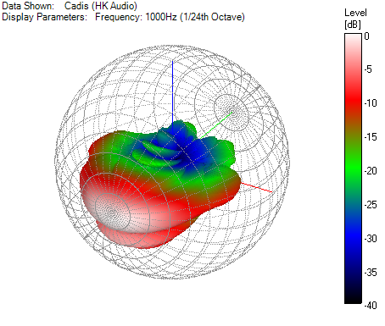
HK CADIS CAD 208 (Cadis-V11.gll)

Slide 34
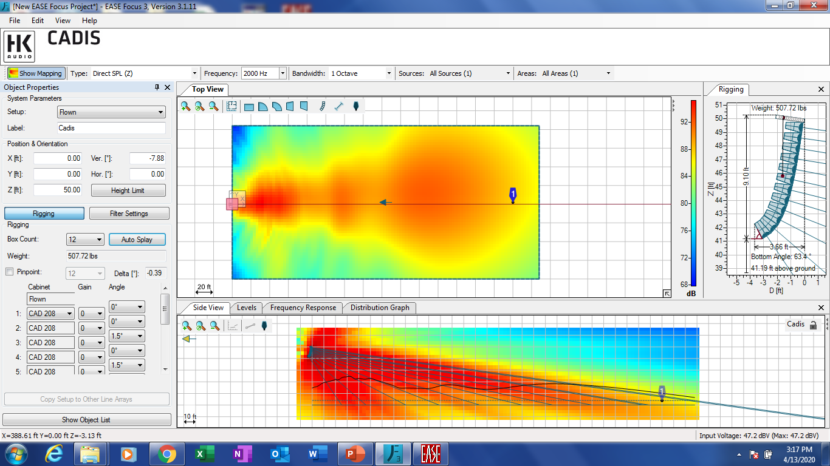

Slide 35
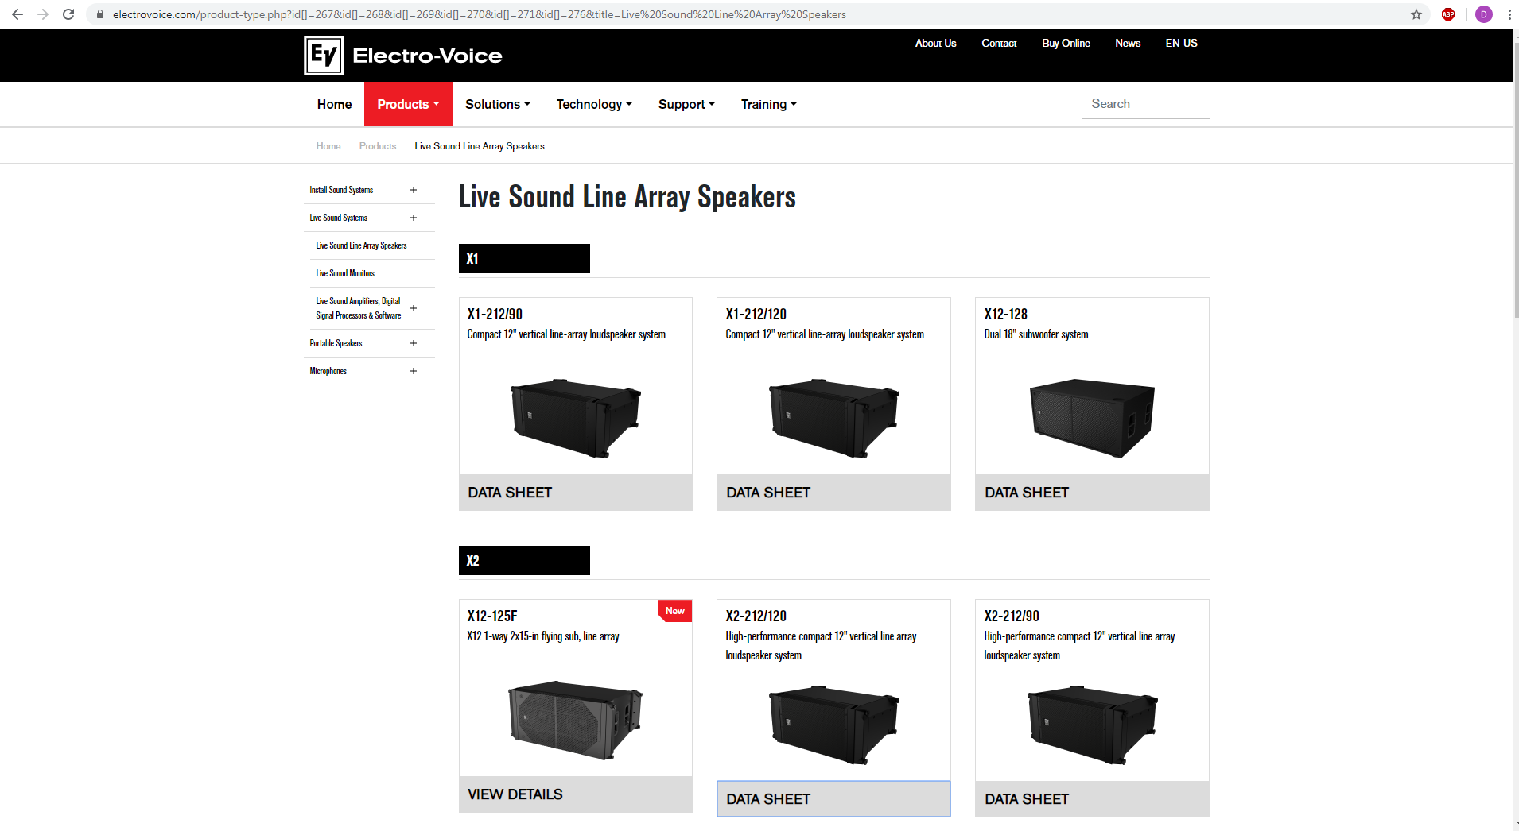

Slide 36
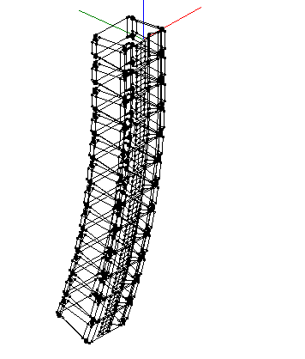
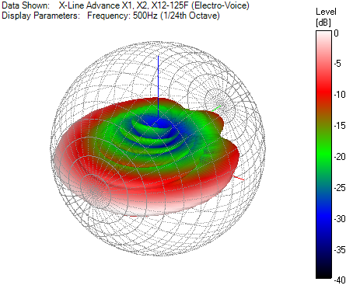
EV X-LINE X2-212/120 (X-Line Advance X1, X2, X12-125F v2.1.gll)

Slide 37
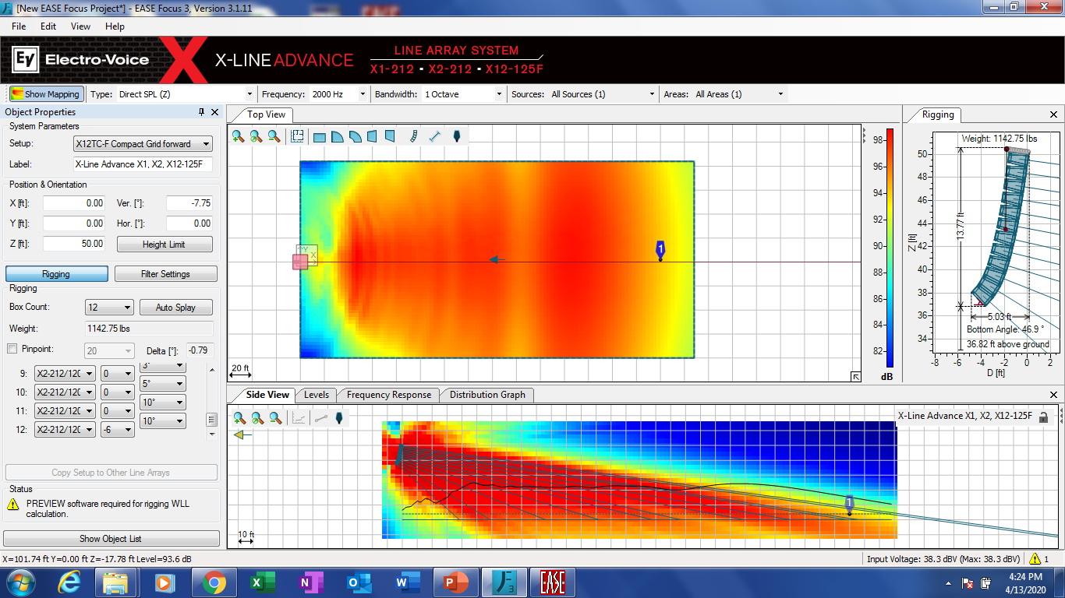

Slide 38
Fills / Distributed Delay Loudspeakers for the EASE Focus 3 Design Project

Slide 39
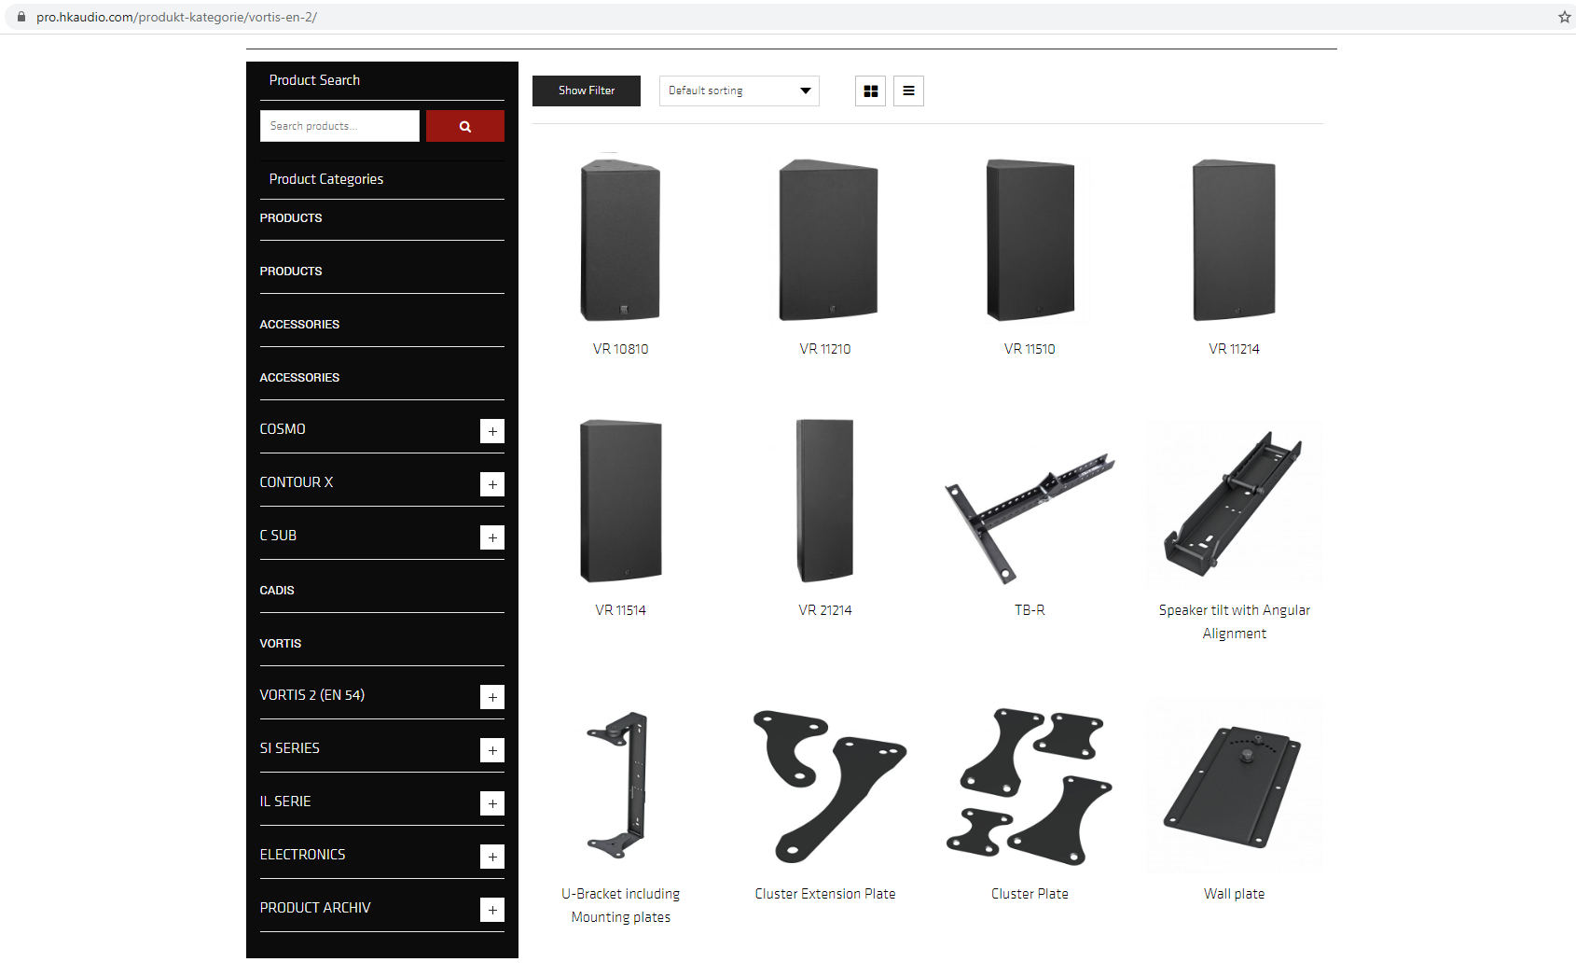

Slide 40
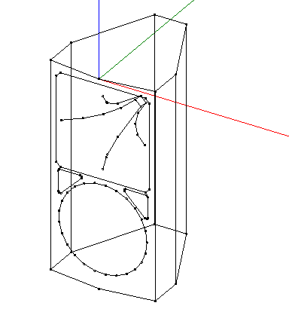
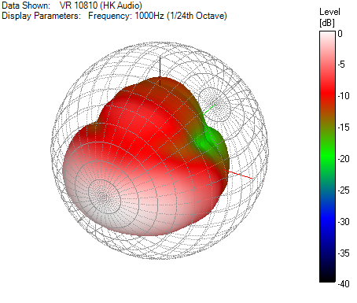
HK VR 10810 (HK-VR10810-V10.gll)

Slide 41
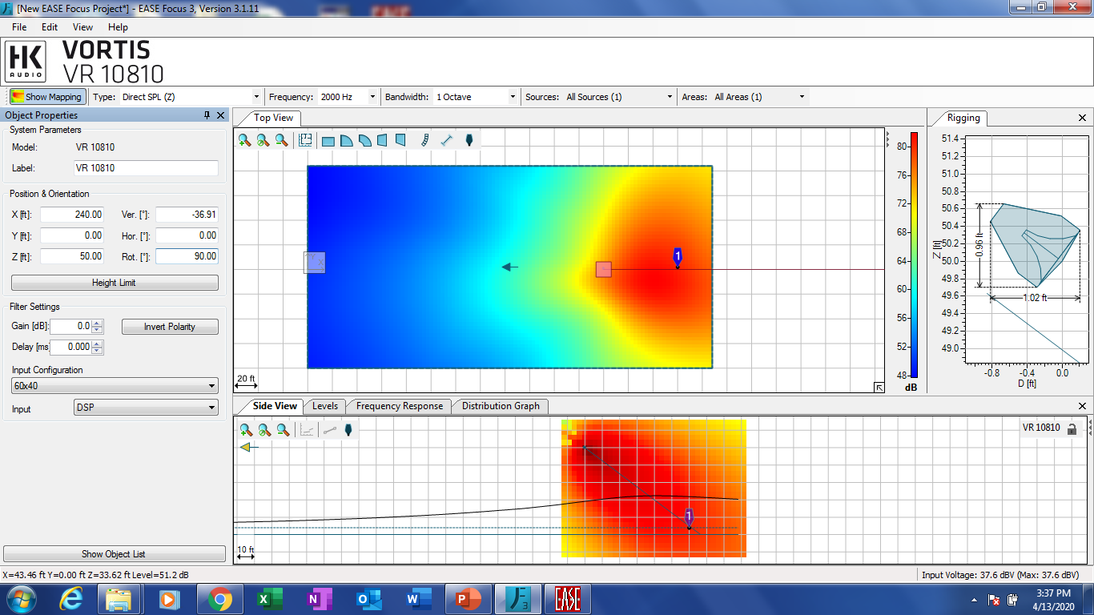

Slide 42
Subwoofer Arrays for the EASE Focus 3 Design Project

Slide 43
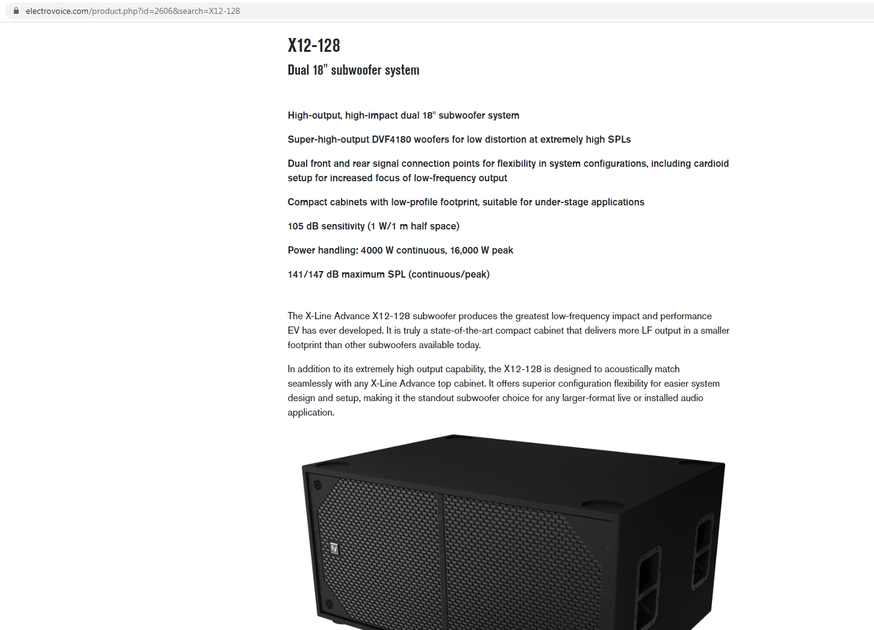
EV X12-128 4 Element FFRF (X12-128 4-Element Cardioid Stack (Front-Front-Rear-Front) v2.2.gll)

Slide 44
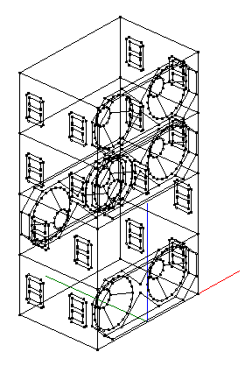
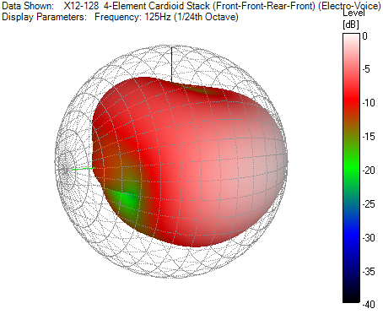
EV X12-128 4 Element FFRF (X12-128 4-Element Cardioid Stack (Front-Front-Rear-Front) v2.2.gll)

Slide 45
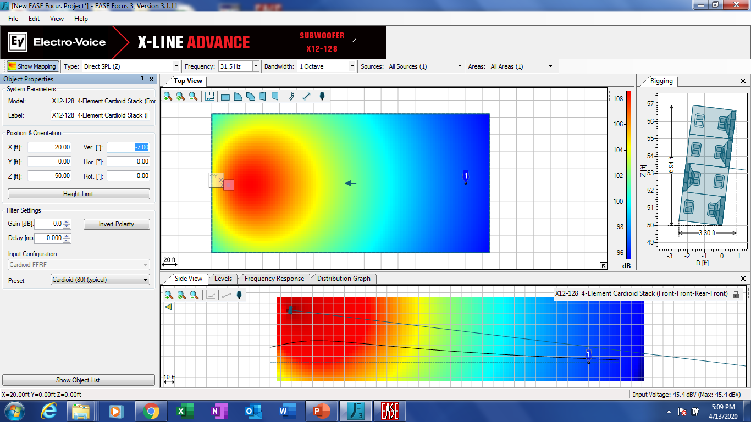

Slide 46
Loudspeaker Selection: Summary / Conclusions
There is no universal, “one size fits all” solution to loudspeaker selection
When selecting loudspeakers for the EASE Focus 3 sound reinforcement design project, compare and contrast offerings from multiple manufacturers – be prepared to defend your choices

