Slide 1
System Components for the EASE Focus 3 Design Project Introduction
Reference: Sound System Engineering (3rd Ed), by Don Davis and Eugene Patronis, Jr. (Focal Press, 2006)

Slide 2
Outline
Good Sound: Context and Complications
Acoustic Environment Indoors
Intelligibility
Designing for Acoustic Gain
Good Sound: Quality Factors and Overall Goals

Slide 3
Good Sound: Context and Complications
EASE Focus 3 Project: multi-purpose venue, fixed installation
Context:
large coverage area plus balcony
multiple arrays and delay zones
high power/SPL
Complications:
room geometry and surface treatments may exacerbate unwanted reflections and excessive reverb → intelligibility issues
temperature gradient more stable (than outdoors), but may shift seasonally (summer vs. winter) → delay compensation
overlap areas in array coverage causes comb filtering effects → necessitating tight array directivity control and careful aiming
variable audience fill effects, seat characteristics

Slide 4
Acoustic Environment Indoors
The sound arriving at a listener’s ears has (at least) three distinct divisions:
direct sound
early reflections
reverberant sound
The direct sound undergoes no reflections and follows inverse-square-law level change (-6 dB per doubling of distance)
The reverberant sound tends to remain at a constant level if the sound source continues to put energy into the room at a regular rate

Slide 5
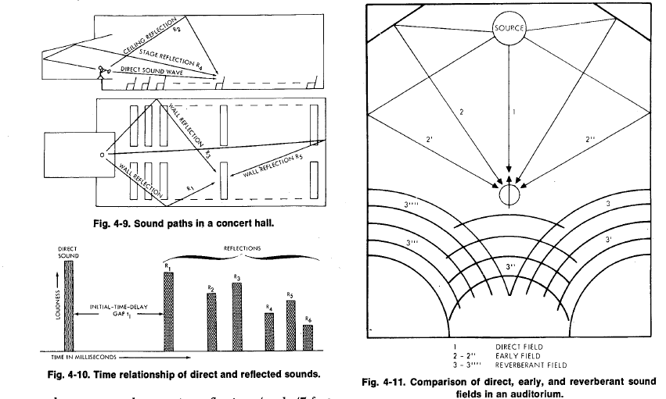
Acoustic Environment Indoors
Sound paths in a concert hall
Time relationship of direct and reflected sounds
Comparison of direct, early, and reverberant sound fields in an auditorium

Slide 6
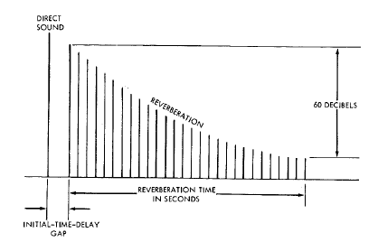
Acoustic Environment Indoors
Consider enclosed space with internal volume V and total boundary surface S
Each surface s_{i} has an absorption coefficient a_{i}
The average absorption coefficient is a_{avg} = [Σs_{i} a_{i}] / S
The room constant R = (S∗a_{avg})/(1-a_{avg})
The room will possess a reverberation time RT₆₀ (time in seconds for steady-state sound to attenuate 60 dB)
Determination of RT₆₀

Slide 7
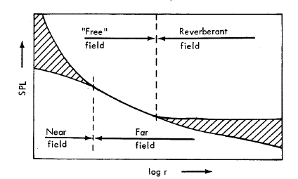
Acoustic Environment Indoors
This gives rise to several basic sound fields:
near field
free field
reverberant field
The near field is typically defined to be within a distance of twice the largest dimension of the sound source
In the (far) free field, inverse-square-law level change prevails
In the reverberant (diffuse) field, sound energy density is nearly uniform
Critical distance (Dc)
far field
Sound fields in an enclosed space

Slide 8
Acoustic Environment Indoors
Dc (the “critical distance”) is the point at which the direct sound and the reverberant sound are both at the same level
Dc determines the maximum acoustical separation, hence maximum acoustic gain
Dc can be “controlled” by changing R (the absorption of the room surfaces) or the Q of the loudspeaker (higher Q, more directive, less reverberant energy)
Dc determines the required directivity of the loudspeaker in an existing room
Critical distance (Dc)
Sound fields in an enclosed space

Slide 9
Intelligibility
Several methods have been devised for assessing the speech intelligibility of sound reinforcement systems
Articulation loss of consonants (%ALCONS) is one method of determining the articulation score of an enclosed space
If ALCONS < 10%, intelligibility is very good
Between 10-15%, intelligibility is sufficient
ALCONS of 15% is considered a practical working limit
Can use EASE to calculate an “ALCONS map” of your venue (not available in EASE Focus 3)

Slide 10
ALCONS – Definition #1
A scale of the percentage of the articulation loss of consonants. A formula derived by V.M.A. Peutz based on distance, RT₆₀, Volume of air in the room, the N factor, and the Q of the source. A measure of how difficult it is to understand someone in a room. The lower the number, the better for speech intelligibility.
Source: Church Audio & Acoustics Glossary

Slide 11
ALCONS – Definition #2
The measured percentage of Articulation Loss of Consonants by a listener. An ALCONS of 0% indicates perfect clarity and intelligibility with no loss of consonant understanding, while 10% and beyond is growing toward bad intelligibility, and 15% typically is the maximum loss acceptable.
Source: http://www.owenscorning.com/around/sound/glossary.asp

Slide 12
Causes of Reduced Intelligibility
Poor signal-to-noise ratio (SNR or S/N)
Excessive reverberation
Long/delayed reflections, echoes
Loudspeaker misalignment
Poor equalization
Q too low (main array beamwidth too wide)
Excessive distance from source

Slide 13
Designing for Acoustic Gain
Sound (at listener’s ears) must be sufficiently loud (25 dB above ambient noise level at mid-frequencies in rooms with RT₆₀ ≥ 1.6 sec)
Sound must reasonably approximate audio spectrum produced by source
Sound must reasonably approximate a ratio of direct-to-reverberant sound within the constraints of acceptable articulation loss

Slide 14
Good Sound: Quality Factors
frequency range/response, “smoothness”
SPL at (furthest) listening position
headroom (“Crest factor”)
evenness of coverage (spectral and spatial stability)
intelligibility (articulation loss of consonants)
ratio of direct sound field to reverberant sound field
gain before feedback
noise (SNR) and distortion (IM and THD)
transient response and damping factor
group delay (frequency-dependent arrival times)
locality of reference

Slide 15
Good Sound: Overall Goals
minimum spectral variance over space
minimum level variance over space
minimum ripple variance over space
maximum power addition over space

Slide 16
System Component Selection
Loudspeakers
Power amplifiers
Signal processors
Mixing consoles
Microphones
Hearing assistive devices
Racks, cabling, and wiring

