Slide 1
Summation
of Audio Signals and Acoustic Waves
Reference: Chapter 4 (3rd Ed.) of Sound Systems: Design and Optimization, by Bob McCarthy (Elsevier, 2017)

Slide 2
Outline
Properties of Audio Summation
Response Ripple
Acoustical Crossovers
Speaker Arrays
Speaker/Room Summation

Slide 3
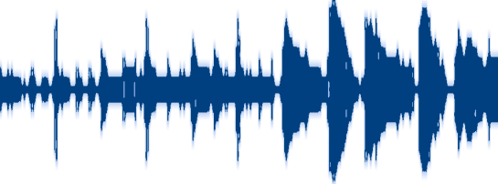

Summation Criteria: Matched Origin
Summed Signal
Signal 1
Signal 2
Summed Signal
Signal 1
Signal 2

Slide 4
Summation Criteria: Matched Origin
Summed Signal
Signal 1
Signal 2
Summed Signal
Signal 1
?
Signal 2

Slide 5
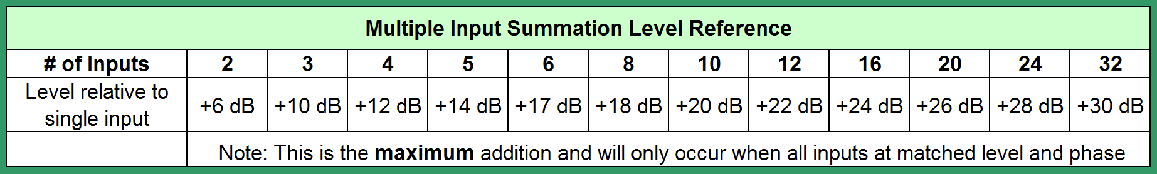
Summation Criteria: Multiple Input Signals
Summed Signal
Signal 1
Signal 2
Signal 3
Signal 4
Signal n

Slide 6
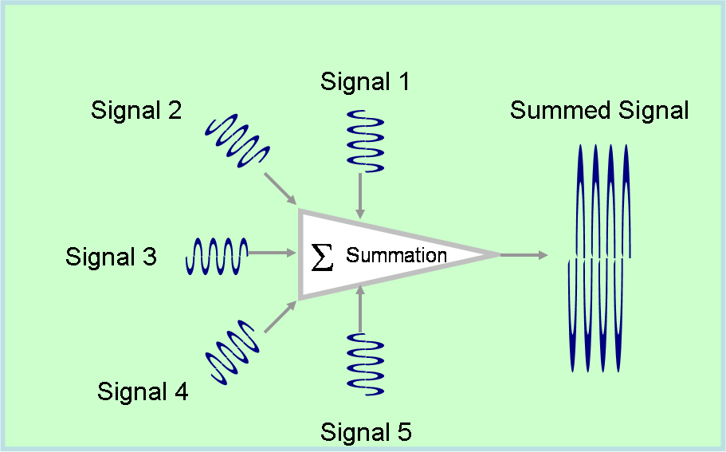
Summation Criteria: Input Signal Direction

Slide 7
Summation Criteria: Overlap Duration
Summed Signal
S 1
S 2
Addition/subtraction during overlap duration
Summed Signal
S 1
S 2
No addition/subtraction

Slide 8
Adding dB-SPL
Two acoustic sources “a” and “b” of relative phase angles θ_{a} and θ_{b}
Σ_{dB-SPLa+b} =
20 log₁₀ [sqrt { (10^{dB-SPLa/20})² + (10^{dB-SPLb/20})²
+ 2(10^{dB-SPLa/20}) (10^{dB-SPLb/20})(cos(θ_{a}-θ_{b}))} ]

Slide 9
Adding dB-SPL – “Simplifications”
If both sources are in phase and only the relative level varies (where source “a” is 0 dB, simplifies to:
Σ_{dB-SPLa+b} = 20 log₁₀ [1 + 10^{dB-SPLb/20} ]
If both sources are at 0 dB and phase angle θ_{a} = 0 (i.e., same level, only relative phase angle varies), simplifies to:
Σ_{dB-SPLa+b} = 20 log₁₀ [ sqrt { 2 + 2cos(-θ_{b}) } ]

Slide 10
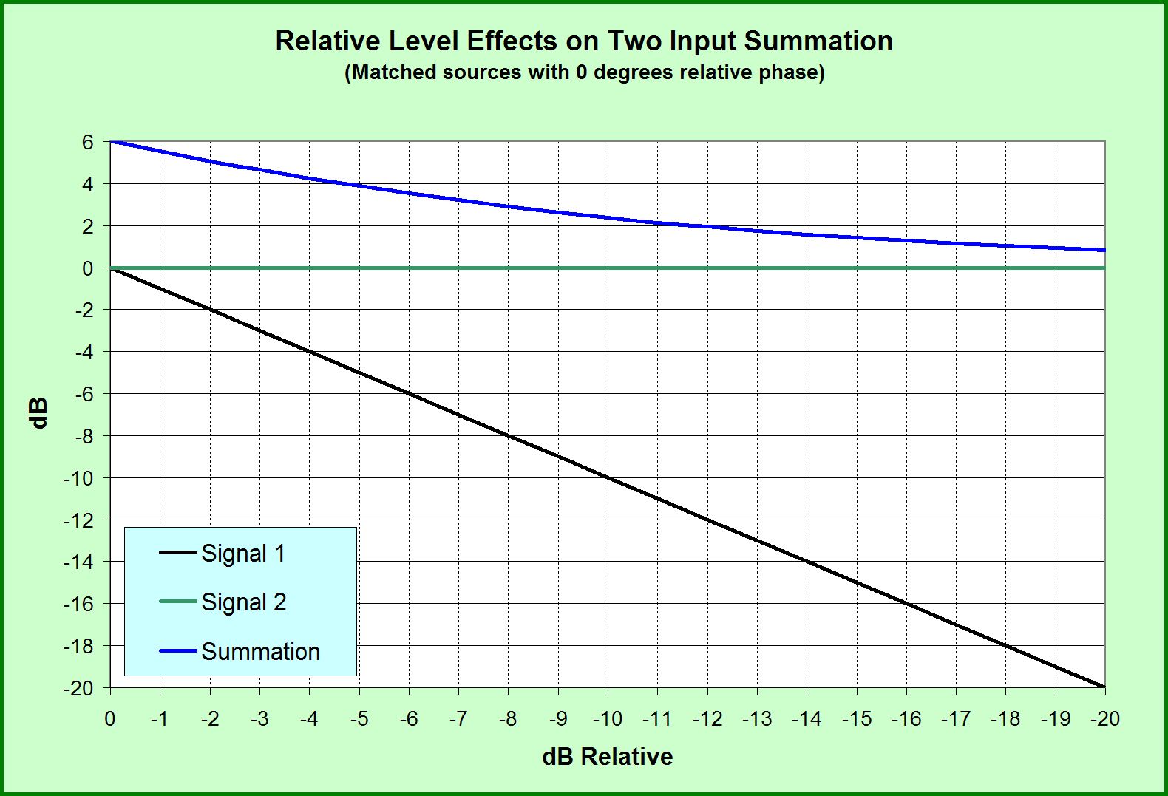

Slide 11
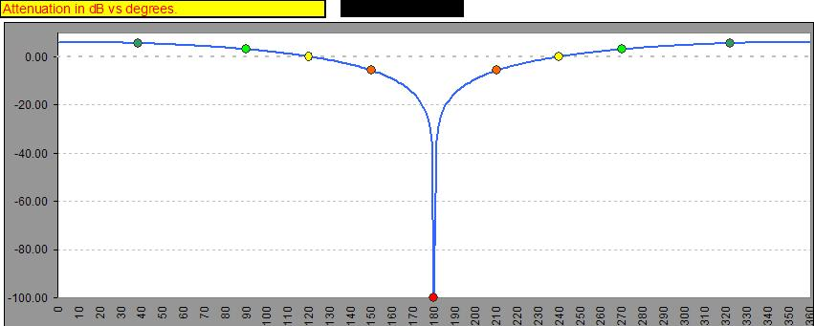
Acoustic Addition & Subtraction: Level vs. Phase
two identical signals summed at same level

Slide 12
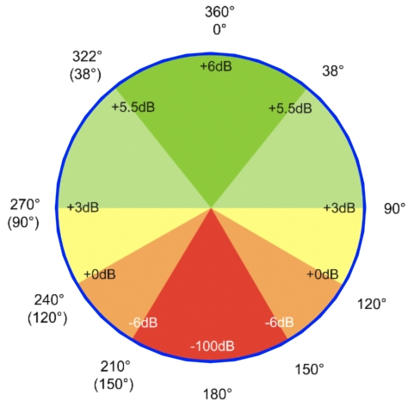
Acoustic Addition & Subtraction: The Phase Wheel
two identical signals summed at same level

Slide 13
Summation: Response Ripple
Time offsets shift all frequencies by the same amount of time
Time offsets shift all frequencies by a different amount of phase
Result of summation with time offset (of signals at same frequency) is response ripple

Slide 14
Acoustic Addition and Subtraction: Level Offset Effects
Max Ripple
Relative Phase=0°
Relative Phase=180°

Slide 15
Summation Zones Defined
Coupling zone
  Sources within ±1/3 wavelength (±120º)
  Amount of addition ranges from 0 to 6 dB depending on phase/level offset
  Ripple is ±3 dB
  Most easily achieved at low frequencies due to large wavelengths

Slide 16
Summation Zones Defined
Cancellation zone
  Effects only subtractive
  Phase offset ±150º to ±180º
  Ripple ±50 dB

Slide 17
Summation Zones Defined
Combing Zone
  Phase offset reaches point where subtraction begins (> ±120º)
  Less than 4 dB level difference
  Characterized by addition at some frequencies and dips at others
  Ripple ranges from ±6 dB to ±50 dB
  To be avoided – highest form of variance over frequency

Slide 18
Summation Zones Defined
Combining Zone
  Level offset ranges from 4 dB to 10 dB
  Semi-isolated state relative to sources, which limits the magnitude of addition/cancellation
  Ripple no more than ±6 dB

Slide 19
Summation Zones Defined
Isolation Zone
  10 dB or more of level offset
  Relative interactions steadily reduced and eventually become negligible
  At large level offset, relative phase has nominal effect
  Ripple does not exceed 6 dB

Slide 20
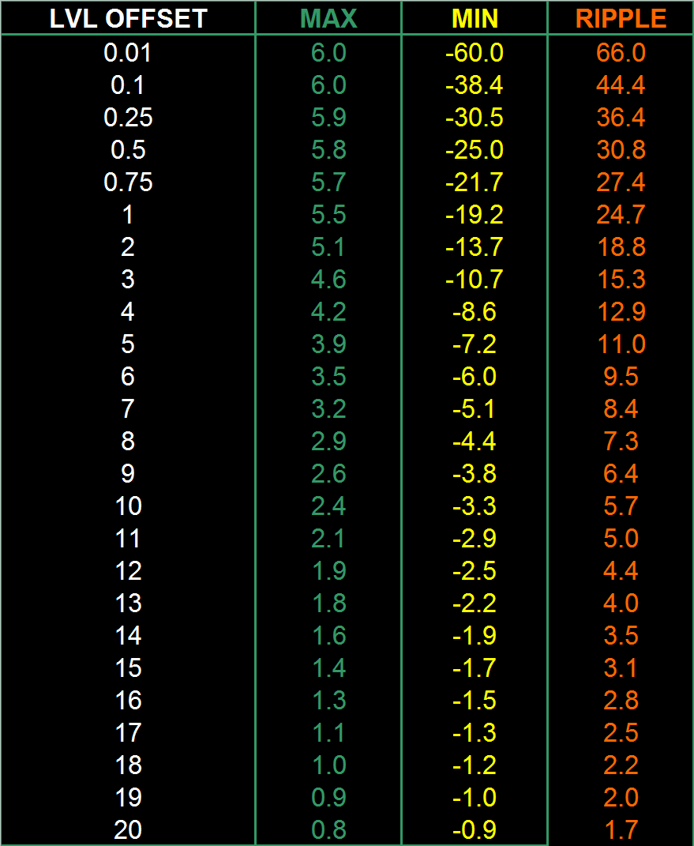
Acoustic Addition and Subtraction: Level Offset Effects
Coupling Zone
0 to -10 dB, 0 to -120° phase
Combing Zone
< 4 dB Level Offset
Relative Phase=0 deg
Relative Phase=180°
Combining Zone
4 to 10 dB Level Offset
Max + Min = Ripple
Isolation Zone
> 10 dB Level Offset

Slide 21
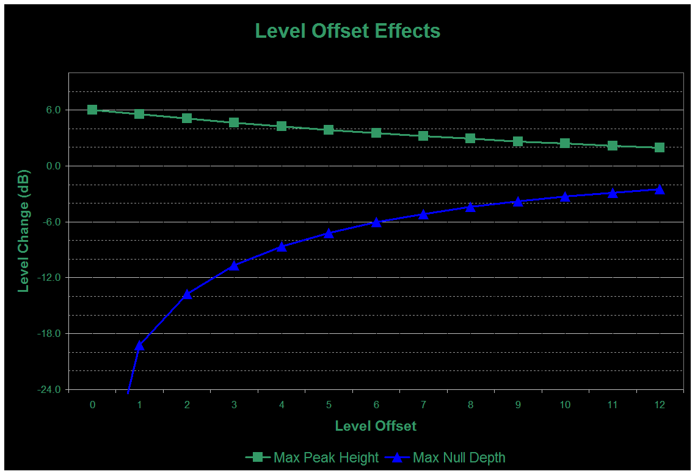

Acoustic Addition and Subtraction: Level Offset Effects
Level Range based on Relative Phase
Combing
Combining
Isolated
Relative Phase=0 deg
Relative Phase=180 deg

Slide 22
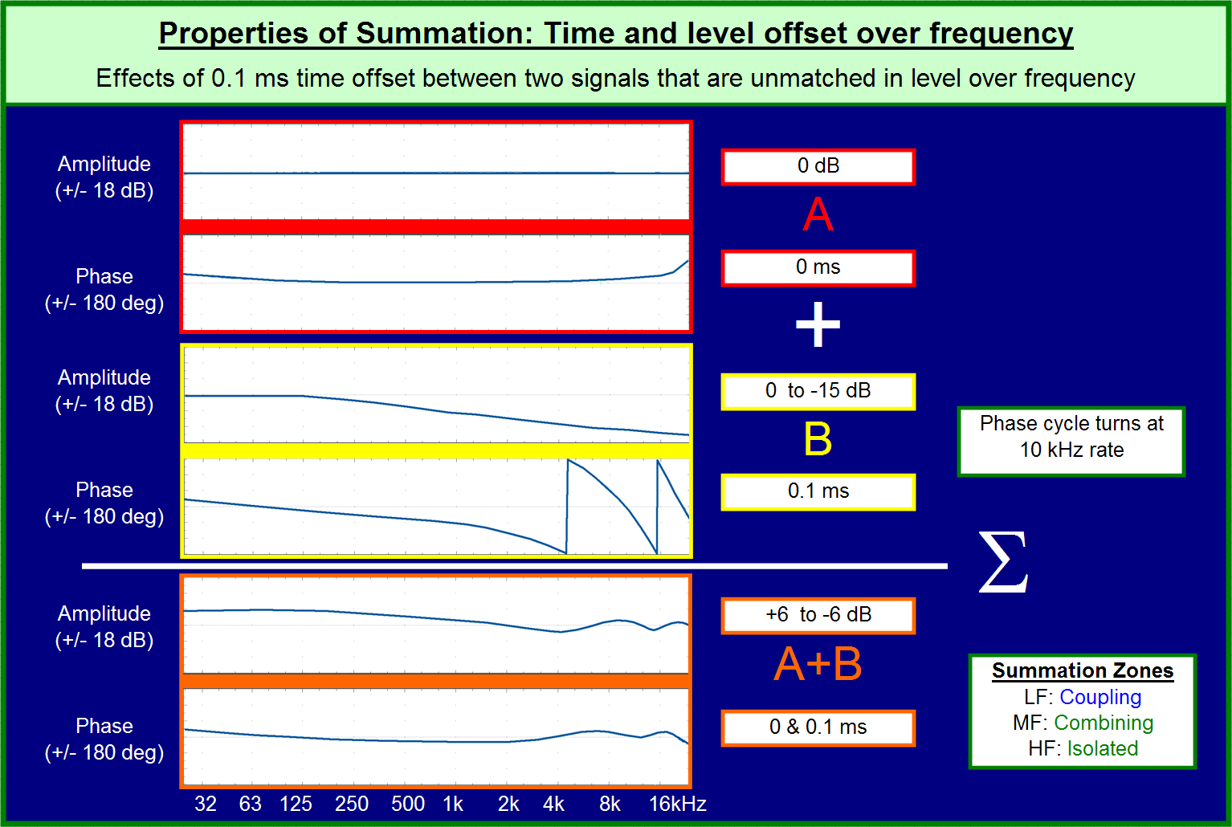
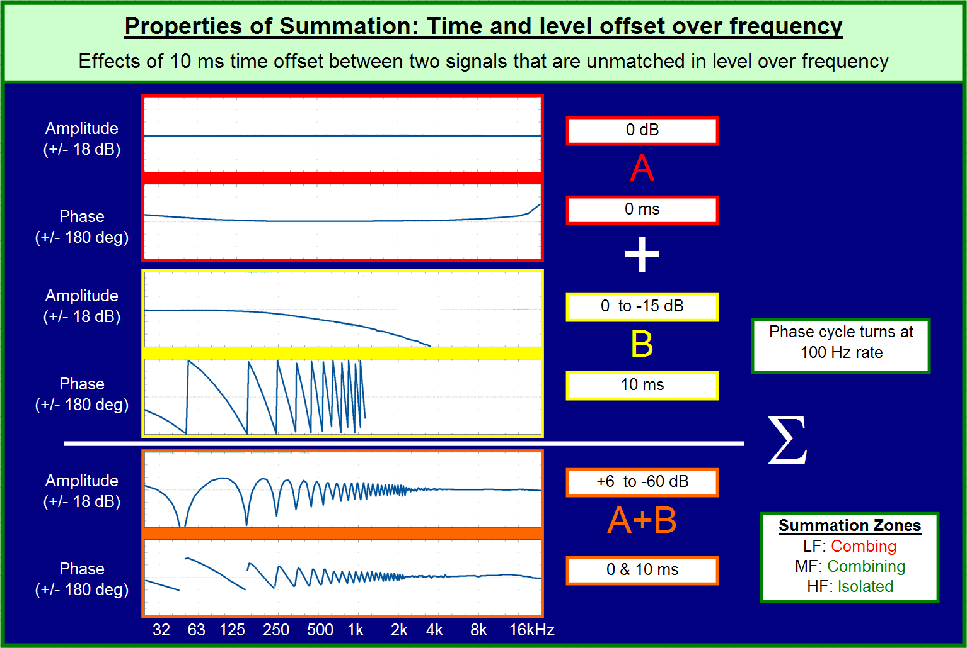
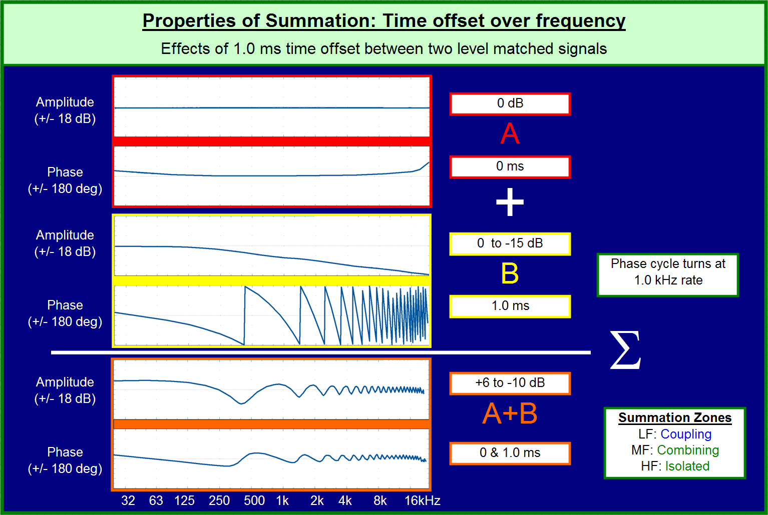
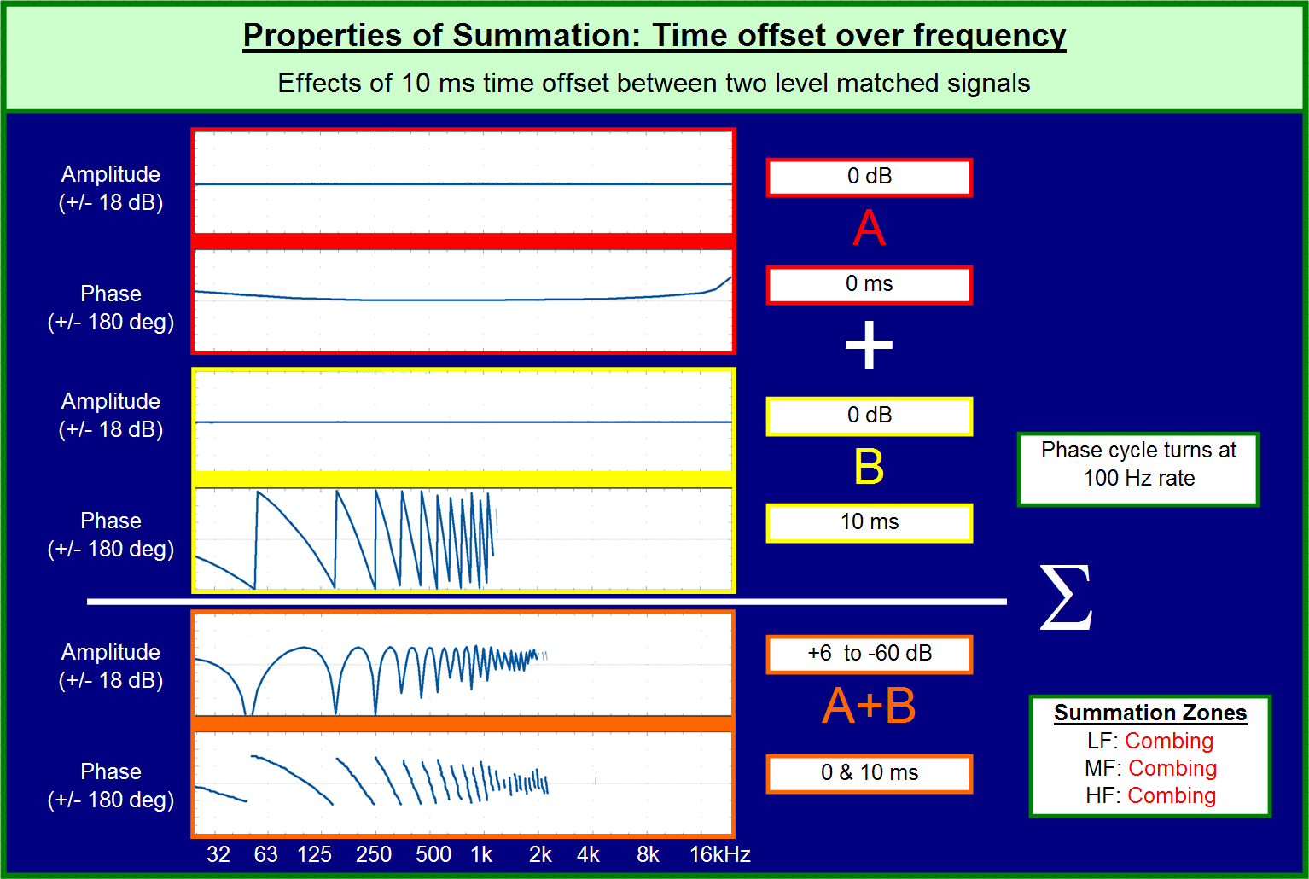
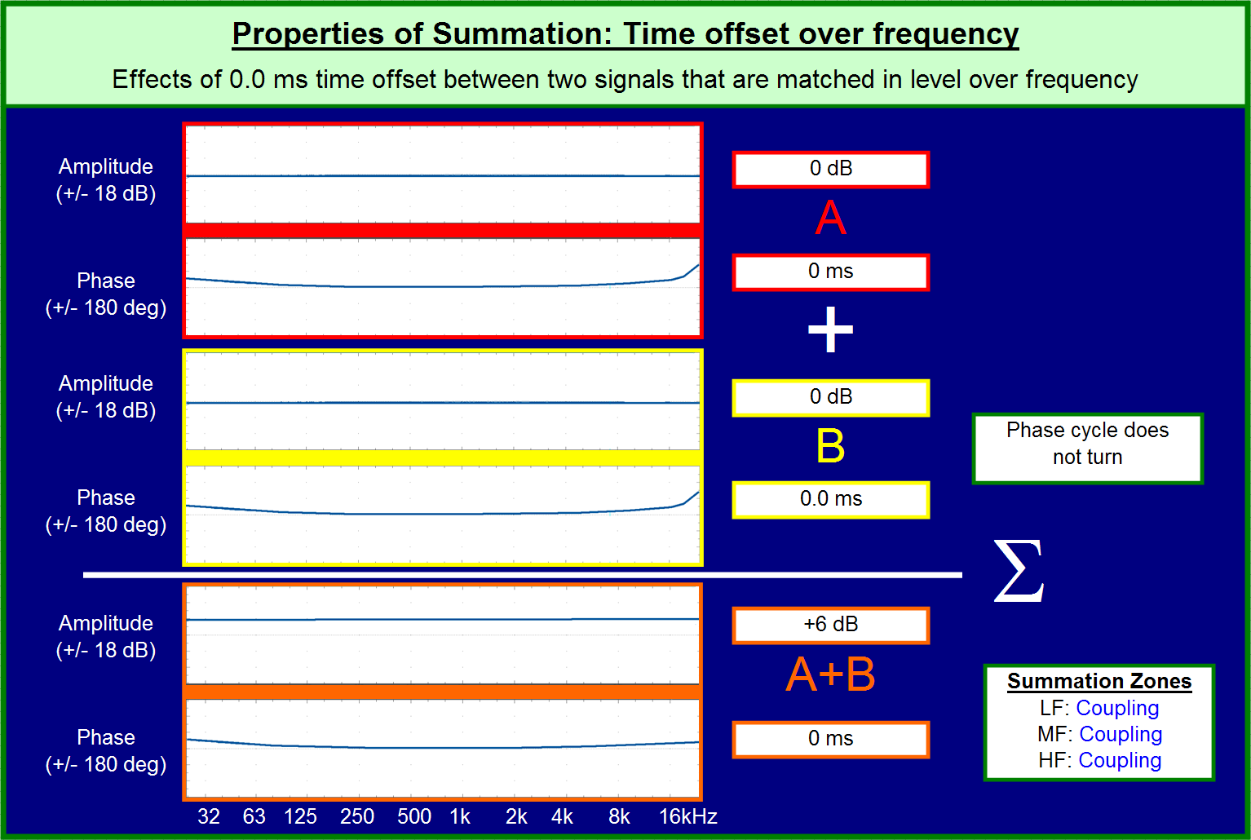
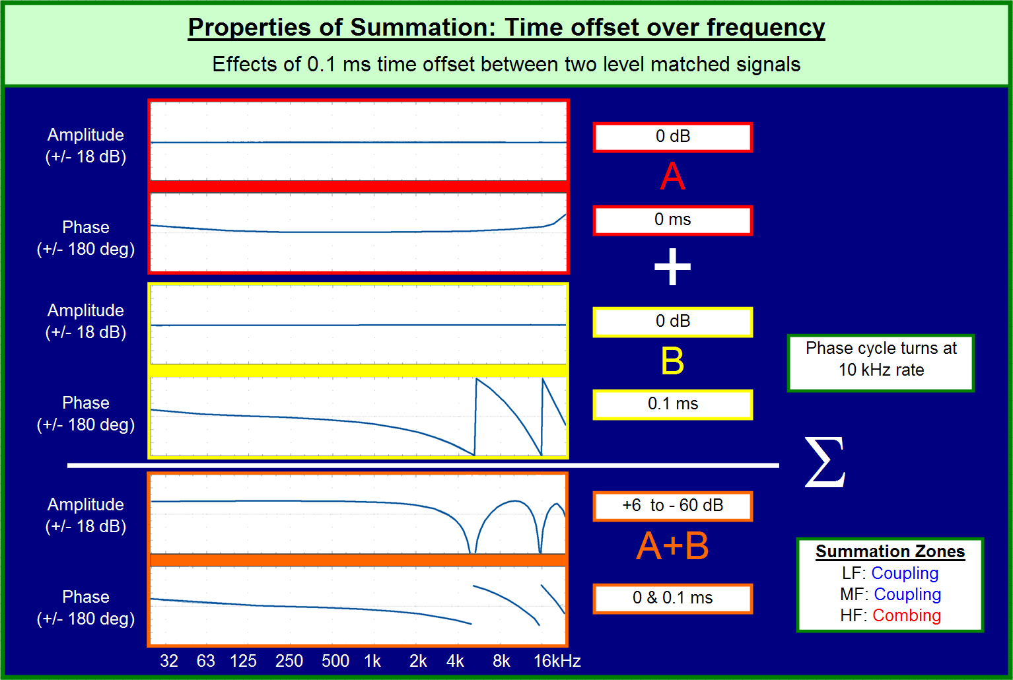
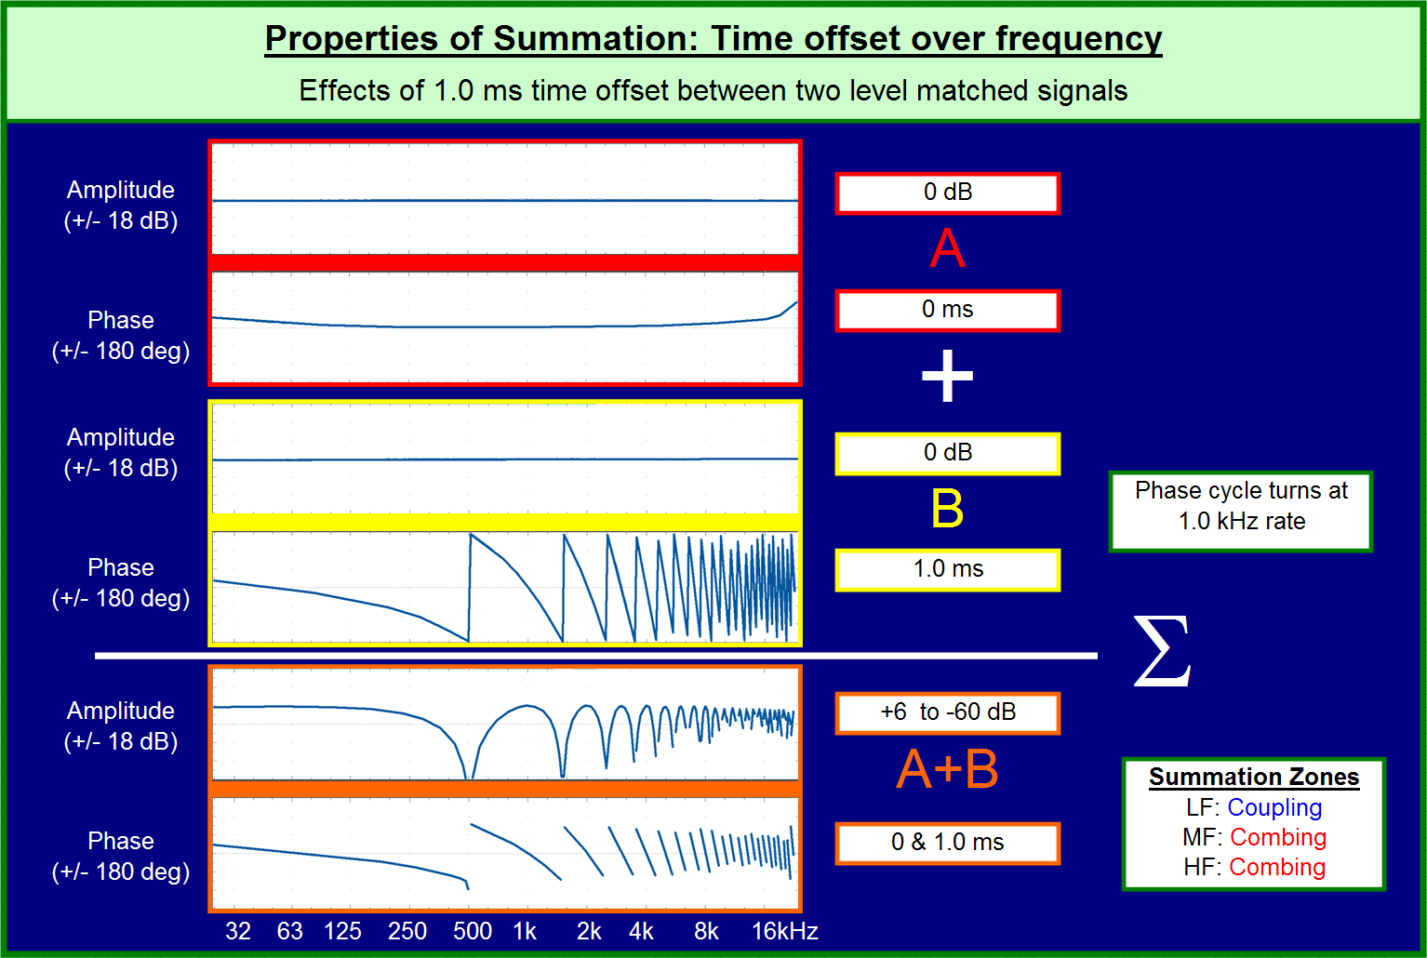

Summation

Slide 23
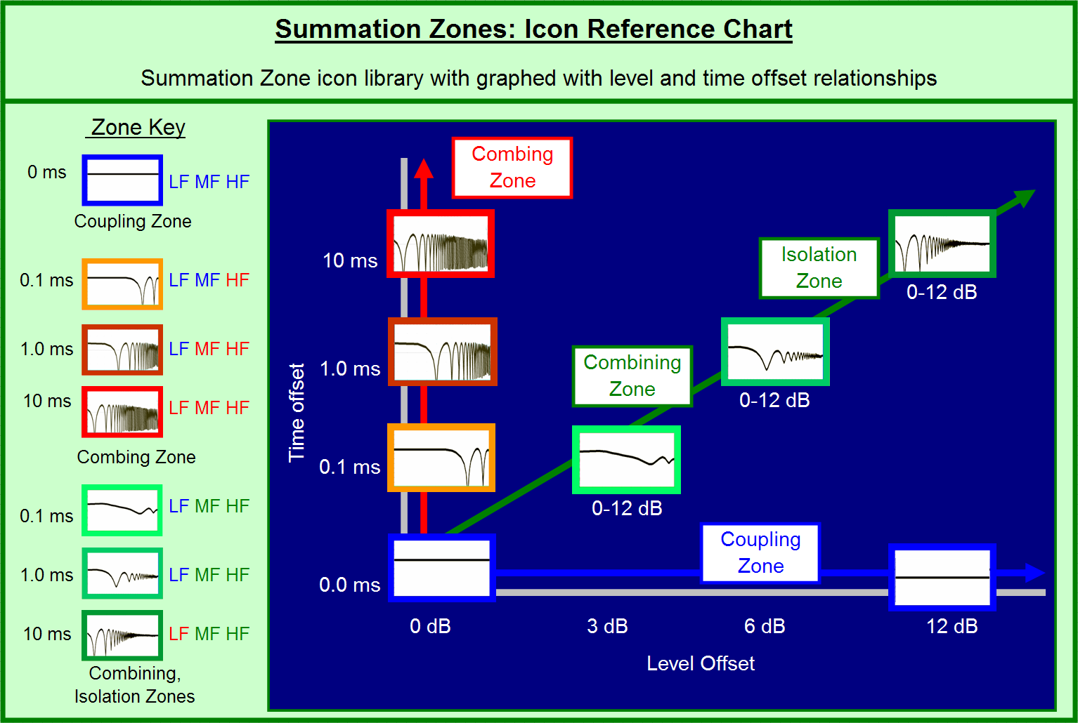

Slide 24
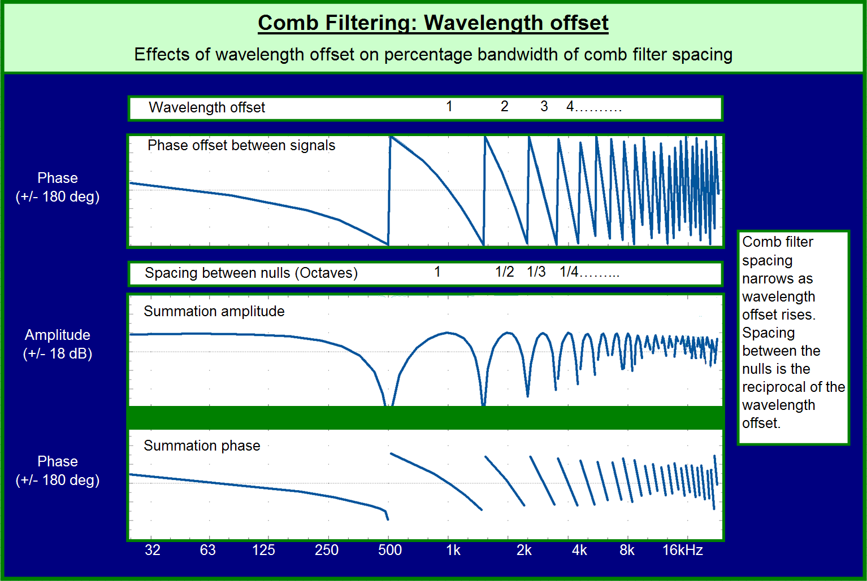

Slide 25
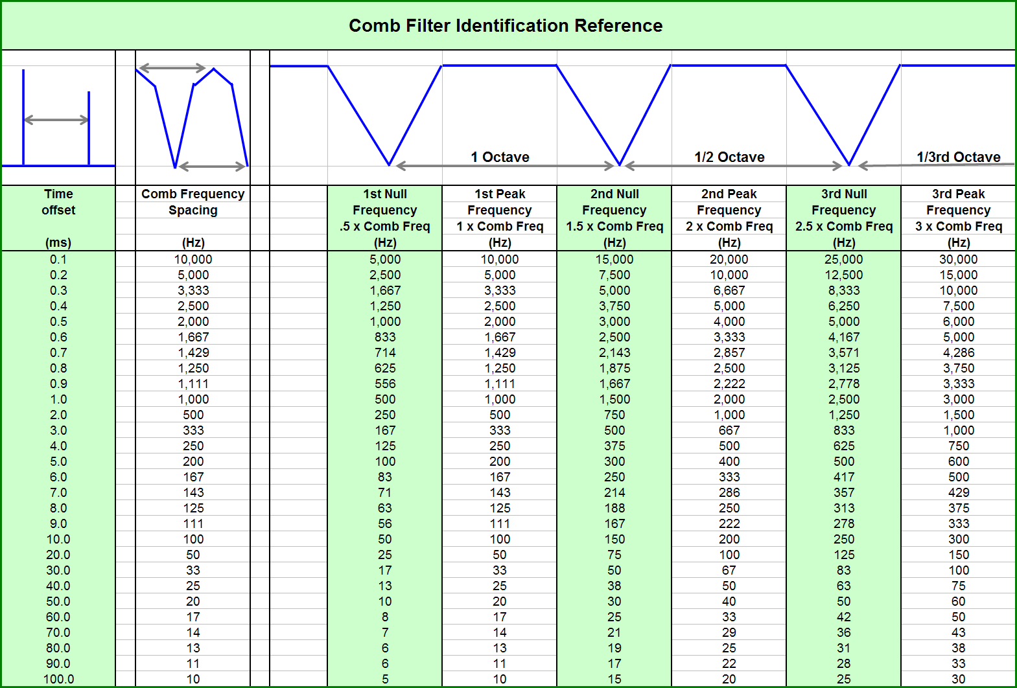

Slide 26

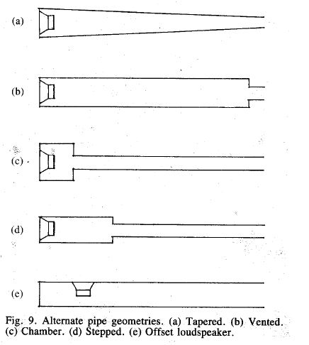
Application: Undamped Pipe
loudspeaker mounted in a rigid (undamped) pipe 3 feet in length, open at one end, observed on-axis from “speaker end” (for now will ignore pipe resonance and only consider phase)
3 feet

Slide 27
Application: Undamped Pipe
how does sound propagate at low frequencies?
3 feet

Slide 28
Application: Undamped Pipe
how does sound propagate at low frequencies?
3 feet

Slide 29
Application: Undamped Pipe
if operated at 150 Hz, how much phase shift occurs as the wave traverses the pipe?
3 feet

Slide 30
Application: Undamped Pipe
if operated at 150 Hz, how much phase shift occurs as the wave traverses the pipe? wavelength = 7.53 feet; phase shift = (360x3)/7.53 = 143 degrees
3 feet

Slide 31
Application: Undamped Pipe
what will be level of “combined” signal at source?
3 feet

Slide 32
Application: Undamped Pipe
what will be level of “combined” signal at source?
total “round trip” phase shift = 180+143+143=466°
(106 degrees net); combined level will be +1.7 dB
3 feet

Slide 33
Application: Undamped Pipe
if frequency changed to 100 Hz, what will be combined level at source?
3 feet

Slide 34
Application: Undamped Pipe
if frequency changed to 100 Hz, what will be combined level at source? wavelength is 11.3 feet; phase shift traversing pipe 96 degrees; round trip phase shift is 371° (nearly “in phase”); combined level is +5.95 dB
3 feet

Slide 35
Application: Flanging vs. Phasing
Flanging is a delay effect used in recording studios since the 1960s
Effect obtained by summing outputs of two reel-to-reel tape machines playing copies of the same recording
Touching the flange on one of the supply reels slows it down (relative to the other machine), creating a time delay (phase offset) between the two machines
Subsequently touching the flange on the supply reel of the other machine (and releasing the first one) will cause the delay to gradually disappear, then grow in the other direction

Slide 36
Application: Flanging vs. Phasing
Echo is not perceived because the delays are relatively short (typically 1-10 ms)
Flangers provide uniformly spaced filter notches, which may cause a discernable pitch to the effect and/or a periodic tone to disappear − therefore provide best effect with inharmonic (non-periodic) sounds
Flanging creates a rapidly varying high-frequency sound by adding a signal to an image of itself that is delayed by a short, variable amount of time (typically 0 to 10 ms)
Demo: https://www.youtube.com/watch?v=r7jhRoZ4NgQ

Slide 37
Application: Flanging vs. Phasing
A phaser (or phase shifter) is a close cousin of a flanger, where the spacing between filter notches is non-uniform
The phaser effect is obtained by replacing the delay line of the flanger with a string of all-pass filters
Unlike a comb filter, all-pass filters do not change the amplitudes of the individual frequency components, but does have a substantial effect on the phase of individual frequency components (“frequency dispersion”)
The phaser effect is most audible on the transient response (attack or decay of a sound)
Demo: https://www.youtube.com/watch?v=Ici_YOVDl_0

Slide 38
Response Ripple: Spatial Distribution
Time offsets between two sources vary over the space
Relationship between the sources and summation destination is triangular
Different types of triangles reveal the variation tendencies

Slide 39
Factors Affecting Response at Summation Point
Level offset due to distance offset (inverse square law)
Level offset due to polar response (frequency and angular dependent)
Phase offset due to path length difference

Slide 40
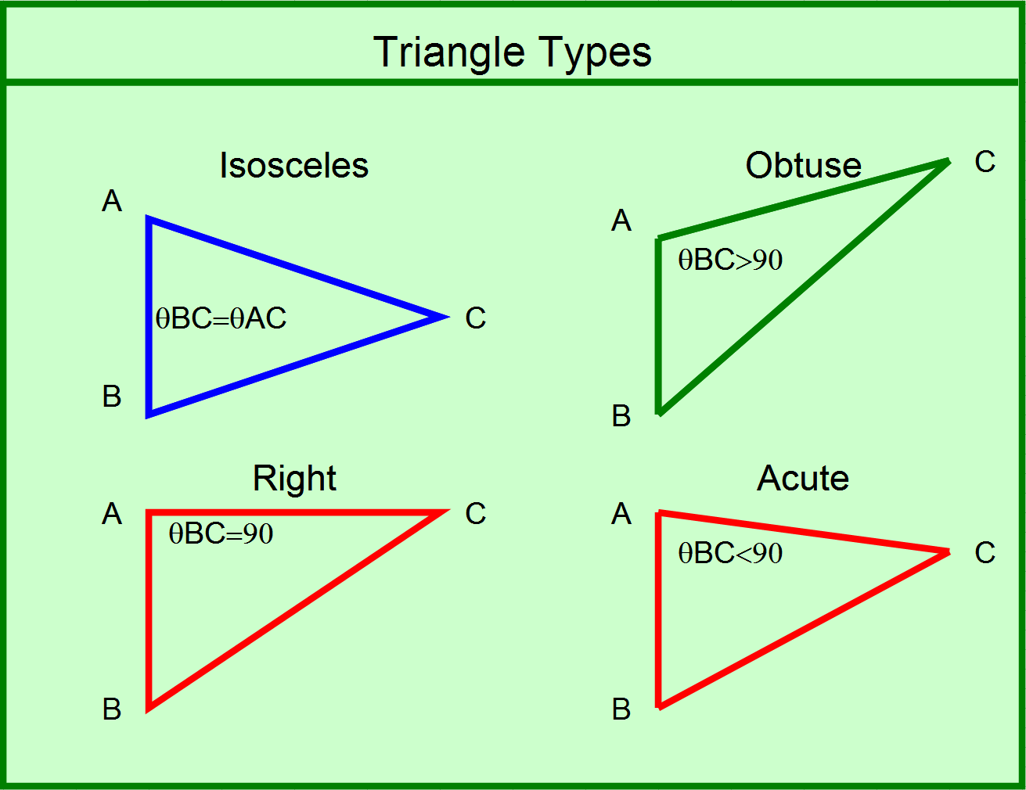

Slide 41
Pythagorean Problem: Level Offset is a Ratio, Time Offset is a Difference
4
8
C
A
3
5
B
6
10
Relative Level: 8/10 = 0.8 (-2dB)
Relative Time: 10-8 = 2.0 (2 ms)
Relative Level: 4/5 = 0.8 (-2dB)
Relative Time: 5-4 = 1.0 (1 ms)

Slide 42
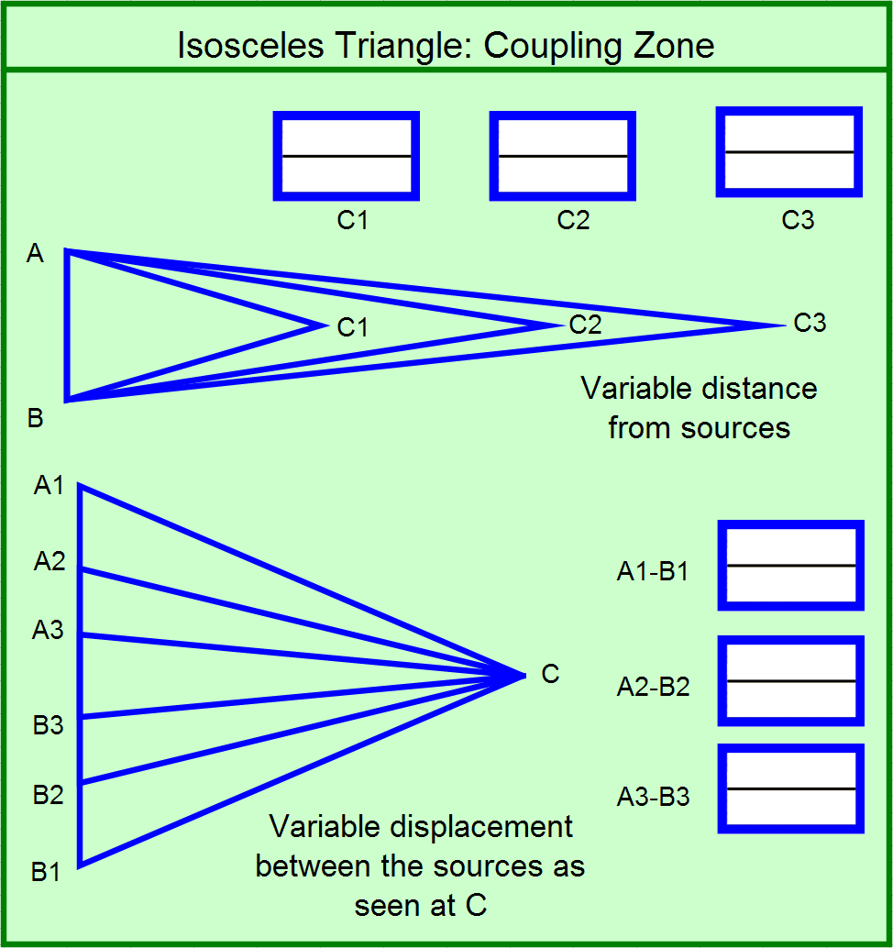
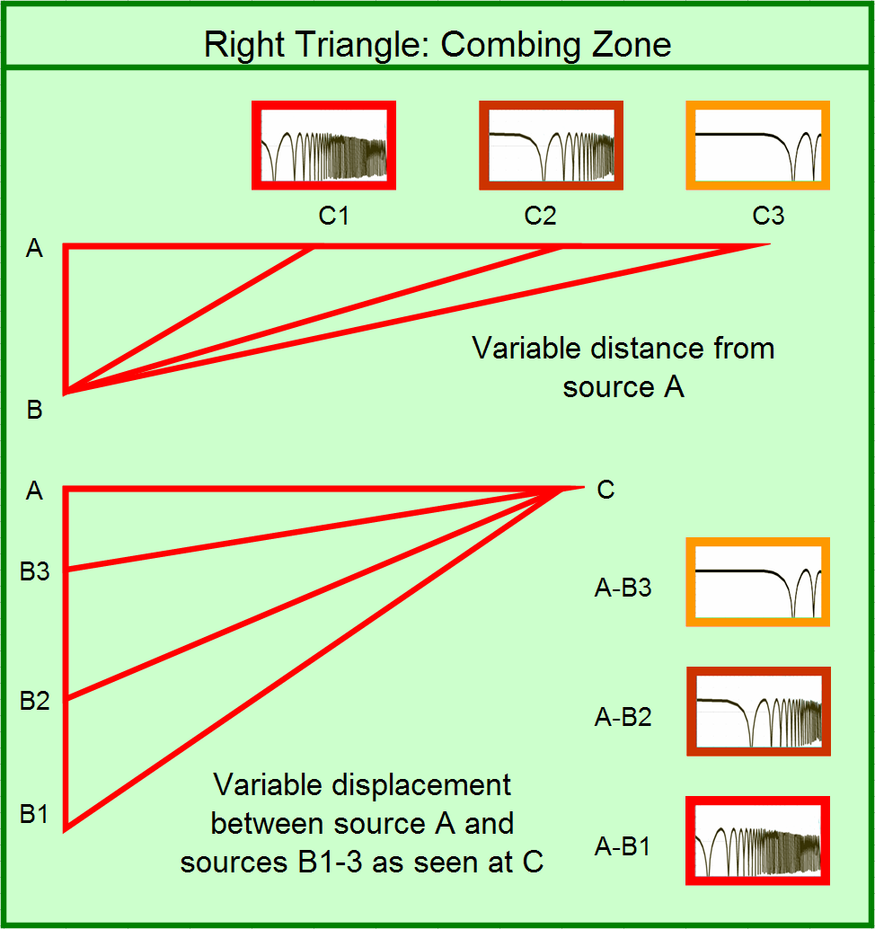
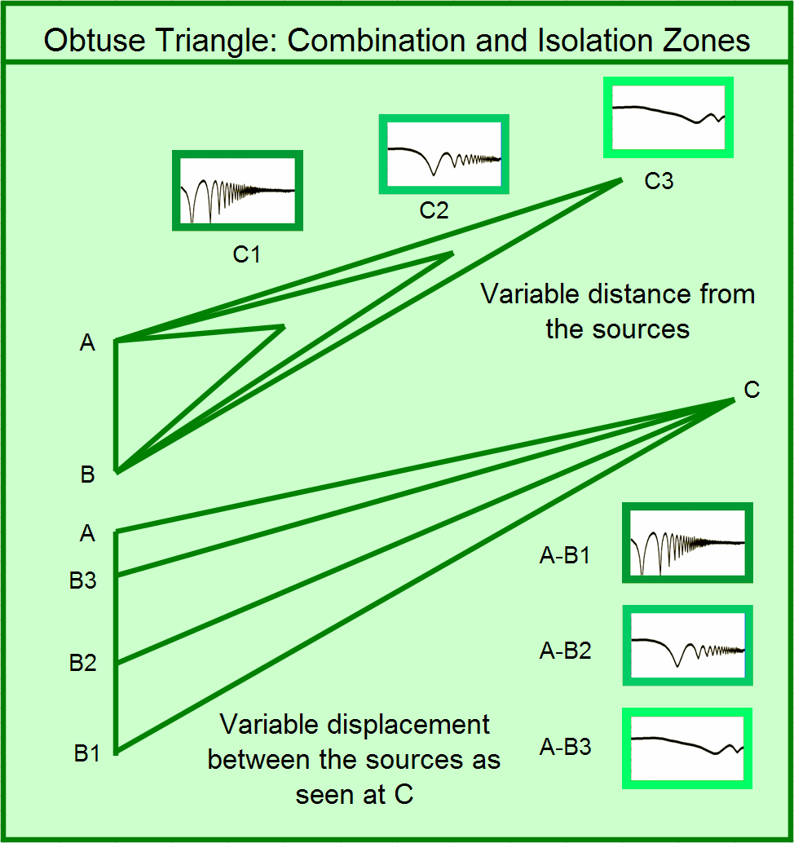
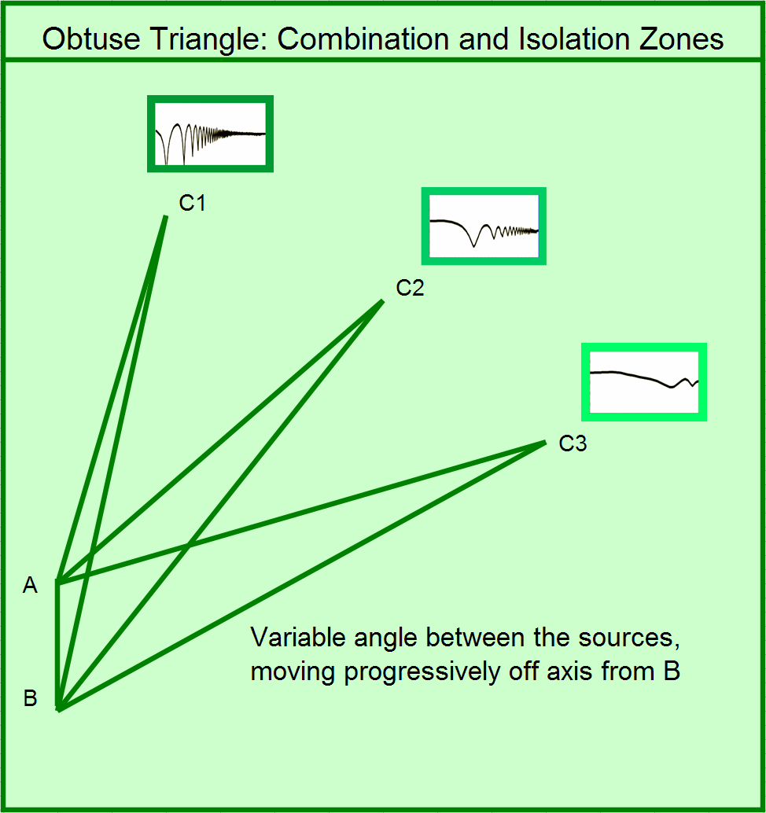
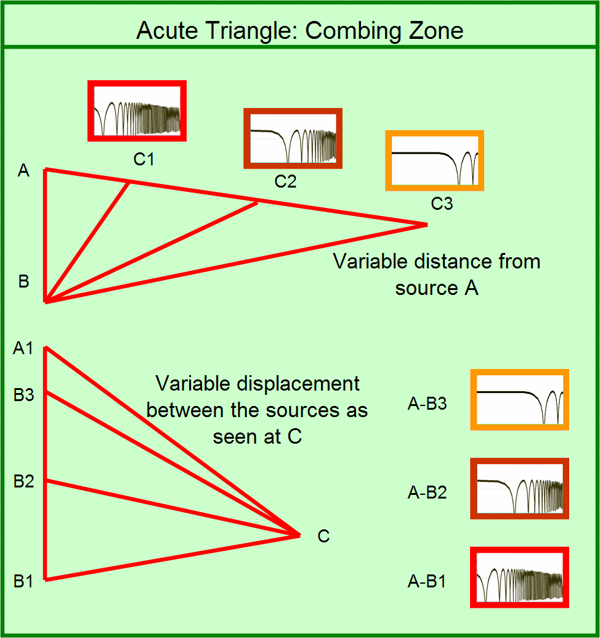

Slide 43
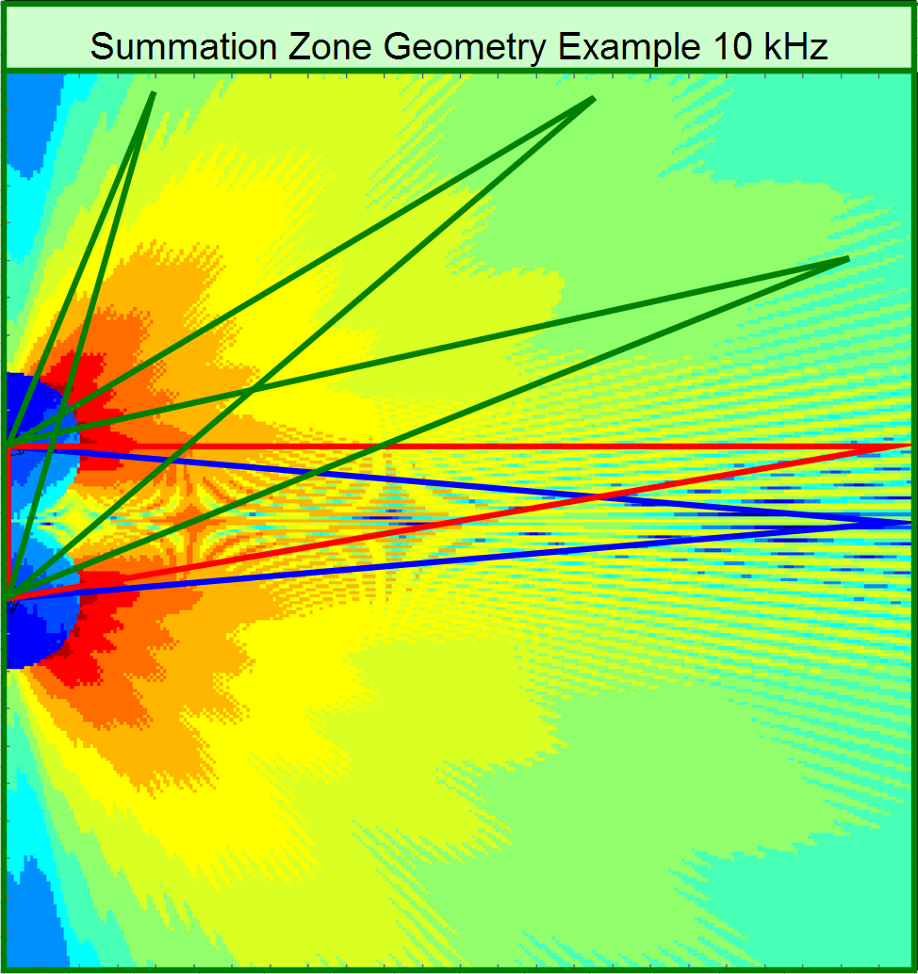
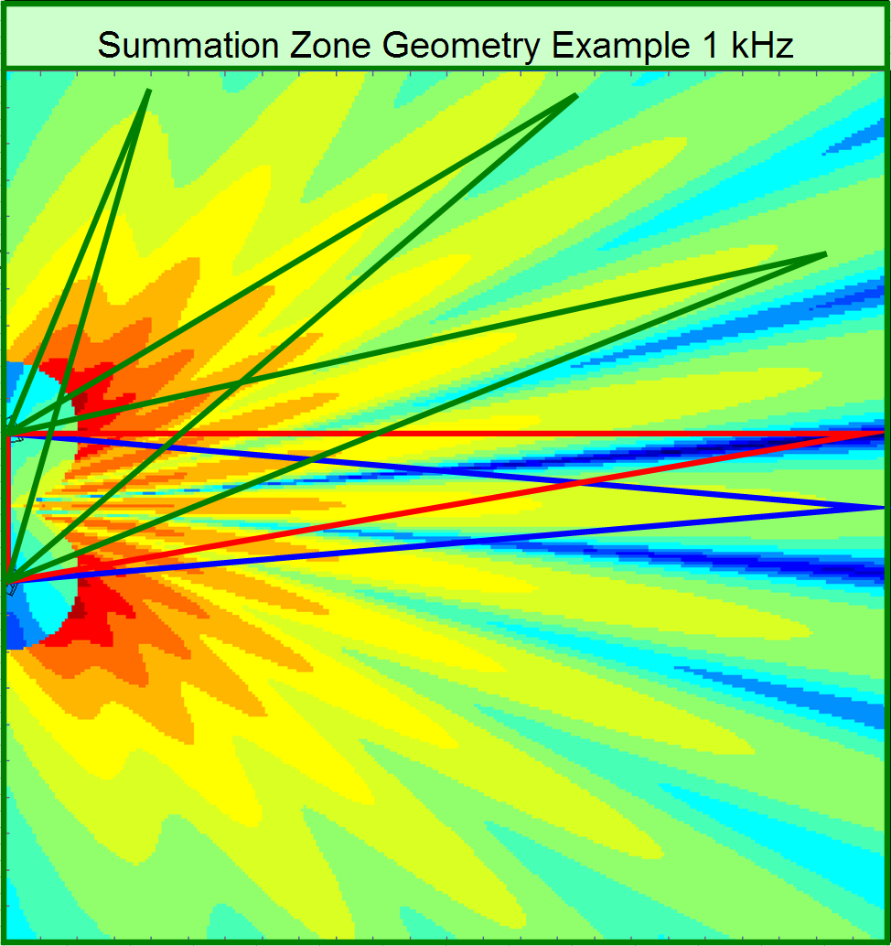
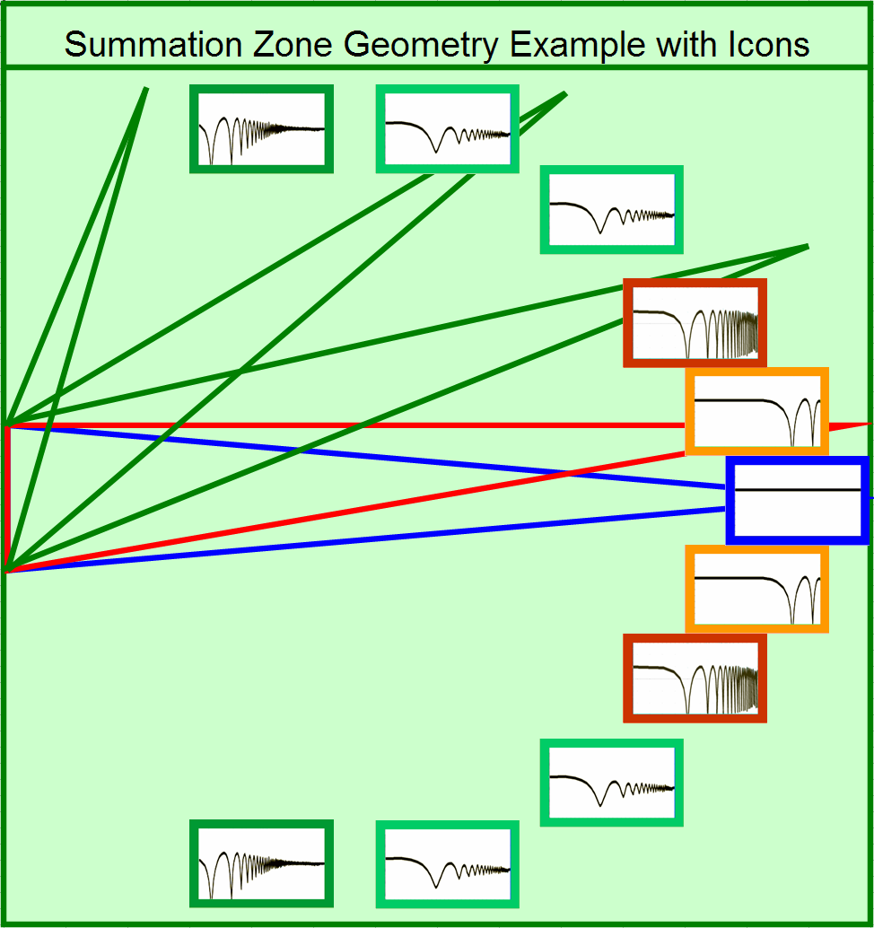
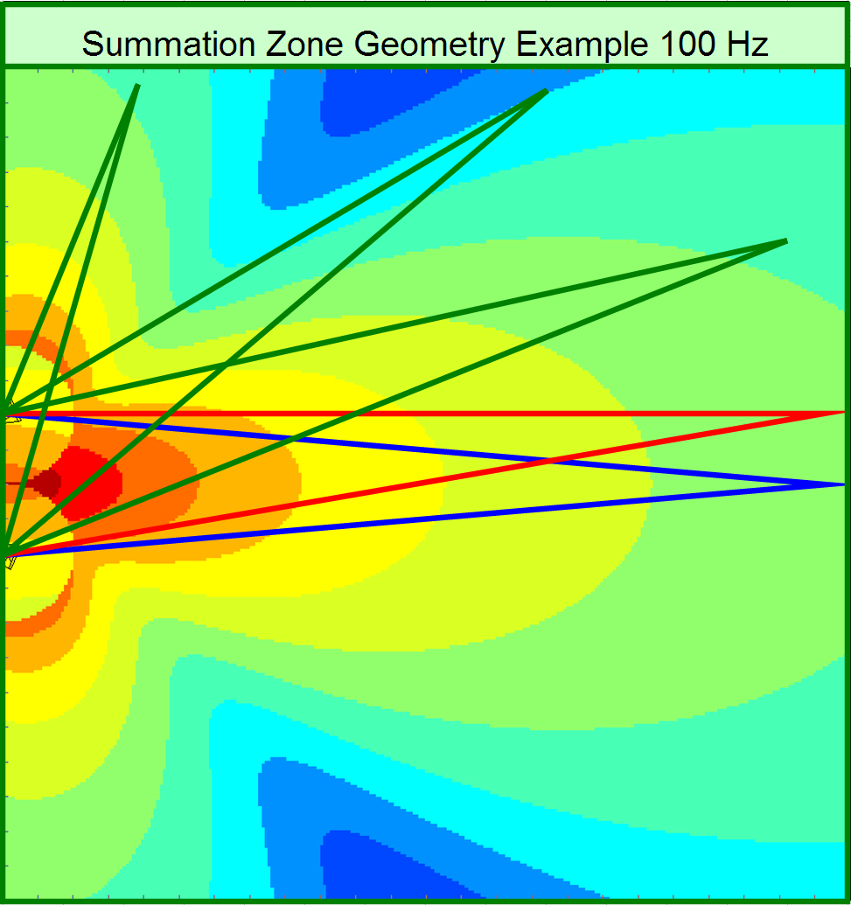

Slide 44
Summation Example Key Features
Maximum addition over all frequencies at center of isosceles triangle (coupling zone)
1 KHz and 10 KHz show deep cancellations around the right triangle point (combing)
10 KHz is first to show reduced combing as move into obtuse triangle (isolation zone)
Area inside isosceles triangle (acute) has highest degree of variation over position/frequency (combing)
Isolation increases as obtuse angle increases
100 Hz pattern does not show cancellation at the right angle position (displacement between sources is less than a wavelength)

Slide 45
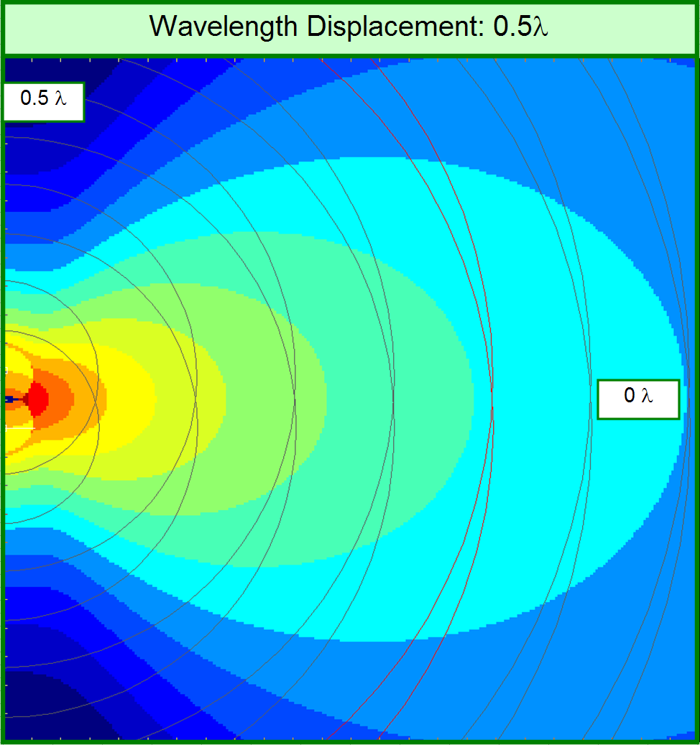
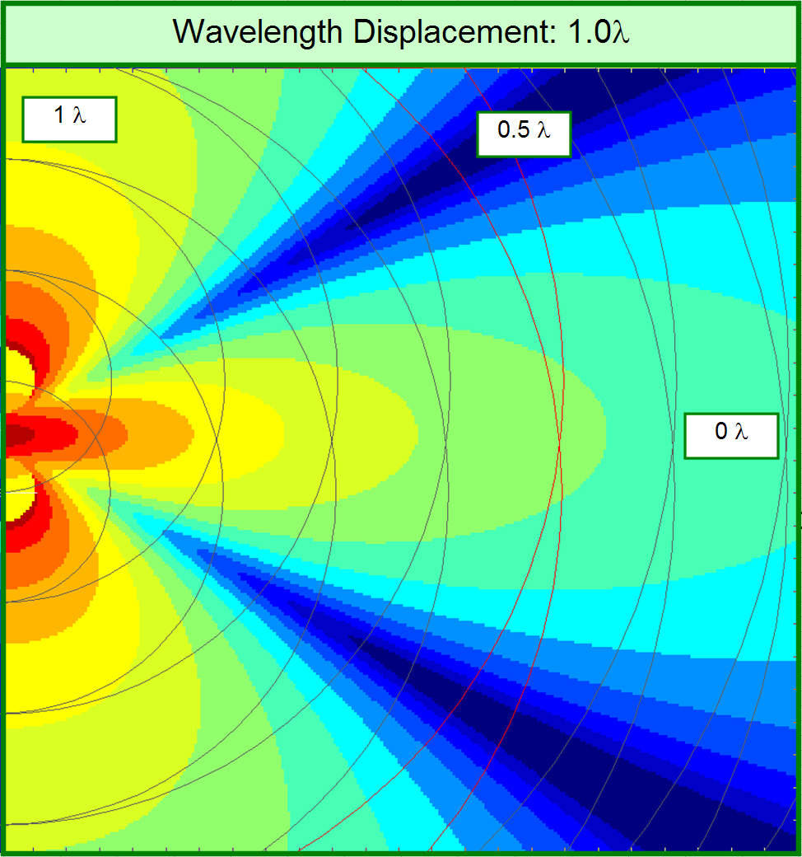
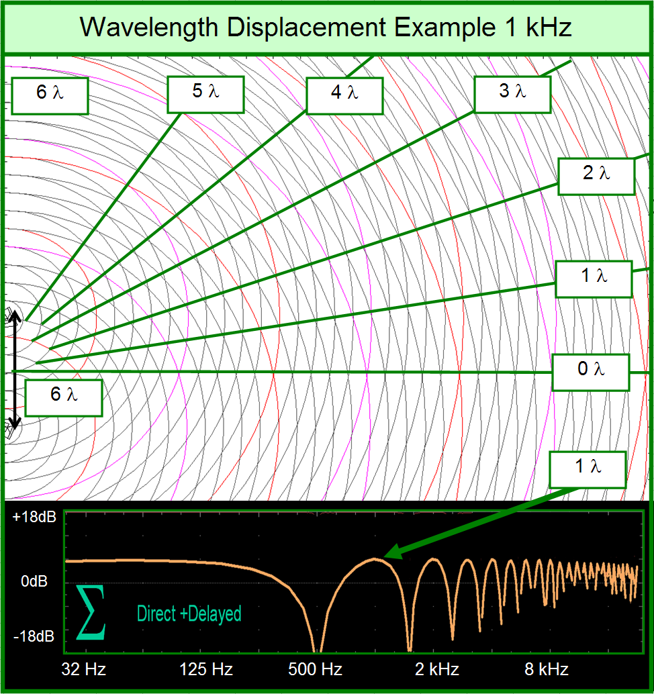
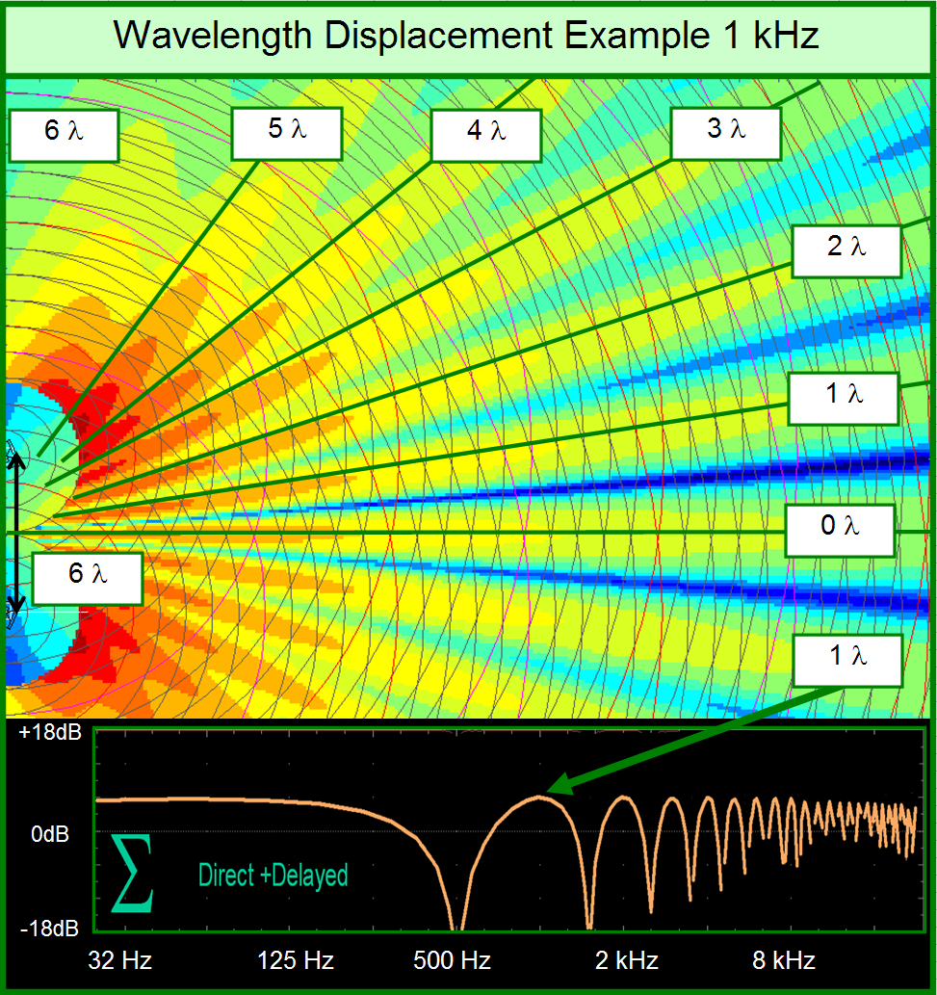
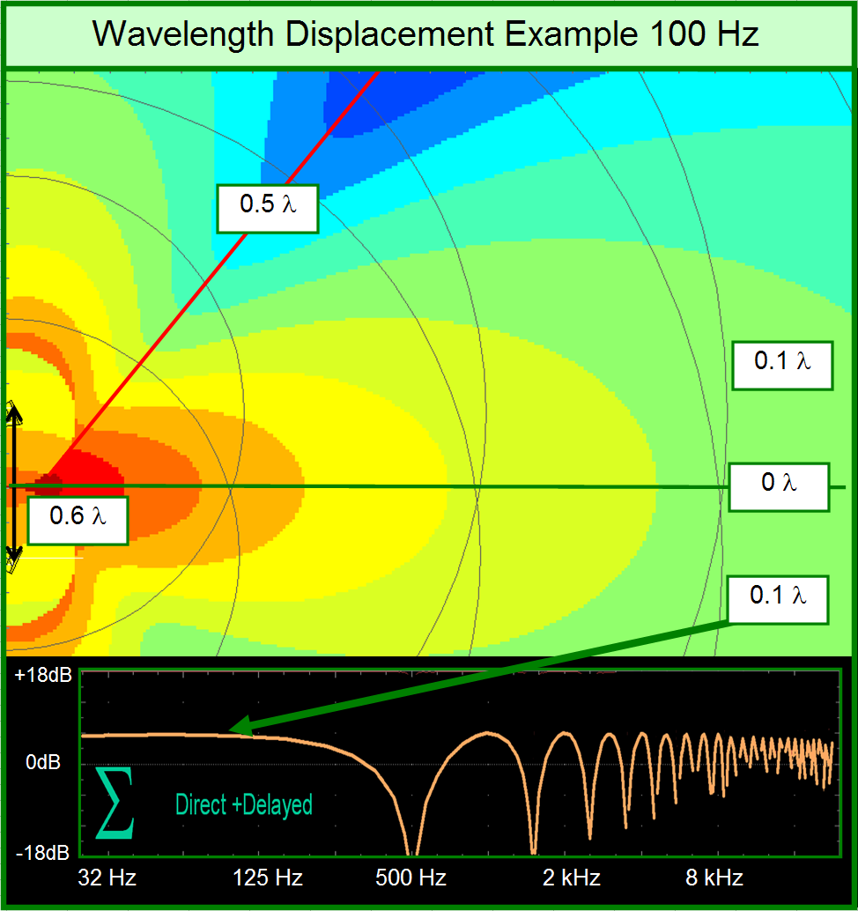
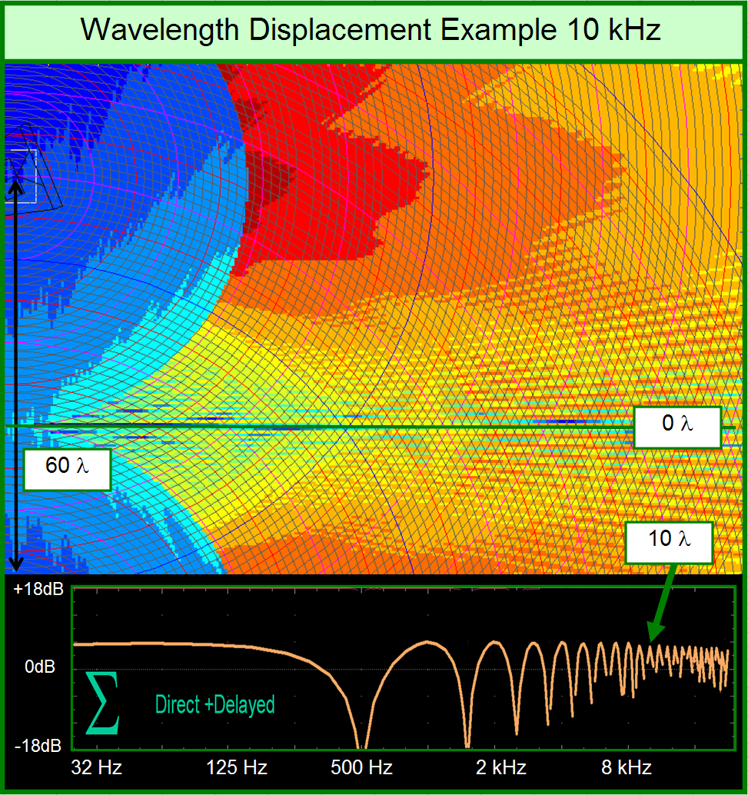
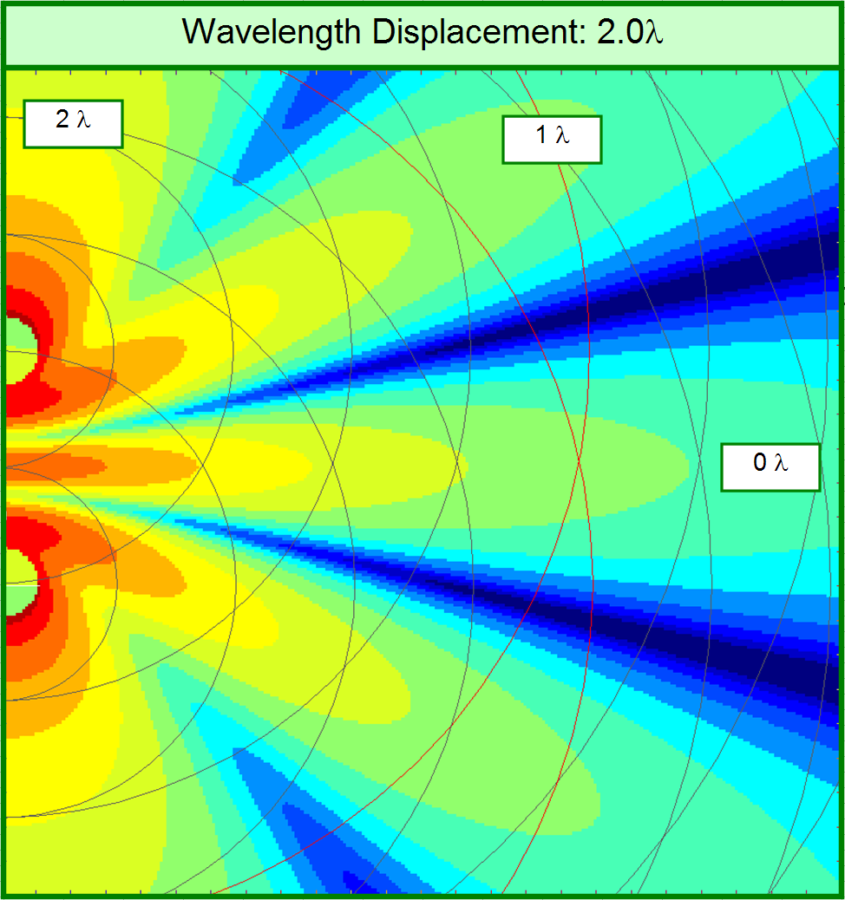
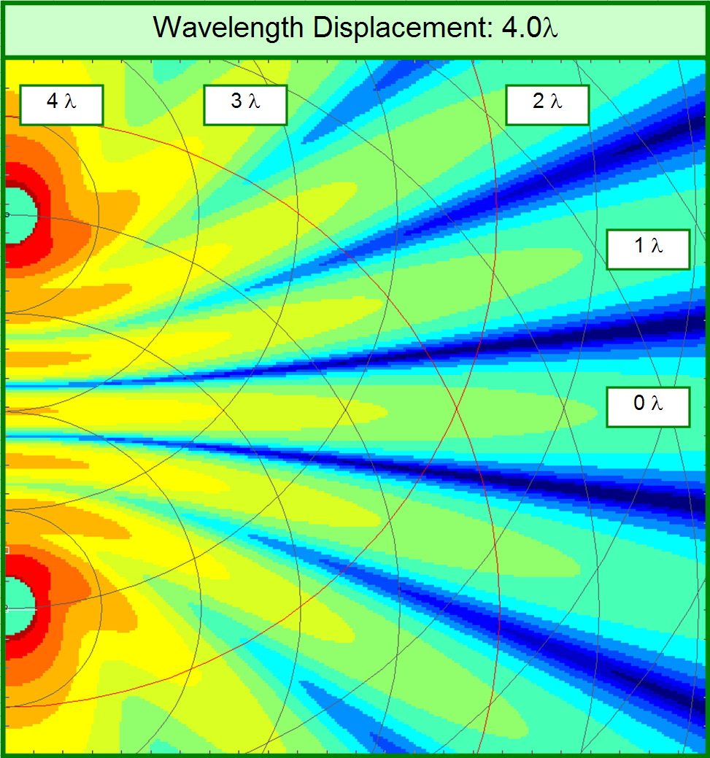

Slide 46
The Acoustic Crossover
Meeting point of two (or more) correlated input signals at comparable levels
Separated by frequency in the same (or separate) enclosure
Separated over a matched range in separate enclosure
Separated by a physical boundary (The Room)

Slide 47
Divider/Crossover Terminology
Spectral divider: electronic device that separates the response into multiple frequency bands for transmission through distinct loudspeakers
Spectral acoustic crossover: frequency range where equal acoustic levels are found from each of the electronically/physically separated elements that converge there
Spatial divider: electronic or acoustic device that separates response into multiple channels of common frequency range for transmission through distinct loudspeakers
Spatial acoustic divider: location where equal acoustic levels are found from the multiple electronically/physically separated elements that converge there

Slide 48
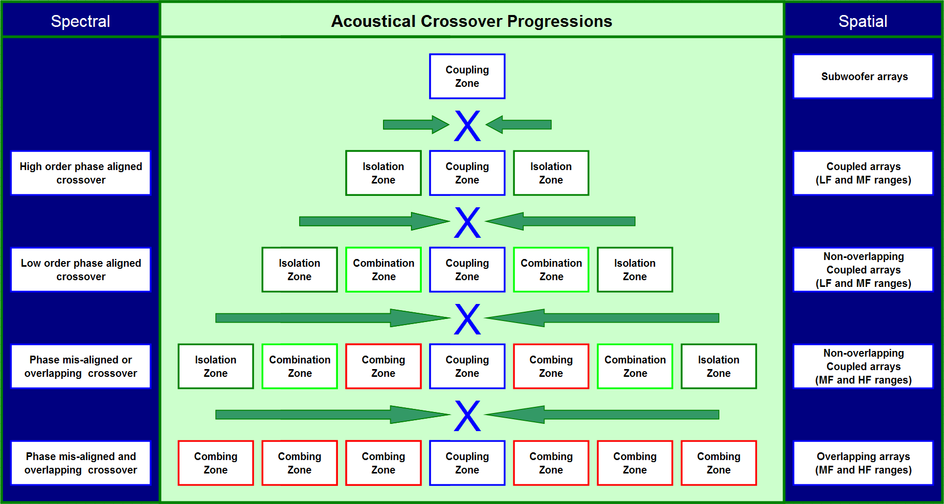

Slide 49
The Acoustic Crossover: Quantified
Crossover class
Crossover slope (order)
Degree of symmetry
Number of elements
Combined response

Slide 50
Crossover Classes
Individual Shapes
Combined Shapes
Overlap
Unity
Gap
Crossover Point
Coupling Zone

Slide 51
Crossover Slope Order
Individual Shapes
Combined Shapes
1st
(6 dB)
2nd
(12 dB)
3rd
(18 dB)
Crossover Point
Coupling Zone

Slide 52
Asymmetric Crossover Levels
Individual Shapes
Combined Shapes
1st Order Slopes
0 dB
- 3 dB
- 6 dB
Crossover Point
Coupling Zone

Slide 53
Asymmetric Crossover Slopes
Individual Shapes
Combined Shapes
1st / 1st Order
1st / 2nd Order
1st / 3rd Order
Crossover Point
Coupling Zone

Slide 54
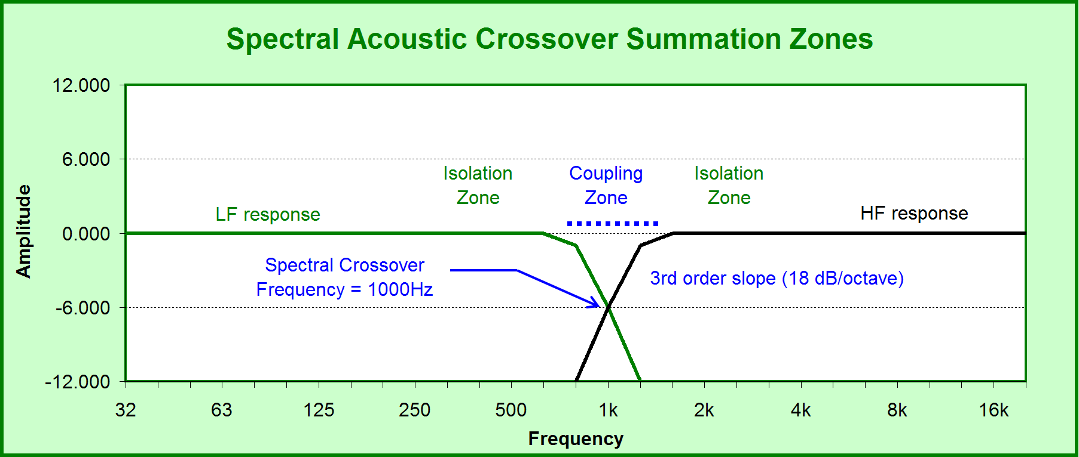

Slide 55
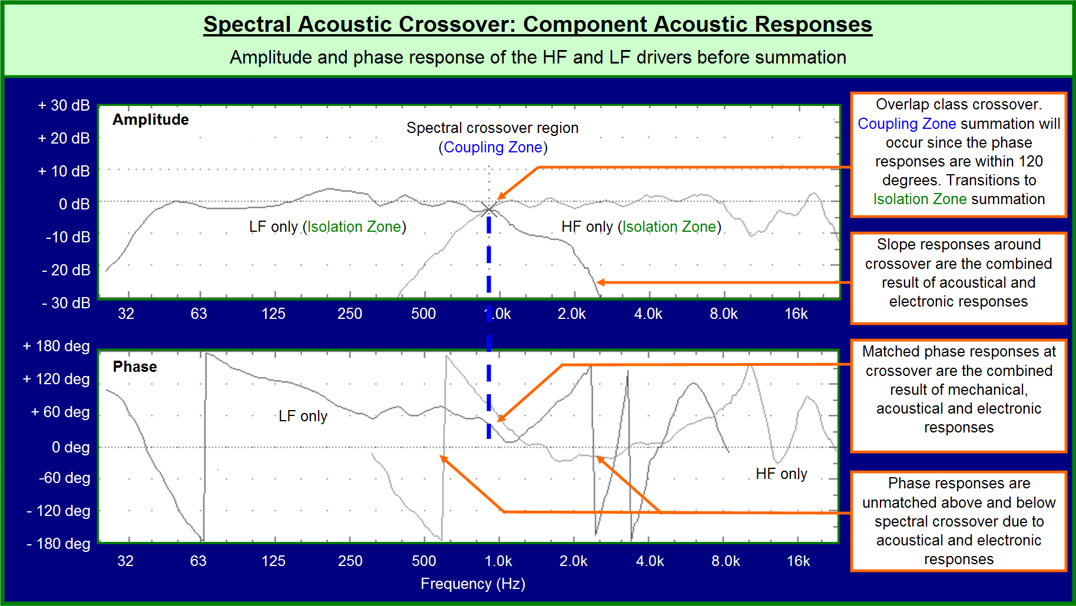
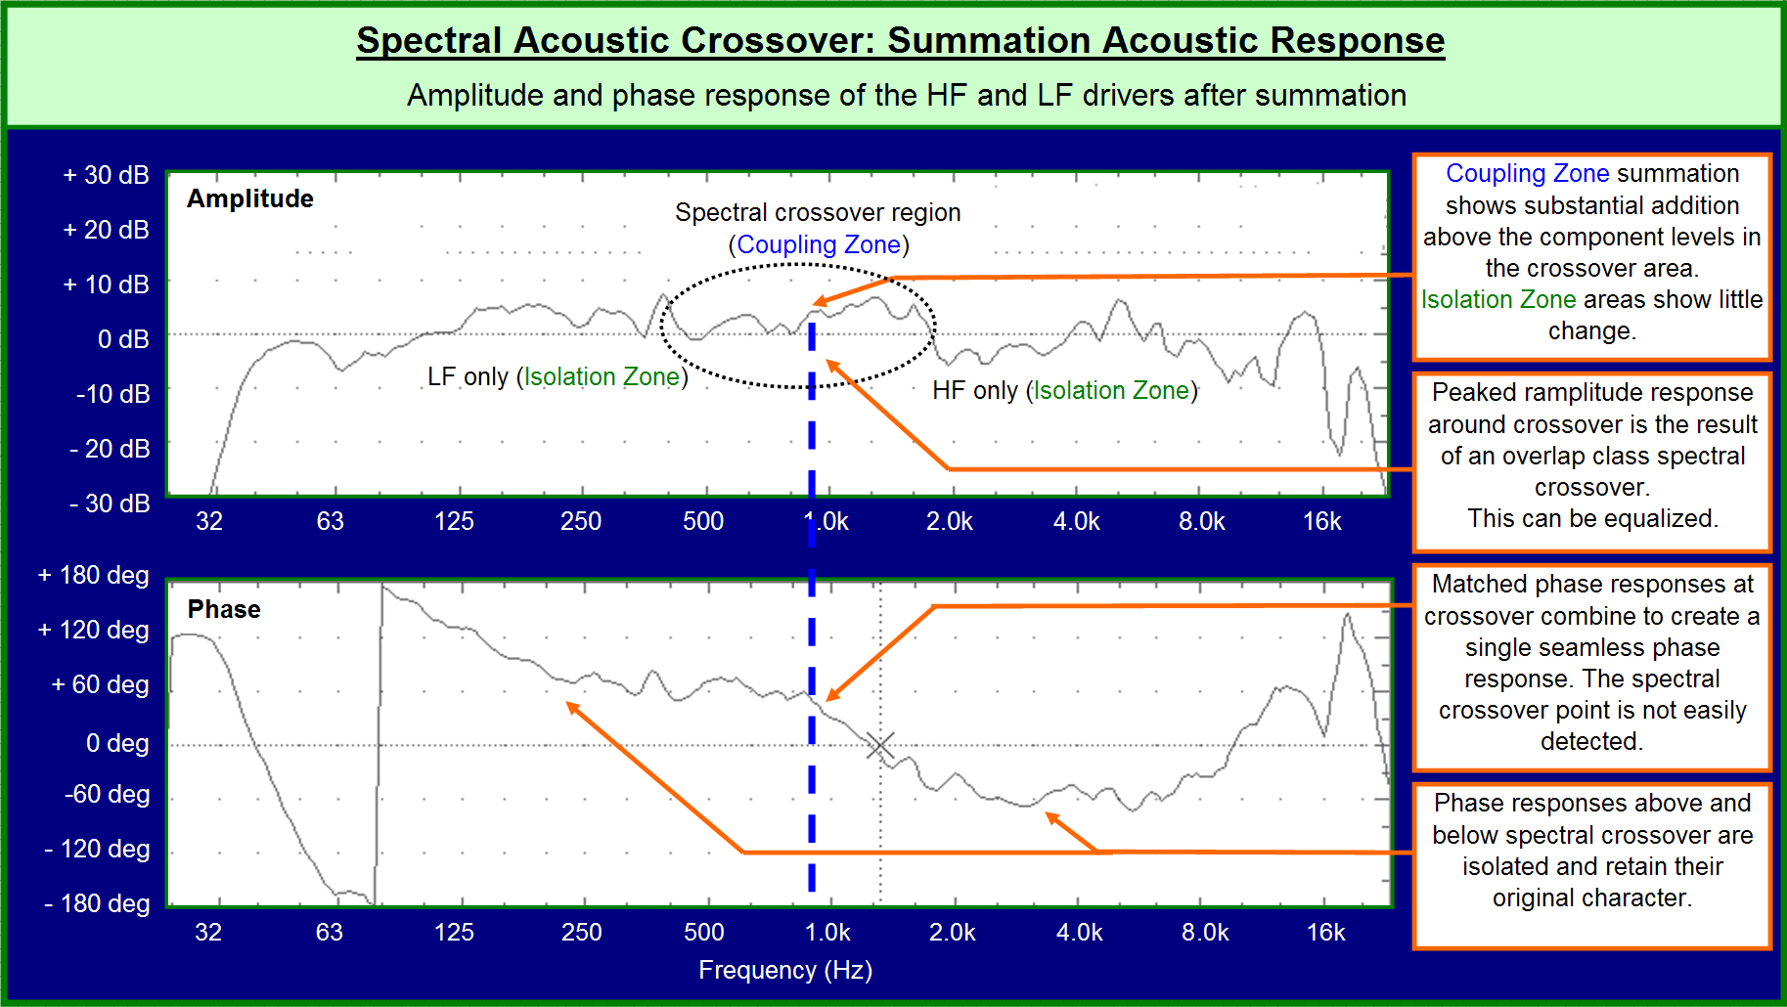
The Spectral Crossover

Slide 56
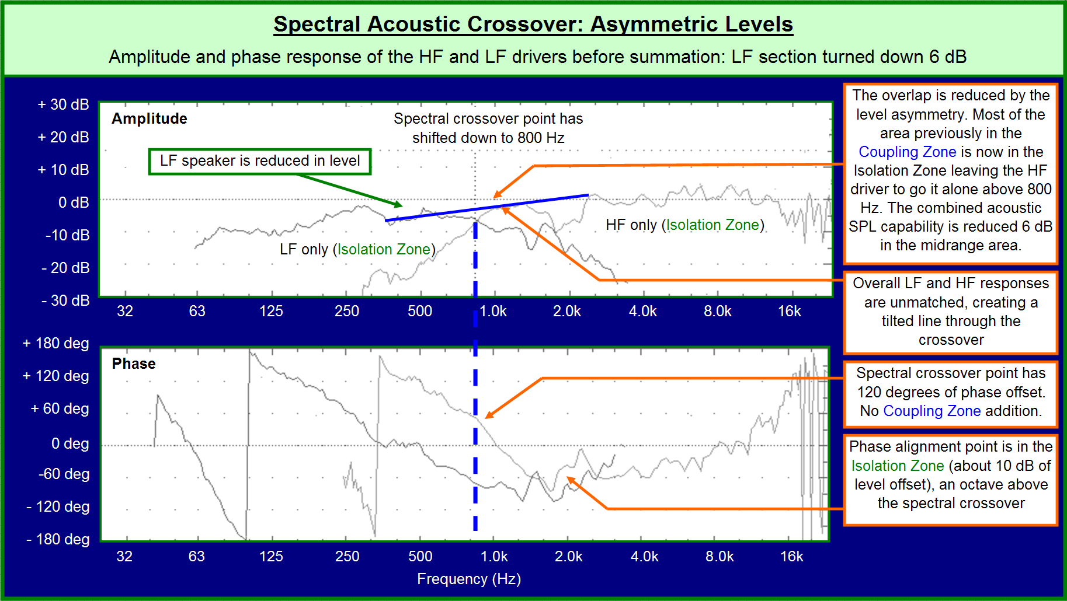
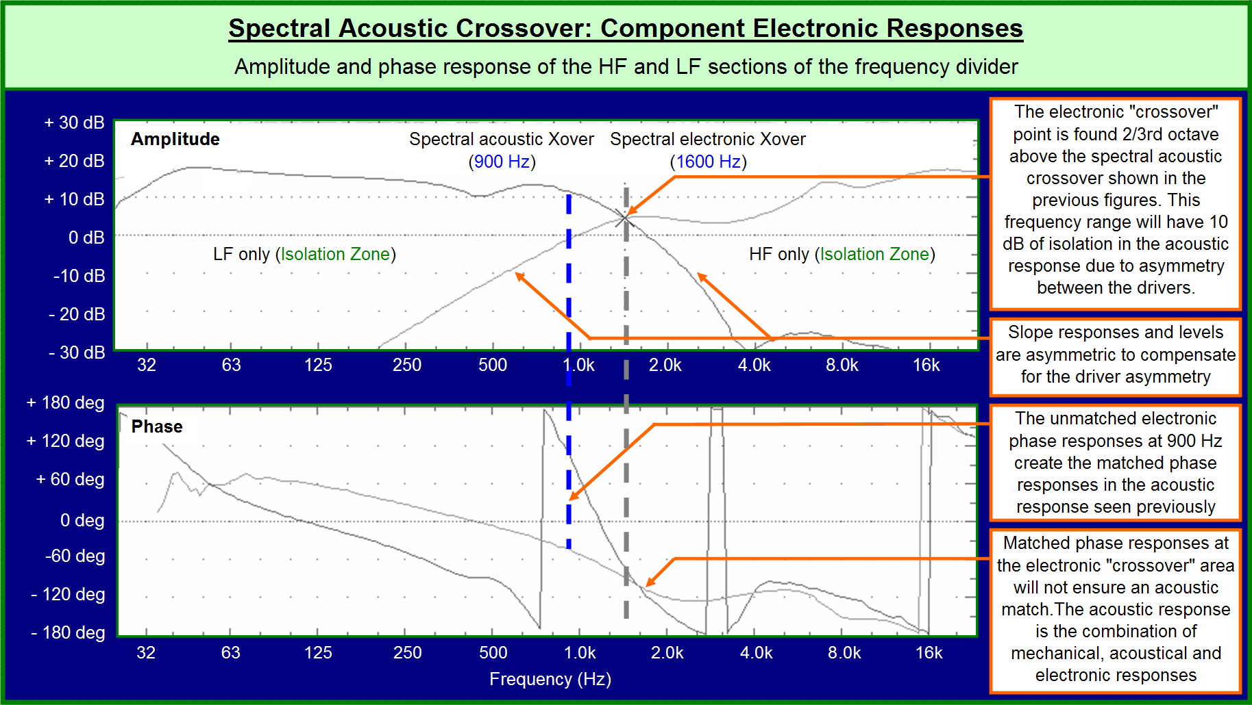
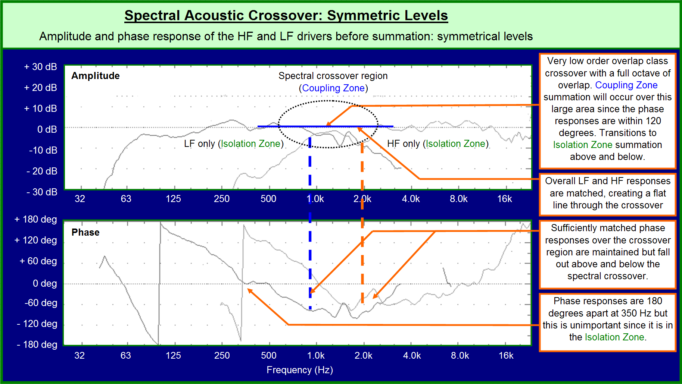
The Spectral Crossover

Slide 57
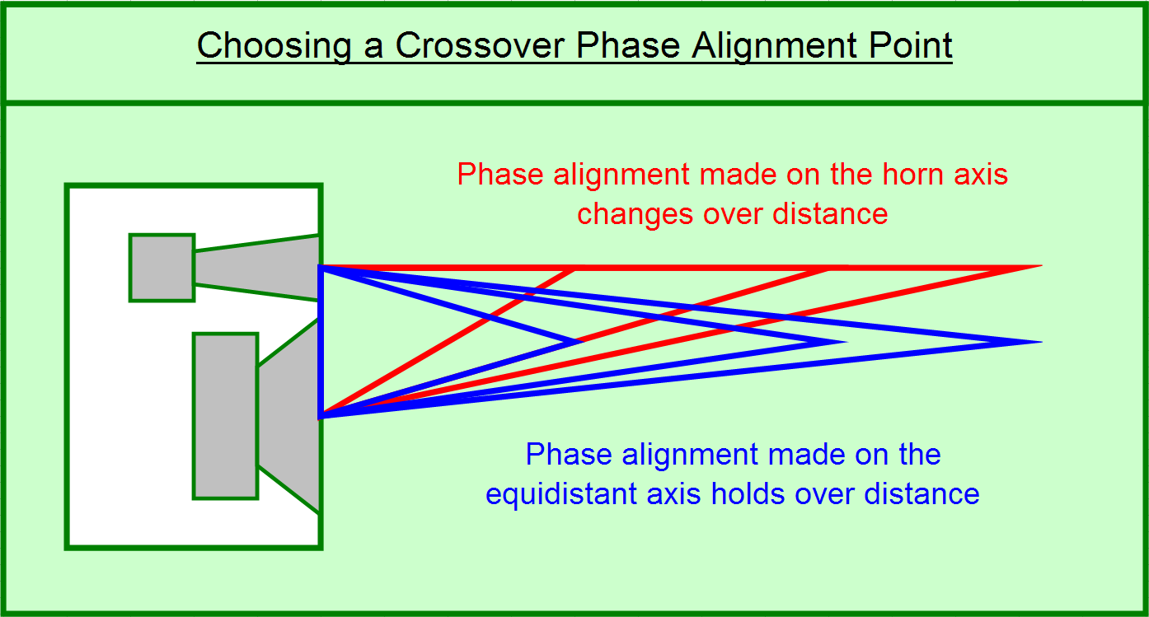

Slide 58
Spectral vs. Spatial Crossovers
Common ground:
Both interactions governed by properties of acoustic summation
Strategies for achieving optimal summation rooted in same concept: the phase-aligned crossover
Differences:
Spatial crossover can run through the full audio range – much more difficult to isolate with cancellation
Relative phase in a spatial divider affects all frequencies, while phase change in spectral divider only affects frequency range of crossover

Slide 59
Spectral vs. Spatial Crossovers
Analogous functions (“duality”):
Position in room where two speakers share equal level is analogous to spectral divider crossover frequency (coupling zone)
Directional control capability of speaker analogous to spectral divider slope – highly directional speaker is like a steep spectral crossover

Slide 60
Spectral vs. Spatial Crossovers
Analogous functions (“duality”):
Change in relative level between speakers becomes a change in position of the spatial crossover point – analogous to crossover frequency shift in spectral divider that results from changing the relative driver level
Power addition capability that comes from H or V overlap in the spatial crossover analogous to useable overlap in the crossover frequency of spectral divider

Slide 61
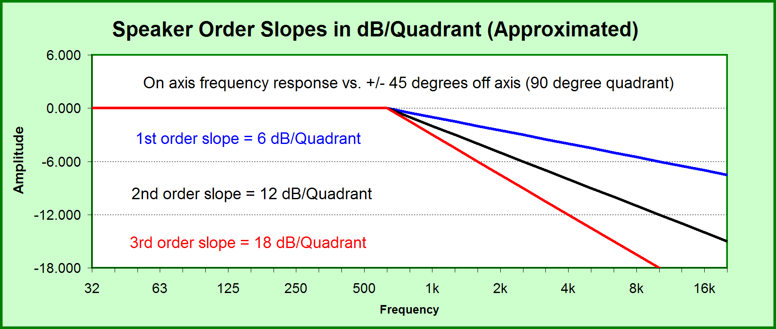

Slide 62
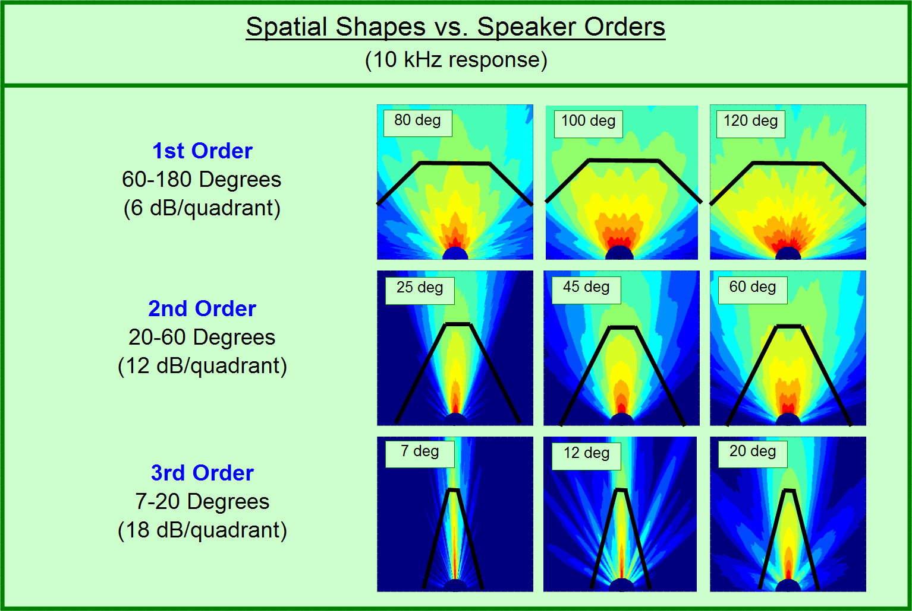

Slide 63
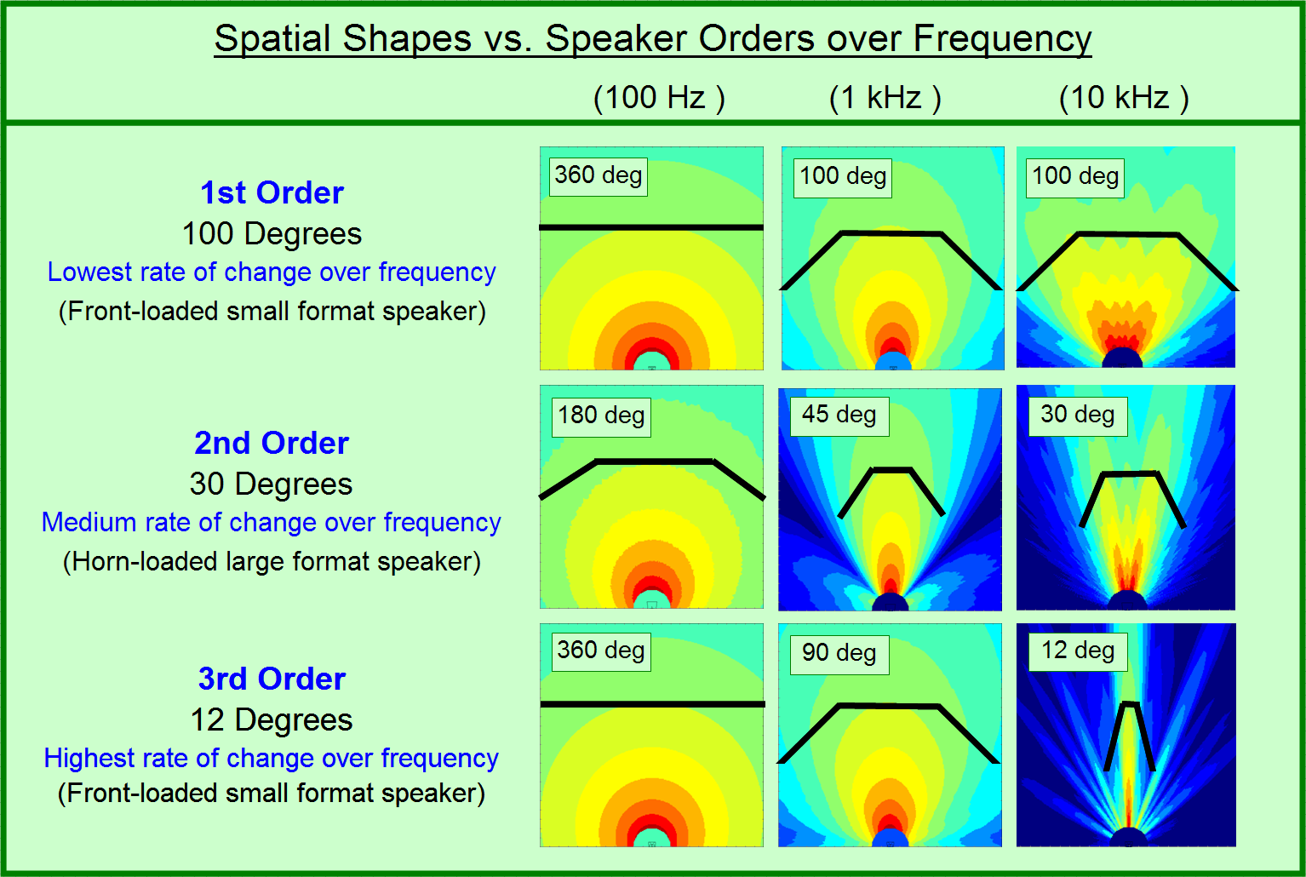

Slide 64
Spatial Crossover Classes
Crossover class varies with distance:
Gap: A+B < 0 dB
Unity: A+B = 0 dB
Overlap: A+B > 0 dB

Slide 65
Crossover Classes
Individual Shapes
Combined Shapes
Overlap
Unity
Gap
Crossover Point
Coupling Zone

Slide 66
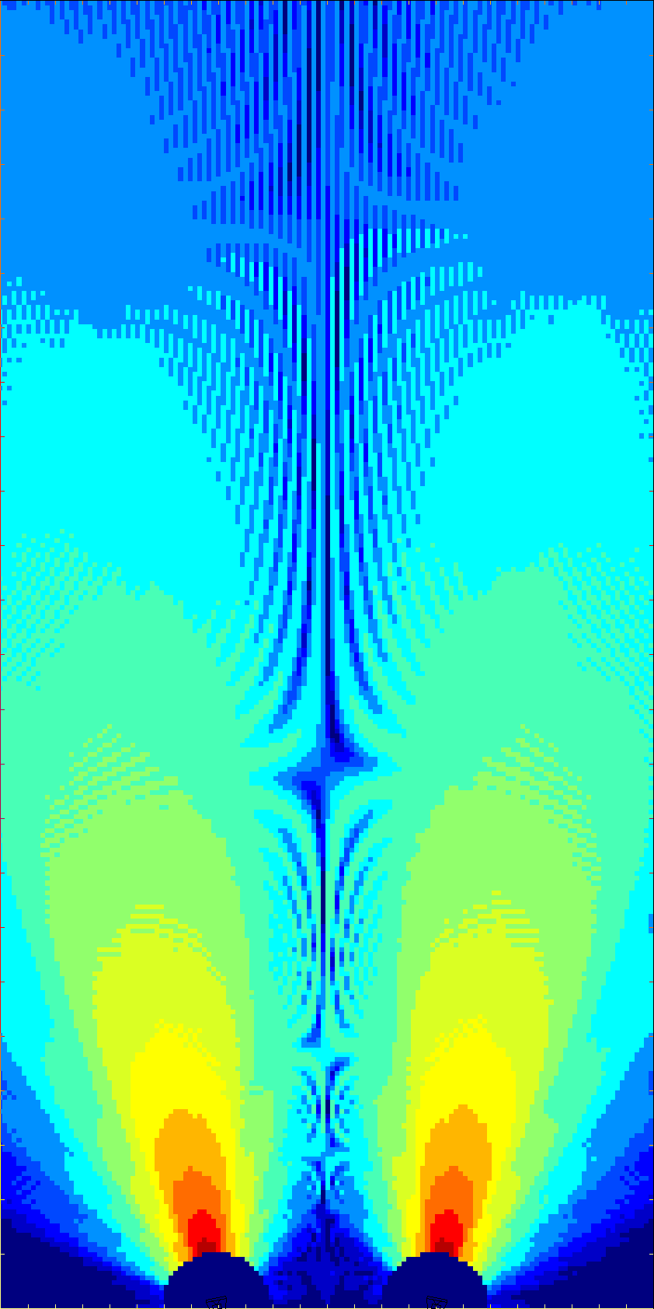
Spatial Crossover Classes
Individual Shapes
Combined Shapes
Overlap
(X+X=>0dB)
Unity
-6 + -6 =0dB
Gap
(X+X=<0dB)
Crossover Point
Coupling Zone

Slide 67
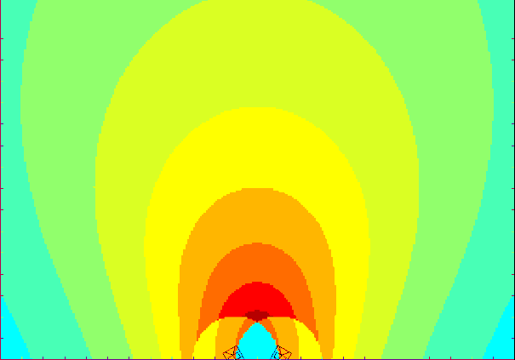


Spatial Crossover Classes vs. Frequency
Individual Shapes
Combined Shapes
Overlap
100 Hz
100 Hz
Unity
1 kHz
1 kHz
Gap
10 kHz
10 kHz
3rd Order Speakers
Crossover Point
Coupling Zone

Slide 68



Spatial Crossover Shapes vs. Speaker Order
1st Order (6 dB)
2nd Order
(12 dB)
3rd Order (18 dB)
Individual Shapes
Combined Shapes
Crossover Point
Coupling Zone
Notes:
Fig 2.46

Slide 69



Asymmetric Spatial Crossover: Level Offset
0 dB
3 dB
6 dB
Individual Shapes
Combined Shapes
Crossover Point
10 kHz
Coupling Zone
Notes:
Fig 2.46

Slide 70


Slide 71


Slide 72


Slide 73


Slide 74


Slide 75


Slide 76


Slide 77

Coupled Line Source Array

Slide 78







10 kHz
1 kHz
Coupled
Line Source
Speaker order effect
1st order spkrs @ 0 deg
100 Hz
1/24th octave
2x 1st order (90)
@ 0 deg
12 x 12 meters

Slide 79



Coupled Line source 2nd Order
10 kHz
1 kHz
Coupled
Line Source
Speaker order effect
2nd order spkrs @ 0 deg
100 Hz
1/24th octave
2x 2nd order (40)
@ 0 deg
12 x 12 meters

Slide 80




Coupled Line source 3rd Order
10 kHz
1 kHz
Coupled
Line Source
Speaker order effect
3rd order spkrs @ 0 deg
100 Hz
1/24th octave
2x 3rd order (08)
@ 0 deg
12 x 12 meters

Slide 81

Coupled Line Source – 3rd Order X 3

Slide 82

Parallel Pyramid for 3 Elements

Slide 83

Parallel Pyramid for 8 Elements

Slide 84

Parallel Pyramid Overlap Effects

Slide 85

Coupled Point Source Array

Slide 86
Coupled Point Source Array
Unique feature: it can maintain a unity class crossover over distance
  not “automatic”
  variable over frequency
  done by creating a splay angle that is equal to the element coverage angle (the “unity splay angle”)
  if coverage angle remains constant over frequency, so will the unity class crossover

Slide 87




Coupled Line source 3rd Order
10 kHz
1 kHz
Coupled
Point Source
Speaker order effect
1st order spkrs @ 90 deg
100 Hz
1/24th octave
2x 1st order (90)
@ 90 deg
12 x 12 meters

Slide 88



Coupled Line source 3rd Order
10 kHz
1 kHz
Coupled
Point Source
Speaker order effect
2nd order spkrs @ 40 deg
100 Hz
1/24th octave
2x 2nd order (40)
@ 40 deg
12 x 12 meters

Slide 89



Coupled Line source 3rd Order
10 kHz
1 kHz
Coupled
Point Source
Speaker order effect
3rd order spkrs @ 8 deg
100 Hz
1/24th octave
2x 3rd order (08)
@ 08 deg
12 x 12 meters

Slide 90
Coupled Line source 3rd Order
Coupled
Point Source
Overlap effects
0 %
1st order spkrs @ 90 deg
90 Deg
10 kHz
0%
1/24th octave
2x 1st order (90)
@ 90 deg
12 x 12 meters

Slide 91





Coupled Line source 3rd Order
Coupled
Point Source
Overlap effects
50%
1st order spkrs @ 45 deg
45 Deg
10 kHz
22 Deg
50%
75%
1/24th octave
2x 1st order (90)
@ 45 deg
12 x 12 meters
45 Deg
50%

Slide 92
Coupled Line source 3rd Order
Coupled
Point Source
Overlap effects
75%
1st order spkrs @ 22 deg
22 Deg
10 kHz
22 Deg
75%
75%
1/24th octave
2x 1st order (90)
@ 22 deg
12 x 12 meters

Slide 93

Coupled Point Source, Level Offset

Slide 94

Coupled Point Source – Level, Splay, Delay

Slide 95


Slide 96

Uncoupled Line Source Array

Slide 97


Slide 98


Slide 99


Slide 100


Slide 101


Slide 102


Slide 103

Uncoupled Point Source

Slide 104


Slide 105


Slide 106


Slide 107


Slide 108


Slide 109


Slide 110


Slide 111


Slide 112


Slide 113




Coupled Line source 3rd Order
10 kHz
1 kHz
Uncoupled Pt. Destination
Angle and level effects
-9 dB with delay
0 deg
100 Hz
-9 dB, 17.45 ms
1/24th octave
2 x 1st order (90)
@ 0 deg
12 x 12 meters

Slide 114


Slide 115
Speaker/Room Summation
Room reflections are inherently copies of the original signal, and therefore correlated to the source signal
Reflections can continue for extended periods of time as they move from surface to surface around the room
Most surfaces do not reflect all frequencies at the same relative level, phase, and angle of incidence
The room/speaker crossover is “self-aligning” (in time) and matched in level at the room boundary surface

Slide 116
Speaker/Room Summation
Distance between speaker and surface analogous to half the source displacement distance between two speaker array elements
Relative angle of speaker and surface is analogous to half the splay angle between two speaker array elements
Coverage angle of the reflected “virtual” speaker is same as coverage angle of source speaker
Room surface is a physical spatial divider, and therefore the spatial crossover (coupling zone)

Slide 117


Slide 118
Speaker/Room Summation
Absorption in wall surface analogous to level reduction of the secondary speaker – analogous to asymmetrical crossover
Power addition capability that comes from H or V overlap in the surface spatial crossover analogous to coupling zone addition in speaker/speaker interactions

Slide 119


Slide 120


Slide 121


Slide 122


Slide 123


Slide 124


Slide 125


Slide 126


