Slide 1
Prediction
Reference: Chapter 7 (3rd Ed.) of Sound Systems: Design and Optimization, by Bob McCarthy (Elsevier, 2017)

Slide 2
Outline
Principal responses
2D to 3D transformations
Loudspeaker aiming
Loudspeaker directivity data

Slide 3
Four Principal Responses
Free-field transmission characteristics of speaker
Effects of the transmission medium (air)
Summation effects of multiple speakers
Summation effects of the room and speakers

Slide 4
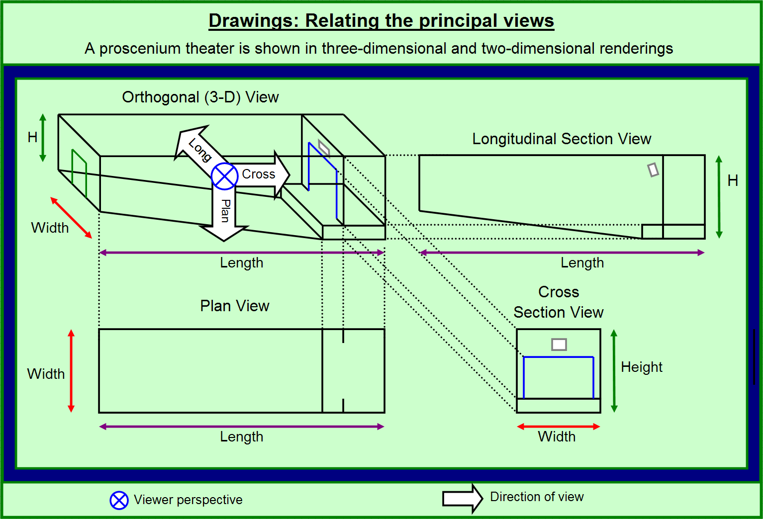
Prediction

Slide 5
2D to 3D Transformations
Basic limitation (of tools like MAPP XT): H and V “slices” do not completely characterize spherical (3-space) radiation
Issue of mismatch between speaker propagation plane vs. prediction plane
Two forms of speaker-prediction divergence
  distance (speaker location to listening position)
  angle (elevation, train, skew)

Slide 6
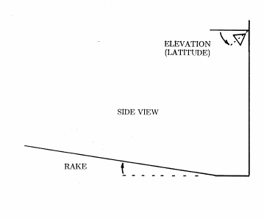
Loudspeaker Aiming

Slide 7
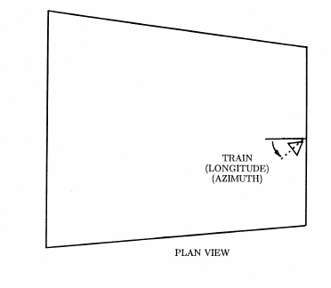
Loudspeaker Aiming

Slide 8
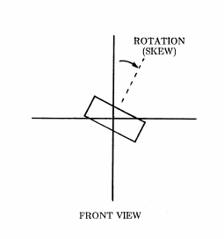
Loudspeaker Aiming

Slide 9
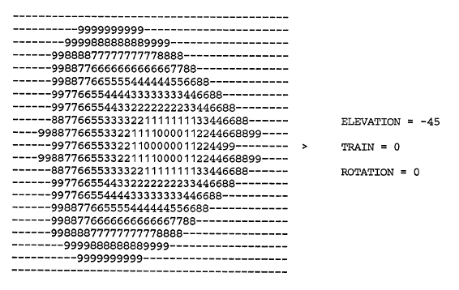
Loudspeaker Aiming

Slide 10
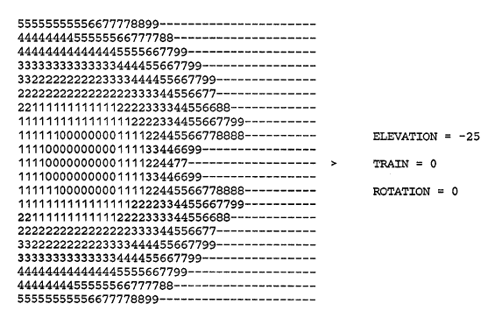
Loudspeaker Aiming

Slide 11
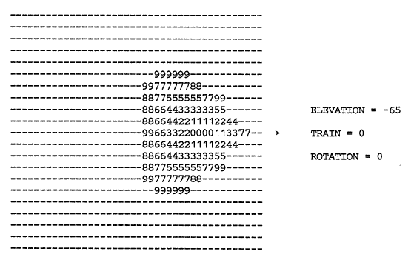
Loudspeaker Aiming

Slide 12
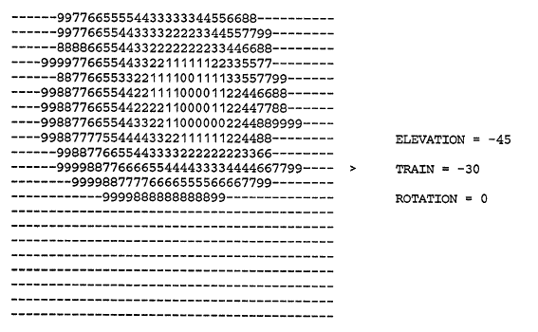
Loudspeaker Aiming

Slide 13
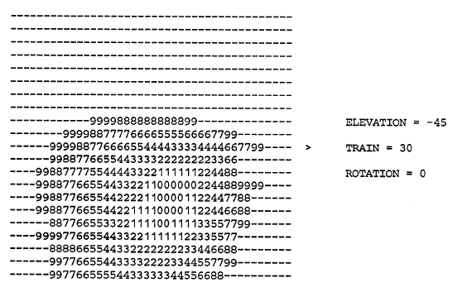
Loudspeaker Aiming

Slide 14
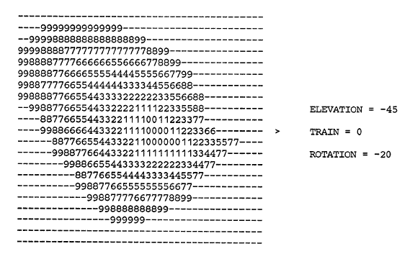
Loudspeaker Aiming

Slide 15
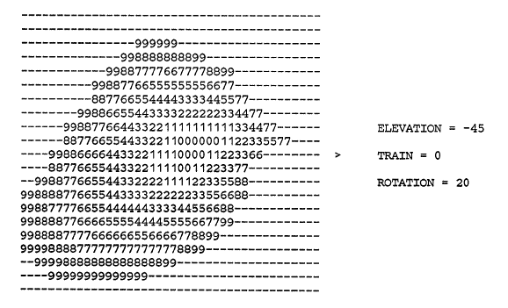
Loudspeaker Aiming

Slide 16
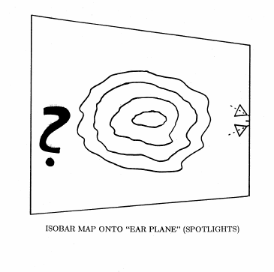
Loudspeaker Aiming

Slide 17
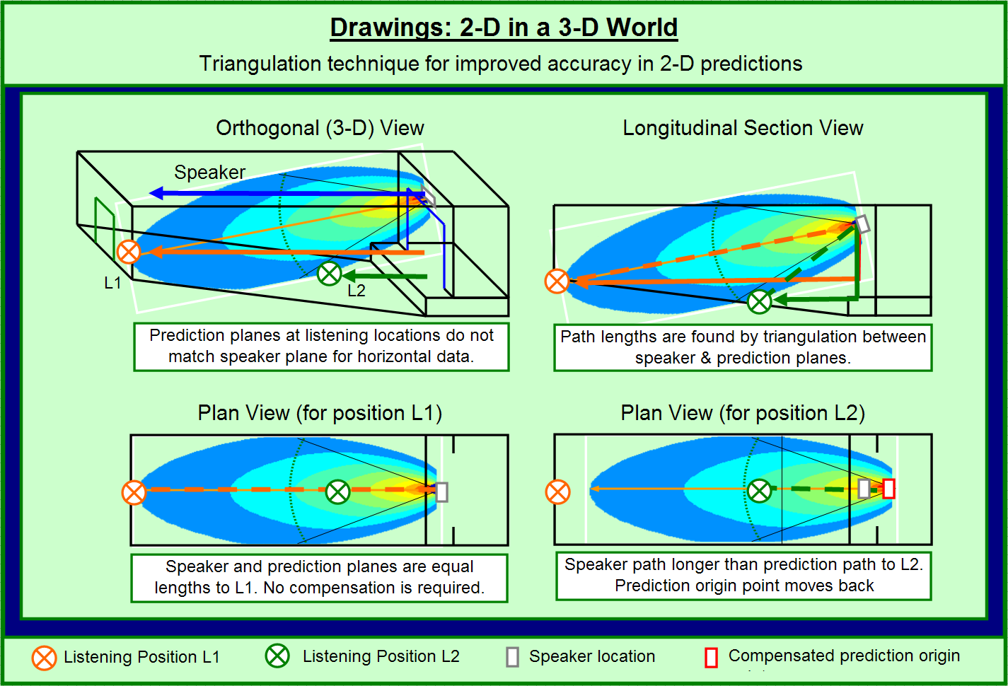
Prediction
Impossible except for cases in which the room geometry is “trivial”

Slide 18
Prediction Software
MAPP XT http://meyersound.com
CATT-Acoustic http://www.catt.se/
LARA http://www.integralacoustics.ca/
ODEON http://www.odeon.dk/
RAMSETE http://www.ramsete.com/
RAY-END https://rayend.software.informer.com/
EASE http://ease.afmg.eu/
FOCUS http://www.renkus-heinz.com/ease-and-ease-focus

Slide 19
Limitations of Prediction Software
Angular (spatial) resolution of loudspeaker directivity data
Frequency resolution (number/width of frequency bands)
Amplitude response of loudspeaker elements
Phase response of loudspeaker elements

Slide 20
Common Loudspeaker Format
http://www.clfgroup.org/author.htm
CLF1
  Frequency resolution: octave (low)
  Angular resolution: 10 degrees (low)
CLF2
  Frequency resolution: 1/3 octave (medium)
  Angular resolution: 5 degrees (medium)

Slide 21
GLL Loudspeaker Data Format
http://ease.afmg.eu/index.php/read-news/items/gll-loudspeaker-data-format-develops-into-industry-standard.html
Generic Loudspeaker Library (GLL) developed by AFMG and published Spring 2007
AES Standards Committee published AES56-2008 (March 2009) – modern description format using high-resolution impulse response or complex frequency response
Spatial resolution
  Low: 15º x 15º
  Medium: 15º x 5º
  Normal: 5º x 5º

Slide 22
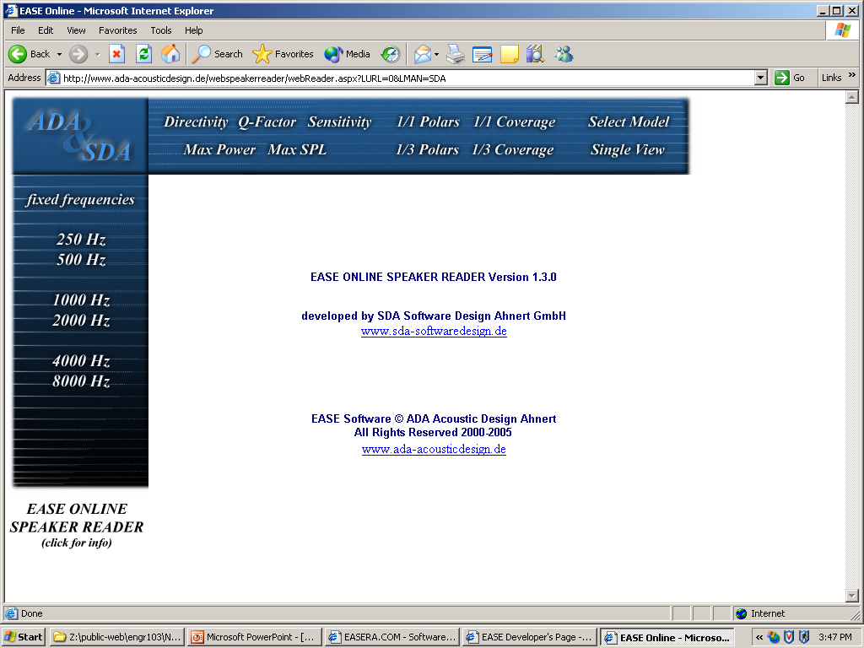

Slide 23
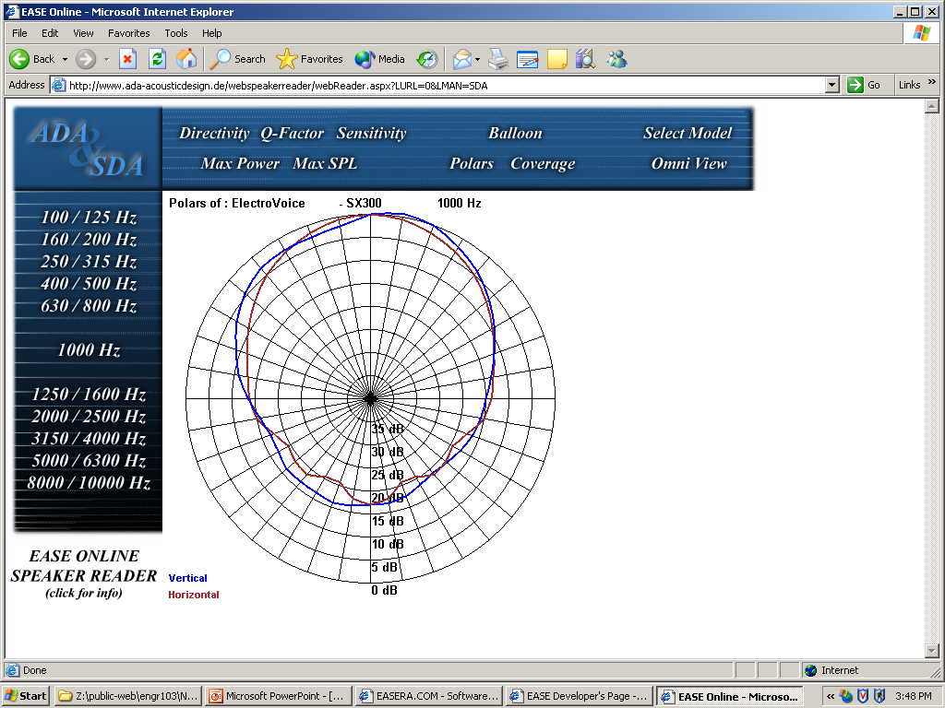

Slide 24
“Ideal” Resolution Needed?
Frequency resolution: 1/24 octave
Angular resolution: 1-2 degrees
Complex (phase/magnitude) response

Slide 25
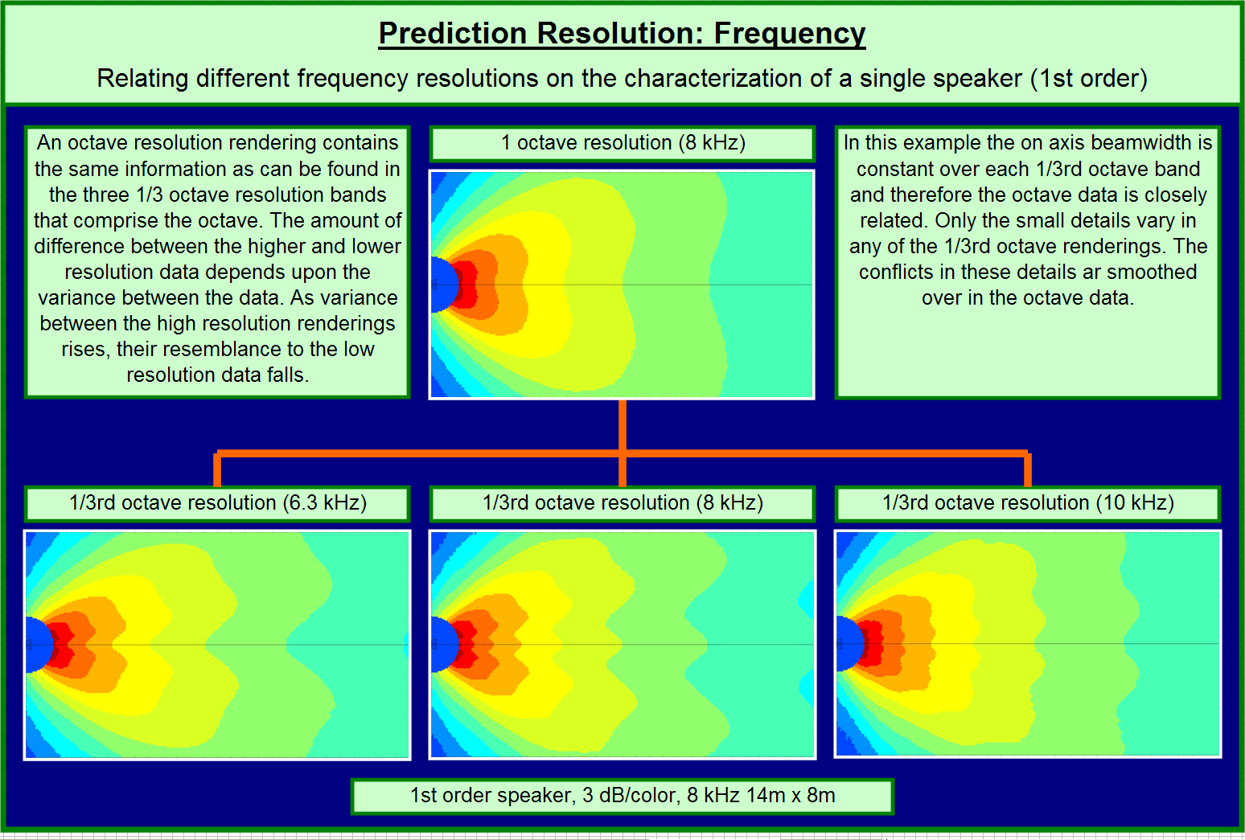
Prediction

Slide 26
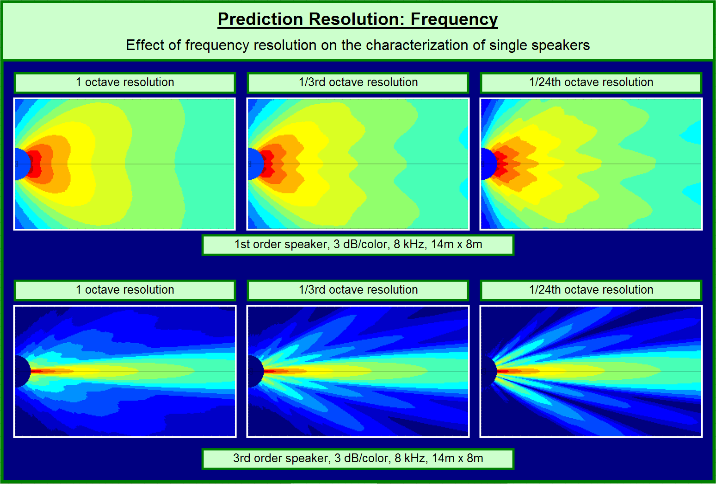
Prediction

Slide 27
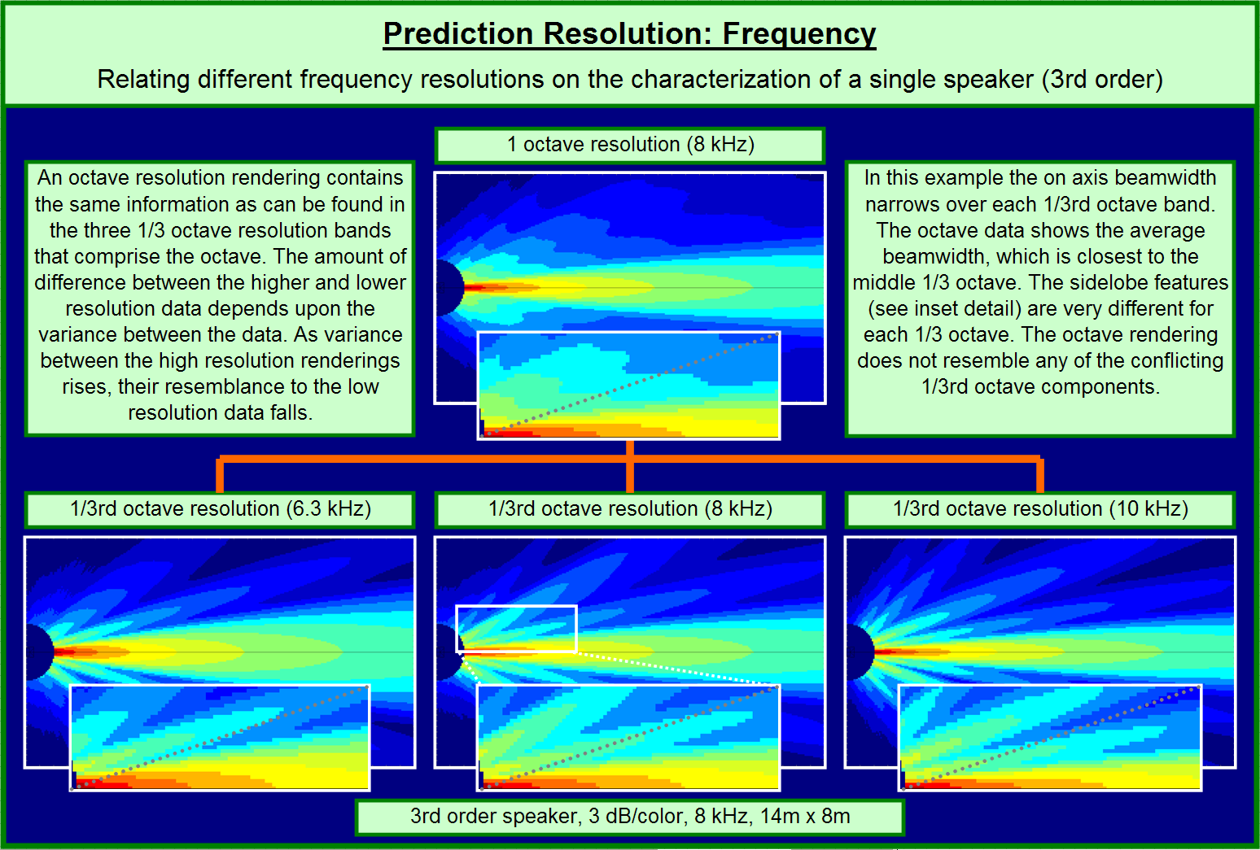
Prediction

Slide 28
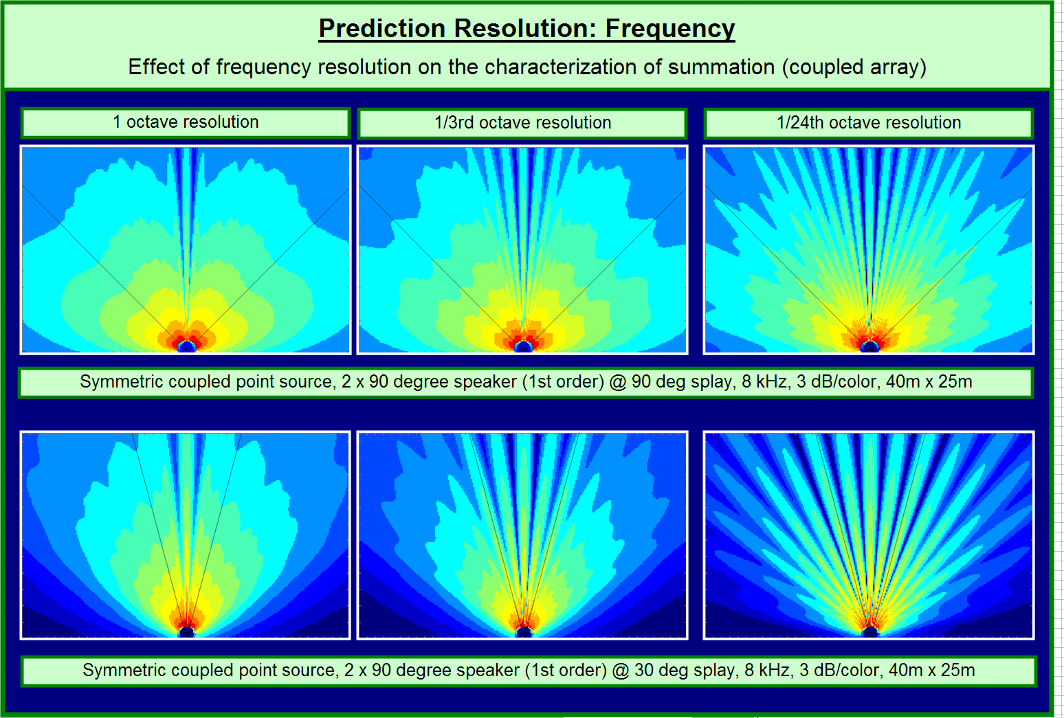
Prediction

Slide 29
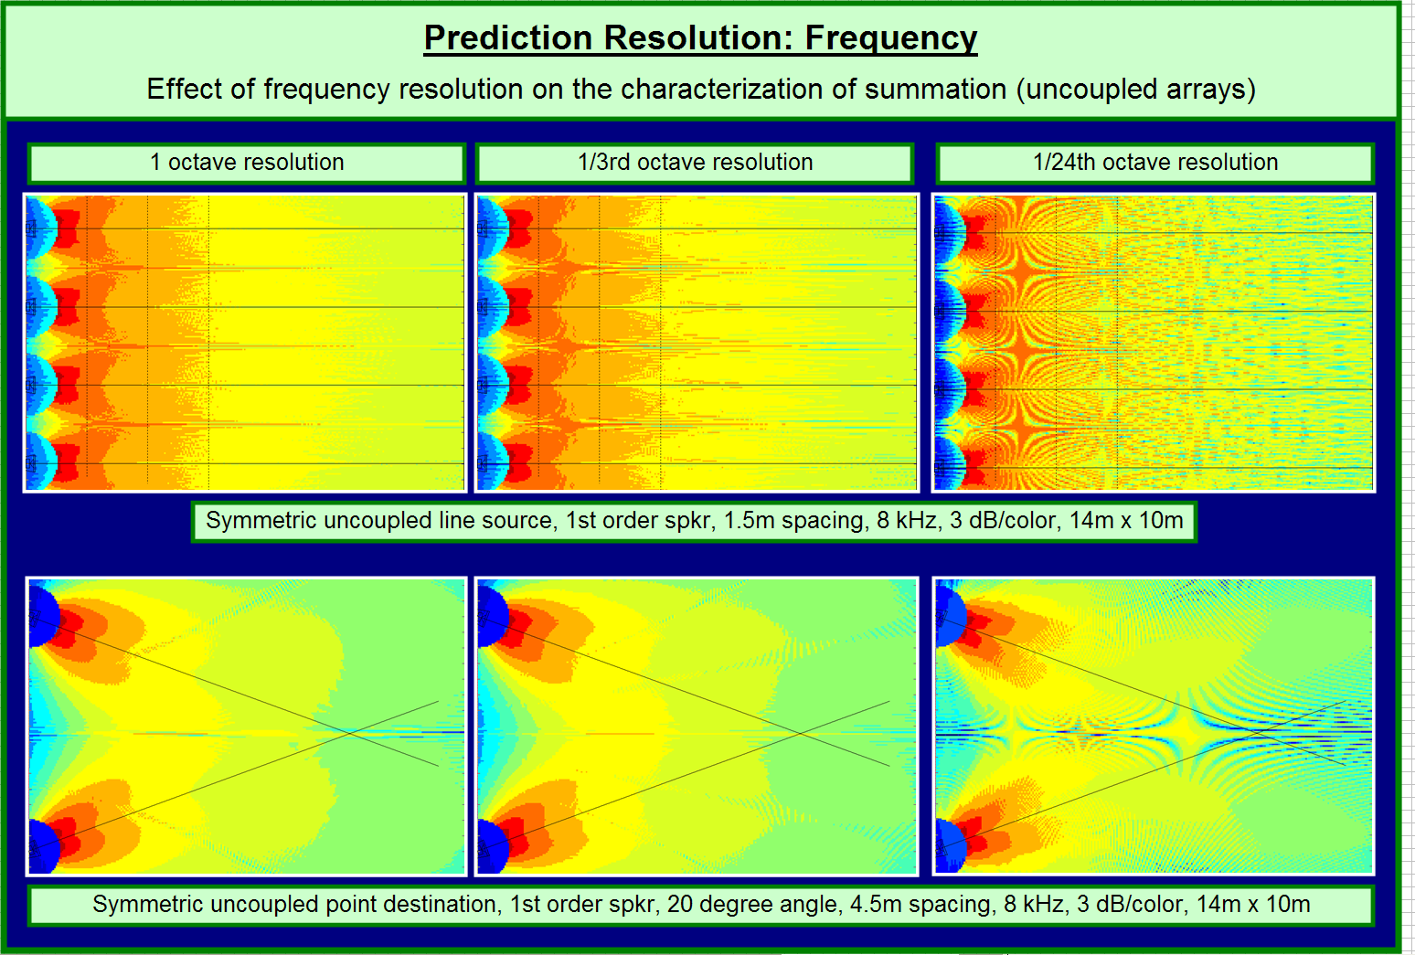
Prediction

Slide 30
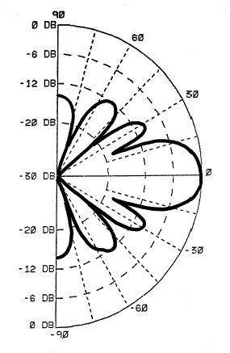
Directivity Data Resolution Requirements

Slide 31
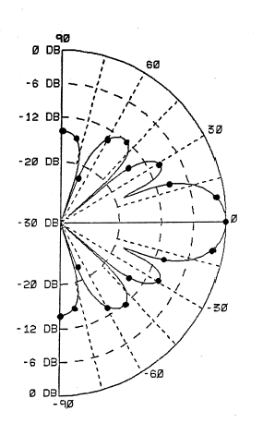
Directivity Data Resolution Requirements
Example with10° angular resolution

Slide 32
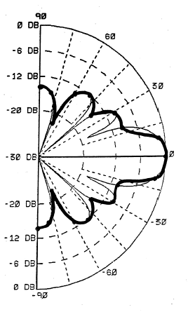
Directivity Data Resolution Requirements
can be thought of as “spatial aliasing”

Slide 33
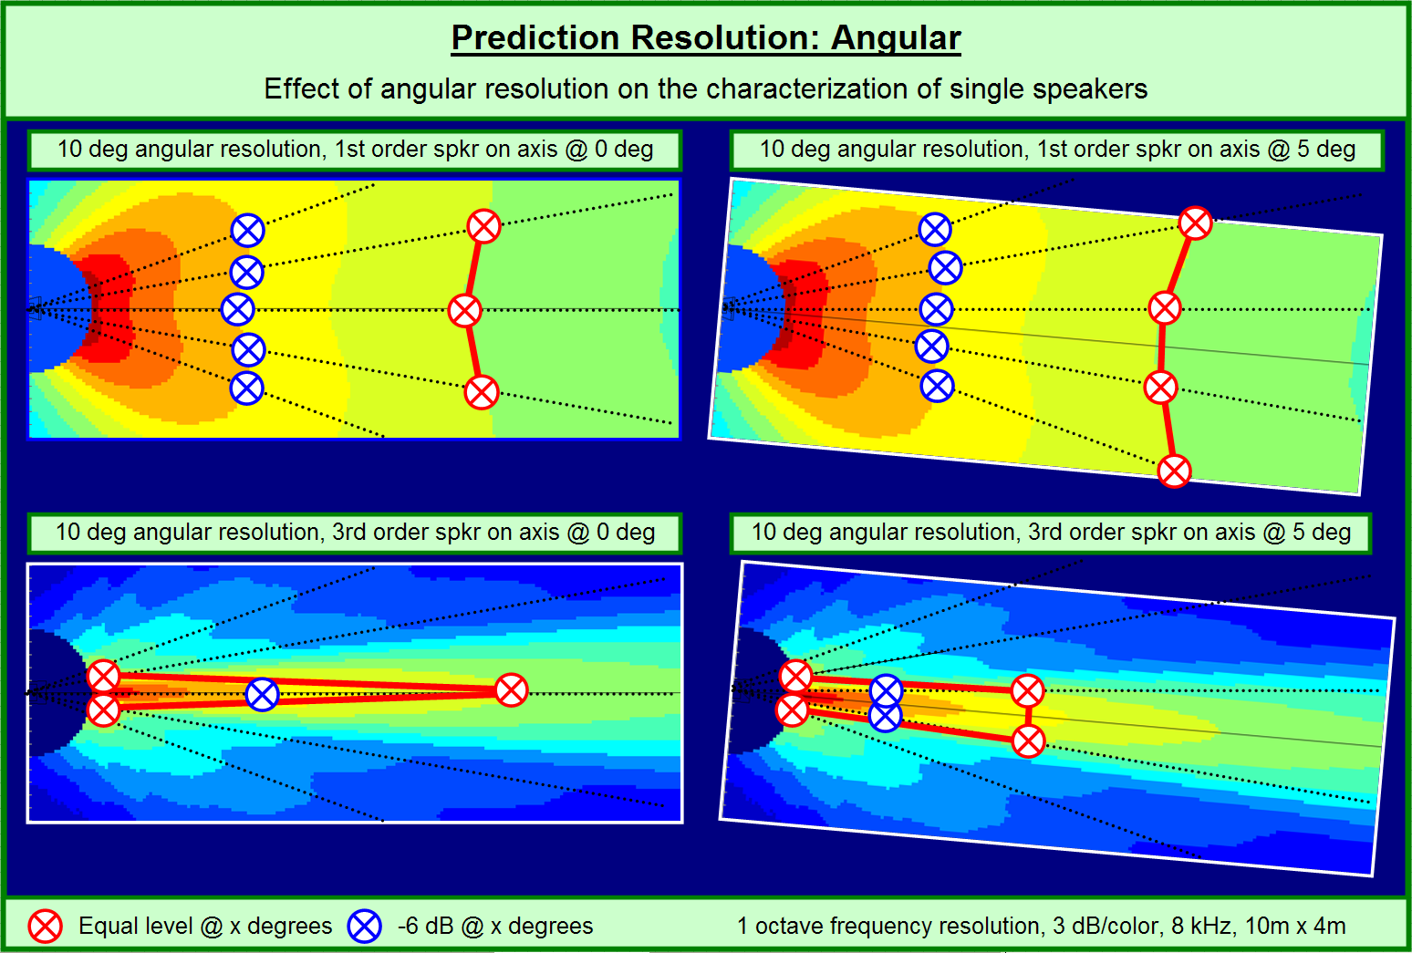
Prediction

Slide 34
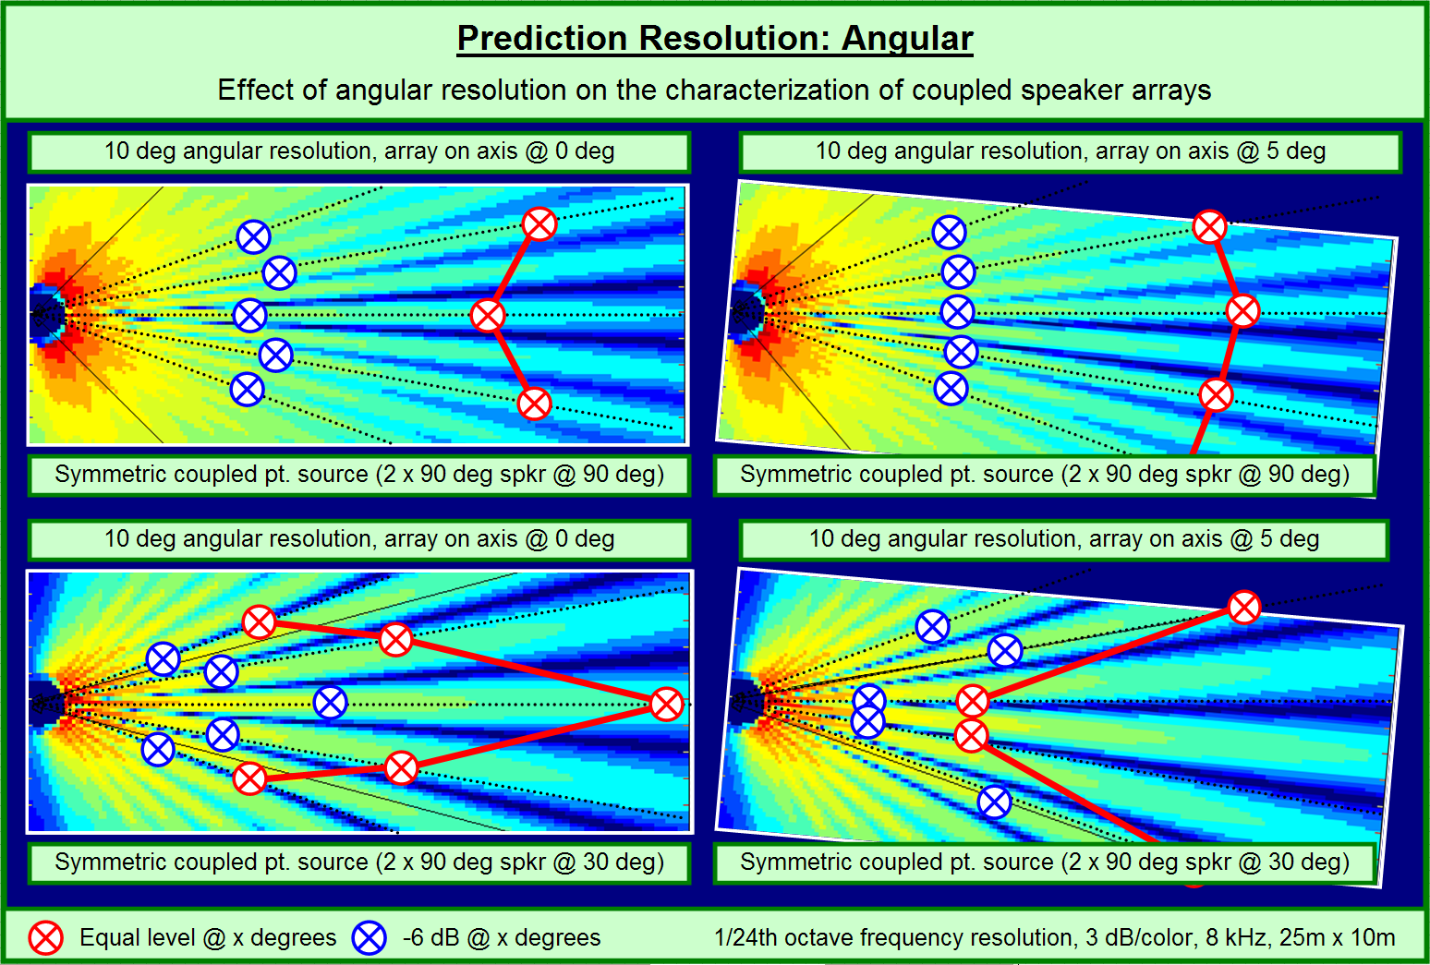
Prediction

Slide 35
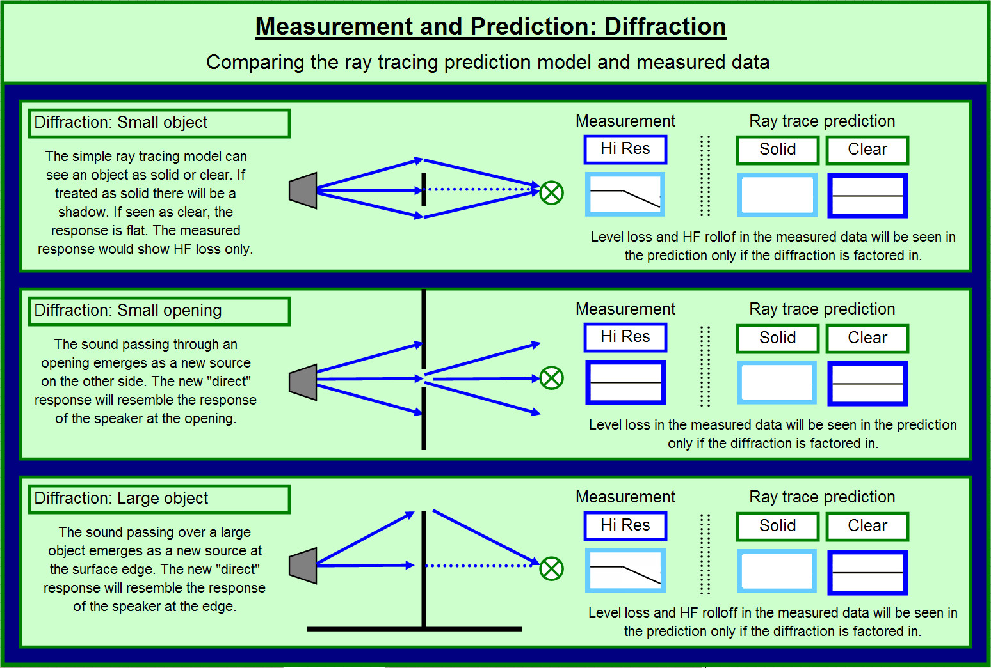
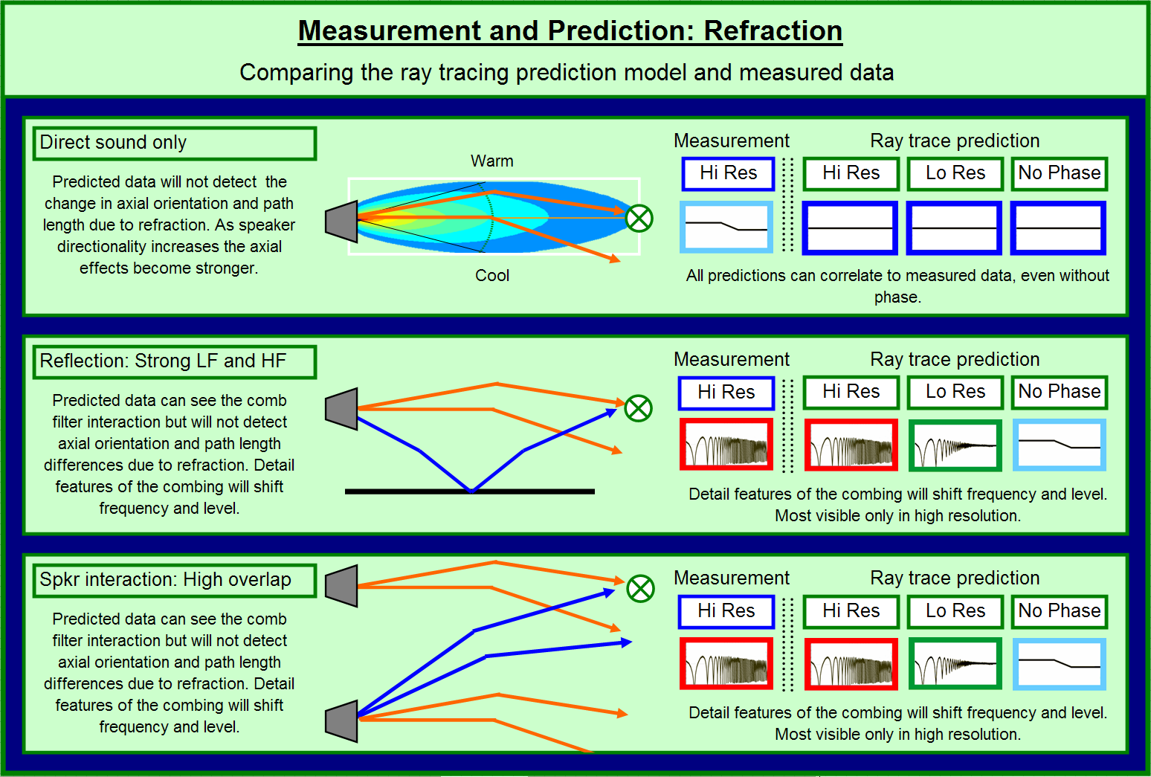
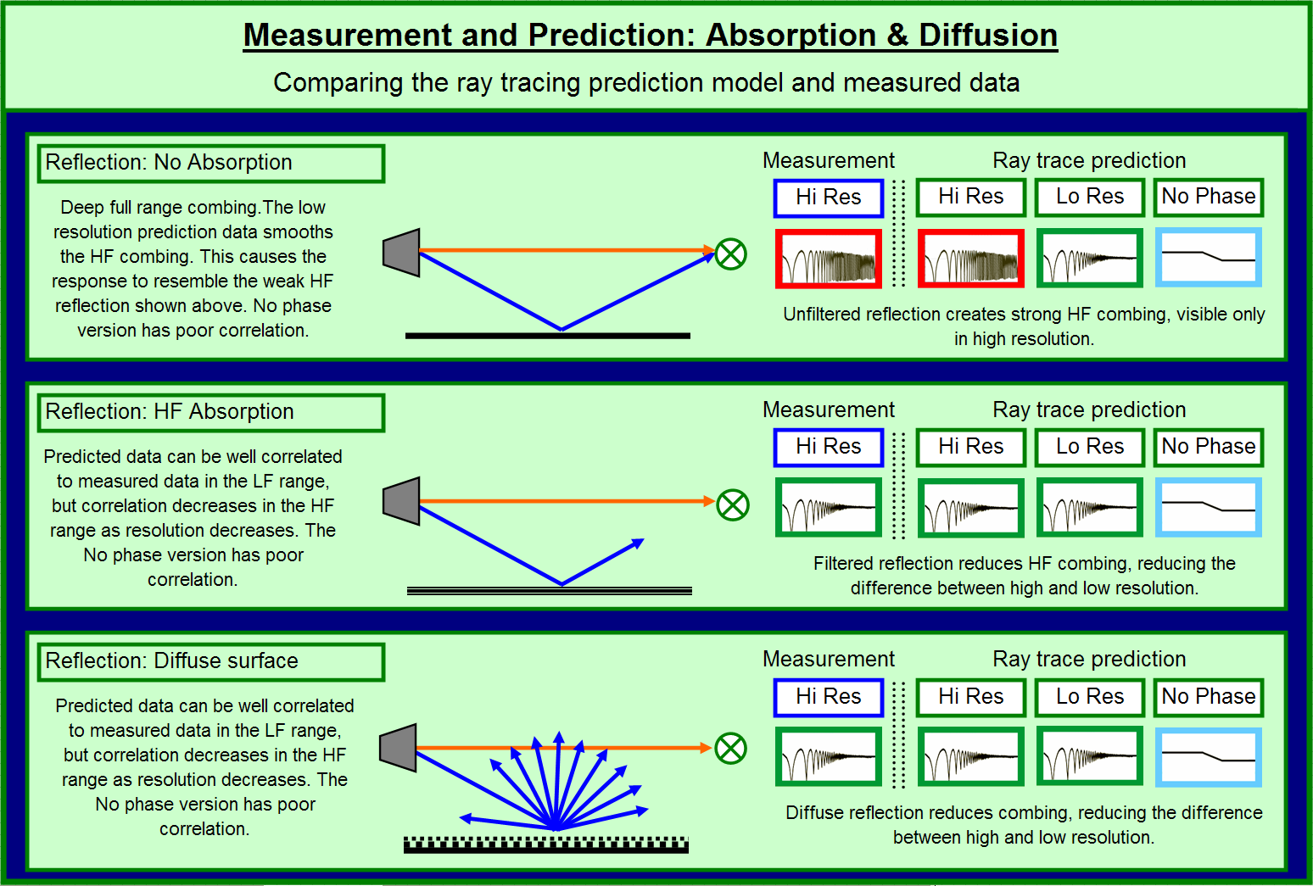
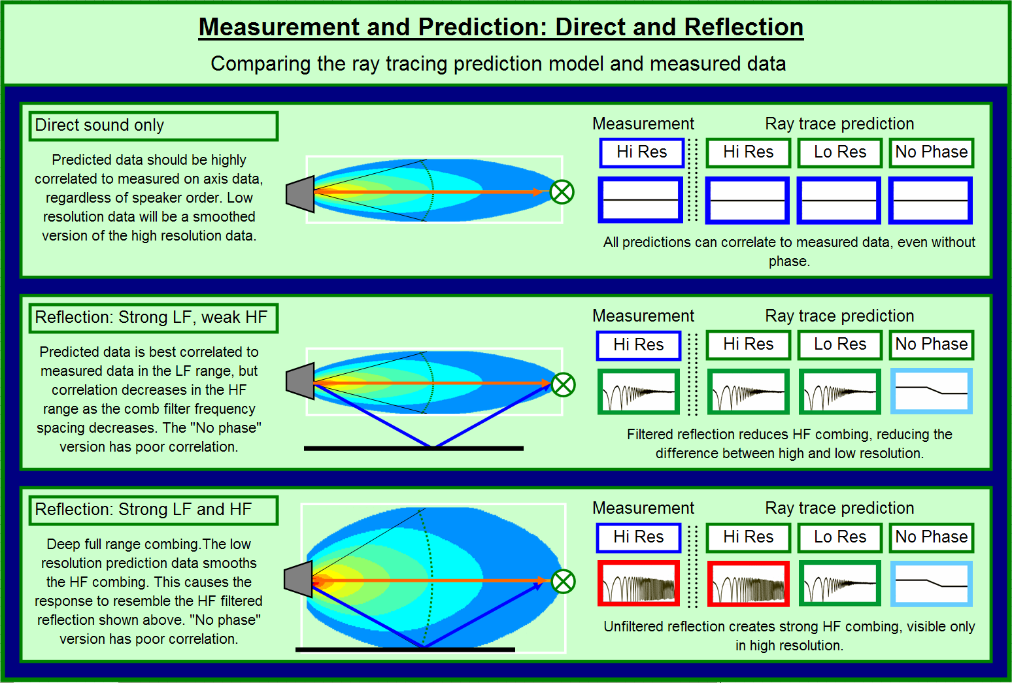
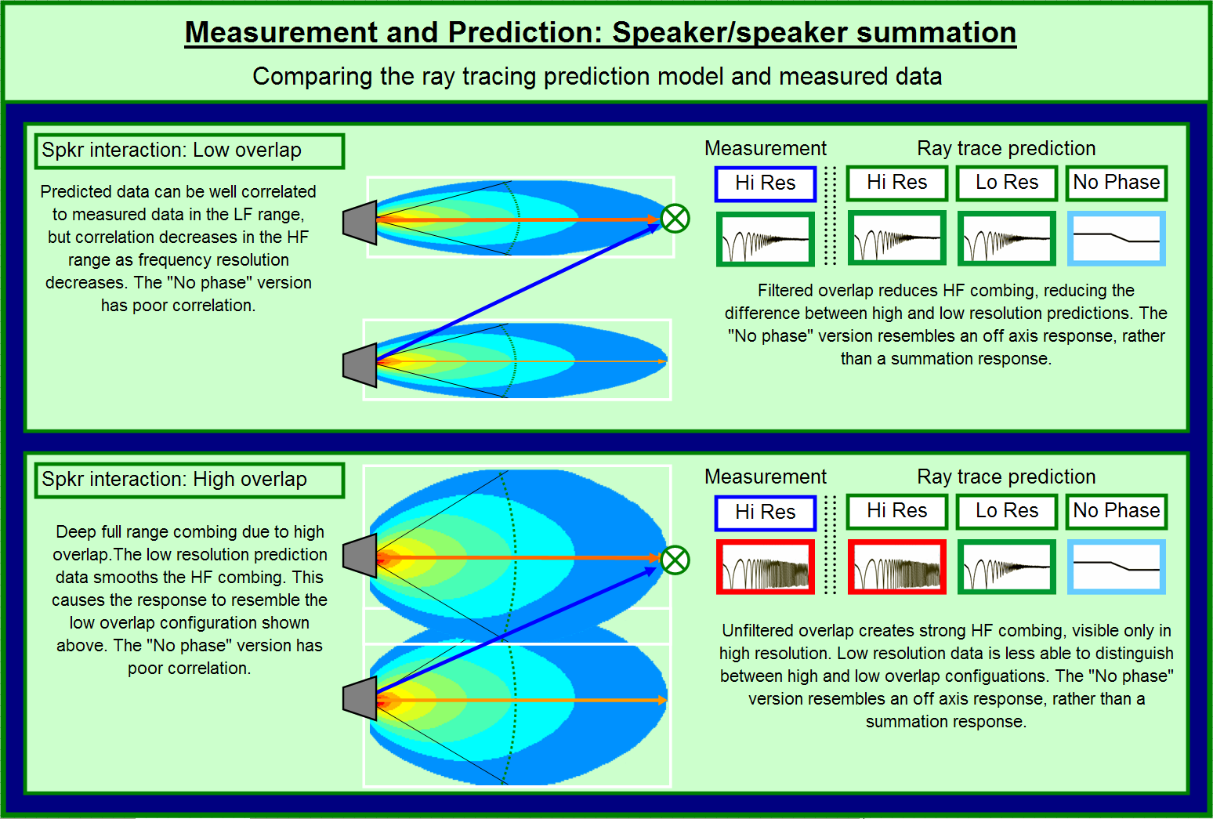
Prediction

Slide 36
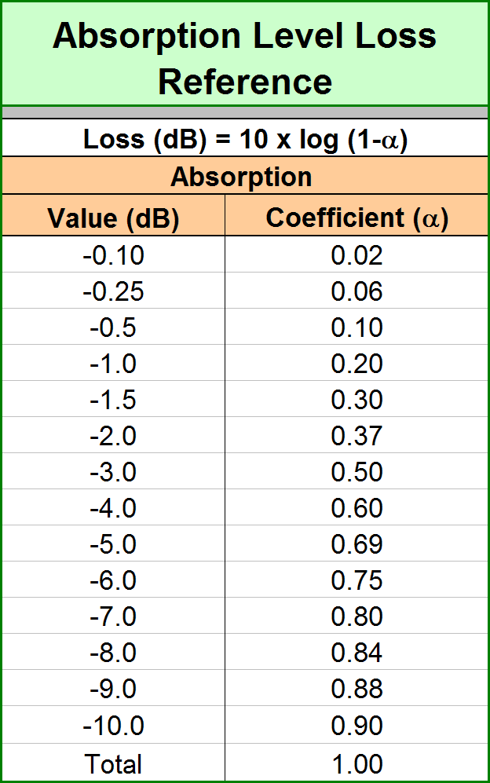
Prediction

