Slide 1
Perception
Reference: Chapter 5 (3rd Ed.) of Sound Systems: Design and Optimization, by Bob McCarthy (Elsevier, 2017)

Slide 2
Outline
Loudness and dB SPL
Crest factor
Localization
  horizontal
  vertical
Panoramic perception
Stereo “everywhere”?

Slide 3
Loudness and dB SPL
perception of loudness comes from combination of sound pressure and duration
ear integrates level over a period of approx. 100 ms
noise floor in a typical venue is 50 dB or more above the bottom of our hearing threshold
actual dynamic range used by the program material will be a matter of artistic concern (job of mix engineer)

Slide 4
Crest Factor
crest factor = difference between peak and continuous level
continuous sine wave has crest factor of 3 dB
pink noise: 12 dB
speech has variable crest factor
  vowels: low
  consonants: high
a system that cannot reproduce speech transients will lose distinction between consonants (%ALCONS) – higher % articulation loss of consonants results in poor intelligibility

Slide 5
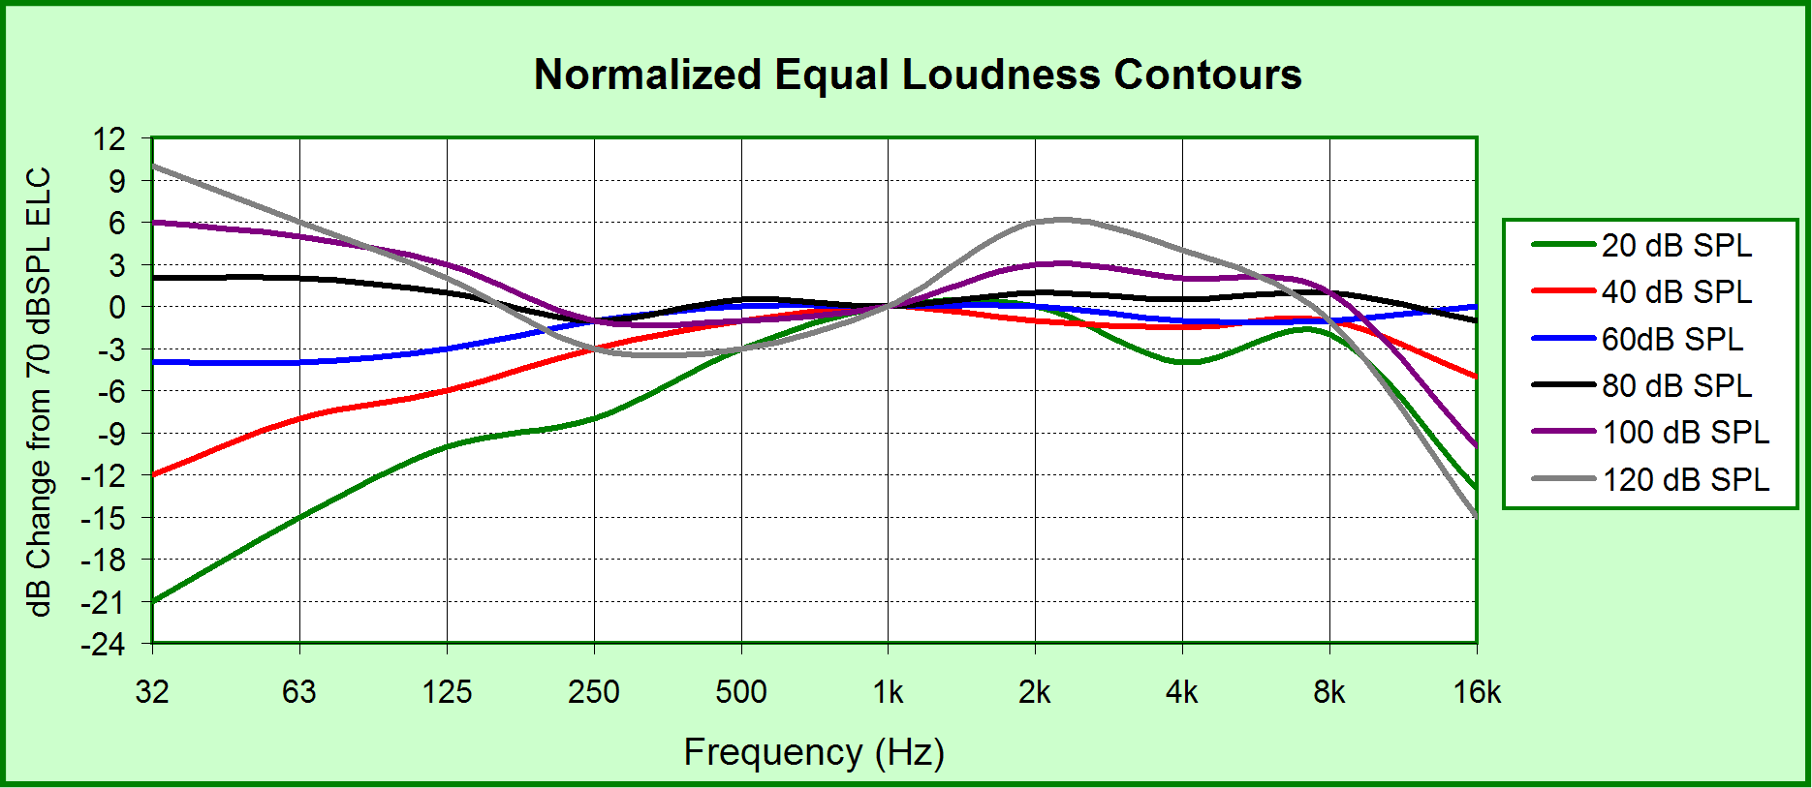
Equal Loudness Contours

Slide 6
Localization
ability to steer sound image to desired location dependent on speaker placement and relative levels
difference in perceived sound image from that of the sound source is the sonic image distortion
want to link the perceived sound location to the visually observed source (“localization”)

Slide 7
Vertical Localization
contours of the outer ear (pinna) create a series of reflections that steer the sound into the inner ear
these reflections cause coloration of the sound as they make their way to the inner ear
the tonal signature of these reflections is encoded in the brain as a vertical map that provides us with our sense of vertical sonic image – called the head-related transfer function (HRTF)
the HRTF operates independently for each ear
there is a different free-field HRTF for each angle in 3-D

Slide 8
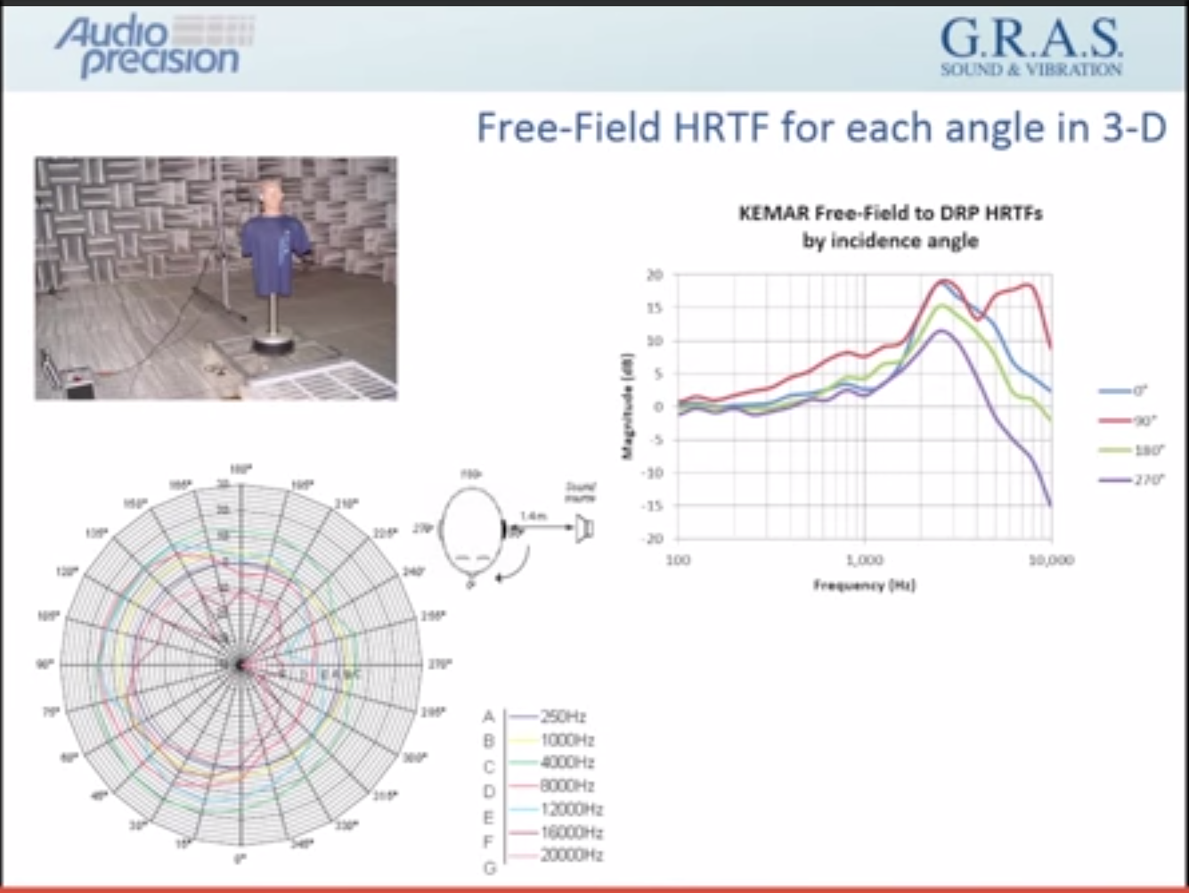
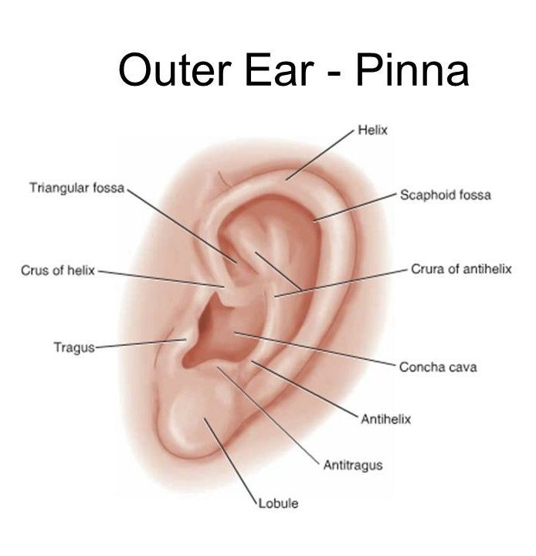
Reference: http://www.innerfidelity.com/content/audio-precision-explains-headphone-measurements-and-head-related-transfer-function

Slide 9
Vertical Localization
vertical position of an isolated source can be localized with ease/high accuracy
when ear is stimulated by multiple arrivals the process of localization becomes more difficult
if two vertically displaced sources arrive at equal levels, the conflicting HRTF values reach a compromise central localization
not experienced as “pinpoint” sound source, but instead as being “spatially spread”
if levels are offset, the dominant source will be perceived as the source of the sonic image
dominance of level over arrival time

Slide 10
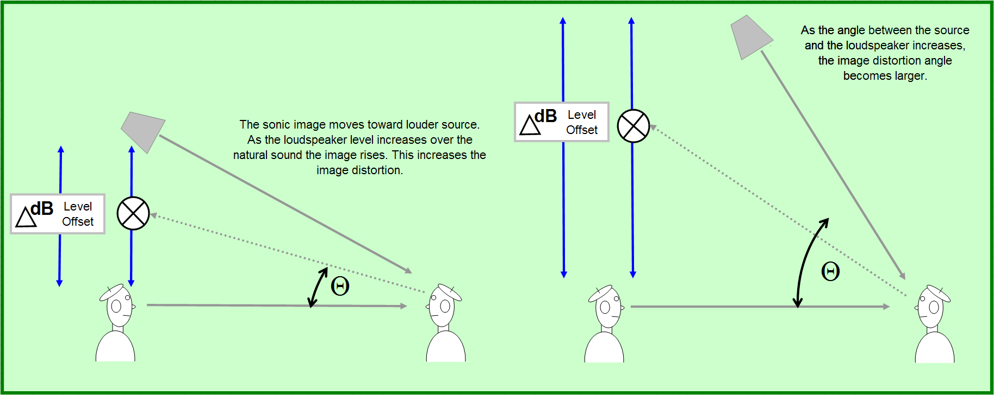
Image Distortion Angle

Slide 11
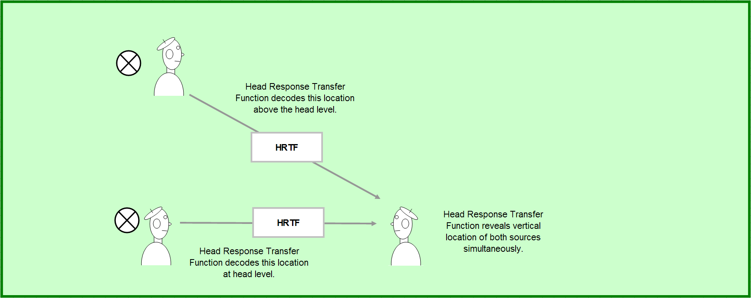
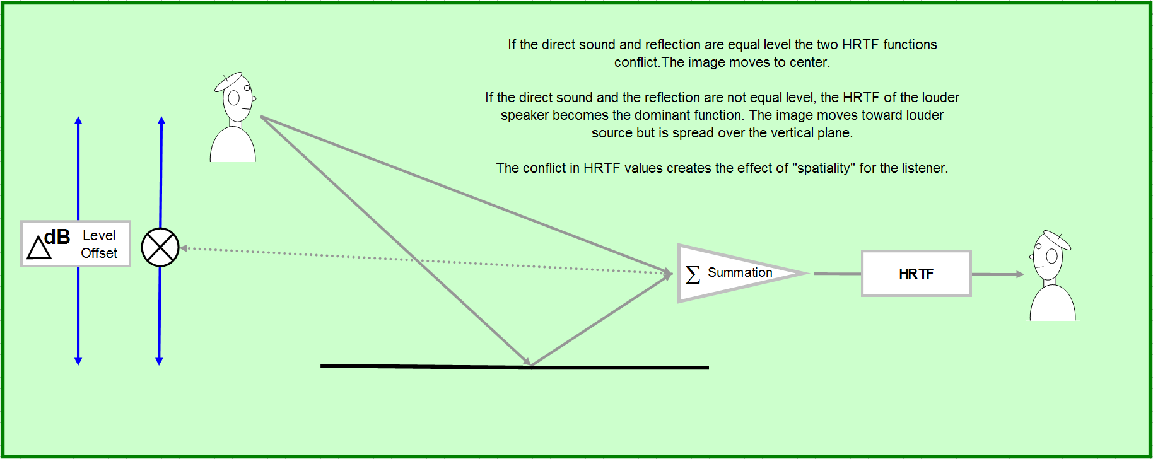
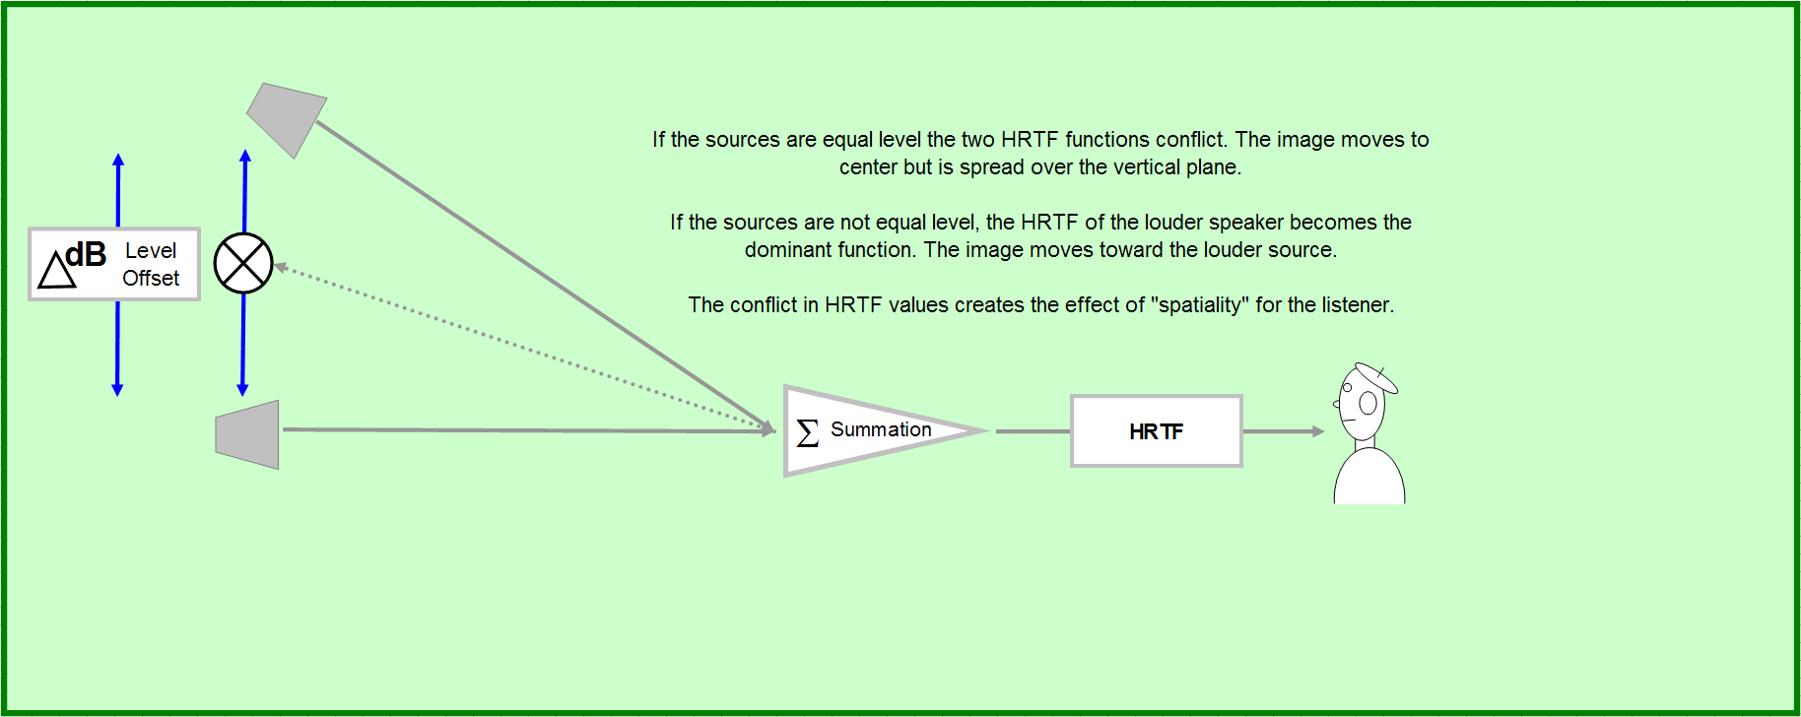
“Spatiality” Effect

Slide 12
Horizontal Localization
horizontal mechanism more sensitive than vertical
spaced placement of ears provides an automatic spatial sensor – any position on the horizon can be found by triangulation (binaural localization)
perceived horizontal sonic image depends on both time and level differences
relative time called the inter-aural time difference (ITD)
relative level called inter-aural level difference (ILD)

Slide 13
Horizontal Localization
ITD is dominant factor in low-frequency localization
ILD is dominant factor in high-frequency localization
when listening to a single source, ILD and ITD track together
if multiple (independent, uncorrelated) sources, each will have distinct ITD/ILD so localization can be done for each source
if sources correlated (reflections, early arrivals), becomes more complex/“spacious” (source is general area rather than pinpoint)

Slide 14
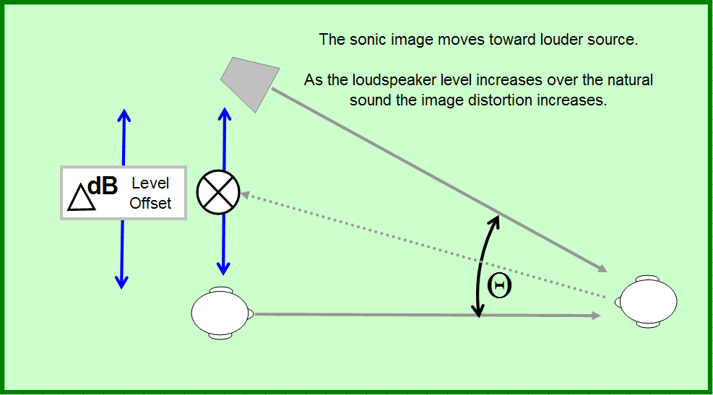
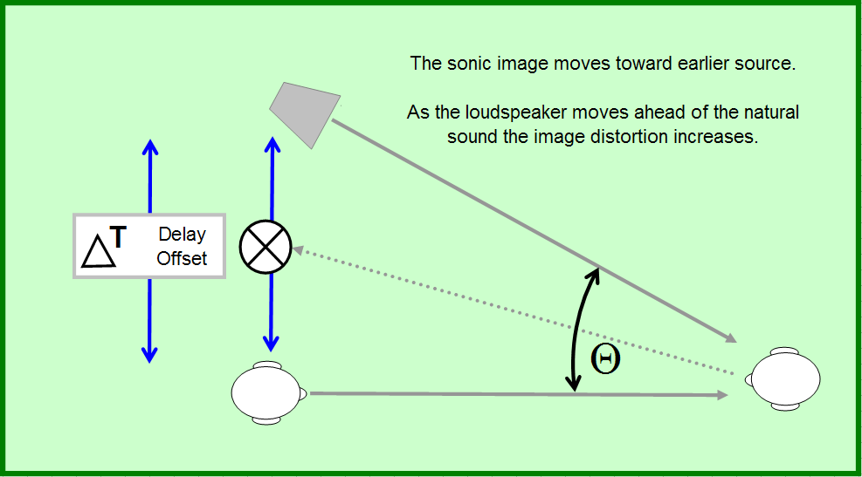
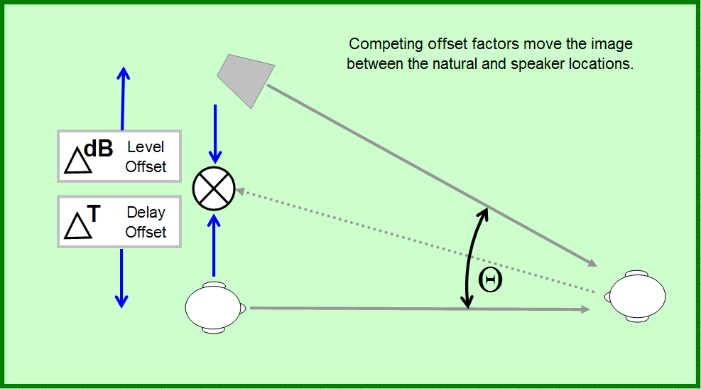
Reception

Slide 15
Panoramic Perception
horizontal image (“pan”) can be moved by offsetting either level or delay
level panning vs. delay panning
relationship between arrivals and our perception of sound image is known as the precedence effect (“Haas” effect)
image control can be maintained over a limited range of time (5 ms) and level (10 dB) between horizontally displaced sources
if the level offset is greater than 10 dB, no amount of delay can move the image

Slide 16
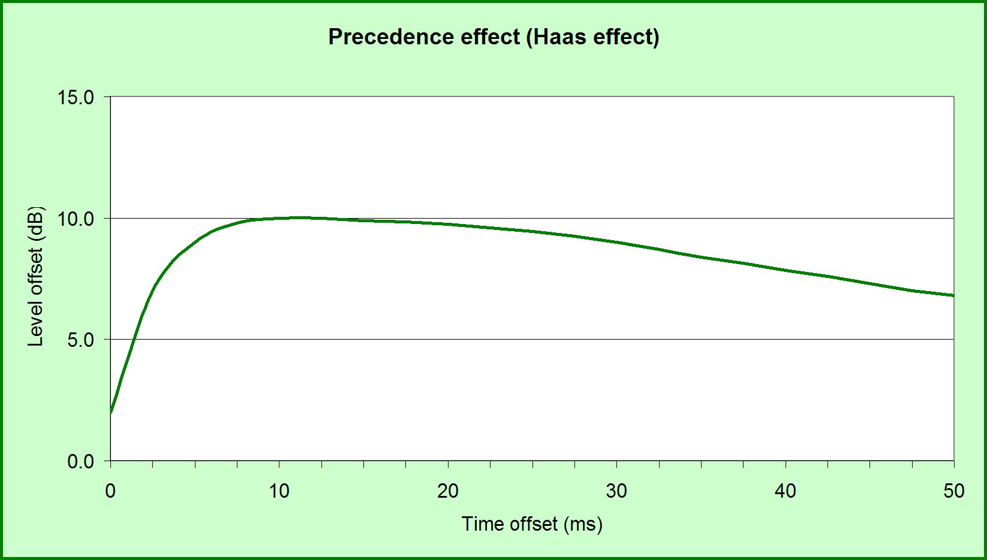
Haas Effect
As time offset increases, the level of the second source must be upwardly compensated in order to maintain a central image – the first 5 ms of time offset are the most critical.

Slide 17
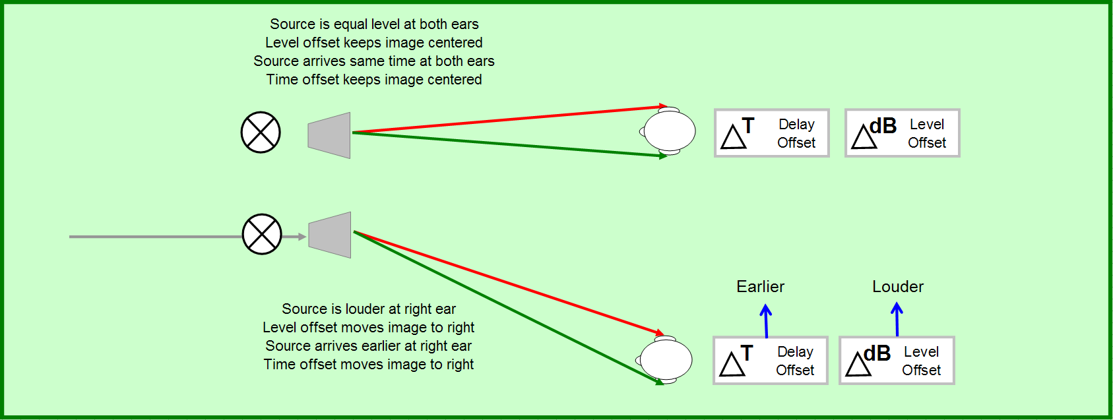
Effect of Time Offset

Slide 18
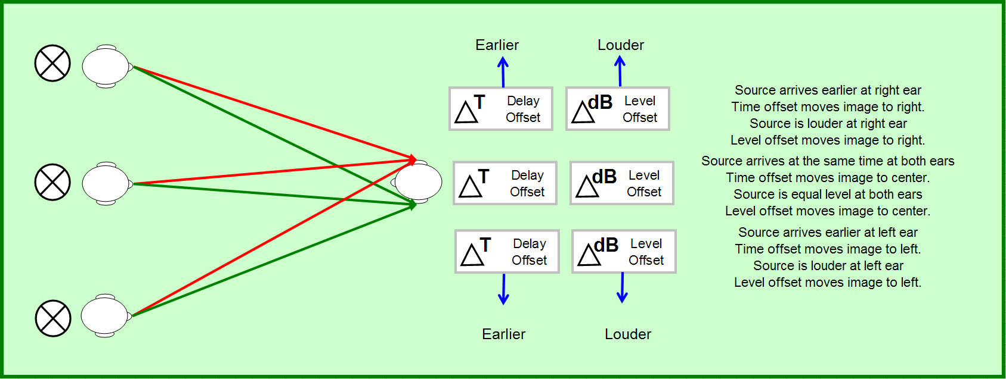
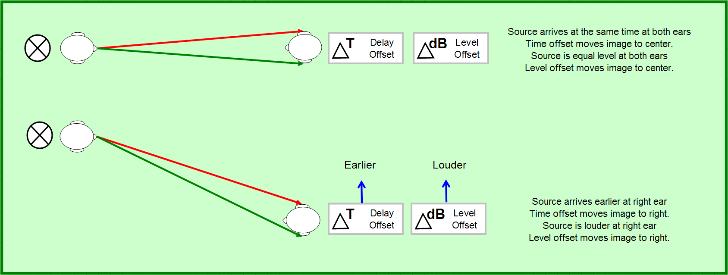
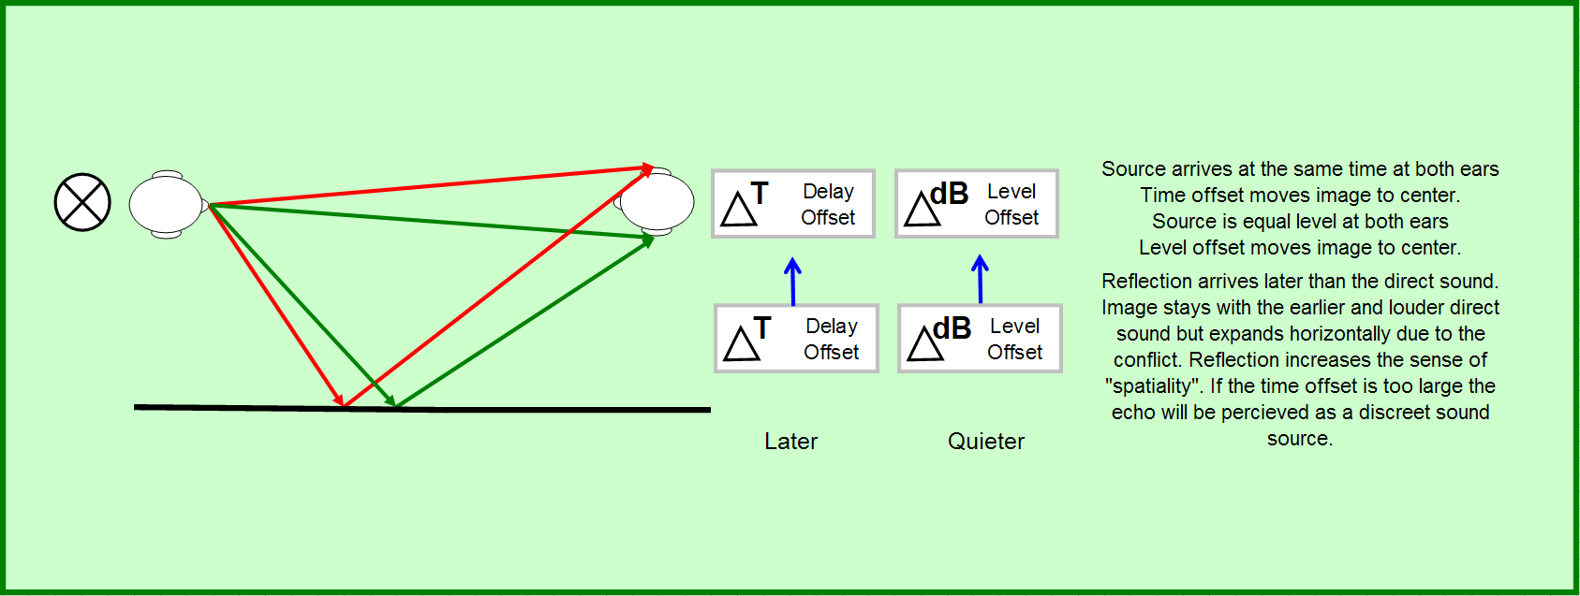
Effect of Time and Level Offset

Slide 19
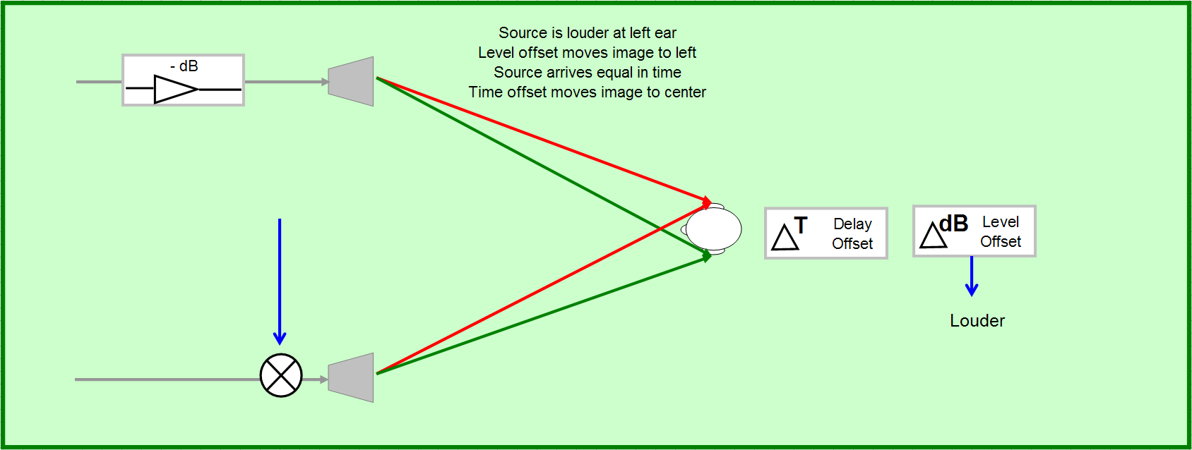
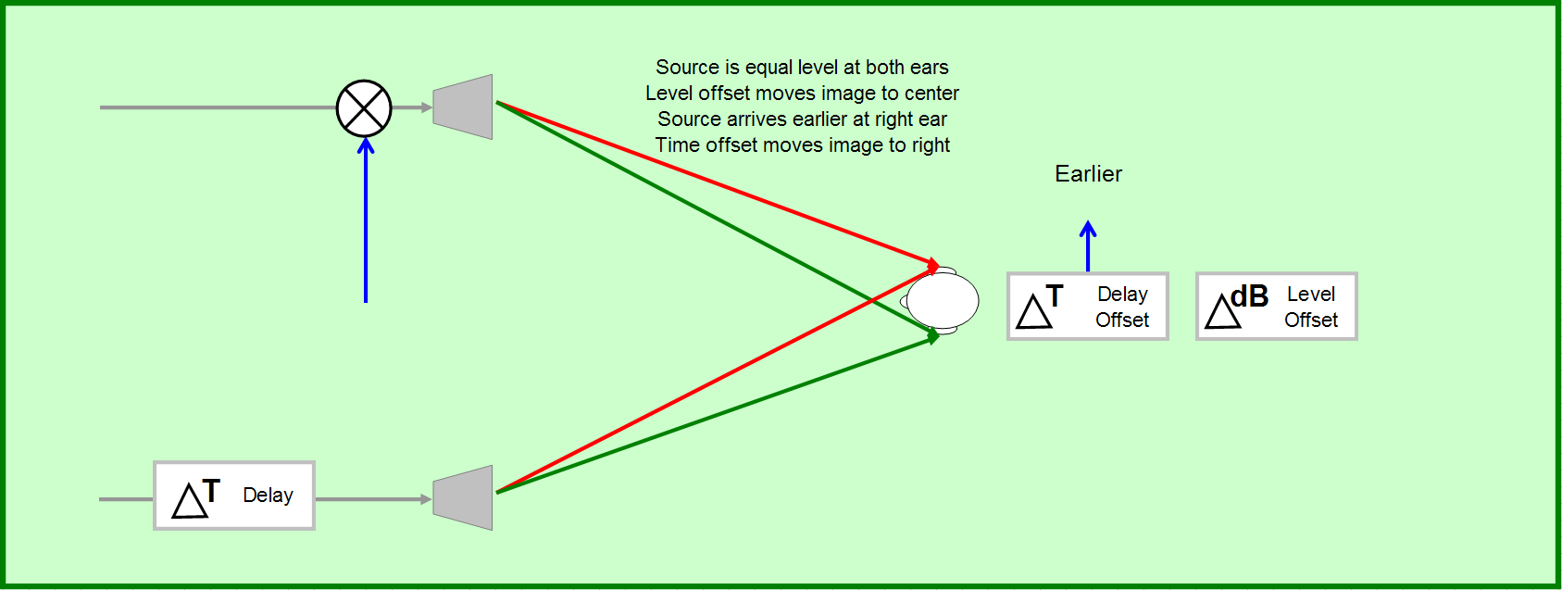
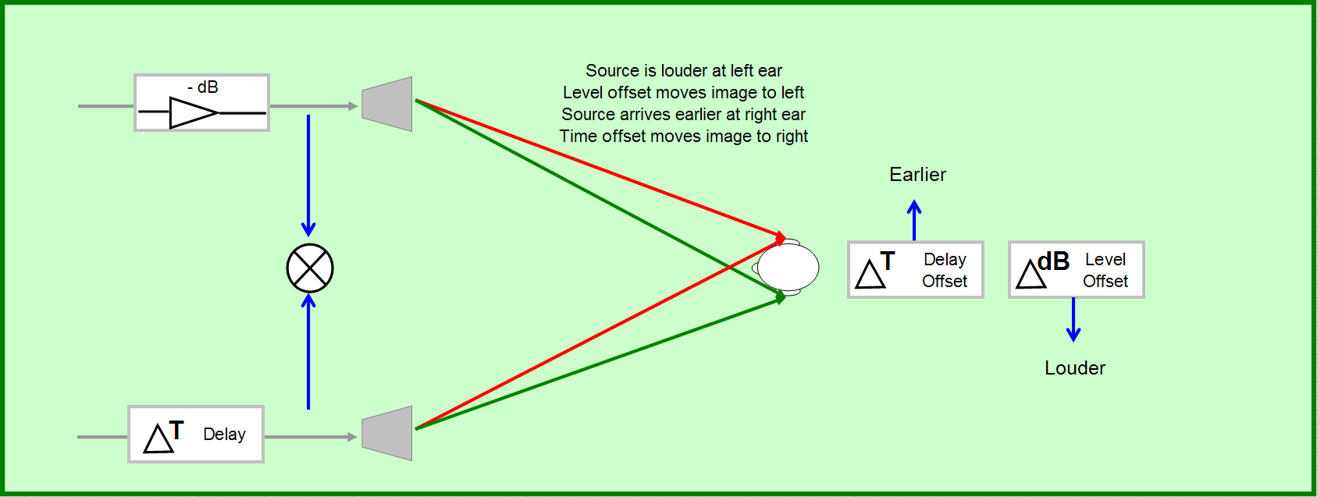
Combined Effect

Slide 20
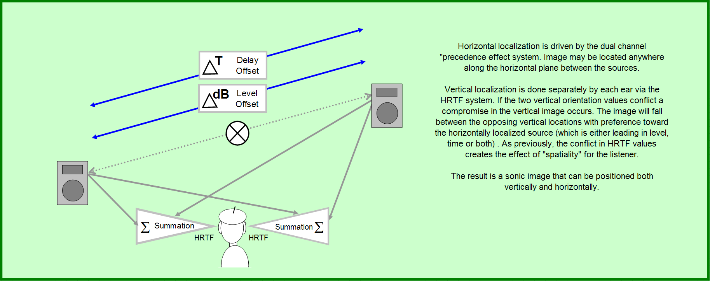
Dual Channel Precedence Effect

Slide 21
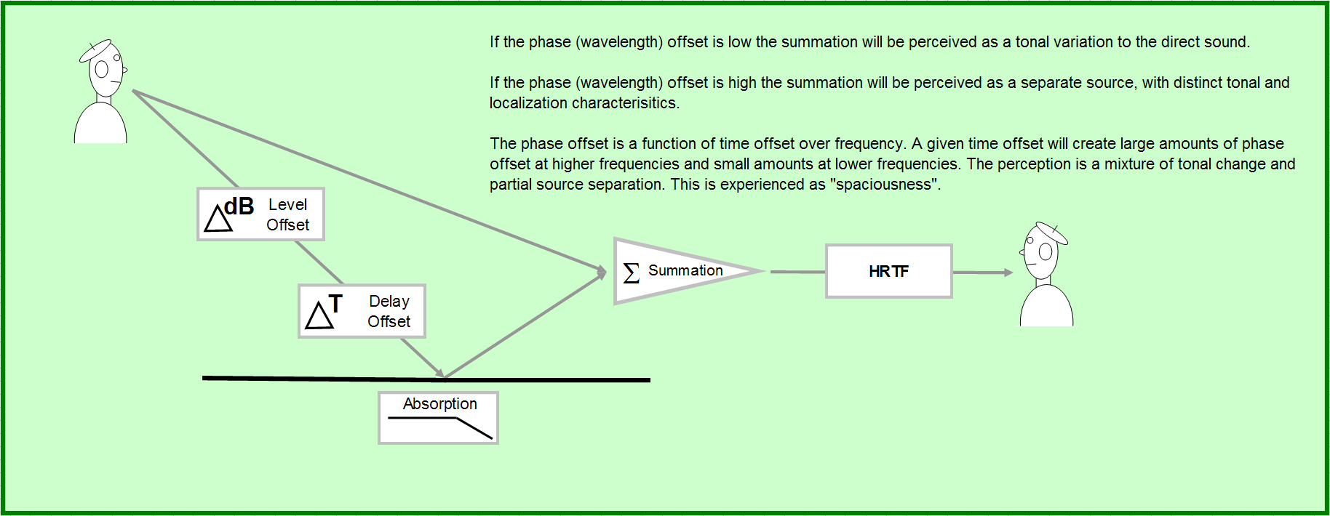
Phase Offset and Spaciousness

Slide 22
Tonal, Spatial, Echo Perception
tonal quality is a combination of direct sound plus arrivals within the duration period of the direct sound
tonal character modified by comb filtering – as summation ripple increases, distortion of tonal quality becomes increasingly perceptible
time offset determines the frequency range where the tonal disturbance is most perceptible – as time offset increases, the affected frequency range falls
filters narrower than λ/6 are generally not perceptible

Slide 23
Tonal, Spatial, Echo Perception
pattern of “bright spots” in sound spectrum is the envelope (audible shape of spectrum, tonal character)
the frequency resolution to which tonal character is audible is known as the critical bandwidth
tonal change comes from early arrival summation
spatial perception comes from middle arrival summation
discrete echoes come from late arrival summation

Slide 24
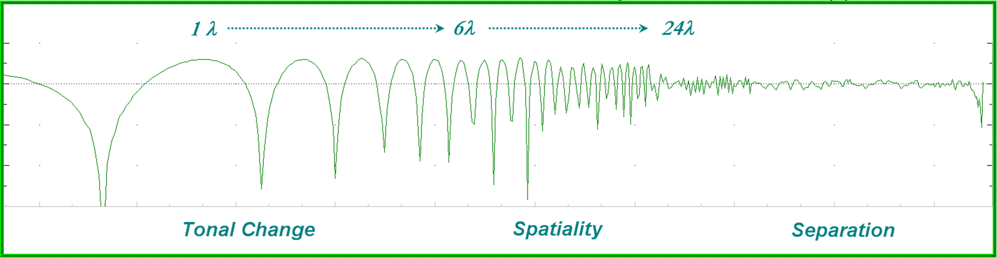
Reception
wavelength offset
Small wavelength offsets create a perception of tonal change while large offsets create the perception of separate sources.

Slide 25
Stereo Scaling
“stereo” does not scale well to large spaces
after we have left the central zone (5 ms Δ), the system becomes two mono channels
basic choices:
  wide panoramic stereo for a tiny majority of seats
  narrow panoramic stereo for a minority of seats
every seat that is off-center will be affected differently due to the changing time and level offsets between the competing sources

Slide 26
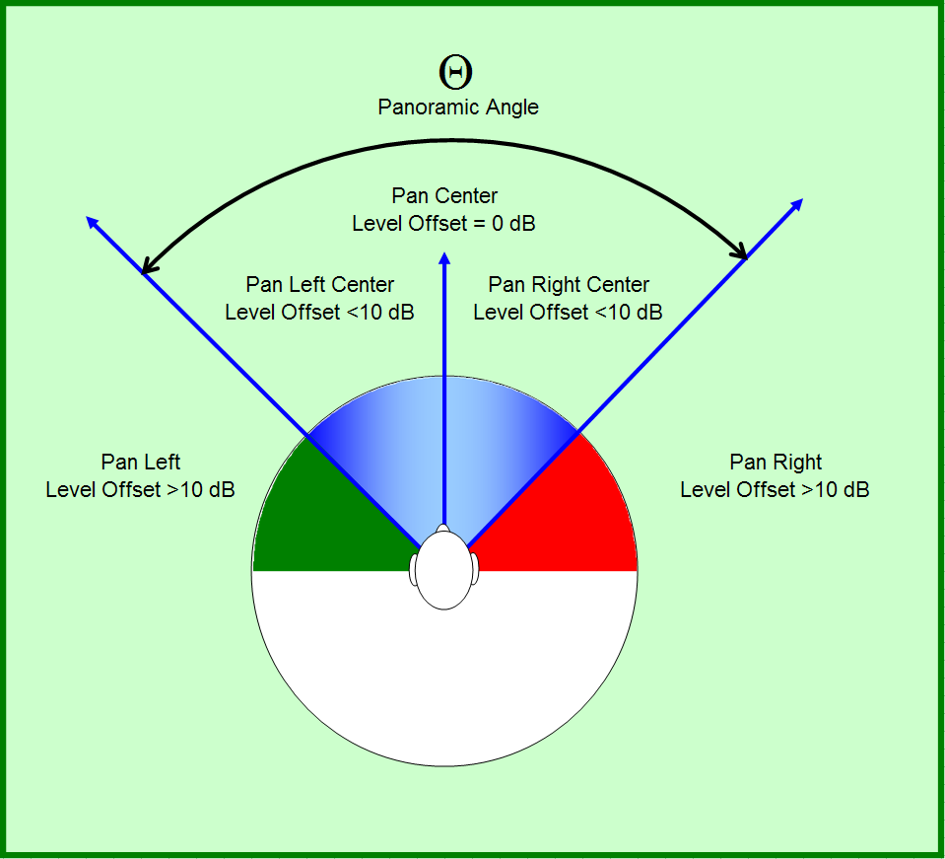
Panoramic Angle
Optimum is about 60º

Slide 27
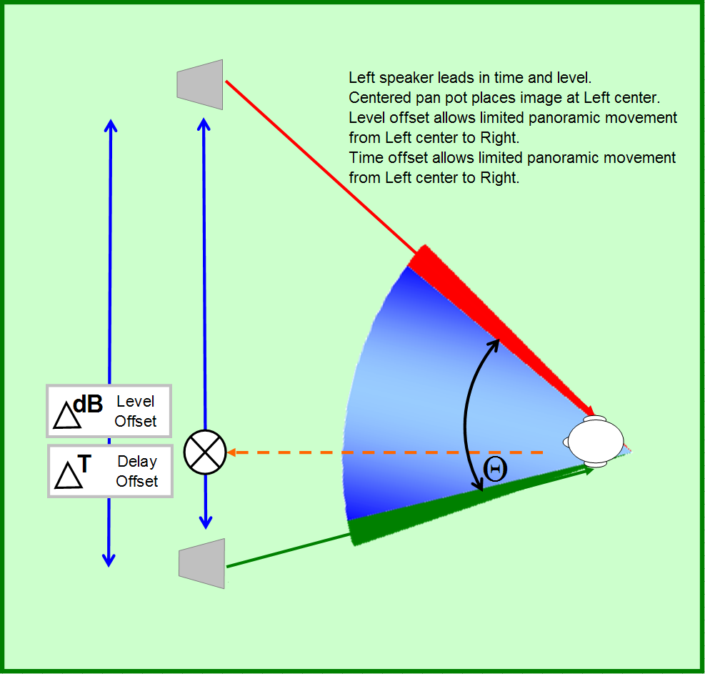
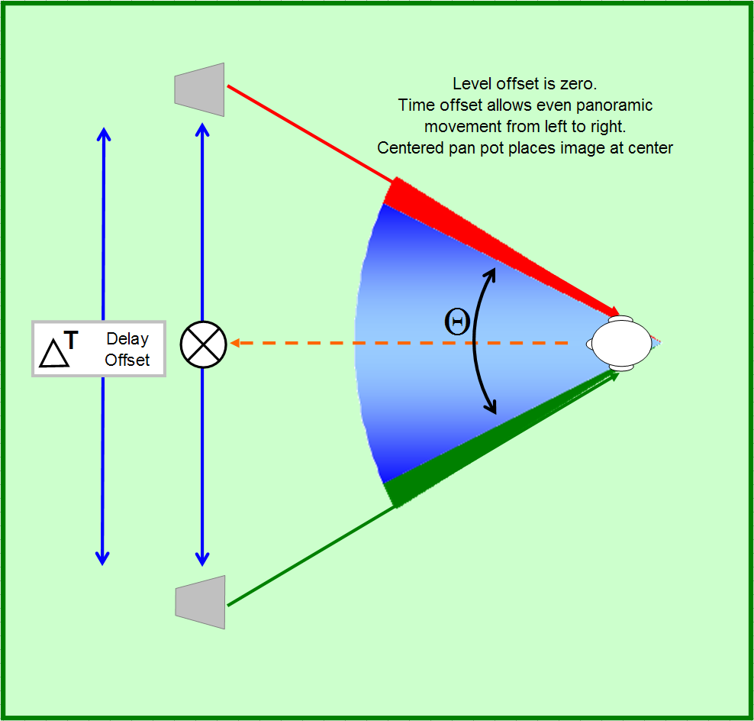
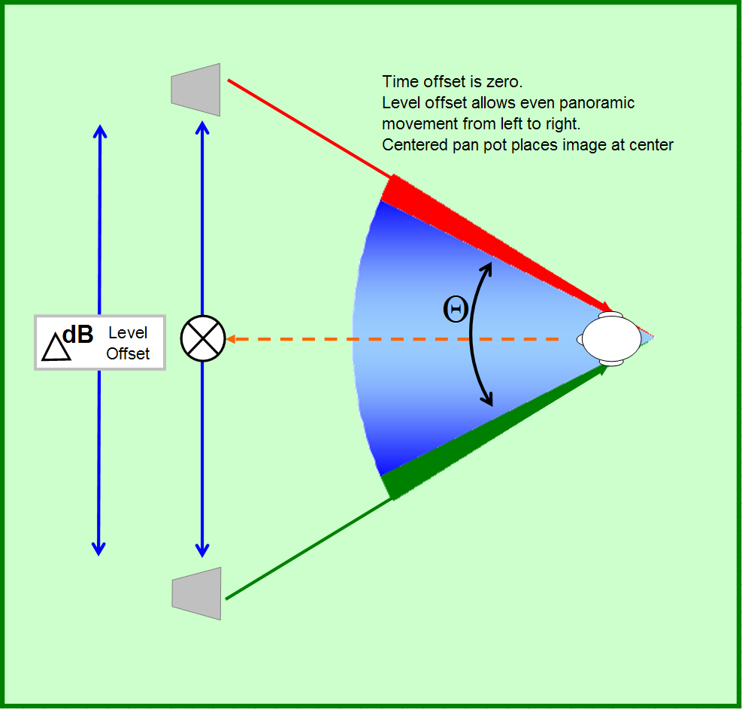
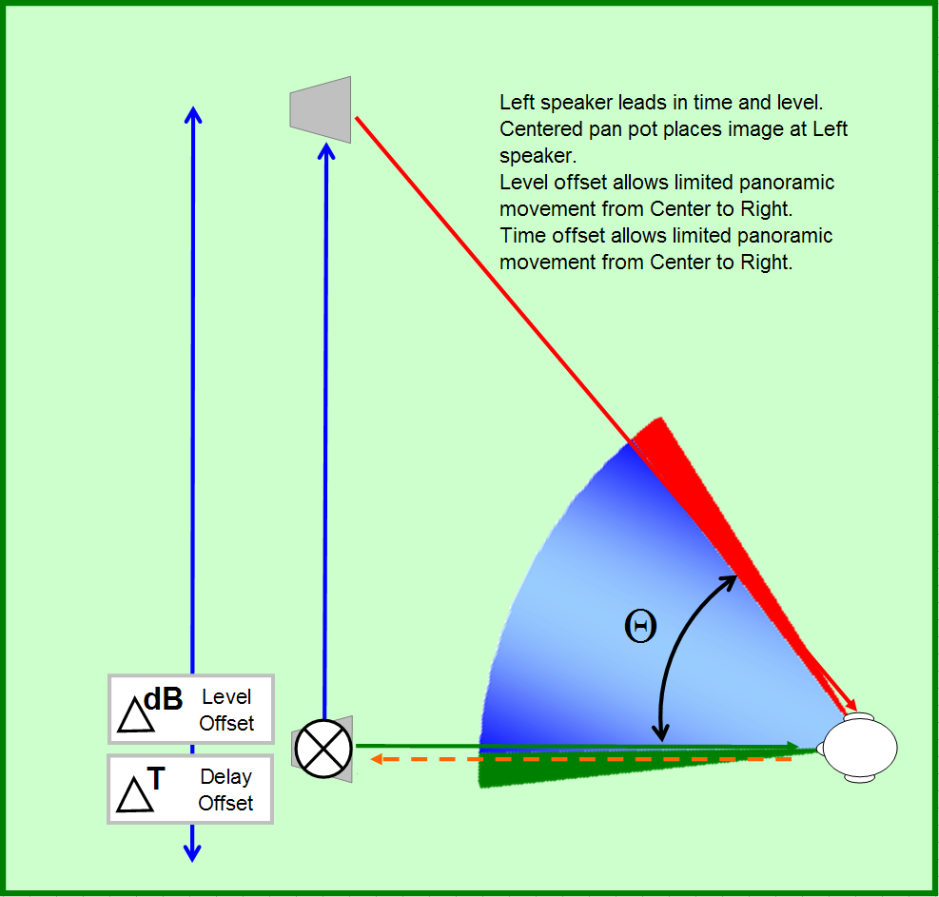
Delay Panning

Slide 28
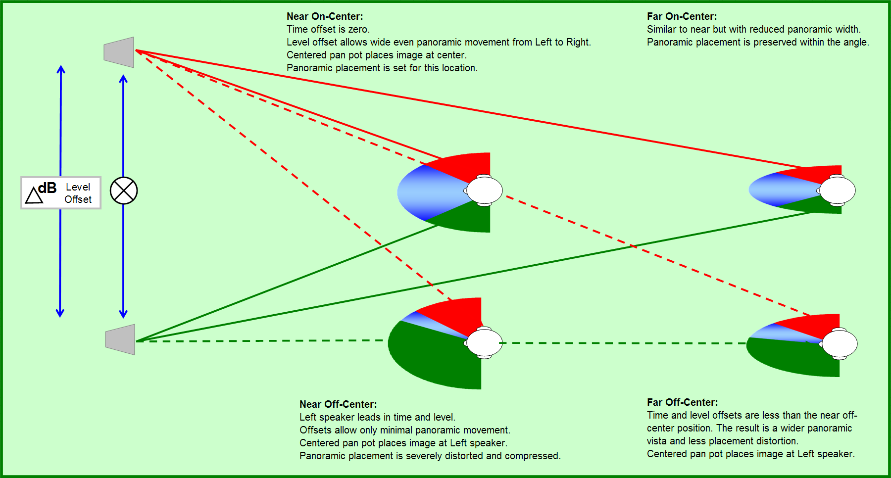
Stereo Image Variation

Slide 29
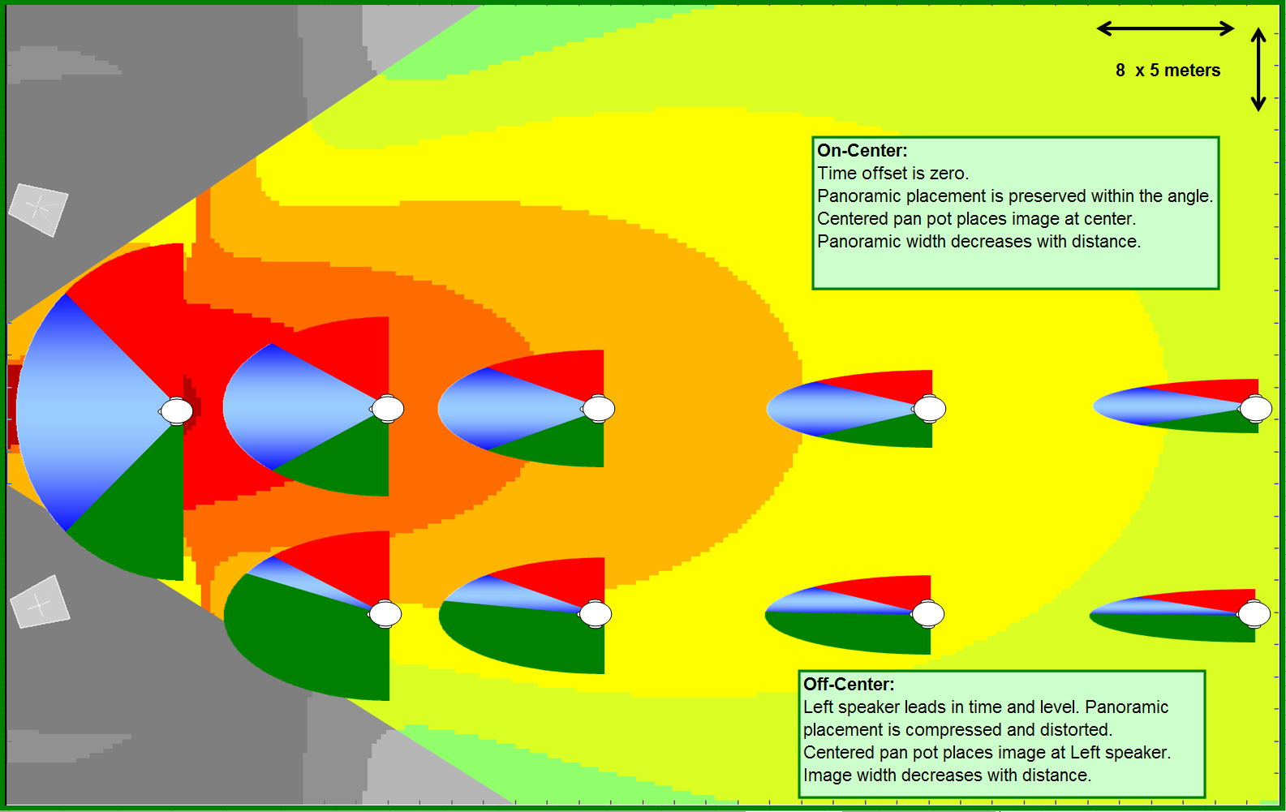
Stereo Image Variation
outside stereo field
outside stereo field

Slide 30
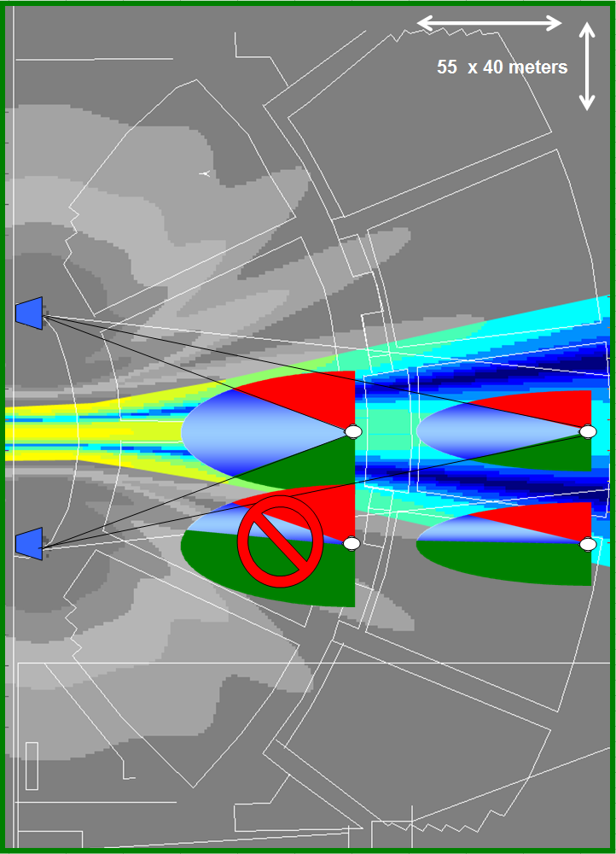
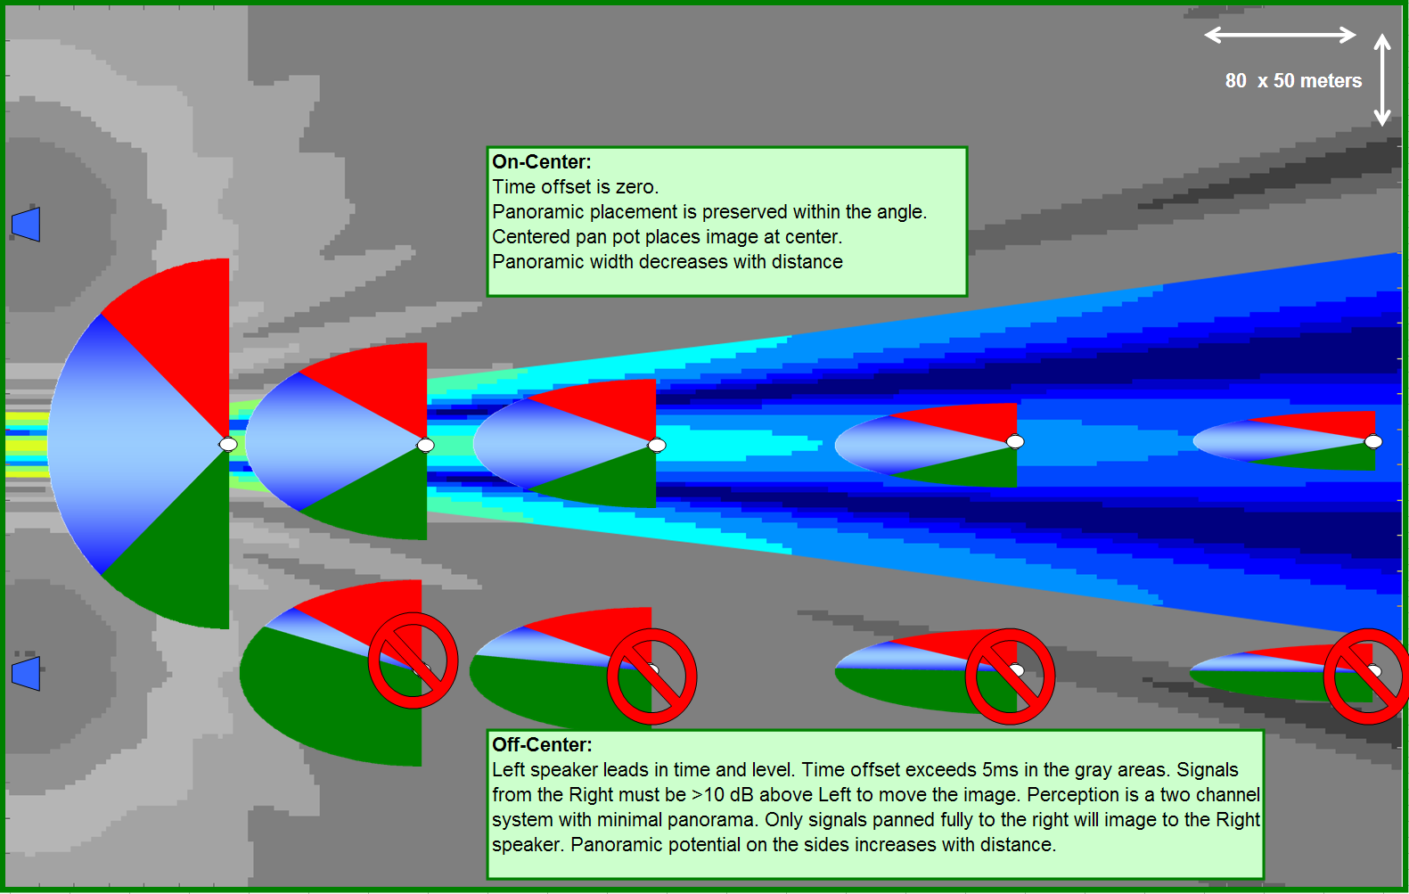
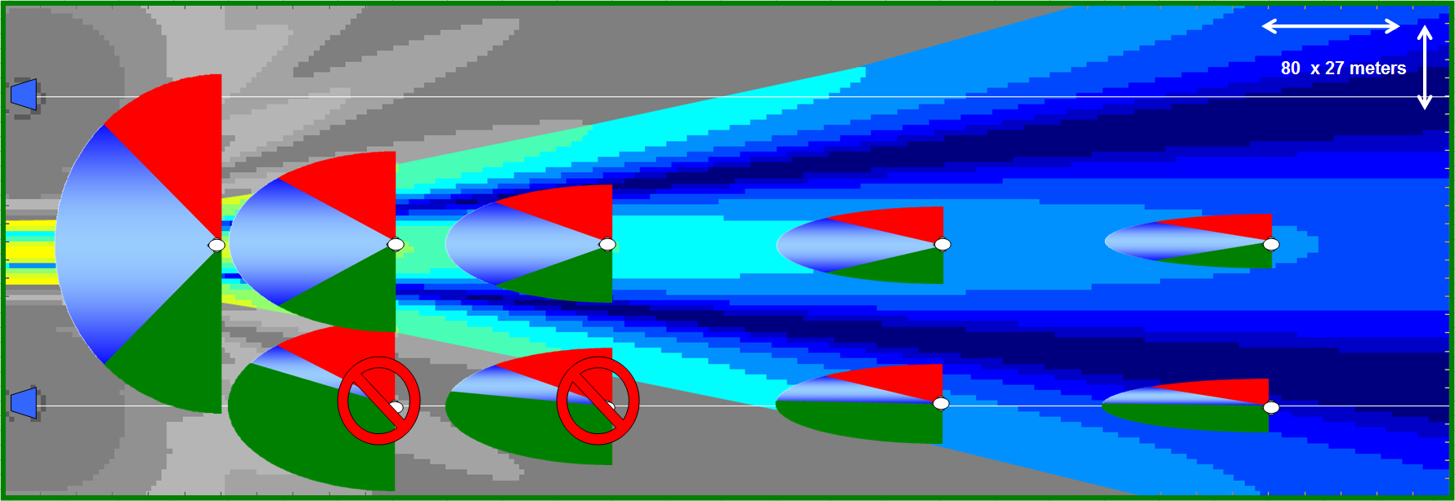
Stereo Image Variation

Slide 31
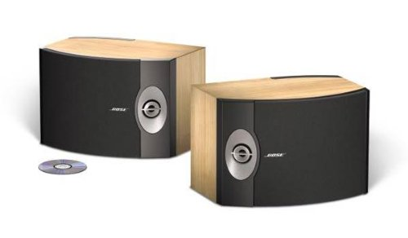
BOSE ® 301-V “Direct/Reflecting” Loudspeakers

Slide 32
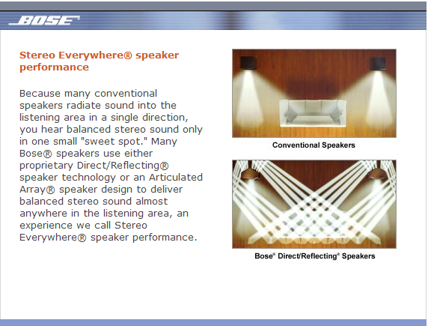
How does this reconcile with what we just learned?
http://www.bose.com/controller?url=/popup/tech_details/pop_stereo_every_spkrs.jsp

