Slide 1
Foundations
of Audio Engineering
Reference: Chapter 1 (3rd Ed.) of Sound Systems: Design and Optimization, by Bob McCarthy (Elsevier, 2017)

Slide 2
Outline
The acoustic decibel
Good sound
Context and complications
Quality factors
Audio transmission
Relationship of time, frequency, and wavelength
How sound propagates
Environmental effects (temperature and humidity)
The waveform
Sound power levels and electrical power requirements
Amplitude and phase response
Coverage angle / beamwidth
Pistonic approximation of cone loudspeaker radiation

Slide 3
Acoustic Decibel (dB-SPL)
In acoustics, the ratios most commonly encountered are changes in pressure level, measured in dB-SPL:
As distance from a sound source doubles, the dB-SPL decreases 6 dB (this is called the inverse square law)
Adding/subtracting dB levels:
Doubling acoustic power corresponds to a 3 dB increase in SPL
Doubling perceived loudness corresponds to a 10 dB increase in SPL
dB-SPL = 20 log₁₀(p/p_{o}) where p_{o} = 20 μN/m²
SPLa ± SPLb = 10 log₁₀ [ 10 ^{db-SPLa/10} ± 10^{db-SPLb/10}]

Slide 4
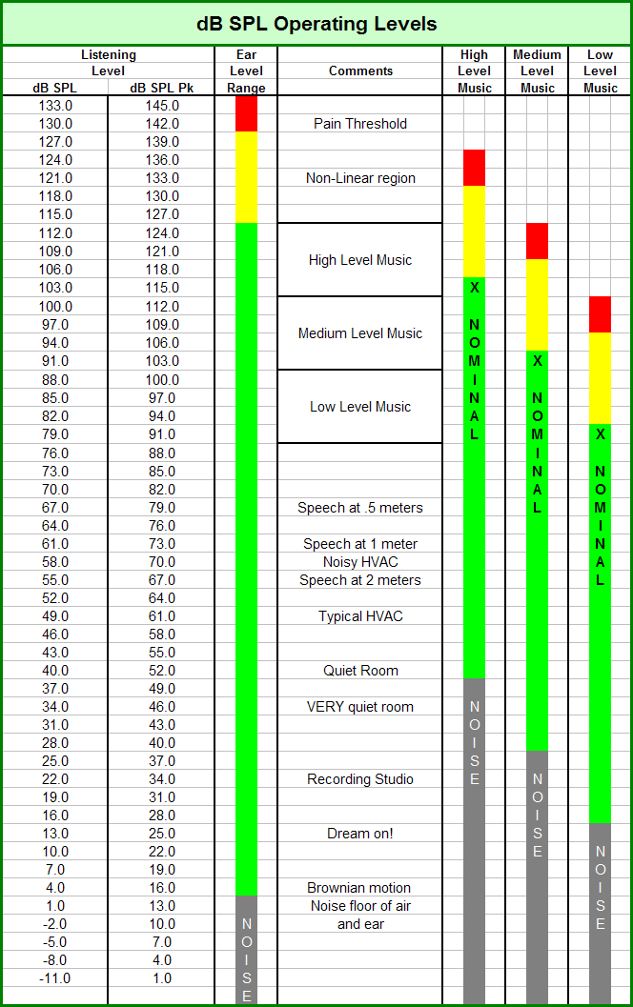

Slide 5
Good Sound: Context and Complications
Outdoor concert
Context:
portable
deep/wide/irregular coverage area, necessitating multiple arrays and delay zones
high power/SPL
Complications:
instability of temperature gradient (due to weather and/or daytime vs. nighttime) → affects sound refraction and array aiming, necessitating a dynamic beamsteering mechanism
overlap areas in array coverage subject to combing → necessitating tight array directivity control
wind → causes comb filtering effects

Slide 6
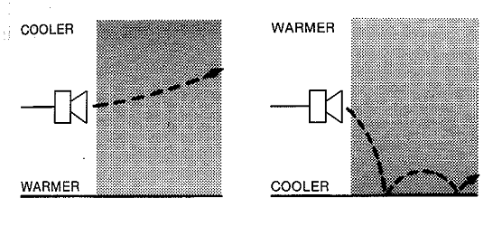
Acoustic Environment Outdoors
SPL decreases 6 dB for every doubling in distance
Sound energy dissipates due to mechanical effects (greater dissipation at higher frequencies)
Relative humidity affects sound absorption (greater at higher frequencies)
Temperature gradient affects sound refraction
Ground surface causes reflection and absorption of sound

Slide 7
Good Sound: Context and Complications
Indoor concert
Context:
fixed installation or portable “touring” (more likely)
large coverage area, necessitating multiple arrays and delay zones
high power/SPL
Complications:
room geometry and surface treatments may exacerbate unwanted reflections and excessive reverb → intelligibility issues
temperature gradient more stable (than outdoors), but may shift seasonally (summer vs. winter) → delay compensation
overlap areas in array coverage causes comb filtering effects → necessitating tight array directivity control and careful aiming
variable audience fill effects, seat characteristics

Slide 8
Acoustic Environment Indoors
The sound arriving at a listener’s ears has (at least) three distinct divisions:
direct sound
early reflections
reverberant sound
The direct sound undergoes no reflections and follows inverse-square-law level change (-6 dB per doubling of distance)
The reverberant sound tends to remain at a constant level if the sound source continues to put energy into the room at a regular rate

Slide 9
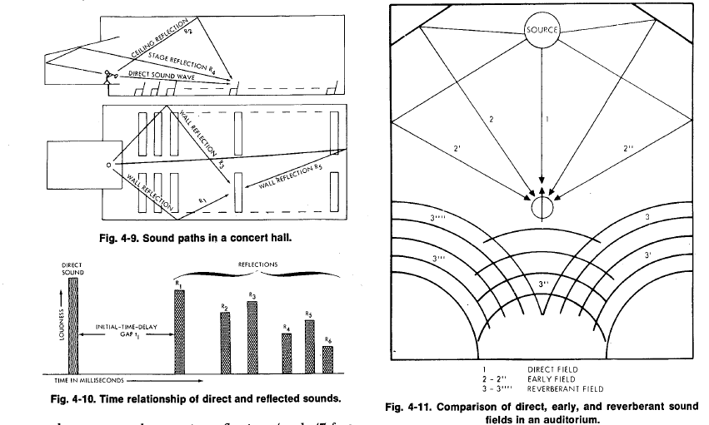
Sound paths in a concert hall
Time relationship of direct and reflected sounds
Comparison of direct, early, and reverberant sound fields in an auditorium

Slide 10
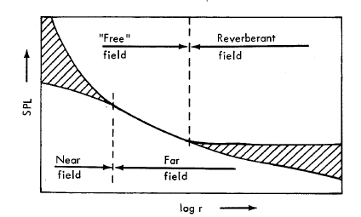
Acoustic Environment Indoors
This gives rise to several basic sound fields:
near field
free field
reverberant field
The near field is typically defined to be within a distance of twice the largest dimension of the sound source
In the (far) free field, inverse-square-law level change prevails
In the reverberant (diffuse) field, sound energy density is nearly uniform
Critical distance (Dc)
far field
Sound fields in an enclosed space

Slide 11
Good Sound: Context and Complications
Home theater
Context:
small room with combination of reflective and absorptive surfaces
typically surround sound (5.1 or 7.1)
low/moderate power/SPL
Complications:
room geometry and surface treatments can cause LF (subwoofer) room modes
reflective surfaces can cause HF comb filtering effects
good directivity control needed for stable “sweet spot” (panoramic angle)
neighbors

Slide 12
Good Sound: Quality Factors
frequency range/response, “smoothness”
SPL at (furthest) listening position
headroom (“Crest factor”)
evenness of coverage (spectral and spatial stability)
intelligibility (articulation loss of consonants)
ratio of direct sound field to reverberant sound field
gain before feedback
noise (SNR) and distortion (IM and THD)
transient response and damping factor
group delay (frequency-dependent arrival times)
locality of reference

Slide 13
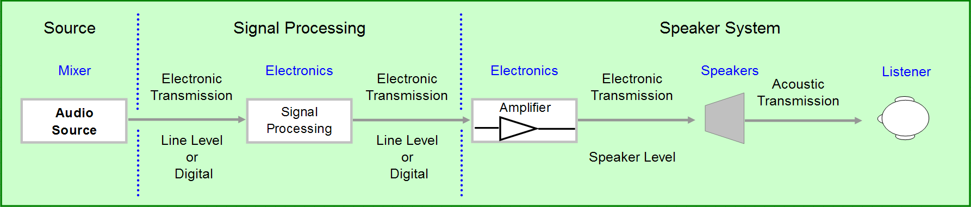
Audio Transmission

Slide 14
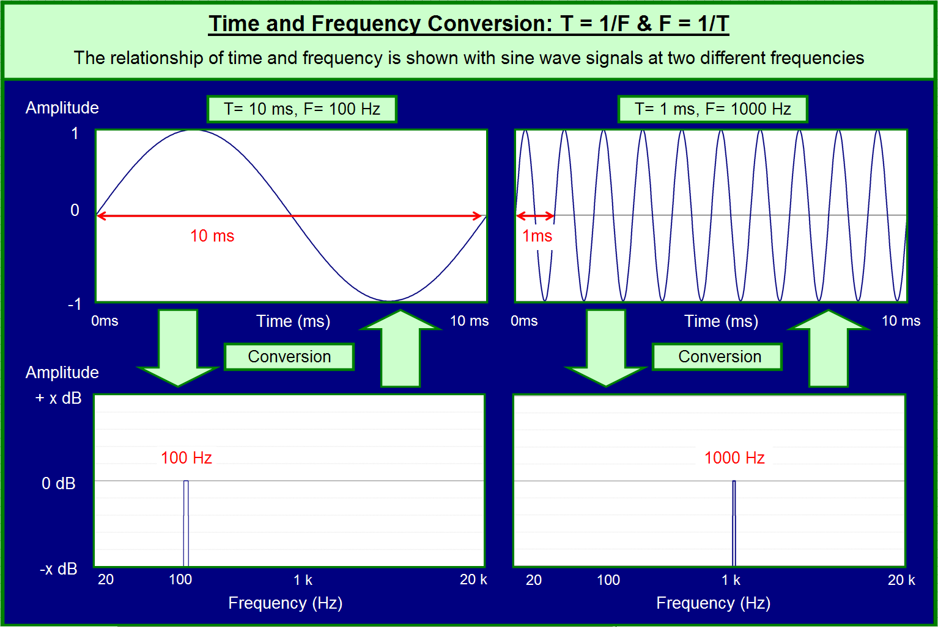

Slide 15
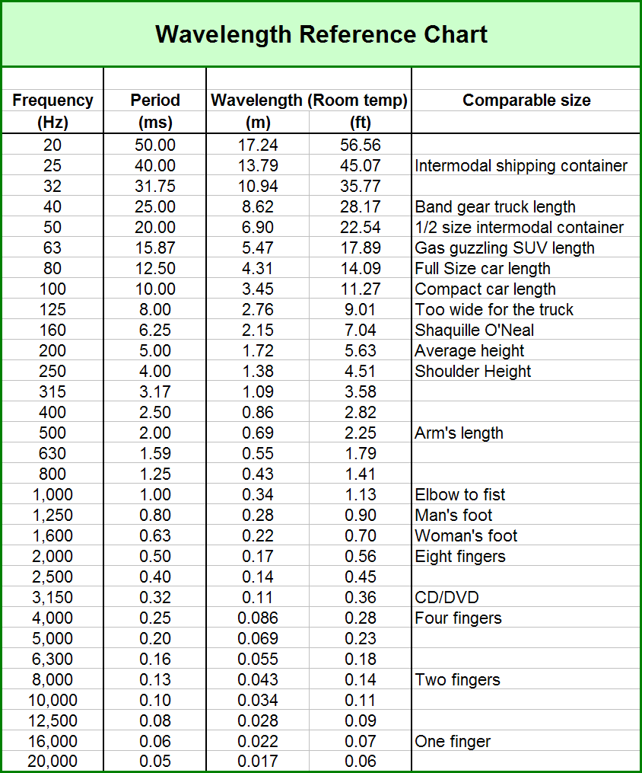
= C/F
C is speed of sound at ambient conditions

Slide 16
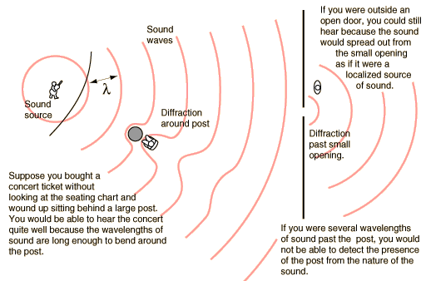
How Sound Propagates

Slide 17
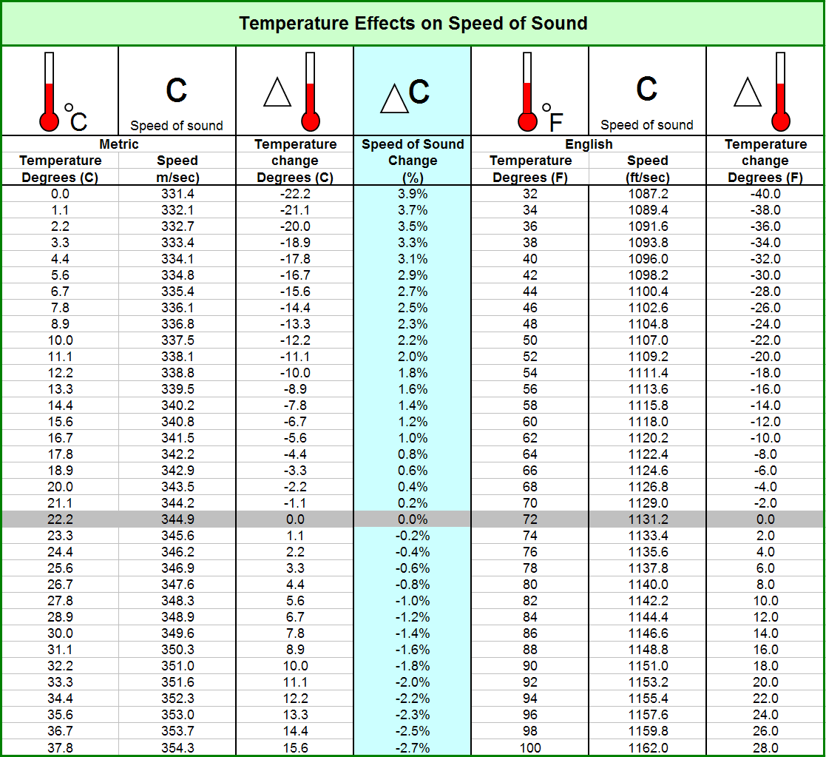

Slide 18
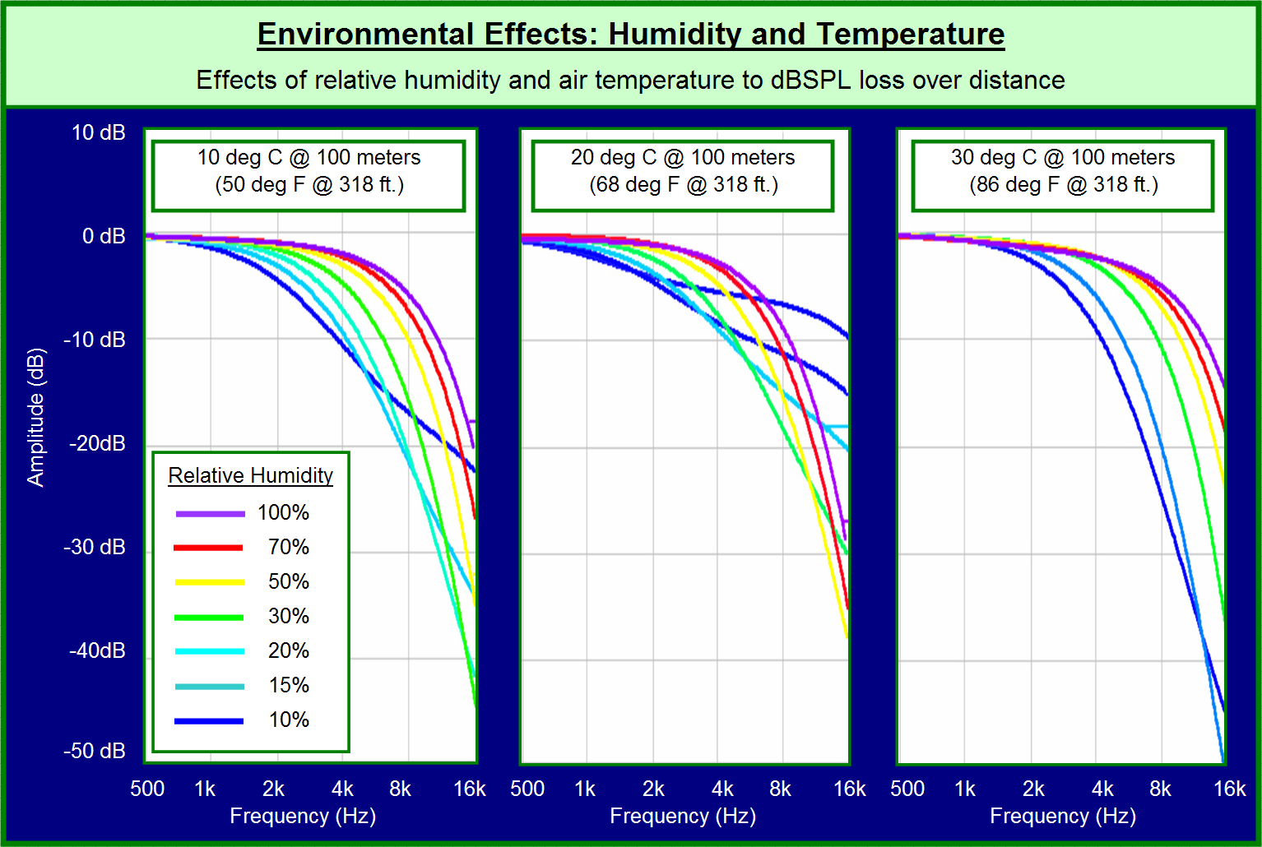

Slide 19
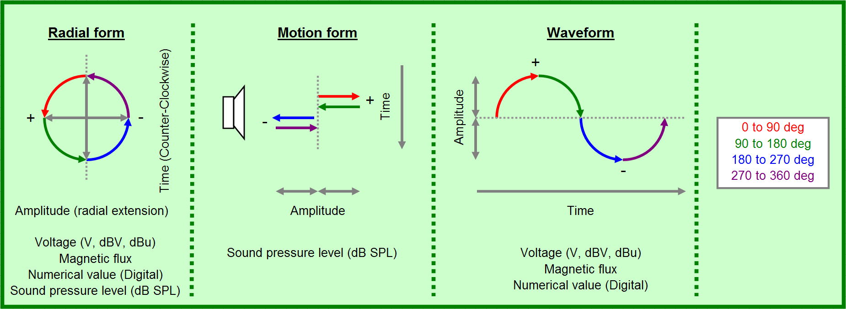
The Waveform
For loudspeakers, + pressure is compression, - pressure is rarefaction

Slide 20
Relative Phase
Stretching transient response due to frequency-dependent phase shift is also called “time smearing”

Slide 21
Frequency-Dependent Phase Delay

Slide 22
Phase Offset (Between 2 Loudspeakers)
Note the difference between phase shift (within single device) vs. phase offset (between devices or systems) – here, LF ranges match but HF range offset by 180°

Slide 23
Time Offset (Between 2 Loudspeakers)
1 ms time offset (signal delay) between two matched speakers

Slide 24
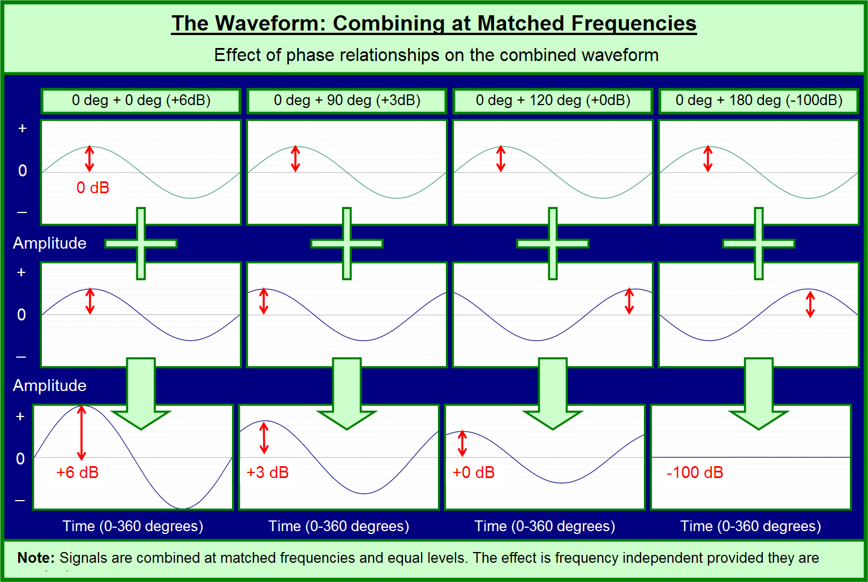

Slide 25
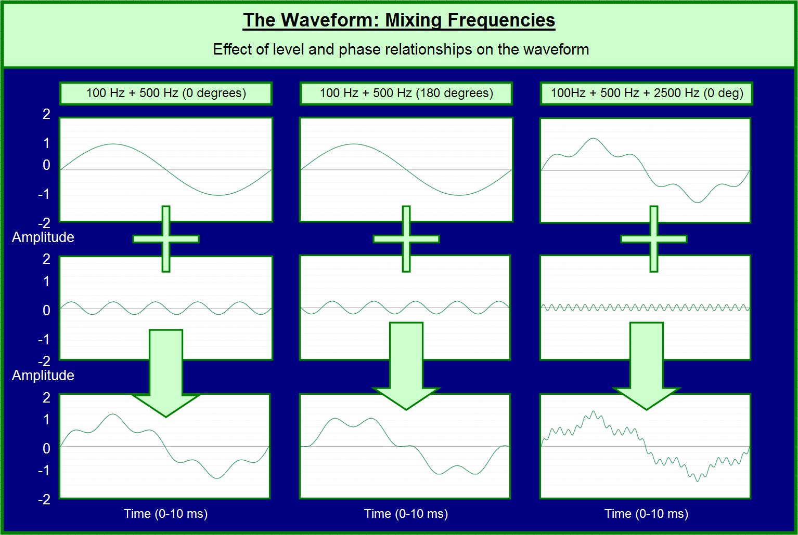

Slide 26
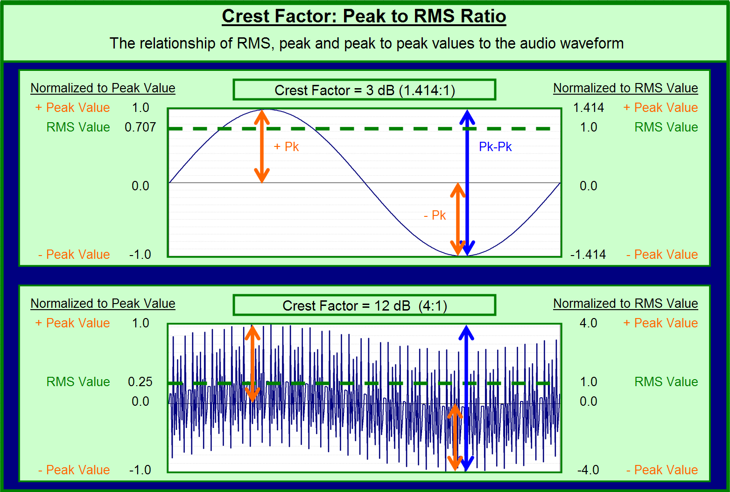

Slide 27
Sound Power Levels
Sound power levels (dB-PWR) are calculated as:
The standard reference for power in audio work is 0.001 watt (1 milliwatt), called 0 dBm, which corresponds to 0.775 volt across 600 Ω (the “VU meter” reference)
Example: The power in watts corresponding to +30 dBm is:
dB-PWR = 10 log₁₀[ (acoustic power) / 10⁻¹² watt ]
30 dBm = 10 log₁₀[ x / 10⁻³] = 10 log₁₀[x∗10³]
= 10 log₁₀ [x] + 10 log₁₀ [10³]
= 10 log₁₀[x] + 30
0 = 10 log₁₀[x] → x = 1 watt

Slide 28
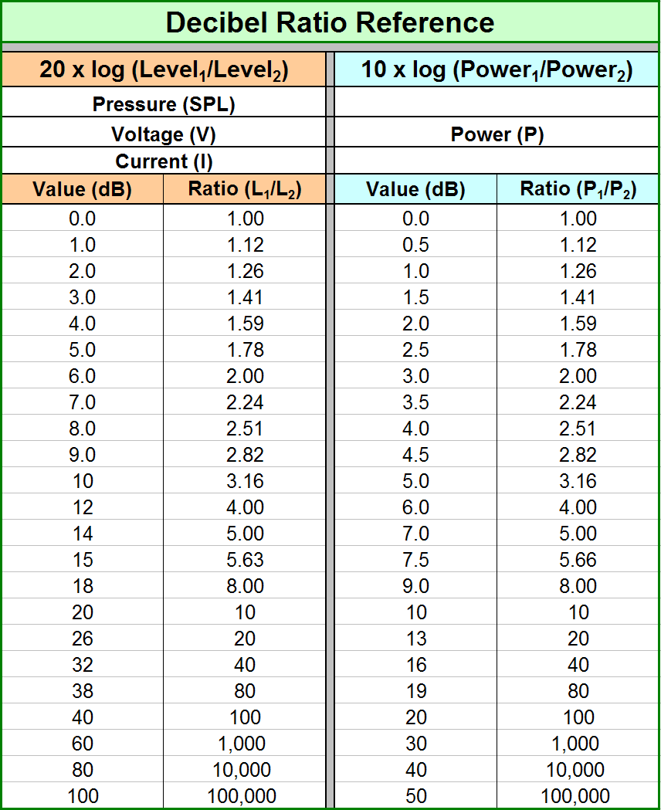

Slide 29
Electrical Power Requirement
When SPL goal at a given listening distance known, also need:
Sensitivity rating of loudspeaker (typically spec as 1m on-axis with input of 1 electrical watt)
Acoustic level change/attenuation between loudspeaker and farthest listening position
Example: 90 dB program level at listening distance of 32 m outdoors
Loudspeaker sensitivity measured as 110 dB
Acoustic level change = 20 log (32) ≅ 30 dB
Add 10 dB for peak (program level) headroom
SPL required at source is 90 + 30 + 10 = 130 dB
Need 20 dB above 1 watt, or 10 ^{(20/10)} = 100 W

Slide 30
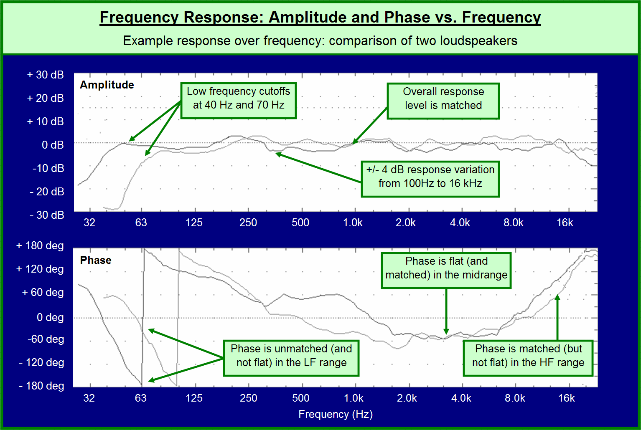

Slide 31
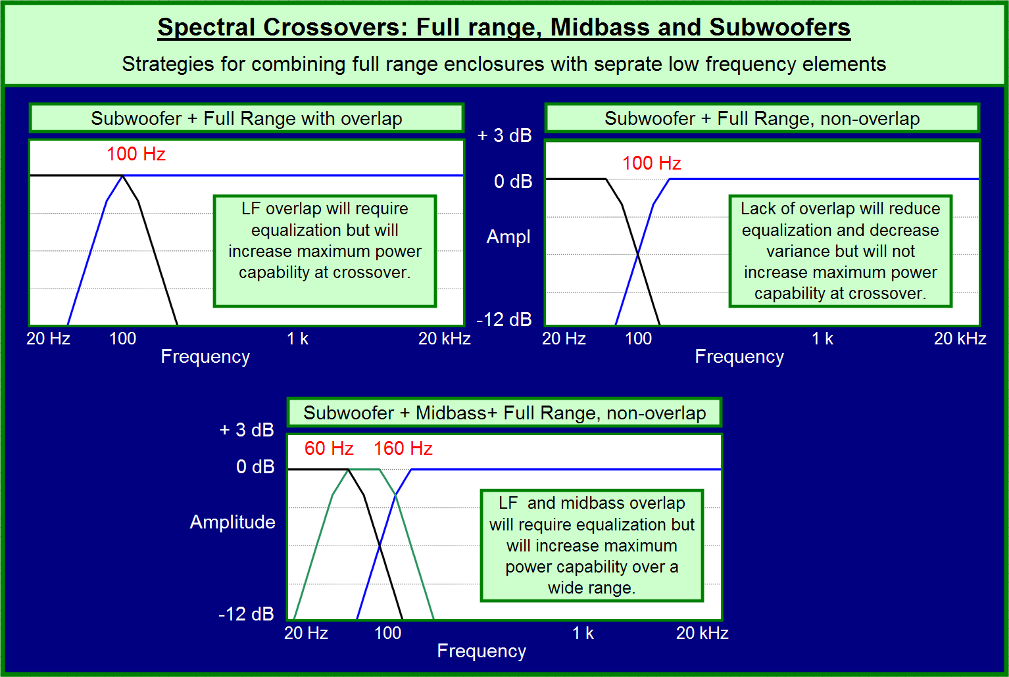

Slide 32
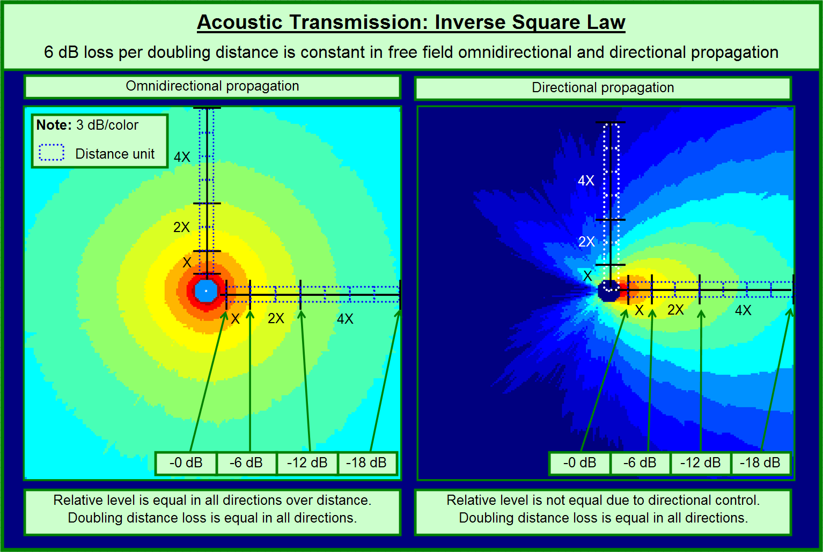

Slide 33
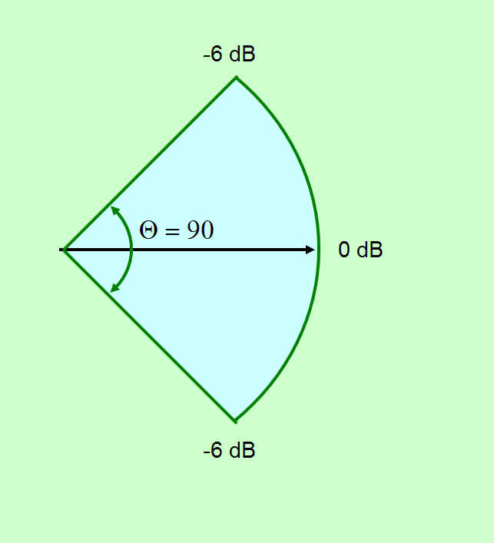
Coverage Angle / (6 dB) Beamwidth

Slide 34
Common Representations of Loudspeaker Coverage
Coverage angle C< (H / V) = 6 dB Beamwidth
Polar pattern
Equal level (isobaric) contours (“isobars”)
Directivity factor (Q)
Directivity index (D_{I}) = 10 log Q (also known as “front to back ratio”)
Beamwidth vs. frequency
3D “balloons”

Slide 35
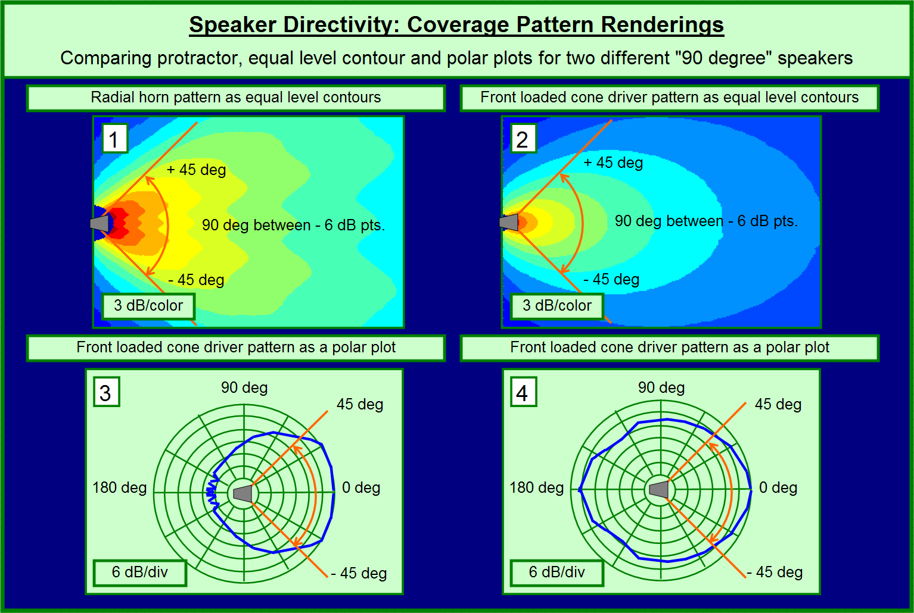

Slide 36
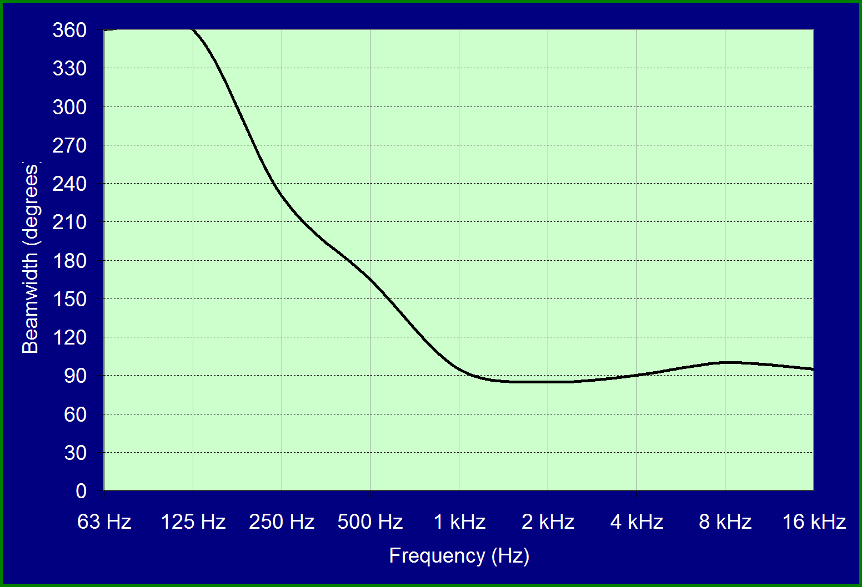
Loudspeaker Directivity / Beamwidth
“CONSTANT DIRECTIVITY”

Slide 37
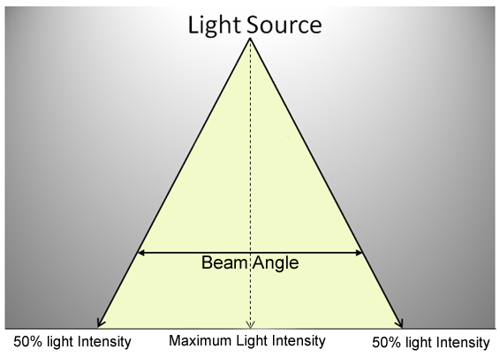
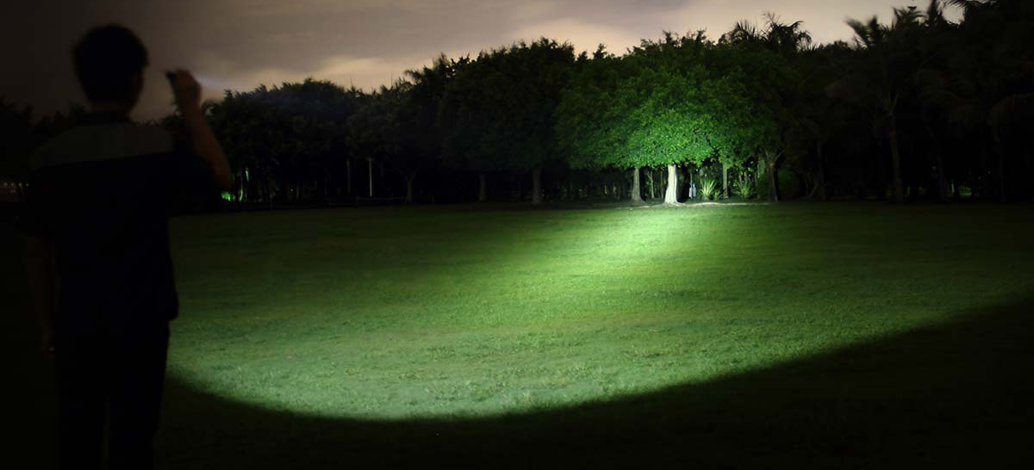
Loudspeaker Beamwidth Light Analogy

Slide 38
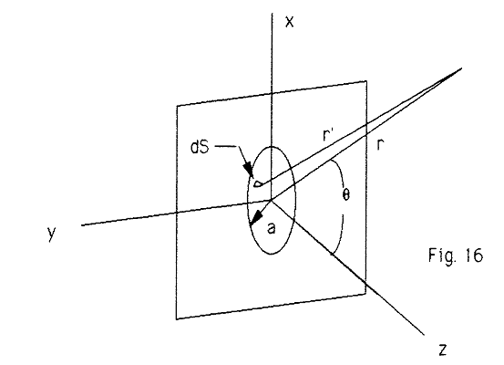
Pistonic Approximation of Cone Loudspeaker Radiation
Piston radiation into half-space (e.g., a cone-type loudspeaker mounted in an “infinite” baffle)
• Observation point
Think of piston as consisting of a large number of very small elements of size ΔS – each one of these elements is observed from distance r′
Piston has radius a and is observed from distance r relative to its center at an angle θ relative to its central (“Z”) axis

Slide 39
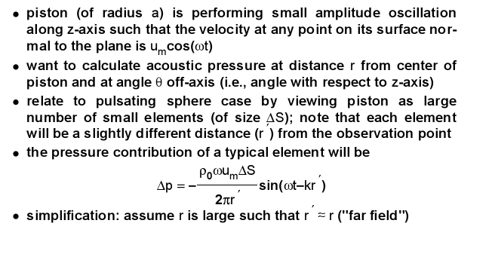

Slide 40
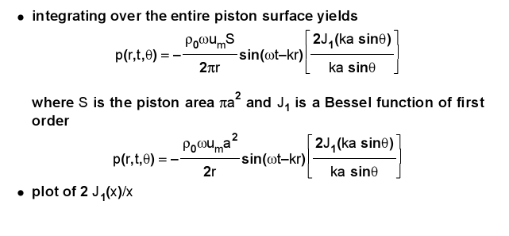
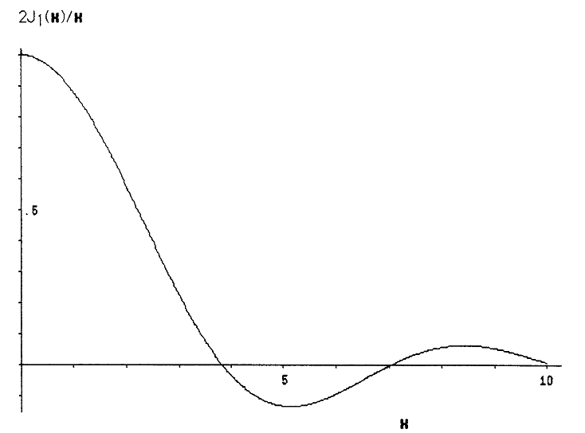
In general, want ka ≤ 3.83 for a cone radiator, where k = 2πf/c
Examples: For 12” woofer, want f ≤ 1378 Hz
For 4” midrange, want f ≤ 4134 Hz
3.83
central lobe only
pair of out-of-phase side lobes
additional pair of in-phase side lobes

Slide 41
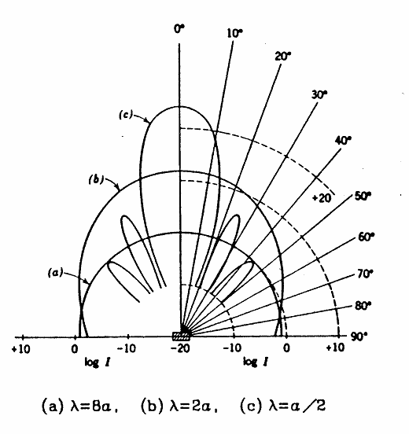
Directivity Pattern of Flat Piston for 3 Different Frequencies
Here, the wavelength λ is 4x the diameter of the piston (cone)
Examples: 12” cone loudspeaker operating at 283 Hz or a 4” speaker operating at 848 Hz
Recall that a is the radius of the loudspeaker → its diameter is 2a

Slide 42
Directivity Pattern of Flat Piston for 3 Different Frequencies
Here, the wavelength λ is equal to the diameter of the piston (cone)
Examples: 12” cone loudspeaker operating at 1130 Hz or a 4” speaker operating at 3390 Hz
Recall that a is the radius of the loudspeaker → its diameter is 2a

Slide 43
Directivity Pattern of Flat Piston for 3 Different Frequencies
Here, the wavelength λ is ¼ the diameter of the piston (cone)
Examples: 12” cone loudspeaker operating at 4520 Hz or a 4” speaker operating at 13,560 Hz
Recall that a is the radius of the loudspeaker → its diameter is 2a

Slide 44
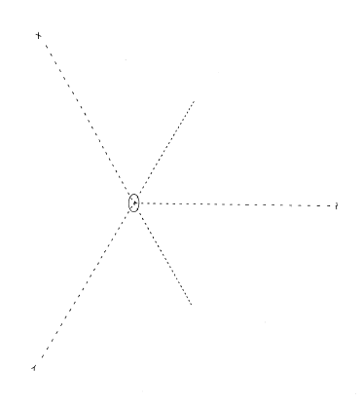
Single 4-inch Loudspeaker

Slide 45
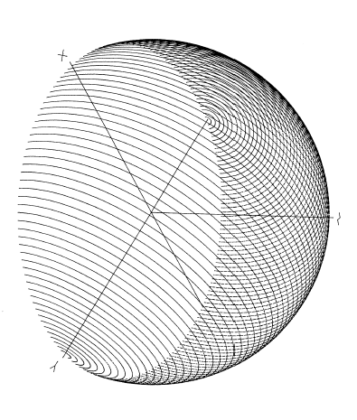
Single 4-inch Loudspeaker @ 500 Hz

Slide 46
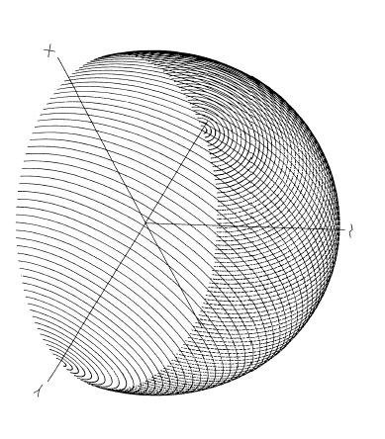
Single 4-inch Loudspeaker @ 1000 Hz

Slide 47
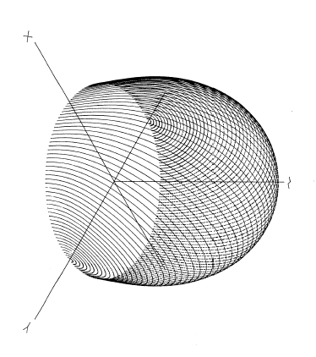
Single 4-inch Loudspeaker @ 2000 Hz

Slide 48
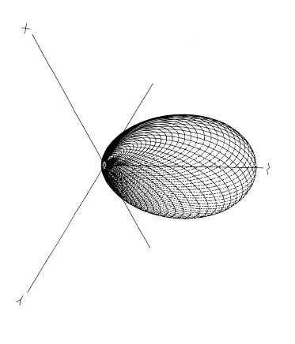
Single 4-inch Loudspeaker @ 4000 Hz

Slide 49
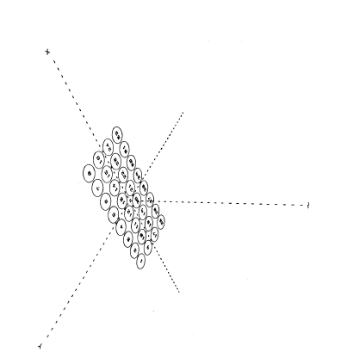
32-Element Array of 4-inch Drivers

Slide 50
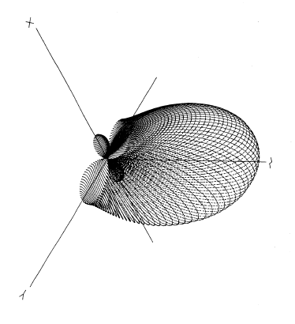
32-Element Array @ 500 Hz

Slide 51
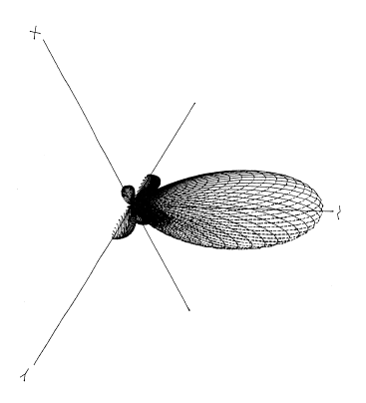
32-Element Array @ 1000 Hz

Slide 52
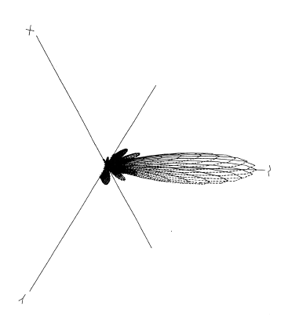
32-Element Array @ 2000 Hz

Slide 53
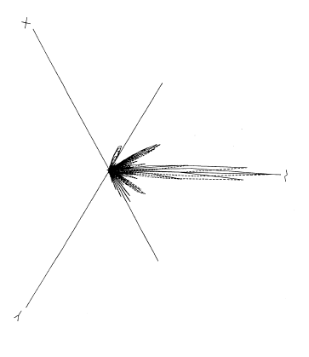
32-Element Array @ 4000 Hz

Slide 54
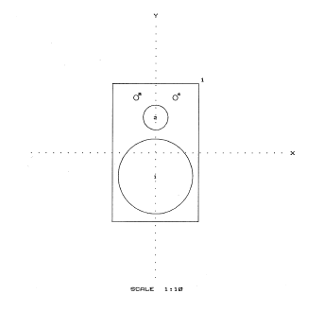
“Home Stereo” Multi-way System

Slide 55
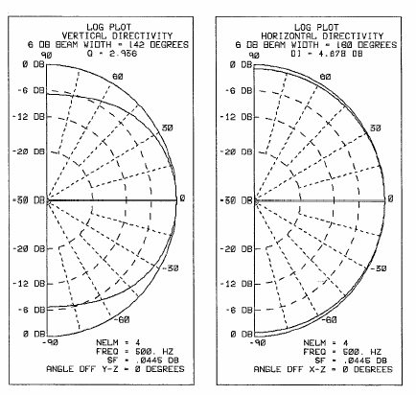
“Home Stereo” Multi-way System

Slide 56
“Home Stereo” Multi-way System

Slide 57
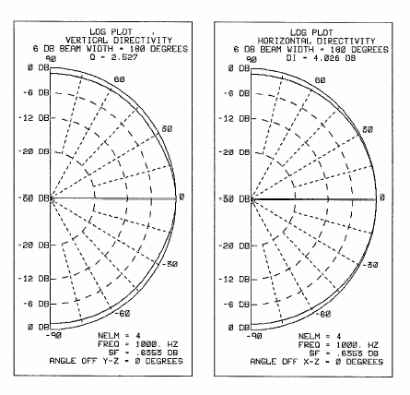
“Home Stereo” Multi-way System

Slide 58
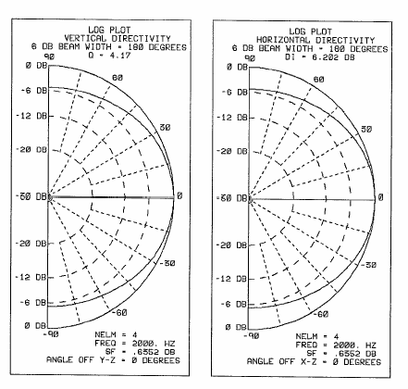
“Home Stereo” Multi-way System

Slide 59
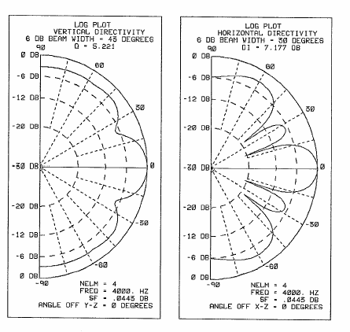
“Home Stereo” Multi-way System

Slide 60
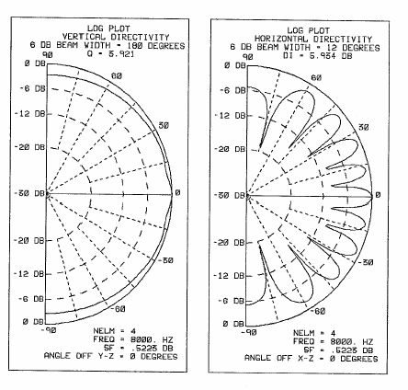
“Home Stereo” Multi-way System

