Slide 1
Evaluation
Relating the Worlds of Acousticians and Audio Engineers
Reference: Chapter 6 (3rd Ed.) of Sound Systems: Design and Optimization, by Bob McCarthy (Elsevier, 2017)

Slide 2
Outline
Natural vs. amplified transmission paths
Subjective room parameters
Natural sound vs. amplified sound
Common goals

Slide 3
Features of Natural Emission/Transmission/Reception
Individual sources are mixed on stage
Emission originates from multiple sources in one general location (the stage)
Transmission support by the room is required
Separation between the emission sources and the transmission medium is prohibited (musician, stage, and house are all one)
Reception becomes uniform in level and tone by lack of separation

Slide 4
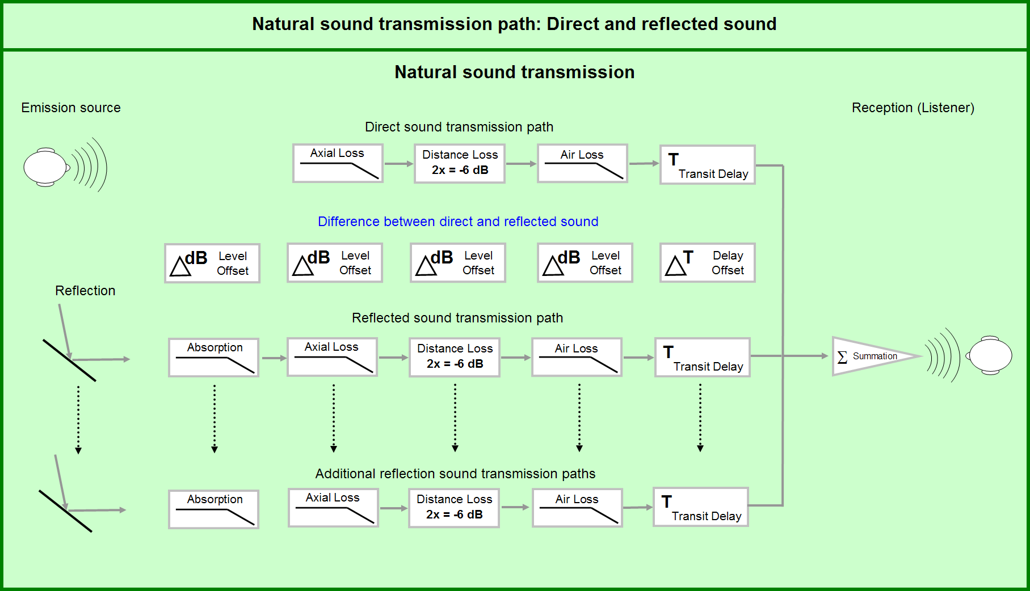
Evaluation

Slide 5
Features of Amplified Emission/Transmission/Reception
Individual emission sources are isolated on stage, and the stage is isolated from the main transmission system
Transmission originates from multiple locations (stage, stage monitors, house main speakers, house auxiliary speakers)
Transmission support by the room is an optional enhancement, not a requirement
Separation between the emission and transmission sources is required (musician, stage, and house are all separate)
Reception becomes uniform in level and tone by virtue of separation

Slide 6
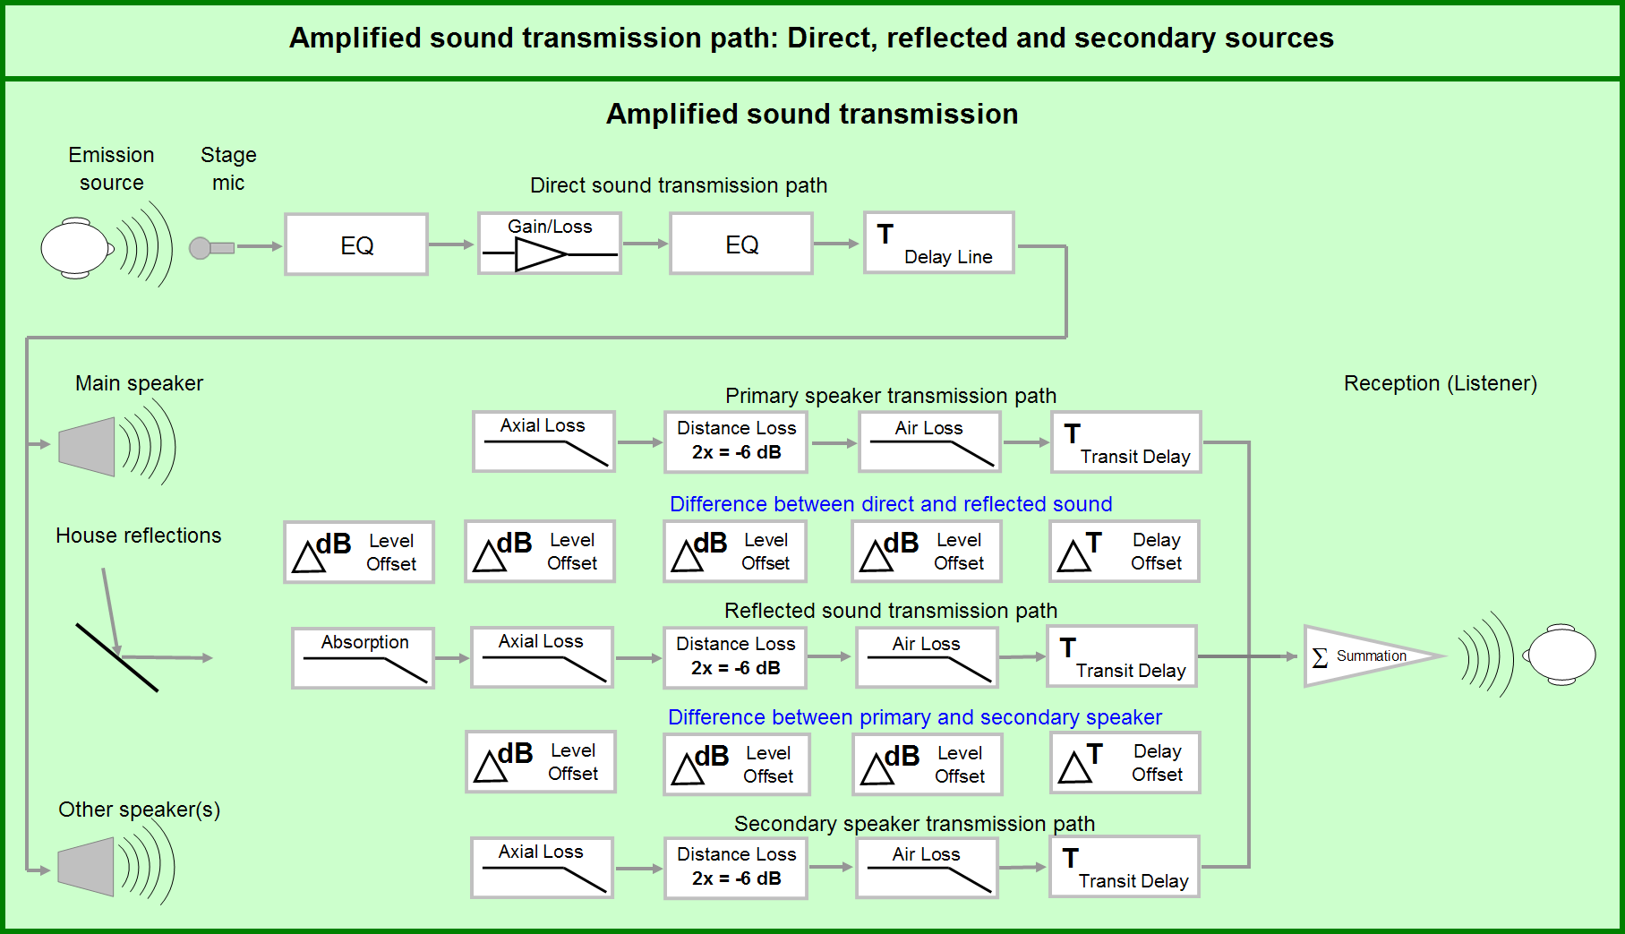
Evaluation

Slide 7
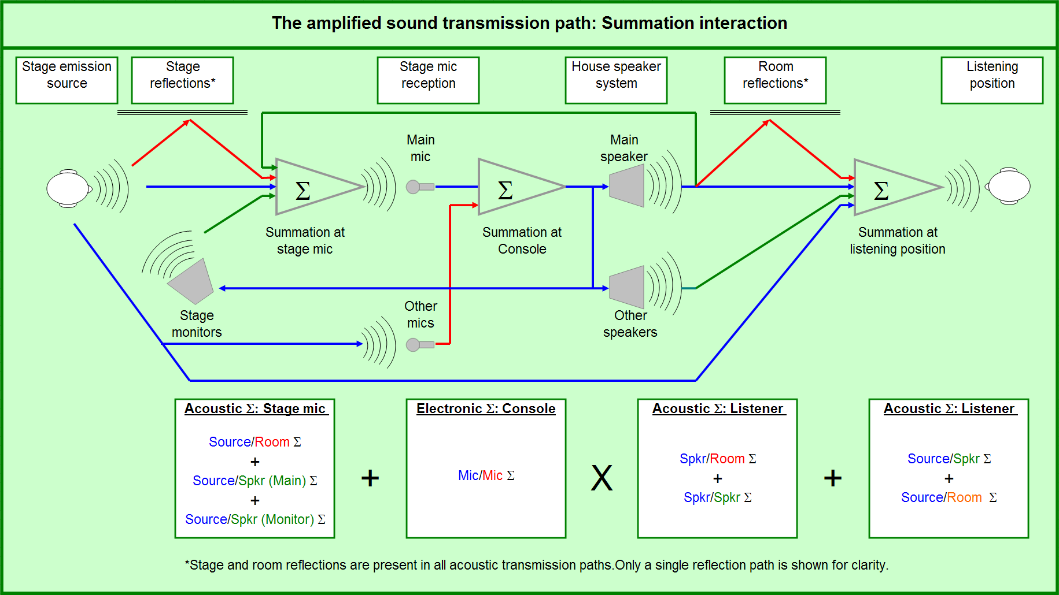
Evaluation

Slide 8
Subjective Room Parameters
intimacy – feeling of proximity to the music (as if listening in a small room)
liveness – fullness of tone in mid/high range
warmth – fullness of tone in low frequencies
loudness of direct sound – appropriately scaled to musical content
loudness of reverberant sound – appropriate mix of level and duration
definition, clarity – clear and distinct sound
brilliance – bright, clear, rich in harmonics
diffusion – spatial aspect of reverberation (sound arriving from all directions)

Slide 9
Subjective Room Parameters
balance – relative level of instruments and voice (instruments heard in proper level perspective) example: lute and bagpipe duet – PDQ Bach, Sinfonia Concertante S. 98.6
blend – harmonious mix of instruments
ensemble – how well musicians can hear themselves
immediacy of response – measure of how well the musicians feel about the responsiveness of the sound
texture – the fine grain of the listening experience (fine texture = richness and complexity in its “outer surface”)

Slide 10
Subjective Room Parameters
freedom from echo – discrete echoes are not heard
freedom from noise – the noise floor of room/system is low
dynamic range – difference between maximum level and noise floor
tonal quality – flat system response
uniformity – the extent to which all listeners have the same experience

Slide 11
Room Design to Support Natural Acoustics vs. Amplified Sound

Slide 12
Agreed

Slide 13
Natural vs. Amplified: Diffusion
Reflections provide a richer reverberation character if the surfaces are diffuse; scattering provides a more gradual and dense reverberation tail
Natural: summation arrivals become more randomized, leading to more texture, a steady decay character, and less risk of echo perception
Amplified: summation arrivals become more randomized, leading to more texture, a steady decay character, and less risk of echo perception

Slide 14
Natural vs. Amplified: Freedom From Echo
Achieved by preventing single reflections to stand out above the decay pattern or focus points to occur from the confluence of multiple reflections
Natural: reflections must transition steadily toward isolation
Amplified: greater risk because of lower reflection density and higher sound levels; concentrated beams of directional speakers increase possibility of focused reflections (“slap back” from rear wall or balcony surface)

Slide 15
Natural vs. Amplified: Freedom From Noise
Natural: achieved by isolating the transmission from noise sources
Amplified: same as natural, with addition of electronic noise and feedback/“ringing” (also, filtering out excessive sibilance – also called de-essing)
Reference: https://www.youtube.com/watch?v=k9exwW0fpw8

Slide 16
Opposed

Slide 17
Natural vs. Amplified: Intimacy
Initial time delay gap: early arrivals should be within 5 dB and 20 ms offset of direct sound
Natural: strong reflective summations are needed for acoustic power addition; multiple arrivals required to provide sufficient comb filter density (so that dips/peaks are beyond tonal resolution of ear)
Amplified: strong reflective summations are NOT needed for acoustic power addition; since speaker is single directional source the reflection pattern lacks complexity, and the combing summation will be perceived as a tonal distraction!

Slide 18
Natural vs. Amplified: Liveness
Optimum reverb time is program-material dependent
Natural: reverberation is highly dense combining zone and isolation zone summation; the density neutralizes the tonal signature and provides a desirable sense of spaciousness
Amplified: separation of room into distinct speaker coverage areas breaks the unifying element of room reverberation, rendering it less uniform; best when meets minimum needs and principally provides spatial enhancement (bulk supplied electronically – discuss “good” and “bad” ways of doing this)

Slide 19
Natural vs. Amplified: Warmth
Achieved by ensuring reverberation time in low frequencies about 25% longer than that of midrange/highs
Natural: reflective surfaces should be of sufficient density and hardness to reflect low frequencies and ensure sufficient LF reverb time (plaster, thick wood)
Amplified: coupled speaker/subwoofer arrays and nearby surfaces provide conditions for uniform LF summation; sufficient LF power capability obviates need for longer LF reverb time

Slide 20
Natural vs. Amplified: Loudness of Reverberant Sound
Natural: must scale with venue size; achieved with strong, extremely dense combing zone, combining zone, and isolation zone summation
Amplified: ratio of direct to reverberant sound should be kept as high as possible – achieved by minimal combing and combining zone summation (isolation zone summation accepted within limits for its ability to provide sense of spaciousness)

Slide 21
Natural vs. Amplified: Ensemble
Natural: strong/dense combing, combining, and isolation zone summation – sound of each instrument must spread across stage to other musicians; instruments not isolated from one another
Amplified: ensemble on stage achieved by isolating the individual sound sources, combining electronically in the mixer, and returning the signal via individually adjustable stage monitors (problems: stage monitors near microphones can re-enter transmission path, causing combing/feedback; also, disturb acoustic partitioning of house speakers – solution: use in-ear monitoring?)

Slide 22
Natural vs. Amplified: Definition/Clarity
Achieved by optimal mix of intimacy, liveness, and loudness
Natural: mix of direct sound, dense combining zone, and isolation zone summation is required
Amplified: clarity is result of a high ratio of coupling and isolation zone summation, and a low ratio of combing zone – achieved by directional speakers with distinct coverage zones and carefully managed patterns

Slide 23
Natural vs. Amplified: Response/Attack
Natural: stage is directly coupled to house; how transmission character of house returns to stage is decisive factor (reverb time)
Amplified: monitors are principal reference on stage, yet sound in house will have an appreciable effect on experience (loudspeaker sidelobes and rear-wall or balcony face reflections)…may need to compromise on isolation from main transmission system trying to achieve through use of monitors

Slide 24
Natural vs. Amplified: Tonal Distortion
Prevented by not allowing absorption to occur at selected frequency ranges
Natural: prevented by dense complex multiple summations of different relative time and level (if a single reflection is too dominant it will cause cancellations and excessive additions)
Amplified: minimized by focusing on coupling zone and isolation zone summations (combing zone is avoided to maximum extent possible); tonal distortions unique to amplified systems include harmonic distortion, dynamic range compression, sonic image distortion, and excessive sibilence

Slide 25
Natural vs. Amplified: Uniformity
Hall is free of “dead spots” and/or response anomalies (maximum similarity of sonic experience)
Natural: achieved by coupling all seating areas to transmission system, and saturating the frequency response with super dense combing, combining, and isolation zone summations
Amplified: achieved by isolating the speakers from each other and the room; frequency response is maintained by coupling and isolation zone summations (combing zone avoided to the extent possible)

Slide 26
Different…But Not Conflicting

Slide 27
Natural vs. Amplified: Loudness of Direct Sound
Natural: maintained by arranging seating as close to conductor as possible (benchmark is 60 feet) – function of transmission path length from stage to listener
Amplified: function of transmission path length, drive level of speaker, and axial orientation; directional speakers in separate locations allow constant level to be maintained over space

Slide 28
Natural vs. Amplified: Brilliance
Achieved when sound is intimate and reverb time in HF balanced with midrange
Natural: mix of direct sound, dense combing zone, and isolation zone summation is required
Amplified: distant speakers will have HF boost to compensate for HF air loss (“pink shift”) – separated directional speakers allow for even amounts of HF distribution

Slide 29
Natural vs. Amplified: Balance
Natural: the room must transmit all instruments in the proper mix; stage and house reflections must have sufficient strength and density for uniform level and frequency response to be achieved – balancing of instruments is in the acoustic space
Amplified: role of speaker system is transmission of pre-mixed signals originating at mix console – stage sources are isolated and balanced in the mix electronically

Slide 30
Natural vs. Amplified: Blend
Natural: harmonious blend achieved by positioning of instruments – spacing between instruments on stage is a key factor
Amplified: role of speaker system is transmission of pre-mixed signals originating at mix console – instruments are blended by separation into multiple transmission channels (left, right, center) and appropriate use of panning; isolated electrical signals are blended in the acoustic space

Slide 31
Natural vs. Amplified: Texture
Achieved by carefully spaced and sequenced reflection patterns
Natural: achieved by a steady transition of the low level reflections through the isolation zone (enhanced by high reflection density)
Amplified: acoustic texture can be augmented electronically with the isolation zone summation induced by outboard reverberation (and can be applied separately to different input channels)

Slide 32
Natural vs. Amplified: Dynamic Range
Maximized by having the strongest summation of the direct sound and early reflections while keeping background noise to a minimum
Natural: maximum acoustic addition requires both coupling and combing zone summation
Amplified: maximum acoustic addition requires both coupling and combining zone summation; limited by power handling capability of system and gain before feedback

Slide 33
Common Goals
tonal balance
freedom from potentially disturbing reflections
uniformity of diffuse energy (e.g., under-balcony)
appropriate (low) levels of ambient noise
uniformity of sound field
clarity and intelligibility

Slide 34
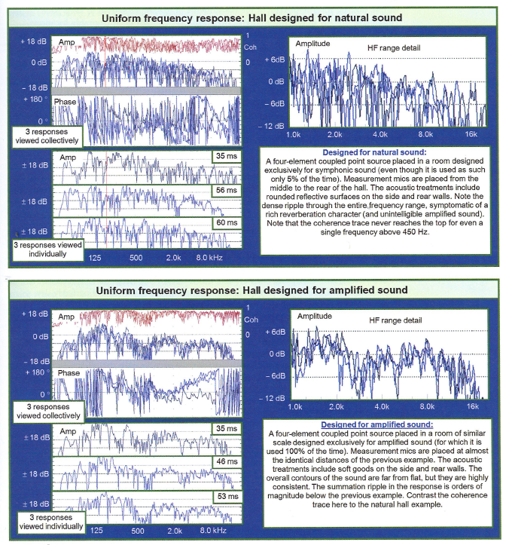

Slide 35
Amplified-Speaker-Centric View
room shape – “line of sound” considerations
matching shape to purpose – “stereo everywhere” difficult in wide spaces
under-balcony spaces – height must increase as depth increases
side seating areas – challenging!
low-frequency absorption/diffusion, bass traps – “tight low end”
mid-frequency diffusion – areas near speakers, or on-axis

Slide 36
Amplified-Speaker-Centric View
high-frequency absorption/diffusion – especially needed on rear walls
ceilings – want to avoid them (preferably splay away from speaker locations)
sidewalls – benefit from outward splay angle
floor/seating/aisle areas – treat with carpeting as needed
hidden speaker locations – must be acoustically transparent
main speaker locations – try to keep image low/central

Slide 37
Amplified-Speaker-Centric View
front fill speakers locations – keep as high as possible
mix position – needs to be in the house
stage – benefit from variable acoustics (e.g., moveable drapes)
surface complexity – aids diffusion
balcony fronts – usually benefit from absorption

Slide 38
Middle Ground
variable acoustics (reverberation control)
curtains
rotating wall panels
acoustic filters
electronic reverberation enhancement
optimum is to have separate (distributed) “reverberation source” loudspeakers (vs. running through main system)

