Slide 1
Loudspeaker Enclosures

Slide 2
Loudspeaker Enclosures
How loudspeakers work
Open-back cabinet
Damped pipe
Loudspeaker “small signal” (T/S) parameters
Baffles
  Infinite
  Sealed box
  Vented
  Passive radiator
  Horn (front and rear loaded)
  Transmission line (labyrinth)
  Damped pipe (“waveguide”)

Slide 3
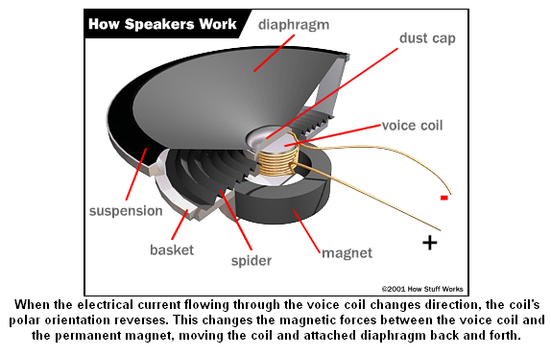
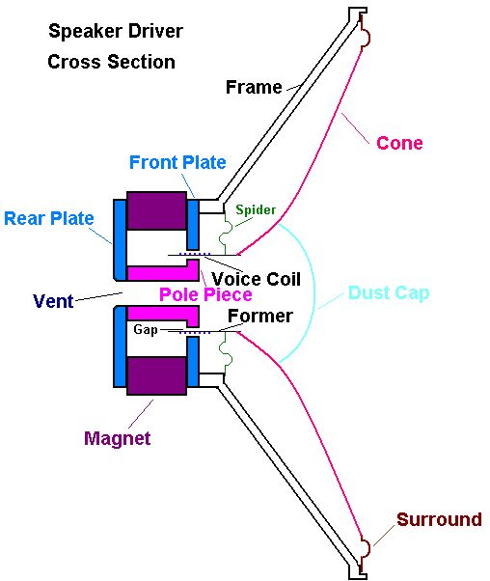
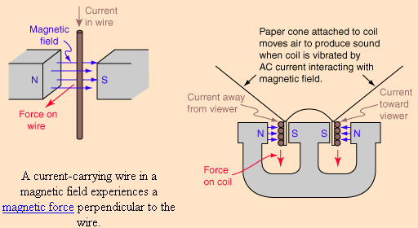
How Loudspeakers Work

Slide 4
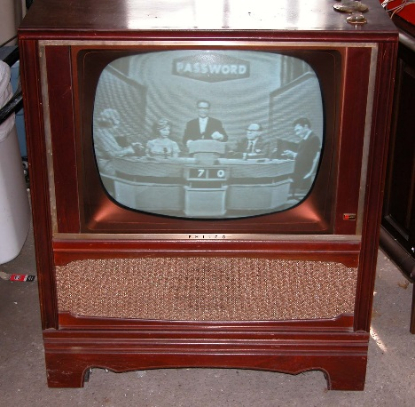
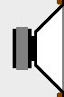
Open Back Cabinet
24”
24”
48”
Note: Assume wave propagation within cabinet (before it exits the back) is planar, i.e. there are no inverse square losses.
A “full-range” loudspeaker is mounted in a free-standing 24” deep open-back cabinet. The loudspeaker is known to produce an SPL of 90 dB at a distance of 12” from the front radiating surface when operated at 100 Hz. Calculate the combined level (of the contributions from the loudspeaker’s front and rear radiating surfaces) at the measurement microphone location (48” from the front vibrating surface). Repeat the calculation if the frequency of operation is 50 Hz or 200 Hz (assume SPL is the same). HINT: Radiation from the rear of the cabinet can be assumed to be omnidirectional.

Slide 5
Review: Adding dB-SPL (General Formula)
Two acoustic sources “a” and “b” of relative phase angles θ_{a} and θ_{b}
Σ_{dB-SPLa+b} = 20 log₁₀ [sqrt { (10^{dB-SPLa/20})² + (10^{dB-SPLb/20})²
+ 2(10^{dB-SPLa/20}) (10^{dB-SPLb/20})(cos(θ_{a}-θ_{b}))} ]

Slide 6
Solution for 100 Hz
24”
Don’t forget: rear radiation is 180º out of phase with front radiation!
24”
48”
Note: Assume wave propagation within cabinet (before it exits the back) is planar, i.e. there are no inverse square losses.
Wavelength (λ) at 100 Hz = (1130x12)/100 = 135.6”
Phase shift of rear radiation relative to front radiation = 180 + (360x48)/135.6 = 307.4º
Given reference level of 90 dB at 12”, level from front vibrating surface at distance of 48” will be 90 - 12 = 78 dB
Level from rear vibrating surface will experience inverse square loss over a distance of 72” (recall that wave propagation for first 24” is planar); level at measurement microphone will be 90 - 15.6 = 74.4 dB
Plugging into general formula yields summed level = 81.5 dB

Slide 7
Solution for 50 Hz
24”
Don’t forget: rear radiation is 180º out of phase with front radiation!
24”
48”
Note: Assume wave propagation within cabinet (before it exits the back) is planar, i.e. there are no inverse square losses.
Wavelength (λ) at 50 Hz = (1130x12)/50 = 271.2”
Phase shift of rear radiation relative to front radiation = 180 + (360x48)/271.2 = 243.7º
Given reference level of 90 dB at 12”, level from front vibrating surface at distance of 48” will be 90 - 12 = 78 dB
Level from rear vibrating surface will experience inverse square loss over a distance of 72” (recall that wave propagation for first 24” is planar); level at measurement microphone will be 90 - 15.6 = 74.4 dB
Plugging into general formula yields summed level = 77.3 dB

Slide 8
Solution for 200 Hz
24”
Don’t forget: rear radiation is 180º out of phase with front radiation!
24”
48”
Note: Assume wave propagation within cabinet (before it exits the back) is planar, i.e. there are no inverse square losses.
Wavelength (λ) at 200 Hz = (1130x12)/200 = 67.8”
Phase shift of rear radiation relative to front radiation = 180 + (360x48)/67.8 = 434.9º
Given reference level of 90 dB at 12”, level from front vibrating surface at distance of 48” will be 90 - 12 = 78 dB
Level from rear vibrating surface will experience inverse square loss over a distance of 72” (recall that wave propagation for first 24” is planar); level at measurement microphone will be 90 - 15.6 = 74.4 dB
Plugging into general formula yields summed level = 80.5 dB

Slide 9
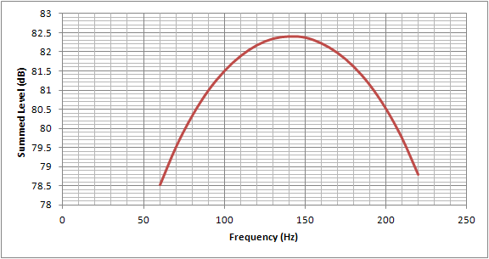
Approximate Useful Range of Level Enhancement From Summation of Front and Rear Radiation
Problem: No way to “stop” (attenuate) rear radiation outside of this band (approx. 60 – 220 Hz) → leads to unacceptable amount of “combing”

Slide 10
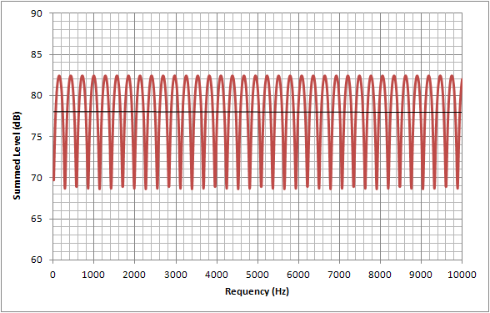
Plot for Range 10 Hz to 10,000 Hz
(Linear Frequency Scale)

Slide 11
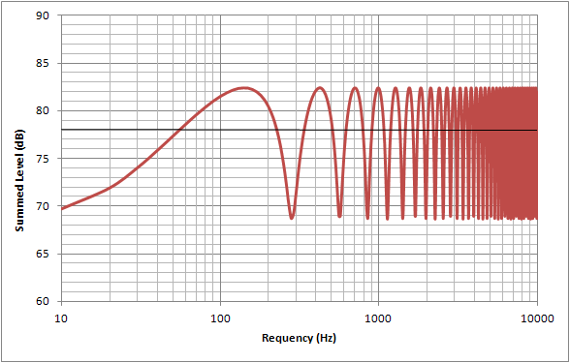
Plot for Range 10 Hz to 10,000 Hz
(Log Frequency Scale)

Slide 12
Damped Pipe
Pipe driven at one end and open at the other will resonate at a frequency of F_{res} = C / 4L, where C is the speed of sound (1130 ft/sec at 72º F) and L is the effective length of the pipe (F_{res} is called its “quarter-wavelength tuning” frequency)
The effective (or “acoustic”) length of the pipe may be longer than its physical length
Use of tapering and/or acoustic absorption material can increase the effective length

Slide 13
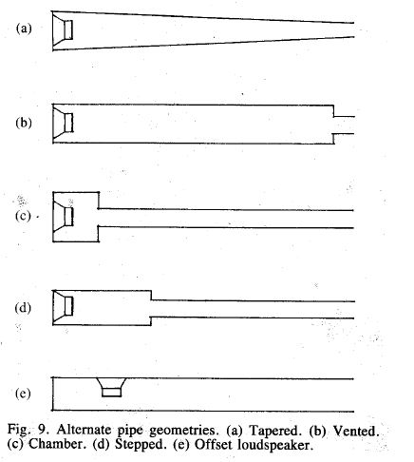
Damped Pipe / Tapered Tube Variations
Illustration from: G. L. Augspurger, “Loudspeakers on Damped Pipes,” J. Audio Eng. Soc., vol. 48, pp. 424-436 (2000 May).

Slide 14
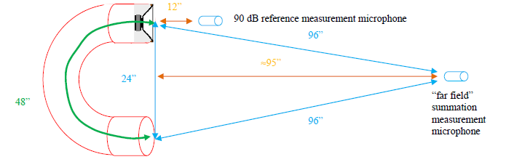
Assume a 4-inch loudspeaker is mounted in one end of a 48-inch long “C-shaped” section of 4-inch diameter PVC pipe (with the rear vibrating surfacing of the speaker facing the interior of the pipe). Assume the center-to-center distance between the two ends of the C-shaped pipe is 24 inches. Upon stuffing the pipe with acoustic absorption material and tightly capping the “rear” end of the pipe, a reference level of 90 dB SPL is measured on-axis (with respect to the “speaker end”) at a distance of 12 inches when operated at 50 Hz.

Slide 15
Determine the minimum frequency and the maximum frequency at which this undamped pipe should be allowed to operate (when observed in the “far field”, e.g. at a distance of approx. 95” on-axis with respect to the midpoint of the two openings, with the stuffing material and end cap removed). Also determine the frequency at which the summation peak occurs due to phase shift. In each case determine the dB SPL measured at the “far field” summation point.
Finally, determine the fundamental resonance frequency of the undamped pipe, and sketch the expected frequency response of this loudspeaker system (observed as indicated above) as the operating frequency is swept from the minimum to maximum frequency calculated above. Discuss what happens outside the “useful operating range”.

Slide 16
Solution
Determine the minimum frequency and the maximum frequency at which this undamped pipe should be allowed to operate based on phase shift, and the level measured at the “far field” summation point.
The minimum frequency (Fmin) is where the phase offset goes below 240º (rotating CCW on phase wheel), i.e. relative phase shift of acoustic path is 60º (180º + 60º = 240º total relative phase shift)
60 = 360 x 48/λ → λ = 288” → Fmin = 47 Hz
The level from front vibrating surface @ 96” = 90 dB – 18 dB = 72 dB; the phase-shifted level from rear vibrating surface is also 72 dB (assuming no losses through pipe)
Σ_{dB-SPLa+b} = 20 log₁₀ [ sqrt { (10^{72/20})² + (10^{72/20})² + 2(10^{72/20}) (10^{72/20})(cos(240))} ] = 72 dB

Slide 17
Solution
Determine the minimum frequency and the maximum frequency at which this undamped pipe should be allowed to operate phase shift, and the level measured at the “far field” summation point.
The maximum frequency (Fmax) is where the phase offset goes above 120º (rotating CW on phase wheel), i.e. relative phase shift of acoustic path is (180º+300º=480º or 120º) following complete rotation
300 = 360 x 48/λ → λ = 57.6” → Fmax = 235 Hz
The level from front vibrating surface @ 96” = 90 dB – 18 dB = 72 dB; the phase-shifted level from rear vibrating surface is also 72 dB (assuming no losses through pipe)
Σ_{dB-SPLa+b} = 20 log₁₀ [ sqrt { (10^{72/20})² + (10^{72/20})² + 2(10^{72/20}) (10^{72/20})(cos(120))} ] = 72 dB

Slide 18
Solution
Also determine the frequency at which the summation peak occurs due to phase shift, and the level measured at the “far field” summation point.
The response peak (Fpeak) based on phase shift is where a relative phase shift of 180º occurs:
180 = 360 x 48/λ → λ = 96” → Fpeak = 141 Hz
The level will be 72 dB + 72 dB = 78 dB SPL

Slide 19
Solution
Finally, determine the fundamental resonance frequency (F0) of the undamped pipe, and sketch the expected frequency response of this loudspeaker system (observed as indicated above) as the operating frequency is swept from the minimum to maximum operating frequency.
The fundamental resonance frequency of the undamped pipe will be:
F0 = c/4L = 70.6 Hz (will expect response “bump” at this frequency)
Will also have resonance peaks at odd integer multiples (1,3,5…) of F0:
F1 = 3 x 70.6 = 211.8 Hz F2 = 5 x 70.6 = 353 Hz (beyond operating range)
Summary:
Fmin = 47 Hz, level = 72 dB
F0 = 71 Hz (level unknown – depends on “Q” of pipe)
Fpeak = 141 Hz, level = 78 dB
F1 = 212 Hz (level unknown, but lower peak than F0)
Fmax = 235 Hz
71
141
212
47
235

Slide 20
Thought Questions
What happens outside the “useful operating range” of low frequency enhancement (due to resonance and summation effects)?
Will experience destructive summation effects due to phase offsets (will occur in a periodic, “combing” fashion).
Also, will experience successive resonance peaks at odd integer multiples of F0.
71
141
212
47
235
Conclusion: Need to “low pass filter” emissions from pipe end (probably best to cut off before F1, say around 200 Hz) – this can be accomplished by lining or stuffing the pipe with acoustic absorption material.
Also note: Turbulence noise will become more apparent at lower frequencies, so will want to “high pass filter” emissions from pipe end as well (probably best to cut off above Fmin) – this can be accomplished by restricting the cross sectional area of the opening.

Slide 21
Fundamental Loudspeaker Electrical & Mechanical Parameters
S_{d} – projected area of driver diaphragm (m²)
M_{ms} – mass of diaphragm (kg)
C_{ms} – compliance of driver’s suspension (m/N)
R_{ms} – mechanical resistance of driver’s suspension (N•s/m)
L_{e} – voice coil inductance (mH)
R_{e} – DC resistance of voice coil (Ω)
Bl – product of magnetic field strength in voice coil gap and length of wire in magnetic field (T•m)
Explanation of T/S Parameters (Part 1): https://www.youtube.com/watch?v=JdQ3mLU5zBE
Explanation of T/S Parameters (Part 2): https://www.youtube.com/watch?v=18v_jp9rYQ4

Slide 22
Small Signal Parameters
These values can be determined by measuring the input impedance of the driver, near the resonance frequency, at small input levels for which the mechanical behavior of the driver is effectively linear.
F_{s} – (free air) resonance frequency of driver (Hz)
  frequency at which the combination of the energy stored in the moving mass and suspension compliance is maximum, which results in maximum cone velocity
  usually it is less efficient to produce output frequencies below F_{s}
  input signals significantly below F_{s} can result in large excursions
  typical factory tolerance for F_{s} spec is ±15%

Slide 23
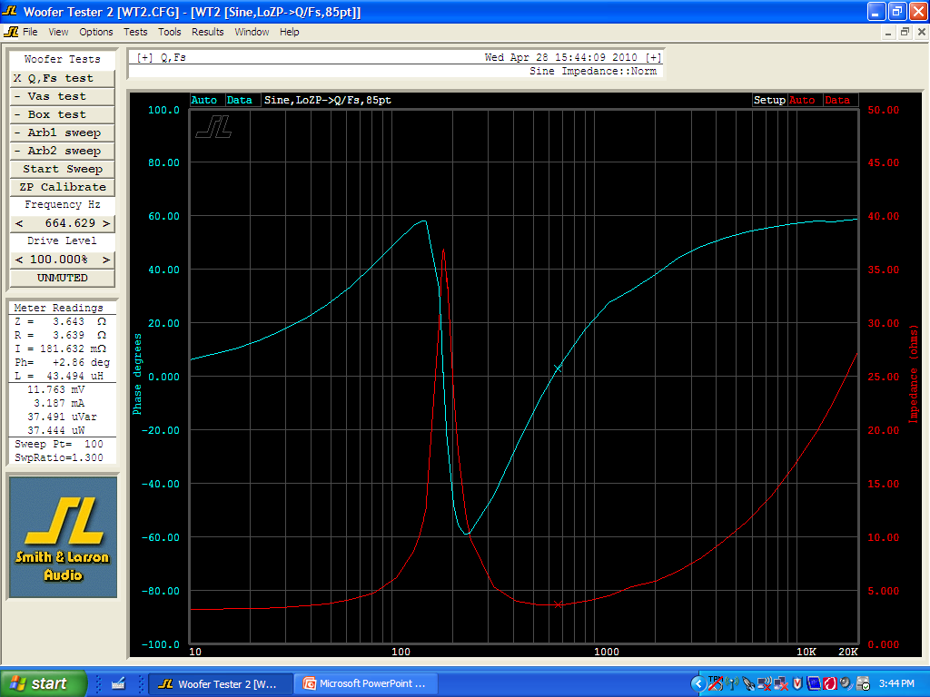
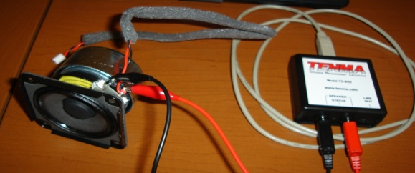
Measurement of Loudspeaker Free-Air Resonance

Slide 24
Small Signal Parameters
These values can be determined by measuring the input impedance of the driver, near the resonance frequency, at small input levels for which the mechanical behavior of the driver is effectively linear.
Q_{ts} – total Q of driver at F_{s}
  unitless measurement, characterizing the combined electrical and mechanical damping of the driver
  proportional to the energy stored, divided by the energy dissipated
  most drivers have Q_{ts} values between 0.2 and 0.5

Slide 25
Small Signal Parameters
These values can be determined by measuring the input impedance of the driver, near the resonance frequency, at small input levels for which the mechanical behavior of the driver is effectively linear.
Q_{ms} – mechanical Q of driver at F_{s}
  unitless measurement, characterizing the mechanical damping of the driver, i.e., losses in the suspension (surround and spider)
  varies roughly between 0.5 and 10 (typical value is 3)
  high Q_{ms} indicates lower mechanical losses
  main effect of Q_{ms} is on impedance: high Q_{ms} drivers display a higher impedance peak

Slide 26
Small Signal Parameters
These values can be determined by measuring the input impedance of the driver, near the resonance frequency, at small input levels for which the mechanical behavior of the driver is effectively linear.
Q_{es} – electrical Q of driver at F_{s}
  a unitless measurement, describing the electrical damping of the speaker
  as the coil of wire moves through the magnetic field, it generates a current which opposes the motion of the coil (“back EMF”)
  the back EMF decreases the total current through the coil near F_{s}, reducing cone movement and increasing impedance
  Q_{es} is the dominant factor in voice coil damping for most drivers (depends on amplifier output impedance)

Slide 27
Aside: How Does Loudspeaker Cable And Power Amplifier Output Impedance Affect Performance?
Damping is a measure of a power amplifier's ability to control the back EMF motion of the loudspeaker cone after the signal disappears
The damping factor of a system is the ratio of the loudspeaker's nominal impedance to the total impedance driving it
Example: Amplifier with damping factor of 300 (bigger is better) driving an 8Ω load means that the output impedance is 0.027Ω (lower is better)
Impedance of speaker cable used can significantly reduce the damping factor (larger gauge wire has lower impedance)
Placing the power amplifier physically close to the loudspeaker (thus reducing the length of the speaker cable to “zero”) can also be a way to maximize damping

Slide 28
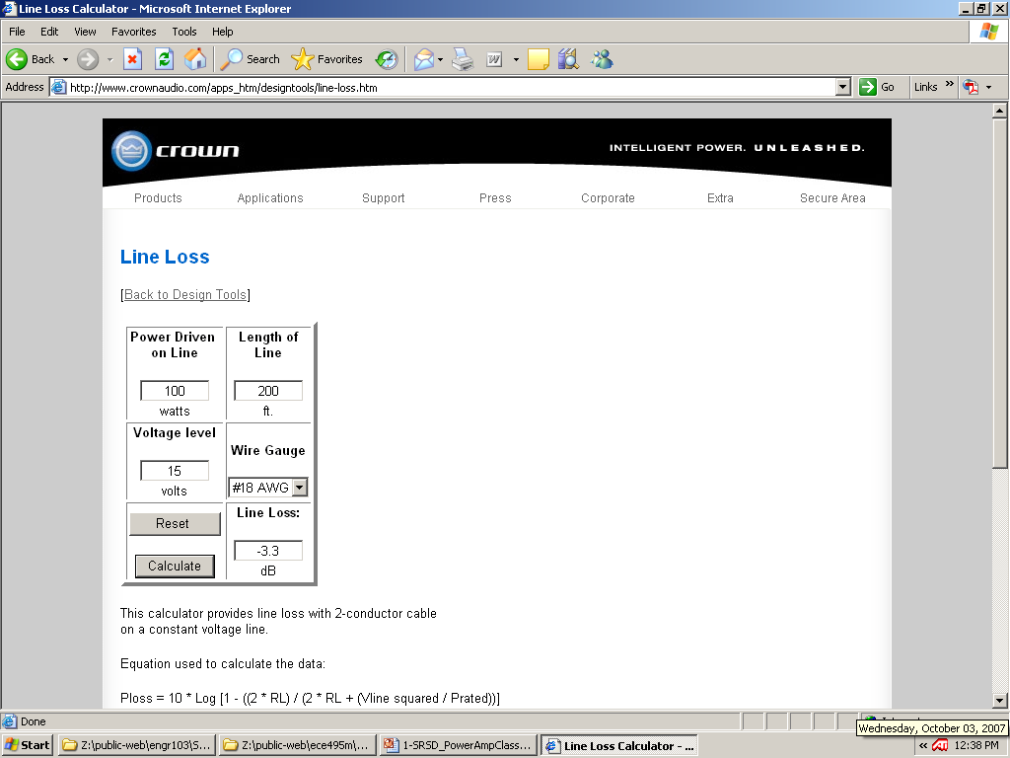
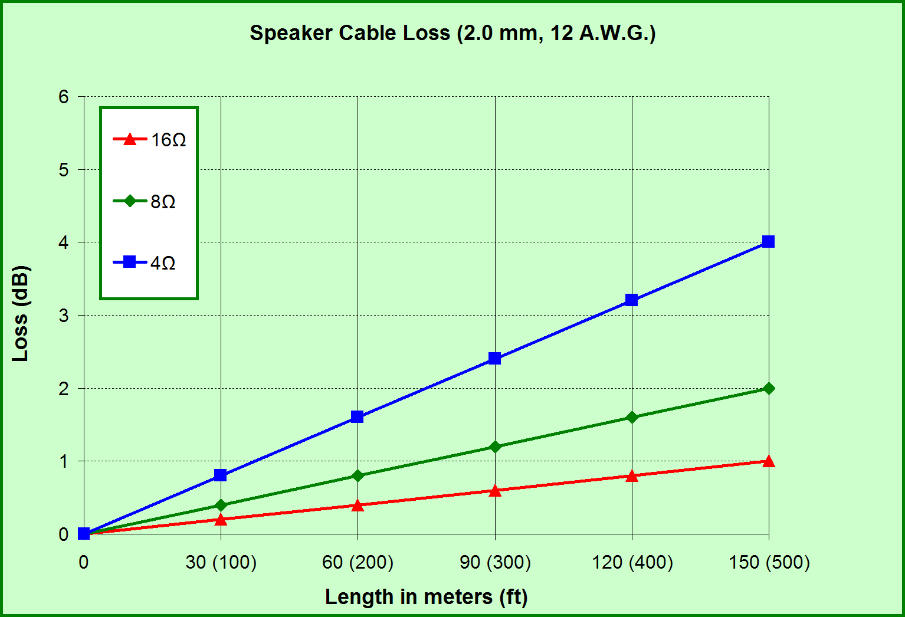
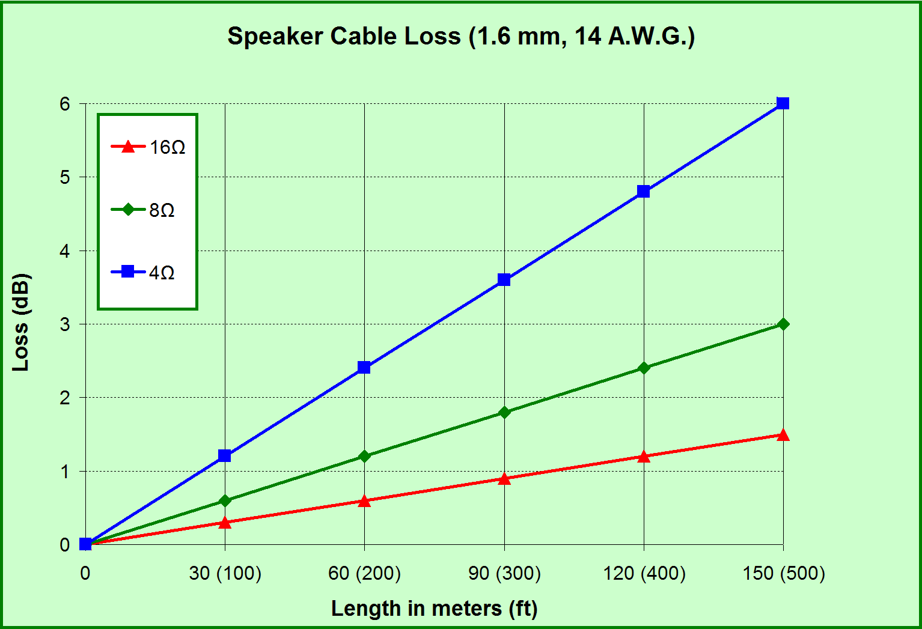
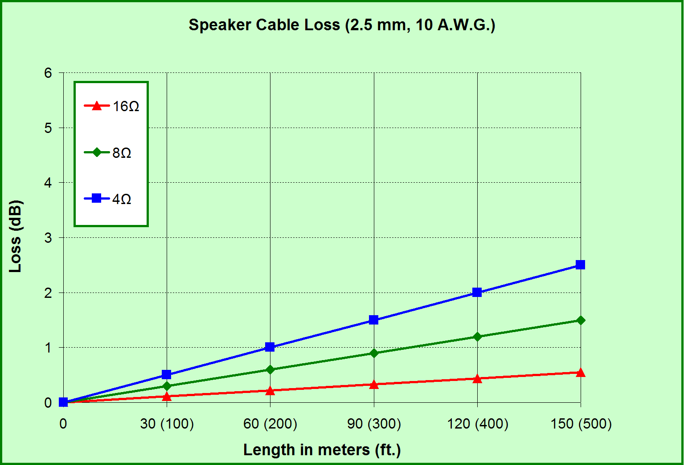

Slide 29
Small Signal Parameters
These values can be determined by measuring the input impedance of the driver, near the resonance frequency, at small input levels for which the mechanical behavior of the driver is effectively linear.
V_{as} – equivalent compliance volume (volume of air which, when acted upon by a piston of area S_{d}, has the same compliance as the driver’s suspension)
  measure of the “stiffness” of the suspension with the driver mounted in free air
  represents the volume of air that has the same stiffness as the driver’s suspension when acted upon by a piston of the same area (S_{d}) as the cone
  larger values mean lower stiffness (and generally require larger enclosures)
  V_{as} varies with the square of the speaker’s diameter
  typical factory tolerance for V_{as} is ±20-30%

Slide 30
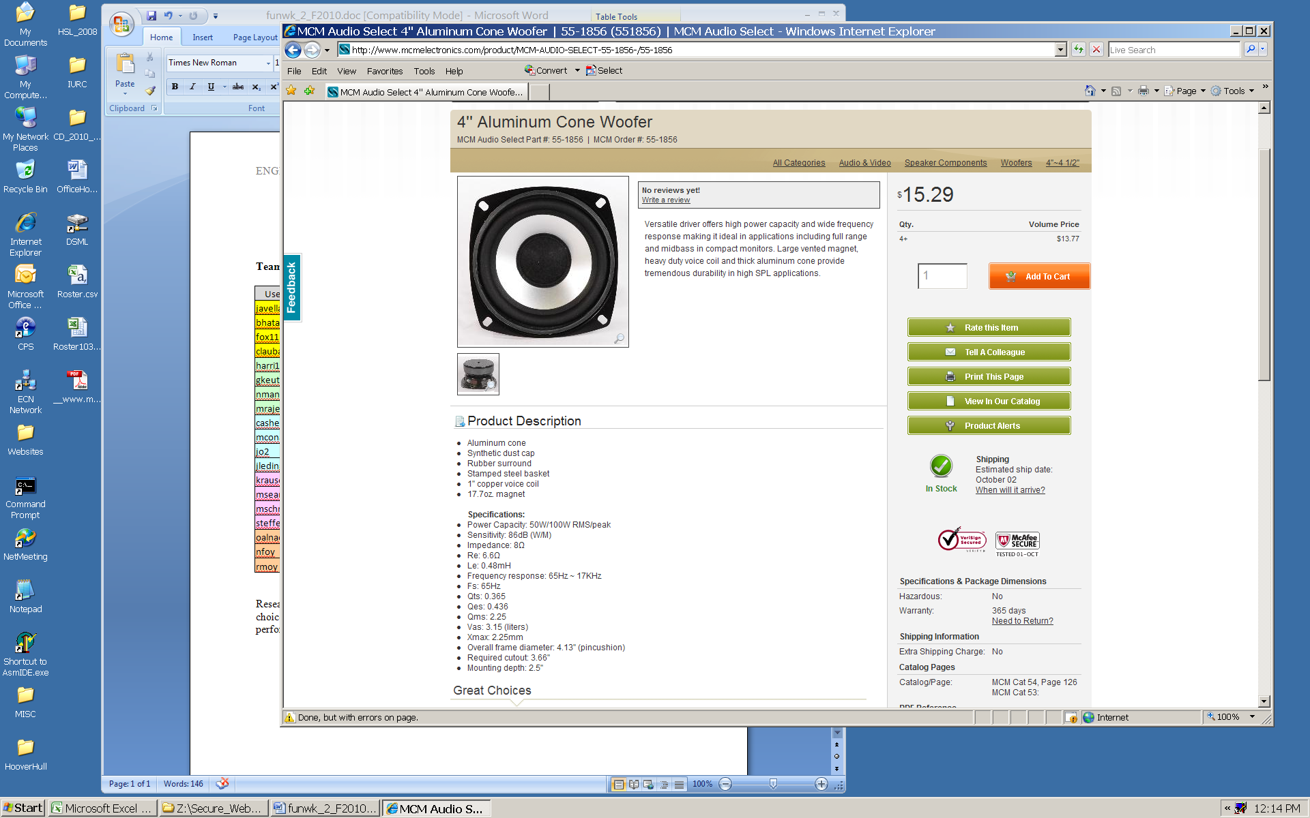
Sample Loudspeaker
Sensitivity = 86 dB
Fs = 65 Hz
Re = 6.6Ω
Le = 0.48 mH
Qts = 0.365
Qes = 0.436
Qms = 2.25
Vas = 3.15 liters

Slide 31
Aside: How Loud Does This Thing Get? (And, How Much Power Do I Need?)
Relating electrical power needed to produce desired SPL at a given listening distance:
  sensitivity rating of loudspeaker (typically spec as 1 m on-axis with input of 1 electrical watt)
  acoustic level change/attenuation between loudspeaker and farthest listening position
Example: want 90 dB program level at listening distance of 4 m outdoors (i.e., no reinforcement of sound due to room reflections)
  loudspeaker sensitivity measured as 86 dB
  acoustic level change = 20 log (4) ≅ 12 dB
  SPL required at source is 90 + 12 = 102 dB
  need 16 dB above 1 watt, or 10 ^{(16/10)} = 40 W
  check to make sure driver can handle it!

Slide 32
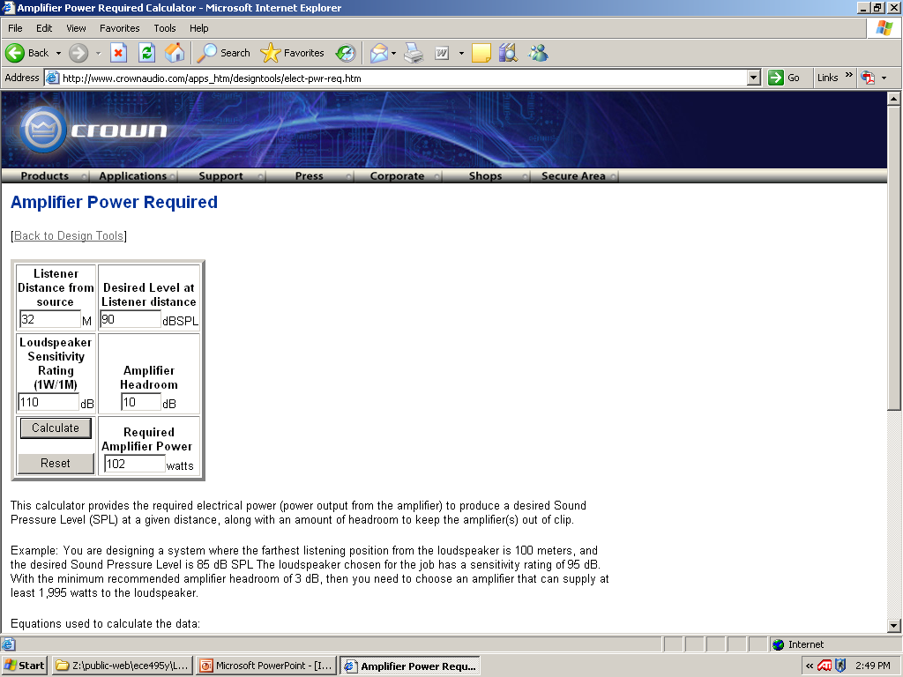
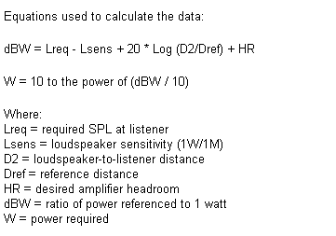
http://www.crownaudio.com

Slide 33
Baffles
A baffle is an enclosure that can be used to isolate (separate) the front and rear radiation produced by a loudspeaker
Basic strategies:
  isolate and damp out the rear radiation completely
    infinite baffle, sealed box, or “perfect” transmission line
  invert the phase of the rear radiation (or at least get it into the ±120° range) and emit it in a controlled, band-limited fashion to provide low-frequency power addition
    bass reflex, passive radiator (“drone cone”), compound/band-pass, rear-loaded horn
  enhance low-frequency output by a creating tuned resonance (“quarter-wavelength tuning”)
    damped/tapered pipe, labyrinth, transmission line

Slide 34
Enclosure-Related Parameters
EBP = F_{s} / Q_{es}
  used loosely to decide what type of enclosure will be best for a given speaker (“rule of thumb”)
  sealed box EBP ≈ 50
  vented enclosure EBP ≈ 100
  sealed vs. ported debate: https://www.youtube.com/watch?v=S-AGcpEVUnQ
F_{c} = sealed enclosure resonance
V_{c} = internal volume of a sealed enclosure
V_{b} = internal volume of a vented enclosure
F_{b} = bass reflex enclosure resonance
L_{v} = length of port
Q_{tc} – desired value determines size and type of enclosure
  value of 0.707 is what most designers aim for (yields flattest response)
  enclosures designed to enhance bass may range from 0.8 to 1.1 (bigger value, “boomier” sound)
  enclosures that are too big (Q_{tc} < 0.707) can sound “tinny”

Slide 35
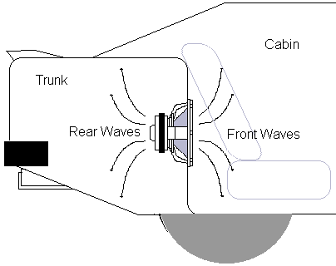
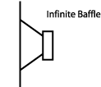
Infinite Baffle

Slide 36
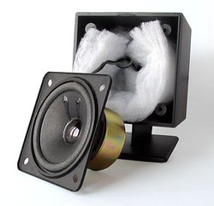
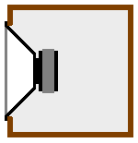
Sealed Box

Slide 37
Sealed Box
Theoretically an infinite baffle with an additional stiffness component added (to the existing suspension compliance) due to the springiness of the air volume trapped in the enclosure
A smaller box will have a greater stiffness contribution than a larger one – in sealed box systems the air restoring force is normally made dominant (compared with that of the driver suspension)

Slide 38
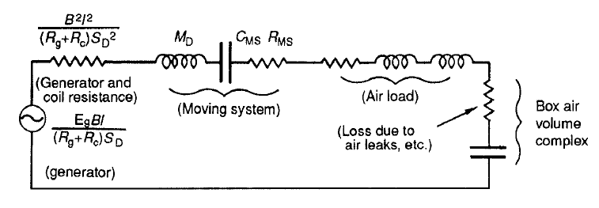
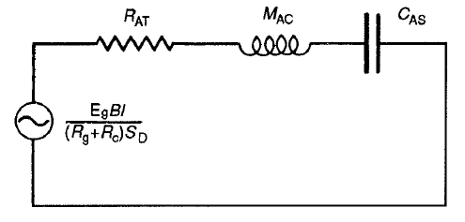
Electromechanical Equivalent for Driver in a Sealed Box
Simplified form – system response is that of a damped single-resonant circuit

Slide 39
Response Shape
Critically damped (Q_{TC} = 0.5): response is -6 dB at resonance (no ringing/overshoot in transient response)
Butterworth alignment (Q_{TC} = 0.7): response is -3 dB at resonance (response is “maximally flat” and has good transient behavior)
Q_{TC} =1: provides greater bandwidth at expense of transient response accuracy
Chebychev alignment (Q_{TC} = 1.1): 2 dB peak in response at resonance – results in optimum efficiency alignment for a sealed box system, and is permissible for a small system of limited bandwidth (e.g., F_{C} of 65 Hz and above)

Slide 40
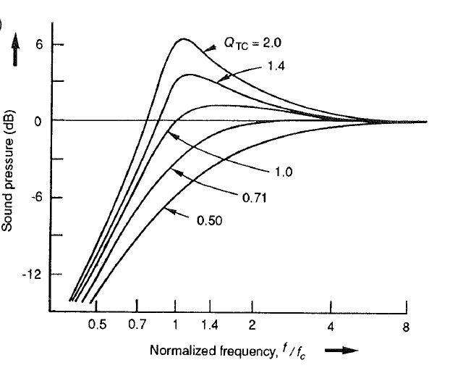
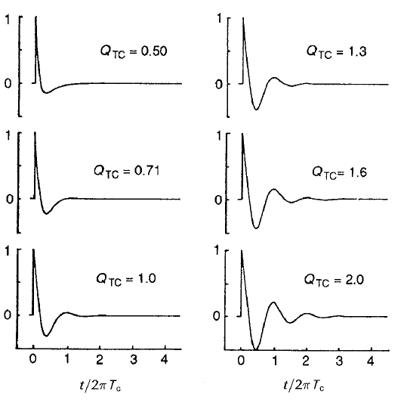
Behavior of a Closed-Box Loudspeaker System for Several Values of Total System Q_{TC}
Amplitude vs. Normalized Frequency Response
Normalized Step Response

Slide 41
Enclosure Volume and Efficiency
The maximum efficiency even a large sealed-box enclosure can achieve is small (1-2%)
Increasing the box cutoff frequency increases the theoretical efficiency
The closed-box system efficiency in the passband region (system reference efficiency) is the reference efficiency of the driver operating with the particular value of air-load mass provided by the system enclosure
Reference efficiency (η₀ ) calculation:
η₀ = 4π²/c³ x (F_{S}³ V_{AS})/Q_{ES} = 4π²/c³ x (F_{C}³ V_{AT})/Q_{EC}
where V_{AT} is a volume of air having the same total acoustic compliance as the driver suspension and enclosure acting together

Slide 42
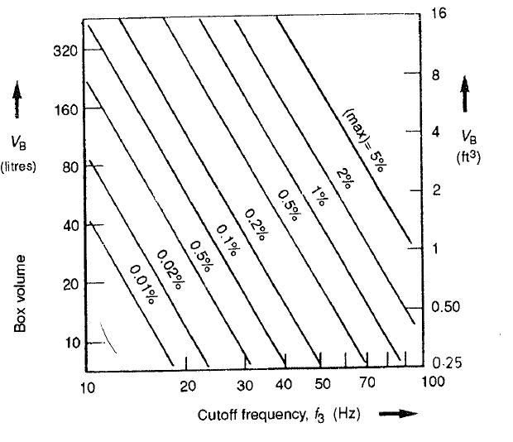
Relationship of Maximum Reference Efficiency (η₀) to Cutoff Frequency and Enclosure Volume
Example: An 8 cu. ft. (e.g. 2’x2’x2’) sealed box with a reference efficiency (η₀ ) of 2% would have a cutoff frequency (Fc) of slightly less than 40 Hz
Chart for Chebychev Alignment

Slide 43
Box Filling or Damping
Stuffing may offer an apparent air volume increase of up to 15%
Additionally, stuffing may add a mass component due to physical movement of the filling at lower frequencies (bad…but “rare”)
Combined effects lower the system resonance and must be accounted for in the design (the effective cone mass increase could be as much as 20%)
Very dense fillings will increase frictional air losses in the enclosed air volume and augment the damping
If system is designed correctly, such damping is not required, but may help control a system where the Q_{TC} is too high (e.g., due to inadequate magnet strength)
Movement of the filling is undesirable!

Slide 44
Sealed Box Design
Compliance Ratio: α = V_{AS} / V_{B}
System-driver relationships:
Q_{TC}/Q_{TS} ≈ Q_{EC}/Q_{ES} = F_{C}/F_{S} = (α + 1)^{0.5}
F_{C} / Q_{TC} ≈ F_{S} / Q_{TS} where Q_{TS} is the total Q of the driver at
F_{S} for zero source resistance, i.e.
Q_{TS} = Q_{ES}Q_{MS} /(Q_{ES} + Q_{MS})
These equations show that for any enclosure-driver combination the speaker resonance frequency must always be lower than that of the system resonance frequency (i.e., value of α) and Q will be in the same ratio as those of the driver, but individually raised by a factor of (α+1)^{0.5}
Provides guidance for both “fixed driver” designs and designs where only a final system specification is given

Slide 45
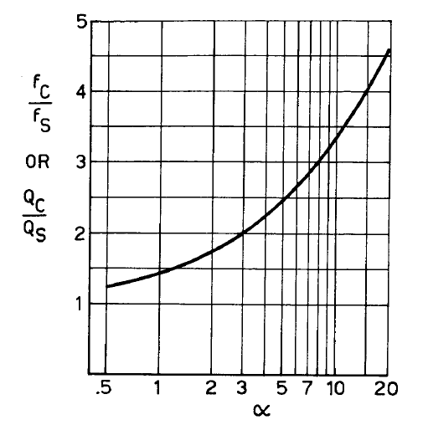
Ratio of Closed-Box System Resonance Frequency (F_{C}) and Total Q (Q_{TC}) to Driver Resonance Frequency (F_{S} ) and Q_{T}, as a Function of the System Compliance Ratio (α)
f_{C} = box cutoff frequency
f_{S} = loudspeaker free-air resonance frequency
Compliance Ratio: α = V_{AS} / V_{B}

Slide 46
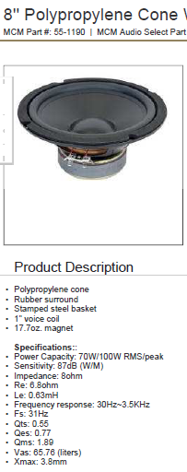
Sealed Box Design Example
F_{S} = 31 Hz EBP = 40 → use sealed enclosure
Q_{ES} = 0.77
Q_{MS} = 1.89
V_{AS} = 65.8 liters
η₀ = 4π²/c³ x (F_{S}³ V_{AS})/Q_{ES}
  = (9.64 x 10⁻⁷) x (31³ x 65.8)/0.77 = 2.45%
effective diaphragm radius = 10.2 cm (0.102 m), giving S_{D} = 3.27 x 10⁻² m²
peak linear displacement (Xmax) given as 3.8 mm (3.8 x 10⁻³ m)
peak displacement volume = V_{D} = S_{D} Xmax = 1.24 x 10⁻⁴ m³ (124 cm³)
power rating given as 70W RMS

Slide 47
Sealed Box Design Example
Constraints
  driver resonance frequency (F_{S}) must always be lower than that of the system (F_{C})
  α must be at least 3
  Q_{TS} must be lower than highest acceptable Q_{TC}
  V_{AS} must be at least several times larger than the enclosure size (volume)
  select most desirable combination of F_{C} and Q_{TC} that satisfies F_{C} / Q_{TC} ≈ F_{S} / Q_{TS} and then calculate α = V_{AS} / V_{B}
Calculations
  Q_{TS} = (0.77)(1.89)/(0.77+1.89) = 0.547
  based on α ≥ 3 requirement, F_{C}/F_{S} ≥ 2 → F_{C} ≥ 62
  F_{S} / Q_{TS} = 56.7 ≈ F_{C} / Q_{TC} → for F_{C} = 62 get Q_{TC} ≈ 1.1 (“Chebychev Alignment” → maximum efficiency)
  internal volume of box needed based on α
  α = V_{AS} / V_{B} (want α ≥ 3) → V_{B} ≤ 22 liters (0.022 m³)
  yields approximate size of: 0.28 m x 0.28 m x 0.28 m

Slide 48
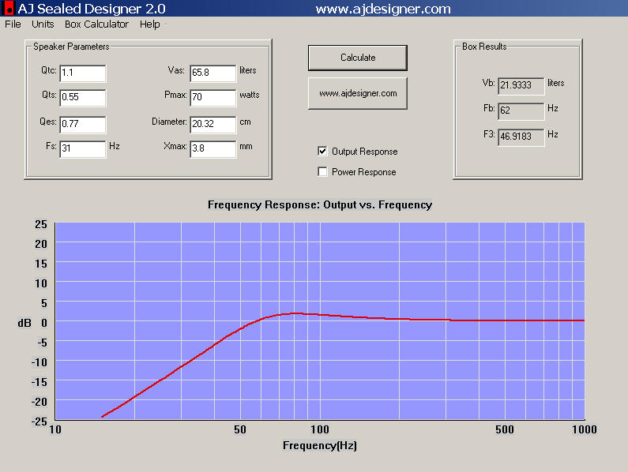

Slide 49
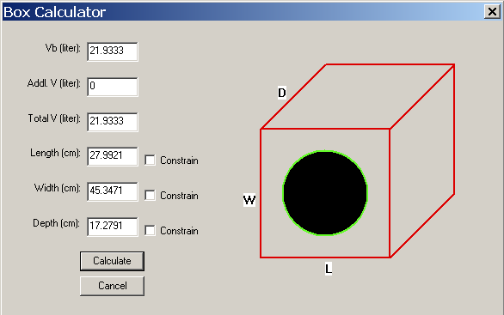
The unconstrained mode determines the optimum dimensions for a particular volume, known as the Golden Ratio
The Golden Ratio reduces or cancels out the standing waves inside a “box” enclosure, which improves sound quality and reduces distortion

Slide 50
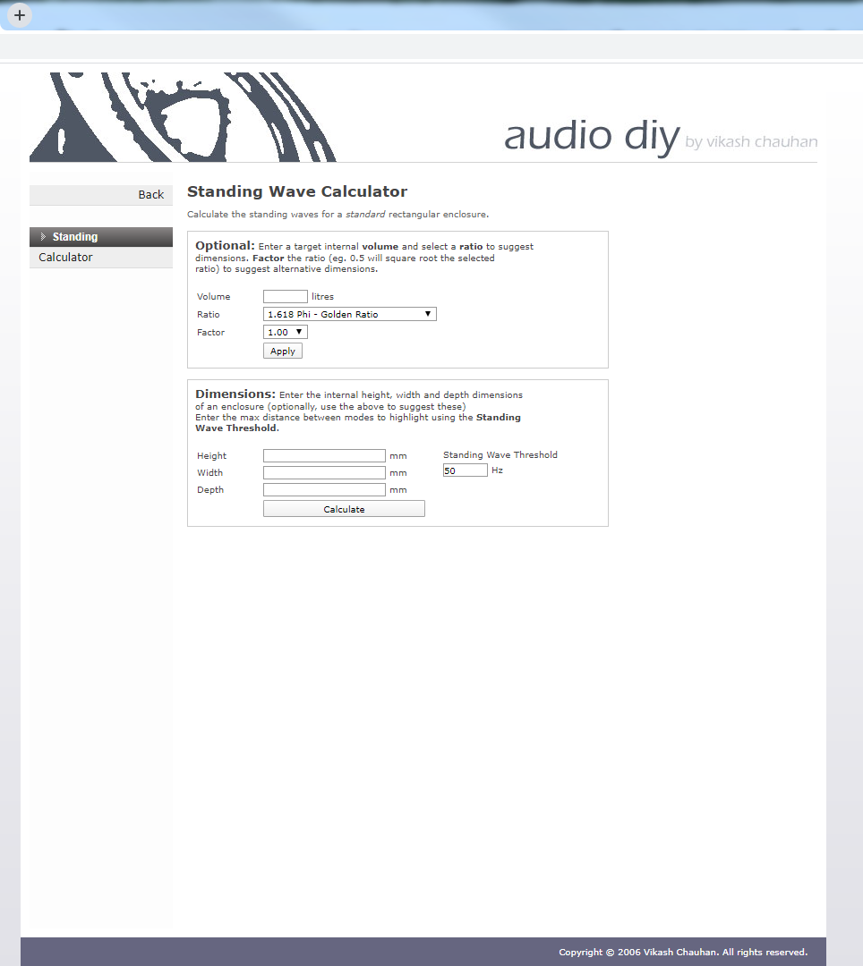

Slide 51


Slide 52
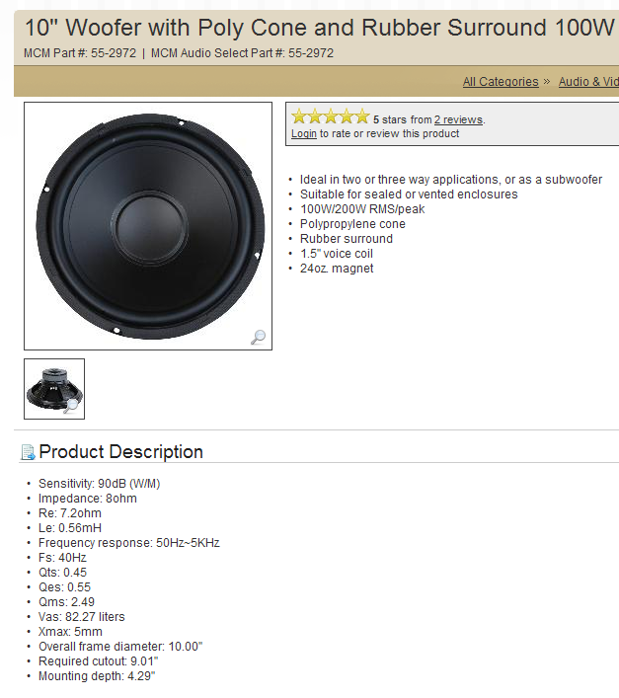
Vented Box Design
alignments (choice depends on Q_{ts})
  QB3 – quasi 3rd order Butterworth
  SBB4 – 4th order Butterworth (“maximally flat”)
  C4 – 4th order Chebychev
need to determine port shape/size/length
Port design considerations: https://www.youtube.com/watch?v=jN-E1dfMfO0

Slide 53
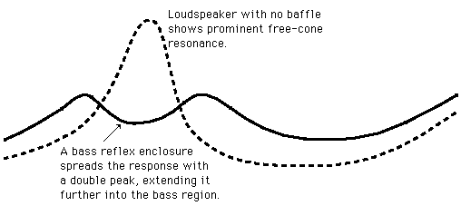
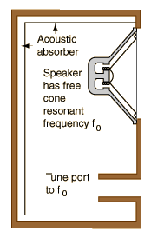
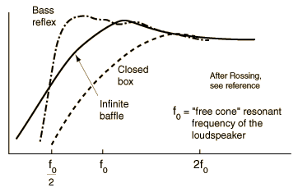
Bass Reflex

Slide 54
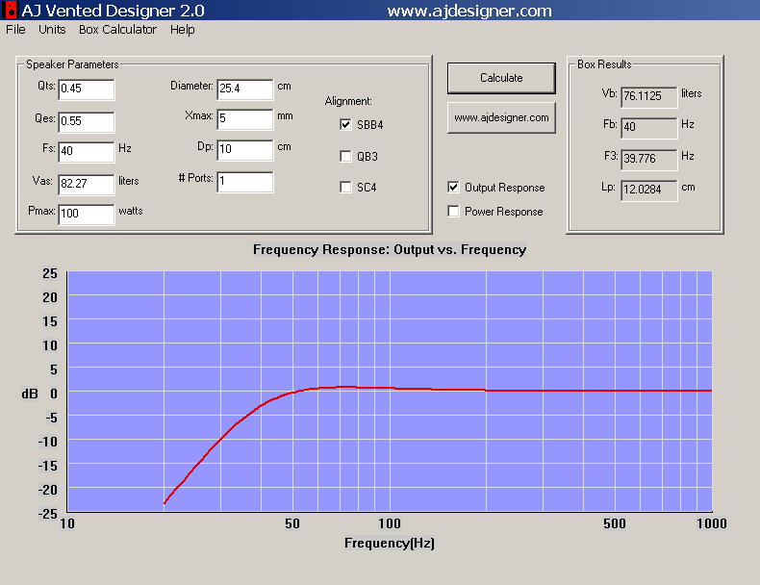

Slide 55


Slide 56


Slide 57
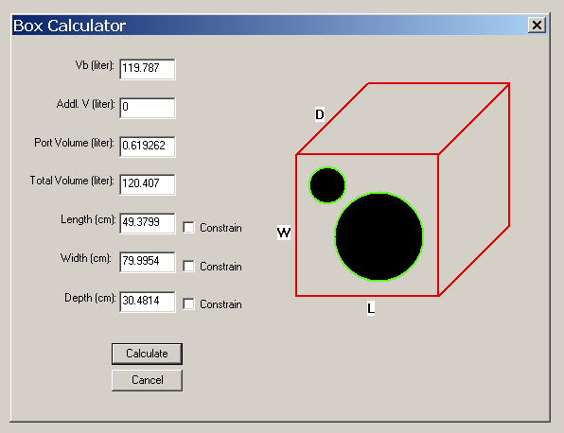

Slide 58
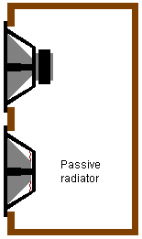
Passive Radiator (“Drone Cone”)
Comment: primarily applicable to subwoofer design

Slide 59
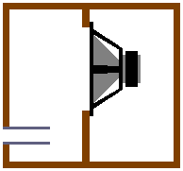
Compound / Band-pass
Comment: primarily applicable to subwoofer design

Slide 60
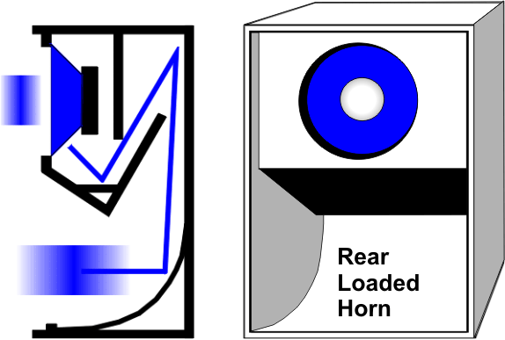
Rear-loaded Horn
Comment: physically large!

Slide 61

Labyrinth / Transmission Line
Phase shift (degrees) =
360 x L / (C/F)
where L is effective length of labyrinth, C is speed of sound, and F is frequency of operation (note – add 180 due to rear radiation)
Length of transmission line has to be long enough to provide at least 90º of phase shift (1/4 of longest wavelength of interest)
Design calculator: http://www.mh-audio.nl/Calculators/TQWT.asp?c=y#ready

Slide 62
Labyrinth / Transmission Line / Damped Pipe
Names are used interchangeability, but some (subtle) differences:
  labyrinth / transmission line typically “lined” (with acoustical absorption material) to help reduce spurious reflections at angular transitions, but otherwise “substantially open” (i.e. nominal airflow restriction, lightly damped)
  damped pipe less prone to spurious internal reflections, eliminating the need for acoustical lining of the pipe (but may still employ “acoustic stuffing” to limit high frequency emissions)
  pipe driven at one end and open at the other will resonate at a frequency of F_{res} = C / 4L, where C is the speed of sound (1130 ft/sec at 72º F) and L is the effective length of the pipe (F_{res} is called its “quarter-wavelength tuning” frequency)
  the effective (or “acoustic”) length of the pipe may be longer than its physical length – use of tapering and/or acoustic absorption material can increase the effective length
  radiation from vent can be limited to low frequencies through use of extra acoustic “stuffing” material and/or use of acoustical filters (e.g. Helmholtz resonators tuned to spurious frequencies that need to be suppressed)
  a “perfect” transmission line is one that is very heavily stuffed and has little/no emission from the vent (or eliminates the vent completely)

Slide 63
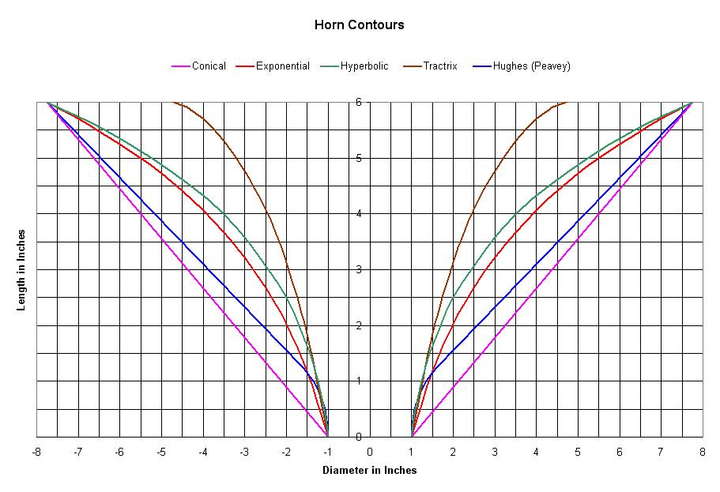
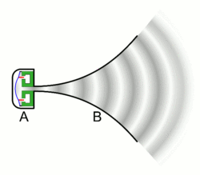
Waveguides
generally applies to a mid- or high-frequency “horn” – provides a means of controlling directivity above a specified cutoff frequency (e.g. constant directivity horn)

Slide 64
Bose AWR1 “Waveguide” (Damped Pipe)
What Bose calls a “waveguide” is really just a damped pipe (or transmission line)
Illustration from: Fig. 4 of U.S. Patent 6,278,789

Slide 65
Bose WRII “Waveguide” (Damped Pipe)
What Bose calls a “waveguide” is really just a damped pipe (or transmission line)
Illustration from: Fig. 6B of U.S. Patent 7,565,948

Slide 66
Bose WRII “Waveguide” (Damped Pipe)
What Bose calls a “waveguide” is really just a damped pipe (or transmission line)
Illustration from: Fig. 9 of U.S. Patent 7,584,820

Slide 67
References
Loudspeaker Design Cookbook, Vance Dickason (any edition)
U.S. Patent 3,523,589 “High Compliance Speaker and Enclosure Combination”
U.S. Patent 4,655,315 “Speaker System”
U.S. Patent 5,821,471 “Acoustic System”
U.S. Patent 6,278,789 “Frequency Selective Acoustic Waveguide Damping”
U.S. Patent 7,426,280 “Electroacoustic Waveguide Transducing”
U.S. Patent 7,565,948 “Acoustic Waveguiding”
Bose “secrets” https://www.youtube.com/watch?v=RR10zEqVRvI
M. J. King, “Construction and Measurement of a Simple Test Transmission Line,” accessed from http://www.quarter-wave.com
G. L. Augspurger, “Loudspeakers on Damped Pipes,” J. Audio Eng. Soc., vol. 48, pp. 424-436 (2000 May) http://diyaudioprojects.com/Technical/Papers/Loudspeakers-on-Damped-Pipes.pdf
L. J. S. Bradbury, “The Use of Fibrous Materials in Loudspeaker Enclosures,” J. Audio Eng. Soc., vol. 24, pp. 162-170 (1976 April) http://www.aes.org/e-lib/browse.cfm?elib=2632
3-D printed subwoofer https://www.youtube.com/watch?v=0tt3QHRiaRI
Calculators: http://www.mh-audio.nl/Loudspeakers.html and http://www.diysubwoofers.org/

