Slide 1
Combination
Reference: Chapter 9 (3rd Ed.) of Sound Systems: Design and Optimization, by Bob McCarthy (Elsevier, 2010 / 2017)

Slide 2
Outline
Array building
Role of overlap as a shaping tool
Role of asymmetry as a shaping tool
Basic idea
Coupled arrays
Uncoupled arrays
Spectral variance effects
Coupled line source arrays
Coupled point source arrays
Uncoupled line source arrays
Uncoupled point source arrays
Uncoupled point destination arrays
Minimum variance coverage shapes

Slide 3
Array Building
Two principal beamwidth shapes suitable for array building
2nd-order “plateau” type that flattens out in the high frequencies (“constant directivity”) – provides consistent unity splay angle
highly sloped 3rd-order elements useful in highly overlapped coupled array configurations (no consistent unity splay angle)
(1st-order speakers best suited for “standalone” applications rather than array building)

Slide 4
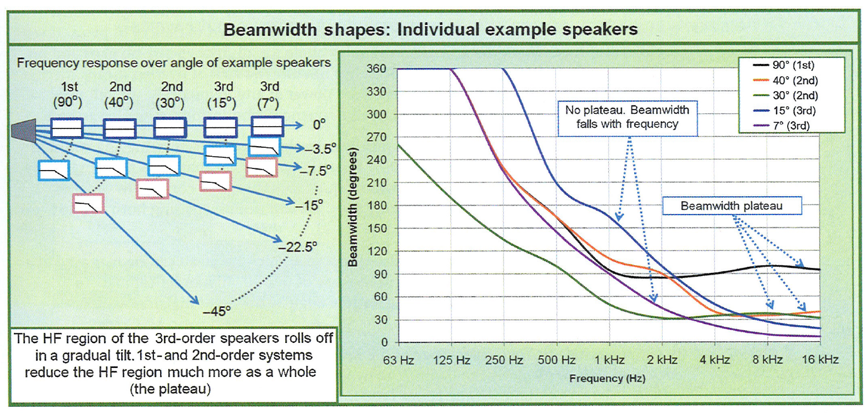
Review: Beamwidth Shapes

Slide 5
Array Building
Ability to fill simple symmetrical shape evenly makes 1st-order speaker leader in horizontal coverage applications
Foremost application of 3rd-order speakers is creation of asymmetric arrays, which make it the leader in vertical applications
Middle ground are 2nd-order speakers, which have applications in both H and V planes (but in limited quantities)

Slide 6
Role of Overlap as a Shaping Tool
If we array two speakers together, what will be the combined coverage angle?
combined angle can range from half as wide to twice as wide
decisive factor: percentage overlap
control of overlap
angular (point in different directions)
displacement (moving elements apart)
low overlap: elements retain much of their individual character (yet merge to make “sculpted shapes” unique to combined arrays)
high overlap: individual elements disappear and merge into combined shape of a “new and different” single speaker
overlap is the “shaping tool”

Slide 7
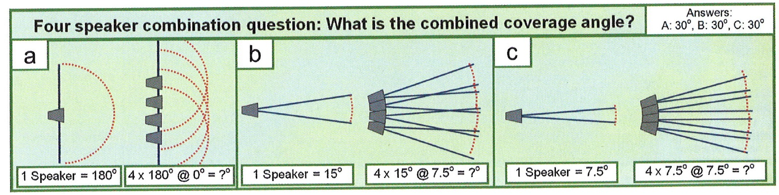
“Quiz”
Four speaker combination question: What is the combined coverage angle?

Slide 8
“Quiz”
Four speaker combination question: What is the combined coverage angle?

Slide 9
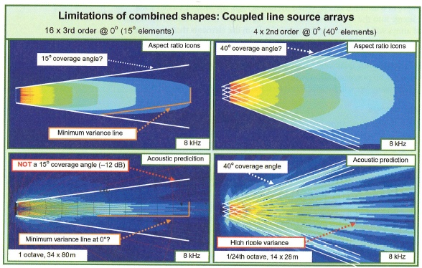
Limitations of Combined Shapes
Will use aspect ratio icons in layout form to visualize individual contributors (works well where isolation zone summation is dominant, not so well when coupling or combing zone summation is dominant)
Note that beam concentration and ripple variance aspects of the combined response are not apparent in the simple icon representation

Slide 10
Role of Asymmetry as a Shaping Tool
What asymmetries are available to the array designer?
Why are asymmetries necessary?
Which asymmetries are static (i.e. fixed)?
Which asymmetries are dynamic (i.e. modifiable while in operation or even as a function of program material)?
Takeaway: DSP changes the rules on array beamforming

Slide 11
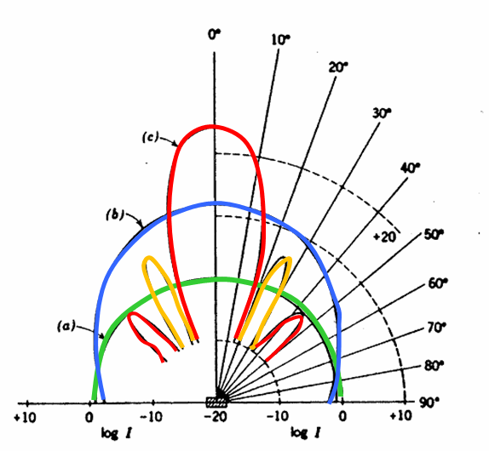
Basic Idea – Coupled Line Source Arrays
Stack the “aspect ratio icons” end-to-end (for side-by-side speakers)
Combined shape of fully-coupled line source can be visualized as a forward extension by means of simple additions of the aspect ratio shapes
Recall: Beamwidth of a single speaker approaches 90° when the transmitted λ equals the radiating cone size (blue line in figure). Beamwidth is wider if λ > cone size (green line) and narrower if λ < cone size (red line).
For a coupled line source, vertical coverage is 72° when the transmitted λ equals the line length (e.g. beamwidth for a 2m long array will be 72° at 170 Hz).
Note that equations relating line length to beamwidth assume omnidirectional (“point”) sources.

Slide 12
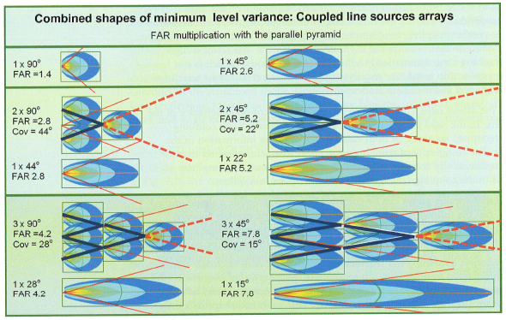
Coupled Line Source – FAR Multiplication
Combined coverage angle is found once the array has fully formed at the top of the parallel pyramid.

Slide 13
Basic Idea – Coupled Point Source Arrays
Arrange the aspect ratio icons side-by-side around a virtual point source (based on unity splay angle)
Combined shape will strongly resemble the radial spread of the individual FAR patterns as long as the amount of combing zone interaction is low

Slide 14
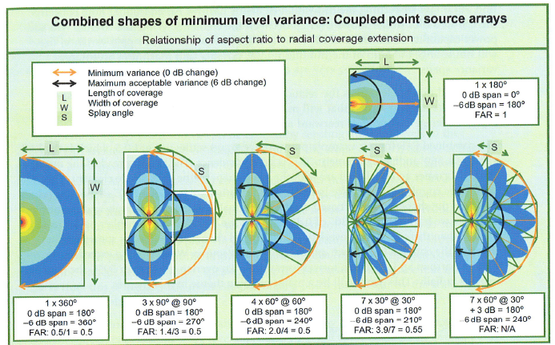
Coupled Point Source Arrays: Aspect Ratio to Radial Coverage Extension

Slide 15
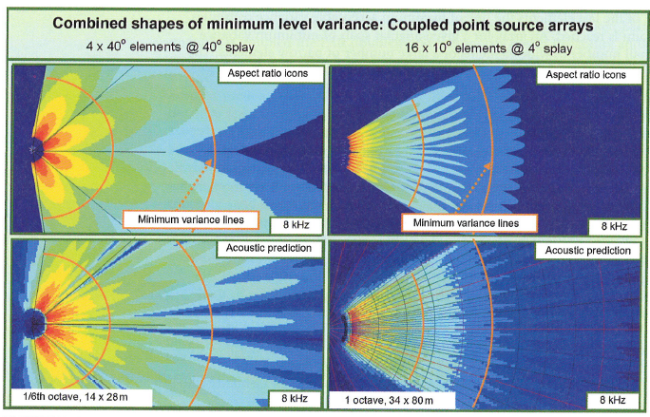
Coupled Point Source Arrays: Combined Shapes of Minimum Level Variance
constant speaker order, unity splay angle, constant level
constant speaker order, 60% overlap splay angle, constant level

Slide 16
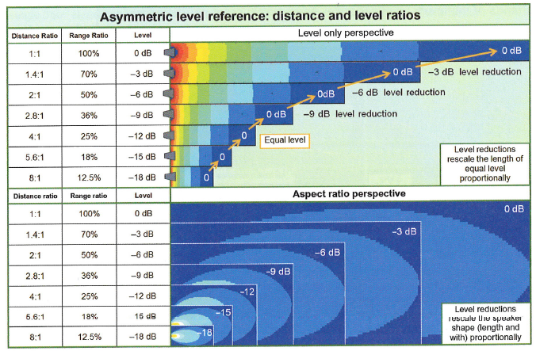
Asymmetric Level Scaling
size of icon reduced by 50% for each reduction in level by 6 dB

Slide 17
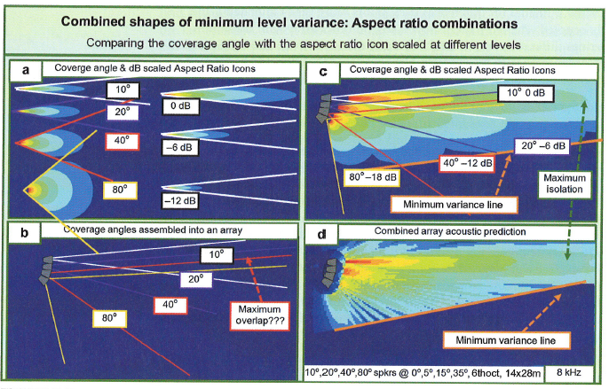
Combined Shapes with Asymmetric Level Scaling
technique of partial overlap mixed with level tapering called “layering”

Slide 18
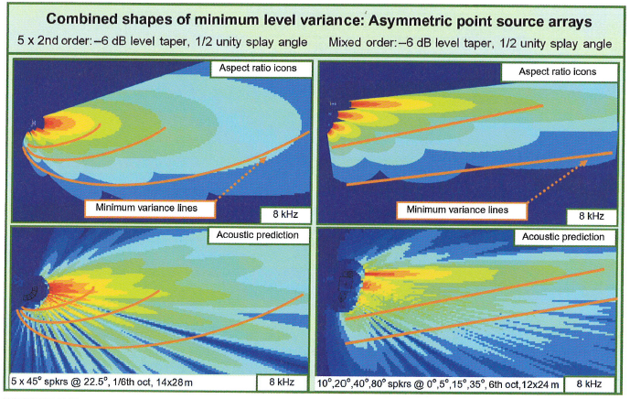
Combined Shapes with Asymmetric Level Scaling
constant speaker order and splay angle, tapered level
mixed speaker order with splay angle tapered to provide constant overlap ratio, tapered level

Slide 19
Basic Idea – Uncoupled Arrays
The best way to deal with overly wide coverage shapes is spread multiple sources (uncoupled arrays)
Combined shape can be seen as a lateral extension by means of simple stacking of the aspect ratio shapes
The combined aspect ratio becomes wider (while not becoming longer) and therefore lower in number
FAR is found by dividing the single element FAR by the number of elements

Slide 20
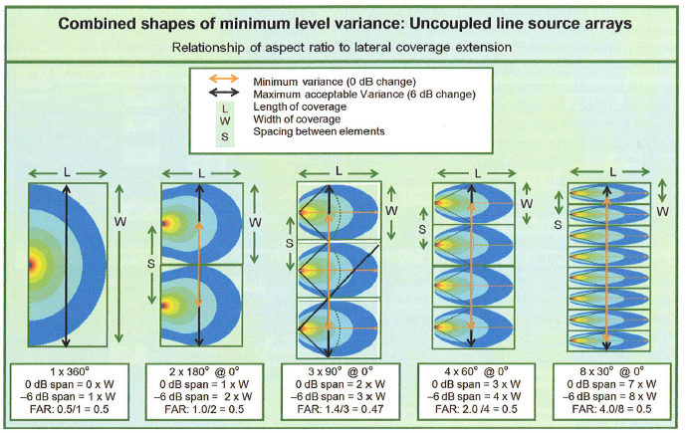
Uncoupled Line Source Arrays: Combined Shapes

Slide 21
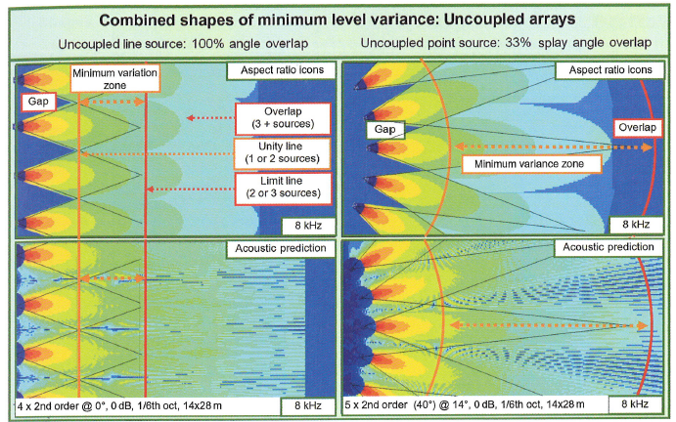
Uncoupled Line Source Arrays: Combined Shapes
4-element second-order array with 0º splay angle, matched line of origin, constant lateral spacing, and levels
5-element second-order array with 14º splay angle, matched line of origin, constant lateral spacing, and levels

Slide 22
Compensated Unity Spacing

Slide 23
Uncoupled Point Destination Arrays

Slide 24
Spectral Variance of Coupled Arrays
Possible outcomes of beam combinations
beam concentration (coupling zone overlap)
beam spreading (isolation zone)
“passing through each other” (combing zone)

Slide 25
Spectral Variance of Coupled Line Source Arrays
Representative element
Length effects
Spacing (displacement) effects
Beamwidth shapes
Quantity effects
Pyramid effects
Speaker order effects
Level tapering effects

Slide 26
Coupled Line Source Element

Slide 27
Coupled Line Source Length Effects
Line length = 2.76m (one λ @ 125 Hz).The coverage angle is about 70° (regardless of quantity) when the line length equals the wavelength. The coverage angle is reduced by half when λ equals half the line length.

Slide 28
Coupled Line Source Element Spacing Effects
Spacing effects for 1/3 λ, 2/3 λ, 3/3 λ, and 4/3 λ.
Side lobes become strong at element spacing beyond 2/3 λ.

Slide 29
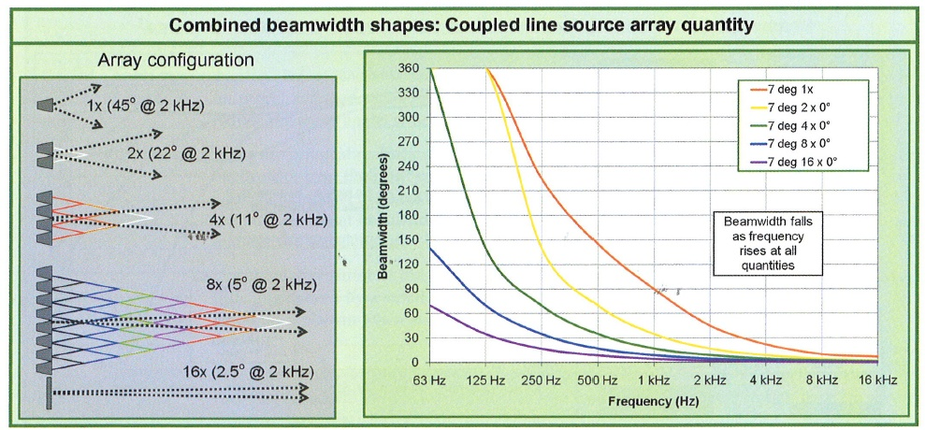
Coupled Line Source Beamwidth Shapes

Slide 30
Coupled Line Source Element Quantity Effects
Coverage pattern narrows as quantity rises
Ratio of spectral variance is unchanged by quantity (as long as line length stays the same)
Beam concentration is the primary driving force in the interactions
Larger quantities give appearance of reduced spectral variance if the range of viewing does not extend far enough for coupling to occur over the full frequency range

Slide 31
Coupled Line Source Element Quantity Effects

Slide 32
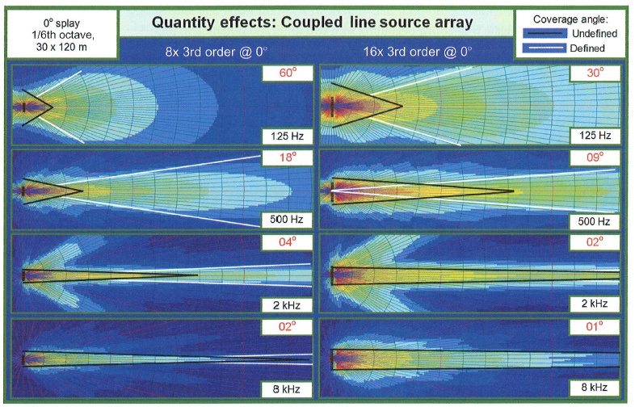
Coupled Line Source Element Quantity Effects

Slide 33
Coupled Line Source Element Pyramid Effects
Note high spectral variance vs. distance away from array – “pink shift” as we approach the array (due to “moving axially inside the pyramid”). Moving radially, there is high spectral variance relative to angle off axis.

Slide 34
Coupled Line Source Speaker Order Effects
Line length is dominant force at lower frequencies (where line length ≥ λ/2)
Side lobes vary with order but main lobes still matched at mid frequencies
At high frequencies, low-order array coverage degenerates into ripple, while high-order array maintains focus

Slide 35
Coupled Line Source Level Tapering Effects
(Symmetric) level (i.e. amplitude) tapering effectively reduces the number of elements contributing to the pyramid
Behavior mimics an array of shorter length
Aside – frequency dependent amplitude tapering is not considered in text, nor is delay tapering (accomplished using digital signal processing and delay techniques)

Slide 36
Coupled Line Source Level Taper Effects
THIS IS NOT HOW YOU WOULD NORMALLY DO LEVEL TAPERING ON A LINE ARRAY

Slide 37
Spectral Variance of Coupled Point Source Arrays
Beamwidth shapes
Splay angle effects
Level taper effects
Speaker order effects

Slide 38
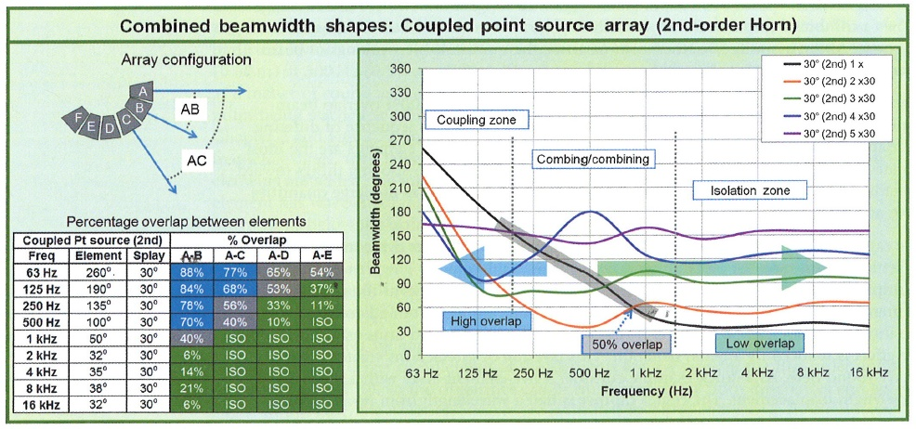
Coupled Point Source Beamwidth

Slide 39
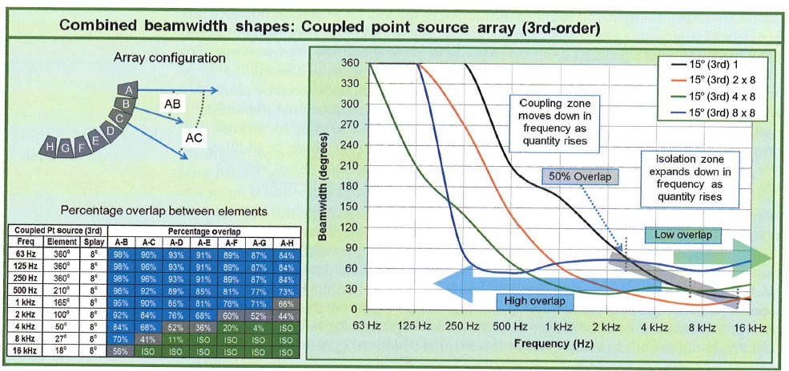
Coupled Point Source Beamwidth

Slide 40
Splay Angle Effects
Even a small splay angle creates an opportunity for reduced spectral variance (that cannot be found in a coupled line source… unless DSP techniques are used)
Isolation (even in small measure) will counteract pattern narrowing

Slide 41
Coupled Point Source Splay Angle Effects

Slide 42
Coupled Point Source Splay Angle Effects

Slide 43
Asymmetric Coupled Point Source Arrays
Reference points
center (on axis): angular orientation of the longest distance covered by the array
top/bottom (off axis): -6 dB points along the target shape, above and below center
total (TTL): the combined angular spread from top to bottom
Symmetry percentage (“amount of asymmetry”): the ratio of angular coverage above and below center
level taper
splay (angle) taper
mixed loudspeaker orders
lateral spacing/level offset
forward spacing/level offsets
hybrid coupled line/point source arrays

Slide 44
Asymmetric Coupled Point Source Arrays
Level taper bends the minimum variance line and raises the acoustic beam center relative to the geometric center.

Slide 45
Asymmetric Coupled Point Source Arrays
Level taper bends the minimum variance line and raises the acoustic beam center relative to the geometric center.

Slide 46
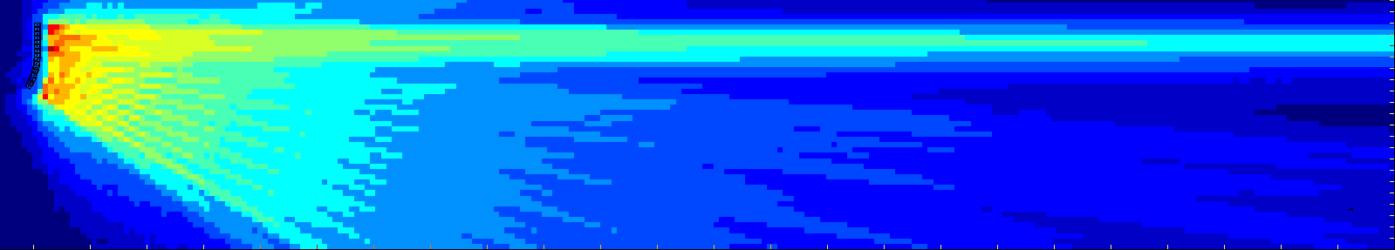
Splay Angle Effects
Hybrid Coupled Line/Point Source Array
Coverage shapes
8 kHz
Point Source
Line Source
Gap
Where would a “gap” in the coverage shape be useful?
16 coupled 3rd order speakers
32 degree overall angle spread, 1 octave,
22 x 120 meters

Slide 47
Uncoupled Arrays
Line source
Point source
Point destination

Slide 48
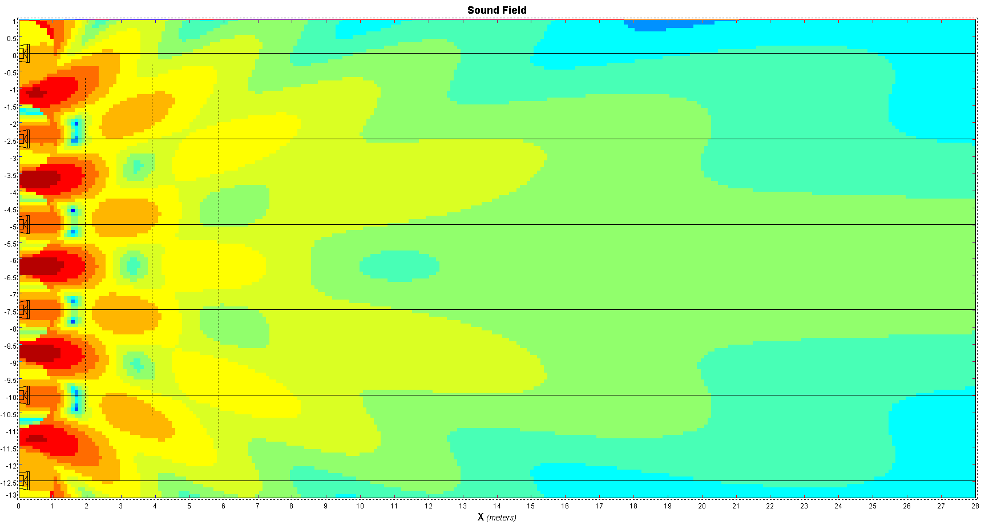
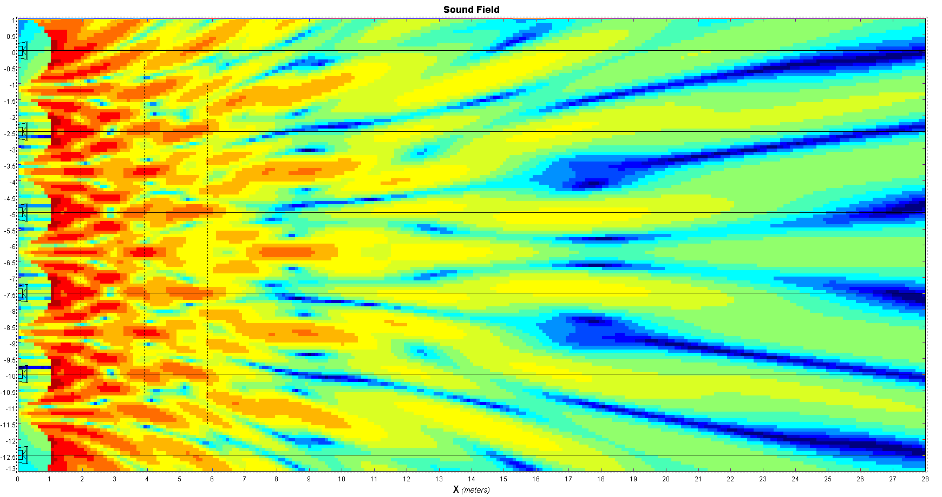
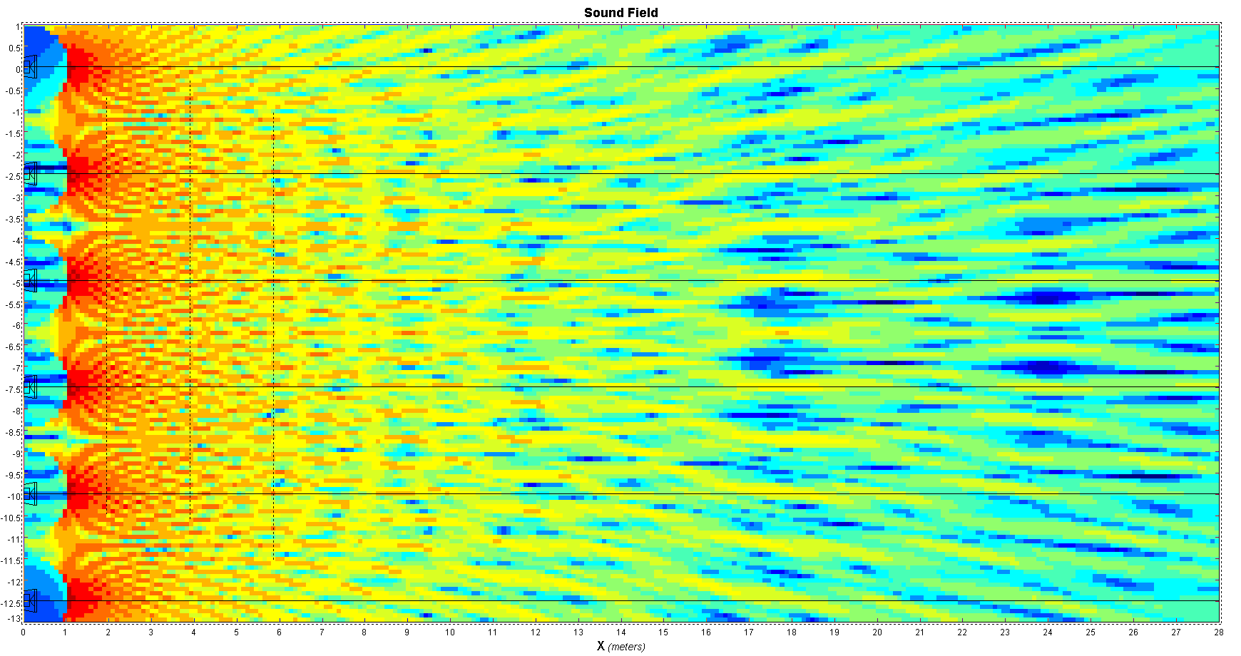
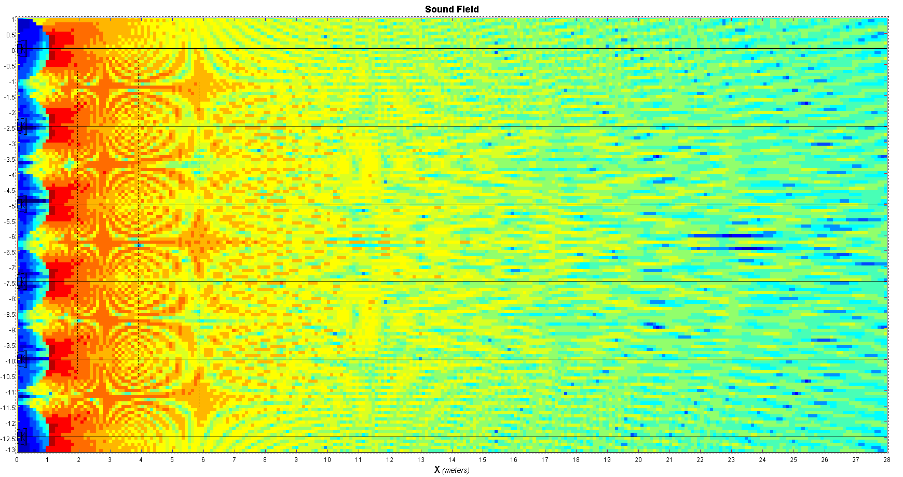
Lateral Spacing and Level Effects
Symmetric Uncoupled Line Source Array
Minimum Variance Zone
8 kHz
2 kHz
125 Hz
500 Hz
6 uncoupled 1st order speakers (90) 1/6th octave 12 x 24 meters
Notes:
Fig 6.38b

Slide 49
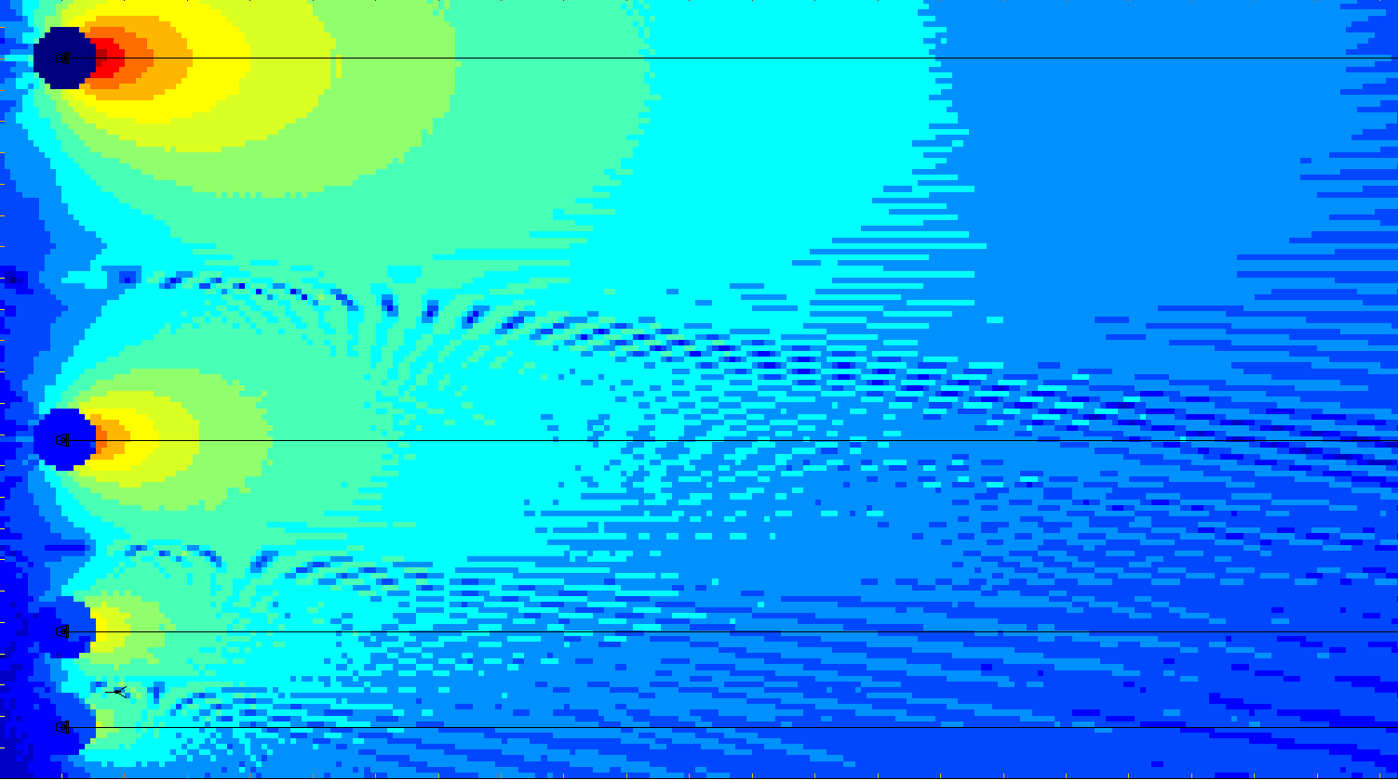
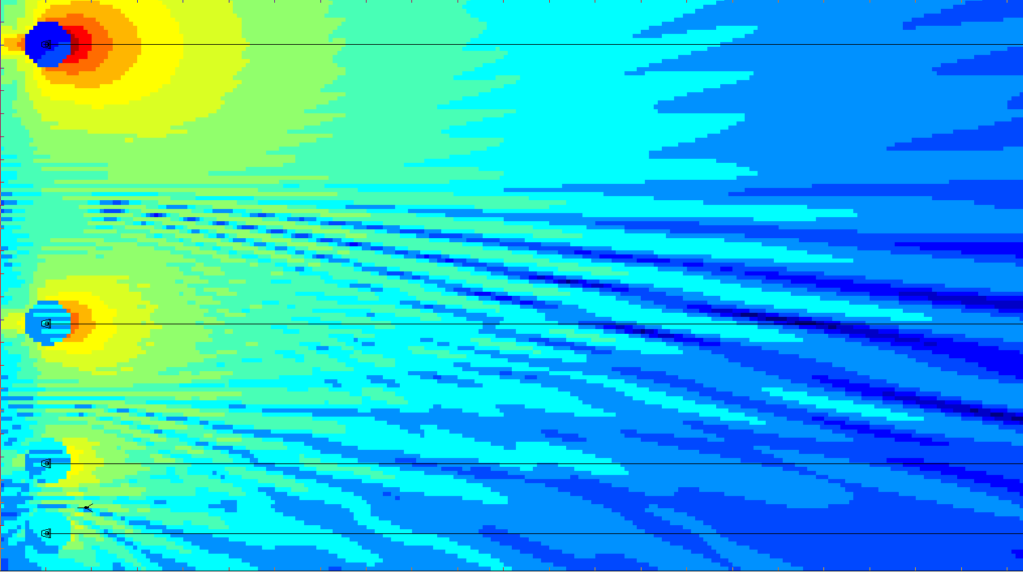
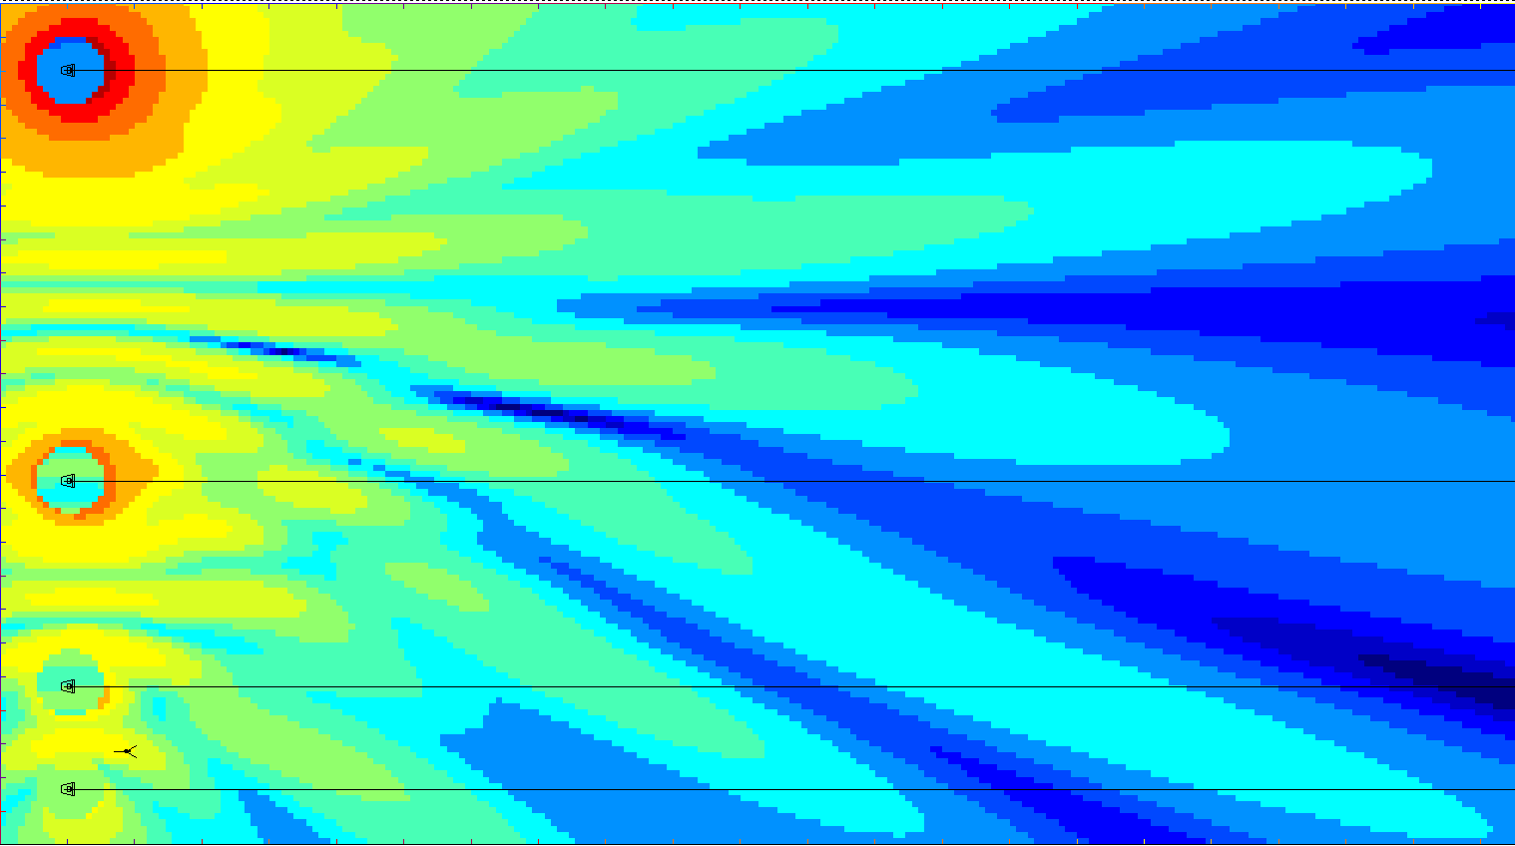
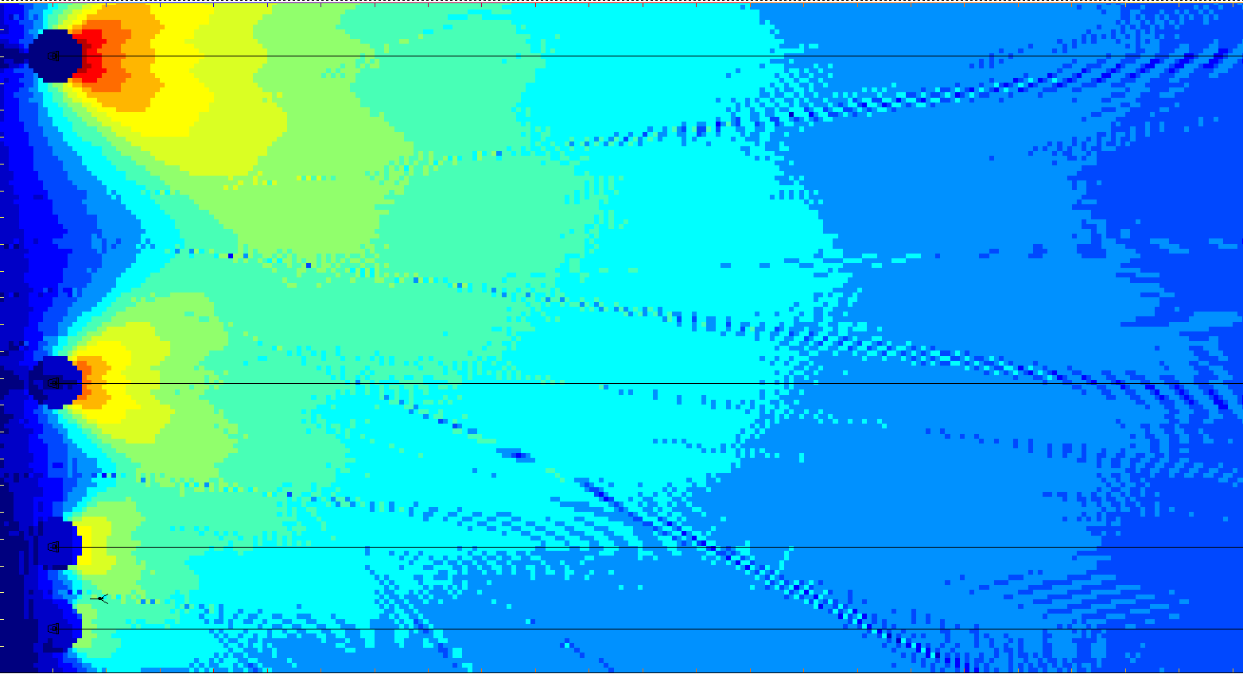
Lateral Spacing and Level Effects
Asymmetric Uncoupled Line Source Array:
Log spacing and level offsets
0 dB
-6 dB
-12 dB
-18 dB
2 kHz
8 kHz
125 Hz
500 Hz
4 x 1st order (90) Spacing is tapered by 50% as level is reduced by 6 dB 1/6th octave 21 x 42 meters
Notes:
Fig 6.38b

Slide 50
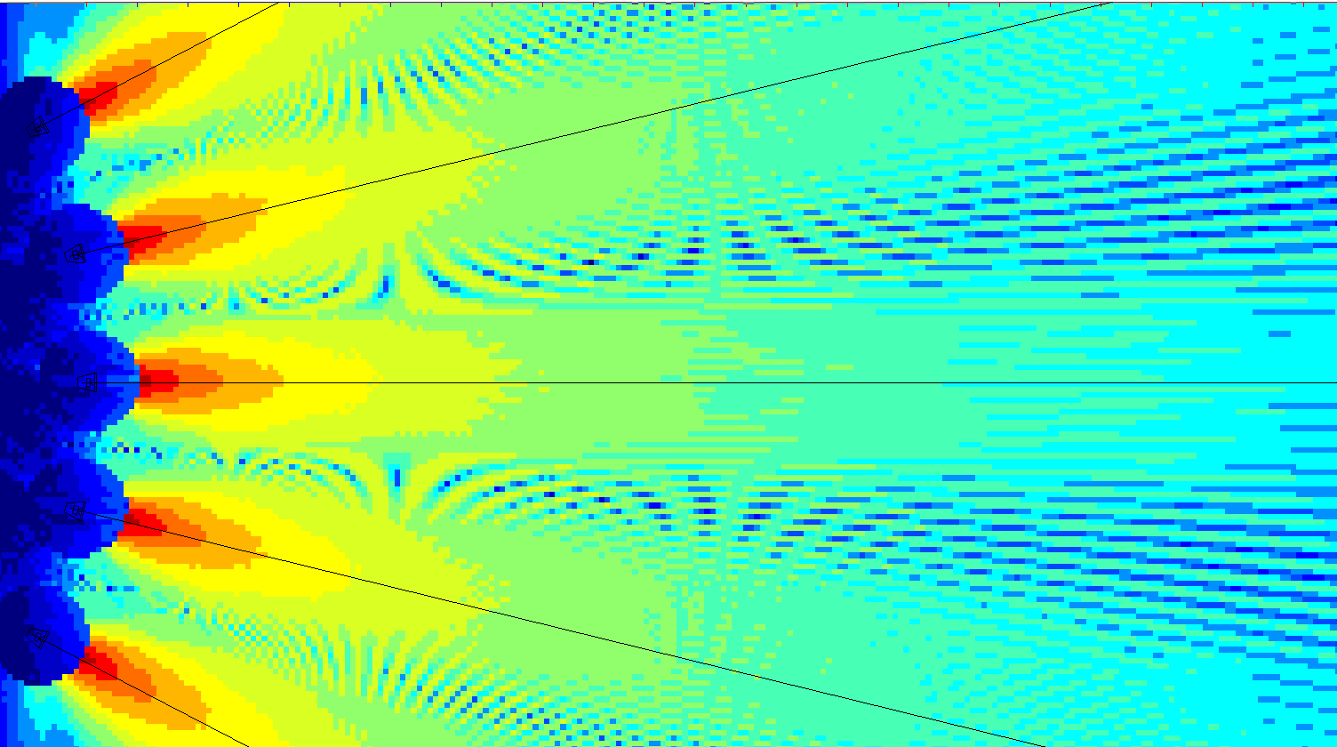
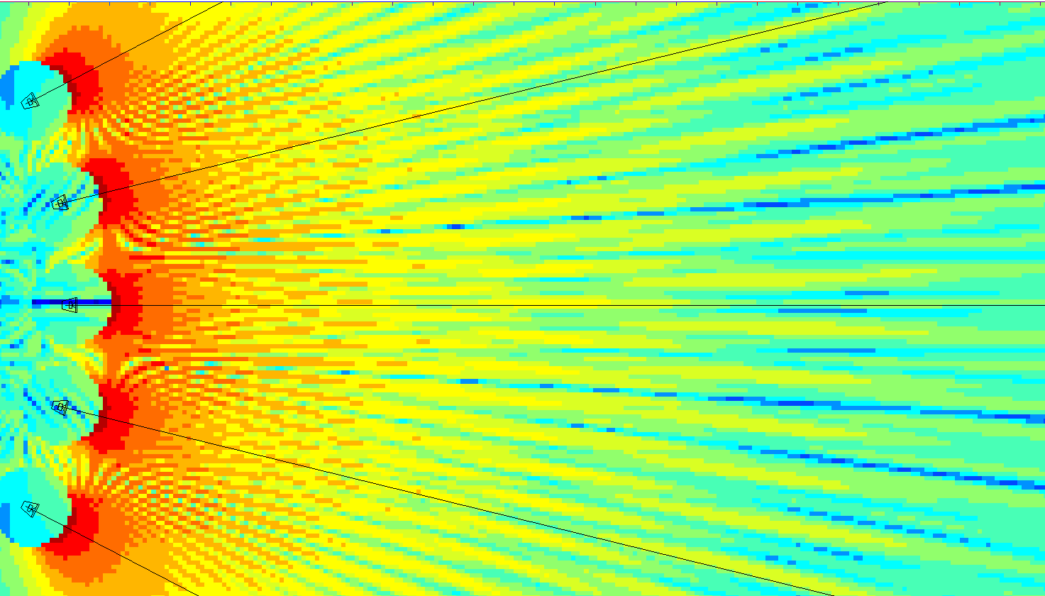
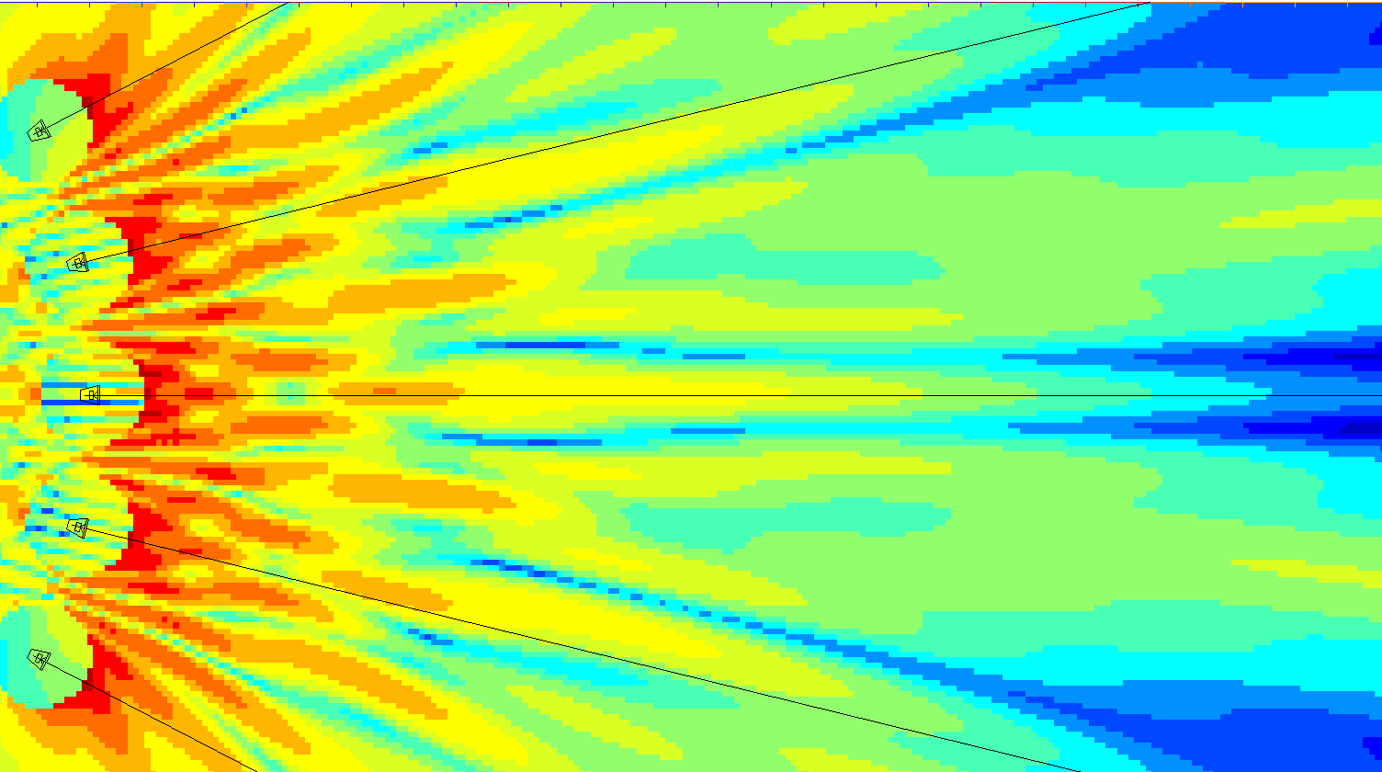
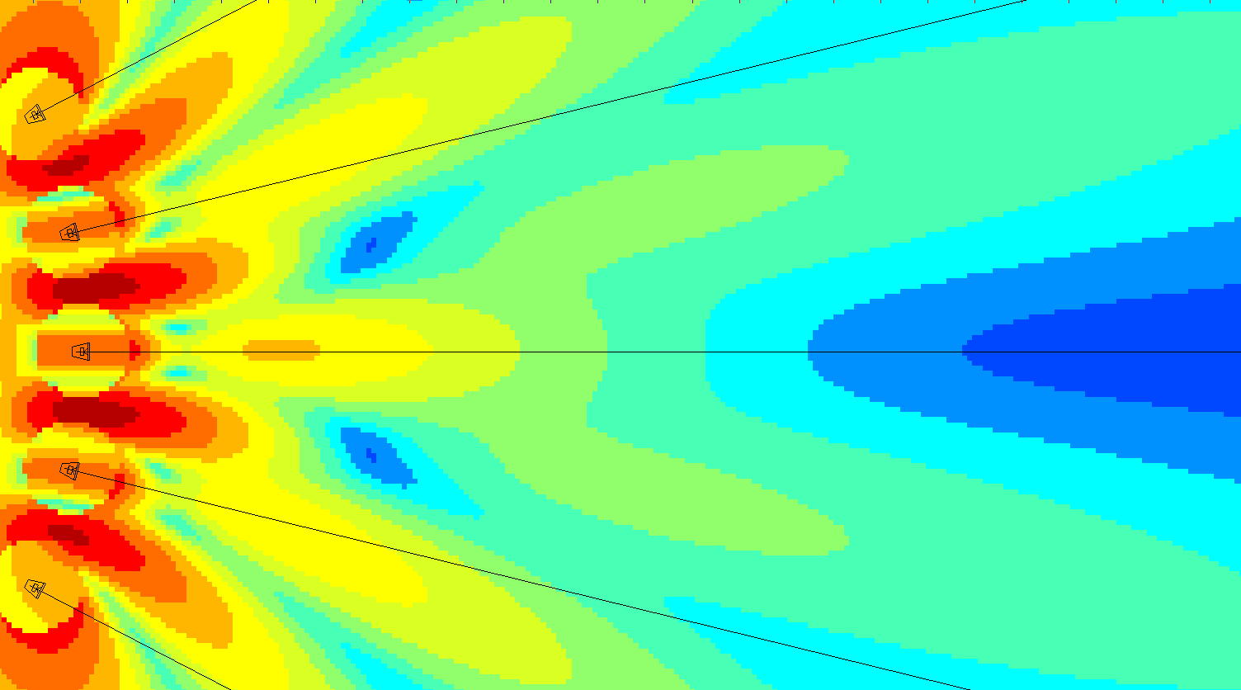
Lateral Spacing and Level Effects
Asymmetric Uncoupled Line Source Array:
33% Angular Overlap
125 Hz
500 Hz
2 kHz
8 kHz
5 uncoupled 2nd order speakers @ 2.5m spacing ( 13.5 deg of 40), 1/6th octave 12 x 24 meters
Notes:
Fig 6.38b

Slide 51
Forward Spacing and Level Effects
Asymmetric Uncoupled Point Destination Array:
Offsetting level & distance ratio effects
Single
2:1
4:1
8:1
2nd order speakers Main spkr @ 40m to crossover. Delays @ 20 m (-6 dB), 10m (-12dB) & 5m (-18 dB) respectively 1/6th oct, 6 x 40 m
Notes:
Fig 6.38b

Slide 52
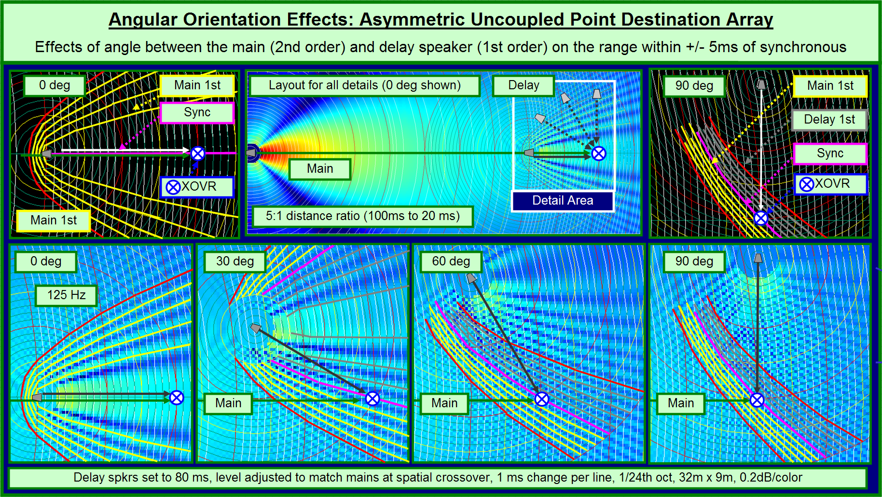

Slide 53
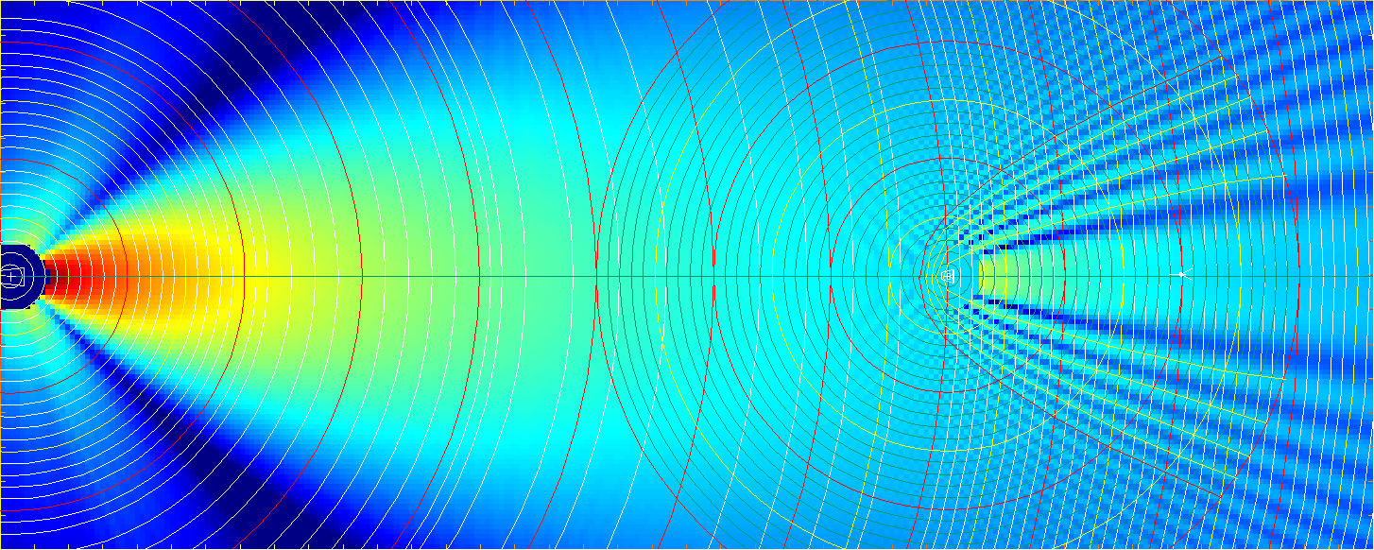
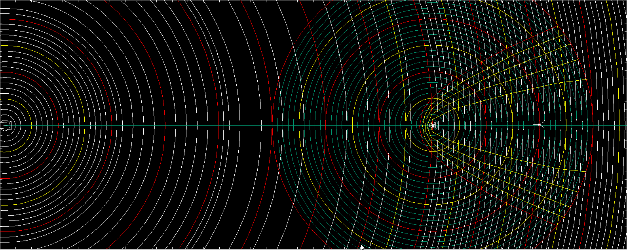
Delay Coverage: 0 degrees
0 degree angle between Main and Delay

Slide 54
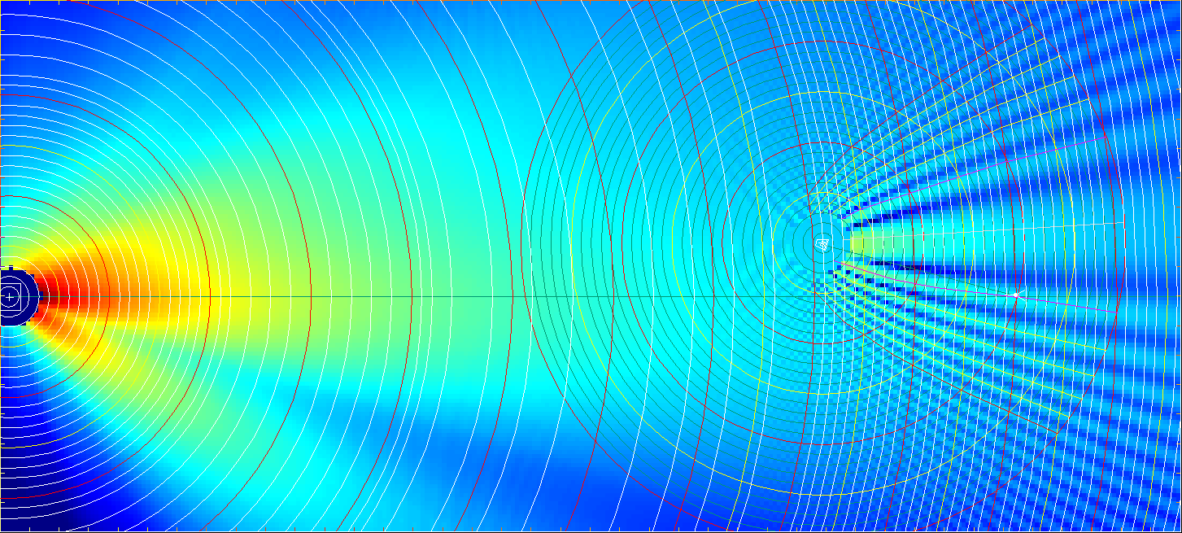
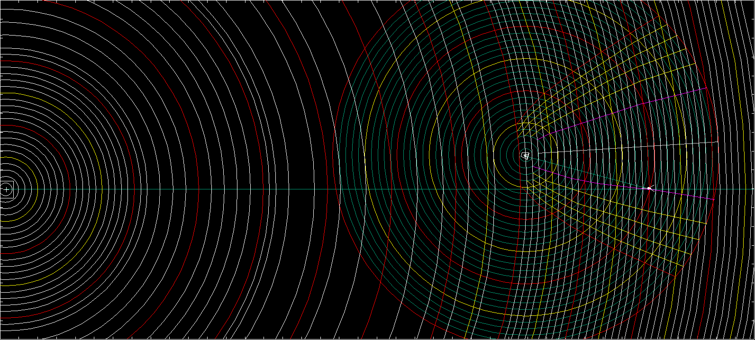
Delay Coverage: 15 degrees
15 degree angle between Main and Delay

Slide 55
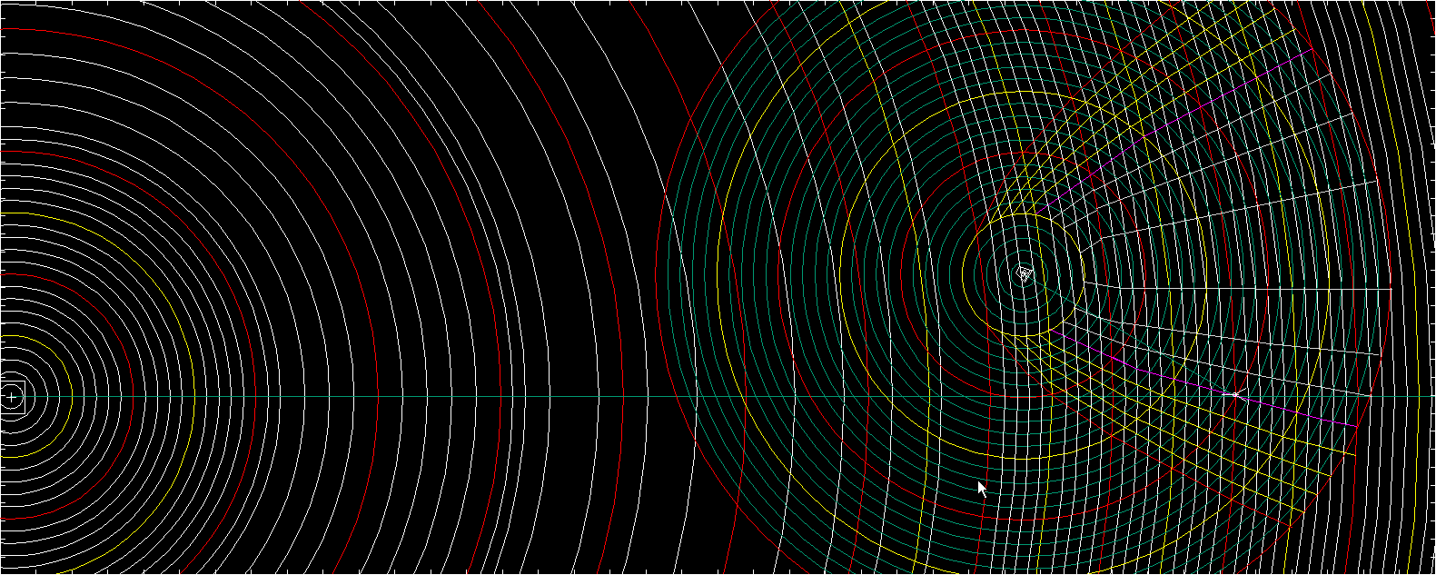
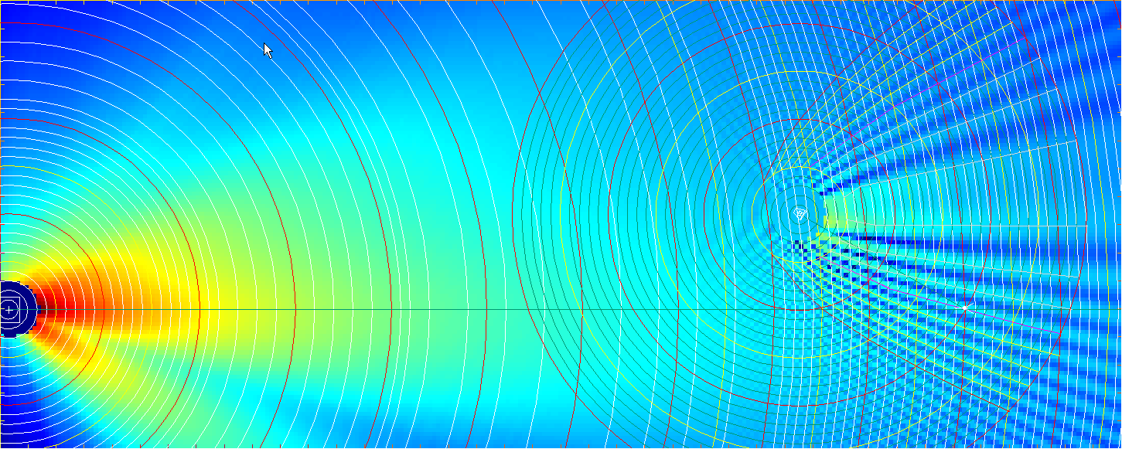
Delay Coverage: 30 degrees
30 degree angle between Main and Delay
30 degree angle between Main and Delay

Slide 56
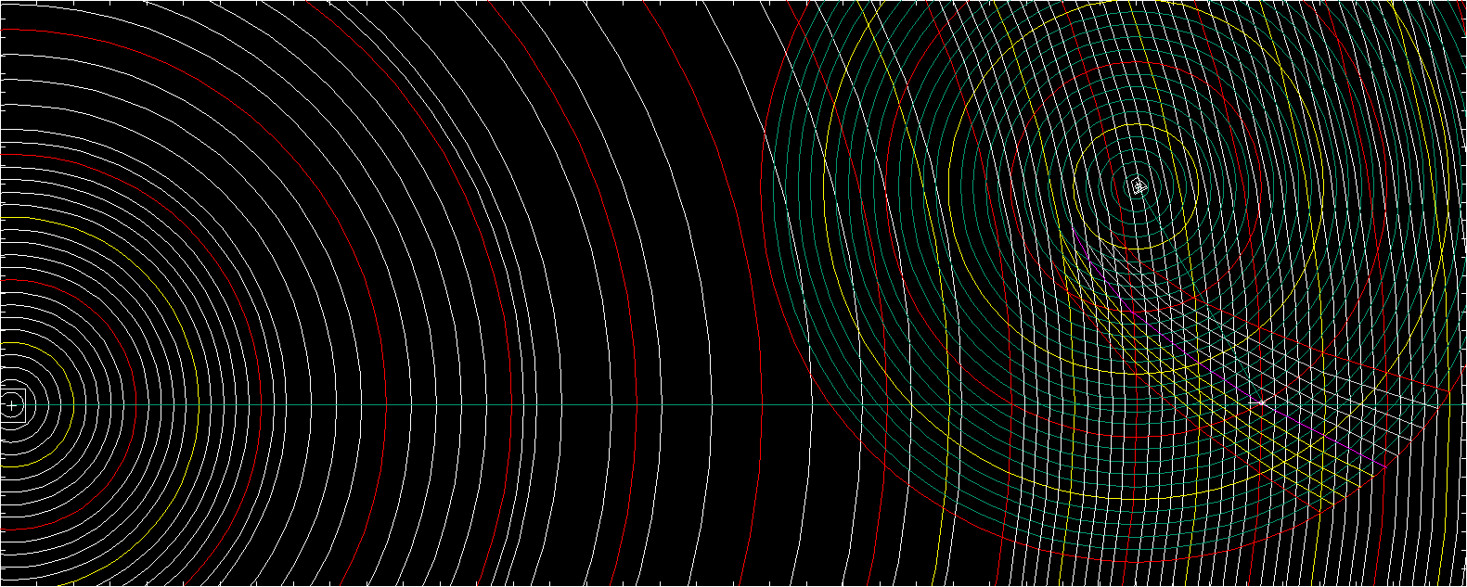
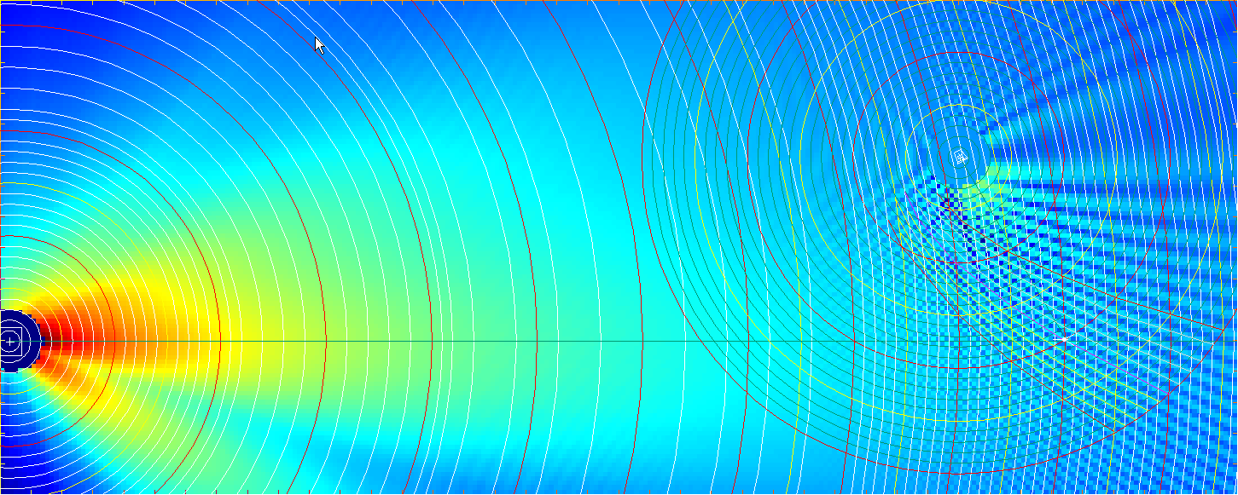
Delay Coverage: 60 degrees
60 degree angle between Main and Delay

Slide 57
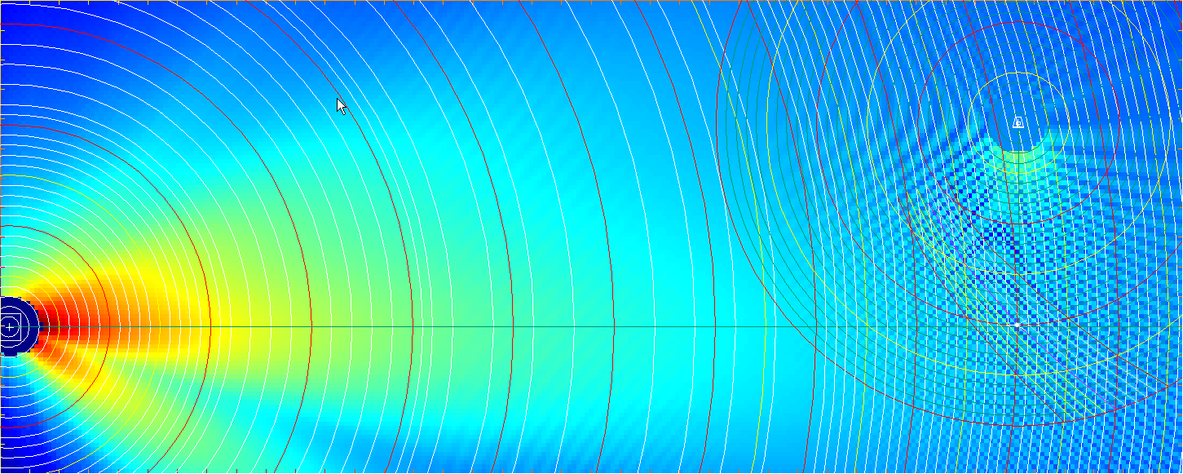
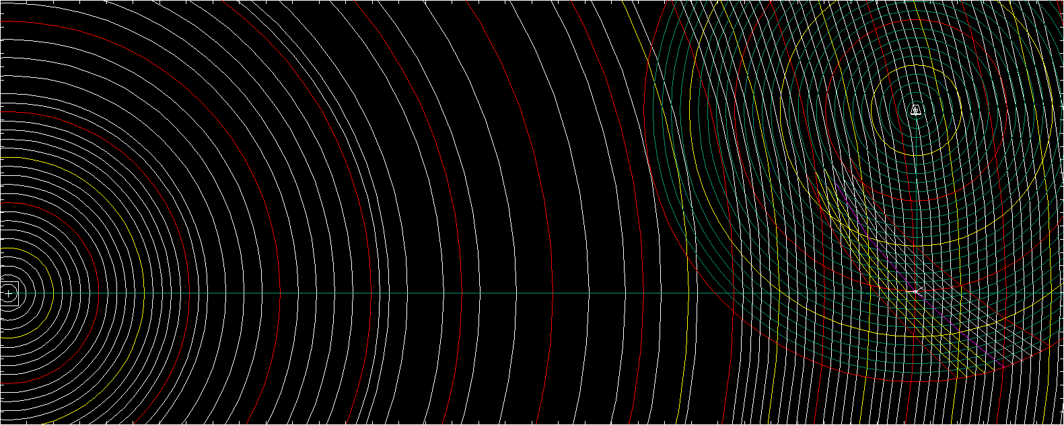
Delay Coverage: 90 degrees
90 degree angle between Main and Delay
90 degree angle between Main and Delay

Slide 58
Conclusions
First-order speakers
most suitable for single-element applications with a low proximity ratio
least suitable for angular overlap
least suitable for combination (power addition)
beamwidth must not widen as frequency rises (once plateau reached must remain constant)
should be arrayed at or near unity splay angle based on beamwidth plateau

Slide 59
Conclusions
Second-order speakers
most suitable for single-element applications with a medium proximity ratio
suitable for combination (power addition) on a limited basis
no beamwidth reversal (widening as frequency increases)
should be arrayed at or near unity splay angle based on beamwidth plateau

Slide 60
Conclusions
Third-order speakers
least suitable for single-element applications
most suitable for angular overlap
suitable for combination (power addition)
constant downward beamwidth slope (with no reversals) as frequency increases
should be arrayed at an angle greater than 0º (relative)

Slide 61
Conclusions
Power capability
coupled arrays can increase concentrated power capability beyond a single element while maintaining minimum variance over long distances
the coupled point source has the highest ratio of increased power to variance over the widest frequency span and spatial area
the coupled line source can provided “unlimited” power but is incapable of minimum spectral variance over the space

Slide 62
Conclusions
Power capability
asymmetric level tapering will decrease the overall power capability at the geometric center of the array but provide the opportunity for minimum variance over an asymmetric space
uncoupled arrays can increase distributed power capability beyond a single element while maintaining minimum variance, but only over a very limited distance

Slide 63
Minimum Variance Coverage Shapes
Rectangle: individual speaker
Arc: symmetric point source
Right triangle: asymmetric coupled point source

Slide 64
Minimum Variance Principles
Single speakers
position the speakers with the lowest possible proximity ratio to the audience in at least one plane
use speakers that have minimum beamwidth ratio over frequency (1st or 2nd order)
match the properties of symmetry
match speaker aspect ratio to audience coverage shape
if speaker coverage pattern overlap on to room surfaces is too strong, use an array instead

Slide 65
Minimum Variance Principles
Symmetric point source coupled arrays
fill the arc angle required to fit the shape of the audience area (number of elements required will depend on speaker order)
low-order speakers must have minimal overlap
high-order speakers can be overlapped for power addition
beam spreading will shape (widen) the HF coverage
beam concentration will shape (narrow) the LF coverage
apply these principles to make shapes meet in the mid-range

Slide 66
Minimum Variance Principles
Uncoupled arrays
achieve isolation by angular offset and/or displacement
as angular offset falls, the usable depth range falls as well
uncoupled array depth is initiated by overlap
before overlap, response is as a single element
after overlap begins, array behavior and ripple variance begin
uncoupled array depth is limited by overlap – multiple overlap provides the ending limit for depth
uncoupled arrays can be scaled by relative level to appropriate depth

Slide 67
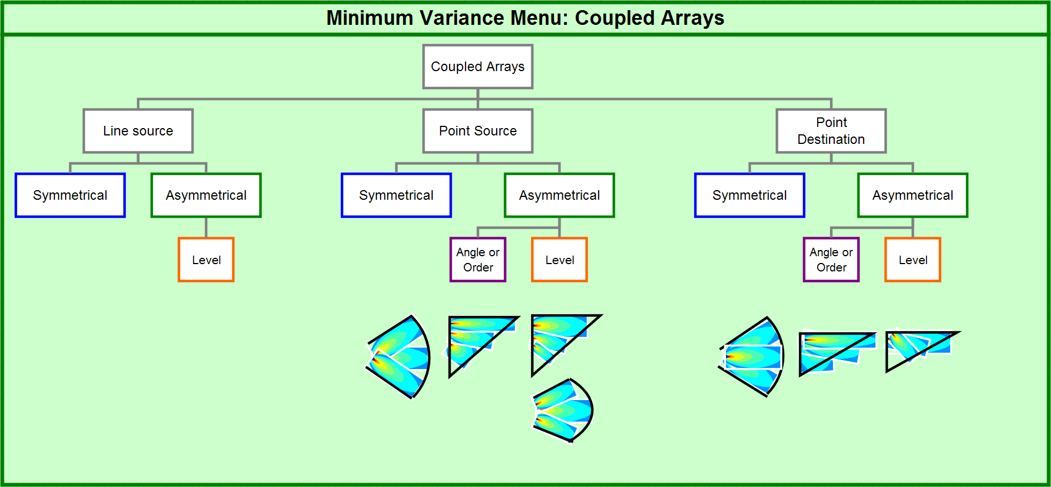

Slide 68
