Slide 1
Topics for 6/10/2024
Course overview
Course topics
Course website
Homework
eceprog
Communication
Policies
Attendance
Grades
Tester
Code Quality
Base Requirements
Academic Integrity

Slide 2
Learning Objectives
Recursion
Files
Structures
Dynamic Structures
Notes:
Topics anyone teaching ECE 264 must cover
Recursion: want to talk about problems where recursion is a good solution
Files: both text and binary files
Structures: allow storing more complex data easily
Dynamic structures: building structures with arbitrary sizes

Slide 3
Other topics
C programing language
Data representation
Strings
Memory management
Complex data structures
Preprocessor
Build automation: Makefile
ANSI color codes
Software Engineering
Writing bigger programs
Avoiding bugs
Testing and debugging
Development tools
TDD and unit testing
Code quality standards
Overall want you to achieve programming maturity and think like a programmer

Slide 4
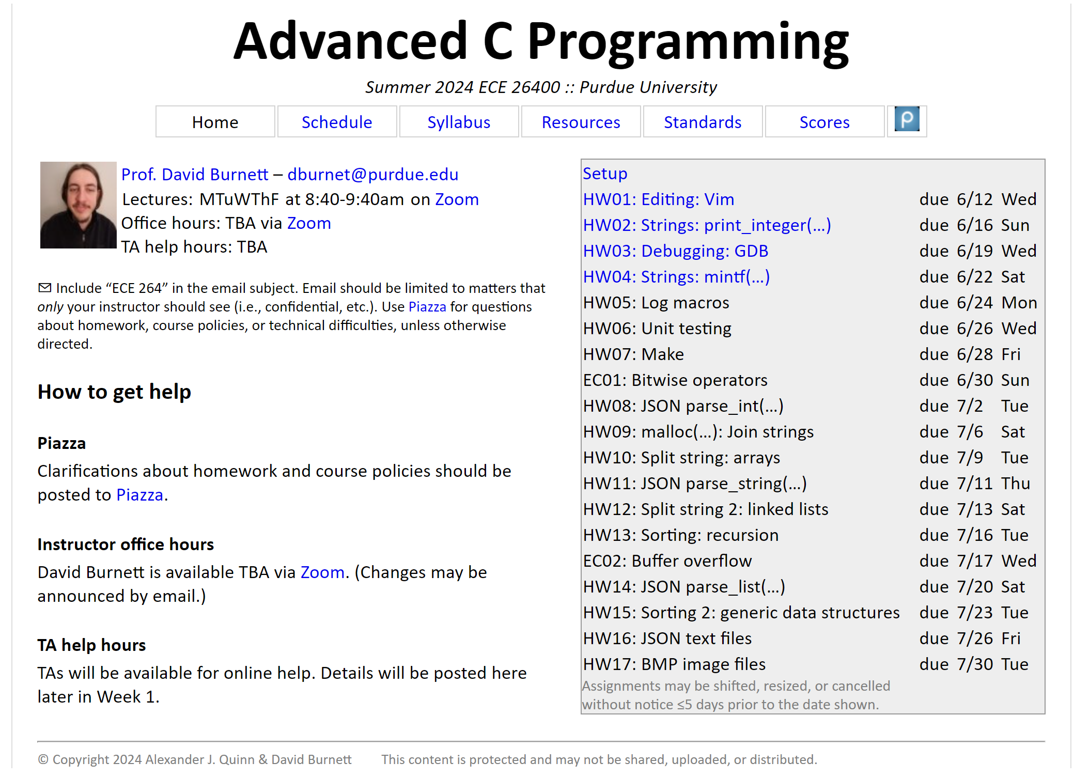
Course Website
https://engineering.purdue.edu/ece264/24su/
Notes:
Spend some time nagivating the website here, point out pages like the syllabus.

Slide 5
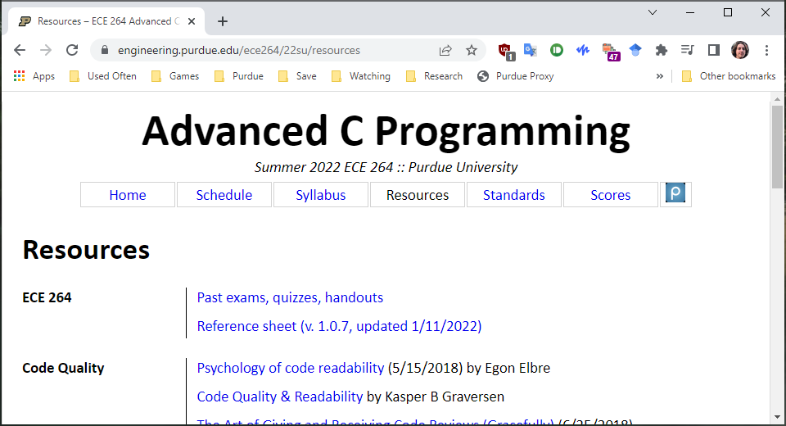
Reference sheet

Slide 6
Programming Environment
Will connect to eceprog using a SSH terminal such as PuTTY
Will use tools such as:
VIM
GCC
GDB
Valgrind
Working with ISO C11
Notes:
We are not using ececomp or ecegrid

Slide 7
eceprog
Linux server maintained by ECN
Located at eceprog#.ecn.purdue.edu
# can be 1, 2, 3, 4, 5, not sure how high it goes
Different from ececomp
If you see any class resources ecegrid or ececomp, it’s a typo

Slide 8
Homework Setup
Get:
264get hw##
Submit:
264submit hw## ##.c ##.c ##.h
Submit often!
You will not be penalized for extra submissions
Some assignments will require multiple submissions to get full credit
Pretest (optional):
264test hw##

Slide 9

Demonstration of eceprog
This slide is a reminder to me to demonstrate eceprog at this point.
Nothing else to say, so have a picture of some kittens
Notes:
Demonstrate: 264get, 264submit, 264get to restore

Slide 10
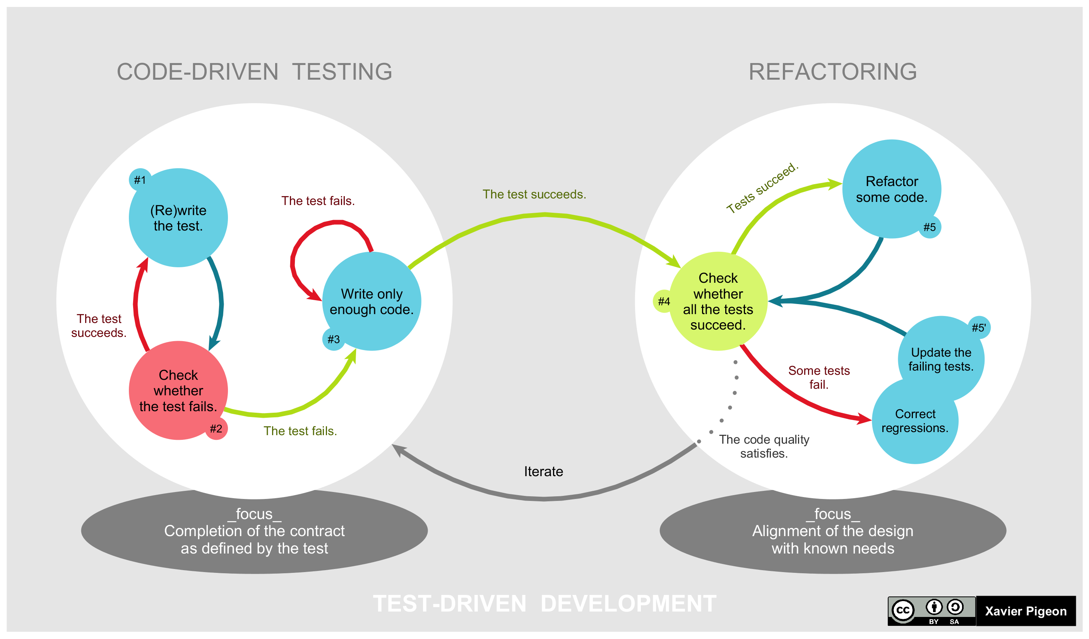

Slide 11
Topic Highlight: Test Driven Development
TDD is a methodology for coding
TDD is not about testing code, it’s about writing code
Starting with HW04, will require you use TDD
Will talk about more in depth later this week

Slide 12
Topic Highlight: Testing
Homework will be tested using hidden test cases
An important skill for any programmer is knowing how to test code
Real programs rarely come with already written test cases
We will provide program specifications, and you will come up with test cases to ensure your program meets the specification
I will give an overview of testing in the first week
To really become good at testing you need to practice

Slide 13
Homework: Pretester
Starting with HW02, many homeworks will have a pretester
Use after you are sure your code works
Not a substitute for your own testing
Not necessary to complete an assignment
100% on the pretester does not guarantee 100% on the HW
Will try to get the pretester out around 2 days before HW deadline

Slide 14
Communication
Course website
Contains homework, grades, syllabus, policies, code quality
Announcements
Sent via email and posted on Piazza
TA office hours
Instructor office hours
Piazza
Preferred over email for any questions which may benefit other students
Brightspace
Lecture lecordings
Quizzes
Participation assignments

Slide 15
Grades
Semester grade is 3 components:
80% homework, 10% quizzes, 10% attendance/participation
Homework is weighted based on number of days to complete
Weights are based on a 16-week semester
The lowest homework will not be dropped, instead letter grades have more lenient requirements
Extra credit opportunities:
Homework bug bounty
Extra credit homework

Slide 16
Attendance
Must either attend lecture or watch recorded lecture via Brightspace
Do not join office hours if you have not watched the latest lecture
If you are unable to attend class for an extended period, let me know ASAP so we can work on accommodations

Slide 17
Participation
Planning several participation assignments
Type of thing you might see as a worksheet done during class
Will be simple, and graded very leniently
Typically will be related to one of the homeworks

Slide 18
Quizzes
Will be taken though Brightspace
At least 24 hours to complete, though may have a time limit once you start
Will be over various topics from lecture
No outside resources allowed during quizzes

Slide 19
Homework grades
Most homework will have partial credit
Late homework accepted, keeps best score between each late period
Homework is due 11:59:59 PM according to the clock on ececomp (EST)
Homework submitted within 24 hours is loses 30% of possible points
Homework submitted 24-48 late hours loses 50% of possible points
Homework submitted 48-72 hours late loses 70% of possible points
Code must compile with the arguments specified on the syllabus
Memory errors (reported by Valgrind) are subject to a 40% penalty
Code quality violations may be penalized 2% per rule violated
Notes:
Briefly show how to run program in valgrind here?

Slide 20

Valgrind example
This is another placeholder slide, doing a valgrind example.
Have a puppy picture to fill up the slide

Slide 21
Tester and regrades
Majority of homework graded based on an automated tester
If you believe the tester graded you inconsistently with the homework description, you can make a regrade request
Details on regrade requests can be found on the scores page

Slide 22
Code Quality
Linked as “Standards” on course website, or directly at https://engineering.purdue.edu/ece264/24su/code_quality
Code quality is not about specific formatting
Goal is to write clean code
Clean code has fewer bugs, and makes bugs easier to debug
Clean code aids in understanding your code

Slide 23
Base requirements (important!!!)
All required files must be included in a single submission
All required files must be named as specified in the assignment description
Code must compile on ecegrid with gcc v8.3.0 (64-bit Linux) with:
-g -std=c11 -Wall -Wshadow -Wvla -Werror -pendantic
Code must run on ecegrid well enough to be tested
Code must finish in a reasonable amount of time
Function signatures and data types must match specification
Any main(…) functions must return EXIT_SUCCESS
Code must follow policy on academic integrity
Failure to meet these 8 requirements may result in zero credit

Slide 24
Academic Integrity
Do your own work, a good grade requires you learn the material well
Cheating is unfair both to those who do work honestly and to those who cheat
Cheating defeats the purpose of the course: to teach and ensure proficiency in advanced C programming
First instance of cheating may result in a 0 on the assignment
Further instances of cheating may result in an F in the class

Slide 25
Integrity Definitions
“Copying” – reproducing any kind of data (code, text, test cases, …) by any means (copy-paste, copying files, hand-typing, …) from one source to another
“Trivial modifications” – changes such as whitespace, variable names, function order, constant values, or changes that affect the appearance but not intellectural content of the material
“Attribution” – explcately acknowledging the source of copied content in the following format:
/* Credit: <author>, <description>, <url_or_location> */

Slide 26
Authorized sources
Code you have written yourself
Starter code from 264get
Names of C standard library functions and keywords
Any other source explicitly allowed by your instructor (with attribution)

Slide 27
Unauthorized sources
Code from Stackoverflow, Github, Wikipedia, or any other website
Code written by artificial intelligence, such as ChatGPT
Code from the textbook or any other book
Test cases copied from assignment descriptions
Snippets provided by the instructor (unless marked “Ok to copy/adapt”)
Code written by another student

Slide 28
Cheating
Copying code from any unauthorized source, even with trivial modifications
Allowing another student to copy your code
Using unauthorized means to altar or affect grades, submission timestamps, contents, or anything else affecting grades
Sharing your code from this class in public locations after the class, such as Github
You may retract any homework submission by emailing the instructor, Syllabus has more details

Slide 29
Grey areas
Discussing abstract ideas and high-level algorithms with TAs or other students is allowed and encouraged
Do not directly write code with other students
Helping a friend find a bug in their code
Do not directly make edits to their code and avoid suggesting specific edits
Learning from code on the web is allowed, provided you are not copying it. Abstract ideas is allowed, but not copying code
Very generic code snippets, such as how to call a function or include statements. These should not require copying as you should know them from memory
Code completion features in IDEs only if its insubstantial (e.g. names of functions or variables) or very generic. You should be capable of writing the code without code completion.

Slide 30
Questions?

