Slide 1
Objectives - 1/10/2022 (Tue)
Get acquainted with ECE 26400.
  What you will learn
  Programming environment: ecegrid
  Homework
  Resources: lab help, office hours, reference sheet
  Quizzes
  Policies: grades, code quality, base requirements, attendance, communication, academic integrity
Note: Syllabus takes precedence over information in these notes in case of inadvertent inconsistency. Please read the syllabus carefully.

Slide 2
Learning objectives
Recursion
Files
Structures
Dynamic structures
This is the bare minimum that the course must cover.

Slide 3
What you will learn
C language
Memory management
Data structures (linked lists, trees, …)
Software engineering
  Build bigger programs
  Bug avoidance
  Testing
  Debugging
Data compression
Programming maturity
Development tools
Test driven development (TDD)
Code quality
Debugging methods

Slide 4
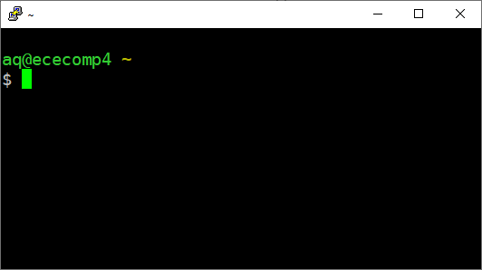


ececomp
Get starter files
Tools: vim, gcc, gdb, valgrind
Test your code
Submit homework
PuTTY or ssh
SSH
CPU
files

Slide 5
You may see “ececomp” referred to as “ecegrid”. ecegrid is an old system that we used in the past.
Some materials have not yet been updated.

Slide 6
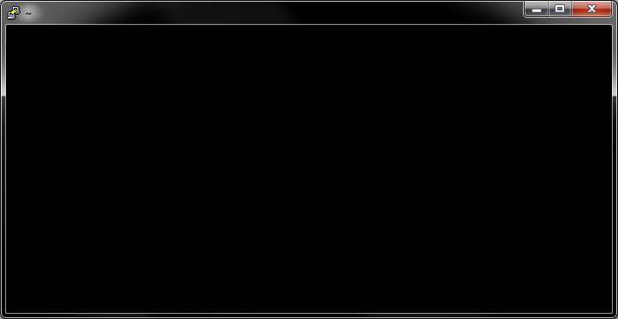
Programming environment
ececomp via SSH (PuTTY or ssh in terminal)
Linux
ISO C11
Tools: Vim 7.4 + GCC 8.3 + GDB 7.1 + Valgrind
Compile with flags given in syllabus
aq@ecegrid-thin7 ~
$

Slide 7
Homework
Get an assignment
  264get hw▒▒
Submit
  264submit hw▒▒ ▒▒.c ▒▒.c
Pre-test (optional)
  264test hw▒▒

Slide 8
Submission
  264submit hw▒▒ ▒▒.c ▒▒.c
Submit often and early
You do not need to be anywhere near finished
Submission creates a backup of your work
To restore
264get --help
… and the follow directions

Slide 9
Pre-test
  264test hw▒▒
Starting with HW02
  HW01 is special; see description
Use only after your own testing determines you are done
Pretester is optional and never necessary
Typically available ≈2 days before deadline
“Best effort” → not guaranteed
Works on your most recent submission
May not catch everything; expect some “false negatives”

Slide 10
Resources
Reference sheet
Lab hours: Zoom + Google Form
Office hours: Zoom
Piazza
Web site: aq.gs/264
There may be changes. Watch your email.
aq.gs/264

Slide 11
Grading
Homework: 90%
  Weighted by the number of calendar days given, except where otherwise noted
  Extending a deadline will increase its weight, except where otherwise noted
  HW01 will be weighted as “4-day assignment”
Quizzes: 10%
+ Bonus
+ Participation
There will be no exams for this section. We will likely have a homework due in the last week.
aq.gs/264

Slide 12
Attendance is required.

Slide 13
Code quality
Write clean code from the start
  Prevents some types of bugs
  Makes other bugs easier to find
  Helps you understand code in the morning
Enables others to help you
  Course staff will not assist with sloppy code
Read Code Quality Standards
  −2% per rule violated (to the extent that we can detect)
Writing clean code is an acquired skill.
aq.gs/264

Slide 14
Code quality
Write clean code from the start
  Prevents some types of bugs
  Makes other bugs easier to find
  Helps you understand code in the morning
Enables others to help you
  Course staff will not assist with sloppy code
Read Code Quality Standards
  −2% per rule violated
Writing clean code is an acquired skill.
aq.gs/264

Slide 15
⚠

Slide 16
⚠ Base requirements
All required files must be included in a single submission.
All required files must be named exactly as specified in the assignment description.
Code can be compiled (as is) on ecegrid with gcc v7.1.0 (64-bit Linux) and the following parameters: -g -std=c11 -Wall -Wshadow -Wvla -Werror -pedantic -DNDEBUG -Wno-unused-function.
Code can run on ececomp well enough to be tested.
Code finishes in a reasonable amount of time (e.g., 2.0 seconds for most assignments)
Function signatures and data types match the specification in the assignment description.
Any main(…) function must return EXIT_SUCCESS.
⚠ ZERO credit if you fail to meet any of the base requirements.
aq.gs/264

Slide 17




⚠ Cheating
Cheating includes:
Copying code from written by other people
  other students
  the web
  the instructor (unless explicitly authorized in writing)
Dishonest conduct
  e.g., attempting to access exam contents, etc.
Helping others to cheat
  Posting your code publicly online (e.g., GitHub)
  Sharing your code with others
Attempting to do any of the above
Doing any of this during or after the semester

Slide 18
⚠ Cheating
Penalties:
Very minor (e.g., copying 1-3 lines from the
web on a homework)
  0 on assignment
Others:
  F in the course
All instances will be referred to the
Office of Student Rights and Responsibilities
Full penalties will be applied for the first offense.
Penalties may be applied any time cheating is discovered.

Slide 19
/⚠

Slide 20
⚠ Read the syllabus carefully.
We will assume you have read the syllabus.
These slides are not comprehensive.

