Slide 1
Objectives for Thu 10/19/2023
Trees
terminology
AVL trees
Credit: Andrew H Jones and Cheng-Kok Koh created most of the content in these slides.

Slide 2
Tree terminology
node | -
edge | -
child (node) | -
parent (node) | -
root (of tree) | node with no parent
root (of subtree) | node with no parent in that subtree
leaf (node) | node with no children
degree (of a node) | number of children
degree (of a tree) | maximum degree of any node in the tree
size (of a tree) | number of nodes
depth (of a node) | number of edges between this node and the root
height (of a tree) | maximum depth of any leaf in the tree
balanced tree | tree where depths of all leaves are different by no more than 1
binary tree | tree with degree 2

Slide 3
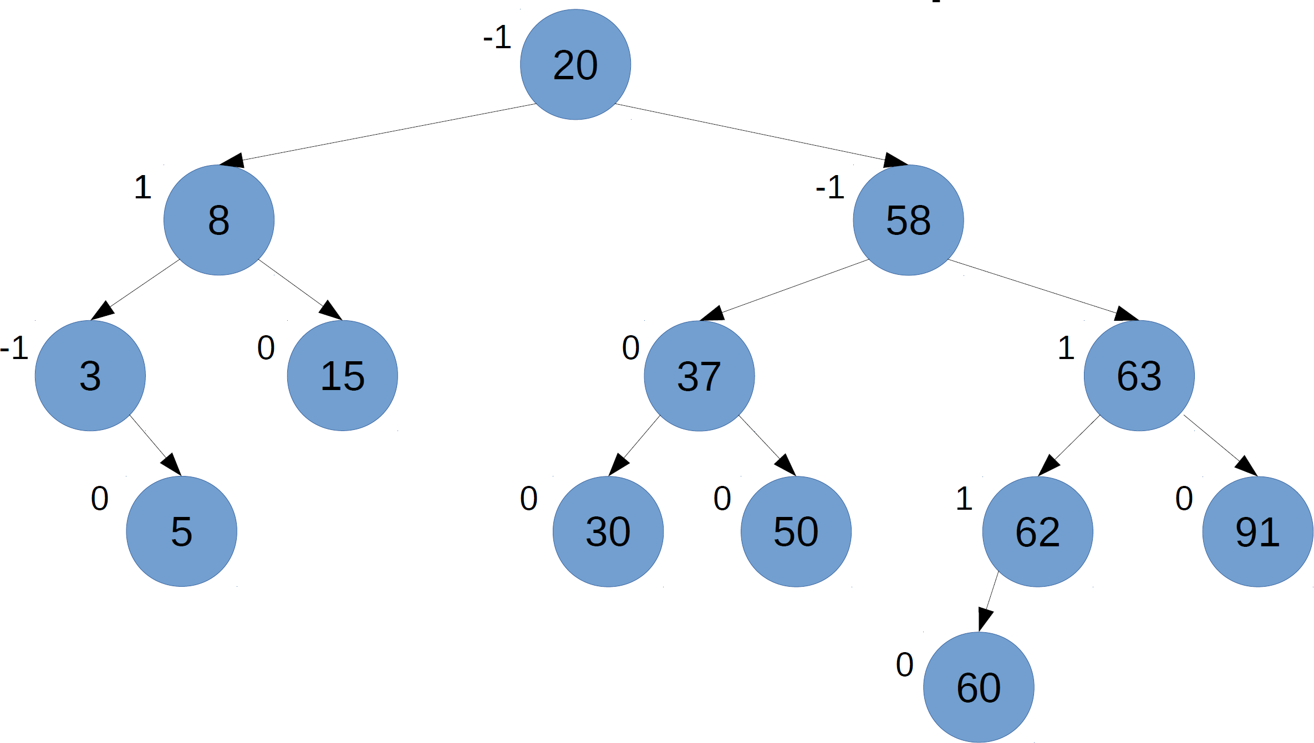
Balanced tree

Slide 4
Goal: Keep BST balanced

Slide 5
AVL Trees
After insert(…) (or delete(…))…
Preserve balance
Preserve BST property (values < are ←, values > are →)
No duplicates allowed (for now)
Rotate as needed to keep balance.
Counter-clockwise (aka "left") rotation
Clockwise (aka "right") rotation

Slide 6
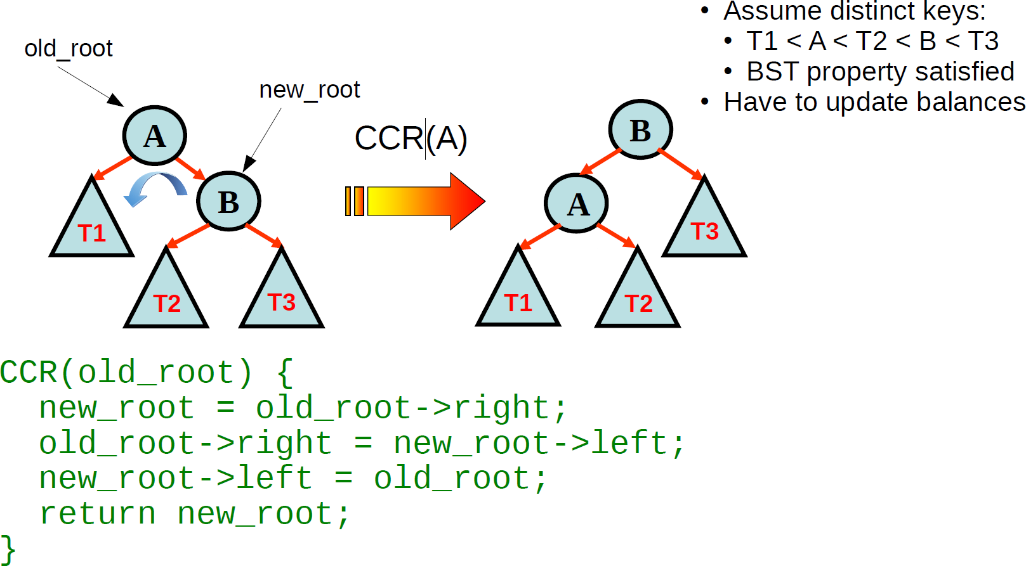
Counter-clockwise (left) rotation

Slide 7
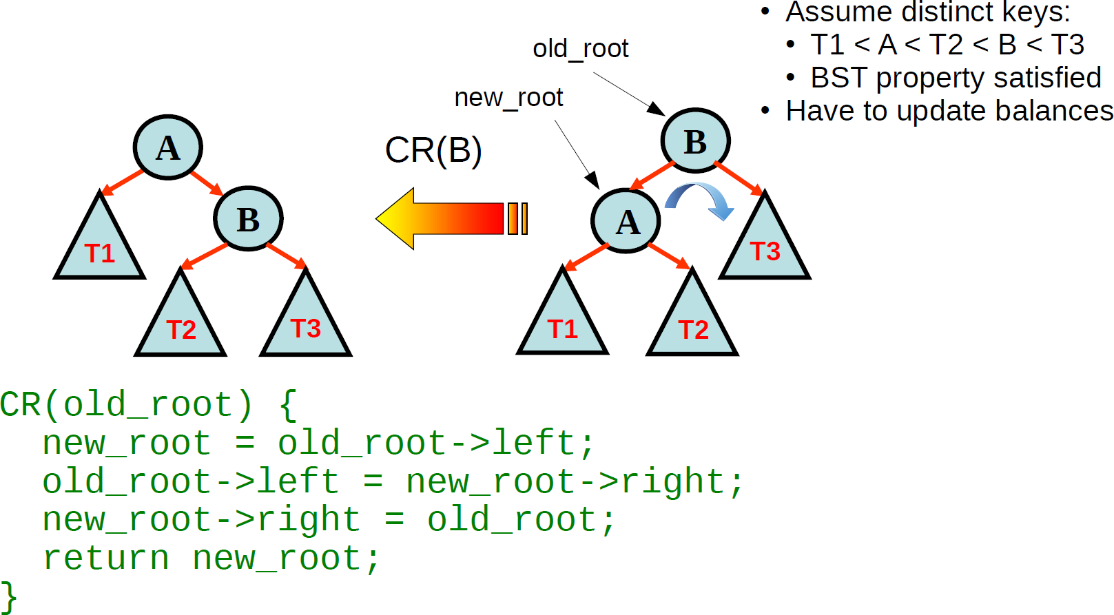
Clockwise (right) rotation

