Slide 1
Topics for 6/13/2022
Course overview
Course topics
Course website
Homework
ecegrid
Communication
Policies
Attendance
Grades
Tester
Code Quality
Base Requirements
Academic Integrity

Slide 2
Learning Objectives
Recursion
Files
Structures
Dynamic Structures

Slide 3
Other topics
C programing language
Data representation
Strings
Memory management
Complex data structures
Preprocessor
Build automation: Makefile
ANSI color codes
Software Engineering
Writing bigger programs
Avoiding bugs
Testing and debugging
Development tools
TDD and unit testing
Code quality standards
Overall want you to achieve programming maturity and think like a programmer

Slide 4
Programming Environment
Will connect to ecegrid using a SSH terminal such as PuTTY
Will use tools such as:
VIM
GCC
GDB
Valgrind
Working with ISO C11

Slide 5
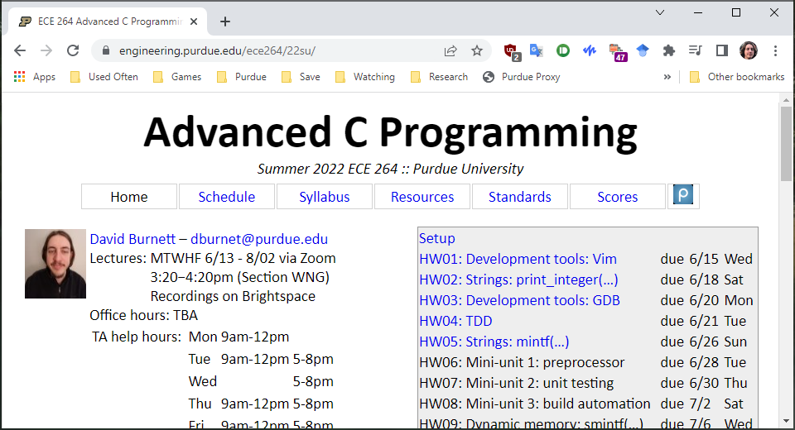
Course Website
https://engineering.purdue.edu/ece264/22su/

Slide 6
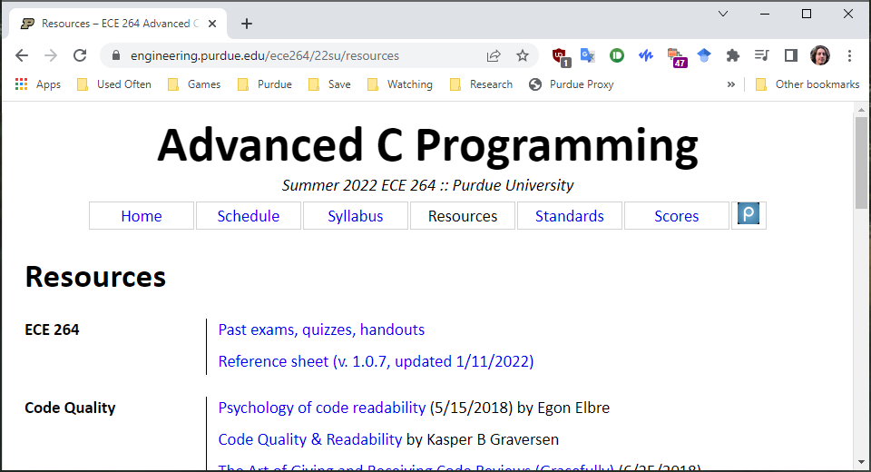
Reference sheet

Slide 7
Homework Setup
Get:
264get hw##
Submit:
264submit hw## ##.c ##.c ##.h
Submit often! You will not be penalized for extra submissions
Pretest (optional):
264test hw##

Slide 8
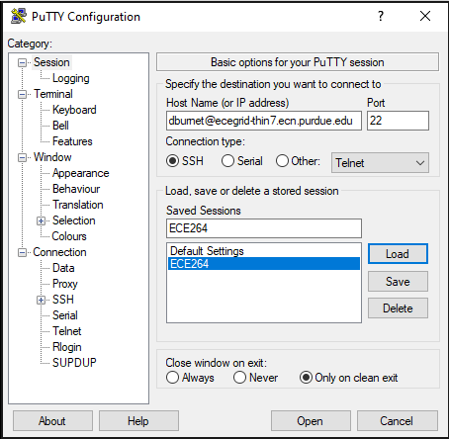
Logging into PuTTY

Slide 9
Downloading homework

Slide 10
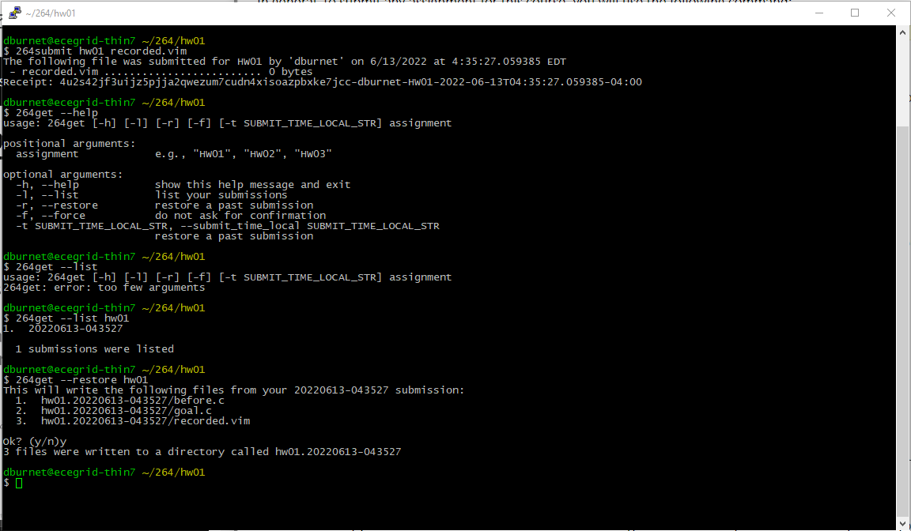
Submitting and restoring

Slide 11
Pretester
Starting with HW02, many homework will have a pretester
Use after you are sure your code works
Not a substitute for your own testing
Not necessary to complete an assignment
100% on the pretester does not guarantee 100% on the HW
Will try to get the pretester out around 2 days before HW deadline

Slide 12
Communication
Course website
Contains homework, grades, syllabus, policies, code quality
Announcements
Sent via email and posted on Piazza
TA office hours
Instructor office hours
Piazza
Preferred over email for any questions which may benefit other students
Brightspace
Mostly unused, will contain mostly lecture recordings

Slide 13
Attendance
Must either attend lecture or watch recorded lecture via Brightspace
Do not join office hours if you have not watched the latest lecture
If you are unable to attend class for an extended period of time, let me know ASAP so we can work on accomidations

Slide 14
Grades
Semester grade is based entirely on homework
Homework is weighted based on number of days to complete
Weights are based on a 16-week semester
The lowest homework will not be dropped, instead letter grades have more lenient requirements
Extra credit opportunities:
Homework bug bounty
Extra credit homework

Slide 15
Grades (cont.)
Many homework will have partial credit
Late homework accepted, keeps best score between each late period
Homework is due 11:59:59 PM according to the clock on ecegrid (EST)
Homework submitted within 24 hours is loses 30% of possible points
Homework submitted 24-72 late hours loses 50% of possible points
Homework submitted 72-100 hours late loses 70% of possible points
Code must compile with the arguments specified on the syllabus
Memory errors (reported by Valgrind) are subject to a 40% penalty
Code quality violations may be penalized 2% per rule violated

Slide 16
Tester and regrades
Majority of homework graded based on an automated tester
If you believe the tester graded you inconsistently with the homework description, you can make a regrade request
Details on regrade requests can be found on the scores page

Slide 17
Code Quality
Linked as “Standards” on course website, or directly at https://engineering.purdue.edu/ece264/22su/code_quality
Code quality is not about specific formatting
Goal is to write clean code
Clean code has fewer bugs, and makes bugs easier to debug
Clean code aids in understanding your code

Slide 18
Base requirements (important!!!)
All required files must be included in a single submission
All required files must be named as specified in the assignment description
Code must compile on ecegrid with gcc v8.3.0 (64-bit Linux) with:
-g -std=c11 -Wall -Wshadow -Wvla -Werror -pendantic
Code must run on ecegrid well enough to be tested
Code must finish in a reasonable amount of time
Function signatures and data types must match specification
Any main(…) functions must return EXIT_SUCCESS
Code must follow policy on academic integrity
Failure to meet these 8 requirements may result in zero credit

Slide 19
Academic Integrity
Do your own work, a good grade requires you learn the material well
Cheating is unfair both to those who do work honestly and to those who cheat
Cheating defeats the purpose of the course: to teach and ensure proficiency in advanced C programming
First instance of cheating may result in a 0 on the assignment
Further instnaces of cheating may result in an F in the class

Slide 20
Integrity Definitions
“Copying” – reproducing any kind of data (code, text, test cases, …) by any means (copy-paste, copying files, hand-typing, …) from one source to another
“Trivial modifications” – changes such as whitespace, variable names, function order, constant values, or changes that affect the appearance but not intellectural content of the material
“Attribution” – explcately acknowledging the source of copied content in the following format:
/* Credit: <author>, <description>, <url_or_location> */

Slide 21
Authorized sources
Code you have written yourself
Starter code from 264get
Names of C standard library functions and keywords
Any other source explicitly allowed by your instructor (with attribution)

Slide 22
Unauthorized sources
Code from Stackoverflow, Github, Wikipedia, or any other website
Code from the textbook or any other book
Test cases copied from assignment descriptions
Snippets provided by the instructor (unless marked “Ok to copy/adapt”)
Code written by another student

Slide 23
Cheating
Copying code from any unauthorized source, even with trivial modifications
Allowing another student to copy your code
Using unauthorized means to altar or affect grades, submission timestamps, contents, or anything else affecting grades
Sharing your code from this class in public locations after the class, such as Github
You may retract any homework submission by emailing the instructor, Syllabus has more details

Slide 24
Grey areas
Discussing abstract ideas and high-level algorithms with TAs or other students is allowed and encouraged
Do not directly write code with other students
Helping a friend find a bug in their code
Do not directly make edits to their code and avoid suggesting specific edits
Learning from code on the web is allowed, as long as you are not copying it. Abstract ideas is allowed, but not copying code
Very generic code snippets, such as how to call a function or include statements. These should not require copying as you should know them from memory

Slide 25
Questions?

