Slide 1
Loudspeaker Response Curves
ENGR 103-10
Fall 2013

Slide 2
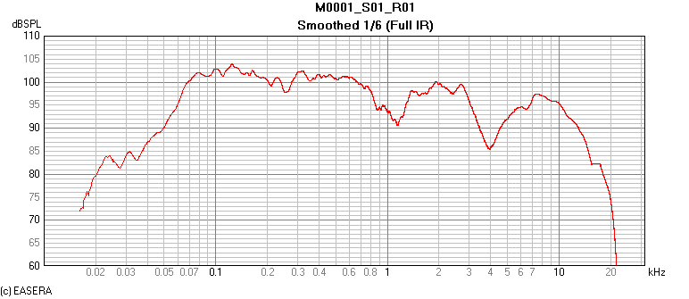
Lavender Team

Slide 3
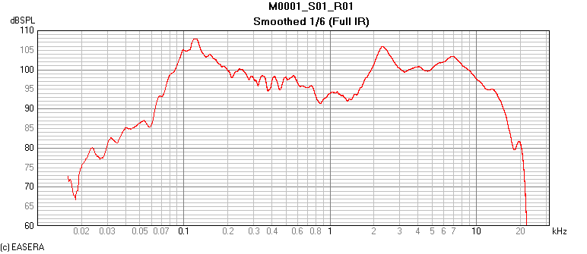
Sonic Blue Team

Slide 4
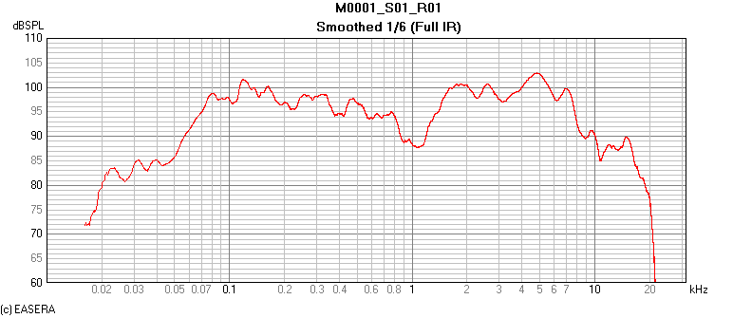
Yellow Team

Slide 5
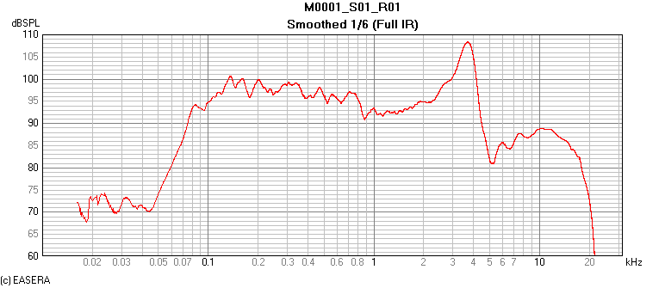
Green Team

Slide 6
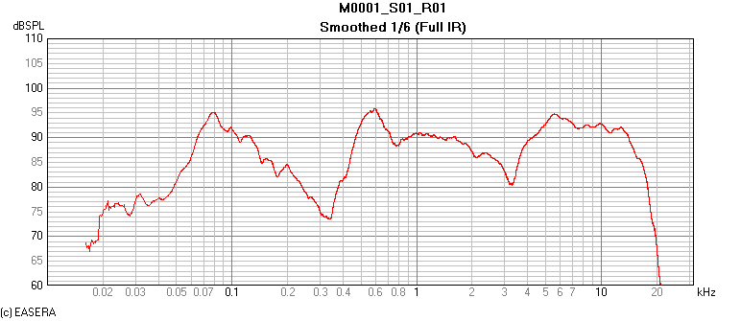
Pink Team

Slide 7
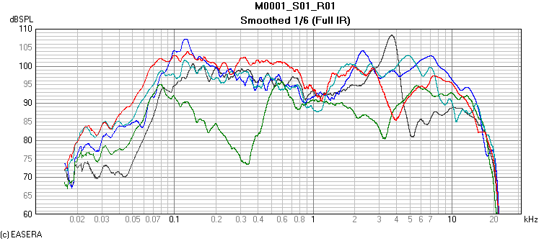
Composite – Equal Drive Level
– YELLOW
– GREEN
– PINK
– BLUE
– LAVENDAR

