Slide 1
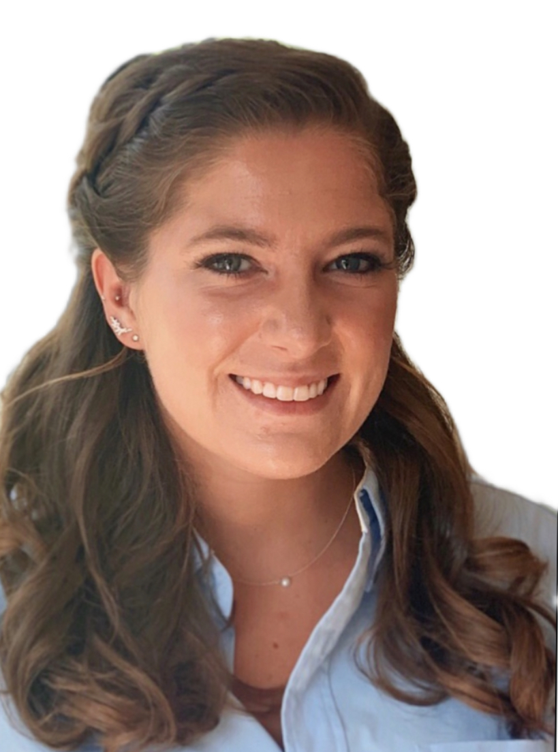
THE PURDUE LECTURE HALL SERIES
Thursday, March 24, 2022
Purdue University
Topic: Drug Development for Neisseria gonorrhoeae
Guest Speaker: Molly Youse
PhD candidate
Medicinal Chemistry and Molecular Pharmacology
I am a graduate student at Purdue University studying drug design and development in the Medicinal Chemistry and Molecular Pharmacology department. This talk will explain my research findings thus far in my PhD career. My research focuses on developing antibiotics that target the bacteria Neisseria gonorrhoeae. This research includes synthesizing molecules and testing them to assess their binding to proteins and their ability to enter and kill bacterial cells. This research is relevant because antibiotic resistance is on the rise. Thus, new drugs are needed to treat infections. I will also discuss how and why I decided to attend Purdue for graduate school, including my undergraduate research and previous job experiences. I hope to inspire students who are interested in studying sciences and to provide a glimpse into what their futures can hold.
Molly is a PhD candidate in the Medicinal Chemistry and Molecular Pharmacology department at Purdue University in Dr. Dan Flaherty’s research group. Molly earned her bachelor’s degree in chemistry from Vassar College in 2019. Upon graduating with a PhD, Molly plans to pursue a career in the pharmaceutical industry to find new therapeutics for infectious diseases.
Molly Youse
PhD candidate

