Slide 1
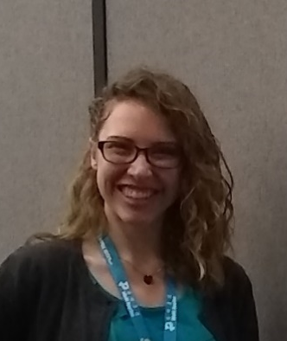

THE PURDUE LECTURE HALL SERIES
Thursday, November 14th, 2019 @ 7pm
Purdue University, LILY 1105
(915 W State St, West Lafayette, IN 47907)
Topic: The link between diet and Parkinson’s disease
Guest Speaker: Rachel Foguth, PhD candidate, School of Health Sciences
Parkinson’s disease is the second most common neurodegenerative disease, affecting over 10 million people worldwide. However, less than 10% of cases are known to be caused by genetic mutations; therefore, we are interested in finding environmental factors that could increase the risk of getting Parkinson’s disease. My research specifically focuses on compounds that are formed in your food or that are in drinking water and how they affect the brain, especially the systems affected in Parkinson’s disease. I will talk about my journey to graduate school, some of the research I am currently working on, and what I plan on doing when I graduate. I hope to spark an interest in science, and especially the brain, in the attendees so science can progress even further!
.
Background: Rachel is a PhD candidate in Dr. Jason Cannon’s laboratory. In the lab, they study chemicals found in the diet, such as in food or contaminated water, that are increasing risk of neurodegenerative diseases like Parkinson’s disease. Rachel got her B.S. in biochemistry at Benedictine College in Atchison, KS.
Rachel Foguth
PhD Candidate
Notes:
Please let me know a title for your talk. For example, “Viruses have a limited genomic capacity” could be “viruses have small genomes and must rely on the host they infect…..”

