Slide 1
Privacy-Preserving Deep Learning
Shokri (U Texas), Reza and Shmatikov (Cornell)
Proceedings of the 22nd ACM SIGSAC conference on computer and communications security, 2015

Slide 2
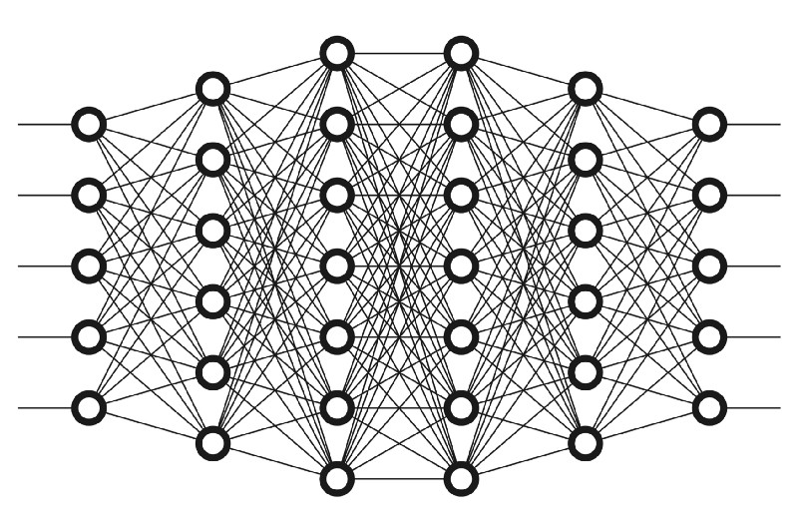
Background
Success of DL techniques is directly proportional to the amount of data available
Centralized data collection poses obvious privacy issues
Notes:
‹#›

Slide 3
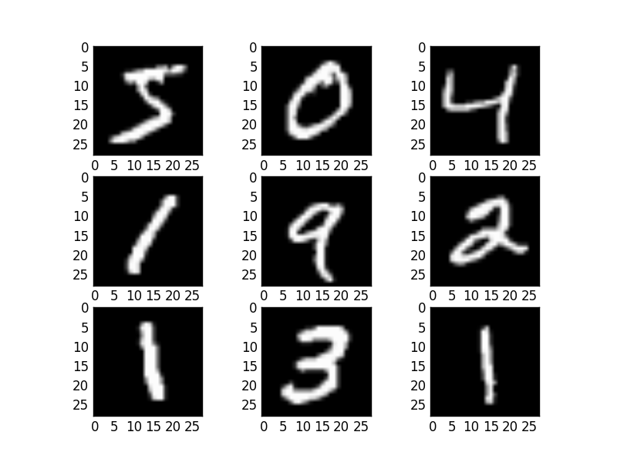
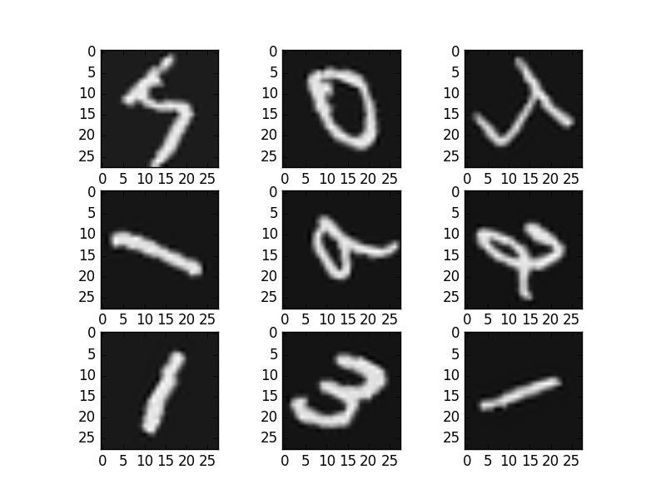
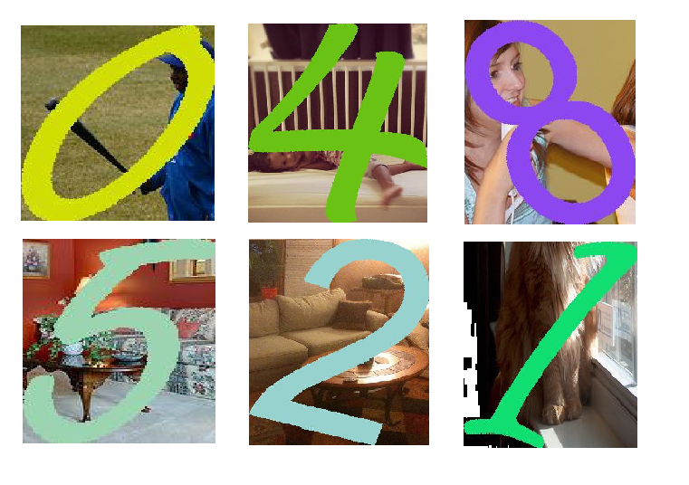
Effect of data size
More data implies monopoly in the AI industry, users benefit from new services
Less data can cause overfitting: Data augmentation techniques used
Coverage is still small

Slide 4
Motivation
Allow multiple clients to share data – Privacy concerns
Companies keep the data forever, user has no control
Images and voice recordings could contain sensitive information
Centrally kept data is subject to extra-judicial surveillance
Sharing medical data may be restricted by law
Privacy and confidentiality restrictions reduce utility

Slide 5
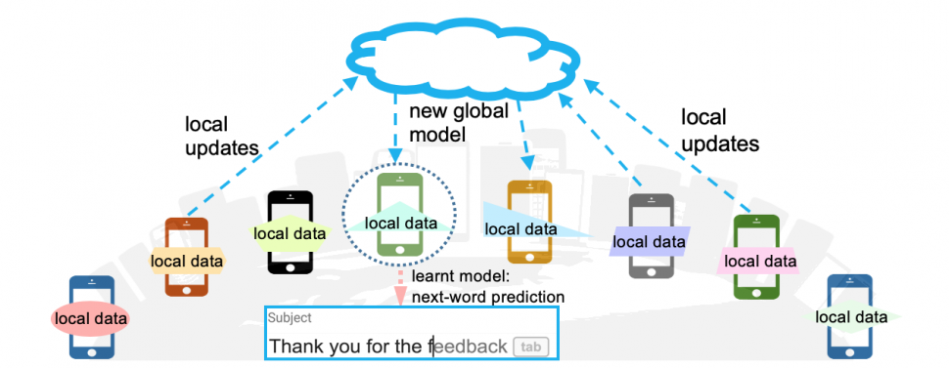
Solution proposed
A distributed system that enables multiple parties with a common objective to jointly learn a neural network model without sharing their input data sets

Slide 6
Key Idea
Aggregation: Selectively sharing small subsets of model’s key parameters during training
Interleaved with local parameter updates during stochastic gradient descent
Generalized protocol: built on top of the learning algorithm
Win-win for all
Trade-off between utility and privacy

Slide 7
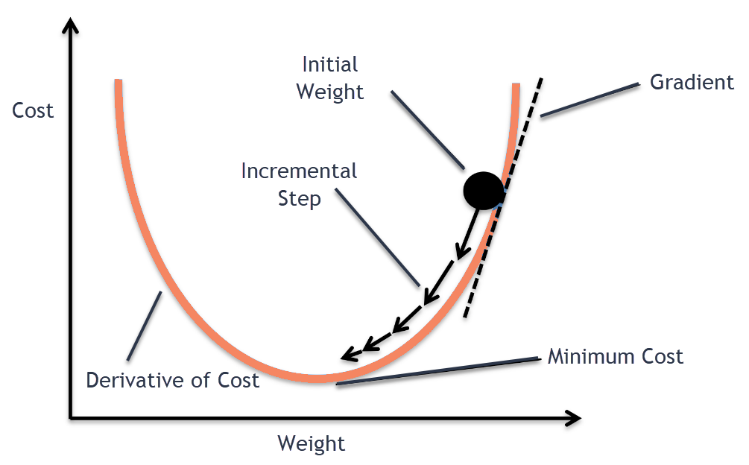
What facilitates this?
Stochastic gradient descent can be parallelized and run asynchronously
SGD is robust to unreliable parameter updates, race conditions, missed updates

Slide 8
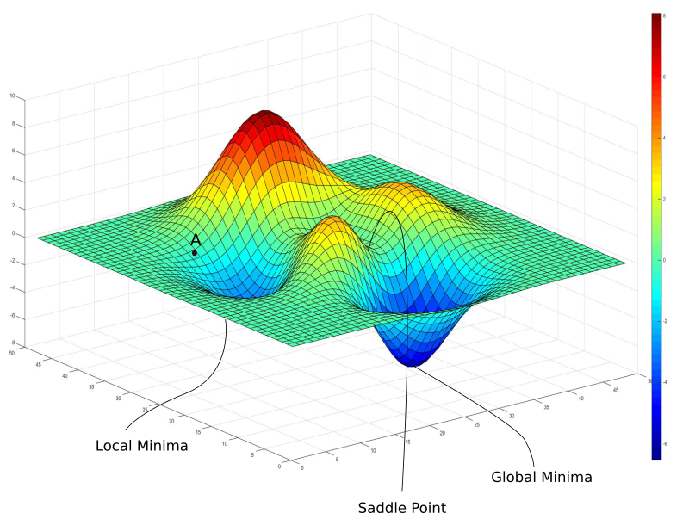
What does it buy us?
Each participant can avoid local minima
Overall accuracy boosted
Trade-off between accuracy and privacy can be controlled by tuning the amount of sharing

Slide 9
Privacy objectives in ML
Data privacy: no direct sharing of one’s input data set (medical data)
Model privacy: how much model information can be revealed
Output privacy: hide the model outputs during training to make it difficult for an adversary to re-create the model

Slide 10
Distributed SGD
Updates to different parameters during GD are independent
Different training data sets contribute to different parameters
Some updates are more important than others (far away from minima)

Slide 11
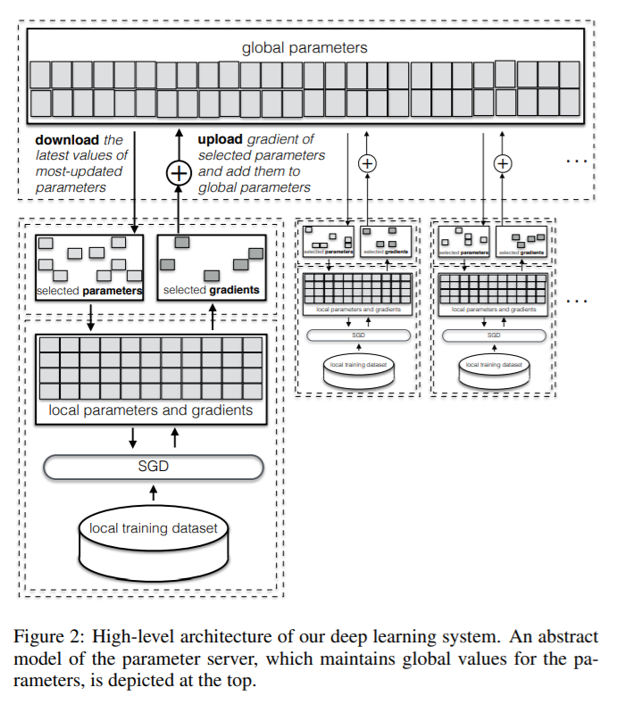
Design

Slide 12
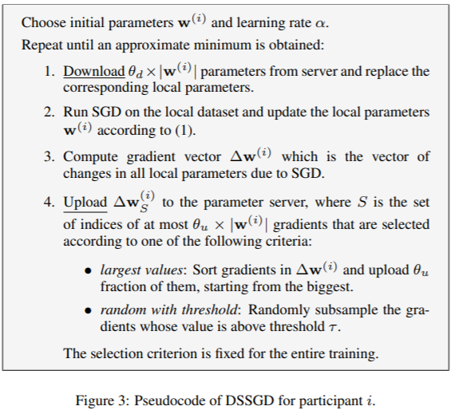
Algorithm

Slide 13
What do we achieve?
Participants independently converge to a set of parameters
Local minima avoided
Overfitting avoided
No coordination between participants required during local training
Participants can independently and privately evaluate its model on new data

Slide 14
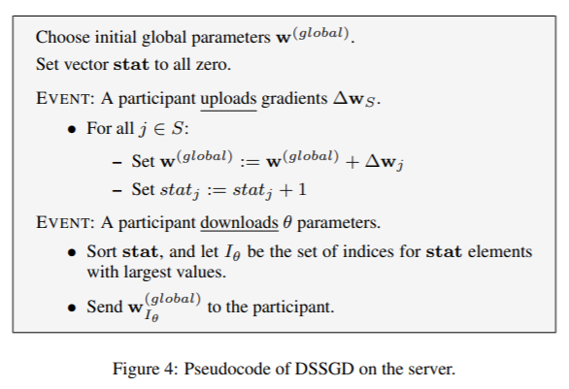
Parameter server

Slide 15
Further advantages of SGD
Overwriting local parameters with a subset of global parameters increases the stochasticity of local SGD : Enables exploration of the parameter space
Asynchronous access, race conditions, failures contribute to stochasticity: acts as a regularization technique we did not ask for
“Whatever happens, happens for good”

Slide 16
Parameter exchange protocol
Round robin: sequential operation – slowest client is the RDS
Random with atomic access: Performance as good as RR
Asynchronous: Participants do not coordinate. Training, parameter upload or download may overlap

Slide 17
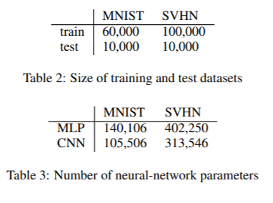
Experiments: Dataset and Model

Slide 18
Experiments: Protocols
Parameter exchange protocol: RR, random, asynchronous
Upload: largest values, random with threshold
Download: parameter with most updates, (parameters undergone biggest change)
Meta-parameters chosen by training on a calibration data set

Slide 19
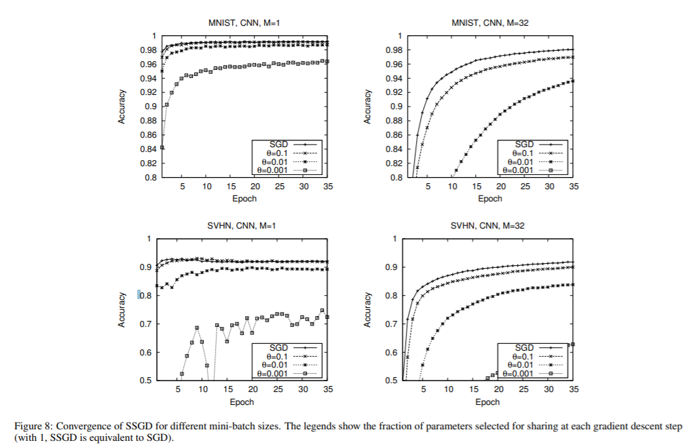
Results: SSGD

Slide 20
Results: SSGD
Smaller M: faster convergence, but unreliable
Even small sharing improves accuracy
Best results when 100% sharing
Selective SGD better than SGD: acts as a regularization technique that prevents overfitting
Train or test accuracy not made clear

Slide 21
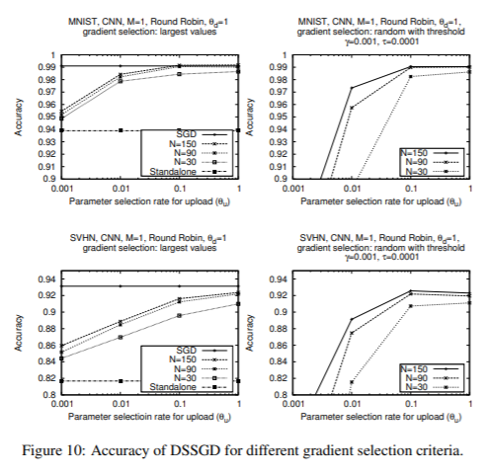
Results: DSSGD

Slide 22
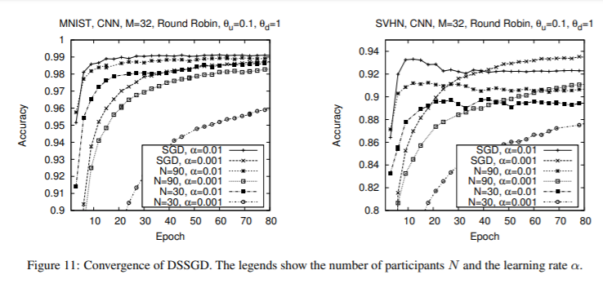
Results: DSSGD

Slide 23
Results: DSSGD
Trade-off between utility and privacy: depends on network architecture
Any cooperation results in higher accuracy than standalone learning
RR almost as good as centralized SGD at the cost of speed (slowest client is the RDS if heterogenous): scope for better scheduling?
Amount of sharing more important than #clients – I disagree
Upload/ Download constraints

Slide 24
Preventing indirect leakage: Differential Privacy
A computation is differentially private if the probability of producing a given output does not depend too much (?) on whether a particular data point is included in the input data set.

Slide 25
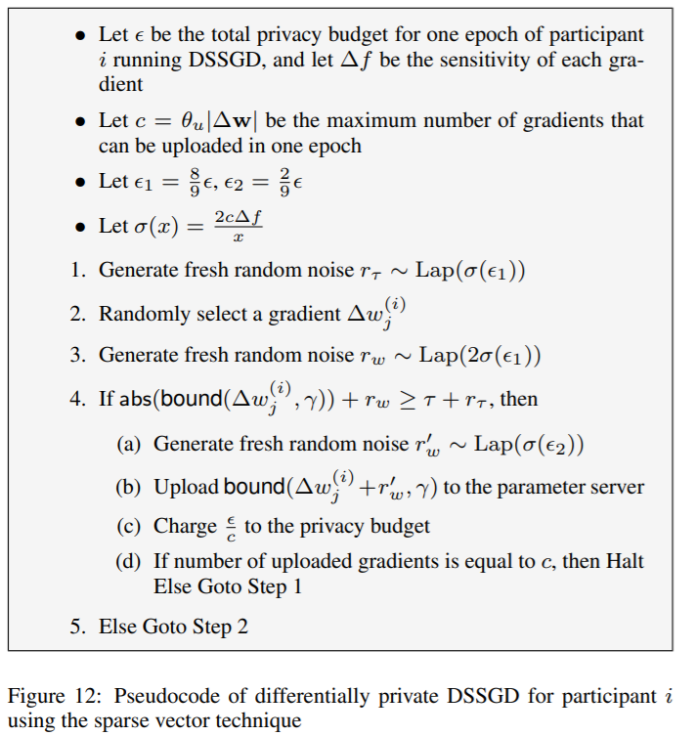
Experiment 2: Sparse vector technique
Tradeoff between accuracy and leakage
2 sources of potential leakage: how gradients are selected and actual value of shared gradients
Randomly select and share perturbed values
Total privacy budget split into ‘c’ parts: no of gradients that can be uploaded in each epoch

Slide 26
Experiment 2: Sparse vector technique
Budget further split
First part spent on checking if the gradient is above the threshold
Second spent on actually releasing the gradient
Laplacian mechanism to add noise
Noise depends on privacy budget and sensitivity of the gradient for each parameter (assumed constant)

Slide 27
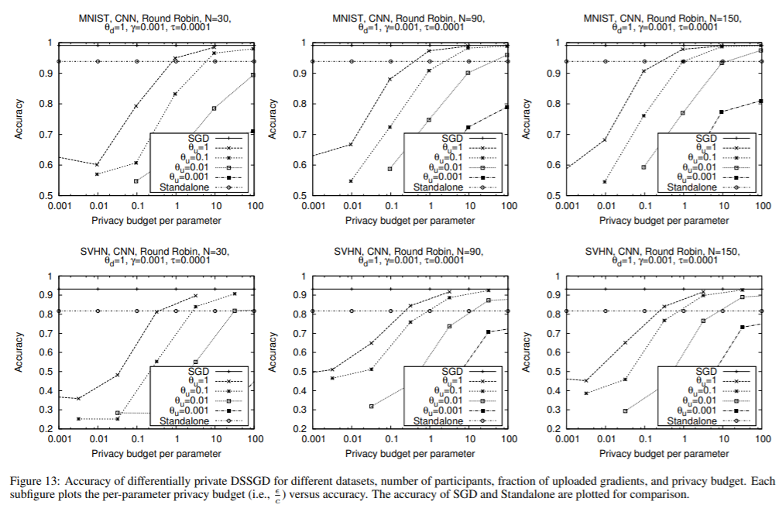
Results

Slide 28
Conclusion
Novelty: Privacy in a distributed machine learning approach
Boosted training without augmentation, maintained privacy at the same time
Works for any type of neural network that uses SGD

