Slide 1
Improving the Resilience of
Cyber-Physical Systems under
Strategic Adversaries
Paul Wood
PhD Final Examination
Chair:
Prof. Saurabh Bagchi
ECE, Purdue
Committee Members:
Prof. Milind Kulkarni Prof. Charles A. Bouman
Dr. Alefiya Hussain
ECE, Purdue
ECE, Purdue
Information Sciences
Institute (USC/ISI)
ECE, Purdue University
June 9, 2016
Notes:
Thank Alefiya for coming from LA

Slide 2


My Background
BS – 2007-2010
Direct PhD – 2011-2016
Electrical
Engineering
Computer Engineering
Electric Power
Embedded Systems
CPS
Security
Control System Integration
Notes:
About 5 years at Purdue
Topic Searching w/ Electrical Background

Slide 3
Presentation Roadmap
Background on cyber-physical systems and use cases
  Research Contributions
  Smart Grid applications
Adversarial modeling and strategy exploration
  Game theory applied to CPS security
Application to real-time cyber-physical systems
  Attacks in real-time power grid control systems
Power market networking impacts
  Interdependence between cyber-level and physical assets
Conclusion

Slide 4

Research Contributions
Model for Optimizing Defensive Investments in CPS
  Developed model for multi-actor attack/defense games
  Created framework for optimizing defensive investments
  Accepted to DPDNS 2015
Application of Defensive Model to Market Layer
  Optimized network-layer attack/defense planning for power market algorithms
  Accepted to COMSNETS 2016
Real-Time Attack Strategies on Market Layer
  Created strategy for online real-time attacks
  Evaluated against real-time pricing model
  Submitted to CNS 2016
Notes:
IEEE Workshop on Dependable Parallel, Distributed and Network-Centric Systems (DPDNS)
IEEE Communication Systems and Networks (COMSNETS)
IEEE Conference on Communication and Network Security (CNS) , July 1 2016

Slide 5
Research Contributions (Continued)
A Framework for Evaluating the Resilience of Dynamic Real-Time Market Mechanisms
  Created a model for applying network effects to market operations and observing resilience
  Measured power-level impacts on IEEE 118 bus test cases
  Joint work, Submitted to IEEE Transactions on Smart Grid
Low Cost Denial-of-Service Defense
  Designed a cloud-based algorithm for mitigating DDoS via overlay networks
  Accepted SRDS 2015
Notes:
Special Issue on Power Grid Resilience – past 2 rounds of reviews, final deadline in 2 weeks
Symposium on Reliable Distributed Systems (SRDS)
RA at w/ MDA Aerospace: (6 semesters)
Presentations and reports in export controlled environment

Slide 6
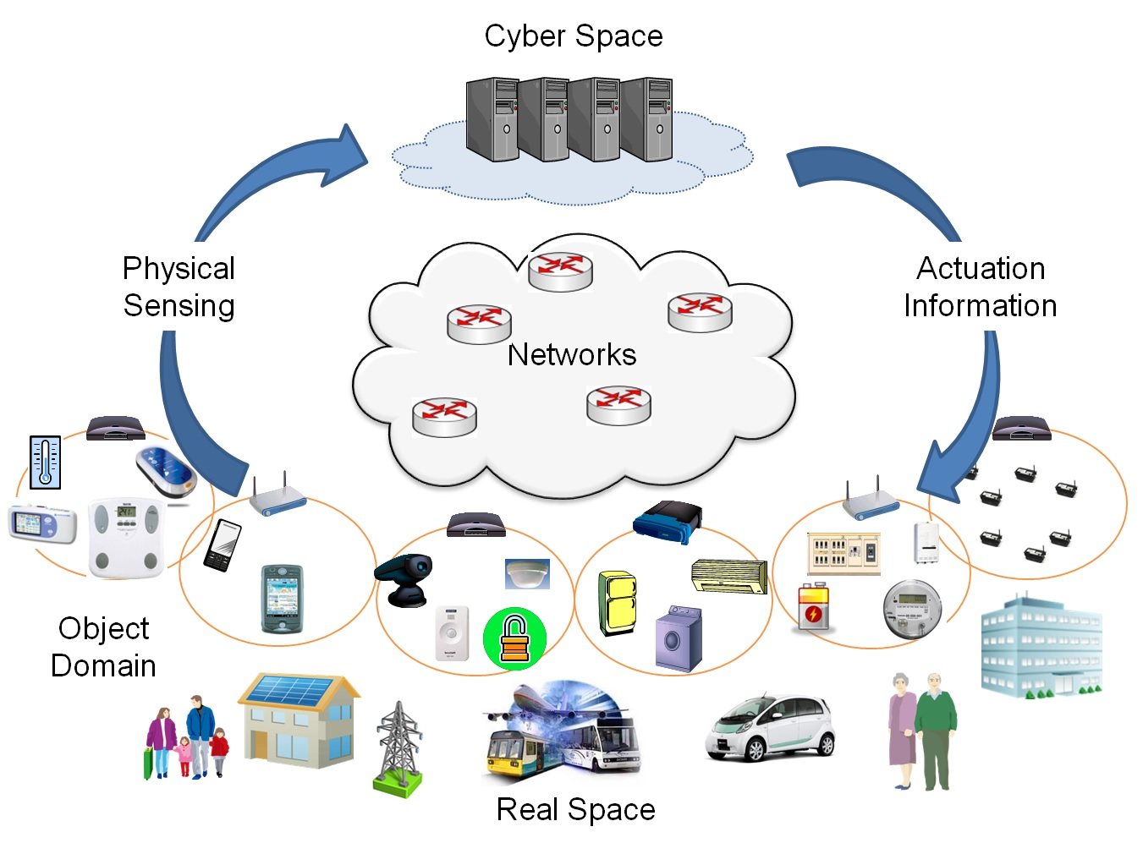
Cyber-Physical Systems
Source: http://www.jaist.ac.jp/is/labs/lim-lab/research.php
Notes:
Similar to internet of things, but with controls emphasis (actuation and sensing)
Smart grid
Interdependence on critical infrastructures
Cloud growth

Slide 7
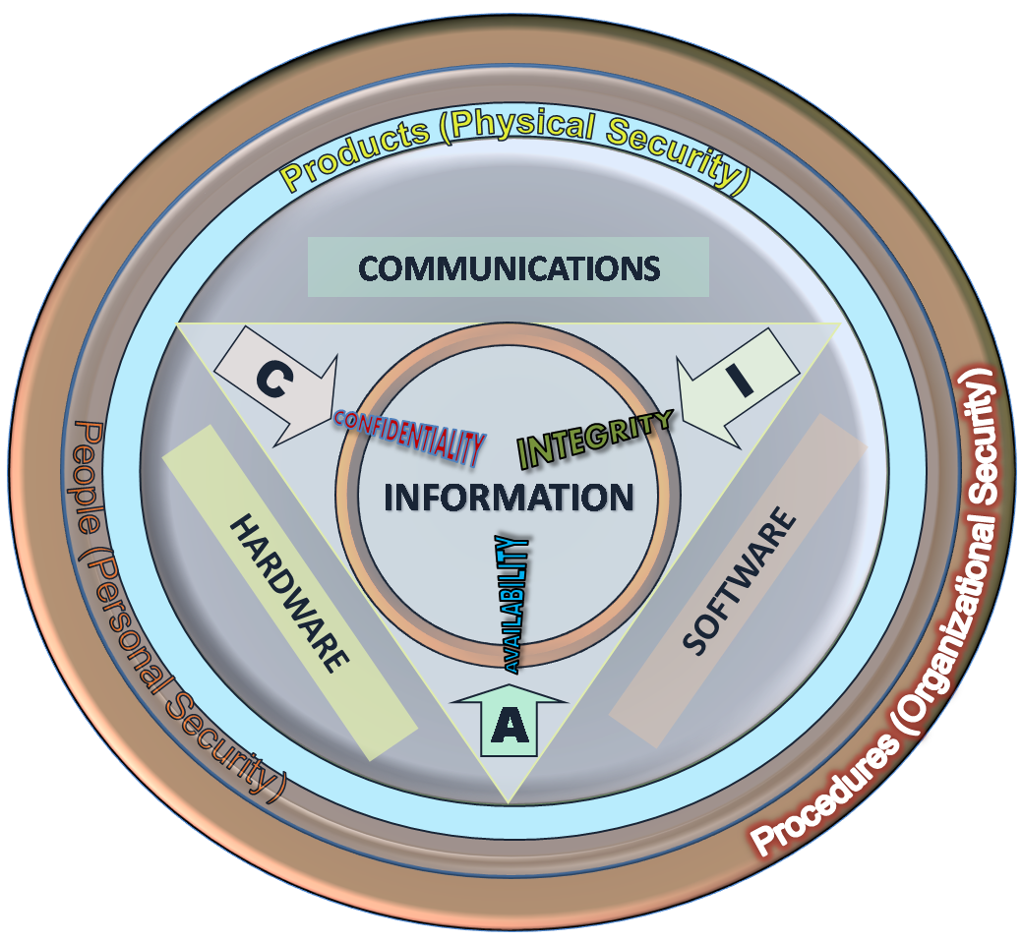
CPS Security: CIA
Confidentiality
  Privacy of physical processes
  Unique control programs
  Proprietary process protection
    How do they make cheese puff snacks?
  Competitive information
    Current production levels
Integrity
  Physical process corruption
    Stuxnet / equipment damage
  Deception
    Underfilling cheese puff bags
Availability
  Focus of this research
  Real-time system constraints
    Damage by delay
    Power systems
Notes:
Emphasis on C
PS : Availability

Slide 8
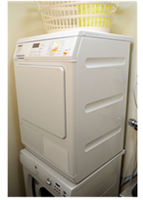



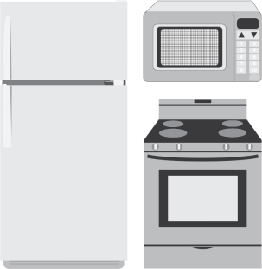
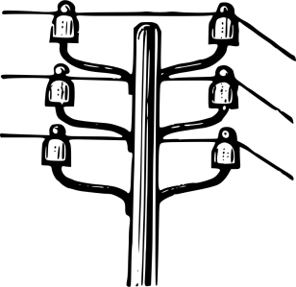

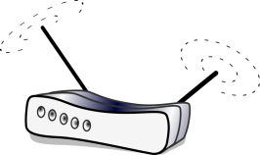

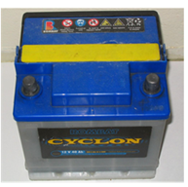
CPS: Smart Grid
Efficiency through coordination
Notes:
Physical Layer
Cyber Layer
Industry 4.0

Slide 9

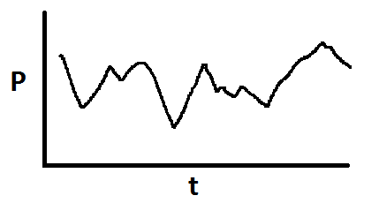
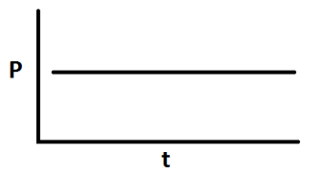
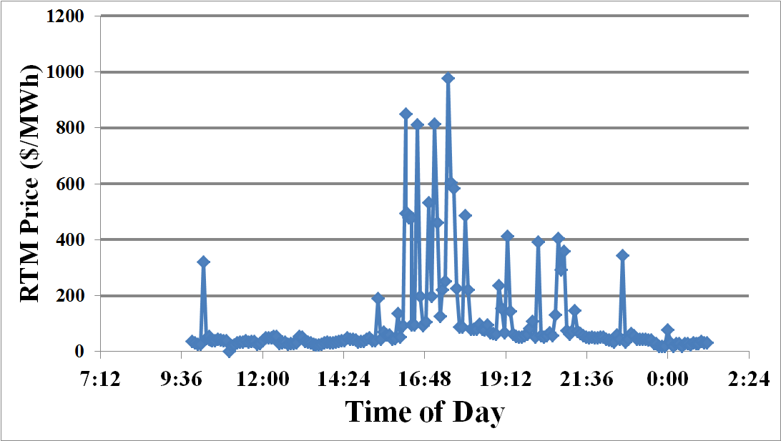
Grid Challenges: Uncertainty of Renewables
Coal = 33%
Natural gas = 33%
Nuclear = 20%
Hydropower = 6%
Other renewables = 7%
  Wind 4.7%
Source: eia.gov
Source: nyiso.com
Notes:
Actual operating power market from July
SRP Solar Tax in Nevada
$400 million/year savings in NYISO

Slide 10
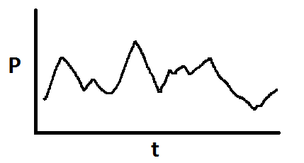
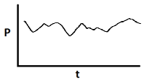
The Grid and Demand Side Management
Traditional Energy Grid
$
Demand Response in Smart Grid
$
Demand response improves efficiency of the power market by modulating load in response to fluctuating demands and supplies

Slide 11
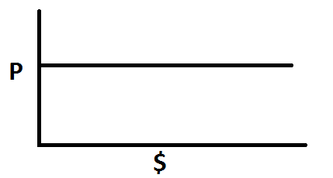
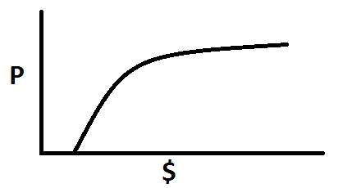
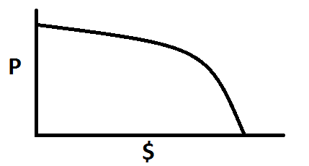
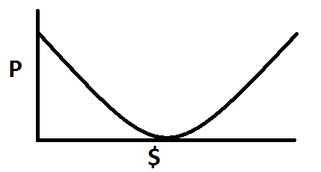

Dynamic Markets
Inflexible
Inflexible
Producer
Consumer
ISO: Balance Power
Market (ISO)
optimizes price signal
to minimize residual power
Loads and supplies
are controlled by price signals
$
$

Slide 12
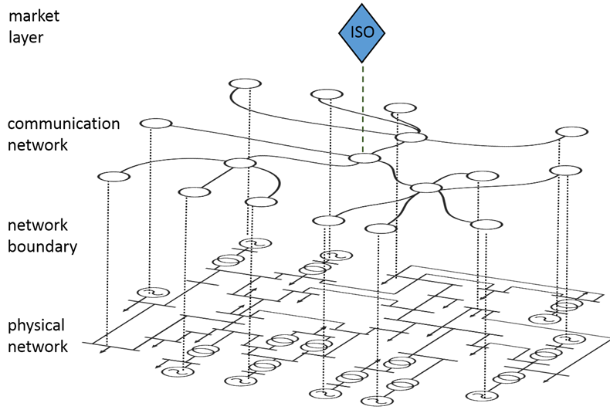


Network Topology
ISO: Find Optimal
$
The ISO must communicate price signals across a network to the grid-connected loads

Slide 13
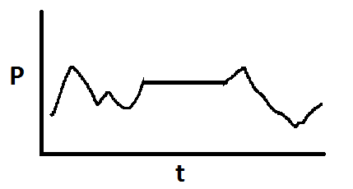
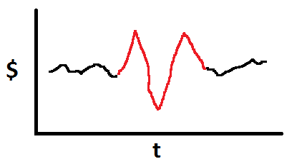
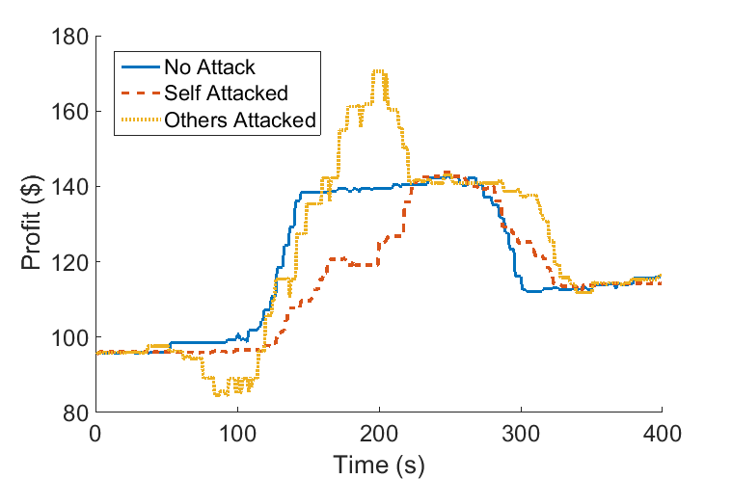
CPS Security: Faults and Attacks
Net Outage
Net Outage
Outage reduces demand response
Outage changes market price
Notes:
Interdependence
Performance

Slide 14
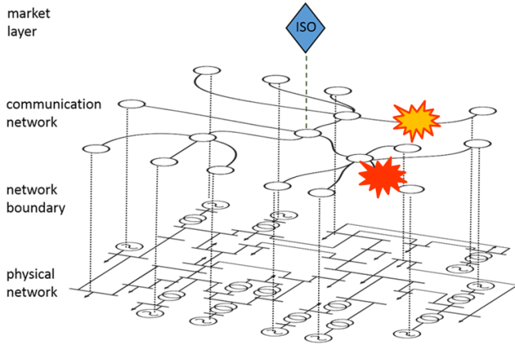
Research Questions
Who attacks where and what is the impact? (Prelim)
  Game theoretic model for attack/defense in energy CPS
  Application of model to power market system
How can random and targeted network outages impact market mechanisms?
  Latency impacts on market mechanisms
  Attacks in real-time on pricing systems
What can be done to mitigate attacks?
  Defense optimization
Notes:
Exogenous attacks

Slide 15
Game Theoretic Model for Attack/Defense
Goal:
  Create an adversarial model and attack/defense strategies
Approach:
  Model the physical system and the economic impact of attacks
  Formulate game/algorithm for maximizing/minimizing impact
  Include support for multiple attackers and defenders
What’s New:
  Multi-agent CPS games
  In-model attacker
  Defensive investment optimizations

Slide 16
Related Work
Single-agent CPS security games
  S. Amin, G. A. Schwartz, and S. Shankar Sastry, “Security of interdependent and identical networked control systems,” Automatica, vol. 49, no. 1, pp. 186–192, 2013.
Exogenous attackers on computer networks
  M. H. Manshaei, Q. Zhu, T. Alpcan, T. Bacs¸ar, and J.-P. Hubaux, “Game theory meets network security and privacy,” ACM Computing Surveys (CSUR), vol. 45, no. 3, p. 25, 2013.
"Most papers in the interdependent security literature consider the attackers as an exogenous, persistent threat and not as players in a game....We believe that the proper modeling of strategic adversaries in interdependent security games is a largely undiscovered research area.“
  A. Laszka, M. Felegyhazi, and L. Buttyan, “A survey of interdependent information security games,” ACM Comput. Surv., vol. 47, no. 2, pp. 23:1–23:38, Aug. 2014.
Notes:
Lojack vs yard security sign

Slide 17
Assumptions and Models
Multiple actors or market players exist in a power system
  Financially independent entities
  Maximal profit goal
Energy transactions captured as linear flow graph (DC model)
  Edges are generators and transmission lines
  Solvable with linear programming
Targets are flow disruptions
  Cyber attacks distilled to physical domain

Slide 18
Optimal Power Flow: ISO Emulation
All Capacity=100 units
Profit = $1100-$300 = $800
Solvable with Linear Programming (LP)
Notes:
Physical system model

Slide 19
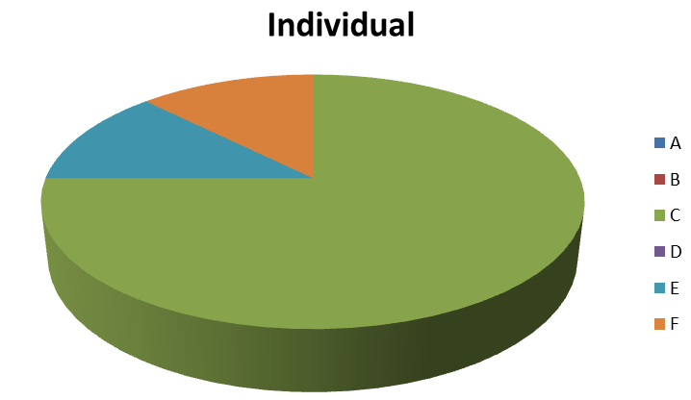
Multiple-Actor Negotiation: Getting the Prices
$100
$100
$800
$600
Notes:
Locational Marginal Pricing

Slide 20

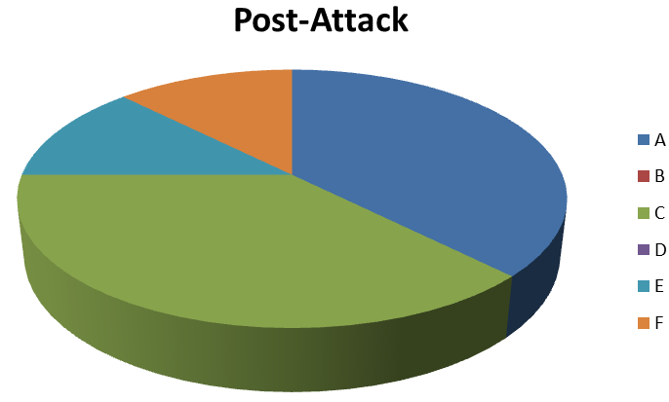
Impact of Attack Calculation
$100
$100
Break ties
evenly
$600
$100
$100
$300
A motivated to attack B
$300

Slide 21
Impact Matrix
 | T-A | T-B | T-C | T-D | T-E | T-F
A | 0 | 300 | 0 | 0 | 0 | 0
B | 300 | 0 | 0 | 0 | 0 | 0
C | -300 | -300 | -600 | 100 | -600 | -600
D | 0 | 0 | 100 | 0 | 0 | 0
E | 0 | 0 | -50 | -50 | -100 | -100
F | 0 | 0 | -50 | -50 | -100 | -100
Total | 0 | 0 | -600 | 0 | -800 | -800
Likely targets
  A,B
Likely defended
  C
A/B redundant
  Low-value without interdependence

Slide 22
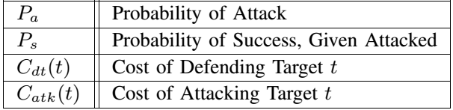
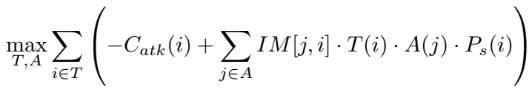
Attacker Strategy
Actor selection
  Financial stake
  May be adversary itself
Optimize
  Targets (binary)
  Actors (binary)
MILP formulation
  Budget constraint

Slide 23
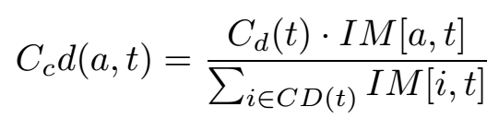
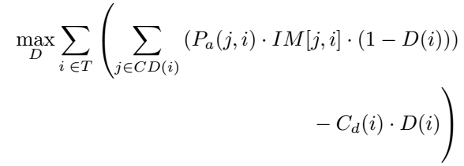
Defender Strategy
Defender
  Envisions attacker
    Prob. of attack
  Cooperation
    CD(t)
    Mutually beneficial
  Selfish defense
    CD(t) = 1
MILP formulation
 | T-A | T-B | T-C | T-D | T-E | T-F
A | 0 | 300 | 0 | 0 | 0 | 0
B | 300 | 0 | 0 | 0 | 0 | 0
C | -300 | -300 | -600 | 100 | -600 | -600
D | 0 | 0 | 100 | 0 | 0 | 0
E | 0 | 0 | -50 | -50 | -100 | -100
F | 0 | 0 | -50 | -50 | -100 | -100
Total | 0 | 0 | -600 | 0 | -800 | -800

Slide 24
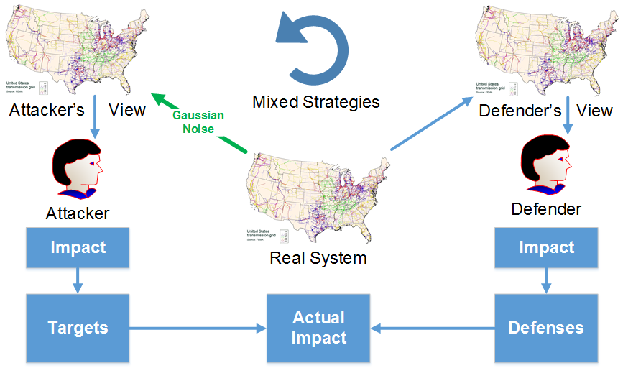
Knowledge Levels

Slide 25
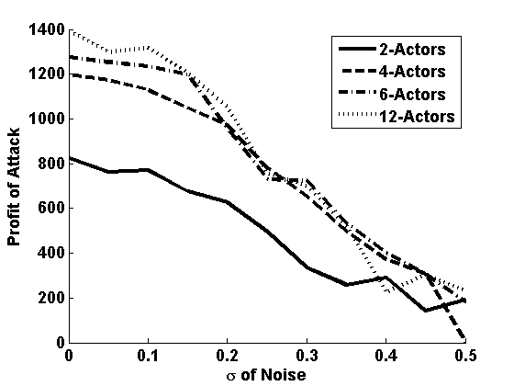
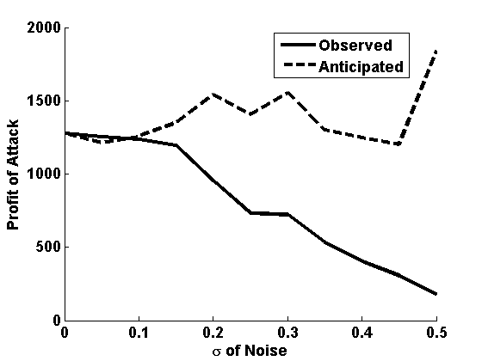
Limited-Knowledge Attacker
Attacker’s view of model perturbed
  Gaussian noise added to flow graph model
Anticipated return misleading
  Deception potential

Slide 26
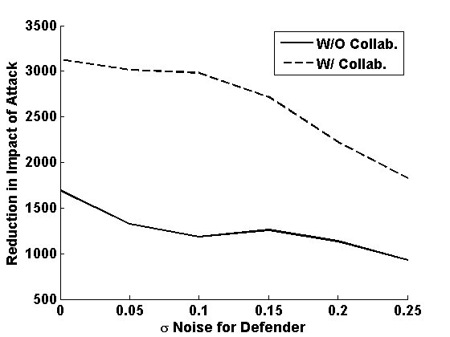
Attacker/Defender Games
Attacker
  Selects profitable targets
    Subset of actors
Defender
  Pretends to be attacker
    Uses probability of attack to drive defenses
Mixed strategies
  Equilibrium reached with probabilistic strategy

Slide 27
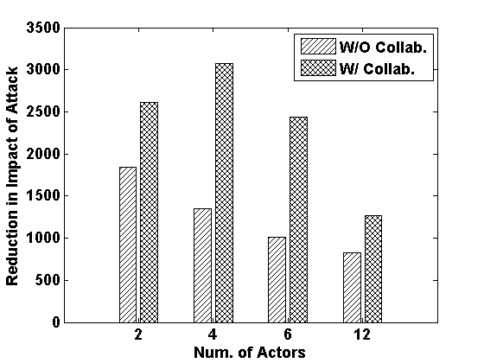
Collaborating Defenders
Defenders have fixed resources to expend
Collaboration
  Proportional
  cost-sharing
    No conflict of interest
Defenders save money
  Overall effectiveness decreases as number of actors increase

Slide 28
Application of Strategy to Networked Power Market
Goal:
  Apply the previous strategies to active cyber assets
Approach:
  Replace physical disruptions with cyber disruptions
  Replace passive impact model with active market model
  Evaluate attacks on real-time energy market
What’s New:
  Game theory with real-time CPS
  Attack and defense on network targets in a market system

Slide 29
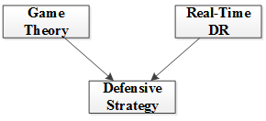
Related Work
In [1], latency impacts in real-time communication in DR is evaluated but without any economic incentives
In [2], economic incentives are introduced but without real-time communications
This work combines real-time DR with game theory to formulate defensive strategies
[1] Tan, Rui, et al. "Impact of integrity attacks on real-time pricing in smart grids." Proceedings of the 2013 ACM SIGSAC conference on Computer & communications security (CCS). ACM, 2013.
[2] Barreto, Carlos, et al. "CPS: market analysis of attacks against demand response in the smart grid." Proceedings of the 30th Annual Computer Security Applications Conference (ACSAC). ACM, 2014.

Slide 30
Faults and Attacks
Net Outage
Net Outage
Outage reduces demand response
Outage changes market price

Slide 31
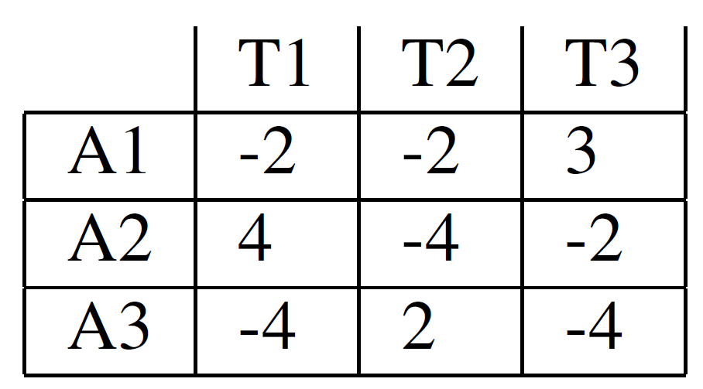
Target Impact Matrix
Successful attacks result in long network outages
The impact of attacking different targets is captured in a matrix (IM)
  No-attack compared with attack profits
A1
T1
T3
A3
T2
A2
Impact Matrix (IM)

Slide 32
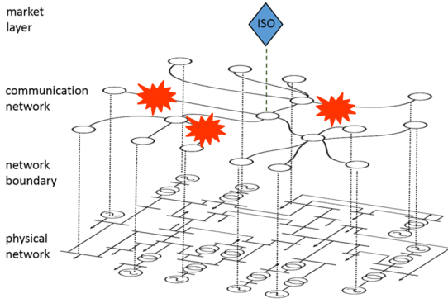




Attacker Strategy

Slide 33
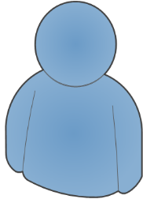


Defender Strategy
T1 most likely attacked
Comes from defender’s estimate
  A1,A3 share benefit from defending T1, so can share costs

Slide 34
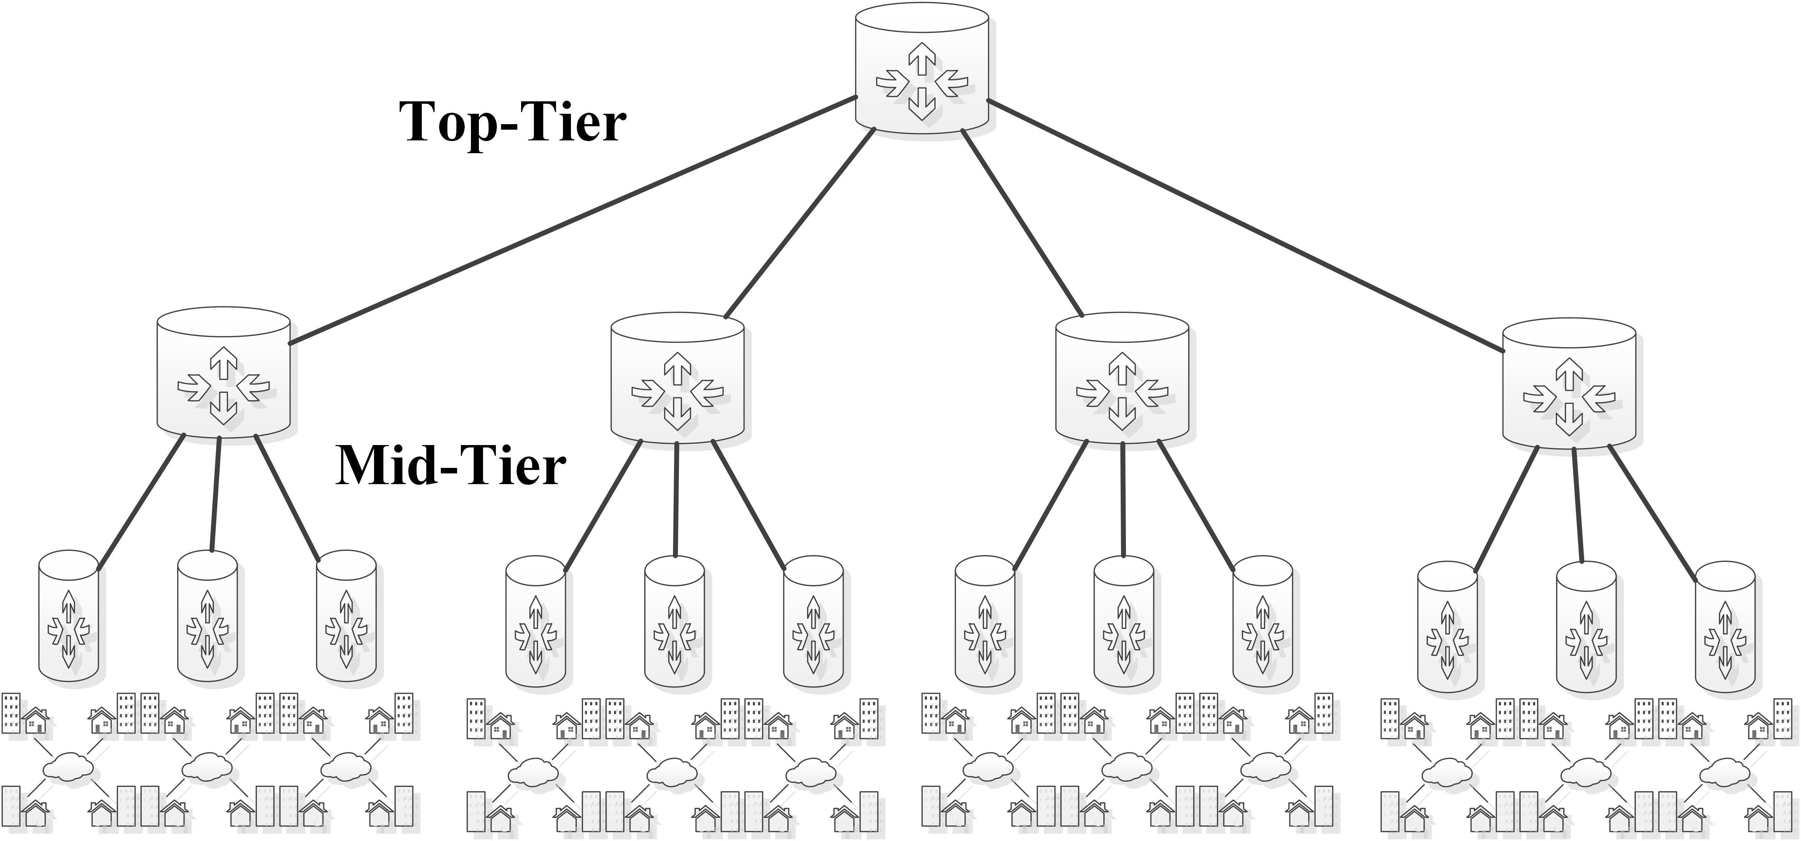
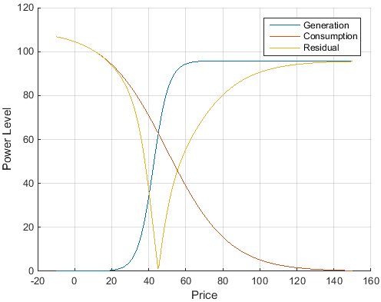
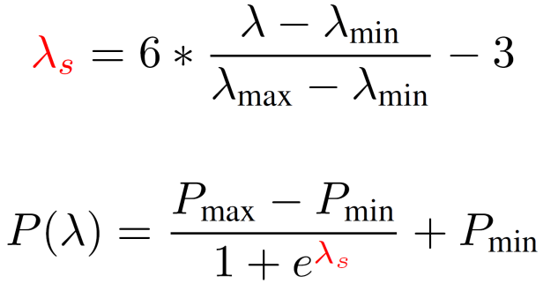
Experimentation Topology
Iterative Nelder-Meade (NM)
used to solve market
Cost parameters for attacking or defending each target = 1
20 Generators 100 Consumers
Power-Price Model
Price Scaling
(Min/Max Price)
Price to Power Mapping
(Min/Max Power)
Sigmoid function

Slide 35
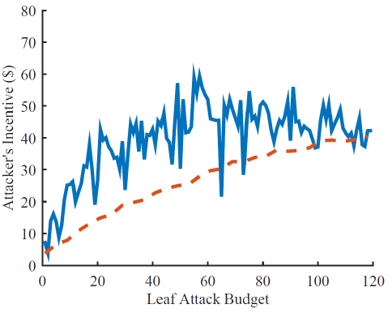

Attack Profits – Leaf Attacks
Attack strategy run for fixed computation limit
  Impractical to completely search large MILP
    Best found solution used
Attack saturated at high budgets
  Target value is imbalanced

Slide 36
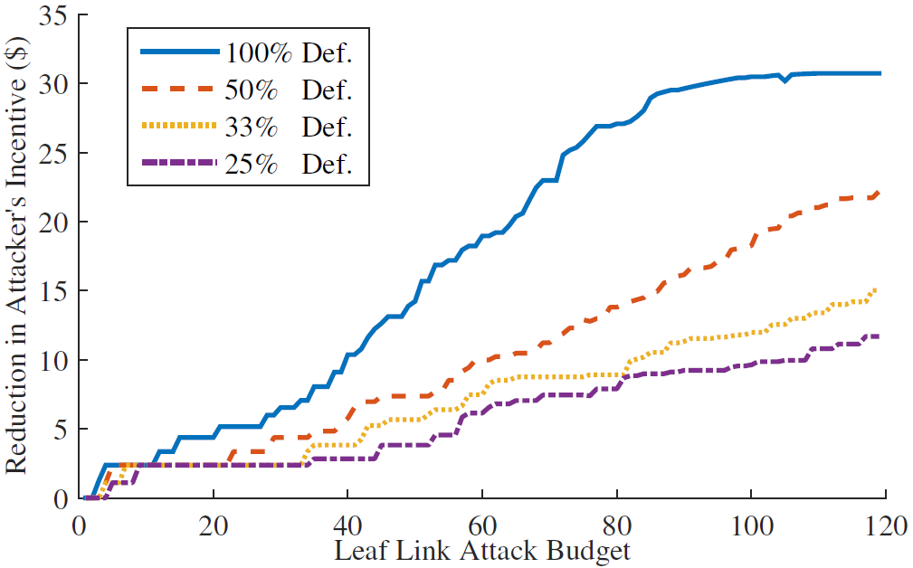
Defensive Strategy
The defensive strategy is tested with increasing defensive budgets
  With 100% defense the attacker has no success
  The attacker is unaware of defensive maneuvers
  Defenders have imperfect system knowledge

Slide 37
Game Theoretic Model for Attack/Defense
Strategic Adversary Model
Defensive Investment Games
Translation of physical system into graph model
  High-speed computation
Profit distribution method
  Competitor’s advantage
Attacker motivation
  Profit-seeking via competitor elimination
Application to RTP system
Asset selection
  Target values, selection in the face of adversary
Knowledge levels
  Model for independent actors and deception
Application to network links
Preliminary work presented March 24th, 2015 at AAAI Spring Symposia
Wood, Paul, Saurabh Bagchi, and Alefiya Hussain. "Optimizing Defensive Investments in Energy-Based Cyber-Physical Systems." Parallel and Distributed Processing Symposium Workshop (IPDPSW), 2015 IEEE International. IEEE, 2015. (DPDNS ‘15)
Wood, Paul, Saurabh Bagchi, and Alefiya Hussain. "Defending against strategic adversaries in dynamic pricing markets for smart grids." 2016 8th International Conference on Communication Systems and Networks. IEEE, 2016. (COMSNETS ‘16)
Notes:
Dependable Parallel, Distributed and Network-Centric Systems

Slide 38
Research Questions
Who attacks where and what is the impact?
  Game theoretic model for attack/defense in energy CPS
  Application of model to power market system
How can random and targeted network outages impact market mechanisms?
  Latency impacts on market mechanisms
  Attacks in real-time on pricing systems
What can be done to mitigate attacks?
  Defense optimization
Notes:
Exogenous attacks

Slide 39
Attacks in real-time on pricing systems
Goal:
  Shift strategy from planning phase to real-time system
Approach:
  Select market mechanism and evaluate network interdependence
  Create real-time, online strategy for attacks
  Evaluate attacks on real-time energy market
What’s New:
  Real-time attack strategy (vs. advanced planning)
  Attack and defense on network targets in a real-time market
    Finer grained strategy space

Slide 40
Related Work
In [3], latency impacts in real-time communication in DR is evaluated but without any economic incentives
In [4], network outages impact real-time negotiations but at a very slow timescale, and with no strategy
This work applies a real-time strategy to power market attacks
[3] Tan, Rui, et al. "Impact of integrity attacks on real-time pricing in smart grids." Proceedings of the 2013 ACM SIGSAC conference on Computer & communications security (CCS). ACM, 2013.
[4] N. Gatsis and G. B. Giannakis. “Residential load control: Distributed scheduling and convergence with lost AMI messages.” Smart Grid, IEEE Transactions on, 2012.

Slide 41
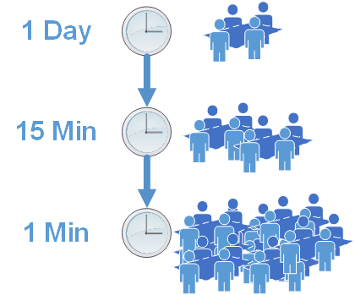
Power Markets
Purpose
  Optimize generation
Deregulation
  Price negotiation
Smart grid
  Negotiation speed
Renewables
  Real-time necessity
Notes:
Nevada SRP solar

Slide 42
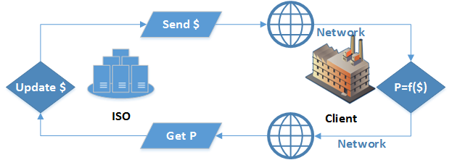
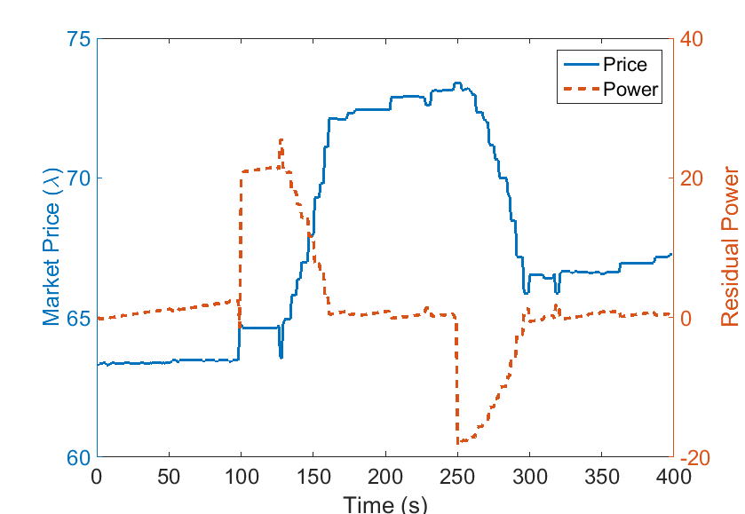
Iterative Market Negotiation
Real-time communication of price signal by ISO to consumers used for controlling the market
  Lower latency means better efficiency

Slide 43
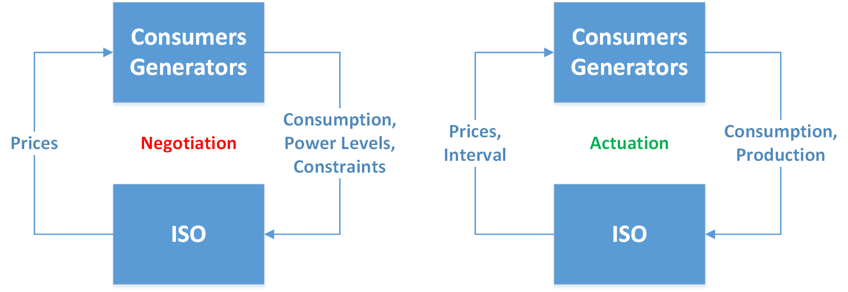
Solving for Market Price
Linear feedback control (Tan et. al.)
Interior point or gradient descent
  E.g. Dynamic Market Mechanism (DMM)
    D. J. Shiltz, M. Cvetković and A. M. Annaswamy, "An Integrated Dynamic Market Mechanism for Real-Time Markets and Frequency Regulation," in IEEE Transactions on Sustainable Energy, vol. 7, no. 2, pp. 875-885, April 2016.
Derivative free search
  E.g. Nelder Mead (chosen for this section)
Notes:
Linear only good for single price point

Slide 44
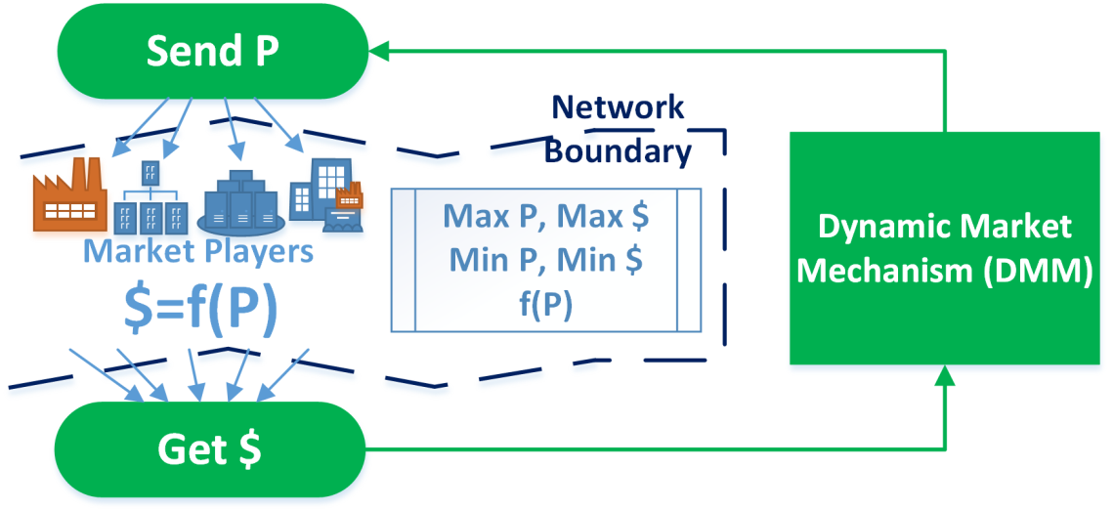
Dynamic Market Mechanism
Newton-Rhapson-like primal-dual interior point method
  Converges quickly with access to gradient functions
Assumes access to derivative functions from connected clients
  Misbehaving clients or network latency can break assumptions
Designed to solve stationary problems
  Non-stationary markets may violate gradient requirements

Slide 45
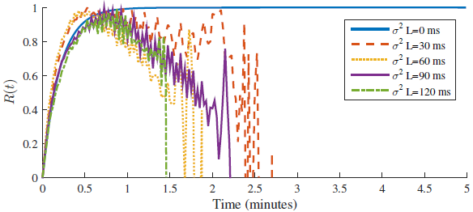
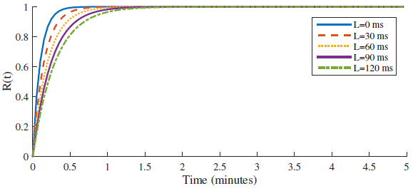
Impact of Latency on DMM
Jitter destabilizes DMM
  Gradient functions become non-continuous
Constant latency slows convergence process
  Iterations stalled
Journal article under review: Wood, Paul, Dylan Shiltz, Thomas R. Nudell, Alefiya Hussain, and Anuradha M. Annaswamy “A Framework for Evaluating the Resilience of Dynamic Real-Time Market Mechanisms” IEEE Transactions on Smart Grid, Special Issue on Power Grid Resilience

Slide 46
Nelder Mead Method
Iterative searching heuristic
  Contracts a simplex around optimal point
Requires no information about client behaviors
  Derivative free
  No assumptions on client price-to-power functions
Will not work with non-stationary functions by default
  Modified to support time-varying objective functions
fminsearch in MATLAB
Notes:
We are trying to minimize the function {\displaystyle f({\mathbf {x}})} where {\displaystyle {\mathbf {x}}\in {\mathbb {R}}^{n}}. Our current test points are {\displaystyle {\mathbf {x}}_{1},\ldots ,{\mathbf {x}}_{n+1}}.
1. Order according to the values at the vertices:
{\displaystyle f({\textbf {x}}_{1})\leq f({\textbf {x}}_{2})\leq \cdots \leq f({\textbf {x}}_{n+1})}
2. Calculate {\displaystyle {\textbf {x}}_{o}}, the centroid of all points except {\displaystyle {\textbf {x}}_{n+1}}.
3. Reflection
Compute reflected point {\displaystyle {\textbf {x}}_{r}={\textbf {x}}_{o}+\alpha ({\textbf {x}}_{o}-{\textbf {x}}_{n+1})(\alpha >0)}If the reflected point is better than the second worst, but not better than the best, i.e.: {\displaystyle f({\textbf {x}}_{1})\leq f({\textbf {x}}_{r})<f({\textbf {x}}_{n})},then obtain a new simplex by replacing the worst point {\displaystyle {\textbf {x}}_{n+1}} with the reflected point {\displaystyle {\textbf {x}}_{r}}, and go to step 1.
4. Expansion
If the reflected point is the best point so far, {\displaystyle f({\textbf {x}}_{r})<f({\textbf {x}}_{1}),}then compute the expanded point {\displaystyle {\textbf {x}}_{e}={\textbf {x}}_{o}+\gamma ({\textbf {x}}_{r}-{\textbf {x}}_{o})(\gamma >0)}If the expanded point is better than the reflected point, {\displaystyle f({\textbf {x}}_{e})<f({\textbf {x}}_{r})}then obtain a new simplex by replacing the worst point {\displaystyle {\textbf {x}}_{n+1}} with the expanded point {\displaystyle {\textbf {x}}_{e}}, and go to step 1.Else obtain a new simplex by replacing the worst point {\displaystyle {\textbf {x}}_{n+1}} with the reflected point {\displaystyle {\textbf {x}}_{r}}, and go to step 1.Else (i.e. reflected point is not better than second worst) continue at step 5.
5. Contraction
Here, it is certain that {\displaystyle f({\textbf {x}}_{r})\geq f({\textbf {x}}_{n})}Compute contracted point {\displaystyle {\textbf {x}}_{c}={\textbf {x}}_{o}+\rho ({\textbf {x}}_{n+1}-{\textbf {x}}_{o}))(0<\rho <0.5)}If the contracted point is better than the worst point, i.e. {\displaystyle f({\textbf {x}}_{c})<f({\textbf {x}}_{n+1})}then obtain a new simplex by replacing the worst point {\displaystyle {\textbf {x}}_{n+1}} with the contracted point {\displaystyle {\textbf {x}}_{c}}, and go to step 1.Else go to step 6.
6. Shrink
For all but the best point, replace the point with{\displaystyle {\textbf {x}}_{i}={\textbf {x}}_{1}+\sigma ({\textbf {x}}_{i}-{\textbf {x}}_{1}){\text{ for all i }}\in \{2,\dots ,n+1\}}. go to step 1.

Slide 47
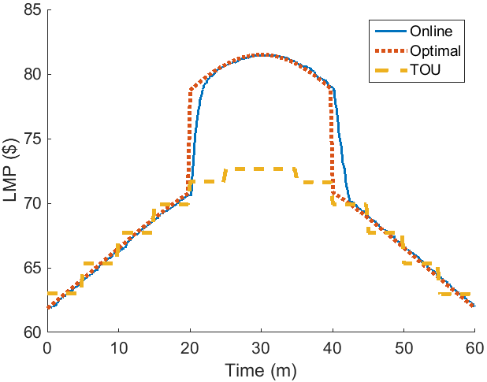
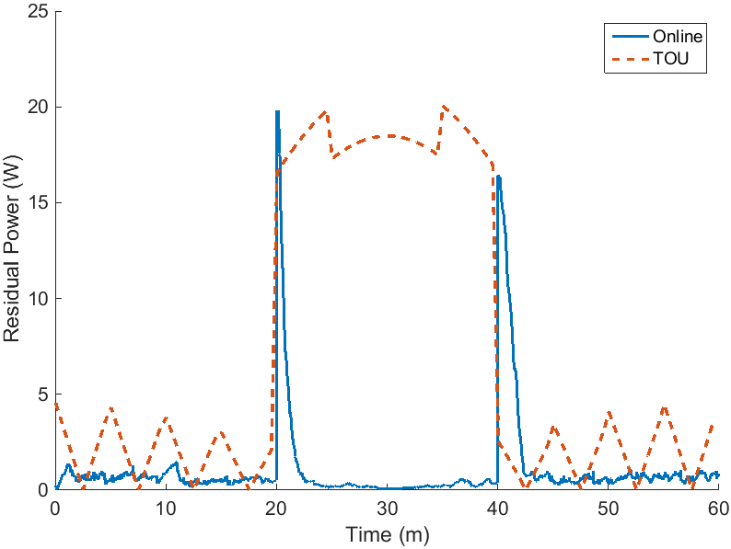
Time of Use (DMM) Vs. Online
Online price setting
  Near-optimal with NM

Slide 48

Impact of Latency on NM
Client delays reduce controllability of loads
  Less clients respond to pricing signals
Sufficient disruptions can underperform fixed prices
  Well-selected fixed price better than poorly selected fault-time price
Delay-based attacks can disrupt power market

Slide 49

Real-Time Adversary
Arbitrage:
Charge / Discharge to maximize profits
Attack:
Disrupt end-user communication links

Slide 50
Real-Time Attacks

Slide 51
Real-Time Attack Strategies

Slide 52
Impacts of Attacks
Profit increased by 68%

Slide 53
Moving Target Defense

Slide 54
Contribution Summary
Latency Impacts on RTP
Real-Time Attacks
Latency model for interactions in RTP systems
Model for solving RTP using Nelder Mead
  Non-stationary adaptation
Analysis of latency on DMM
Algorithm for launching attacks on RTP
Strategy for maximizing profits in real-time
Algorithm for moving target defense
Under Review:
Wood, Paul, Dylan Shiltz, Thomas R. Nudell, Alefiya Hussain, and Anuradha M. Annaswamy “A Framework for Evaluating the Resilience of Dynamic Real-Time Market Mechanisms” IEEE Transactions on Smart Grid, Special Issue on Power Grid Resilience, 2016
Wood, Paul, Saurabh Bagchi, Alefiya Hussain “Profiting from Attacks on Real-Time Price Signals in Smart Grids” IEEE Conference on Communications and Network Security (CNS), 2016

Slide 55
Thesis Conclusions
Smart Grid systems are vulnerable to availability attacks
  Multi-agent models for CPS create new target value assessment
  Profit-motivated adversaries can use DoS to extract profits
  Low-level network behaviors can destabilize market systems
Well-placed defenses can minimize protection costs
  Most-vulnerable network links can be secured
  Cost sharing constructs can optimize even in multi-agent case
Moving target defense can protect some SG applications
  Swapping high and low valued targets can reduce defense costs
  Deception can cause economic denial of sustainability

Slide 56
Future Work Directions
Expanded game theoretic planning
  Strategy can be adapted to multiple rounds of negotiation
  Time dimension can be added to solution space
Improved solution space searching for planning
  Strategy space becomes too large with time dimension
  Solution via surrogate models, genetic algorithms, or learning algorithms may improve quality
Resilient operational modes during network outages
  Zero-order hold may be inefficient model of operation
Improved network defense for consumer networks
  DoSE can be applied directly to the RTP systems
Microgrid and Peer-to-Peer market systems
Notes:
LAST SLIDE STOP HERE

Slide 57
Questions?

Slide 58
Questions?

Slide 59
Questions?

Slide 60
Research Questions
Who attacks where and what is the impact? (Prelim)
  Game theoretic model for attack/defense in energy CPS
  Application of model to power market system
How can random and targeted network outages impact market mechanisms?
  Latency impacts on market mechanisms
  Attacks on real-time pricing systems
What can be done to mitigate attacks?
  Defense in real-time on pricing systems
  Low-cost moving target DDoS defense

Slide 61
Defenses
Filtering
Moving Targets
Drops attack traffic
Expensive to deploy deep in distributed system
  High layer 2 support burden
Easily controlled
Evades attack traffic
Less expensive to deploy
  Overlay networks
  DHCP modifications
Supports deception
  Honeypots
  Economic Denial of Sustainability

Slide 62
Summary of Contributions
Game theoretic model for attack/defense in energy CPS
  Wood, Paul, Saurabh Bagchi, and Alefiya Hussain. "Optimizing Defensive Investments in Energy-Based Cyber-Physical Systems." Parallel and Distributed Processing Symposium Workshop (IPDPSW), 2015 IEEE International. IEEE, 2015. (DPDNS ‘15)
Application of model to power market system
  Wood, Paul, Saurabh Bagchi, and Alefiya Hussain. "Defending against strategic adversaries in dynamic pricing markets for smart grids." 2016 8th International Conference on Communication Systems and Networks. IEEE, 2016. (COMSNETS ‘16)
Attack/defense in real-time on pricing systems
  Under Review: Wood, Paul, Saurabh Bagchi, and Alefiya Hussain. "Profiting from Attacks on Real-Time Price Signals in Smart Grids." 2016 IEEE Conference on Communications and Network Security. IEEE, 2016. (CNS ‘16)
Low-cost moving target DDoS defense
  Wood, Paul, Christopher Gutierrez, and Saurabh Bagchi. "Denial of Service Elusion (DoSE): Keeping Clients Connected for Less." Reliable Distributed Systems, 2015 IEEE 34th Symposium on. IEEE, 2015. (SRDS ‘15)

Slide 63
Secondary Research at Purdue
Missile Defense Simulation
  Object-Oriented MATLAB
  Agent-Based Modeling
    Communication
    Computation
  Locked environment
    No admin access
    No external software
  Embarrassingly parallel batch scheduling and CI testing

Slide 64
Limited-Knowledge Attacker
Attacker’s view of model perturbed
  Gaussian noise added to flow graph model
Anticipated return misleading
  Deception potential
Notes:
When the profit of attack on the test system is examined with varying knowledge levels for the attacker, the success of the strategy is seen to diminish, an expected result. One interesting result from this analysis is that the observed versus anticipated profit of attack creates a deception potential for the attacker. Unless the attacker is aware of his own knowledge level, it will lead to poor decision making.

Slide 65
Network Topology
ISO: Find Optimal
$

Slide 66
Attacker/Defender Games
Attacker
  Selects profitable targets
    Subset of actors
Defender
  Pretends to be attacker
    Uses probability of attack to drive defenses
Mixed strategies
  Equilibrium reached with probabilistic strategy
Notes:
--Hold out collaboration until next slide
Similarly, the defenders may not know everything about the system and are impacted by noisy views. The probability of attack for a particular target is a sampled form the defender’s particular knowledge level. This creates a compounding effect where a defender with a noisy view will subsequently have an extra-noisy attacker view.

Slide 67

Optimal Power Flow (OPF)
Single company
Wide area negotiation
  Locational Marginal Price
  (LMP)
Regulated consumer
Goal:
maximize social welfare
  Minimize costs
  Maximize revenues

Slide 68



Multiple-Actor Negotiation Algorithm
Solve via Linear Programming
Multi-Actor Algorithm:
a’=a+margin s.t. f’=f, Utility -> 0
Notes:
The previous example is described here algorithmically and solved using linear programming. The costs along each edge can be increased as long as the flows remain the same, until the utility approaches zero, based on the earlier assumption. The margins define the profit distribution, and the margins themselves are found using the capacity withholding method. Some special situations arise where actors in series may be unable to both claim the marginal price they see, and that is why the algorithm is defined like this.

Slide 69
Modeling Attacks and Defenses

Slide 70

Multi-Actor Impact
Total gain/loss summed across all actors
Multi-actor model creates profit elements
  Diminishing impact as actor count approaches # competition points
Interdependence

Slide 71
Market Mechanisms
DMM (Gradient Descent)
Nelder-Mead
Optimizes price via gradient information (marginal $)
Quick to converge
Assumes
  Continuous functions
  Smooth gradients
Optimizes via set and test
Slower to converge
Assumes
  Nothing about clients

Slide 72

Attack and Defense
Maximize profit for subset of players
Minimize losses from attacks

Slide 73



Mixed Defender Strategies
N samples of underlying game
Each A1-A3 has a different market view, thus different view on probability of attack
Notes:
SB: Clarify why each defender (A1-A3) has a different market view.
PW: I moved the slide about sampling to before this one so that it makes more sense logically.
SB: We are abusing notation here Ai is attacker, and A_i is boolean if network link i is attacked. If it cannot be fixed, it cannot be fixed.
PW: Ai is actor 1-3 not necessarily attacker, but yes this notation is a bit confusing (Actor, Attacked, Targets, etc.). It cannot be easily fixed without losing consistency with the paper.
PW: I’ve redone the figure in this slide a bit, but it’s getting dense. Each actor A1-A3 gets a view of the system from the sampling on the previous slide. This represents imperfect knowledge of the system as a whole i.e. no global oracle. From this view, the defender then again samples (two sample phases in total) to generate their view of the attacker’s strategy. They do this N times to create A[I,n] for each defender A1-A3. They then weight these probabilities together in P^a_i to get a mixed strategy on what they think the attacker will do. The purpose of this is to prevent overfitting on a single strategy.

Slide 74

Sampling for Mixed Strategies
  The real system is sampled
  to provide mixed strategies
  for the attackers and defenders
Knowledge level
Constraint maintenance

Slide 75
Market Mechanism Details

Slide 76

Energy Market Domains

Slide 77
Real-Time Control

Slide 78

Physical System as a Graph
Physical (Logical) assets
  Generators (Sources)
  Wells (Sources)
  Transmission (Edges)
  Consumers (Sinks)
Ownership
  Actors own assets
Constraints
  Capacity
  Losses
Costs

Slide 79
DMM: Impact of Networking
Moderate latency increases convergence time

Slide 80
DMM: Impact of Jitter
Moderate jitter destabilizes DMM, violates constraints

Slide 81
Comparison to Communication Networks
Power Flow
Data Flow
Fungible
  Power at A identical to B
Tightly controlled
  Imbalances can damage equipment
High-impact during shortage
  Brownouts
Unique data
  End-to-end path maintenance
Best-effort
  Imbalances degrade quality of service, but not permeant damage
Becoming high-impact

Slide 82


Nelder Meade Modified Algorithm

Slide 83
DOSE
DOSE
DOSE

Slide 84
Defense for General Computing Services
Goal:
  Reduce costs to mitigate attacks on networked services
Approach:
  Use overlay networks to mask true service identities
  Adapt network when under attack
  Profile and identify high-risk clients
What’s New:
  Cost management for overlay-based DDoS defense
  In-band, attack-resilient entry node assignment service

Slide 85

Prior Work for DoS Protection: Overlay Networks
Protection via Proxy/Relay
Lacks entry point (SOAP)
management, beacon management
DoSE: Cloud-Based Relay Management
Source: Angelos D. Keromytis, Vishal Misra, and Dan Rubenstein. 2002.
SOS: secure overlay services. SIGCOMM Comput. Commun. Rev. 32, 4 (August 2002), 61-72.

Slide 86

Prior Work: MOTAG
Subject to DDoS
1000 Replicas
DoSE: Cost-Effective Replica Management
Q. Jia, H. Wang, D. Fleck, F. Li, A. Stavrou, and W. Powell, “Catch me if you can: A cloud-enabled ddos defense,” in
Dependable Systems and Networks (DSN), 2014
Notes:
MOTAG/ Catch-Me claims that the load balancer on EC2 can absorb large attacks. Practically, however, it is just like any other cloud service and must grow elastically to absorb large requests. Once fully-grown, it can sustain >40 Gbps, but to do this often you must contact EC2 support and ask them to “warm it up” for you.
They also use large fixed numbers of replicas, 1000 in their experimentations, which keeps the cost of the solution very high.

Slide 87

DoSE Overview
Clients access Protected Services via Relays
  Relays are assigned via CDN Interface
Attacks are filtered in remote datacenters

Slide 88

Relays
EC2 Instances
Goals:
Hide protected service IP (Relay)
Shield service from attacks (Firewall)
Notes:
SB: Some text saying what kind of protection this design achieves.
PW: The relay operates as a simple linux-based firewall. IPTables can rate-limit clients and provide a fine-grained level of protection to the service. Small DoS attacks can potentially be absorbed by the firewall itself, but usually the attack is much larger than the relay can handle. In this case, it is taken offline and removed from service.

Slide 89

DoSE Overview
Assumptions:
CDN DoS-Proof
Independent Relay Faults
Protected Service IP hidden
Notes:
SB: Split into 2 figures – one is in the benign case (no attack) to show how a client connects to the service and enjoys the service. The other is with attacks. Put numbers on the edges to denote the temporal order.
PW:
CDN DoS Proof—high bandwidth services at the network edge that perform only simple file services
Independent relay faults– attacks on Relay 1 do not disable Relay 2 (datacenter isn’t taken offline), easy to achieve by picking different zones in EC2
Protected Service IP hidden – attacker cannot directly attack the service, else the system could be bypassed—can be done via whitelisting, maintaining silence on external probes, etc.

Slide 90

Attacker Model
Notes:
PW: The attacker passes his assignments on to a botnet service that disrupts the relay to which she is assigned.

Slide 91

Client Assignment Service
Goal: Resilient Client-Relay Assignments
Puzzles rate-limit assignments (repeat attacks)
Notes:
SB: Some text saying what kind of protection this design achieves.
PW: The client assignment service selects which relay to assign to each client. The first part of this service (the management portion) decides which clients should be connected to which relays. Once that assignment is established, it is encrypted and published to the CDN as a read-only file. The client can read the file, decrypt the address, and establish a connection with the relay node.
The first part is described in more detail next.

Slide 92

Attack Mitigation: Risk Assignment
Risk: Likelihood client is malicious
Risk-Proportional Relay Assignment
One unit of risk evenly divided
Attacker eventually singled
Problem: Growth during non-contiguous attacks
Solution: Consolidation with Risk Memory
Notes:
SB: If you can do animation without spending too much time preparing the slide, then do that. For example, protocol proceeds in multiple rounds. This slide also needs some notes.
PW: I added animations via white-box disappearing since it is easy to do this way.
Client assignment is designed to maximize the number of legitimate clients connected to unattacked relays while minimizing costs. To accomplish this, clients are assigned risk values based upon their association with disrupted relays. Since attackers are insiders, passing relay IP’s off to a botnet, then the insiders need to be isolated. This can be accomplished by risk-proportional relay assignment. In this example, each relay is allowed to have a risk of 1, and after each attack, risk is added to each client.
In the first event, the attacker disrupts the relay and risk is assigned to each client (click to see ¼)
The clients are then reassigned to new relays, brought online in the cloud. (click)
The clients are split into two groups, and two of the clients are saved while a 3rd is colocated with the attacker. When the attacker attacks again (click) then the insider is isolated.
(click) Lead into the next slide--- the problem with this approach is that if the attacker stops after a few rounds, then she may not be isolated. Meanwhile, the number of relays in use can become quite large. To account for this, a consolidation method is introduced that enables a trade off between attacker identification speed and costs.

Slide 93


Cost Reduction via Consolidation
Consolidation
Consolidation
Notes:
SB: Mention the goal of the design first before bringing in the design (possibly as an animation).
Also add some notes.
PW: Added design goal to previous slide as final animation
This slide shows what happens when an attacker is not persistent and how the risk system is still able to isolate her eventually.
Just as before, the attacker disrupts the relay and gets reassigned with another client. The attacker attacks again, but then waits to launch another attack. In response to the lack of attacks, the clients are consolidated back to a single relay. The process repeats, but this time the higher risk clients are split apart by the equal-risk assignment strategy. This makes the attacker have the highest risk of any of the clients—eventually she is identified.

Slide 94

Controlling Growth
Cumulative Risk per Attack (CRPA)
Risk per Relay (RPR)
CRPA=1 RPR=1
CRPA/RPR=2
CRPA=1 RPR=0.25
CRPA/RPR=4
Notes:
SB: Define CRPA and RPR in the slide.
PW: These were already defined at the top?
This slide shows how the growth can be controlled as a function of the CRPA/RPR ratio. High growth promotes faster isolation, but if the attacker is not consistently attacking, then it can cause higher costs for the defensive service.

Slide 95

Stopping Large Attacks
Attack Absorbed by Full Relay Exposure
Notes:
PW: There is a practical limit to how many relays are necessary. With enough relays, the low-level firewall functions of each relay become sufficient to fend off attacks. Thus large attacks (in number of insiders) can still be filtered with a secondary plan.

Slide 96

Experimental Results: Defending Against Single Attacker
Agent-Based MATLAB
(Source Available)
Relay Start Time: 40s
CPRA/RPR=3
1000 Clients
Single Attack Source
UDP Stream
Attacker identified in 300 seconds
Majority of clients kept online during attack
Notes:
SB: For each results slide, in a separate text box, indicate what are the main takeaways from that plot.
PW: This slide shows the effectiveness of DoSE over time for a single insider. The scenario starts with two relays, and the attacker persistently attacks until she is identified within 400 seconds.

Slide 97


Defending Against Single Attacker: Cost
Attacker found in 3 rounds
  1000 clients
  CRPA/RPR=30
21 Relays Consumed
  $0.07 EC2 Spot (Micro)
Higher CPRA
  Faster isolation
Lower CRPA
  Economic sustainability
Attacker identified faster with larger CRPA/RPR
Notes:
EC2 Instances each come with a public IP address. The way amazon allocates IPv4 addresses is changing, but currently it is possible to use EC2 to generate new IP addresses. Additionally, it is possible to get separate IP pools for each datacenter that they operate instances within.
EC2 charges a minimum of one hour for each instance used, so getting a “Fresh” IP costs one hour of usage. The spot price for the micro instance is $0.003 currently for linux.
PW: This slide shows the number of relays used during the attack. Each consumed relay represents a cost on a cloud provider, and this gives some idea of the expense paid and efficiency of DoSE.
On the bottom chart, the CRPA parameter is explored to determine how aggressiveness pays off for a persistent attacker.

Slide 98

Repeated Attacks
Clients:Attackers = 100:1
New clients every 1.6 s
  Connected for 400 s
New attacks every 160 s
  Fresh insiders
Risk-history minimizes disruptions for connected clients
Notes:
PW: This streaming sybil attack has multiple clients connecting and leaving with attackers coming in waves. After the system stabilizes (in the beginning there are only a few relays since risk is low), the prf is kept low for each subsequent attack despite a large number of attackers coming in each wave.

