Slide 1
Software and Hardware Approaches for Record and Replay of Wireless Sensor Networks
Matthew Tan Creti
Final Exam for Ph.D.
Purdue University
April 22, 2015
Major Professor: Saurabh Bagchi
Advisors: Vijay Raghunathan, Yung-Hsiang Lu, Zhiyuan Li
Notes:
I’m Matthew Tan Creti and my topic is Record and Replay of Wireless Sensor Networks.

Slide 2
Outline
Motivation
Related work
Review: Hardware based tracing and profiling of WSNs
Software based record and replay of WSNs
Conclusion
Notes:
The outline for this talk is: Motivation, a hardware based approach to the problem, a software based approach, and proposed work.

Slide 3
Motivation
Why record and replay for
wireless sensor networks?
Notes:
First, motivation.

Slide 4
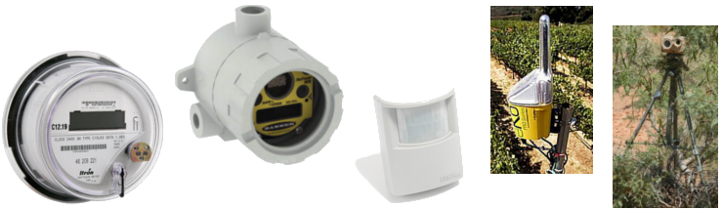
Motivation: applications of wireless sensor networks
Industrial Monitoring
Precision Agriculture
Smart Grids
Smart Buildings
Surveillance
Applications of Wireless Sensor Networks (WSN) is growing
Advantages over wired embedded systems:
Less cost to deploy and less costly sensors
Rapid and flexible deployment
Deployment in areas with no existing infrastructure
Notes:
Wireless Sensor Networks have many applications including…

Slide 5
Motivation: real world deployment experiences
“Without decent debugging tools… it proved very hard to diagnose the cause of the lack of incoming data at the gateway; trial and error with opening/closing waterproof casings is not to be recommended.”
Murphy Loves Potatoes: Experiences from a Pilot Sensor Network Deployment in Precision Agriculture. Koen Langendon, Aline Baggio, Otto Visser. In IPDPS 2007.
“We have experienced various faults during the deployments, such as sensor failure, reading error, packet loss, node failure, etc. Up to now there is not any universal diagnosis tool provided for WSNs…”
Landslide Monitoring with Sensor Networks: Experiences and Lessons Learnt from a Real-World Deployment. A. Rosi, M. Berti, N. Bicocchi, G. Castelli, A. Corsini, M. Mamei and F. Zambonelli. International Journal of Sensor Networks, Volume 10 Issue 3, August 2011.
“It is thus of great importance to be able to determine what happens inside the network, and not only at the sink. This issue has already been pinpointed—and proved to be of prime importance—in previous work, but is unfortunately still widely underestimated in the WSN community.”
The Hitchhiker’s Guide to Successful Wireless Sensor Network Deployments. Guillermo Barrenetxea, François Ingelrest, Gunnar Schaefer, and Martin Vetterli. In SenSys 2008.
Notes:
However, they do have some disadvantages. One is difficulty in debugging failures. Here are a few real world deployment experiences.

Slide 6
WSN debugging
Pre-deployment techniques for debugging WSNs
Simulation and emulation (e.g., Cooja, TOSSIM)
Formal testing
Language enforced safety [SafeTinyOS SenSys07]
Experience shows not all bugs found pre-deployment
171 vulnerabilities reported to ICS-CERT in 2012
Clearly need for post-deployment debugging tools
This presentation covers the latter category (i.e., post-deployment debugging)
Notes:
So how can WSN debugging be performed?

Slide 7
Principle from real world experience
“Do not throw away even a single byte of raw data.”
The Hitchhiker’s Guide to Successful Wireless Sensor Network Deployments. Guillermo Barrenetxea, François Ingelrest, Gunnar Schaefer, and Martin Vetterli. In Sensys 2008.
Can’t predict all future uses of collected data
Rerunning experiments is time consuming
May want to process raw data in new way
Notes:
The Hitchhiker’s Guide gives the following advice “Do not throw away even a single byte of raw data”.

Slide 8
Motivating principle of thesis
Maintain as much detailed information as possible about the execution of the WSN in deployment.
Questions:
Why keep detailed execution information?
How feasible is it to record detailed executions?
Notes:
> Motivated by the Hitchhiker’s Guide the motivating principle of this thesis is to “Maintain as much detailed information as possible about the execution of the WSN in deployment”.

Slide 9
Why keep detailed execution information?
Traditional in-deployment debugging of WSNs
Ad-hoc printf statements
Instrument code to log specific events
Alternative approach is record and replay
Captures remote execution (control flow and memory)
Faulty execution can be repeatedly replayed in emulator
Mote – Record Execution
Emulator – Replay Execution
send
trace
trigger
trigger
fault
error
failure
fault
error
failure
execution
execution

Slide 10
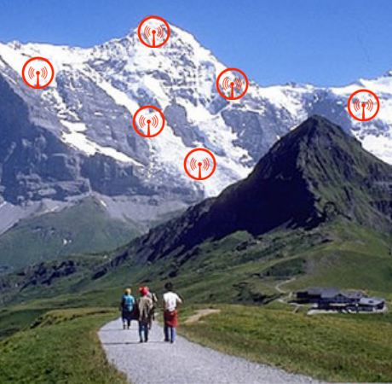
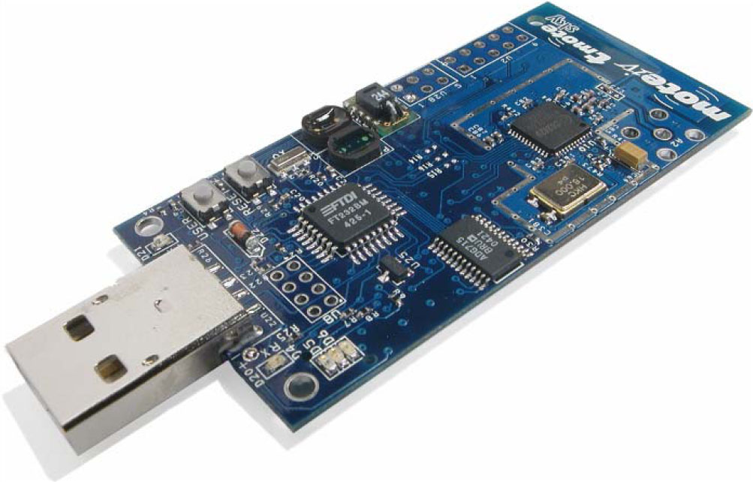
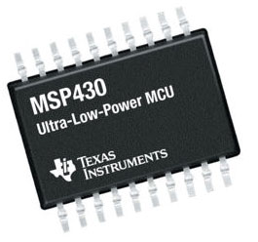
Is record and replay feasible? Challenges of WSN
Low Bandwidth
Remote Deployments
250 kbps
unreliable
Low Resources
8 Mhz CPU
10 KB RAM
1 MB Flash
Limited Hardware Support
Real-Time Demands
No Memory Management Unit (MMU)
Reactive systems must respond to physical events
Notes:
However, is it feasible to record complete executions in WSN? There are many challenges…

Slide 11
Problem: execution recording
Objectives
Record as detailed information on execution as possible
Do not interfere with real-time constraints
Fit enough recording into memory or flash to diagnose failures
Be energy efficient
Hardware approach
Use FPGA to poll the debug port (JTAG) for events
Set watchpoint triggers to record useful trace data
Software approach
Use efficient compression techniques
Record only the non-deterministic data
Observing common characteristics of μC and WSN
Notes:
The objectives are:…

Slide 12
Related work
WSN energy estimation:
Quanto [Fonseca OSDI08]
Estimates energy based on trace of activities
WSN Record and Replay:
Envirolog [Luo Infocom06]
Logs specified functions and variables (e.g., sensor and radio events)
Can replay events in network under different conditions
Targeted at performance debugging
TinyTracer [Sundaram SenSys10]
Records control flow for WSN
Does not replay memory states
Distributed Record and Replay:
Liblog [Geels USENIX-ATC06]
Application record and replay
Record non-determinism by intercepting system calls
Replay network using Lamport clocks
Notes:
The related work includes…

Slide 13
Two approaches
 | Aveksha | TARDIS
Implementation | Hardware | Software
System-level record and replay | No | Yes
Non-interfering to CPU timing | Yes | No

Slide 14
Hardware based trace and profiling of WSNs
Notes:
The first work is a hardware approach.

Slide 15
Reference
SenSys 2011 Best Paper
Matthew Tancreti, Mohammad Hossain, Saurabh Bagchi, and Vijay Raghunathan. Aveksha: A Hardware-Software Approach for Non-intrusive Tracing and Profiling of Wireless Embedded Systems. In 9th ACM Conference on Embedded Networked Sensor Systems (SenSys), 14 pages, Seattle, Washington, November 1-4, 2011.

Slide 16
Problem statement
How to perform tracing and profiling of software
Non-intrusively
With high spatial and temporal granularity
Low energy
Low cost
Easy to integrate and deploy
Tracing provides a sequence of events useful for debugging
Profiling provides energy consumption and time per event
Notes:
The problem is

Slide 17
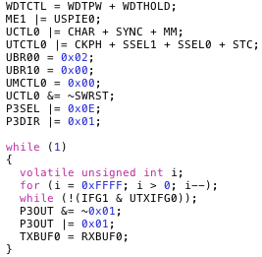
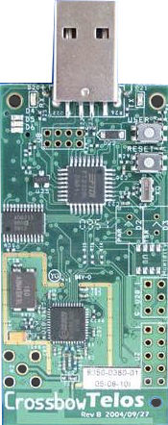
Solution approach: AVEKSHA
Debug
Board
JTAG
10010011011100
AVEKSHA is a hardware/software approach
Exploit on-chip debug module (OCDM)
Comes free on most μCs
Exposed through JTAG interface
Asynchronous with μC operation (therefore non-interfering)
Advanced features: complex triggers for breakpoints and watchpoints, store state on trigger
Notes:
Our strategy is a combination of hardware and software.

Slide 18
What We Built: The Telos Debug Board
Connects to mote I/O and JTAG
Has an μC for initialization and configuration
Has an FPGA for high speed polling of JTAG
Notes:
To test or approach we built a hardware device called the Telos Debug Board (TDB).

Slide 19
Our contributions
Reverse engineered important JTAG protocol (MSP430)
Common low-power sensor network μC
Enables profiling and tracing for this class of μC chips
Designed a HW/SW debugger suitable for deployed WSN
Non-intrusive (does not alter software timing)
OS and compiler agnostic
Low power
No significant hardware modification to mote
Easy to deploy (does not need to be customized per application)
Validated design through case studies
Tracing and profiling in TinyOS and Contiki
Found resource consuming bug in TinyOS low-power-listening radio stack
Notes:
Our key contributions are…

Slide 20
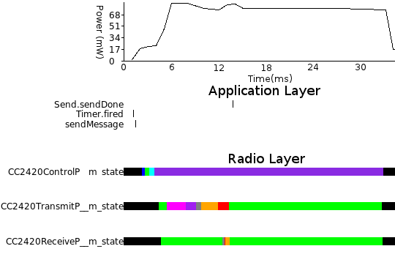
Case study: using watchpoints to trace TinyOS states
Instrumented
Each state transition (indicated by an assignment to variables *m_state)
Each task handler
Gives visibility of fine grained events
Notes:
This first case study shows using watchpoints to trace TinyOS states
Timer fired
Radio startup
Message sent
Acknowledgement received

Slide 21
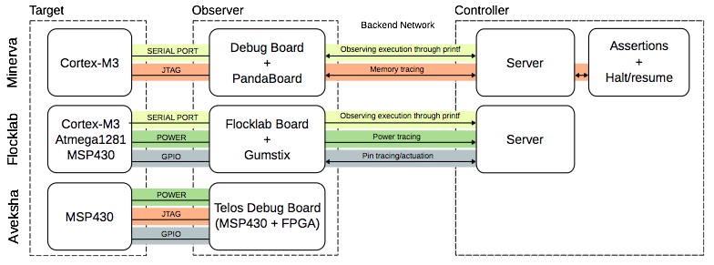
Community impact
Minerva (SenSys13) expands on Aveksha concept with event synchronization and debug capabilities

Slide 22
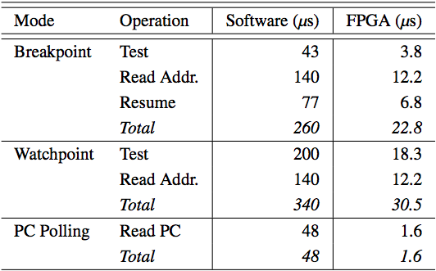
Aveksha conclusion
Achieved fine grained tracing (tasks and function calls)
Not able to achieve complete execution record and replay
Watchpoint mode to slow (cannot exceed 8 events in 976 mote cycles)
PC mode not able to record memory reads (control flow only)

Slide 23
Software record and replay of WSNs

Slide 24
Reference
IPSN 2015
Matthew Tancreti, Vinai Sundaram, Saurabh Bagchi, and Patrick Eugster. TARDIS: Software-Only System-Level Record and Replay in Wireless Sensor Networks. In Proceedings of the 14th ACM/IEEE Conference on Information Processing in Sensor Networks (IPSN), 12 pages, Seattle, Washington, April 14-16, 2015.

Slide 25
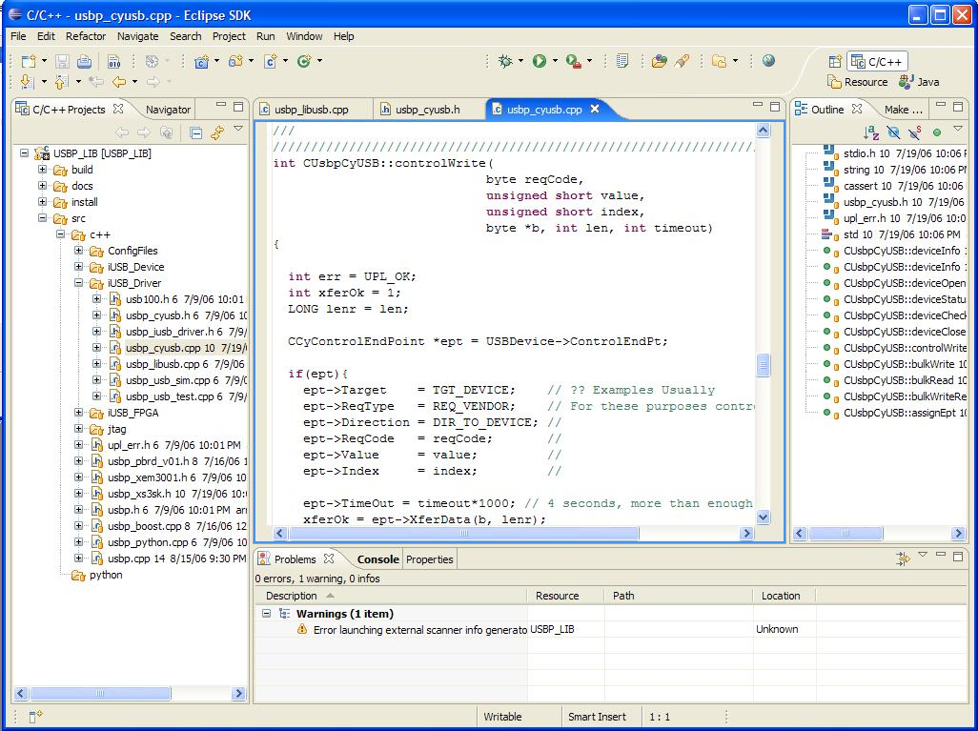
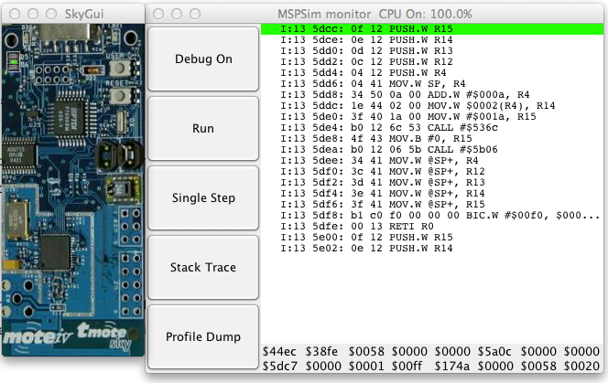
Objectives
Deployment
Instrument
and deploy
On request
transmit log
Code
Debugger
Programmer writes normal C code
TARDIS uses flash storage like a black box recorder
Debugger faithfully reproduces every instruction and memory access
Notes:
At a high level the objective of TARDIS is to provide the ability to record traces on deployed nodes, such that they can be replayed in an emulator.
The emulator provides a GDB like debugging interface.
The programmer write in regular C code, which is then automatically instrumented by a source-to-source compiler.
In deployment each node records to its flash everything needed for replay.
Finally, on request (for example, when a bug is detected) the log is transmitted to a debugger tool.
Our debugger goes beyond replay of select events, it reproduces every instruction and memory access that was performed on the node.
>>> Providing such detailed replay has many challenges.

Slide 26
Challenges
Must record all sources of non-determinism
Peripheral register reads (e.g., ADC, I2C, and timer)
Interrupt timing
TelosB has 1MB flash, 10KB RAM, 8MHz clock
Typical app (MHO) generates 12.9 KB/sec of non-determinism, fills flash in about 1 minute
Solution should not interfere with real-time constraints
Notes:
Providing such detailed replay has many challenges.
In order to achieve instruction level record and replay all sources of non-determinism must be recorded.
There are basically two sources of non-determinism:
1) Reads from peripheral registers. These are registers that are controlled from external sources, for example ADC, I2C, and timer registers
2) The timing of interrupts.
Our target platform, the TelosB, has only 1MB of flash, 10KB of RAM, and an 8MHz clock.
To get an idea, a typical application, for example, MultihopOscilloscope, generates 12.9 KB/sec of non-determinism, which fills the flash in about 1 minute
Also, we want to be carful not interfere with real-time constraints of the application.
>>> At a high level our solution approach is to use a source-to-source compiler to instrument recording of regular C code.

Slide 27
Solution approach
Source-to-source compiler instruments C code to record all non-determinism
Reduce log size by
Carefully identifying only what needs to be recorded
Efficient compression techniques tailored to each source of non-determinism
Contributions
first system-level record and replay for sensor networks
Demonstrate with both TinyOS and Contiki
Notes:
At a high level our solution approach is to use a source-to-source compiler to instrument recording of regular C code.
The advantage of this approach is that it is automated and OS agnostic (we demonstrate it for both TinyOS and Contiki).
We reduce the amount of information that need to be logged by carefully identifying only what is truly non-deterministic.
And by using efficient compression techniques which we tailor specifically to each source of non-determinism.
Our main contribution is that this is the first system-level record and replay for sensor networks.
We demonstrate this with both TinyOS and Contiki.
Prior work has look only at record and replay for control flow or specific events.
>>> This talk will cover…

Slide 28
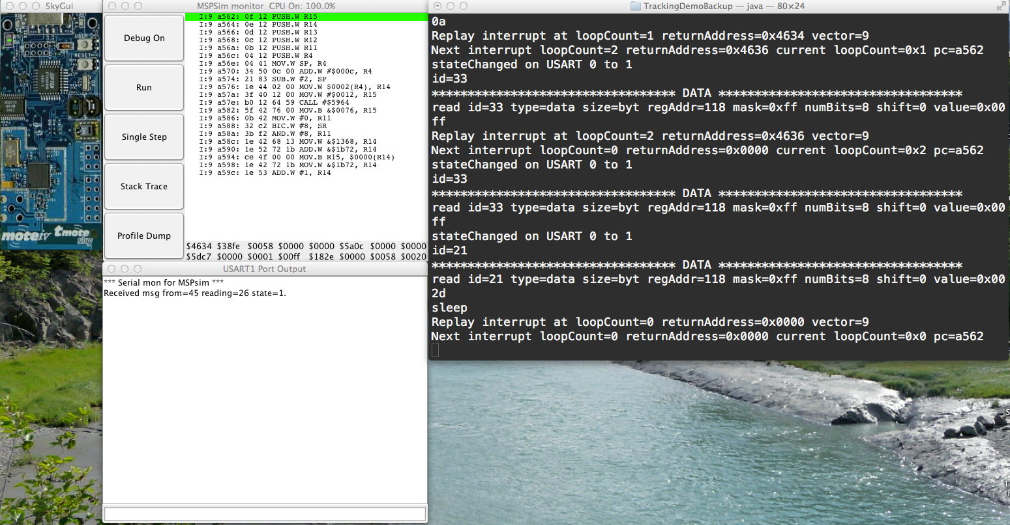
Quick demo
Demo presented to IPSN 2015
Simple light tracking application
Demonstrates GDB like features

Slide 29
Outline
Objectives, challenges, and approach
Design
7 compression techniques
Performance evaluation
Case study: diagnosing CTP bug
Conclusions
Notes:
This talk will cover the design of TARDIS.
The 7 compression techniques used to improve the performance of TARDIS.
An evaluation of the performance.
A case study of diagnosing a bug in CTP.

Slide 30
Compiler design
Peripheral registers
Assumes peripheral registers are addressed statically
TARDIS-CIL discovers and instruments all reads in code
Creates mapping file so emulator knows how each register encoded
Interrupt timing
Instruction counter not available on μC
Software approach record interrupt return address and loop count
Loops and functions instrumented to increment loop counter
Notes:
The compiler needs to instrument code to record the two sources of non-determinism: peripheral registers and interrupt timings.
TARDIS-CIL makes the simplifying assumption that peripheral registers are addressed statically, with only a few exceptions this is true in common operating systems TinyOS and Contiki.
Each read is instrumented to store the value of the read.
A mapping file is created so that the replay emulator will know the location of each instrumentation in the binary and how it was compressed.
For interrupt timing, a hardware instruction counter is not available on the micro-controller, so we use a software approach.
A loop counter is incremented in each loop and repeated function call, to uniquely identify the time of an interrupt.

Slide 31
Runtime design
Record log into buffers in RAM
Buffers compressed and written to flash during down time (before sleep is called)
Flash is a circular buffer, similar to black box recorder
Notes:
During runtime TARDIS logs into RAM buffers, which are then flushed into flash storage.
Some of the compression and the writing to flash occur during slack time, before the node enters sleep mode.
Flash acts as a circular buffer, similar to a black box recorder.

Slide 32
Replay design
Emulator (mspsim) executes code
Starts from known state or checkpoint
Whenever peripheral register read encountered, value is taken from log
Interrupts delivered at logged time
Notes:
For replay we modified the mspsim emulator.
The emulator starts from a known state or checkpoint and executes the code.
Whenever it reaches a read from a peripheral register it uses the value from the log.
Also, all interrupts are delivered based on the log.

Slide 33
Overview of compression techniques
Non-determinism of registers
Polling loops
Register masking pattern
Sleep-wake cycling and interrupts
Timer registers
State registers
Data registers
Notes:
There are 7 techniques to efficient compression of the log, which I will now briefly describe.

Slide 34
Basic experimental setup
MHO (Multihop Oscilloscope) – one node and base station
Typical WSN collection application
5 node network
All nodes actively sending sensor readings

Slide 35
1. Only record non-determinism
Timer B Control Register
non-deterministic
Not all peripheral registers are non-deterministic
In some registers only particular bits are non-deterministic
Record only the non-deterministic bits, reduces log by 26.8%
Notes:
First, we only want to record what is truly non-deterministic.
Not all peripheral registers are non-deterministic, for example, a configuration register.
Some registers are deterministic except for a single bit.
For example, the Timer B Control Register has an interrupt flag bit.
In this case we record only that bit when the register is read.
This reduces the log by about 27%.

Slide 36
2. Polling loops
while (IFG & TXFLG);
Example, interrupt register checked until transmitting flag is cleared
TARDIS-CIL identifies loops that have no side effect on execution
We assume polling loops are eventually exited
Therefore, no need to record peripheral register reads in polling loops, reduces log by 25.9%
Notes:
A common occurrence in embed code is polling loops.
Polling loops contain peripheral register reads that could be costly to logging.
Take for example this polling loop in the Contiki operating system.
The interrupt register is polled until the transmit flag is cleared.
For the purposes of debugging, there is no need to replay these loops, so we ignore them.
This reduces the log by about 26%.

Slide 37
3. Register masking pattern
not_done_transmitting = IFG & TXFLG;
Example, IFG masked except for single flag bit
Masked bits have no relevance to execution of code
Ignore masked bits, reduces log by 56.7%
Notes:
Register masking is another common pattern in embedded code.
In this example the interrupt register IFG is being masked to revile only the transmit flag bit.
Because only the unmasked bit is relevant to the execution of the code, we log only that bit.
This technique reduces the log by about 57%.

Slide 38
4. Sleep-wake cycling and interrupts
WSNs depend on sleep-wake cycling for energy conservation
Interrupts normally require recording 16-bit return address and 16-bit loop counter
Sleep mode can only exit with an interrupt
Design: interrupts that exit sleep mode do not need timing logged, reduces interrupts log by 12.7%
Notes:
Sleep-wake cycling is a key feature of sensor networks for energy conservation.
Normally recording the timing of an interrupt requires logging the 16-bit return address and the 16-bit loop counter.
However, the only way to exit sleep mode is for an interrupt to execute, so during replay we can deliver the next interrupt whenever sleep mode is entered without having recorded the return address and loop counter.
This reduces the interrupt log by about 13%.

Slide 39
5. Timer registers
timer_A = TAR;
Delta between timer reads or capture/compare register after interrupt is usually small
Design: record timer delta, reduces timer log by 72.7%
Notes:
Timer registers typically change very little between consecutive reads.
Also, following an interrupt the value of a time is likely to be close to the value of the capture/compare register that cased the interrupt.
We record only the delta between timer reads.
This reduces the timer log by about 73%.

Slide 40
6. State registers
pending_interrupts = IFG;
State registers report a state, for example, interrupt flags indicating pending interrupt
Consecutive reads often repeat value
Design: encode state registers with RLE, reduces state log by 47.8%
Notes:
State registers report a state, for example an interrupt flag indicating a pending interrupt.
We have observed that consecutive reads often repeat values.
For this reason we use the very simple compression method of run-length encoding.
This reduces the state log by about 48%.

Slide 41
7. Data registers
receive_byte = RXBUF;
Example: I2C data
Comes from radio and sensors
Design: compression using light-weight generic compression LZRW-T
Reduces data log by 65.7%
Notes:
There are some peripheral registers that contain generic data, such as an I2C register that is used for sensor and radio data.
For this we use a generic light-weight compression algorithm, LZRW-T.
This reduces the data log by about 66%.

Slide 42
Evaluation setup
MHO (Multihop Oscilloscope) – one node and base station
MHO network – 9 node network
EM (Earthquake Monitor) – 100Hz samples
Collect – Contiki OS
Notes:
For the evaluation we used at the TinyOS application Multihop Oscilloscope to represent a common data collection application.
We evaluate Multihop Oscilloscope as a single node to represent a network without radio traffic and in a network of 9 nodes where all nodes are sending sensor readings.
We used an earthquake monitor application to represent an application with a high sample rate of 100Hz.
We also show that our approach works in other operating systems by sowing Collect in Contiki.

Slide 43
Static overhead
Program size increased ~10KB due to added instrumentation and logging code
RAM usage increased ~2KB due to compression and logging buffers
Notes:
Here is the static overhead of TARDIS.
The program size is increased about 10KB due to added instrumentation and logging code.
This depends on the number of locations in the code that read from peripheral registers, because this is abstracted away in the OS it is not highly application dependent.
The RAM usage is increased about 2KB due to compression and logging buffers.

Slide 44
Rate of log growth
“Uncompressed” is recording only non-deterministic registers
Logging increases with LPL and with radio traffic due to more interrupts and timer events
Why does TARDIS increase significantly from Network 64ms to Network 512ms?
Notes:
For log size in flash we compare to an uncompressed trace of non-deterministic registers and interrupts.
We see that the logging rate increases with LPL mode due to more interrupts and timer events.
Logging increases the most when radio traffic is present.

Slide 45
Size by log component
Currently interrupts and timer registers take the most log space
Interrupt log increases in conditions where nodes not sleeping often (e.g., heavy network traffic with LPL)
Timer compression can be improved by taking advantage of capture/compare register knowledge
Notes:
Here we see the size in log by type of register or interrupt.
Currently interrupts and timer registers take the most log space.
For interrupts, the log increases in conditions where the nodes are not sleeping often, for example, in heavy network traffic with low power listening mode.
Timer compression can be improved by taking advantage of capture/compare register knowledge.
This is the register that is used to trigger the next timer interrupt.

Slide 46
Duty cycle
Do not want to interfere with application
TARDIS performs some compression and writes to flash during down time, when node would be sleeping
Unmodified Network 512ms increases over Network 64ms due to longer active time to send and receive messages
TARDIS Network 64ms increases over Network 512ms due to longer radio on time to perform clear channel assessment
Notes:
We want to be careful that TARDIS does not interfere with the timing of the application.
TARDIS preforms some of its compression and writes to flash during slack time, when the node would be sleeping.
We see that 64ms LPL has the largest increase in duty cycle because TARDIS is keeping the node awake longer on clear channel assessments.

Slide 47
Average power consumption
Change in power consumption only noticeable when using LPL
TARDIS power consumption increases when going from 512ms to 64ms
Radio is most significant consumer of energy
Notes:
The change in power consumption is only noticeable when using low-power listening mode, this is because the radio dominates power consumption.
In the previous slide we saw that for 64ms LPL mode the amount logged is lower.
The increase in power consumption is due to the radio being on longer during clear channel assessment.

Slide 48
Comparison to other compression techniques
MHO significantly more compressed compared to generic compression (gzip and SLZW)
Also performs well against control flow recording

Slide 49
Case Study: CTP Bug
When partition forms for longer than 30 seconds, network takes 30 minutes to heal
Goes against CTP principal of quick recovery from broken links
ETX value continues to rise because of routing loops in partitioned nodes
Because TARDIS can replay all memory state we can see ETX increasing
Logging rate is low in healthy network but raises due to high traffic cased by routing loops
Notes:
We have demonstrated using TARDIS to diagnose a new bug in the CPT routing protocol.
When the network becomes partitioned for longer than 30 seconds, it often takes the network 30 minutes to heal.
This goes against the CTP principal of quick recovery from broken links.
Because TARDIS can replay all memory state we can see ETX increasing due to polling loops that are not being resolved.

Slide 50
Future Work
Replay of entire network (need to connect messages)
Replay of multiple code versions (Envirolog provides conditions under which this is possible)
In-network replay (eliminates need for potentially costly log retrieval)

Slide 51
Conclusions
Deployment
Code
Debugger
First system-level record and replay for sensor networks
Programmer writes normal C code
Debugger faithfully reproduces every instruction and memory access
Provides GDB like interface for remote nodes
Notes:
In conclusion we have developed the first system-level record and replay for sensor networks.
The programmer can write applications in normal C code.
The debugger is able to reproduce every instruction and memory access, which means any software bug can be reproduced.
This provides a GDB like interface to the user.
Thank you.

Slide 52
Backup

Slide 53
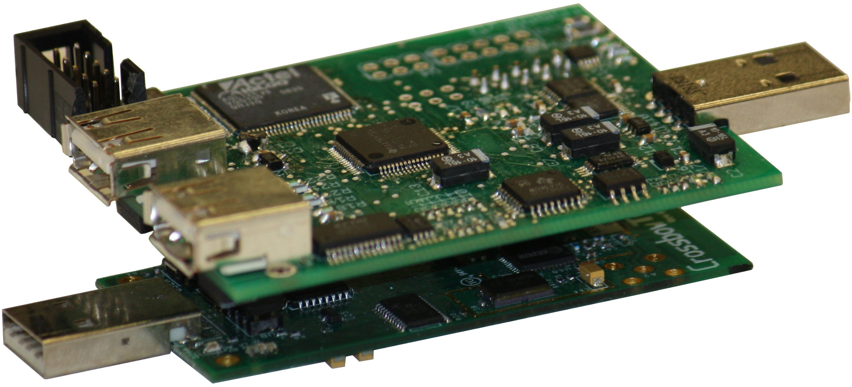
Other Features of the Board
Energy monitoring
Range of 18uA to 30mA
Two amplifiers x10 and x105
Inexpensive 12bit ADC (on MSP430)
Samples at 20kHz
Streaming data over USB
Can also be used as a bench-top debugger
Can be powered through USB or battery
Provides power to the mote
Low power, board enters sleep when mote is in sleep
Notes:
Other features of the board are…

Slide 54
Background: Interfacing to the OCDM over JTAG
JTAG commands
Set watchpoint and breakpoint triggers
Poll CPU status (e.g., if halted at a breakpoint)
Poll the state-storage buffer (for information stored at watchpoint trigger)
Poll the program counter (PC)
These sequences map to 3 operation modes of the debug board: watchpoint (WP), breakpoint (BP), and PC polling
Notes:
JTAG is how our board interfaces with the mote. The JTAG commands include…

Slide 55
WP/BP Mode: MSP430 OCDM Triggers
Total of 8 triggers can be set
Each trigger specifies a condition on
Value present on data or address bus (MDB/MAB)
Operation type: read, write, or instruction fetch (-R/-W/-F)
Can combine individual triggers to create complex triggers
8 entry state-storage circular buffer stores MDB and MAB when trigger fired; can be read out through JTAG
Code
Triggers
data=0x12B0
addr=0x4545
next
next
...
0x4545: call 0x5550
...
MDB-F==0x12B0
State
Storage
Key design challenge: read buffer at a fast rate to prevent overwritten data
Notes:
First I will cover watchpoint and breakpoint polling modes.

Slide 56
PC Polling: Extracting Function Start Addresses
At boot-up, read program binary from mote through JTAG and perform disassembly
Discover location of function and interrupt start addresses
Used to lookup what function a PC address belongs to
Has the advantage of requiring no setup in advance
ffe0 <InterruptVectors>:
403a
8536
8c24
8876
8460
40c4
4078
86aa
4078 <sig_TIMERA0_VECTOR>:
4078: 0f 12 push r15
407a: 0e 12 push r14
407c: 0d 12 push r13
407e: 0c 12 push r12
4080: b0 12 94 40 call #0x4094
4084: 3c 41 pop r12
4086: 3d 41 pop r13
4088: 3e 41 pop r14
408a: 3f 41 pop r15
408c: b1 c0 f0 00 bic #240, 0(r1)
4090: 00 00
4092: 00 13 reti
4094 <Msp430TimerCapComP__0__Event__fired>:
4094: 1f 42 62 01 mov &0x0162, r15
4098: 8f 10 swpb r15
409a: 5f f3 and.b #1, r15
409c: 02 24 jz $+6
409e: 1f 42 72 01 mov &0x0172,r15
40a2: 30 41 ret
Function start address table
0x4078
0x4094
...
Notes:
In order to map a PC value to a code block we need to know the start address of each code block.
NEXT: Both watchpoint polling and PC polling have limitations.
Now I will discuss the overall steps of the system. When the TDB is connected to a mote it uses JTAG to halt the motes processor. It then reads the program from the mote and performs disassembly. This is used to discover the location of function pointers. The function pointer table is used to lookup what function a PC address belongs to. The advantage of disassembly is that the TDB does not need to be setup ahead of time (just plug it into a mote an it starts working). This aids in ease of use. Next, watchpoint trigger are set. Then, the mote is restarted. Then, the polling of the state storage buffer or PC address begins. When events are triggered they are sent though a filter recorded if they are important.

Slide 57
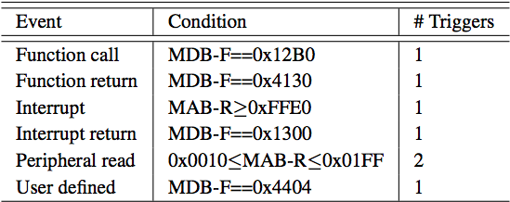
WP/BP Mode: Mapping Software Events to Triggers
Triggers can be set for generic events e.g., function call and return
A nop instruction can be used by the programmer to specify arbitrary trigger locations in code
provided to tracer
name value
if (ready()) {
NOP; // state_m ON
state_m = ON;
} else {
NOP; // state_m OFF
state_m = OFF;
}
Notes:
Here are examples of triggers that can be used in the first two modes (Watchpoint and Breakpoint)

Slide 58
PC Polling Mode
JTAG allows continuous polling of program counter
This provides information about program control flow
PC value can be mapped to a code block or function
Need to know the start address of each code block or function
Basic use of PC polling
flow a
flow b
void f() {
if (x) {
a();
} else {
b();
}
...
}
f
a
b
f
Notes:
The final mode is PC polling.

Slide 59
Limitations of Watchpoint and PC Polling Modes
Watchpoint mode
Circular (black box recorder) state-storage buffer of 8 entries
Each poll takes 122 mote cycles
Therefore, cannot exceed burst of 8 events in 976 mote cycles
For example, suitable for monitoring task execution and state transitions in TinyOS, but not function calls
PC polling mode
Only provides PC values, cannot get MDB and MAB values
Each PC poll takes 7 mote cycles
Suitable for task and function call granularity
Notes:
Both watchpoint polling and PC polling have limitations.

Slide 60
Design Challenge: Speed of JTAG Polling
If JTAG is controlled by a μC on the debug board
μC has to generate a JTAG clock signal and process trace data
Using an MSP430 running at 8MHz would take the time shown
1,360 cycles
192 cycles
Not suitable for fine grained tracing
Notes:
If…

Slide 61
FPGA Pipeline for Function Profiling
Implemented a pipelined architecture on an FPGA to improve the throughput
For example, PC polling pipeline stages are
Poll PC address
Binary search for function pointer
Filter block: does PC value indicate entry into a new function
Output buffer interfaces to debug board MCU
Notes:
To get around this limitation we…

Slide 62
Case Study 1: Using Watchpoints to Trace TinyOS States
Instrumented
Each state transition (indicated by an assignment to variables *m_state)
Each task handler
Gives visibility of fine grained events
Notes:
This first case study shows using watchpoints to trace TinyOS states
Timer fired
Radio startup
Message sent
Acknowledgement received

Slide 63
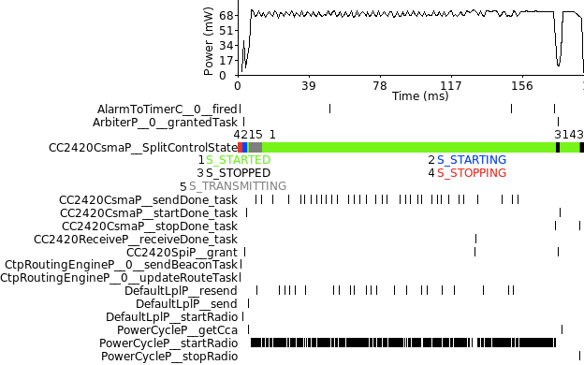
PowerCycleP Re-post Bug
Discovered a bug in TinyOS when tracing tasks
PowerCycleP__startRadio re-posts itself
Notes:
We also discovered a resource consumption bug

Slide 64
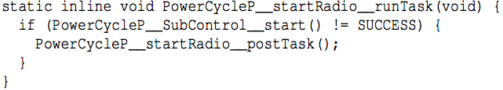
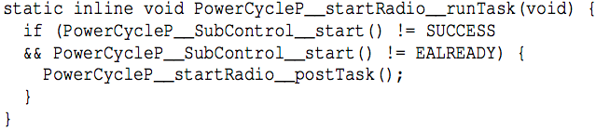
PowerCycleP Bug Explained
startRadio task re-posts if SubControl__start() != SUCCESS
When radio is already started SubControl__start() = EALREADY
Simple fix
Now patched in TinyOS repository (bug tracker issue 51)

Slide 65
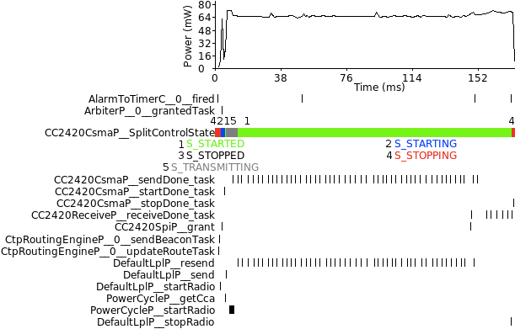
With Bug Fixed
Notes:
Providing this visibility, we believe that our board provides more powerful forms of debugging.

Slide 66
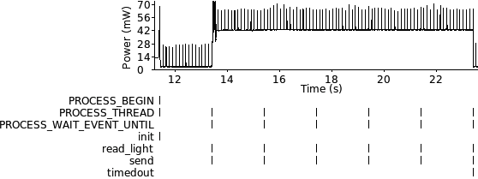
Case Study 2: Monitoring Contiki Processes
LightTracking application [IPSN’11]
Trace Contiki processes
Verifies OS agnostic nature of our architecture
Required no change of TDB switching from TinyOS to Contiki application
Notes:
To demonstrate that our approach is OS agnostic we also traced a Contiki application

Slide 67
Requirement for record and replay
Must record all sources of non-determinism
Peripheral register reads
Data from external sources (e.g., ADC, I2C, and timer)
Assume peripheral registers addressed statically (almost always true in TinyOS and Contiki)
TARDIS-CIL discovers and instruments all reads in code
Interrupt timing
Instruction counter not available on μC
Software approach record interrupt return address and loop count
Loops and functions instrumented to increment loop counter

Slide 68
Deterministic Record and Replay
Deterministic replay requires
A checkpoint of processor state
A log of all non-deterministic processor events
Non-deterministic events
Interrupts (specifically when in instruction stream they occur)
Reads from “peripheral registers”
Peripheral registers include
I2C
ADC (Analog-to-digital converter)
Timer
Interrupt vector
Notes:
Deterministic replay requires…

Slide 69
Key Insight: Register Classification
Typical μC: all non-deterministic I/O passes through peripheral registers
We can observe the common behavior of registers and classify them into three sets that compress well together
State – interrupt vectors, interrupt flags, overflow flags, and ready flags
Data – general purpose I/O and tx/rx communications
Timer – counters incremented by possibly asynchronous clock
Notes:
One key insight is to classify registers into types. It is typical on microcontrollers that all non-deterministic I/O passes through peripheral registers.

Slide 70
Key Insight: Only Record Necessary Non-determinism
Common case | Example | Optimization
Register masking | not_done_transmitting = IFG & TXFLG; | Only record non-deterministic bits
Polling loop | while (IFG & TXFLG)); | Do not record polling loops
In some cases the entire register does not need to be recorded
When a register is used in masked form, only unmasked bits need to be recorded
Polling loops that have no side effects on memory state do not need to be recorded
Notes:
Another key insight is to only record the necessary non-determinism.

Slide 71
Question 1: What is the time between a fault-triggering input and detection?
Why this question? | It is useful when using record and replay to know how much trace the black box recorder needs to store Some numbers have been published in literature for other types of systems, but not WSN [Sathre 2009]
How? | Assemble list of bugs from bug reports Use bugs that have simple detectors Measure time from trigger to detection For example, with buffer overflow, time from first write to buffer to time of overflow
Evaluation | Time from trigger to detection

Slide 72
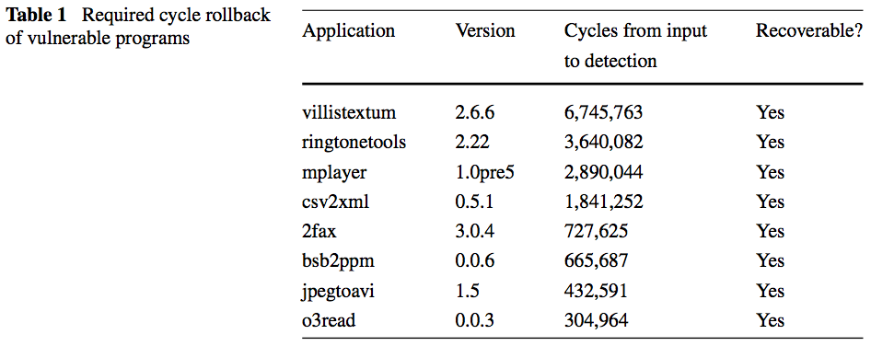
Time from Input to Detection

Slide 73
Question 2: What remote diagnostic approaches are feasible for WSN?
Why this question? | A key motivating of remote replay is to develop systems that can diagnose failures This forms a key step in self-healing and self-protecting systems
How? | Investigate self-diagnoses approaches such as Triage [Tucek SOSP07] What is the time and performance of delta generation and analysis when using the previously proposed WSN replay

Slide 74
Unanswered Research Question
We have demonstrated two methods of record
But a question of replay remains: Where should replay take place, at the server or at the node?

Slide 75
Why Replay at the Node?
We have assumed replay occurs in a central server
Network bandwidth is limited and unreliable
Ideal transmission rate (TelosB) is 250 kbps, but limited by path loss, noise floor, radio congestion, low power protocols, and queuing time
Failed node may have lost network connection

Slide 76
Log Download Requirements
checkpoint₁
events₁
checkpoint₂
events₂
empty
head
When bug detected programmer wants to replay time before detection
Often only a short replay in time is enough to find the cause of the bug
The smallest possible download is all of checkpoint₂ + events₂
Best case 10KB + 0KB = 10KB
Worst case 10KB + 490KB = 500KB
One solution is to take checkpoints more often
strongly discouraged because taking checkpoints is disruptive to applications
ideally take as few checkpoints as possible

Slide 77
Inter-node Bug Tracking Scenario
node₁
node₂
node₃ (cluster head)
1. bug
checkpoint₁
checkpoint₁
checkpoint₁
events₁
events₁
events₁
2. send
checkpoint₂
checkpoint₂
3. fwd
checkpoint₂
events₂
events₂
events₂
4. detection
The bug results in an erroneous sensor reading.
Node₁ sends the sensor reading to node₂.
Node₂ forwards the sensor reading to node₃ (a cluster head node).
The cluster head aggregates the sensor readings and sends them to the base station where an operator identifies a suspicious aggregated result
Because the result is aggregated it is not immediately clear where the erroneous sensor reading originated.

Slide 78
Naïve Replay Approach
node₁
node₂
node₃ (cluster head)
1. bug
checkpoint₁
checkpoint₁
checkpoint₁
events₁
events₁
events₁
2. send
checkpoint₂
checkpoint₂
3. fwd
checkpoint₂
events₂
events₂
events₂
4. detection
First download n₃-checkpoint₂ and n₃-events₂ and replay to find that message came from node₂
Download n₂-checkpoint₂ and n₂-events₂ and replay
Turns out not enough of the log is downloaded
Download n₂-checkpoint₁ and n₂-events₁
Download n₁-checkpoint₁ and n₁-events₁ and replay to find bug

Slide 79
Solution
Replay on the nodes themselves
Challenges
Is it possible to efficiently emulate execution on such low resources (e.g., no memory manager)?
Can replay be performed quickly enough to make a significant difference compared to the naïve approach?
How does the programmer interact with the replay system?
How can different diagnostic tools be used during replay?

Slide 80
Basic Replay Process
User requests replay
Disable interrupts
Dump RAM to flash
Load checkpoint from flash to RAM
Program node with a replay version of the code*
Execute replay, storing results to flash
Program node with normal version of the code
Load RAM with previous dump
Enable interrupts
Send replay results to user
* This is likely to be the most significant factor in how much time switching between replay and normal execution costs, making it disruptive to the execution of the sensor network. Can this be avoided by combining replay and normal code?

Slide 81
Implementing Replay
Interrupts
Execute until loop count reaches next logged interrupt
When the PC reaches the logged value execute interrupt
This is tricky
Pessimistic timer algorithm or precompiled tables?
Is their a better way?
Reads from registers
Similar to the record phase
During compile, when static read is encountered add code to load correct value from flash
Write to registers
Cannot allow code to write to some registers or it will disrupt replay (e.g. interrupt enable) or send peripherals (e.g. radio) into unknown state or consume unnecessary energy
During compile, static writes need to have code added to guard them during replay

Slide 82
Fast Switching between Replay and Normal Execution
There is a significant time to reprogram for replay and normal execution (~10 sec)
Better approach is to combine replay code with the normal code that has been instrumented for record
When a peripheral register read is encountered check if it is in record or replay mode
However, this makes it more difficult to add debugging instrumentation

Slide 83
Debugging Instrumentation
The advantage of record and replay is that it enables any debugging technique to be applied after the initial run
How to achieve a high level of flexibility without knowing at compile time what type of debugging techniques might be used?
At the point in code where instrumentation needs to be added, insert jump to special location
The special location calls the log function with the correct parameters and then returns

Slide 84
Repeated Replay
checkpoint₁
events₁
checkpoint₂
events₂
Time K
Time J
checkpoint_{J}
checkpoint_{K}
It is expected that the user will not find the bug on the first try
Also the user will not always know how far to go back to find the source of the bug
User requests to start debugging replay at time J
Replay must start at a checkpoint
At half way between checkpoint at time J a new checkpoint_{K} is created
When replay reaches time J a new checkpoint_{J} is created

Slide 85
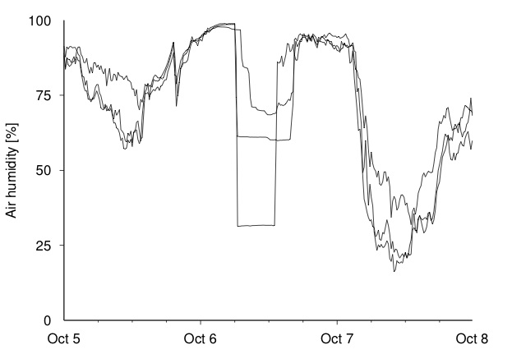
Multiple Node Debugging
node₁
node₂
1. bug
checkpoint₁
checkpoint₁
events₁
events₁
2. send
checkpoint₂
checkpoint₂
3. fwd
events₂
events₂
suspicious behavior observed at time
Need a system to describe time and establish partial ordering of events between nodes
Each checkpoint contains [timestamp, send_count]
The send_count is also attached to message sent by a node

Slide 86
Conclusion
Innovations in sensor network replay
New algorithm for interrupt timing replay
Fast switching between replay and normal execution
Efficient debugging instrumentation
Quick repeated replay
Multiple node debugging
No described here
What is the language and protocol for running replay remotely?
How to describe where to begin the replay?

