Slide 1
ACES: Automatic Compartments for Embedded Systems
Abraham A. Clements
clemen19@purdue.edu
Naif Saleh Almakhdhub,
nalmakhd@purdue.edu
Saurabh Bagchi
sbagchi@purdue.edu
Mathias Payer
mathias.payer@nebelwelt.net
Sandia National Laboratories is a multimission laboratory managed and operated by National Technology & Engineering Solutions of Sandia LLC, a wholly owned subsidiary of Honeywell International Inc., for the U.S. Department of Energy’s National Nuclear Security Administration under contract DE-NA0003525. SAND2018-8907 C

Slide 2
Problem Statement
Bare-metal IoT devices/ SoC’s are vulnerable
Google P0’s Broadcom SoC
CVE-2017-6957
Legacy code
IoT devices, vehicles, etc.
No defenses
Even DEP is missing
No separation of privileges
Bare-metal Application
Application Logic
Image
Proc.
TCP
Stack
Serial
Coms
Signal
Proc.
Camera
HAL
WIFI
HAL
UART
HAL
ADC
HAL
Camera
2.4Ghz Radio
UART
ADC
Privileged code
Hardware peripheral
Result: Single vulnerability compromises the entire system

Slide 3
ACES Overview
ACES creates many compartments
Applies least privileges
Creates sub-thread compartments
Protects integrity of sensitive data and peripherals
Uses static analysis to automatically infer compartments using a policy
Separates compartmentalization from application development
Each compartment has associated data/peripherals
Compartmented Application
Application Logic
Comp.
Switcher
Image
Proc.
TCP
Stack
Serial
Coms
Signal
Proc.
Camera
HAL
WIFI
HAL
UART
HAL
ADC
HAL
Camera
2.4Ghz Radio
UART
ADC
Privileged code
Compartmented unprivileged code
Hardware peripheral

Slide 4
Related Work
EPOXY – DEP, diversity, and stack protections for bare-metal systems
Does not address least privileges
Clements A. A. et al. Oakland 2017 (Our work)
Mbed uVisor – runtime and API to manually create compartments
Intermixes source and compartmentalization policy
Requires Mbed OS
https://www.mbed.com/en/technologies/security/uvisor/
MINION – Creates thread level compartments on micro-controllers
Fixed algorithm used to determine compartments
Kim, C. H. et al. NDSS 2018

Slide 5
Compartments
Set of concurrently accessible memory regions and authorized control-flows between them
Compartments restrict
Accessible memory
Control-flow between compartments
A
B
Comp A
OnBtn
WIFI
Peripherals
CAMERA
GPIO
TakeImg
UART
RAM
Region 1
Comp B
TxImg
Region 2
Control-flow
Function
Memory Regions
TcpTx
Comp A
Code
Data
Peripheral
Code
Comp B
Accessible for compartment
Notes:
Compartment is collection of memory regions and authorized control flow transfers.
Compartments data and code.

Slide 6
Creating Compartment
Static analysis identifies code, data, and peripheral dependencies
ACES ensures compartments can access all required data and peripherals
Mirco-Emulator used to dynamically identify missed due to dependencies aliasing
Compartments are code centric
i.e. code belongs to only one compartment
Policy determines how functions, global variables, and peripherals are grouped to create compartments
Different policies possible
We evaluate: Naïve Filename, Optimize Filename, and Peripheral policies
MPU is used to restrict access to memory regions

Slide 7
Program Dependency Graph
void OnBtn()
GPIO.led = ON
CAMERA.pwr = ON
g_btn = PUSHED
TakeImg()
TxImg()
void TakeImg()
CAMERA.take_pic = 1
g_image.buf = CAMERA.rx_reg
GPIO.led = OFF
void TxImg()
g_tx_state = ACTIVE
TcpTx(g_image.buf)
g_image.sent = TRUE
void TcpTx(*buf)
GPIO.led_tx = ON
WIFI.tx_reg = buf
g_tcp_stats.tx_count++
g_tx_state = IDLE
TakeImg
CAMERA
OnBtn
GPIO
g_btn
TxImg
g_image
g_tx_state
TcpTx
g_tcp_stats
WIFI
Notes:
P1, F1, G1 for variables

Slide 8
Region Graph
CAMERA
PDG mapped to a Region Graph
Functions 1:1
Control edges not transferred
Data 1:1
Data edges transferred
Peripherals 1:Many
Unique region created per dependency edge
TakeImg
GPIO
TakeImg
CAMERA
CAMERA
GPIO
OnBtn
GPIO
OnBtn
g_btn
g_btn
g_image
TxImg
g_image
TxImg
g_tx_state
g_tx_state
g_tcp_stats
TcpTx
g_tcp_stats
TcpTx
WIFI
WIFI
GPIO

Slide 9
Compartmentalization Policy
CAMERA
Defines what should be grouped to form compartments
Implemented policies
Naïve Filename
Optimized Filename
Peripheral
Many more are possible
TakeImg
GPIO
CAMERA
OnBtn
GPIO
g_btn,
g_image
g_btn
TxImg
g_image
TxImg,
TcpTx
g_tx_state
TcpTx
g_tcp_stats
WIFI
GPIO

Slide 10
Optimize
CAMERA
Improve security
Improve performance
TakeImg,
OnBtn
GPIO
TakeImg
CAMERA
OnBtn
GPIO
g_btn,
g_image
TxImg,
TcpTx
g_tx_state
g_tcp_stats
WIFI
GPIO

Slide 11
Lowering
Reduces graph to meet HW constraints
Degree of each code regions must be less than the number of MPU regions
Lowest cost regions merged until constraints are met
Lowing may increases permissions of compartments
Merging peripherals may capture additional peripherals
TakeImg,
OnBtn
CAMERA
GPIO
g_btn,
g_image
TxImg,
TcpTx
g_tx_state
g_tx_state,
g_tcp_stats
g_tcp_stats
UART,GPIO,
CAMERA,WIFI
WIFI
GPIO

Slide 12
Mapping to Memory
A
B
Comp. A
TakeImg,
OnBtn
WIFI
CAMERA
CAMERA
Peripherals
GPIO
GPIO
UART
Region 1
g_btn,
g_image
Comp. B
TxImg,
TcpTx
Region 1
RAM
Region 2
g_tx_state,
g_tcp_stats
Region 2
Code
Comp A
UART,GPIO,
CAMERA,WIFI
Comp B

Slide 13
Restricting Control-Flow
Comp A
Instrument calls and returns crossing compartment boundaries
Invoke compartment switcher
Compartment switcher authenticates both directions
Memory permissions only changed for valid transitions
OnBtn
TxImg
TakeImg
Comp B
TcpTx
Call
Comp. Switcher
OnBtn
Return
TxImg

Slide 14
Micro-Emulator
Emulates store instructions in software
Overcomes limitations of static analysis in generating PDG
Authenticated writes outside a compartment’s regions
Dynamic profiling run creates white-list of accesses per compartment
Used for stack protection
Previous Stack
RO
New Locals
RW
Stack Memory Space
MPU Permissions

Slide 15
Evaluation
Evaluated policies for security, runtime, resource usage
Naïve Filename
Optimized Filename
Peripheral
Five applications run on Cortex-M4
PinLock
FatFs-uSD
TCP-Echo
LCD-uSD
Animation

Slide 16
PinLock Case Study
Attacker trying to unlock lock
Assume write-what-where vulnerability in HAL_UART_Receive_IT
 | Overwrite |  | Control Hijack
Policy | Global | GPIO | Direct | Deputy
Naïve Filename | ✔ | ✔ | ✔ | ✔
Opt. Filename | ✔ | ✔ | ✔ | ✔
Peripheral | ✘ | ✔ | ✘ | ✘

Slide 17
Runtime Evaluation
Can have moderate runtime impact
Emulating instructions accounts for largest increase in execution time

Slide 18
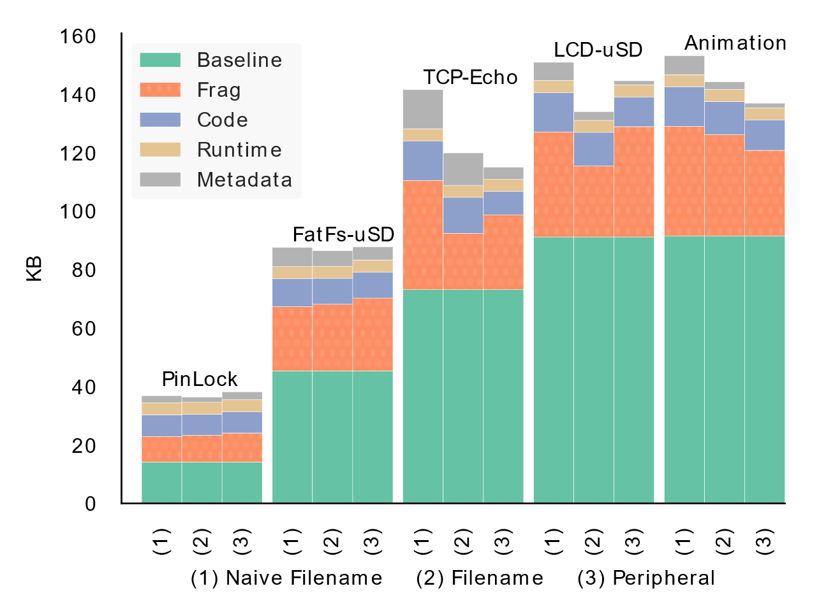
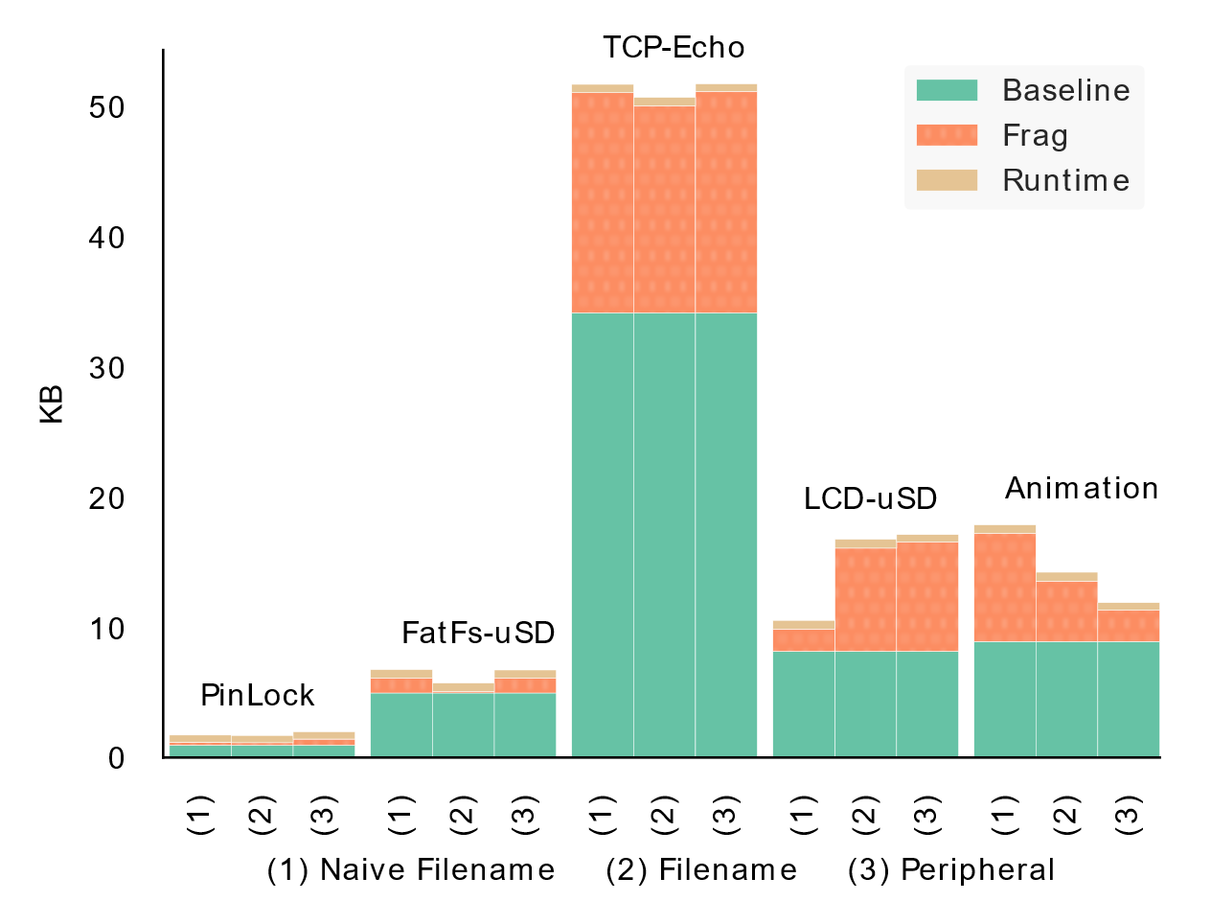
Memory OverhEad
Flash Overhead
RAM Overhead
Notes:
Runtime: Compartment Switcher, Micro-Emulator

Slide 19
Conclusion
Applies least privileges bare-metal IoT devices
Does not require changes to application logic
Uses existing hardware
ACES automatically creates and enforces sub-thread
Decouples security policy from application
Frees developer from having to manage underlying security hardware
Enables research in creating compartmentalization policies
Code will be available at:
https://github.com/embedded-sec/ACES

