Slide 1
User-Centric Workload Analytics: Towards Better Cluster Management
Saurabh Bagchi
Purdue University
Supported by National Science Foundation (NSF) Jul `15-Jul `18
Joint work with: Subrata Mitra, Suhas Javagal, Stephen Harrell (Purdue), Adam Moody, Todd Gamblin (LLNL)
Presentation available at: engineering.purdue.edu/dcsl

Slide 2
Problem Context
Shared computing clusters at university or government labs is not uncommon
Users have a varying level of expertise
Writing own job scripts
Using scripts like a black box
Varying user needs
High computation power
Analysis of large structures (Civil, Aerospace engineering)
High Lustre bandwidth for file operations
Working with multiple large databases/files (Genomics)
High Network Bandwidth
A parallel processing application

Slide 3
Motivation
Challenge for the cluster management
Need for customer centric analytics to pro-actively help users
Improve cluster availability
In addition to failures, investigate performance issues in jobs
Need for open data repository of system usage data
Currently, lack of publicly available, annotated quantitative data for analyzing workloads
Available public data sets provide only system level information and not up-to-date
Dataset must not violate user privacy or IT security concerns
URL: https://github.com/purdue-dcsl/fresco

Slide 4
Cluster Details: Purdue
Purdue’s cluster is called Conte
Conte is a ``Community” cluster
580 homogeneous nodes
Each node contains two 8 core Intel Xeon E5-2670 Sandy Bridge processors running at 2.6 GHz
Two Xeon Phi 5110P accelerator card, each with 60 cores
Memory: 64GB of DDR3, 1.6 GHz RAM
40 Gbps FDR10 Infiniband interconnect along with IP
Lustre file system, 2GB/s
RHEL 6.6
PBS based job scheduling using Torque
Notes:
These are shared clusters called “community clusters”
They have become common in big organizations, academic, industrial, and government labs
A diverse set of sub-units within the organization buy assets in a cluster and these are then put together by central IT
Flexible usage policies, such that partners in the cluster have ready access to the capacity they purchase and potentially to much more, when there are idle resources

Slide 5
Cluster Details: LLNL
SLURM: Job Scheduler
TOSS 2.2 OS
16-core Intel Xeon processors (Cab)
12-core Intel Xeon processors (Sierra)
32GB memory (Cab)
24GB memory (Sierra)
1296 nodes (Cab) and 1944 nodes (Sierra)
Infiniband network

Slide 6
Cluster Policies
Scheduling:
Each job requests for certain time duration, number of nodes and in some cases, amount of memory needed
When job exceeds the specified time limit, it is killed
Jobs are also killed by out-of-memory (OOM) killer scripts, if it exhausts available physical memory and swap space
Node sharing:
By default only a single job is scheduled on a an entire node giving dedicated access to all the resources
However, user can enable sharing by using a configuration in the job submission scripts
Notes:
The job requirements are specified through the PBS submission scripts.

Slide 7
Data Set
Accounting logs from the job scheduler, TORQUE
Node-level performance statistics from TACC stats
CPU, Lustre, Infiniband, Virtual memory, Memory and more…
Library list for each job, called liblist
Job scripts submitted by users
Syslog messages
Summary | Conte | Cab and Sierra
Data set duration | Oct’14 – Mar’15 | May’15 – Nov’15
Total number of jobs | 489,971 | 247,888 and 227,684
Number of users | 306 | 374 and 207
URL: https://github.com/purdue-dcsl/fresco

Slide 8
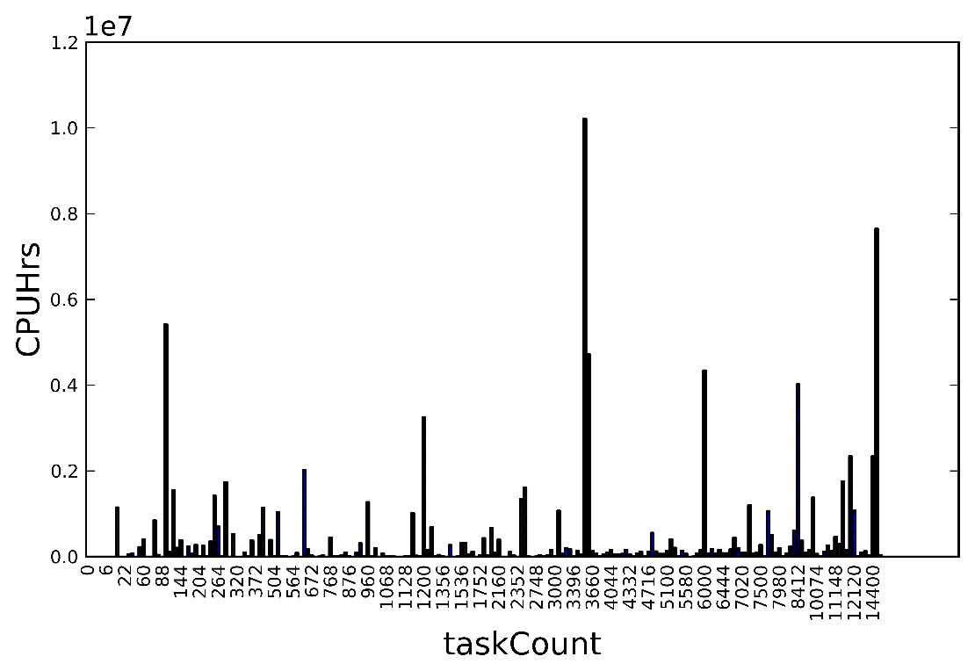
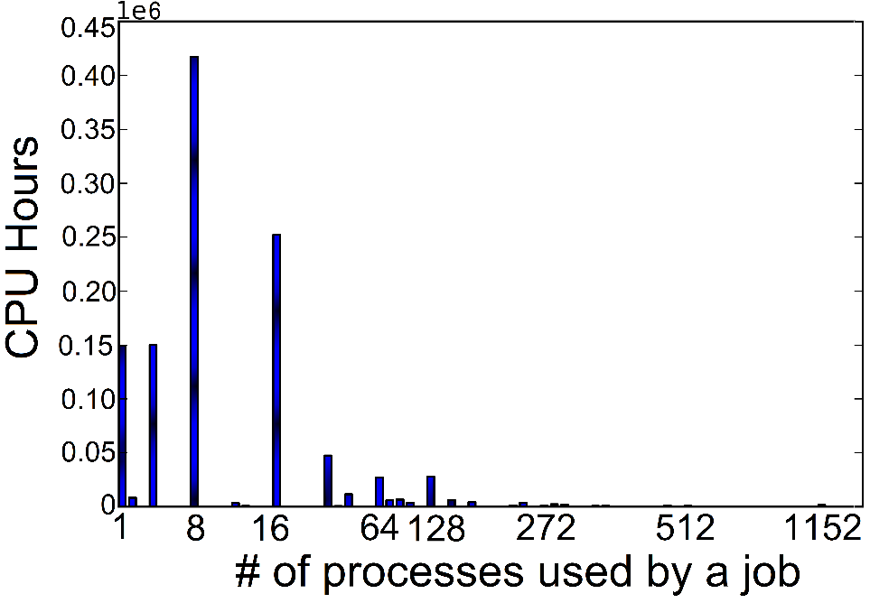
Analysis: Types of Jobs
(A)
(B)
LLNL cluster
Purdue cluster
Different job sizes
Purdue has a large number of “narrow” jobs
LLNL jobs span hundreds to thousands of processes

Slide 9
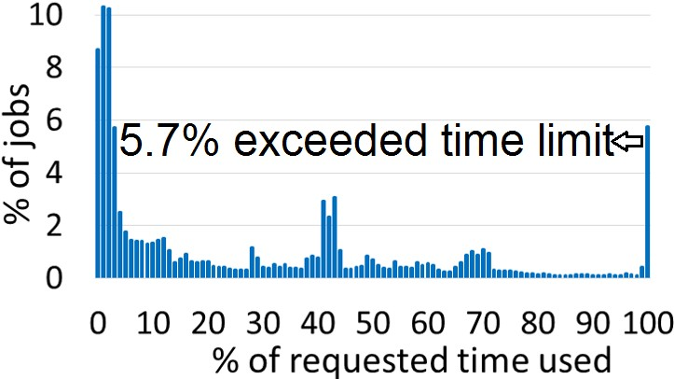
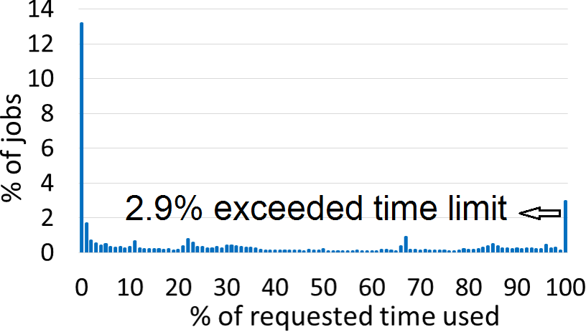
Analysis: Requested versus Actual Runtime
Purdue cluster
LLNL cluster
Users have little clue how much runtime to request
Purdue: 45% of jobs used less than 10% of requested time
LLNL: 15% of jobs used less than 1% of requested time
Consequence: Insufficient utilization of computing resources

Slide 10
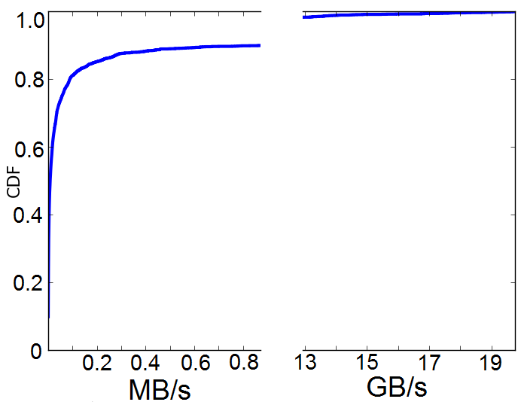
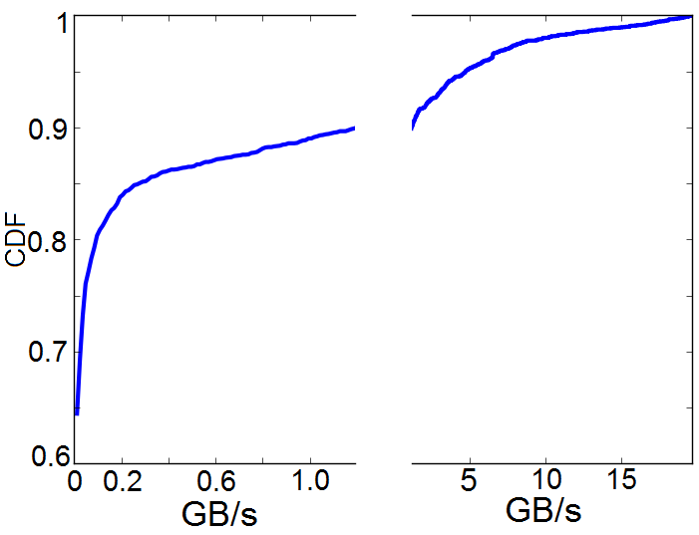
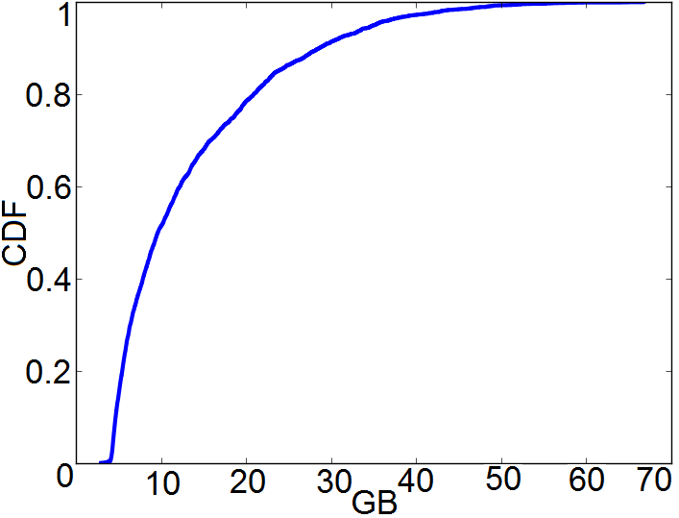
Analysis: Resource Usage by App Groups
Infiniband read rate on Conte
Lustre read rate on Conte
Memory usage on Conte
Clearly, there are 2 distinct types of jobs
Few jobs need high bandwidth backplane for Network and IO
In case of memory, such a distinction is not present
Follow-on: Specialized cluster built in 2015 for high resource demands
Has 56 GBps Infiniband network

Slide 11
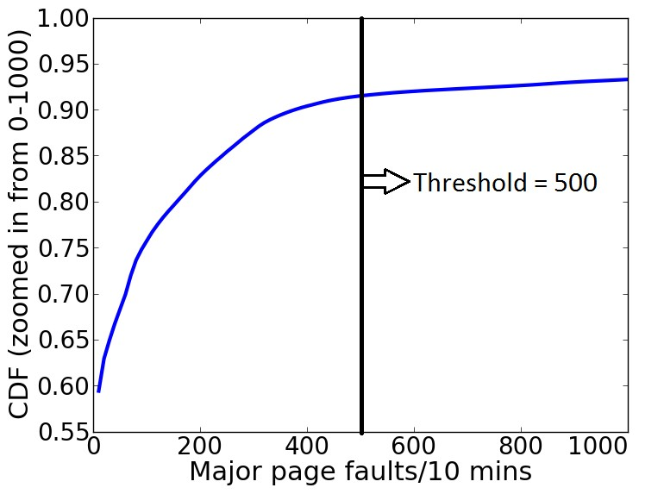
Analysis: Performance Issues due to Memory
Find a (quantitative) threshold on major page fault rate
Find all jobs (and job owners) which exceed the threshold
In the extreme, memory exhaustion leads to invocation of oom-killer, kernel level memory manager
Multiple evidence for memory problems: Syslog messages with out-of-memory (OOM) code and application exit code
92% of jobs with memory exhaustion logged OOM messages
77% of jobs with OOM messages had memory exhaustion exit code

Slide 12
Current status of the repository
Workload traces from Purdue cluster
Accounting information (Torque logs)
TACC stats performance data
User documentation
Privacy
Anonymize machine specific information
Anonymize user/group identifiers
Library list is not shared
For privacy reasons
URL: https://github.com/purdue-dcsl/fresco
Notes:
Bullet 3: Hardware configuration - number of cores on a node, amount of memory on a node, the network backplane, etc.. Software configuration - which libraries and applications to pre-install and where to locate them.
3: We analyzed approximately 500K jobs for this study. This part of a continuing study.

Slide 13
Conclusion
It is important to analyze how resources are being utilized by users
Scheduler tuning, resource provisioning, and educating users
It is important to look at workload information together with failure events
Workload affects the kinds of hardware-software failures that are triggered
Open repository started with the goal for different kind of analyses to enhance system dependability
URL: https://github.com/purdue-dcsl/fresco

