Slide 1


A Study of Failures in Community Clusters: The Case of Conte
Subrata Mitra, Suhas Javagal, Amiya K. Maji, Todd Gamblin, Adam Moody, Stephen Harrell, Saurabh Bagchi
Purdue University ECE, Purdue University ITaP, Lawrence Livermore National Lab (LLNL)
Presentation available at: www.purdue.edu/dcsl

Slide 2
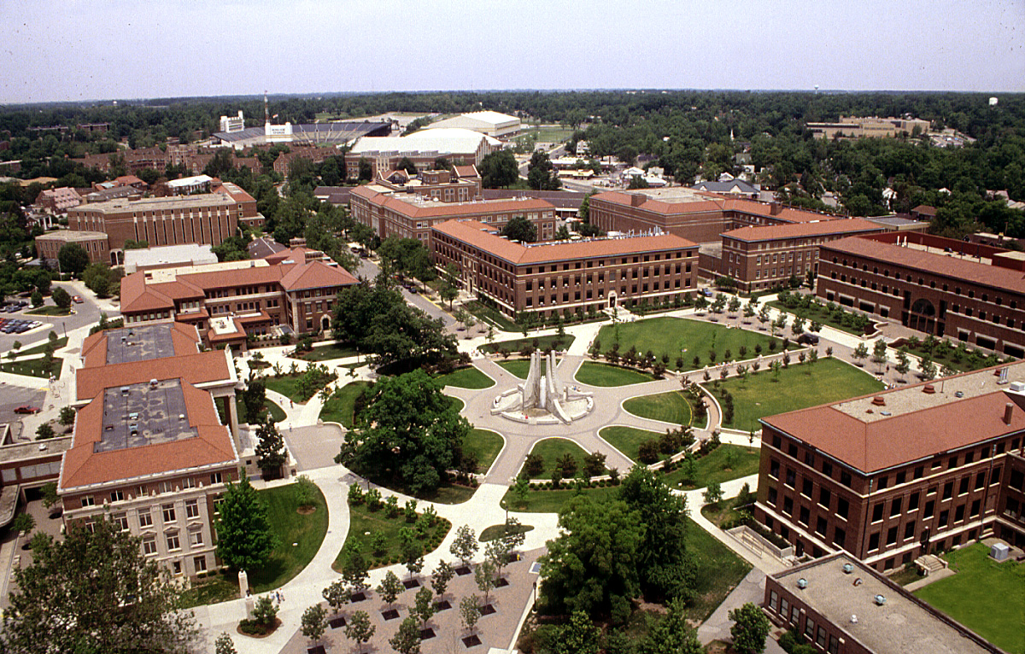
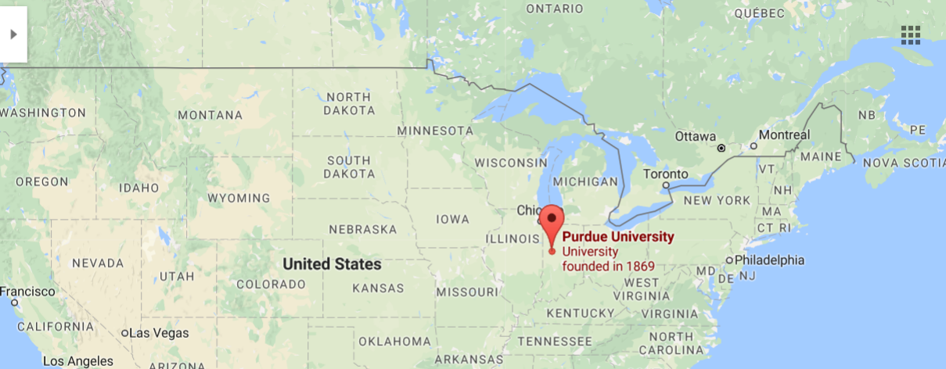
Greetings come to you from …

Slide 3
Roadmap
Motivation for the study
Specifications of the target clusters
Library usages
Requested vs. Actual job execution times
Use of network, IO, memory resources
Analysis of job exit codes
Takeaways

Slide 4
Need for large-scale clusters
The necessity of large scale computing
Bioinformatics
Weather forecasting
Aeronautics
Banking/Finance
Simulations and Numerical computation in Physics/Chemistry
Facilitated by
Faster processors
Accelerators
Cheaper storage and memory

Slide 5
Challenges with large-scale system management
Challenges in balancing multiple factors
  Usability for a large set of diverse users
  Minimizing unplanned outages of the infrastructures
  Minimizing impact of buggy software
  Keeping the job throughput high
Economic/operational challenges
  Improve resource utilization because they are graded on this
  Understand user frustrations and demands (often implicit)
  Low headcount of IT personnel

Slide 6
Key Contributions
Analysis of resource request and usage patterns in a large community cluster
Techniques to
  Classify applications without violating user privacy
  Identify suspicious libraries for job failures
  Identify performance issues in jobs
Validating utility of techniques through user case-studies
First step to setup Open Workload Data Repository – FRESCO

Slide 7
Open Source System Usage Data Repository: FRESCO
Reluctance in providing workload data sets
Set up open, annotated, anonymized workload data repository
Satisfy the need for open, quantitative data for dependability research
Enable comparative study of different clusters
First anonymized data set (from Conte) is uploaded to “FRESCO – Open Data Repository”
www.purdue.edu/fresco

Slide 8
Roadmap
Motivation for the study
Specifications of the target clusters
Library usages
Requested vs. Actual job execution times
Use of network, IO, memory resources
Analysis of job exit codes
Takeaways

Slide 9
Cluster Description: Conte (Purdue)
TORQUE – Job Scheduler
TACC Stats – System performance monitor RHEL v6.6 – OS
LUSTRE file system – File system used by all the jobs
Infiniband and IP network – Communication medium
16-core Intel Xeon processors – CPU (580 nodes)
2 Xeon-Phi Accelerators cards 64GB of memory

Slide 10
Cluster Description: Cab and Sierra (LLNL)
SLURM – Job Scheduler TOSS 2.2 – OS
16-core Intel Xeon processors (Cab) 12-core Intel Xeon processors (Sierra)
32GB memory (Cab) 24GB memory (Sierra)
1296 nodes (Cab) and 1944 nodes (Sierra) Infiniband network

Slide 11
Data Sets and Data Collection Method
Accounting logs from the job scheduler, TORQUE
System-wide performance statistics from TACC stats
Library list for each job, called liblist
Job scripts submitted by users
Syslog messages
Summary | Conte | Cab and Sierra
Data set duration | Oct’14 – Mar’15 | May’15 – Nov’15
Total number of jobs | 489,971 | 247,888 and 227,684
Number of users | 306 | 374 and 207

Slide 12
Roadmap
Motivation for the study
Specifications of the target clusters
Library usages
Requested vs. Actual job execution times
Use of network, IO, memory resources
Analysis of job exit codes
Takeaways

Slide 13
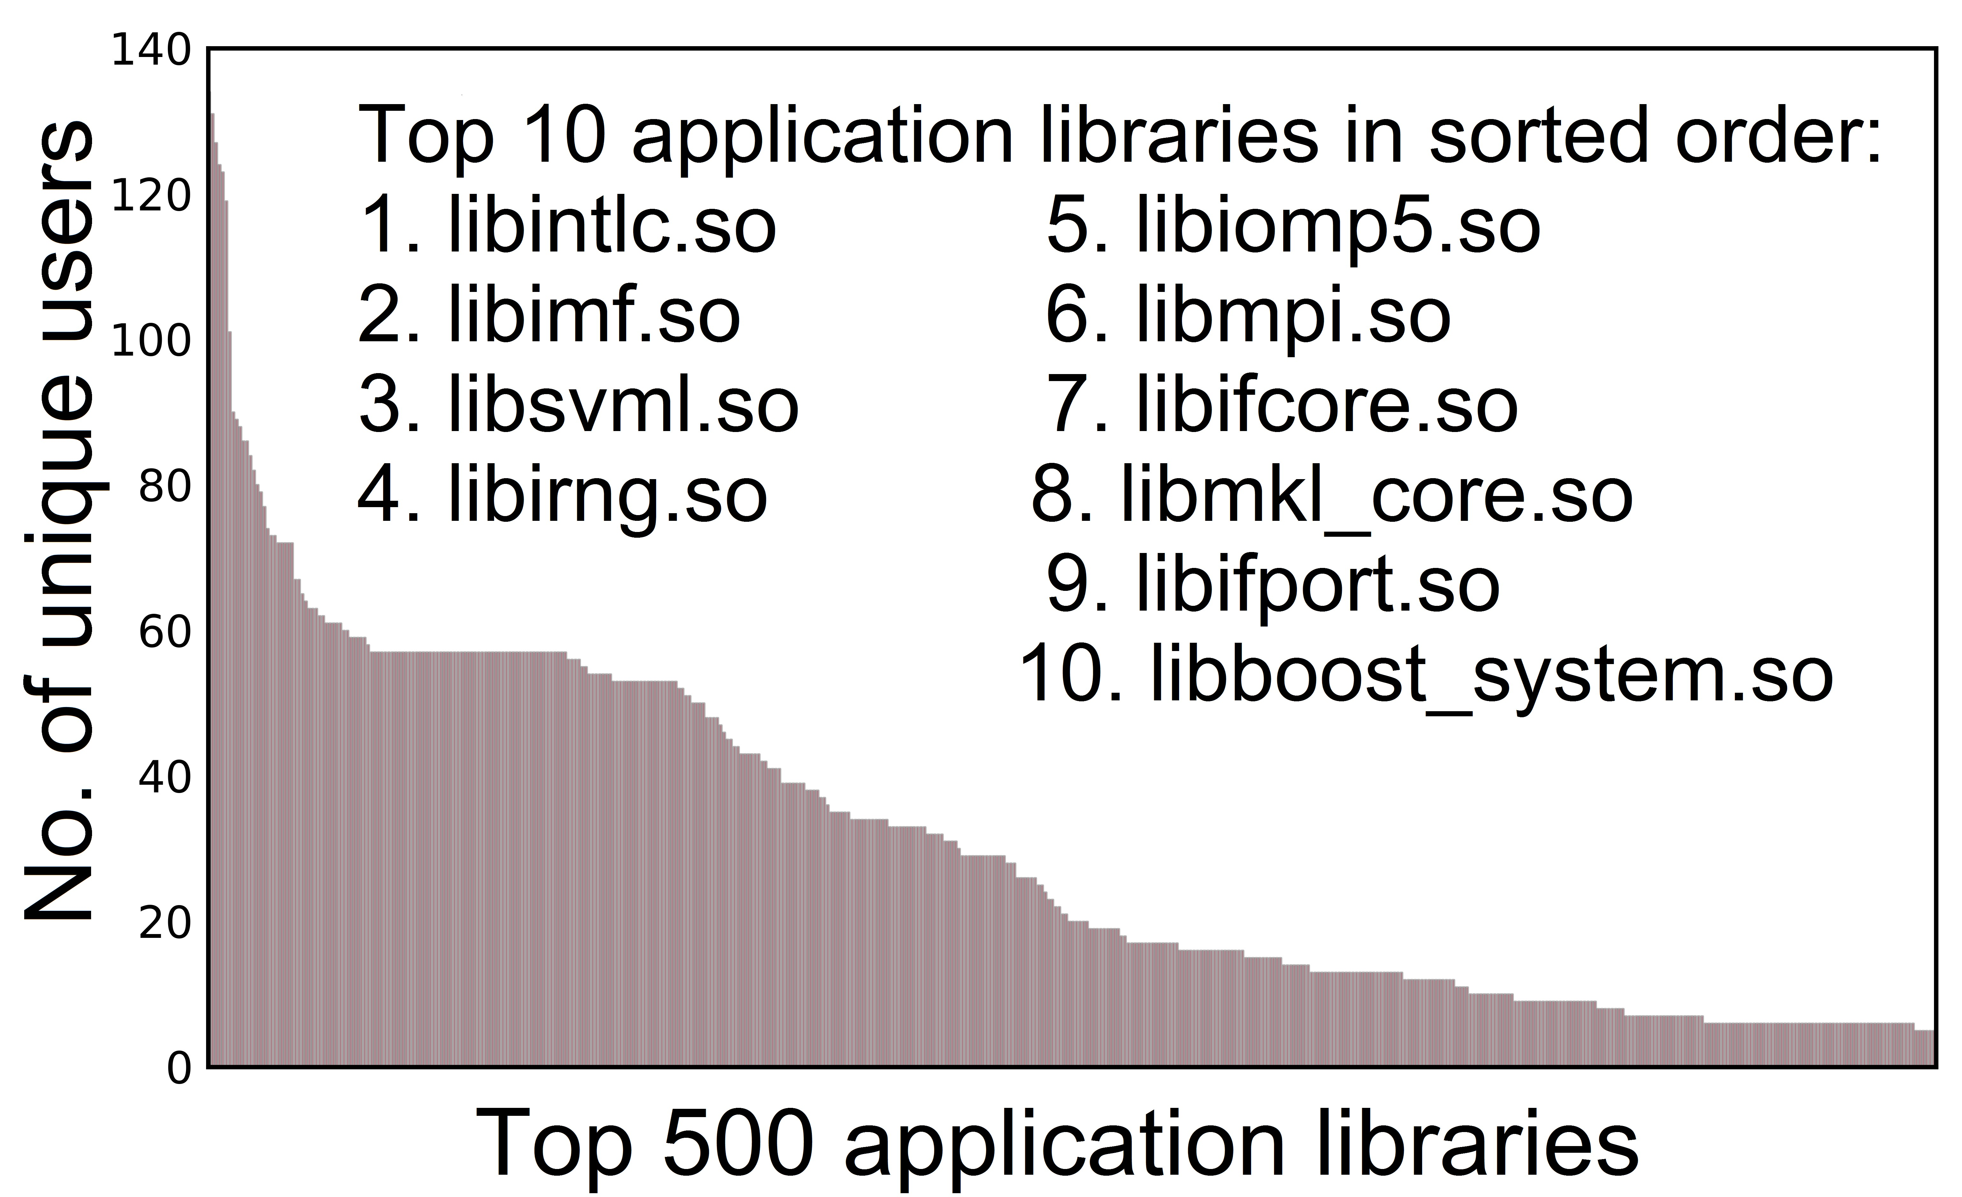
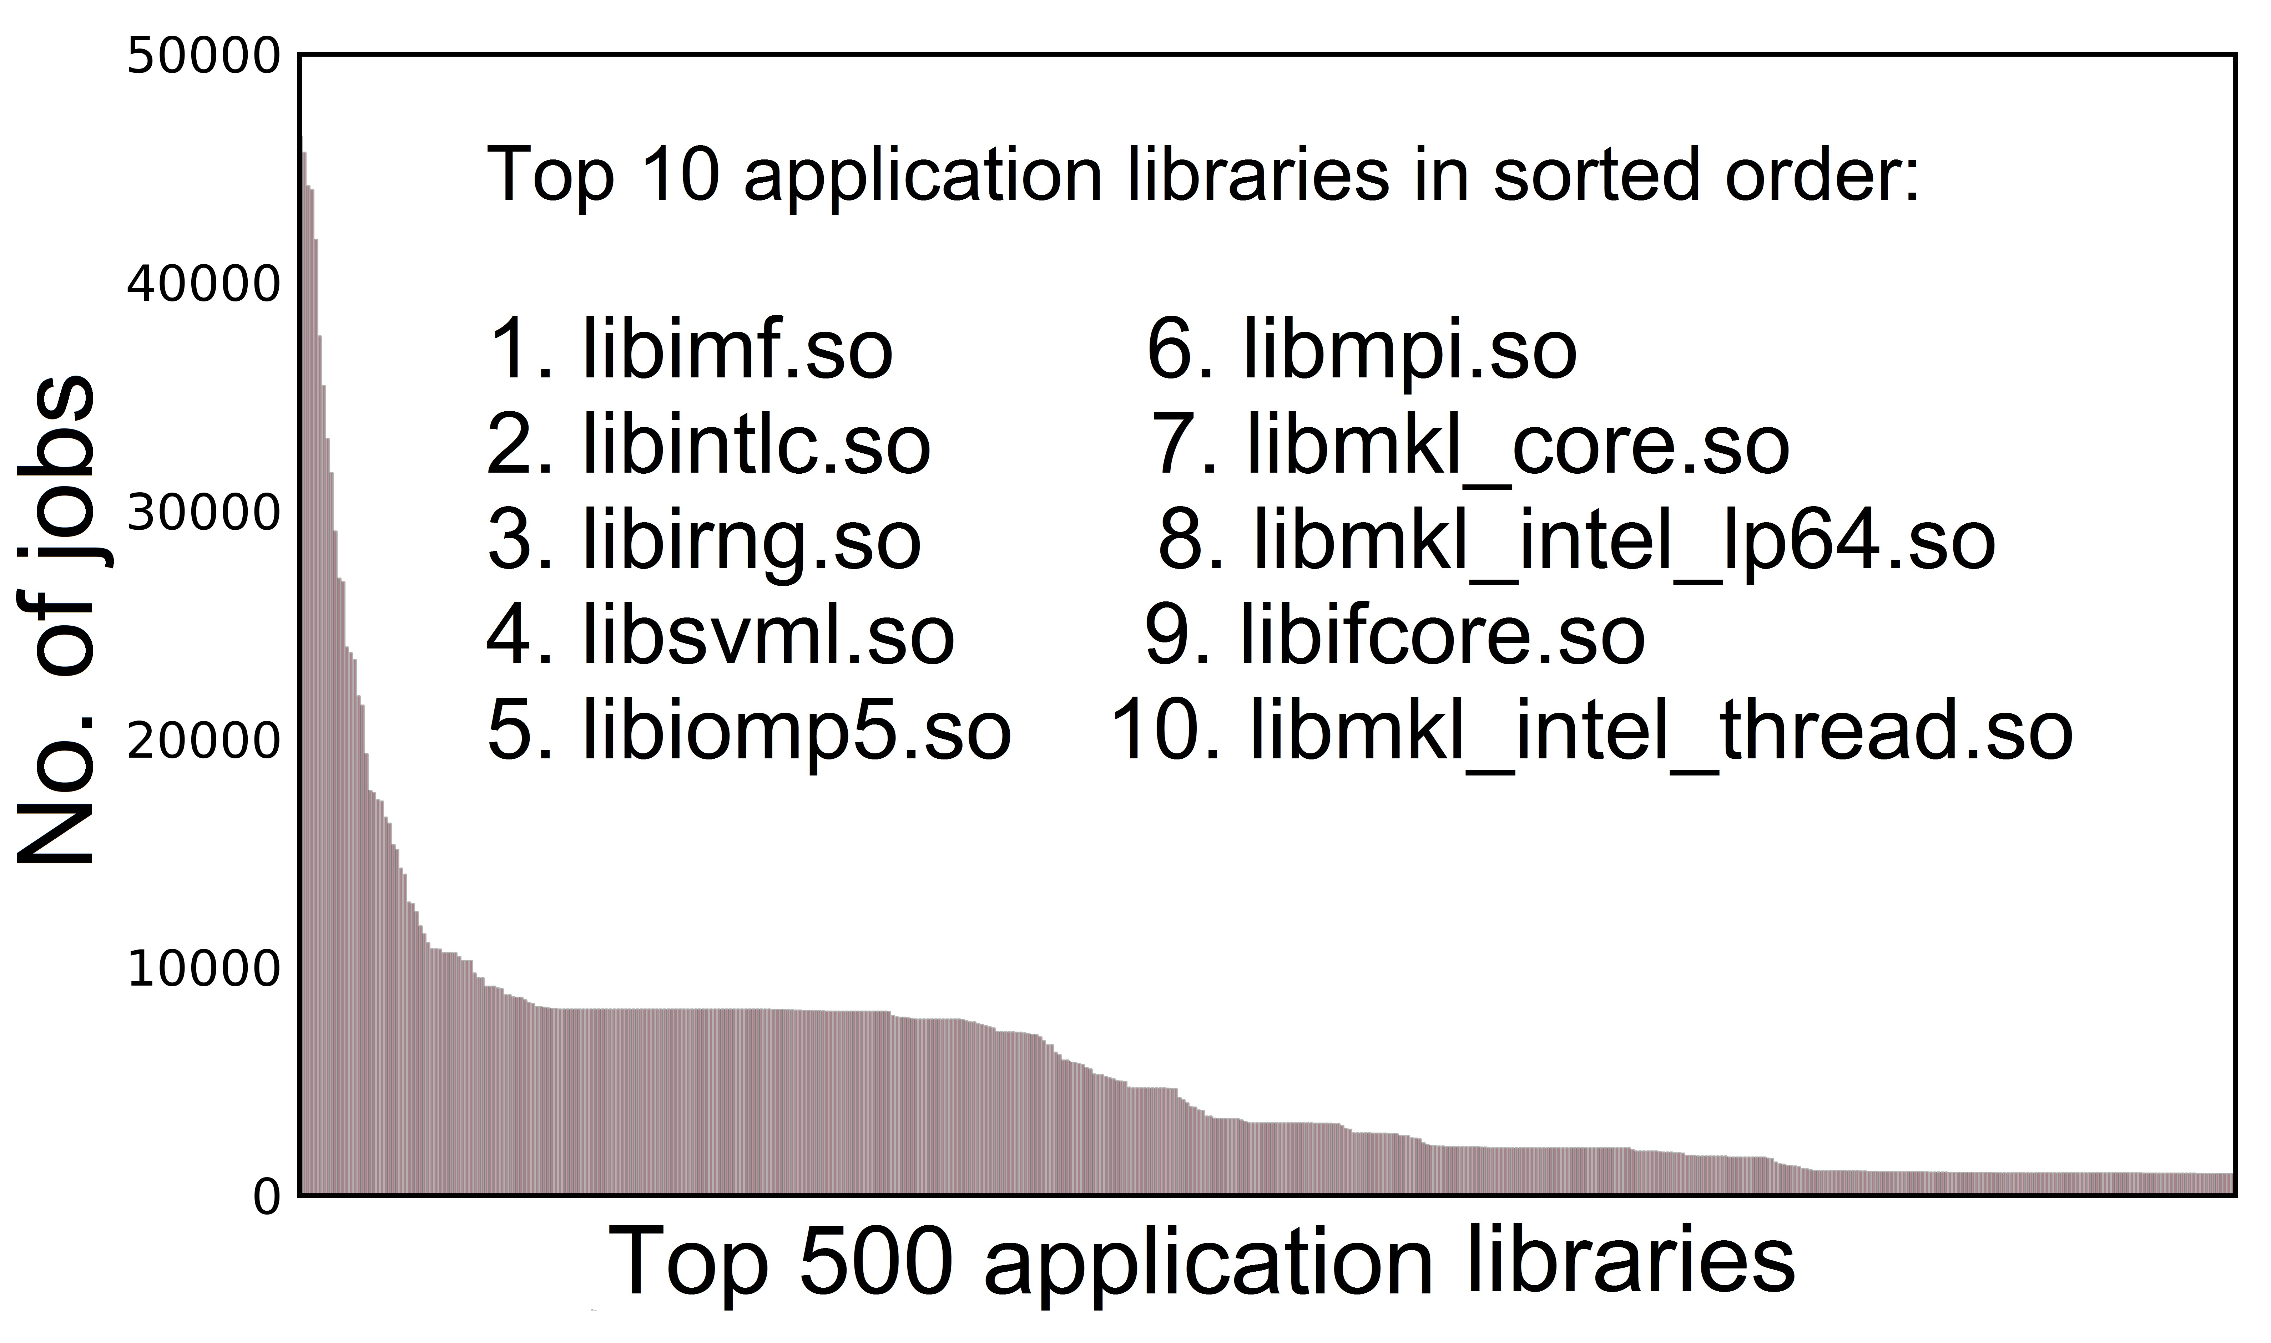
Shared Library Usage
Goal: Identify the mostly-used (popular) libraries and check if they are readily available
Method: Use the liblists
  Consolidate list of libraries used by all jobs
  Remove the libraries given by default OS distribution
  Remove the libraries picked from /usr/lib64 and /lib64 paths
Result: 3080 unique libraries

Slide 14
Availability of Popular Libraries
Are these popular libraries readily available?
Mostly not
  Only 10 out of Top 50 libraries were pre-installed
  Only 188 out of Top 500 libraries were pre-installed
Takeaways
  Install the popular libraries before hand
  Ensure libraries bug-free and optimized for cluster hardware
  Users need not install them in their home directories

Slide 15
Roadmap
Motivation for the study
Specifications of the target clusters
Library usages
Requested vs. Actual job execution times
Use of network, IO, memory resources
Analysis of job exit codes
Takeaways

Slide 16
Requested vs. Actual Time for Job Execution
Goal: Analysis of requested runtime vs actual runtime of jobs
Longer requested time leads to longer queue time
  Queue time increases with requested time of jobs in Conte’s shared queue
  Job with requested time > 30 minutes will face longer queue time
  No significant effect on jobs with ≤ 30 minutes requested time
Observations:
  Many jobs use a small fraction of runtime requested by the job
  A small percentage of jobs run out of time

Slide 17
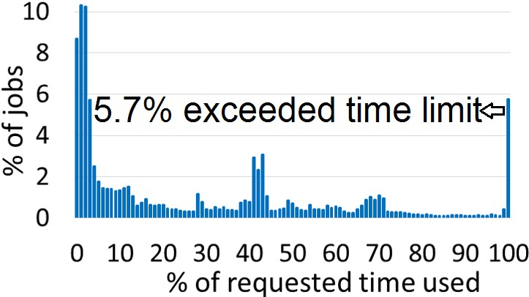
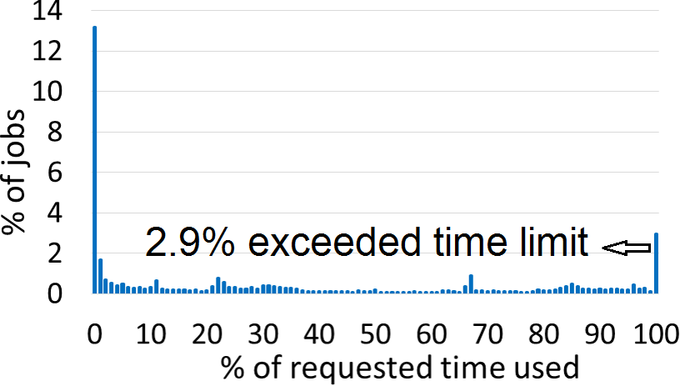
Requested vs. Actual Time for Job Execution
Conte: 45% of jobs used less than 10% of requested time
Sierra: 15% of jobs used less than 1% of requested time
Probable reasons: (1) Legacy code (2) Unaware scheduling mechanism
Conte (Purdue)
Sierra (LLNL)

Slide 18
Requested vs. Actual Time for Job Execution: Takeaways
Users are unaware of inefficient resource utilization
Proactive user support is needed
  Help users with legacy code
  Educate users on techniques utilize resources effectively
LLNL developed a script to estimate completion time of an application prior to submission into their computing cluster queue

Slide 19
Roadmap
Motivation for the study
Specifications of the target clusters
Library usages
Requested vs. Actual job execution times
Use of network, IO, memory resources
Analysis of job exit codes
Takeaways

Slide 20
Resource Provisioning on Conte
Goal: How applications use Lustre file system, Infiniband network, Memory?
Actual application used by user is unknown!
Create app groups, a technique to cluster jobs
Idea: Jobs that use same set of libraries (ignoring version and library path) fall under same app group
Experiment: Evaluated with 30 popular applications chosen from various domains
Our technique distinguished 26 applications out of 30 (86%)
Advantages:
  Non-intrusive technique and no violation of user privacy
  Need not know the actual application being run
Using app groups we analyze resource usage

Slide 21
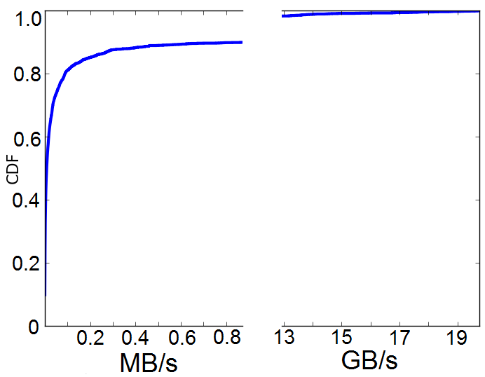
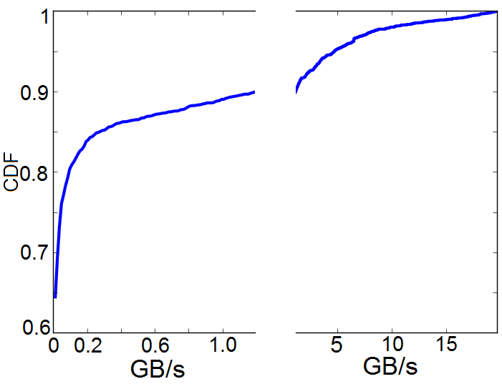
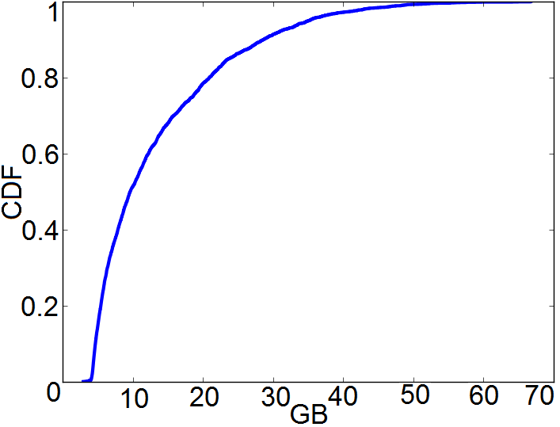
Evaluate Resource Provisioning based on App Groups
Extract corresponding usage information from TACC stats
Average resource usage across all jobs in an app group
CDF of resource usage across app groups
Infiniband read rate on Conte
Lustre read rate on Conte
Memory usage on Conte

Slide 22
Resource Provisioning: Takeaways
Infiniband read rate on Conte
Lustre read rate on Conte
Memory usage on Conte
Clearly, there are 2 distinct types of jobs
  Few jobs need high bandwidth backplane for Network and IO
  In case of memory, such a distinction is not present
Follow-up: Specialized cluster built in 2015 (Rice)
  Has 56 GBps Infiniband network
  Has higher processor power (20 Intel Xeon cores)

Slide 23
Roadmap
Motivation for the study
Specifications of the target clusters
Library usages
Requested vs. Actual job execution times
Use of network, IO, memory resources
Analysis of job exit codes
Takeaways

Slide 24
Analysis of Job Failures
Goal: Understand how jobs fail using exit codes, syslog messages and libraries associated with the job?
Exit code is a manifestation of the underlying problem
Users typically follow Linux exit code convention
On Conte, 16.2% of total jobs have failed
In LLNL, 4.4% (Cab) and 3.8% (Sierra) of total jobs have failed
Reason | % of failed jobs in Conte
Time expired (timeout) | 20.3
Memory exhaustion | 15.2

Slide 25
Analysis of Job Failures: Backup evidence from syslog
Supporting evidence for jobs that failed due to memory exhaustion
Memory exhaustion leads to invocation of oom-killer, kernel level memory manager
Search syslog messages for out-of-memory (OOM) messages
  92% jobs with memory exhaustion logged OOM messages
  77% jobs with OOM messages had memory exhaustion exit code
Takeaway: Syslog messages can be used further understand reasons for failure of jobs
In addition, a library that does extensive error handling/logging could further help in localizing the root cause of the failure

Slide 26
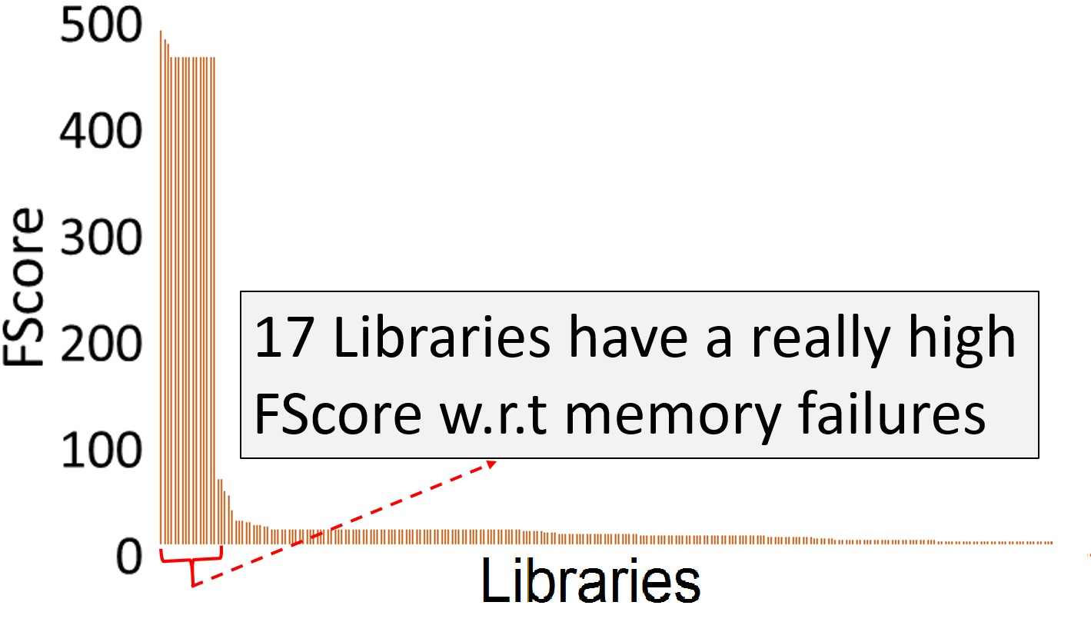
Analysis of Job Failures: Blaming Libraries
Goal: How are libraries related to a failure in jobs?
We need a ranking method for the libraries associated with failure
Req. 1: How likely is it that a library contributes to a failure?
Req. 2: Prioritize a popular library over rarely used ones
Given a type of failure, find the FScore of a library
Takeaway: Using such library ranking techniques it is possible to identify (probably) faulty libraries

Slide 27
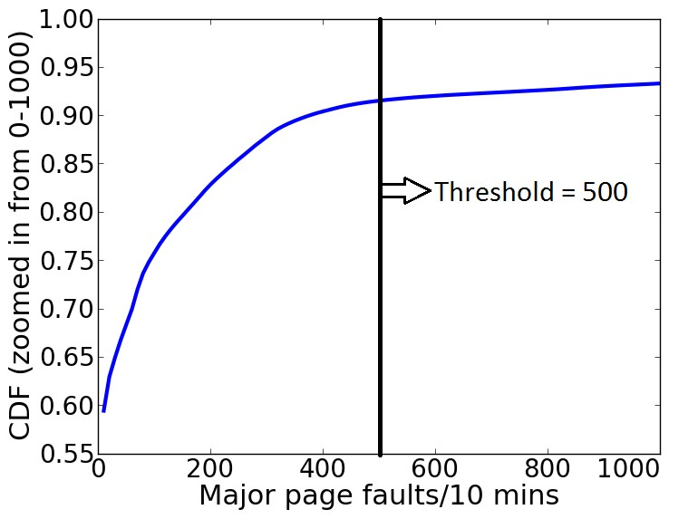
Analysis of Job Failures: Memory Thrashing
Goal: Are memory-related failures related to memory thrashing?
Analyze the Virtual memory usage – major page faults incurred by a job
Find a (quantitative) threshold on major page fault rate
Find all jobs (and job owners) which exceed the threshold
Follow-up: Contacted the users with the high page fault rate and suggest remediation

Slide 28
Case Study: Unoptimized MPI Communication
With one user, the high memory usage was diagnosed to unoptimized MPI communication in weather forecasting application
Problem: 15% of the jobs experienced time-out
Issue: Increased memory consumption connection due to numerous MPI communication
Resolution: Change in the directive for Intel MPI library
Outcome: 1% of the jobs experienced time-out

Slide 29
Take-Aways: Managing Large Compute Clusters
We provide initial results from a user-Centric workload analytics on 3 large-scale computing clusters
Observations:
  Some hugely popular libraries being reused across application domains
  User education and awareness needed for efficient utilization of resources
  Applications with 3 orders of magnitude different resource demands
Non-intrusive techniques to
  Classify applications without violating security or user-privacy concerns
  Identify performance issues and suspects for job failures
Public data sets, FRESCO – Open Data Repository
  For hosting diverse workload/failure data sets
  First anonymized data set from Conte is uploaded
www.purdue.edu/fresco

Slide 30

Presentation available from: engineering.purdue.edu/dcsl
Credits:
ITaP at Purdue University
Livermore Computing at Lawrence Livermore National Lab

Slide 31
Backup Slides

Slide 32
Duty cycle
TARDIS performs some compression and writes to flash during down time, when node would be sleeping
This increases duty cycle and consequently power consumption
Unmodified Network 512ms increases over Network 64ms due to longer active time to send and receive messages
TARDIS Network 64ms increases over Network 512ms due to longer radio on time to perform clear channel assessment
Notes:
We want to be careful that TARDIS does not interfere with the timing of the application.
TARDIS preforms some of its compression and writes to flash during slack time, when the node would be sleeping.
We see that 64ms LPL has the largest increase in duty cycle because TARDIS is keeping the node awake longer on clear channel assessments.

Slide 33
Example of Scale-dependent Bugs
A bug in MPI_Allgather in MPICH2-1.1
  Allgather is a collective communication which lets every process gather data from all participating processes
P1
P1
Allgather
P2
P2
P3
P3

Slide 34
Example of Scale-dependent Bugs
MPICH2 uses distinct algorithms to do Allgather in different situations
Optimal algorithm is selected based on the total amount of data received by each process
Notes:
Latency and transmission. Small data, latency dominant, so we go for recdbl where you have less number of iterations; large data, transmission dominant, we go for ring where you only communicate with nearest neighbors

Slide 35
Example of Scale-dependent Bugs
int MPIR_Allgather (
……
int recvcount,
MPI_Datatype recvtype,
MPID_Comm *comm_ptr )
{
int comm_size, rank;
int curr_cnt, dst, type_size, left, right, jnext, comm_size_is_pof2;
……
if ((recvcount*comm_size*type_size < MPIR_ALLGATHER_LONG_MSG) &&
(comm_size_is_pof2 == 1)) {
/* Short or medium size message and power-of-two no. of processes.
* Use recursive doubling algorithm */
……
else if (recvcount*comm_size*type_size < MPIR_ALLGATHER_SHORT_MSG) {
/* Short message and non-power-of-two no. of processes. Use
* Bruck algorithm (see description above). */
……
else { /* long message or medium-size message and non-power-of-two
* no. of processes. use ring algorithm. */
……
recvcount*comm_size*type_size can easily overflow a 32-bit integer on large systems and fail the if statement
Notes:
Emphasize it is a noncrashing bug
1.Due to an integer overflow in the computation of total amount of data, it may choose a suboptimal algorithm for large-scale runs
2.As a result, the bug may cause a substantial slowdown in the Allgather operation if the total amount of data exceeds MAX_INT
3.comm_size

Slide 36
Roadmap
Debugging in the large: Large-scale distributed applications
  Using metric mining (DSN 12, SRDS 13)
  Scale-dependent bugs (HPDC 11, HPDC 13)
  Computational genomics (Supercomputing 14, ICS 16)
Debugging in the small: Embedded and mobile platforms
  Record and replay using hardware-software (Sensys 11)
  Record and replay using software only (IPSN 15)
    Reducing amount of logged information
    Evaluation
  Cellular network data analytics (HotDep 15, Movid 16)

Slide 37
Domain-specific & Lightweight Compression
Non-determinism of registers
Polling loops
Register masking pattern
Sleep-wake cycling and interrupts
Timer registers
State registers
Data registers
Notes:
There are 7 techniques to efficient compression of the log, which I will now briefly describe.

Slide 38
1. Only record non-determinism
Timer B Control Register
non-deterministic
Not all peripheral registers are non-deterministic
In some registers only particular bits are non-deterministic
Record only the non-deterministic bits, reduces log by 26.8%
Notes:
First, we only want to record what is truly non-deterministic.
Not all peripheral registers are non-deterministic, for example, a configuration register.
Some registers are deterministic except for a single bit.
For example, the Timer B Control Register has an interrupt flag bit.
In this case we record only that bit when the register is read.
This reduces the log by about 27%.

Slide 39
2. Polling loops
while (IFG & TXFLG);
Example, interrupt register checked until transmitting flag is cleared
TARDIS-CIL identifies loops that have no side effect on execution
We assume polling loops are eventually exited
Therefore, no need to record peripheral register reads in polling loops, reduces log by 25.9%
Notes:
A common occurrence in embed code is polling loops.
Polling loops contain peripheral register reads that could be costly to logging.
Take for example this polling loop in the Contiki operating system.
The interrupt register is polled until the transmit flag is cleared.
For the purposes of debugging, there is no need to replay these loops, so we ignore them.
This reduces the log by about 26%.

Slide 40
6. State registers
pending_interrupts = IFG;
State registers report a state, for example, interrupt flags indicating pending interrupt
Consecutive reads often repeat value
Design: encode state registers with RLE, reduces state log by 47.8%
Notes:
State registers report a state, for example an interrupt flag indicating a pending interrupt.
We have observed that consecutive reads often repeat values.
For this reason we use the very simple compression method of run-length encoding.
This reduces the state log by about 48%.

Slide 41
7. Data registers
receive_byte = RXBUF;
Example: I2C data
Comes from radio and sensors
Design: compression using light-weight generic compression LZRW-T
Reduces data log by 65.7%
Notes:
There are some peripheral registers that contain generic data, such as an I2C register that is used for sensor and radio data.
For this we use a generic light-weight compression algorithm, LZRW-T.
This reduces the data log by about 66%.

