Slide 1
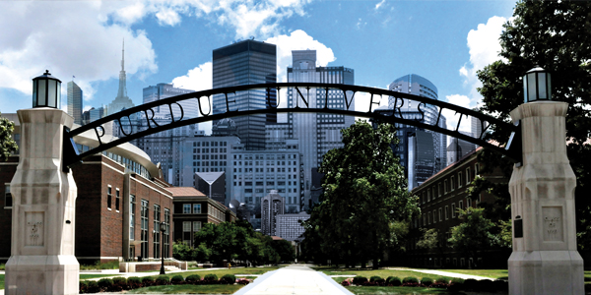
Fast Training on Large Genomics Data using Distributed Support Vector Machines
Nawanol Theera-Ampornpunt, Seong Gon Kim, Asish Ghoshal, Saurabh Bagchi, Ananth Grama, and
Somali Chaterji
Department of Computer Science, Electrical and Computer Engineering
Purdue University
Notes:
http://www.sigmaaldrich.com/life-science/learning-center/biofiles/biofiles-7-3.html

Slide 2
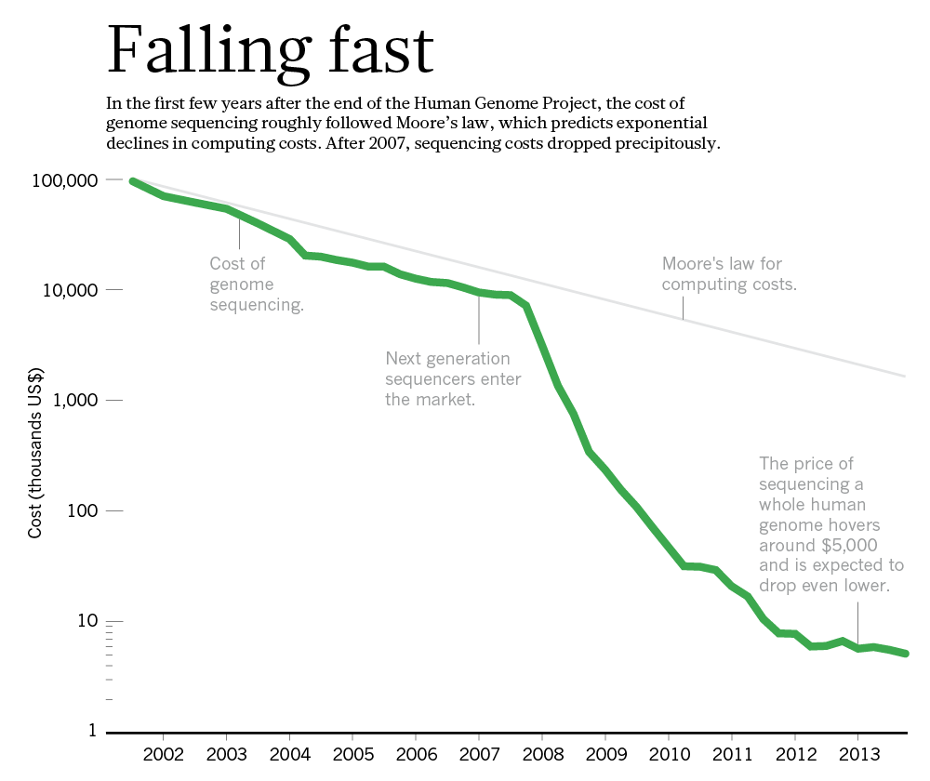
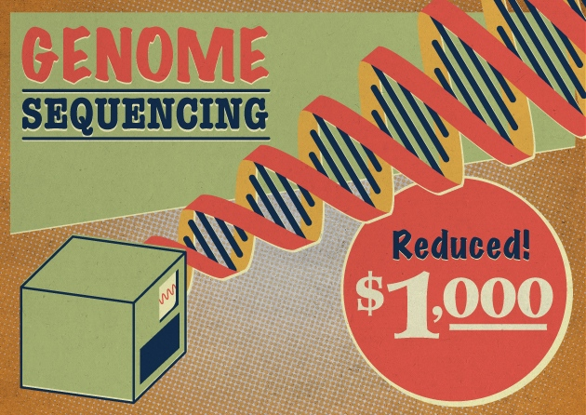
Motivation
Amount of genomics data is increasing rapidly
ML classifiers are slow in their training phase
We want to speed up training
  New datasets are being generated through genomics experiments at a fast rate
  Diverse datasets need separate models to be trained
Can we make use of large distributed clusters to speed up training?
Notes:
Global prediction of enhancers will enable the rapid prediction of enhancers in new cell types, without the need for a separate training set for every new cell type. Once these putative enhancers in different cell types have been identified, it will be important to link them to the specific genic promoters that they regulate. This kind of interaction is complex with many-to-many associations, wherein one enhancer can regulate the expression of multiple genes, and multiple enhancers can affect the same gene, acting in synergy. Such predictions will lower the cost of generating enhancer and gene interaction data using experimental methods such as chromatin conformation capture-based protocols, which provide direct evidence for such physical interactions [11].
http://www.nature.com/news/technology-the-1-000-genome-1.14901
http://www.nature.com/nature/journal/v470/n7333/box/nature09764_BX3.html: Charting a course for genomic medicine from base pairs to bedside
Bullet 4: Different backends are available for the distribution (clusters of machines, GPUs, etc.) and different distribution software packages are available (Map-Reduce, Spark, MLlib, etc.).

Slide 3
Contributions
We show how to build a machine learning (ML) classifier (an SVM classifier) for a biologically important use case, i.e., prediction of DNA elements (called “enhancers”) that amplify gene expression and can be located at great distances from the target genes, making the prediction problem challenging.
We show that a serial SVM is not able to handle training of even a fraction of the experimentally available dataset. We then go on to apply a previously theoretically proposed technique called Cascade SVM to the problem and adapt it to create our own computationally efficient classifier called EP-SVM.
We do a detailed empirical characterization of the effect of number of cores, communication cost, and number of partitions on the runtime of training of Cascade SVM.

Slide 4
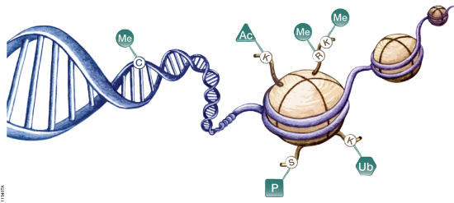
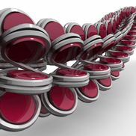
Background: The Epigenetic Code
Histones are highly alkaline proteins found in eukaryotic cell nuclei that package and order the DNA into structural units called nucleosomes. They are the chief protein components of chromatin, acting as spools around which DNA winds, and playing a role in gene regulation.
Epigenetic mechanisms involved in regulation of gene expression. Cytosine residues within DNA can be methylated and lysine and arginine residues of histone proteins can be modified.
Notes:
Biological background: genome, epigenome
https://www.promega.com/resources/product-guides-and-selectors/protocols-and-applications-guide/epigenetics/
Me = methylation, Ac = acetylation, P = phosphorylation, Ub = ubiquitination.
http://www.nature.com/scitable/definition/histone-histones-57: Histones are a family of basic proteins that associate with DNA in the nucleus and help condense it into chromatin. Nuclear DNA does not appear in free linear strands; it is highly condensed and wrapped around histones in order to fit inside of the nucleus and take part in the formation of chromosomes.
Histones are basic proteins, and their positive charges allow them to associate with DNA, which is negatively charged. Some histones function as spools for the thread-like DNA to wrap around.
Under the microscope in its extended form, chromatin looks like beads on a string. The beads are called nucleosomes. Each nucleosome is made of DNA wrapped around eight histone proteins that function like a spool and are called a histone octamer. Each histone octamer is composed of two copies each of the histone proteins H2A, H2B, H3, and H4. The chain of nucleosomes is then wrapped into a 30 nm spiral called a solenoid, where additional H1 histone proteins are associated with each nucleosome to maintain the chromosome structure.
https://www.youtube.com/watch?v=eYrQ0EhVCYA
https://www.youtube.com/watch?v=Tj_6DcUTRnM

Slide 5
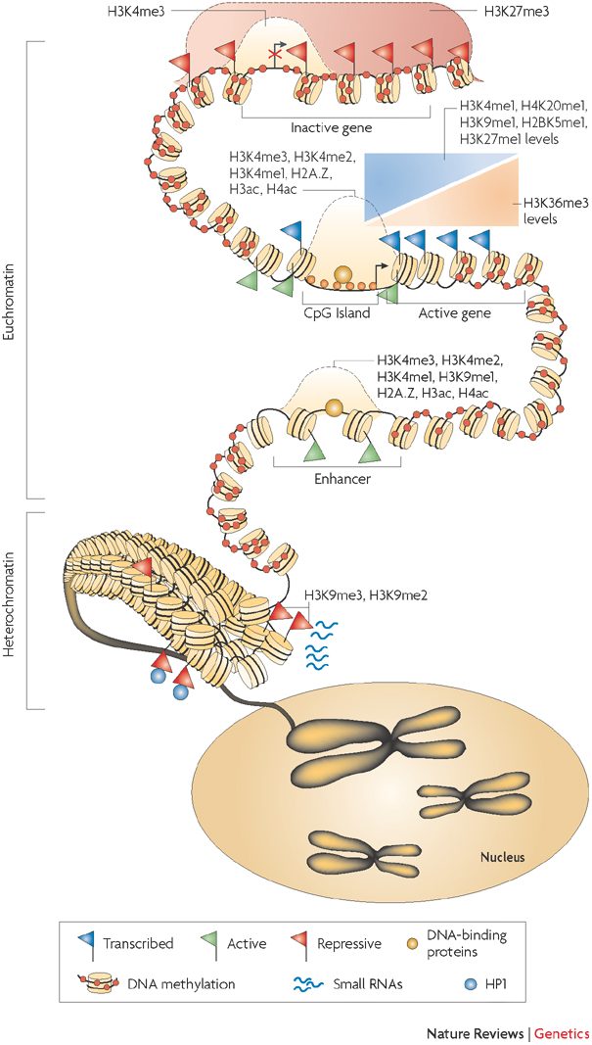
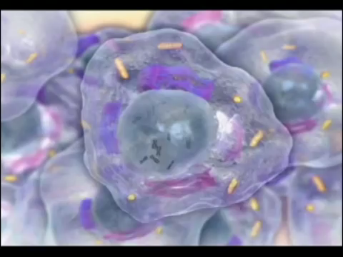
Background: Histone Modifications
The interaction of DNA methylation, histone modification, nucleosome positioning, and other factors, such as small RNAs, contribute to an overall epigenome.
Notes:
Epigenetic regulation of gene expression
http://www.nature.com/nrg/journal/v9/n3/fig_tab/nrg2270_F5.html
The interaction of DNA methylation, histone modification, nucleosome positioning and other factors such as small RNAs contribute to an overall epigenome that regulates gene expression and allows cells to remember their identity. Chromosomes are divided into accessible regions of euchromatin and poorly accessible regions of heterochromatin. Heterochromatic regions are marked with histone H3 lysine 9 di- and trimethylation (H3K9me2 and H3K9me3), which serve as a platform for HP1 (heterochromatic protein 1) binding. Small RNAs have been implicated in the maintenance of heterochromatin. DNA methylation is persistent throughout genomes, and is missing only in regions such as CpG islands, promoters and possibly enhancers. The H3K27me3 modification is present in broad domains that encompass inactive genes. Histone modifications including H3K4me3, H3K4me2, H3K4me1 as well as histone acetylation and histone variant H2A.Z mark the transcription start site regions of active genes. The monomethylations of H3K4, H3K9, H3K27, H4K20 and H2BK5 mark actively transcribed regions, peaking near the 5' end of genes. The trimethylation of H3K36 also marks actively transcribed regions, but peaks near the 3' end of genes.

Slide 6
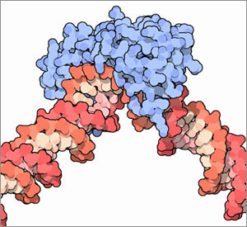
Enhancer Prediction Problem
Epigenetic Regulation by TFs
Predict the genome-wide locations of intergenic enhancers
Based on pattern matching of proteins flanking the DNA, i.e., the patterns of the histone modifications
Specifically, we look at locations where specific transcription factors bind to the DNA base pairs
We look at histone modification patterns at those locations to predict if enhancers are active
Transcription factors are proteins that control which genes are turned on or off in the genome. They do so by binding to DNA and other proteins. Once bound to DNA, these proteins can promote or block the enzyme that controls the reading, or “transcription,” of genes, making genes more or less active.
Notes:
Explain “intergenic”, “epigenetic patterns”, “histones”
Transcription factors are proteins that control which genes are turned on or off in the genome. They do so by binding to DNA and other proteins. Once bound to DNA, these proteins can promote or block the enzyme that controls the reading, or “transcription,” of genes, making genes more or less active.
Transcription factors are essential for the regulation of genes. For example, different genes are turned on in liver cells than in skin cells. Different genes are turned on in cancer cells than in healthy cells. Through the action of transcription factors, the various cells of the body, which all have the same genome, can function differently.
These proteins are so important to life that they are found in all living organisms. Roughly 8% of genes in the human genome encode transcription factors. They play important roles in development, the sending of signals within the cell, and the events in a cell that lead to division and duplication, known as the cell cycle. Several human diseases are linked to mutations in transcription factors, such as diabetes, autoimmune diseases, and cancer.
https://www.broadinstitute.org/education/glossary/transcription-factor
http://www.nature.com/scitable/definition/general-transcription-factor-transcription-factor-167
Transcription factors are proteins involved in the process of converting, or transcribing, DNA into RNA. Transcription factors include a wide number of proteins, excluding RNA polymerase, that initiate and regulate the transcription of genes. One distinct feature of transcription factors is that they have DNA-binding domains that give them the ability to bind to specific sequences of DNA called enhancer or promoter sequences. Some transcription factors bind to a DNA promoter sequence near the transcription start site and help form the transcription initiation complex. Other transcription factors bind to regulatory sequences, such as enhancer sequences, and can either stimulate or repress transcription of the related gene. These regulatory sequences can be thousands of base pairs upstream or downstream from the gene being transcribed. Regulation of transcription is the most common form of gene control. The action of transcription factors allows for unique expression of each gene in different cell types and during development.

Slide 7
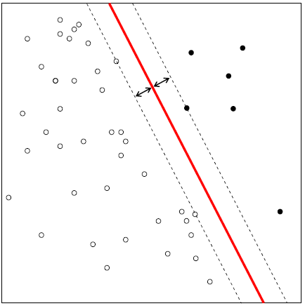
Support Vector Machine (SVM)
Popular binary
classification method
Finds maximum-margin
hyperplane that
separates two classes
Linear SVM

Slide 8
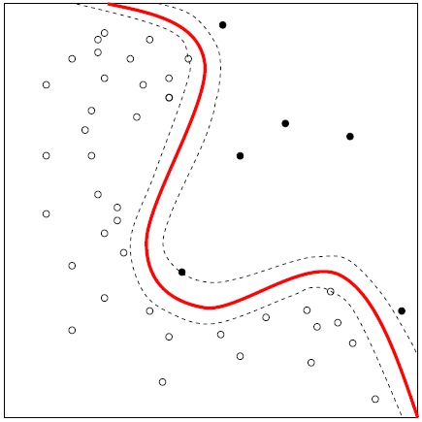
SVM — Kernel Trick
“Kernel trick” allows
non-linear decision
boundary
  Kernel function maps
  input features to higher-
  dimensional space
Time complexity for training: O(n³)
Running serial version on entire dataset (300 GB) will take 45.4×10³ years!
Kernel SVM
Notes:
After kernel function maps input features to higher-dimensional space, the linear decision boundary in the higher-dimensional space becomes non-linear in the original input space.

Slide 9
Cascade SVM (1)
Proposed by Graf et al. in NIPS 2004
SVM learning involves finding support vectors (SVs)
Training data split into disjoint subsets
SVs created independently for each subset
SVs from one layer are fed as input to next layer
A hierarchical arrangement of layers of SV creation finally leads to a single integrated set of SVs

Slide 10
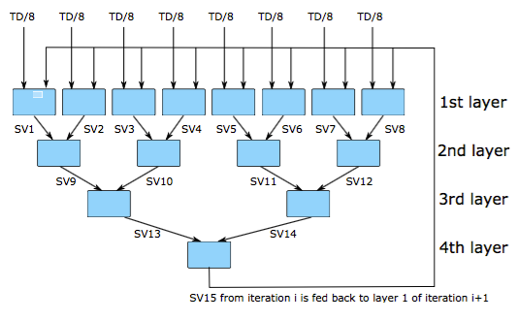
Cascade SVM (2)
Example schematic with 8 partitions

Slide 11
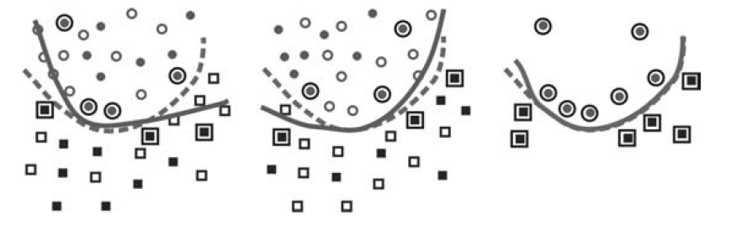
SV Creation in Cascade SVM
(a)
(b)
(c)
A toy example illustrating the filtering process
SVs are calculated independently (and concurrently) for partitions of the entire data (Figs. (a) and (b)).
These SVs are merged at the next stage (Fig (c)).
Result is close to this if SVs had been computed in one go on the entire dataset (dashed curve in Fig. (c)).
Notes:
A toy problem illustrating the filtering process. Two disjoint subsets are selected from the training data and each of them is optimized individually (left, center; the data selected for the optimizations are the solid elements). The support vectors in each of the subsets are marked with frames. They are combined for the final optimization (right), resulting in a classification boundary (solid curve) close
to the one for the whole problem (dashed curve).

Slide 12
Cascade SVM (3)
Multiple iterations are needed to ensure optimal solution
  Empirically for us, one iteration is enough to produce a good model
Last layer is the serial bottleneck
  Training time of this step depends on number of support vectors, which is dependent on dataset
High memory consumption of kernel SVM is alleviated due to partitioning
Notes:
So in our experiments, we only use one iteration.

Slide 13
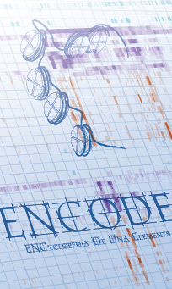
Data Set
From ENCODE (ENCyclopedia Of DNA Elements)
24 histone modifications from ChIP-seq
  Binned into 100bp intervals
  Inputs: 20 input features * # of histones​
  Pre-processing: Replicates RPKM normalized, 100bp bins​
  Histone modification level readings around target site ranging -1kb to 1kb as vectored 100bp bins (20 features / histone mod.)​
  24 histone modifications gives 480 input features max.​
TFBS as positive samples,
TSS as negative samples
Disjoint training and test sets
  135 MB data size
  5.5k negative samples
  25k positive samples
  Negative : Positive = 18 : 82
All 24 chromosomes of H1 embryonic stem cell​
Notes:
Explain ENCODE: The ENCODE (Encyclopedia of DNA Elements) Consortium is an international collaboration of research groups funded by the National Human Genome Research Institute (NHGRI).
ChIP-Seq is a powerful tool with which to investigate protein-DNA interactions on a global scale.

Slide 14
Experimental Testbed
Cluster of 8 machines connected by 1 Gigabit Ethernet
2.4GHz Intel Xeon X3430 CPU with 4 cores
8GB memory
Notes:
Add dataset sizes for training and test.
Answer: They are on the previous slide. You can move them here if you think they belongs here.
Qs: Add cross validation strategy (it is also not mentioned in the paper).
Answer: We did not use cross validation. We used disjoint training and test sets.
Qs: Did we try boosting to handle the class imbalance?
Answer: No. The class imbalance was not too bad (82% vs 18%) so we did not need to do anything to handle it.

Slide 15
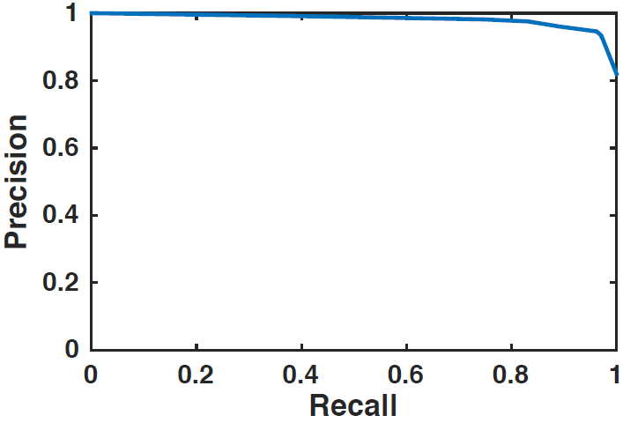
Results – Accuracy
Precision-recall curve
  At equal weight, precision = 94.6%, recall = 96.2%
Conclusion: SVM is an appropriate classifier for the problem
For DEEP and RFECS, the two latest approaches that use sophisticated statistical models, the highest recall is less than 93% and 88%
Notes:
Qs: Show the comparison point, compared to which our precision-recall are better.
Answer: There is no direct comparison point. Our problem is much easier than what other people try to solve, as we are using TFBSs as positives and TSSs as negatives. You can mention results from other papers as long as it is made clear that they are not directly comparable.

Slide 16
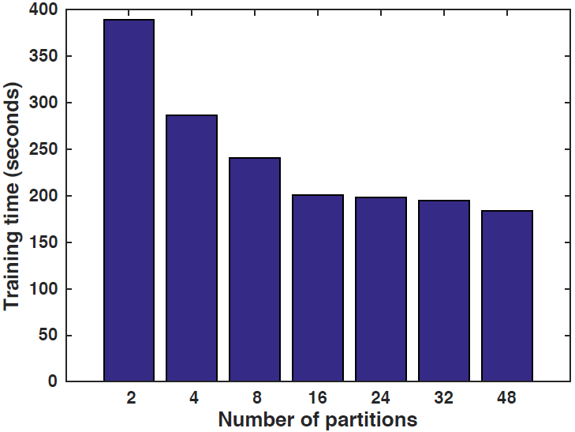
Results – Partitioning
Training time vs. # partitions of Cascade SVM
Setup: 2 machines x 1 core
Conclusion: # partitions should be multiple times # cores
Even 24X number of cores shows decreasing trend of time
Notes:
It would have been nice to see an inflection point in this plot. We did not carry the experiments far enough in terms of # partitions?
Answer: That is correct. We did not have time to go beyond 48 partitions, although we do expect that after some point, training time will start increasing.

Slide 17
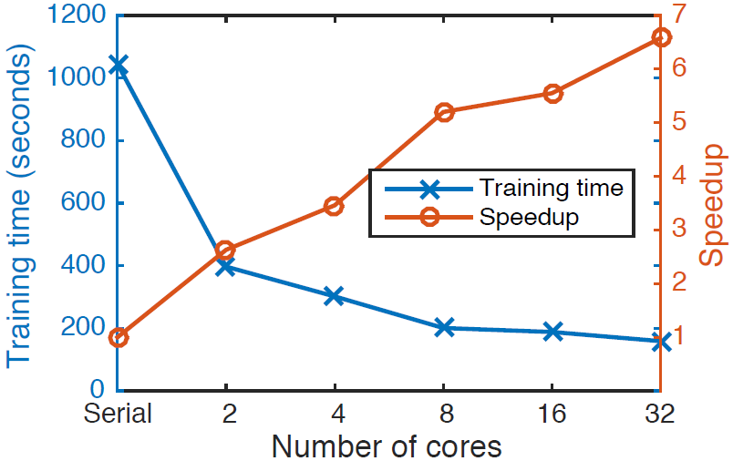
Results – Distributed SVM (1)
Training time vs. # cores (# partitions = # cores)
Superlinear speedup at 2 cores, due to partitioning of cascade SVM
Sublinear speedup beyond 2 cores due to serial bottleneck
Number of support vectors = 28.2% of training data points
Notes:
Beyond 2 cores, however, the speedup is sublinear, as the training time in the final round starts to dominate.
Qs: Put the 28.2% number in context. Is that too many or small enough to be good?
Answer: This number tells us how big the bottleneck at the last layer is. Put into context, it means that for this dataset, the approximate maximum speedup we can ever achieve (i.e., with infinite number of cores) is (100/28.2)^3 = 44.6, because SVM’s complexity is O(n^3). Actual speedup can be lower or higher because the complexity can only serve as a rough approximation of running time.
In this case I would say maximum speedup of 44.6 is useful, but still not enough, because if we use the entire dataset, it will reduce the training time from 45000 years to 1000 years, which is still too long. It is still useful because essentially we can use 100/28.2 = 3.5 times bigger dataset than the serial SVM and keep the same running time.

Slide 18
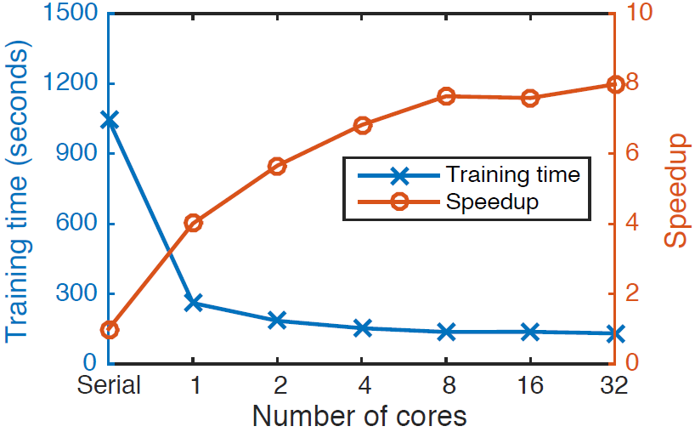
Results – Distributed SVM (2)
Training time vs. # cores (# partitions = 96)
Conclusion: More partitions = higher speedup
Speedup of 4 even with a single core!
Notes:
Cascade SVM was developed for multiple core architectures.

Slide 19
Conclusion
We applied a distributed SVM algorithm, Cascade SVM, to a large genomics dataset
SVM gives high accuracy and is thus an appropriate classifier for this domain (Recall = 0.96, Precision = 0.94)
We achieved speedup of 8 with 32 cores
  Limited by number of support vectors at final stage
Number of partitions should be set larger than number of cores
Speedup can be obtained even with a single core!
Code at: https://bitbucket.org/cellsandmachines/kernelsvmspark

Slide 20


While we are here..

Slide 21
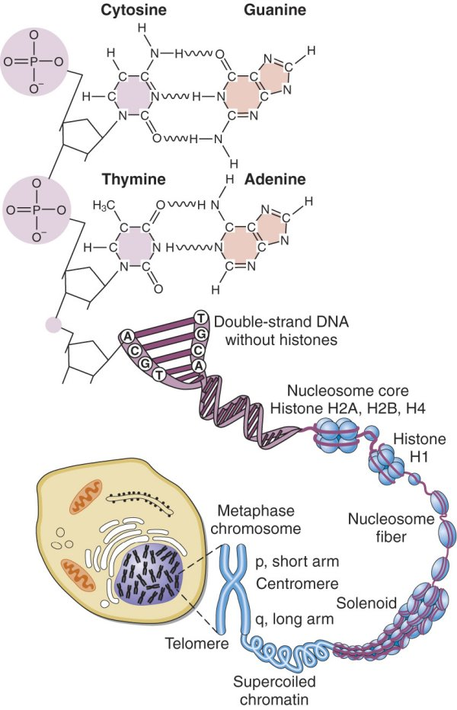
Extra
Notes:
http://highered.mheducation.com/sites/dl/free/0071402357/156709/figure56_2.html

Slide 22
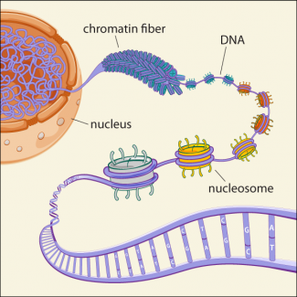
Extra 2
Notes:
https://www.broadinstitute.org/news/1504: The chromatin fiber that makes up our chromosomes is composed of nucleosome units, each consisting of DNA wrapped around eight histone proteins. The tails of these histone proteins can undergo numerous post-translational modifications, encoding distinct chromatin states, represented here by different colored nucleosomes. By studying the distinct patterns of histone modifications found across the complete
human genome, Ernst and Kellis found 51 different chromatin states, grouped into five large classes, corresponding to promoters, transcribed, active intergenic, repressed, and repetitive regions.

