Slide 1
Denial of Service Elusion (DoSE): Keeping Clients Connected for Less
Paul Wood, Christopher Gutierrez, Saurabh Bagchi
School of Electrical and Computer Engineering
Department of Computer Science
Purdue University
Presentation available at: engineering.purdue.edu/dcsl

Slide 2
Outline
Problem Motivation
Prior Work
DoSE Overview
Experimental Results
Conclusions

Slide 3
Denial of Service: The Lingering Threat
Attacks almost impossible to stop at end users

Slide 4
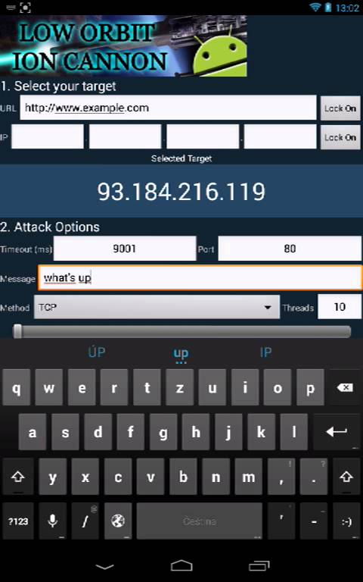
Ease of Attack
IP + Click

Slide 5
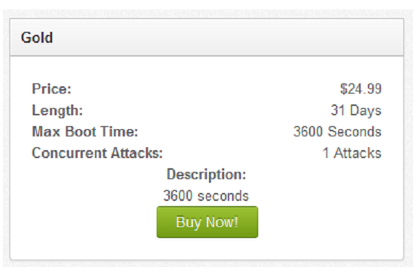
Attack and Defense Costs
$2.99 for an attack
$1800 for defense
Source: liquidweb.com/services/ddos.html

Slide 6
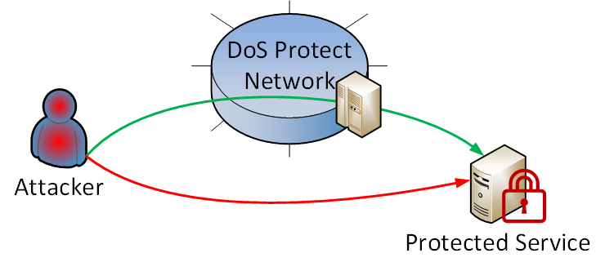
Commercial Proxy Service Limitations
HTTP/HTTPS Only (No TCP/UDP apps)
Server IP leakage:
During large attacks
DMCA Complaints

Slide 7
Prior Work for DoS Protection: Overlay Networks
Protection via Proxy/Relay
Lacks entry point (SOAP) management, beacon management
DoSE: Cloud-Based Relay Management
Source: Angelos D. Keromytis, Vishal Misra, and Dan Rubenstein. 2002. SOS: secure overlay services. SIGCOMM Comput. Commun. Rev. 32, 4 (August 2002), 61-72.

Slide 8
Prior Work: MOTAG
Subject to DDoS
1000 Replicas
DoSE: Cost-Effective Replica Management
Q. Jia, H. Wang, D. Fleck, F. Li, A. Stavrou, and W. Powell, “Catch me if you can: A cloud-enabled ddos defense,” in Dependable Systems and Networks (DSN), 2014

Slide 9
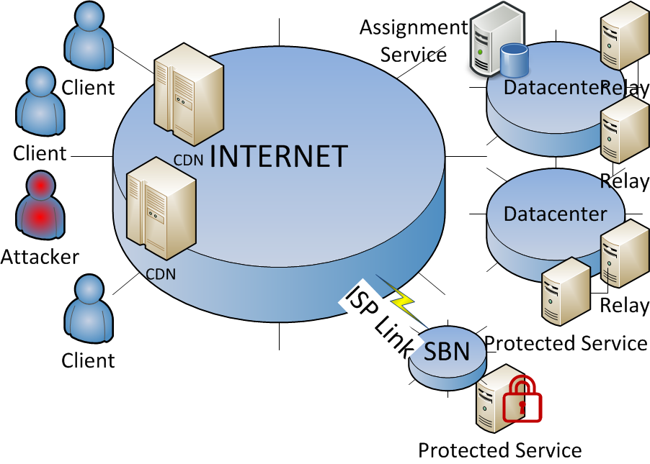
DoSE Goals
Cost-Conscious Defense
Repel DDoS-as-a-Service
Self-owned cloud resources
No DMCA leak
Commodity Service Usage
No load-balancer customization
Off-the-shelf cloud components

Slide 10
DoSE Overview
Clients access Protected Services via Relays
Relays are assigned via CDN Interface
Attacks are filtered in remote datacenters

Slide 11
DoSE Overview
Assumptions:
CDN DoS-Proof
Independent Relay Faults
Protected Service IP hidden

Slide 12
Attacker Model

Slide 13
Relays
EC2 Instances
Goals:
Hide protected service IP (Relay)
Shield service from attacks (Firewall)

Slide 14
Client Assignment Service
Goal: Resilient Client-Relay Assignments
Puzzles rate-limit assignments (repeat attacks)

Slide 15
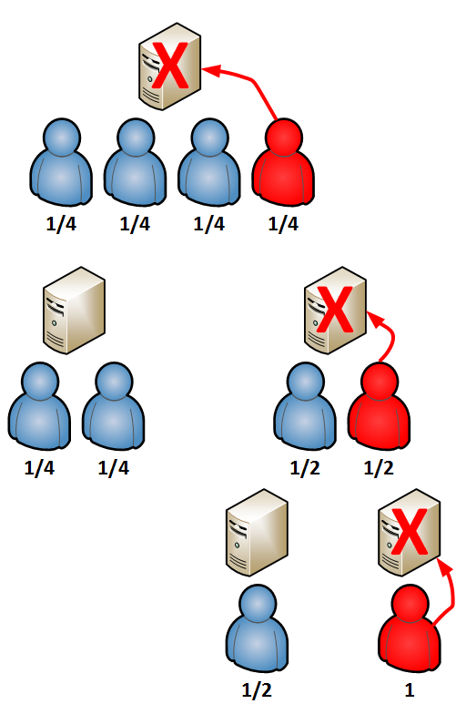
Attack Mitigation: Risk Assignment
Risk: Likelihood client is malicious
Risk-Proportional Relay Assignment
One unit of risk evenly divided
Attacker eventually singled
Problem: Growth in the number of relays for ON-OFF attacks
Solution: Consolidate number of relays using a parameter

Slide 16
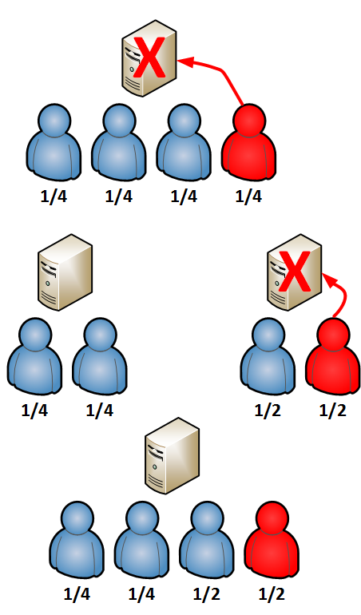
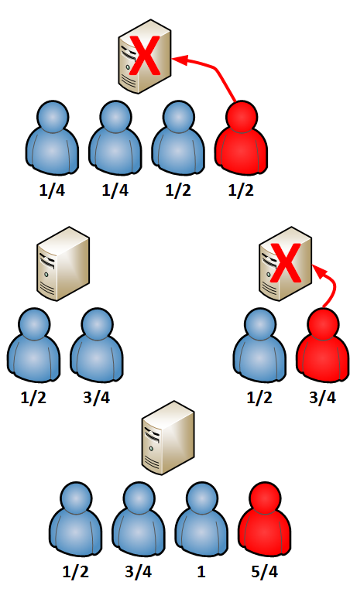
Cost Reduction via Consolidation
Consolidation
Consolidation

Slide 17
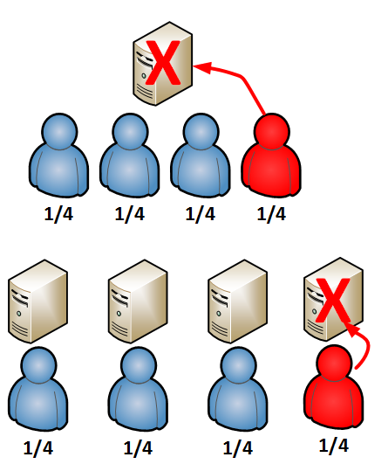
Controlling # Relays versus Speed of Attacker Identification
Cumulative Risk per Attack (CRPA)
Risk per Relay (RPR)
CRPA=1 RPR=0.5 CRPA/RPR=2
CRPA=1 RPR=0.25 CRPA/RPR=4

Slide 18
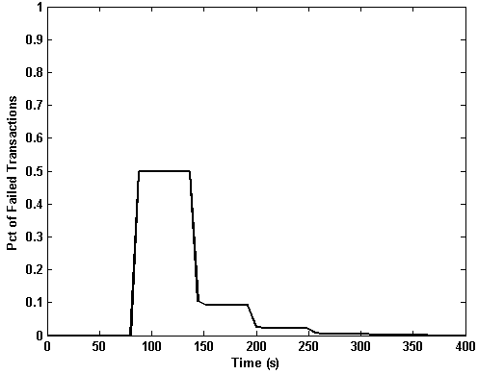
Experimental Results: Defending Against Single Attacker
Agent-Based MATLAB solution (Open Source release on github)
Relay Start Time: 40s
CPRA/RPR=3
1000 Clients
Single Attack Source
UDP Stream
Attacker identified in 300 seconds
Majority of clients kept online during attack

Slide 19
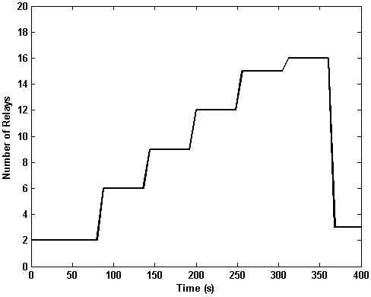
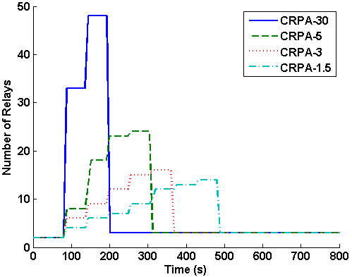
Defending Against Single Attacker: Cost
Attacker found in 3 rounds
1000 clients
CRPA/RPR=30
21 Relays Consumed
$0.07 EC2 Spot (Micro)
Higher CPRA
Faster isolation
Lower CRPA
Economic sustainability
Attacker identified faster with larger CRPA/RPR

Slide 20
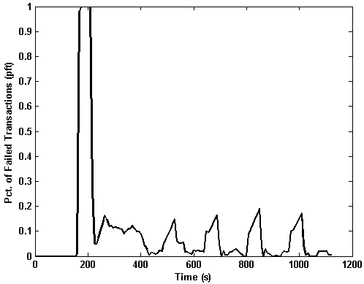
Repeated Attacks
Clients:Attackers = 100:1
New clients every 1.6 s
Connected for 400 s
New attacks every 160 s
Fresh insiders
Risk-history minimizes disruptions for connected clients

Slide 21
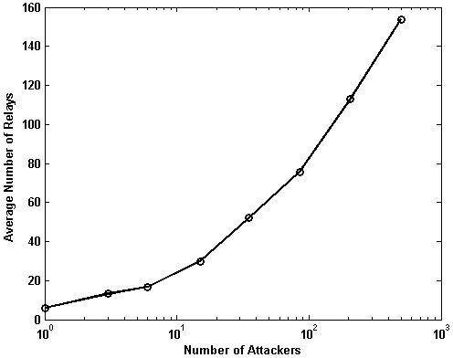
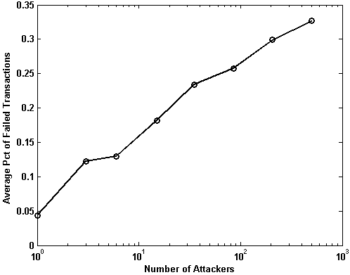
Success with Larger Attacks
300 Attackers = $0.47
DoSE is cost effective and efficient for most sizes of attacks

Slide 22
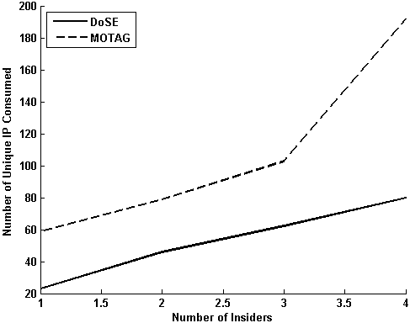
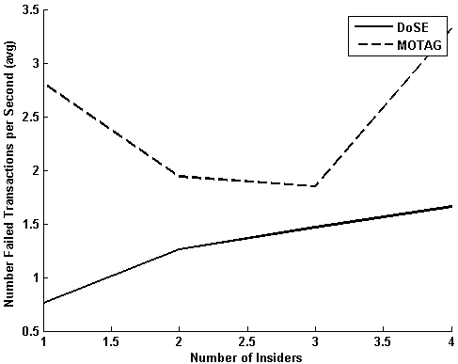
Comparison w/ MOTAG
DoSE is less costly and more effective than MOTAG for small attacks

Slide 23
Costs
Assignment and Relays
$2-9/Relay per Month (x3)
$0.008 per 5000 assigns
Attack Mitigation
$0.07-$0.47 per Attack
Commercial
$1800+ for UDP/TCP
MOTAG
$2000+ for 1000 Relays
Additional $ for IP release
Retransmission Bandwidth Costs
$0.09/GB
$0.02/GB if Service in Cloud

Slide 24
Conclusion
Low Cost
$0.07-$0.47 Defense/Attack
$2.99+ to launch attack
Off-the-Shelf
Unmodified CDN
Simple Linux relays

Slide 25
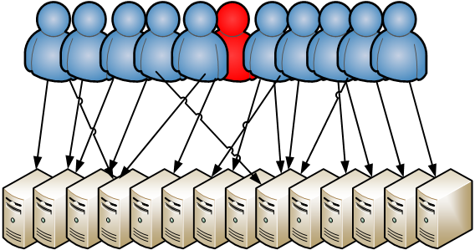
Stopping Large Attacks
Attack Absorbed by Full Relay Exposure
Notes:
PW: There is a practical limit to how many relays are necessary. With enough relays, the low-level firewall functions of each relay become sufficient to fend off attacks. Thus large attacks (in number of insiders) can still be filtered with a secondary plan.

