Slide 1
Dealing with the Unknown: Resilience to Prediction Errors
Subrata Mitra Purdue University
Greg Bronevetsky Google / LLNL
Suhas Javagal Purdue University
Saurabh Bagchi Purdue University
PACT 2015, San Francisco
Notes:
This work is collaboration between Purdue and LLNL. Greg just moved to Google.

Slide 2
The need for accurate performance prediction
Scheduler: More accurate execution time and resource usage prediction
Approximate computing: Level of approximation might be adjusted based on prediction of performance with different inputs
Anomaly detection: False alarms can be reduced with accurate prediction mechanism
Too many factors influencing performance:
Execution environment, config parameters, input size, data characteristic
Not possible to test or model all the combinations
Notes:
Software performance depend on parameters, input data, characteristics of data.
Accurate performance prediction is useful in many scenarios
We focus on the input dependence (config params and data)

Slide 3
Example of a performance bug
1 2 3 4 5 6 7 8 9 | void main (argc, argv){ int p = readInput() int q = argv[1]; int r = calculationsOnInput(p); float s = otherCalculations() float someVal = (r % q) + 0.001; int iterCount = s / someVal; for (int i=0; i < iterCount; i++){ doMoreCalculations(); } }
Test: Looks GOOD ☺
When a production execution takes too long how would you know whether it is because of
large input size
OR
(B) bug?
q | r | s | someVal | iterCount
2 | 21 | 10 | 1.001 | 9
3 | 14 | 20 | 2.001 | 9
5 | 28 | 30 | 3.001 | 9
40 | 85 | 40 | 5.001 | 7
Production: Blown Up ☹
q | r | s | someVal | iterCount
20 | 40 | 10 | 0.001 | 10000
Notes:
Untested parameter combination leads to a performance bug. Command-line parameter is stored in q. Value of r is calculated based on input data. During limited testing execution time was reasonable.
In production it blew up. How do we know the increase in runtime is expected because of a larger input or is it a bug ?

Slide 4
Previous works tried to solve this problem
DIDUCE¹ and Daikon²: Identifies hard invariants. Good for detecting constants, a valid range, ordering, linear relationship etc.
E.g.: v1 = 5
2 < v1< 6
v1 > v2
v1 + v2 = 3v3 etc.
.
Not suitable for detecting performance anomalies
No statistical prediction mechanism
- Cannot operate on unseen ranges of data
Binary decision: violated/not violated.
- No notion of how bad
[1] Hangal et al., ICSE-2002
[2] Ernst et al., Science of Computer Programming-2007
Notes:
DIDUCE and Daikon: More suitable for correctness problems (value checking). Hard invariants can not be used to detect performance anomalies.
X-ray: Performance summarization technique. Associates costs to each blocks and tries to find a root-cause of the performance problem.

Slide 5
Previous works related to performance anomaly
Many existing research for performance anomaly detection
“Fingerprinting the datacenter: automated classification of performance crises” by Bodik et al. (Eurosys 2010)
“Ensembles of models for automated diagnosis of system performance problems” by Zhang et al. (DSN 2005)
X-ray: Automating Root-Cause Diagnosis of Performance Anomalies in Production Software” by Attariyanet al. (OSDI 2012)
None can bound prediction confidence based on input data
Notes:
DIDUCE and Daikon: More suitable for correctness problems (value checking). Hard invariants can not be used to detect performance anomalies.
X-ray: Performance summarization technique. Associates costs to each blocks and tries to find a root-cause of the performance problem.

Slide 6
Roadmap of the talk
Need for prediction error characterization
Our tool chains
Details of error characterization techniques
Show a use case of anomaly detection
Present results and conclude

Slide 7
Statistical models are NOT fully accurate
Many configuration parameters, large range of acceptable values – impossible to cover all combinations
Performance changes with input size
Performance changes with characteristics of input data
- Examples: density of a graph, sparsity of a matrix
Models created with limited training runs. Production inputs can be very different
Errors in performance prediction models must be characterized
Notes:
Again to reiterate, too many parameters influence performance. Hence statistical models can not be fully accurate.
Statistical models created using limited runs can not capture all the scenarios.

Slide 8
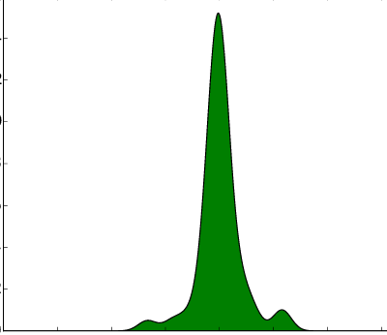
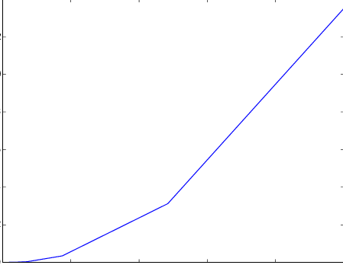
Examples of prediction errors
Predictors have inherent inaccuracies.
They can not capture all possible input scenarios.
CoMD
Prediction error in # executed instructions
SpMV
Prediction error in # executed instructions
120
100
80
60
40
20
Density
% error in prediction
-20 -10 0 10 20
% error in prediction
Distance from training set
Interpolation error
Extrapolation error
Notes:
Show some real examples of prediction errors. CoMD is a molecular dynamic application. We tried to model number of executed instructions for a particular function in coMD. We train using some set of parameters and then test the predicticted values with a slightly different sets of values, although drawn from the same range.
As we will see, both of these errors influence the confidence of the predicted value

Slide 9
Our contributions
Showed how to characterize errors in performance prediction from statistical models
Built associated tools for data collection and modeling
Showed how such error characterization can be used for anomaly detection which is sensitive to input parameters and data
Notes:
In this work we introduce a technique ..

Slide 10
Tool chain: Sight – Sculptor – E-Analyzer - Guardian
Features & Observations List
feedback
Identify duplicate features
Remove noisy observations
Context based modeling
Create distribution of prediction errors
Create profile for extrapolation error
Test/train runs
feedback
f1 f2 | o1 o2
SIGHT
SCULPTOR
E-ANALYZER
Production runs
Alarm Monitoring System
Observation | Value | Probability of fault
L2_miss time |  | 0.9 0.0
Input aware anomaly detection
GUARDIAN
High
Normal
Graphical interface
Notes:
We have proposed a technique for characterizing prediction errors in performance models. Then created a tool chain that uses this technique for anomaly detection in order to reduce false alarms

Slide 11
Sight: Instrumentation & data collection framework
Simple annotation APIs:
float func (float x, float y) {
//creating a module for the scope of this function
SightModule funcMod (“func”, inputs (“x”, x, “y”, y));
DoCalculations () // some computation done by the function
r = calculateResidual (); // function computes a residual value to verify convergence
funcMod.outputs (“r”, r); // SIGHT tracks the residual as an output observation
}
Track input features and observation features of each module
Input features examples: input size, matrix sparsity (SpMV), bit-rate (FFMpeg), # threads (LINPACK) etc.
Observation features example: execution time, # executed instructions, # load instructions, cache miss rate, residue value etc.
Notes:
To create a performance model we first need to gather execution related data. We need performance metrics, input parameters and characteristics etc. Sight tracks inputs and outputs identified by developer + performance metrics such as execution time, H/w metrics

Slide 12
Sculptor: The modeling tool
Features & Observations List
feedback
Identify duplicate features
Remove noisy observations
Context based modeling
Create distribution of prediction errors
Create profile for extrapolation error
Test/train runs
feedback
f1 f2 | o1 o2
SIGHT
SCULPTOR
E-ANALYZER
Production runs
Alarm Monitoring System
Observation | Value | Probability of fault
L2_miss time |  | 0.9 0.0
Input aware anomaly detection
GUARDIAN
High
Normal
Graphical interface
Notes:
Now I will briefly talk about the modeling tool, SCULPTOR

Slide 13
Sculptor: The modeling tool
Creates models for code regions identified by the developers
Choose the most useful input and observation features
Maximal information coefficient (MIC) based analysis¹.
Identifies if any relationship exists between two variables
Works even for non-linear relationships
Polynomial regression model built for each output feature
Polynomial of up to degree 3
LASSO to restrict the number of terms
[1] “Detecting Novel Associations in Large Data Sets,” Science, 2011.
Notes:
Creates context based models
Identify the input features that carry most useful information
Removes duplicate or highly correlated features LASSO (Least Absolute Shrinkage and Selection Operator)
Filter out outputs which does not show relationship with inputs – to reduce noise

Slide 14
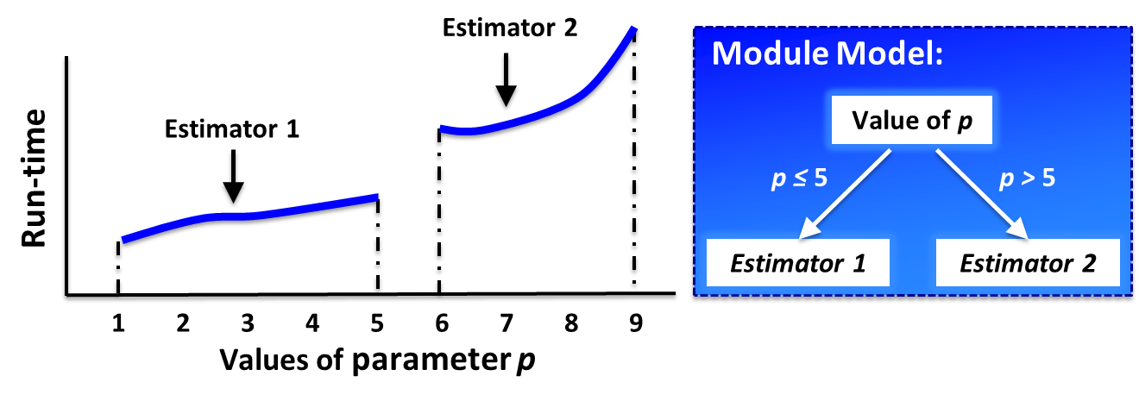
Handling discontinuity, incremental update
Ask for more input features if model is still not accurate
Features & Observations List
feedback
Identify duplicate features
Remove noisy observations
Context based modeling
Create distribution of prediction errors
Create profile for extrapolation error
Test/train runs
feedback
f1 f2 | o1 o2
SIGHT
SCULPTOR
E-ANALYZER
Notes:
There might be discontinuity in the behavior of observation metrics. We can incrementally update our models.
No need to retrain for the whole
If model is still not accurate enough, ask for more descriptive inputs from the developers

Slide 15
E-Analyzer: The error characterization tool
Features & Observations List
feedback
Identify duplicate features
Remove noisy observations
Context based modeling
Create distribution of prediction errors
Create profile for extrapolation error
Test/train runs
feedback
f1 f2 | o1 o2
SIGHT
SCULPTOR
E-ANALYZER
Production runs
Alarm Monitoring System
Observation | Value | Probability of fault
L2_miss time |  | 0.9 0.0
Input aware anomaly detection
GUARDIAN
High
Normal
Graphical interface
Notes:
Now I will talk about how E-Analyzer, can characterize the prediction errors made by statistical models

Slide 16
E-Analyzer: The error characterization tool
Interpolation error
Probability
Round 1
Round 2
Round 3
% Error
Training points
Test points
Error distribution
Extrapolation error
Predict at production point
distance
Available data
Prediction error
Extrapolation distance
Training points
Test points
Training sub-region
Notes:
As mentioned before: Interpolation => test points fall within the same range of training points
Extrapolation => test points are far apart from the training points
Interpolation error characterization => repeated sampling and test (also called Bootstapping method)
Extrapolation, we want to capture how error grows as we move away

Slide 17
How to calculate the distance ?
Example:
Trained with two input features:
f1 (using range 0-1000) and f2 (using range 0-10)
How far is the production point (f1=2000, f2=11) ?
Which one is closer to training region
(f1=2000, f2=11) or (f1=1100, f2=20) ?
Practical limitations: Input features can not be normalized
- Valid ranges may not be known (no a priori bound: e.g. input size)
Predict at production point
distance
Available data
Prediction error
Extrapolation distance
Training sub-region
Training points
Test points
Notes:
But calculating a distance is not so easy. Euclidian or Mahalanobis distance formula can not be directly used
Input feature ranges might be on different scale.
May be a valid range is not known a priori
What are the best ways to calculate these distance between f1 and f2 ?

Slide 18
Proposed notion for distance:
Distance along one input feature dimension = | $\frac{fp − \text{µ}\text{S}\text{train}}{\text{σ}\text{S}\text{train}}$ |
µ_{Strain} : Mean of the training set
σ_{Strain} : Standard deviation of the training set
Create error profiles for individual input feature dimensions
At production, combine these profiles to estimate overall error
Notes:
To avoid such issues, we have come up with a new notion for distance which will be measured only along an individual feature dimension.
Distance => How many standard deviations away from the training set, the production point is

Slide 19
Example of Error Calculation
Sort training data w.r.t f1
Create error profile for varying f1
Sort training data w.r.t f2
Create error profile for varying f2
% error
% error
Δ f1= $\frac{f1 − μ}{σ}$
Δ f2= $\frac{f2 − μ}{σ}$
To estimate overall error at a production point (f1 = X1, f2= X2):
Combine the projected errors from feature specific error profiles
Notes:
Lets show an example, how we can create extrapolation error profiles for f1 and f2 separately, using the new approach

Slide 20
Combining individual error components
Errors might be correlated
We calculate overall error as:
$\sqrt{\left[Ef1\right]2+\left[\left(1−mf1f2\right)Ef2\right]2 + . . . }$
E_{f1}, E_{f2} : Extrapolation errors at the production point
m_{f1f2} : MIC (correlation) of extrapolation errors
When errors are uncorrelated (i.e., m_{f1f2} = 0.0):
$Overall error= \sqrt{\left[Ef1\right]2+\left[Ef2\right]2 + . . . }$ = RMS error
When errors are fully correlated (i.e., m_{f1f2} = 1.0):
$Overall error=Ef1$ = Error coming from any single component
Notes:
The “correlated error” because input-features was slightly correlated. We remove duplicate improves at the beginning (mic > 0.9 ), but do not remove anything with lower correlation because in that case we might loose some important behavior. Here we compensate for that reluctance. Note, for correlated inputs, it is not possible to “fix” one feature and see the error trend of another feature, because, values of those features will always change together. In this case, instead of fixing (f2), we choose values of f1 where values of f2 are similar, that is the variation remains within a bound

Slide 21
Guardian: The anomaly detection tool
Features & Observations List
feedback
Identify duplicate features
Remove noisy observations
Context based modeling
Create distribution of prediction errors
Create profile for extrapolation error
Test/train runs
feedback
f1 f2 | o1 o2
SIGHT
SCULPTOR
E-ANALYZER
Production runs
Alarm Monitoring System
Observation | Value | Probability of fault
L2_miss time |  | 0.9 0.0
Input aware anomaly detection
GUARDIAN
High
Normal
Graphical interface
Notes:
Now we talk about Guardian, the anomaly detection tool.
It monitors the production run and uses the models created by Sculptor and error profile created by E-Analyzer to detect if any observation metrics is behaving in an anomalous way.

Slide 22
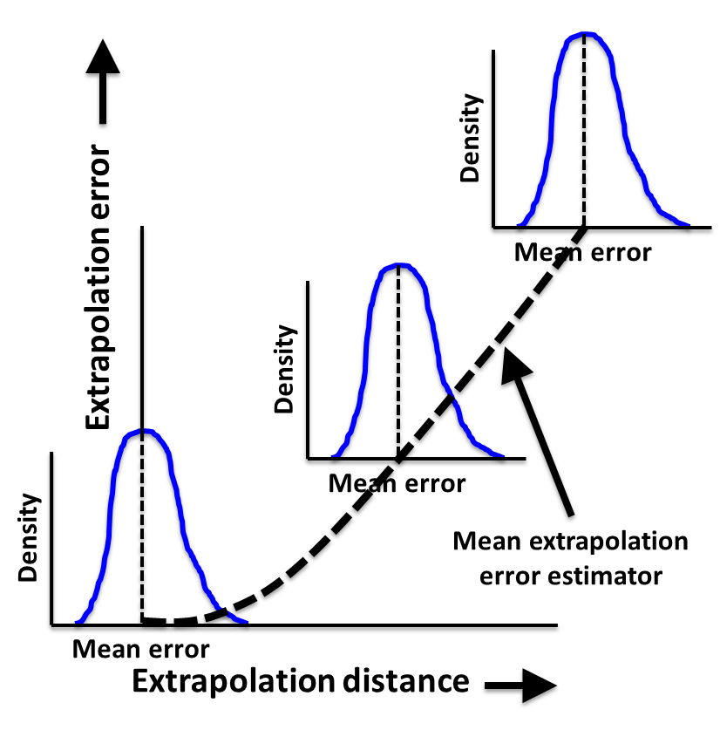
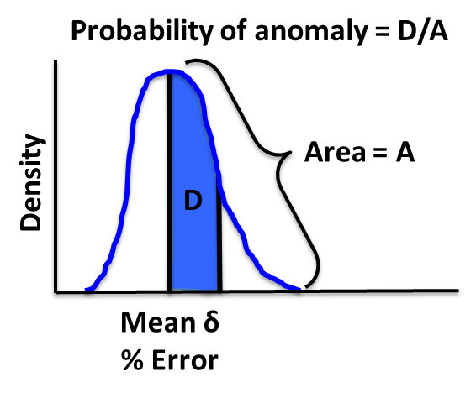
Guardian: The anomaly detection tool
How extrapolation and interpolation error fit together ?
Production run: calculate a probability of anomaly
Notes:
Guardian puts interpolation and extrapolation error together while calculating a probability of anomaly.
As we move away from training set, extrapolation error would grow – which is also the mean error.
Previously we characterized interpolation error as a distribution around a mean. The mean is most of the time zero, if the model is reasonably accurate.
When we combine error arising from interpolation and extrapolation we assume the nature of that distribution remains the same, but now the interpolation errors distribute around the mean error identified due to extrapolation.
Delta is the difference of observed error and predicted error
Now during production run, when we see a deviation of an observation metric from its predicted value, we calculate how likely it is to see such a deviation under normal scenarios and based on that probability mark it is normal or anomalous

Slide 23
How did we evaluate Guardian
Used 7 applications from different domains:
- CoMD, LULESH (scientific simulations)
- LINPACK, SpMV (math)
- PageRank, BlackScholes, FFmpeg (diverse)
False positive rate:
Training: Using given range of parameter values
Production: Parameter values away from the training range (low/high distance)
Anomaly detection accuracy:
Injected computation and memory intensive code as anomaly
Varied intensity of anomaly
Compared with fixed percentage threshold based detection
- Guardian A: Only extrapolation error considered
- Guardian B: Both interpolation and extrapolation errors considered
Notes:
We evaluated Guardian using 7 applications chosen from multiple domains
Evaluated in terms of false positive rates and detection accuracy
Usually anomaly detection is done based on fixed percentage of threshold. So we chose different thershold percentages as comparison points.
Two flavors of Guardian A and B.

Slide 24
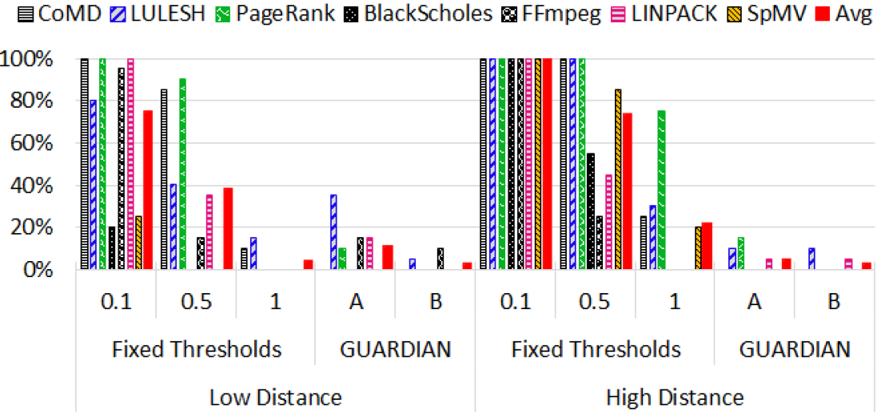
Experiment: False positive rates
Lower is better
% of time false alarm raised
Guardian A : Only extrapolation error characteristics
Guardian B: Both interpolation and extrapolation error characteristics
Guardian significantly reduces false positives rates
Notes:
Low distance: 5-10 std deviations away from the training set
High distance: 30-35 std deviations away from the training set
Ran each application 15 times
100% threshold almost show no false postives. But bad for anomaly detection. 50% is reasonable.
At higher distance, the advantage of error characterization based technique becomes more prominent as threshold based techniques throw many false positives
Interpolation error distribution is very narrow, and does not provide much advantage at higher distance

Slide 25
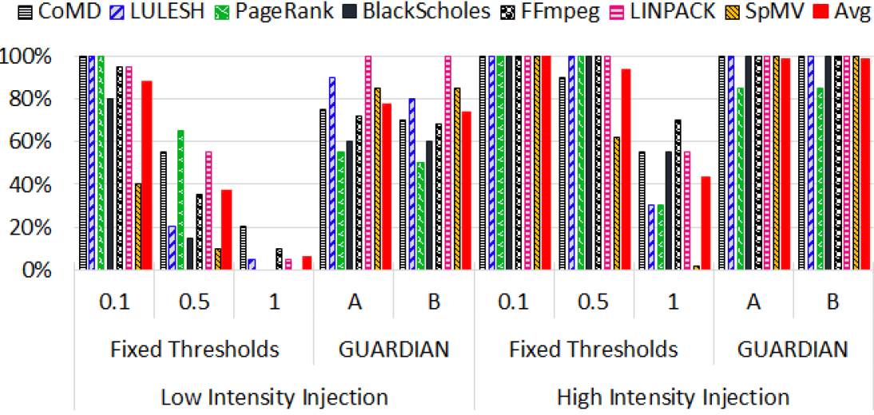
Experiment: Detection accuracy
Higher is better
% of time detected
injected extra computation loop
Guardian maintains a high detection accuracy
Other experiments: injected memory allocation and cache interference codes
Refer to the paper for the details
Notes:
Using binary instrumentation tool called PIN, injected extra computation codes at random locations, as anomaly.
We counted what percentage of time Guardian was able to flag an anomaly.
10% fixed threshold is very good, but throw many false positives. 50% threshold is a reasonable comparison.
Tested only at low distance. At high distance, threshold based technique was already through high false postives.
Another experiment: injected extra code that allocates and reads randomly and multiple times from an array Results are similar

Slide 26
Summary
Input parameters have substantial influence on software performance
Not all possible scenarios can be modeled or tested
Confidence in performance prediction by a statistical technique must be quantified based on the input data
Future directions
Input-aware scheduling
Adjust estimation based on prediction errors characteristics
Approximate computing
Adjust level of approximation based on modeling error characteristics and input properties
Notes:
Input-aware scheduling strategies: Execution time, resource usages vary with inputs
User provided estimations are inaccurate – wastage of resources
Input-aware approximate computing: Some applications are immune some amount of error introduced through approximate models: Error varies with the inputs

Slide 27
Thank you!
Questions ?

Slide 28
Backup slides

Slide 29
SIGHT: The inputs and observation features we track

Slide 30
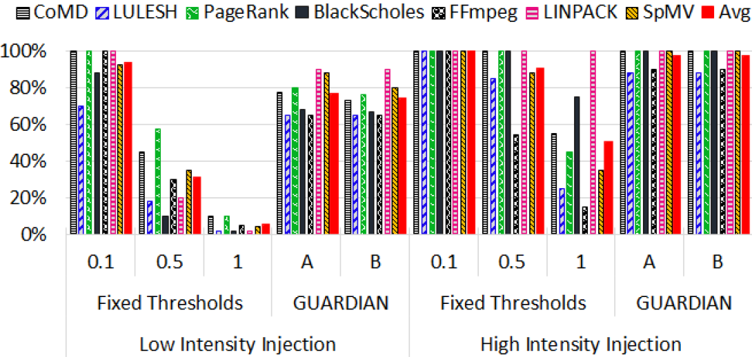

Slide 31
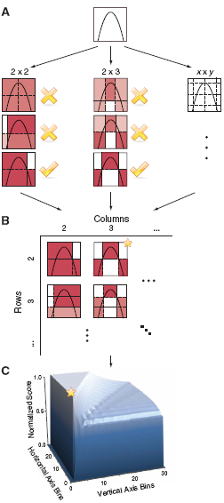
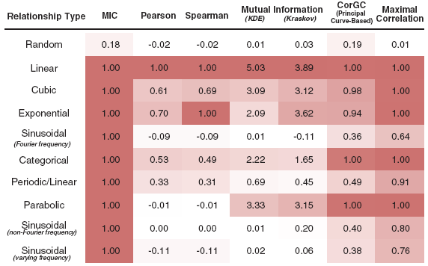
Background: MIC
Reference:
Detecting Novel Associations in Large Data Sets
by Reshef et al.
Science, Dec 2011

Slide 32
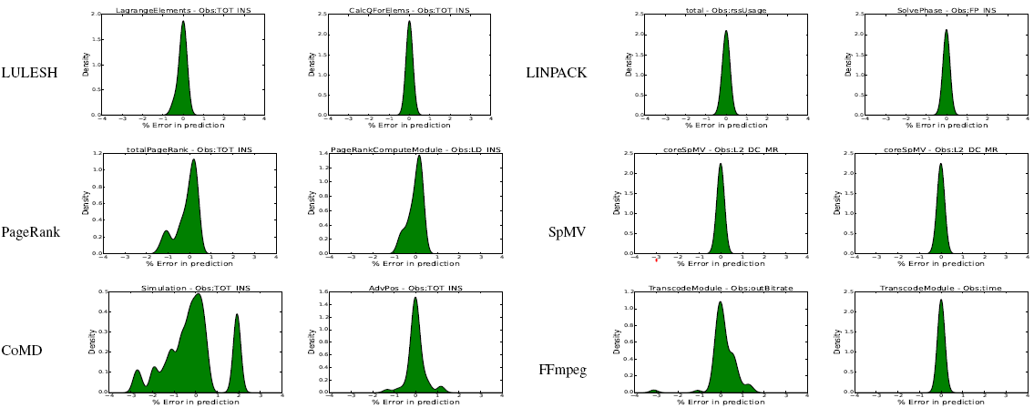
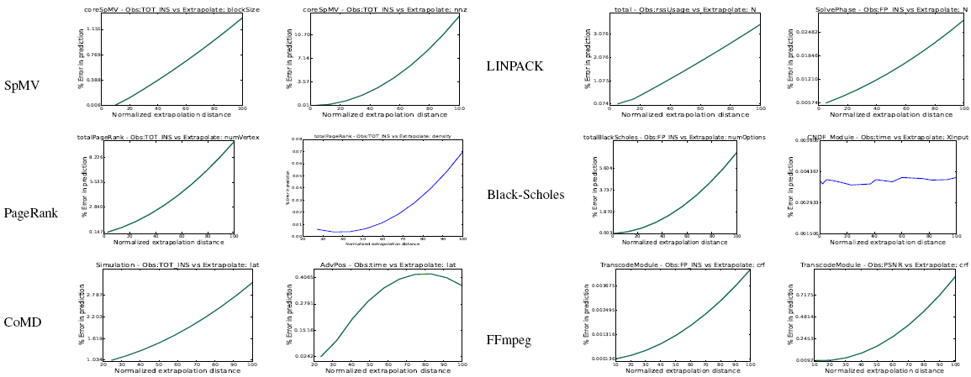

Slide 33
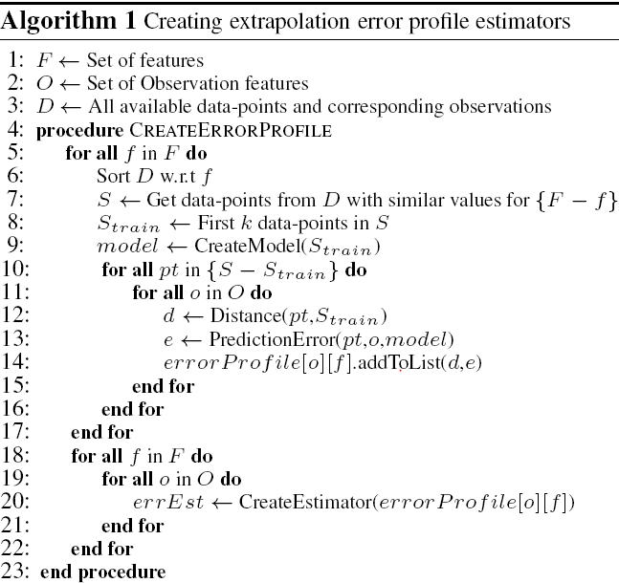

Slide 34
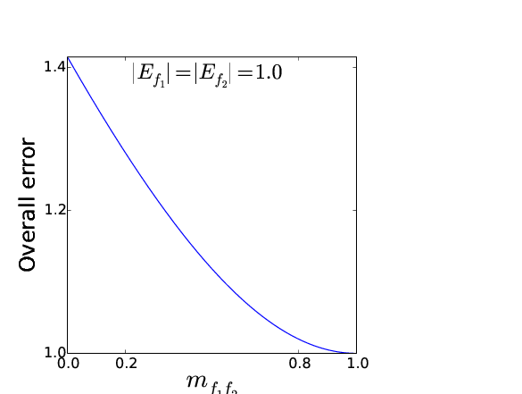
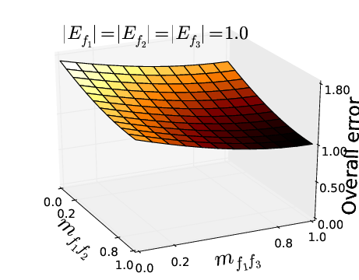
How does this equation scale ?
When no features are correlated, the overall error rises to √k for k features
(identical to RMS norm)
The error grows with number of features contributing to extrapolation error

Slide 35
Too many factors influencing performance
Many configuration parameters, execution environment, input size, input characteristics
Not possible to test all the combinations
When performance degrades, hard to understand whether it was expected or something went wrong

