Slide 1
FRESCO: An Open Failure Data Repository for Dependability Research and Practice
& Resource Usage
∧
Saurabh Bagchi, Carol Song (Purdue University)
Ravi Iyer, Zbigniew Kalbarczyk (University of Illinois at Urbana-Champaign)
Nathen DeBardeleben (Los Alamos)
Presentation available at: engineering.purdue.edu/dcsl

Slide 2
Roadmap
Motivation
Why do we need an open data repository?
What are our plans
Context
Large computing cluster at Universities
Demography of the cluster users
Challenge in supporting user needs
Insights from analysis of Purdue’s cluster
Cluster environment
The data set
Analysis and Results
Current status of the repository
The next steps

Slide 3
Motivation
Dependability has become a necessary requisite property for computing systems that we rely on
Dependable system design should be based on real failure modes of systems
BUT
There does not exist any open failure data repository today for any recent computing infrastructure that is
large enough,
diverse enough, and
with enough information about the infrastructure and
the applications that run on them

Slide 4
So what do we do about it?
Stop bemoaning the lack of publicly available dependability dataset and start building one
But, who will want to share such data publicly?
Start with local IT organizations: Purdue and UIUC
Get NSF backing – some of the IT clusters have been set up with NSF funding
Collect an initial dataset for a small time window of
Applications and libraries
Resource usage – node and job level
Health information – node and job level
Release the dataset after heuristic-based anonymization

Slide 5
National Science Foundation Context
Planning grant from the National Science Foundation (NSF) in 06/14-06/15, $100K
Computational and Information Sciences Directorate (CISE)
Computing Research Infrastructure (CRI) Program
Deliverable: Data collection tools in place on Purdue’s IT infrastructure; Requirements gathering
Regular grant from NSF: 3 years, started 07/15, $1.2M
Involves UIUC with their Blue Waters cluster
Delivered: First release of the dataset with DOI
Deliverable:
Large set of diverse data, from the PI/co-PI’s institutions plus others
Large set of users
Large set of analytical tools made available by the community

Slide 6
University Compute Cluster Context
Computing clusters at university is not uncommon
Users have a varying level of expertise
Writing own job scripts
Using scripts like a black box
Varying user needs
High computation power
Analysis of large structures (Civil, Aerospace engineering)
High Lustre bandwidth for file operations
Working with multiple large databases/files (Genomics)
High Network Bandwidth
A parallel processing application

Slide 7
Goals of Data Analysis & Related Efforts
Goals for data analysis of cluster resource usage and failures
Improve cluster availability
Minimize the maintenance cost
``Customer satisfaction”
Several synergistic efforts
XDMoD (U of Buffalo): NSF-funded project to audit utilization of the XSEDE cyberinfrastructure by providing a wide range of metrics on XSEDE resources, including resource utilization, resource performance, and impact on scholarship
XALT (U of Chicago, UT Austin): NSF-funded project to collect and understand job-level information about the libraries and executables that jobs use
[Past project] Computer Failure Data Repository (CFDR) (CMU, U of Toronto)

Slide 8
Purdue Cluster Details and Initial Dataset

Slide 9
Cluster Details
Purdue’s cluster is called Conte
580 homogeneous nodes
Each node contains two 8 core Intel Xeon E5-2670 Sandy Bridge processors running at 2.6 GHz
Two Xeon Phi 5110P accelerator card, each with 60 cores
Memory: 64GB of DDR3, 1.6 GHz RAM
40Gbps FDR10 Infiniband interconnect along with IP
Lustre file system, 2GB/s
RHEL 6.6
PBS based job scheduling using Torque
Conte is a ``Community” cluster
Notes:
These are shared clusters called “community clusters”
They have become common in big organizations, academic, industrial, and government labs
A diverse set of sub-units within the organization buy assets in a cluster and these are then put together by central IT
Flexible usage policies, such that partners in the cluster have ready access to the capacity they purchase and potentially to much more, when there are idle resources

Slide 10
Cluster Details
Scheduling in Conte:
Each job requests for certain time duration, number of nodes and in some cases, amount of memory needed
When job exceeds the specified time limit, it is killed
Jobs are also killed by out-of-memory (OOM) killer scripts, if it exhausts available physical memory and swap space
Node sharing:
By default only a single job is scheduled on a an entire node giving dedicated access to all the resources
However, user can enable sharing by using a configuration in the job submission scripts
Notes:
The job requirements are specified through the PBS submission scripts.

Slide 11
Conte’s Data Set
Data set spans Oct ‘14 – Mar ‘15 (6 months)
~500k jobs (489, 971 jobs)
306 unique users
Per job data
Accounting logs from PBS scheduler
Job owner details
Start/end time, resource requested/used
List of shared libraries used (using lsof)
Node-wise performance data
Collected using Tacc stats
Lustre, Infiniband, Virtual memory, Memory and more…
Syslog messages

Slide 12
System Usage Repository
Objectives
Enable systems research in dependability that relies on system usage and failure records from large-scale systems
Provide synchronized workload information, system usage information, some user information, hardware status information
Provide this repository for a diversity of workloads and diversity of computing systems
Provide common analytic tools to allow for dependability-related questions to be asked of the data
URL: https://diagrid.org/resources/247

Slide 13
Questions for the Repository
URL: https://diagrid.org/resources/247
What is the resource utilization (CPU, memory, network, storage) of jobs with a certain characteristic?
Characteristic could be the application domain, the libraries being used, parallel or serial, and if parallel, how many cores
We want to know this especially if resource utilization is anomalously high
What is the profile of users submitting jobs to the cluster?
Are they asking for too much or too little resources in the submission script?
Are they making the appropriate use of the parallelism?
What kinds of problem tickets do they submit and how many rounds are needed to resolve these tickets?

Slide 14
Current status of the repository
Workload traces from Conte
Accounting information (Torque logs)
TACC stats performance data
User documentation
Privacy
Anonymize machine specific information
Anonymize user/group identifiers
Library list is not shared
For privacy reasons
Notes:
Bullet 3: Hardware configuration - number of cores on a node, amount of memory on a node, the network backplane, etc.. Software configuration - which libraries and applications to pre-install and where to locate them.
3: We analyzed approximately 500K jobs for this study. This part of a continuing study.

Slide 15
Insights from Data Analysis
Few libraries (not pre-installed) are highly popular
45% jobs use less than 10% requested time
70% jobs use less than 50% requested memory
20% jobs showed memory thrashing
Memory thrashing behavior of jobs the share the node and jobs that do not are exactly opposite
Few jobs place very high demand for I/O and network resources

Slide 16
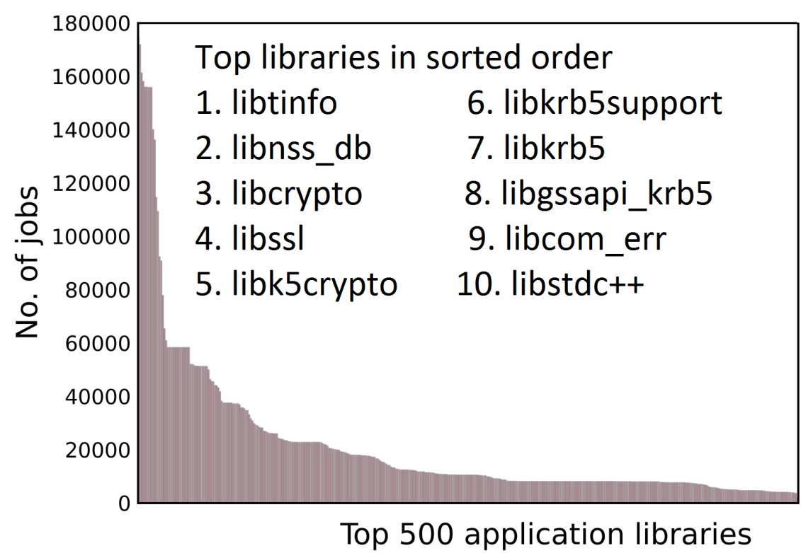
Hot Libraries
Extract all dynamically linked libraries being used by the applications
Sorted histogram of top 500 libraries as used by the jobs
Out of a total 3,629 unique libraries, some are used much more often
Each of the top 50 libraries is used by more than 80 % of the users
Notes:
the top-most library is used 4X more frequently than the 50-th most used one

Slide 17
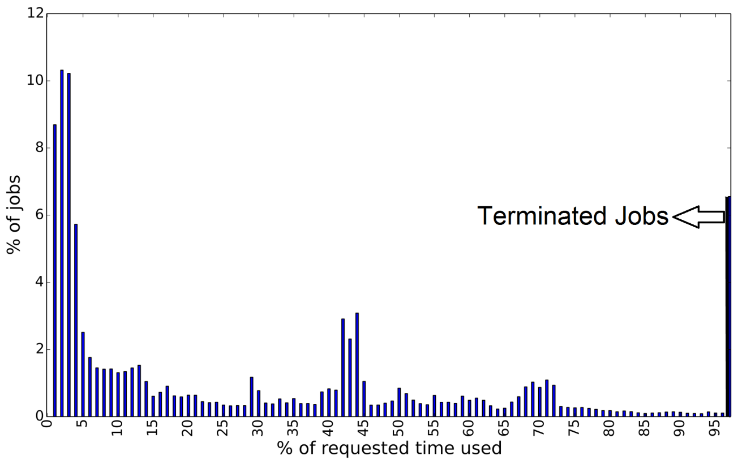
Resource Request Patterns
Percentage of the user requested time actually used by the jobs
Almost 45% of jobs actually used less than 10% of requested time
But, scheduler during busy periods gives higher priority to shorter jobs
Notes:
Requesting for longer times is not only frustrating for users (due to longer queuing time) but also leads to sub-optimal allocation by the scheduler of jobs to nodes

Slide 18
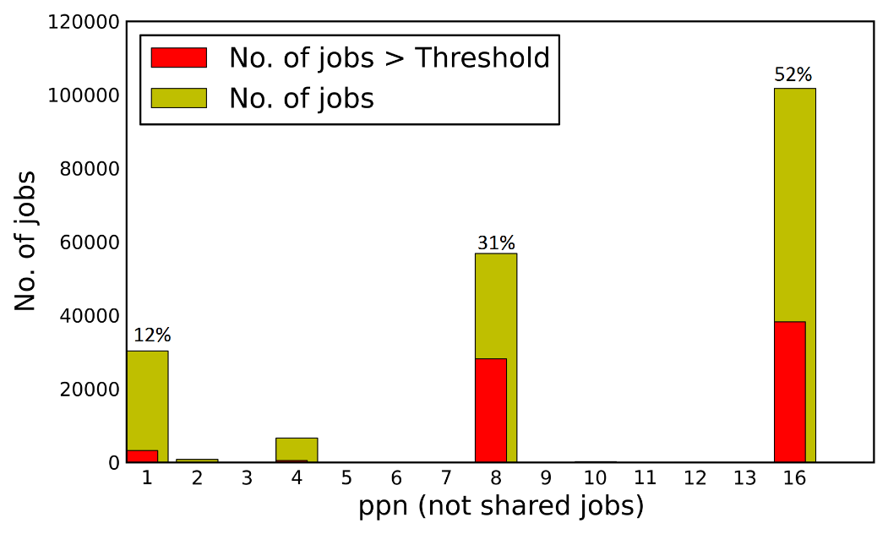
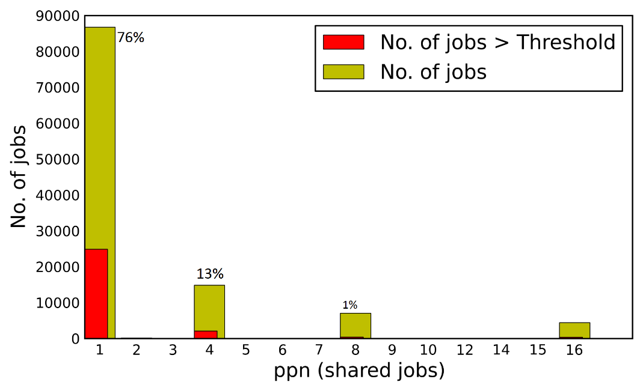
Shared v/s non-shared Jobs
Jobs that share node have higher thrashing compared to jobs that do not share the node

Slide 19
Project Plans

Slide 20
Immediate next steps
Continued data collection on Purdue clusters
Analysis of Blue Waters logs
Analyze workloads on similar lines as Conte
Investigate the similarities and differences in the results
Identify the user behavior and workload characteristic for better cluster management
Close the loop
Implement the remediation measures, e.g., move some jobs to a different cluster, increase the memory asked for
Check the effect of the remediation measures

Slide 21
A Wish List for Types of Data
Accounting information
Job Owner ID, group ID
Start/End time
Resources requested/used
Memory, CPUs, Walltime ,etc
Performance statistics
I/O usage (Lustre, Disk)
Network usage (IP, Infiniband)
Memory usage
Virtual memory statistics
Library List per job
Shared objects used by the job
Notes:
1) User problem resolution tickets
2) Failure resolution reports

Slide 22
A Wish List for Types of Data
User Tickets
Problem and resolution
Failure resolution reports
Failure description
Root cause identification
Issue resolution

Slide 23
Conclusion
It is important to analyze how resources are being utilized by users
Scheduler tuning, resource provisioning, and educating users
It is important to look at workload information together with failure events
Workload affects the kinds of hardware-software failures that are triggered
Open repository enables researchers for different kind of analyses to enhance system dependability
Contributors
Purdue: Suhas Javagal, Subrata Mitra, Chris Thompson, Stephen Harrell, Chuck Schwarz
UIUC/NCSA: Saurabh Jha, Joseph Fullop, Jeremy Enos, Fei Deng, Jin Hao
DOE: Todd Gamblin, Ignacio Laguna, Dong Ahn

Slide 24
Thank you

