Slide 1

pSigene: Webcrawling to Generalize
SQL Injection Signatures
Gaspar Modelo-Howard †, Chris Gutierrez*, Fahad Arshad*,
Saurabh Bagchi*, Yuan Qi*
†
*
IEEE/IFIP International Conference
on Dependable Systems and Networks (DSN 2014)
Notes:
Name
Collaboration with…
Thanks for the invitation…
We have about 1 hour, feel free to bring questions as we go thru the presentation
Hope you like the presentation, understand there is some overlap between this topic and some of the work you guys do here.

Slide 2
Motivation
Misuse-based detection systems (WAF/IDS)
union+select
ALERT
IDS
union+select
Signatures Set
  Drawbacks:
  Manual creation and update of signatures, a herculean task
  Relative static nature of signatures (missing attacks' variations)
Notes:
-the accuracy of the signatures is paramount for an effective IDS/WAF, still today’s practitioners rely on manual techniques to improve and update those signatures
-as new attacks are created and new kinds of benign traffic are observed, signatures need to be updated. The current approach to this process is manual
-goal is to created generalized signatures; “generalized” implies the signatures will be able to match some zero-day attacks as weel, not just the attack samples that is has been trained on

Slide 3
Motivation
Misuse-based detection systems (WAF/IDS)
union+select
ALERT
IDS
union+select
Selected SQL injection attacks
as subject matter
Top 3 attack type [IBM14]
Most of previous work has been on malware-related activity
Signatures Set
Notes:
-most of the efforts to date to automate the signature creation process has been related to malware activity
-we target attack steps that have a small distnace from legitimate activity
-there exist elegant preventive solutions to solve SQLi attacks, but seem elusive to completely implement such solutions. We complement these solutions
-signatures to improve detection mechanisms, such as what pSigene delivers, are necessary as they complement prevention mechanisms

Slide 4
Motivation
Example of existing signature for detection system
(?i:(?:\b(?:(?:s(?:ys\.(?:user_(?:(?:t(?:ab(?:_column|le)|rigger)|object|view)s|c(?:onstraints|atalog))|all_tables|tab)|elect\b.{0,40}\b(?:substring|users?|ascii))|m(?:sys(?:(?:queri|ac)e|relationship|column|object)s|ysql\.(db|user))|c(?:onstraint_type|harindex)|waitfor\b\W*?\bdelay|attnotnull)\b|(?:locate|instr)\W+\()|\@\@spid\b)|\b(?:(?:s(?:ys(?:(?:(?:process|tabl)e|filegroup|object)s|c(?:o(?:nstraint|lumn)s|at)|dba|ibm)|ubstr(?:ing)?)|user_(?:(?:(?:constrain|objec)t|tab(?:_column|le)|ind_column|user)s|password|group)|a(?:tt(?:rel|typ)id|ll_objects)|object_(?:(?:nam|typ)e|id)|pg_(?:attribute|class)|column_(?:name|id)|xtype\W+\bchar|mb_users|rownum)\b|t(?:able_name\b|extpos\W+\()))
Reference: OWASP ModSecurity Core Rule Set, v.2.2.4

Slide 5
Motivation
Example of existing signature for detection system
(?i:(?:(?:s(?:t(?:d(?:dev(_pop|_samp)?)?|r(?:_to_date|cmp))|u(?:b(?:str(?:ing(_index)?)?|(?:dat|tim)e)|m)|e(?:c(?:_to_time|ond)|ssion_user)|ys(?:tem_user|date)|ha(1|2)?|oundex|chema|ig?n|pace|qrt)|i(?:s(null|_(free_lock|ipv4_compat|ipv4_mapped|ipv4|ipv6|not_null|not|null|used_lock))?|n(?:et6?_(aton|ntoa)|s(?:ert|tr)|terval)?|f(null)?)|u(?:n(?:compress(?:ed_length)?|ix_timestamp|hex)|tc_(date|time|timestamp)|p(?:datexml|per)|uid(_short)?|case|ser)|l(?:o(?:ca(?:l(timestamp)?|te)|g(2|10)?|ad_file|wer)|ast(_day|_insert_id)?|e(?:(?:as|f)t|ngth)|case|trim|pad|n)|t(?:ime(stamp|stampadd|stampdiff|diff|_format|_to_sec)?|o_(base64|days|seconds|n?char)|r(?:uncate|im)|an)|m(?:a(?:ke(?:_set|date)|ster_pos_wait|x)|i(?:(?:crosecon)?d|n(?:ute)?)|o(?:nth(name)?|d)|d5)|r(?:e(?:p(?:lace|eat)|lease_lock|verse)|o(?:w_count|und)|a(?:dians|nd)|ight|trim|pad)|f(?:i(?:eld(_in_set)?|nd_in_set)|rom_(base64|days|unixtime)|o(?:und_rows|rmat)|loor)|a(?:es_(?:de|en)crypt|s(?:cii(str)?|in)|dd(?:dat|tim)e|(?:co|b)s|tan2?|vg)|p(?:o(?:sition|w(er)?)|eriod_(add|diff)|rocedure_analyse|assword|i)|b(?:i(?:t_(?:length|count|x?or|and)|n(_to_num)?)|enchmark)|e(?:x(?:p(?:ort_set)?|tract(value)?)|nc(?:rypt|ode)|lt)|v(?:a(?:r(?:_(?:sam|po)p|iance)|lues)|ersion)|g(?:r(?:oup_conca|eates)t|et_(format|lock))|o(?:(?:ld_passwo)?rd|ct(et_length)?)|we(?:ek(day|ofyear)?|ight_string)|n(?:o(?:t_in|w)|ame_const|ullif)|(rawton?)?hex(toraw)?|qu(?:arter|ote)|(pg_)?sleep|year(week)?|d?count|xmltype|hour)\W*\(|\b(?:(?:s(?:elect\b(?:.{1,100}?\b(?:(?:length|count|top)\b.{1,100}?\bfrom|from\b.{1,100}?\bwhere)|.*?\b(?:d(?:ump\b.*\bfrom|ata_type)|(?:to_(?:numbe|cha)|inst)r))|p_(?:sqlexec|sp_replwritetovarbin|sp_help|addextendedproc|is_srvrolemember|prepare|sp_password|execute(?:sql)?|makewebtask|oacreate)|ql_(?:longvarchar|variant))|xp_(?:reg(?:re(?:movemultistring|ad)|delete(?:value|key)|enum(?:value|key)s|addmultistring|write)|terminate|xp_servicecontrol|xp_ntsec_enumdomains|xp_terminate_process|e(?:xecresultset|numdsn)|availablemedia|loginconfig|cmdshell|filelist|dirtree|makecab|ntsec)|u(?:nion\b.{1,100}?\bselect|tl_(?:file|http))|d(?:b(?:a_users|ms_java)|elete\b\W*?\bfrom)|group\b.*\bby\b.{1,100}?\bhaving|open(?:rowset|owa_util|query)|load\b\W*?\bdata\b.*\binfile|(?:n?varcha|tbcreato)r|autonomous_transaction)\b|i(?:n(?:to\b\W*?\b(?:dump|out)file|sert\b\W*?\binto|ner\b\W*?\bjoin)\b|(?:f(?:\b\W*?\(\W*?\bbenchmark|null\b)|snull\b)\W*?\()|print\b\W*?\@\@|cast\b\W*?\()|c(?:(?:ur(?:rent_(?:time(?:stamp)?|date|user)|(?:dat|tim)e)|h(?:ar(?:(?:acter)?_length|set)?|r)|iel(?:ing)?|ast|r32)\W*\(|o(?:(?:n(?:v(?:ert(?:_tz)?)?|cat(?:_ws)?|nection_id)|(?:mpres)?s|ercibility|alesce|t)\W*\(|llation\W*\(a))|d(?:(?:a(?:t(?:e(?:(_(add|format|sub))?|diff)|abase)|y(name|ofmonth|ofweek|ofyear)?)|e(?:(?:s_(de|en)cryp|faul)t|grees|code)|ump)\W*\(|bms_pipe\.receive_message\b)|(?:;\W*?\b(?:shutdown|drop)|\@\@version)\b|'(?:s(?:qloledb|a)|msdasql|dbo)'))\b(?i:having)\b\s+(\d{1,10}|'[^=]{1,10}')\s*[=<>]|(?i:\bexecute(\s{1,5}[\w\.$]{1,5}\s{0,3})?\()|\bhaving\b ?(?:\d{1,10}|[\'\"][^=]{1,10}[\'\"]) ?[=<>]+|(?i:\bcreate\s+?table.{0,20}?\()|(?i:\blike\W*?char\W*?\()|(?i:(?:(select(.*)case|from(.*)limit|order\sby)))|exists\s(\sselect|select\Sif(null)?\s\(|select\Stop|select\Sconcat|system\s\(|\b(?i:having)\b\s+(\d{1,10})|'[^=]{1,10}')
Signature with regular expression of 2,917 characters

Slide 6
Related Work
Automatic Signature Creation
  [Rafiqu13], [Perdis10], [Li06], [Newsom05], [Yegnes05]
  Work aimed at malware case (not our case)
Protocol knowledge-based detection
  [Zand14], [Chandr11], [Robert10], [Perdis10], [Vigna09]
  Different protocols, similar assumption
Signature Generalization
  [Rafiqu13], [Aickel08], [Robert06], [Yegnes05]
  Deterministic approach
Notes:
Framework requires protocol knowledge in order to produce effective signatures
Signature generalization: generates signatures that consist of multiple disjoint substrings

Slide 7
Contributions
An automatic approach to generate and update signatures for misuse-based detection systems
A non-deterministic framework to generalize existing signatures
Rigorously benchmarked our solution with a large set of attack samples and compare our performance
to popular misuse-based NIDS
Notes:
A solution for the automatic creation of generalized signatures represented as regular expressions, by applying a sequence of two data mining techniques to a corpus of attack samples
The detection of new variations of attacks is achieved by using regular expressions for the generalized signatures
Our evaluation also brings out the impact of practice use case whereby periodically new attack samples are fed into our algorithm and consequently the signatures can be progressively updated

Slide 8
Agenda
Motivation and Related Work
Framework Design
Evaluation
Future Work
Conclusions

Slide 9
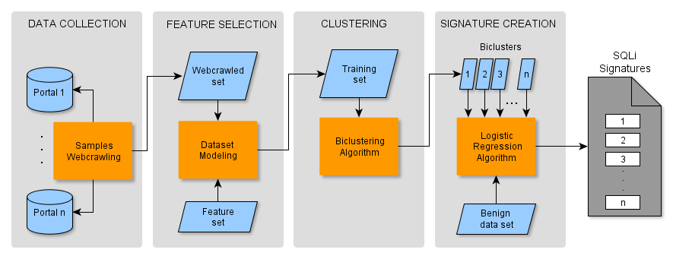
Framework Design
pSigene: probabilistic Signature Generation
  Create a dataset $S$ of URLs containing SQL injection attacks
Notes:
-webcrawling to proactively collect samples because we are targetting slow moving attacks, they present a greater diversity than typically handled by honepots
Exploit Database, Security Focus, Packetstorm Security, Open Source Vulnerability Database
Collected over 30k samples

Slide 10
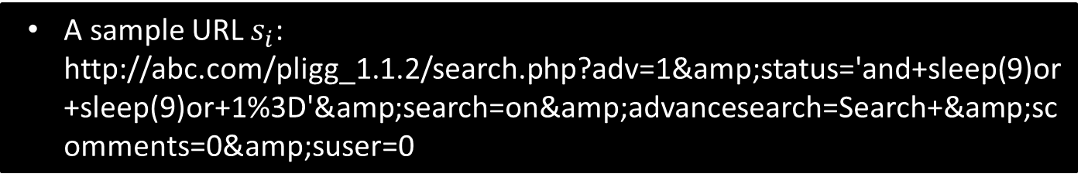
Framework Design
pSigene: probabilistic Signature Generation
  A sample URL $s_{i}$: http://abc.com/pligg_1.1.2/search.php?adv=1&amp;status='and+sleep(9)or+sleep(9)or+1%3D'&amp;search=on&amp;advancesearch=Search+&amp;scomments=0&amp;suser=0
Notes:
-many high profile incidents were attributed to SQLi
-threat model assumes attacks against web apps, connected to a database. An attacker starts by having publicly accessible description of system and then browsing the web app, looking for forms where she can provide user input and then this input can serve as parameters for an SQL statement

Slide 11
Framework Design
pSigene: probabilistic Signature Generation
Each sample $s_{i}$ is converted into a vector, using set $F$ of numerical features
Notes:
-In the second step, a set of features is extracted from attack samples

Slide 12
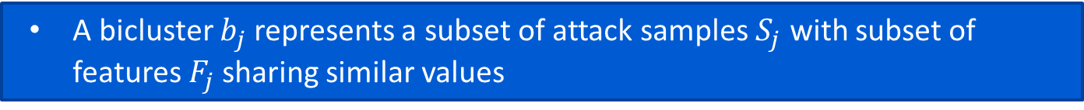
Framework Design
pSigene: probabilistic Signature Generation
  A bicluster$b_{j}$ represents a subset of attack samples $S_{j}$ with subset of features $F_{j}$sharing similar values
Notes:
-the third step calls for the sample set to be grouped using a clustering technique. This step also gives the features that distinguish each cluster
-The objective of using biclustering is to identify subsets of attack samples which share similar values for a subset of features

Slide 13

Framework Design
pSigene: probabilistic Signature Generation
  A signature is expressed as a sigmoid function
  $Signature\left(b_{j}\right)=\frac{1}{1+e^{−\left(θ_{j}^{T}F_{j}\right)}}<{threshold}_{j}$

Slide 14
Phase 2: Feature Selection
Three sources used to create set of features
Resulting feature set used in the experiments had 159 numerical entries
Feature set also consider relative position of tokens among them
FEATURE SOURCE | EXAMPLES
MySQL Reserved Words | create insert
NIDS/WAF Signatures | in\s*?\(+\s*?select \)?; [^a-zA-Z&]+=
SQLi Reference Documents | \’ ORDER BY [0-9]-- - /\*/
Notes:
-looked at existing signatures for features since the signarures are the result of a usually long optimization process
-70 out of 159 entries in the resulting feature set performed as binary features
-in the case of analyzing the reference documents, this was partially automated and served more to validate features created by other sources
The creation of the feature set should be considered a one-time task
Matrix is sparse as 85% of cells were populated with zeroes. About 6% of its cell values were ones.

Slide 15



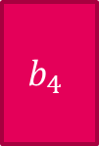
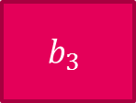
Phase 3: Creating Clusters for Similar Attack Samples
features
biclustering
$$b_{1}$$
$$b_{2}$$
samples
$$S×F$$
$$b_{4}$$
$$b_{3}$$
We performe a 2-way hierarchical agglomerative clustering algorithm, using
  Dissimilarity metric: Euclidean pairwise distance
  Linkage Criteria: Unweighted Pair Group Method with Arithmetic Mean (UPGMA)
Biclusters are non-overlapping and non-exclusive
  We create a signature for each bicluster
Notes:
A subset of rows which exhibit similar behavior across a subset of columns
Non-overlapping: no spatial overlap
Non-exclusive: two biclusters may use overlapping set of features
To choose distance metric and linkage method, we used the following parameters:
Produced monotonic cluster trees, high cophenetic coefficient (linear correlation coefficient), and produced “clean” biclusters

Slide 16
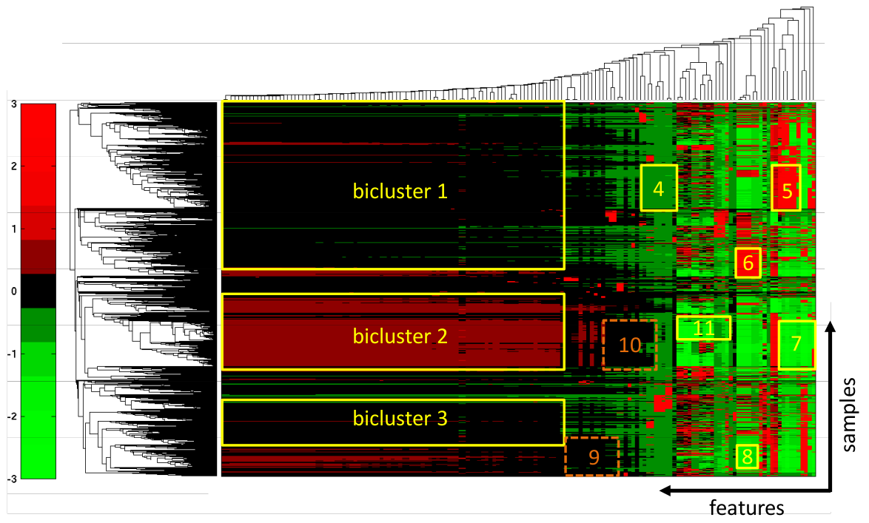
Phase 3: Creating Clusters for Similar Atack Samples
Heatmap representation of biclustering algorithm
on the matrix representing samples set
Notes:
-each column in matrix is standarized as follows: the statistical mean and standard deviation of the values is computed. The mean is then substracted from each value and the result divided by the standard deviation
-note that not all features nor samples are used in the cluster formation (noise)

Slide 17
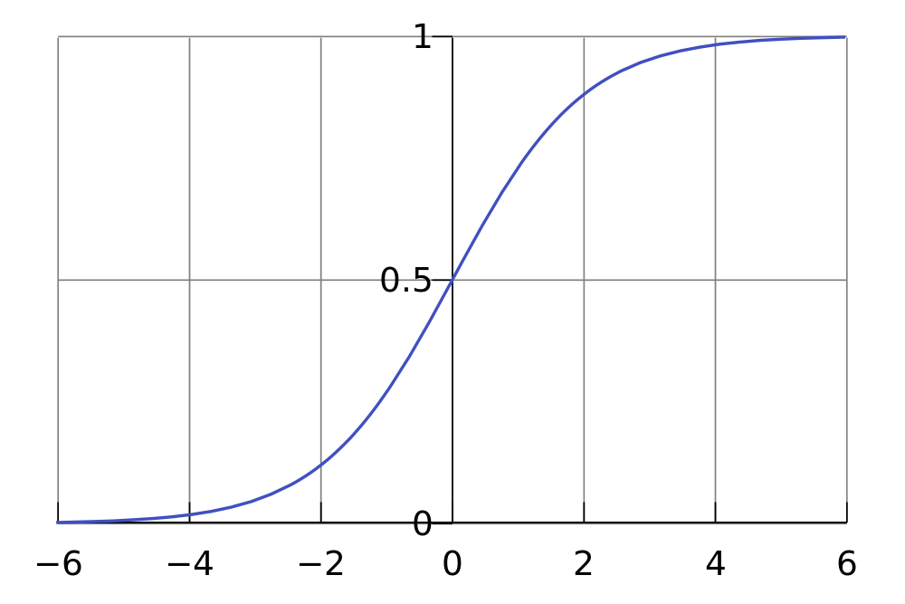
Phase 4: Creation of Generalized Signatures
A generalized signature is created from each bicluster
  A signature is a logistic regression (LR) model
  of the corresponding bicluster
A signature predicts whether an SQL query is an attack similar to the samples in the bicluster
sigmoid function
Notes:
* Output values are interpreted as estimated probability that a sample belongs to a class
Reasons for Logistic Regression:
Relative simplicity of implementations
Bayesian framework is straight-forward
Allows thresholding of the response
No “tuning” parameters

Slide 18
pSigene: Example of a Generalized Signature
“<=>|r?like|sounds+like|regex“
“=[-0-9%]*“
“=“
“[\?&][^\s\t\x00-\x37\|]+?“
“([^a-zA-Z&]+)?&|exists“
“\)?;“
TESTING SAMPLE | TYPE | PROB.
?option=com\_simplefaq\&amp;task=answer\&amp;Itemid=9999\&amp;catid=9999\&amp;aid=-1+union+select+1,concat\_ws(0x3,username,password,email),3,4,5,6,7,8,9,10,11,12,13,14,15,16,17,18,19, 20+from+jos\_users | Attack | 0.9926
/mod/resource/view.php?id=21154 | Benign | 0.0694
/blocks/mle/dwn/index.php?vendor=samsung\&device=X830 | Benign | 0.1928

Slide 19
Evaluation: SQLi Test Datasets
 | TRAINING | TESTING
BENIGN | Captured all HTTP traffic to several web servers (institutional, registration, payment, webmail) at university institution
 | 2-days network trace 1.32GB / 0.4 millions HTTP GET requests | 1-week network trace 4.53GB / 1.4 millions HTTP GET requests
MALICIOUS | Webcrawled SQLi samples | Generated from running standard SQLi scanning tools against vulnerable (Java-based) web app
 | Biclusters from 30000 SQLi attacks | +7200 HTTP GET requests +8500 HTTP GET requests
Notes:
Datasets
Benign
Training: 2 days
Testing: 1 week
2. Malicious
webcrawl → training
sqlmap → testing

Slide 20
Evaluation
Evaluated pSigene and the signatures from 3 other IDSes
Used Bro NIDS to run experiments
EXPERIMENT | DESCRIPTION
Accuracy and Precision Comparison | Determine TPR and FPR, using traces from real networks
Incremental learning | Incrementing no. of attack samples during learning step
Performance Evaluation | Determine impact of pSigene signatures on real IDS
Comparison to [Perdis10] | Automatic generation of signatures for HTTP-based malware
Notes:
-involves analysis of HTTP traces like in our SQLi scenario / based on popular token-subsequence technique used to generate signatures for polymorphic worms / ability to create signatures for variants of malware

Slide 21
Experiment 1: Accuracy and Precision Comparison
RULES | TPR(%) | FPR (%)
ModSecurity | 98.72 | 0.052 (730)
pSigene (9) | 90.52 | 0.037 (523)
pSigene (7) | 89.48 | 0.016 (226)
Snort – Emerging Threats | 76.59 | 0.174 (2,463)
Bro | 76.33 | 0.00

Slide 22
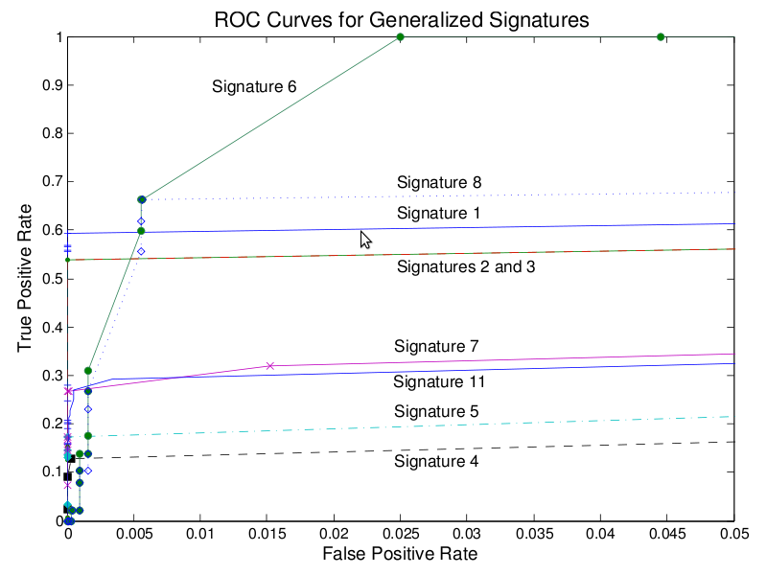
Experiment 1: Accuracy and Precision of Individual Signatures
Wide variability in the quality and coverage of the signatures
Each signature can be tuned, using the threshold value
Notes:
-drill deeper into the overall accuracy and precision result of pSigene to see contribution from each signature

Slide 23
Experiment 1: Accuracy and Precision of Individual Signatures
Signatures insensitive to threshold settings

Slide 24
Experiment 1: Accuracy and Precision of Individual Signatures
Signatures 6 and 8 produce false positives faster
than other signatures (share same set of features)

Slide 25
Experiment 2: Incremental Learning
TEST DATASET USED FOR TRAINING | TPR(%) | FPR(%)
0% | 86.53 | 0.037
20% | 89.13 | 0.039
40% | 91.15 | 0.044
Incremented the number of attack samples used
to learn 𝚯 parameters
TPR showed an improvement of >2% in each round
  pSigene is getting similar attack samples in each round
FPR also increased slightly in each round
  We added more malicious samples only

Slide 26
Conclusions
Presented pSigene, a system for the automation generation and update of intrusion signatures
  Tested architecture for the prevalent class of SQLi attacks
  and found signatures with high accuracy (90.52% TPR) and low false alarm rate (0.037%)
  Non –deterministic framework to generalize existing signatures and detection of new variations
  Features filtering process with biclustering + logistic regression
Rigorously benchmarked the system with a large set
of real attack samples
  Compare performance to popular misuse-based IDS
Notes:
Incremental
Performance
Different attack types

Slide 27
Thank YOU!

Slide 28
References
[Aickel08] U. Aickelin, J. Twycross, and T. Hesketh-Roberts, “Rule generalisation in intrusion detection systems using snort,” CoRR 2008.
[Chandr11] R. Chandra, T. Kim, M. Shah, N. Narula, and N. Zeldovich, “Intrusion recovery for database-backed web applications,” SOSP 2011
[IBM14] IBM Corp. X-Force Threat Intelligence Quarterly1Q 2014.
[Kreibi04] C. Kreibich and J. Crowcroft, “Honeycomb: creating intrusion detection signatures using honeypots,” SIGCOMM Comp. Comm. Rev., Jan 2004.
[Li06] Z. Li, M. Sanghi, Y. Chen, M.-Y. Kao, and B. Chavez, “Hamsa: fast signature generation for zero-day polymorphic worms with provable attack resilience,” IEEE S&P 2006
[Newsom05] J. Newsome, B. Karp, and D. Song, “Polygraph: automatically generating signatures for polymorphic worms,” IEEE S&P 2005
[Perdis10] Roberto Perdisci, Wenke Lee, and Nick Feamster. "Behavioral Clustering of HTTP-based Malware and Signature Generation using Malicious Network Traces"., NSDI 2010
[Rafiqu13] M. Zubair Rafique and Juan Caballero, “FIRMA: Malware Clustering and Network Signature Generation with Mixed Network Behaviors,” RAID 2013
[Robert06] W. Robertson, G. Vigna, C. Kruegel, and R. Kemmerer, “Using Generalization and Characterization Techniques in the Anomaly-based Detection of Web Attacks,” NDSS 2006
[Robert10] W. Robertson, F. Maggi, C. Kruegel, and G. Vigna, “Effective anomaly detection with scarce training data,” NDSS 2010
[Vigna09] G. Vigna, F. Valeur, D. Balzarotti, W. Robertson, C. Kruegel, and E. Kirda, “Reducing Errors in the Anomaly-based Detection of Web-Based Attacks through the Combined Analysis of Web Requests and SQL Queries,” J. Comp. Sec., vol. 17, no. 3, 2009
[Yegnes05] V. Yegneswaran, J. T. Giffin, P. Barford, and S. Jha, “An architecture for generating semantics-aware signatures,” USENIX Security 2005
[Zand14] Ali Zand, Giovanni Vigna, Xifeng Yan, and Christopher Kruegel, “Extracting Probable Command and Control Signatures for Detecting Botnets,” SAC 2014

