Slide 1
Automatic Problem Localization via Multi-dimensional Metric Profiling
Ignacio Laguna¹, Subrata Mitra², Fahad A. Arshad²,
Nawanol Theera-Ampornpunt², Zongyang Zhu²,
Saurabh Bagchi², Samuel P. Midkiff², Mike Kistler³, Ahmed Gheith³
¹LLNL, ² Purdue University, ³IBM Research Austin

Slide 2
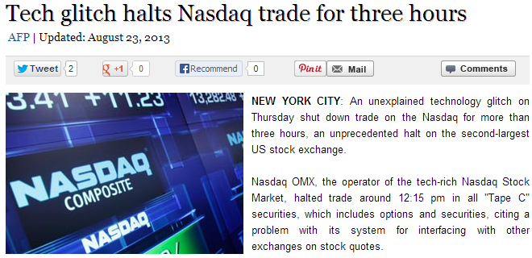
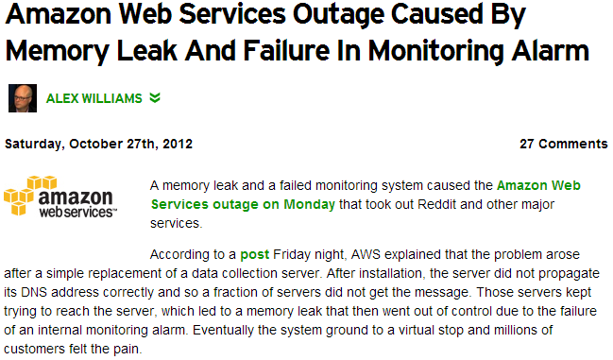
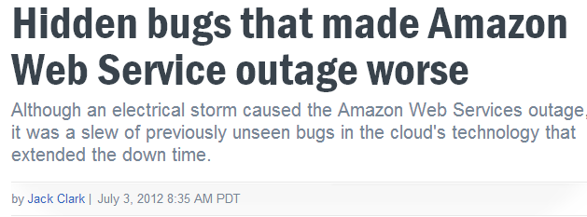
Debugging large scale systems is difficult
Bug causes loss of millions of dollars..
Can not eliminate all the bugs !
Need for quick detection and diagnosis.

Slide 3
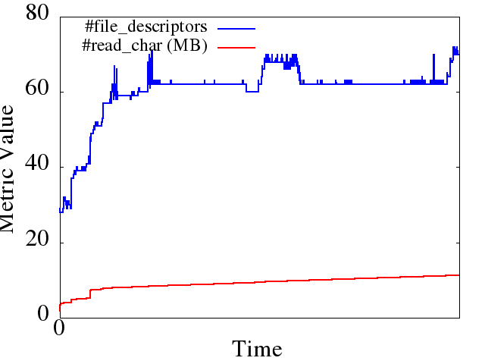
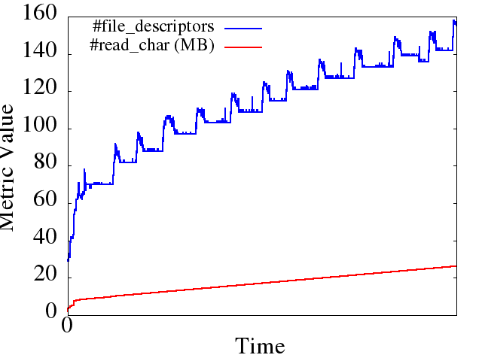
Observation: Bugs Change Metric Behavior
Healthy Run
Unhealthy Run
Patch
} catch (IOException e) {
ioe = e;
LOG.warn("Failed to connect to " +
targetAddr + "...");
+ } finally {
+ IOUtils.closeStream(reader);
+ IOUtils.closeSocket(dn);
+ dn = null;
+ }
Behavior is different
Hadoop DFS file-descriptor leak in version 0.17
Correlations differ on bug manifestation

Slide 4
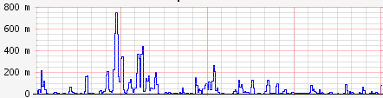
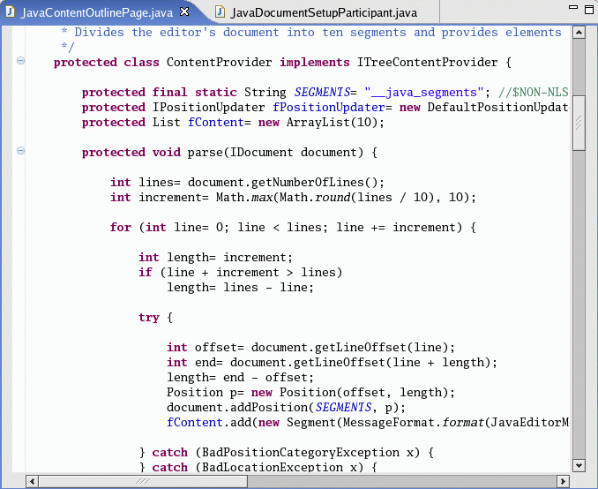
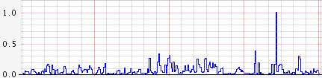
Diagnosis process high-level idea
Manifested-in-metrics (MM) bugs
Abnormal temporal pattern in one of the metrics
Program
Metric 1
Abnormal code blocks
Metric 2
Code Region
Metric 3
…
Code Region
Metric 100

Slide 5
ORION: Framework for localizing origin of MM faults

Slide 6
Overview of the workflow
ORION: Framework for localizing origin of MM faults
Normal Run
Failed Run
Filter out noise. Keep the ones which show a trend
Select metrics
When correlation model of metrics broke
Find Abnormal Windows
Those that contributed most to the model breaking
Find Abnormal Metrics
Instrumentation in code used to map metric values to code regions
Find Abnormal Code Regions

Slide 7
Measurements for various metrics
Collect from different layers: hardware, OS, middleware, application
Use open source monitoring tools: PAPI, /proc and other middleware and application level info
Some examples:
  H/W: Cache related, branching related, LD/ST counts
  OS: CPU/Memory usage, Context switches, File descriptors, Disk IO, Network Packets
  Middleware: Busy threads, request processing time
  Application: Per-servlet stats, exception count
No exhaustive list of metrics, include whatever might be relevant
ORION will address curse of dimensionality, filter out noise

Slide 8
Why collect from different layers ?
Faults come from:
Hardware
Software
Network
Bugs from many components:
Application
Libraries
OS & Runtime system
It is necessary to monitor metrics from all layers
Array data of random nature
Array.sort()
for(int I; I < Array.size; I++)
{
if(Array[I] > 50)
do_some_thing
//Array.sort()
Branch-mispredicted
2.4 slowdown
if(Array[I] > 50)

Slide 9
Application Profiling
Asynchronous
Process 1
(App)
Process 2
(Profiler)
Metrics gathered by separate process
Lightweight, low interference with app
Requires offline processing to line-up measurements
Function 1
Function 2
Function 3
Process 1
(Profiler + App)
Synchronous
Instruments binary code
Collects measurements at the beginning and end of classes/methods
Higher overhead, but more accurate
Function 1
Function 2
Function 3

Slide 10
Metric Selection for
Accurate Diagnosis
Dimensionality reduction:
  Filter out redundant/noisy metrics
  Reduce computational overhead for subsequent steps
Heuristic based on PCA to rank metrics based on its contribution in explaining overall variance
Fore more detailed analysis after PCA: Choose only the metrics for which rank changes between normal run and abnormal run
  Do a light-weight filtering before a heavy-weight detailed analysis

Slide 11
Selecting Abnormal Window via Nearest-Neighbor (NN)
Windows of fixed size
Traces
Normal Run
Faulty Run
3, 55, 47, 0.7,…
3, 55, 47, 0.7,…
Window₁
2, 54, 45, 0.8,…
2, 55, 45, 0.6,…
▪ Sample of all metrics
▪ Annotated with code region
Window₂
Repeat with different window sizes
Window₃
…
…
Correlation Coefficient Vectors (CCV)
[cc_{1,2}, cc_{1,3},…, cc_{n-1,n}]
Normal Run
Faulty Run
Nearest-Neighbor to find Outliers
x
x
x
0.2, 0.8, 0, -0.6,…
0.1, 0.6, 0, -0.5,…
x
x
x
x
x
x
x
x
x
x
Outliers
x
x
Notes:
Here’s the algorithm to select abnormal windows. We start with two set of traces: normal and faulty. Traces contain records that are samples of all the monitored metrics. These samples are annotated with the code regions that they correspond to. For the Java applications that we evaluated, code regions are Java class and method calls.
Then, we divide the traces in windows of the same size.
Then, for each window, we calculate correlation coefficients between all pairs of metrics. We save them in a vector that we call correlation coefficient vector or CCV.
Then we find outliers CCVs using the CCVs of the normal run as a model of normal behavior. We use nearest-neighbor to find these outliers. The distance metric that we use to compare two CCVs is the Euclidean distance (as in the slide), where dimensions are correlation coefficients between pairs of metrics.

Slide 12
Selecting Abnormal Metrics by Frequency of Occurrence
Distance (CCV₁, CCV₂)
Steps
Example
Contribution to the distance
Window X
CC_{6,1}
CC_{5,1}
CC_{10,11}
0.1
0.7
0.2
1
Get top-k abnormal windows
Window Y
CC_{5,2}
CC_{7,2}
CC_{3,12}
0.5
0.05
0.3
Window Z
CC_{15,16}
CC_{8,20}
CC_{19,5}
Rank Correlation Coefficients (CC) based on contribution to the distance for each window
0.5
0.05
0.8
2
CC_{19,5}
CC_{5,1}
CC_{5,2}
3
Select the most frequent metric(s)
Abnormal metric: 5
Notes:
After we find abnormal windows, we look for an abnormal metric. Here’s the algorithm to find the abnormal metric.
First, we take the abnormal windows that we found using the previous algorithm and observe the contribution of each CC in the Euclidean distance as we have in the figure.
Then, we rank correlation coefficients based on their contributions to the nearest-neighbor distance. For this example, in window X, CC between metric 5 and 1 is the one with the greatest contribution.
Finally, based on this ranking, we select the metric that occurs most frequently as the abnormal metric. In this example, metric 5 is in all the correlation coefficients, so it is the abnormal metric.

Slide 13
Pinpointing anomalous code regions
Traces
Normal Run
Faulty Run
3, 55, 47, 0.7,…
3, 55, 47, 0.7,…
Window₁
2, 55, 46, 0.7,…
2, 95, 45, 0.6,…
Window₂
Window₃
…
…
Only for anomalous metric
Find top-k abnormal windows
Build a histogram of code regions
Output top-3 most frequent code regions

Slide 14
Example 1: File descriptor leak in Hadoop DFS
45 java classes and 358 methods were instrumented inside hadoop/dfs package
} catch (IOException e) {
ioe = e;
LOG.warn("Failed to connect to " + targetAddr + "...");
Top abnormal metrics:
Minflt
Num_file_desc
…
+ } finally {
+ IOUtils.closeStream(reader);
+ IOUtils.closeSocket(dn);
+ dn = null;
+ }
Top abnormal code region:
1. /dfs/DFSClient
Rank | Class | Average # file descriptors
1 | NamespaceInfo | 6
. . . . . . . .
8 | DFSClient | 1.16

Slide 15
Example 2: Failures in distributed regression test framework (MHM)
An application from IBM for testing architecture simulators
NFS connection fails intermittently
  Emulate by dropping out-going NFS packets
Code-Annotation
  Asynchronous, manual
Notes:
- MHM executes tests to figure out whether new bugs have been introduced due to new development
-We emulate NFS problems by dropping outgoing NFS packets with a probability of 0.1

Slide 16
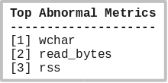
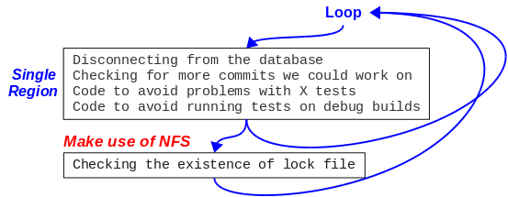
MHM – debugging results in asynchronous mode
Abnormal code-region is selected almost correctly
  Reason for inaccuracy: code region is very small
Abnormal metrics are correlated with the failure origin: NFS connection
Abnormal code regions given by the tool
Where the problem occurs
Notes:
- The code-region diagnosis inaccuracy is primarily due to asynchronous metric-collection.

Slide 17
Example 3: Debugging an unknown bug
StationsStat: multi-tier distributed application at Purdue
  Used by students to check the availability of work stations in computer labs throughout campus
Periodic failure – application became unresponsive
Restart – problem appears to go away temporarily
Particularly challenging – there was no error free data
ORION used data segments collected right after restart to build its model
Anomalous metric that ORION identified: # active SQL connections
SQL driver was in fact buggy. Upgrade fixed the problem

Slide 18
Overhead and performance
Profiling overhead is a function of number and type metrics collected
Asynchronous profiling has very little overhead but is less accurate and requires offline alignment
Localization time is a function of the size of available profile log files
Application | Training time (sec) | Localization time (sec)
Hadoop | 31.06 | 213.06
MHM | 12.48 | 16.66
StationsStat | 217.43 | 1645.1

Slide 19
Conclusion
We present ORION – a tool for root cause analysis for MM failures
Pinpoints the metric that is highly affected by a failure and highlights corresponding code regions
ORION models application behavior through pairwise correlation of multiple metrics
Our case studies with different applications show the effectiveness of the tool in detecting real world bugs

Slide 20
Thank you
Questions ?

Slide 21
Future directions
Improve scalability
Create a library for collecting various metrics as part of the tool.

Slide 22
Current debugging techniques
Interactive, requires manual intervention: gdb, totalview
Memory, CPU profilers can identify bottlenecks: gprof, .NET memory profiler
Log analysis
Model checking
Some tools use a threshold corresponding to a single metric to identify bugs
In advanced cases: thresholds are learned through training

