Slide 1
Applying Machine Learning to Computer System Dependability Problems
Saurabh Bagchi
Dependable Computing Systems Lab (DCSL)
School of ECE and CS, Purdue University
Joint Work With:
Purdue: Milind Kulkarni, Sam Midkiff, Bowen Zhou, Fahad Arshad
Purdue IT Organization: Michael Schulte
LLNL: Ignacio Laguna
IBM: Mike Kistler, Ahmed Gheith

Slide 2
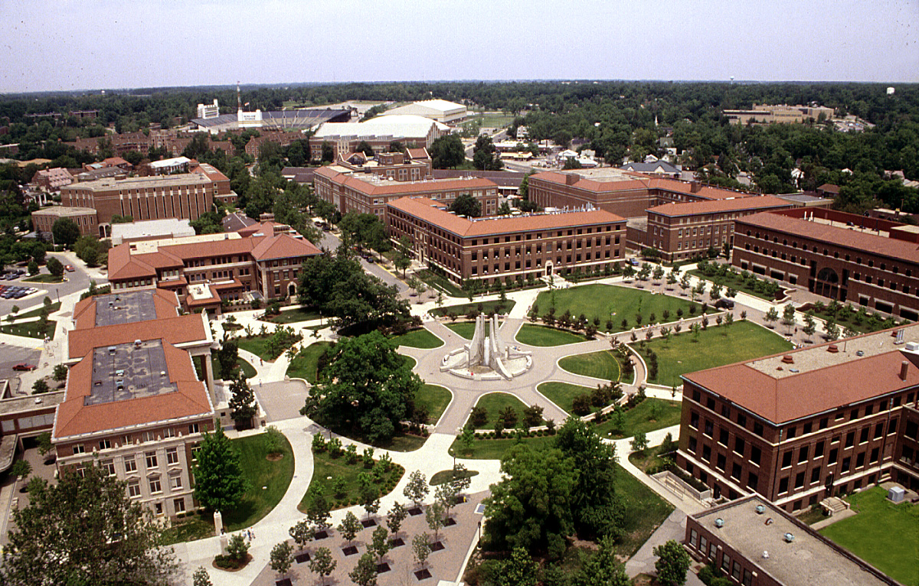
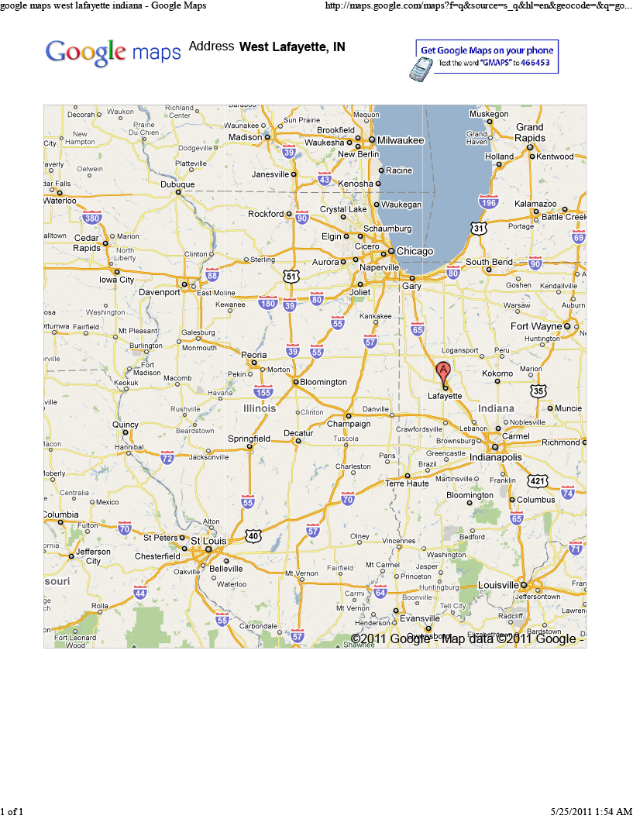
Greetings come to you from …
ECE

Slide 3
A Few Words about Me
PhD (2001): University of Illinois at Urbana-Champaign (CS)
Joined Purdue as Tenure-track Assistant Professor (2002)
Promoted to Associate Professor (2007)
Promoted to Professor (2012)
Sabbatical at ARL Aug 2011 – May 2012
Working here during summer 2012 and 2013
  Mobile systems management [DSN12, DSN13-Workshop]: Benjamin (Purdue); Jan, Mike (ARL)
  Automatic problem diagnosis [DSN12-Workshop, SRDS13]: Fahad (Purdue); Mike, Ahmed (ARL)

Slide 4
A few words about Purdue University
One of the largest graduate schools in engineering
  362 faculty
  10,000 students
  US News rank: 8th
About 40,000 students at its main campus in West Lafayette
Electrical and Computer Engineering @ Purdue
  About 85 faculty, 650 graduate students, 900 undergraduate students
  One of the largest producers of Ph.D.s in Electrical and Computer Engineering (about 60 Ph.D's a year)
  Research expenditure annually around $45M
  US News rank: 10th (both ECE and Computer Engineering)
Computer Science @ Purdue
  About 50 faculty, 245 graduate students
  US News rank: 20th

Slide 5
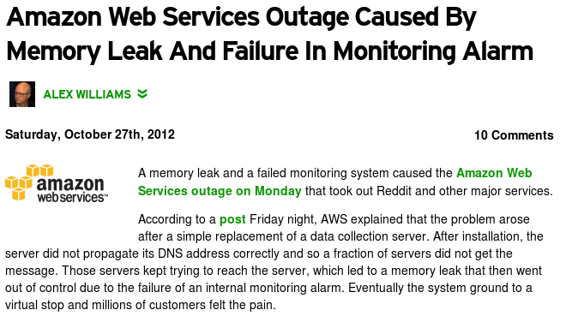
Bugs Cause Million of Dollars Lost in Minutes
Amazon failure took ~6 hours to fix
Need for quick error detection and accurate problem-determination techniques

Slide 6
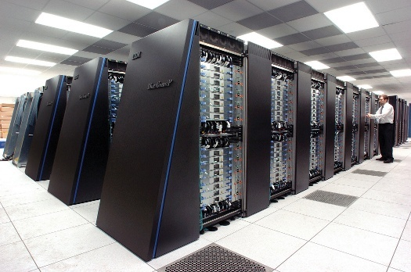

Failures in Large-Scale Applications are More Frequent
The more components the higher the failure rate
Faults come from:
Hardware
Software
Network
Bugs from many components:
Application
Libraries
OS & Runtime system
Multiple manifestations:
Hang, crash
Silent data corruption
Application is slower than usual

Slide 7
Problems of Current Diagnosis/Debugging Techniques
Poor scalability
  Inability to handle large number of processes
  Generate too much data to analyze
  Analysis is centralized rather than distributed
  Offline rather than online
Problem determination is not automatic
  Old breakpoint-based debugging (> 30 years old)
  Too much human intervention
  Requires large amount of domain knowledge

Slide 8
Roadmap
Scale-dependent bugs: intro
Pitfalls in applying machine learning
Solution approach
  Error detection (HPDC 11)
  Fault localization (HotDep 12, HPDC 13)
Evaluation: Fault injection and case study
Metric-based fault localization: intro
Case study
Take-away lessons

Slide 9
Scale dependent program behavior
Manifestation of a bug may depend on a particular platform, input or configuration
Correctness problem or performance problem
Example: Integer Overflow in MPICH2
  allgather is an MPI function that allows a set of processes to exchange data with the rest of the group
  MPICH2 implemented 3 different algorithms to optimize the performance for different scales
  Bug can make the function choose a suboptimal algorithm
P1
P1
allgather
P2
P2
P3
P3

Slide 10
Example: Integer Overflow in MPICH2
int MPIR_Allgather (
int recvcount,
MPI_Datatype recvtype,
MPID_Comm *comm_ptr )
{
int comm_size, rank;
int curr_cnt, dst, type_size, left, right, jnext, comm_size_is_pof2;
if ((recvcount*comm_size*type_size < MPIR_ALLGATHER_LONG_MSG) &&
(comm_size_is_pof2 == 1)) {
// algorithm 1
}
else if (recvcount*comm_size*type_size < MPIR_ALLGATHER_SHORT_MSG) {
// algorithm 2
}
else {
// algorithm 3
}
}
recvcount: number of units to be received
type_size: size of each unit
comm_size: number of processes involved
The overflow can be triggered Whenever you get a large size of data from each process or a large number of processes

Slide 11
Academic Thoughts meet the Real-world
Subject: Re: Scaling bug in Sequoia
Date: Tue, 30 Apr 2013 16:12:54 -0700
From: Jefferson, David R. <XXX@llnl.gov>
The other scaling bug was inside the simulation engine, ROSS. In a strong scaling study you generally expect that as you spread a fixed-sized problem over more and more nodes, the pressure on memory allocation is reduced. If you don't run out of memory at one scale, then you should not run out of memory at any larger scale because you have more and more memory available but the overall problem size remains constant. However ROSS was showing paradoxical behavior in that it was using more memory per task as we increased the number of tasks while keeping the global problem size constant. It turned out that ROSS was declaring a hash table in each task whose size was proportional to the number of tasks — a classic scaling error. This was a misguided attempt to trade space for time, to take advantage of the nearly constant search time for hash tables.
We had to replace the hash table with an AVL tree, whose search time was logarithmic in the number of entries instead of constant, but whose space requirement was independent of the number of tasks.
Notes:
Sequoia is a Blue Gene/Q supercomputer. ROSS is a parallel discrete-event simulator that executes on multiprocessor systems and/or supercomputers. ROSS is geared for running large-scale simulation models (millions of object models) and has been used for example to represent all 7 billion people in the world or the entire Internet's few billion hosts.

Slide 12
Software Development Process
Develop a new feature and its unit tests
Test the new feature on a local machine
Not tested on production systems
Push the feature into productoin systems
Break production systems
Roll back the feature

Slide 13
Bugs in Production Run
Properties
  Remains unnoticed when the application is tested on developer's workstation
  Breaks production system when the application is running on a cluster and/or serving real user requests
Examples
  Configuration Error
  Integer Overflow

Slide 14
Bugs in Production Run
Properties
  Remains unnoticed when the application is tested on developer's workstation
  Breaks production system when the application is running on a cluster and/or serving real user requests
Examples
  Configuration Error
  Integer Overflow
Scale-Dependent Bugs

Slide 15
Roadmap
Scale-dependent bugs: intro
Pitfalls in applying machine learning
Solution approach
  Error detection (HPDC 11)
  Fault localization (HotDep 12, HPDC 13)
Evaluation: Fault injection and case study
Metric-based fault localization: intro
Case study
Take-away lessons

Slide 16
Machine Learning for Finding Bugs
Dubbed as Statistical Debugging
[Gore ASE ’11] [Bronevetsky DSN ‘10] [Chilimbi ICSE ‘09] [Mirgorodskiy SC ’06] [Liblit PLDI ‘03]
  Represents program behavior as a set of features that can be measured in runtime
  Builds a model to describe and predict the features based on data collected from many labeled training runs
  Detects error if observed behavior deviates from the model's prediction beyond a certain threshold
  Bug relates to the most dissimilar feature, e.g. a function, a call site, or a phase of execution
Notes:
Add more recent citations

Slide 17
Problems Applying Statistical Debugging
Traditional statistical debugging approach cannot deal with scale-dependent bugs
If the statistical model is trained only on small-scale runs, the technique results in numerous false positives
  Program behavior naturally changes as programs scale up (e.g., # times a branch is taken in a loop depends on the number of loop iterations, which can depend on the scale)
  Then, small scale models incorrectly label bug-free behaviors at large scales as anomalous.
Can we “just” incorporate large-scale training runs into the statistical model?
  How do we label large-scale behavior as correct or incorrect?
  Many scale-dependent bugs affect all processes and are triggered in every execution at large scales
Notes:
Bullet 2: This effect can be particularly insidious in strong-scaling situations, where each process of a program inherently does less work at large scales than at small ones.
Bullet 3: Thus, it would be impossible to get any sample of bug-free behavior at large scales for training purposes.
A further complication in building models at large scale is the overhead of modeling. Modeling time is a function of training-data size, and as programs scale up, so, too, will
the training data. Moreover, most modeling techniques require global reasoning and centralized computation.

Slide 18
Problems Applying Statistical Debugging
A further complication in building models at large scale is the overhead of modeling
  Modeling time is a function of training-data size
  As programs scale up, so, too, will the training data and so to will modeling time
Most modeling techniques require global reasoning and centralized computation
  The overhead of collecting and analyzing data becomes prohibitive for large-scale programs

Slide 19
Modeling Scale-dependent Behavior
Training runs
Production runs
# OF TIMES LOOP EXECUTES
Is there a bug in one of the production runs?
RUN #

Slide 20


Modeling Scale-dependent Behavior
Training runs
Production runs
# OF TIMES LOOP EXECUTES
Accounting for scale makes trends clear, errors at large scales obvious
SCALE

Slide 21
Roadmap
Scale-dependent bugs: intro
Pitfalls in applying machine learning
Solution approach
  Error detection (HPDC 11)
  Fault localization (HotDep 12, HPDC 13)
Evaluation: Fault injection and case study
Metric-based fault localization: intro
Case study
Take-away lessons

Slide 22

Solution Idea
Key observation: Program behavior is predictable from scale of execution
  Predict the correct behavior on a large scale system from observing a sequence of small scale runs
  Compare predicted and actual behaviors to find anomalies as bugs on the large scale system
N >> K
scale = 1,…,K
scale = N

Slide 23
Vrisha: Workflow
Model the relationship between scale of execution and program behavior from correct runs at a series of small scales
We always know the correct value of the scale of execution, such as the number of processes or the size of input
Use the relationship to predict the correct behavior in execution at a larger scale

Slide 24
Features to Use for Scale-Dependent Modeling
Observational Features (behavior)
  Unique calling context
  A vector of measurements, e.g. numbers of times a branch is taken or observed, volumes of communication made at unique calling context
  Where to measure them depends on the feature itself
Control Features (scale)
  Number of tasks (processes or threads)
  Size of input data
  All numerical command-line arguments
  Additional parameters can be added by users

Slide 25
Vrisha: Using Scaling Properties for Bug Detection
Intuitively, program behavior is determined by the control features
There is predictable, albeit unknown, relationship between control features and observation feature
The relationship could be linear, polynomial, other more complex functions, or may not even have a closed form

Slide 26
Model: Canonical Correlation Analysis (CCA)
Control
feature
X
Xu
Correlation
maximized
Y
Yv
Observational
feature
In our problem, the rows of X and Y are processes in the system
Columns of X: The set of control features of process
Columns of Y: The observed behavior of the process
Notes:
The goal of CCA is to identify relationships between two sets of variables, X and Y, where X and Y describe different properties of particular objects. CCA determines two vectors u and v to maximize the correlation between Xu and Yv. In other words, we find two vectors such that when X and Y are projected onto those vectors, the results
are maximally correlated. This process can be generalized from single vectors to sets of basis vectors. In our particular problem, the rows of X and Y are processes in the system. The columns of X describe the set of “control” features of process; the set of characteristics that determine the behavior of a process in a run. For example,
the features might include the number of processes in the overall run, the rank of the particular process and the size of the input. The columns of Y, on the other hand, capture the observed behavior of the process, such as the number of communicating partners, the volume of communication, etc.
Intuitively, a row xi of X and a row yi of Y are two different ways of describing a single process from a training run, and CCA finds two functions f and g such that, for all i, f(xi) and g(yi) are maximally correlated.

Slide 27
Model: Kernel CCA
Control
feature
X
ϕ(X)
ϕ(X)u
Correlation
maximized
Y
ϕ(Y)
ϕ(Y)v
Observational
feature
We use “kernel trick”, a popular machine learning technique,
to transform non-linear relationship to linear ones via a non-linear mapping ϕ(.)
Notes:
A fundamental limitation of CCA is that the projection functions that map X and Y to a common space must be linear. Unfortunately, this means that CCA cannot capture
non-linear relationships between the control features and the observational features. Because we expect that the relationship between the control features and the observational features might be complex (e.g., if the communication volume is proportional to the square of the input size), using linear projection functions will limit the technique’s applicability.
We turn to KCCA, an extension of CCA that allows it to use kernel functions to transform the feature sets X and Y into higher dimensional spaces before applying CCA. Intu-
itively, we would like to transform X and Y using non-linear functions X and Y into X(X) and Y (Y), and apply CCA to these transformed spaces. By searching for linear relations between non-linear transformations of the original spaces, KCCA allows us to capture non-linear relationships between the two feature spaces.
Rather than explicitly constructing the higher dimensional spaces, KCCA leverages a “kernel trick” [6], allowing us to create two new matrices X and Y from X and Y, that implicitly incorporate the higher dimensional transformation, as follows:
K_X(i, j) = \phi(xi) · phi(xj)
with K_Y defined similarly.
Because we use a Gaussian to construct the K’s, when we apply CCA to X and Y , we effectively allow CCA to discover correlations using infinite-degree polynomials. The upshot of KCCA is that we can determine two non-linear functions f and g such that, for all i, the correlation between f(xi) and g(yi) is maximized. We can thus capture complex relationships between the control features and the observed features.

Slide 28
KCCA in Action
Kernel Canonical Correlation Analysis takes control feature X and observational feature Y to find f and g such that f(X) and g(Y) is highly correlated
y
corr(f( ), g( )) < 0
BUG!
x

Slide 29
Roadmap
Scale-dependent bugs: intro
Pitfalls in applying machine learning
Solution approach
  Error detection (HPDC 11)
  Fault localization (HotDep 12, HPDC 13)
Evaluation: Fault injection and case study
Metric-based fault localization: intro
Case study
Take-away lessons

Slide 30
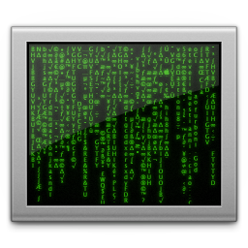

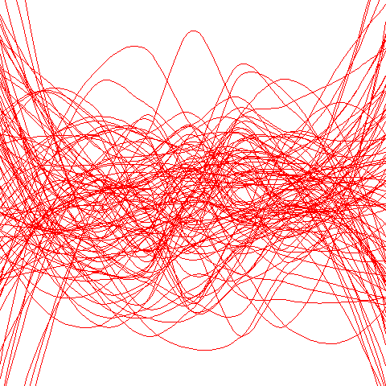
What about Localization?
What is the “correct” behavior at large scale?
Extrapolate large-scale behavior of each individual feature from a series of small-scale runs
Feature 1
scale 1
Feature 2
scale 2
Feature 3
scale 3
……
scale N
Behavioral Feature
Through Manual Analysis
(as in Vrisha)
Feature 4
Small-scale Runs
Scale of Execution

Slide 31
ABHRANTA: a Predictive Model for Program Behavior at Large Scale
ABHRANTA replaced non-invertible transform g used by Vrisha with a linear transform g’
The new model provides an automatic way to reconstruct “bug-free” behavior at large scale, lifting the burden of manual analysis of program scaling behavior
g’⁻¹(f (x))
g’(*)
f(x)
x
Notes:
Describe in operational way

Slide 32
ABHRANTA: Localize Bugs at Large Scale
Bug localization at a large scale can be automated by contrasting the reconstructed bug-free behavior and the actual buggy behavior
Identify the most “erroneous” features of program behavior by ranking all features by:
|y – g’⁻¹(f(x))|

Slide 33
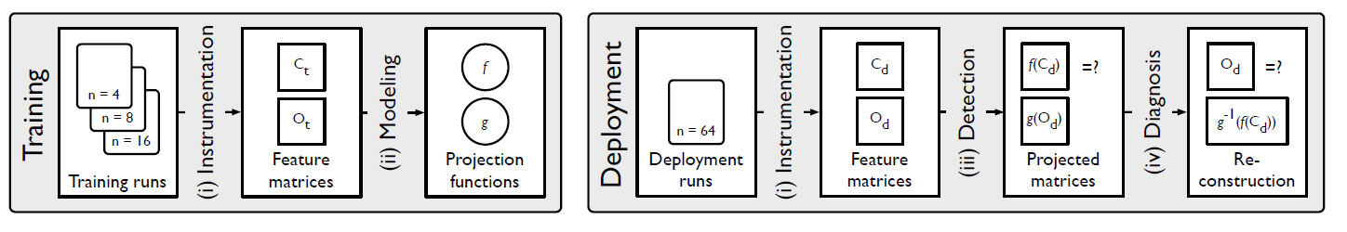
Workflow
Training Phase (A Series of Small-scale Testing Runs)
  Instrumentation to record observational features
  Modeling to train a model that can predict observational features from control features
Deployment Phase (A Large-scale Production Run)
  Instrumentation to record the same features
  Detection to flag production runs with negative correlation
  Localization
    Use the trained model to reconstruct observational feature
    Rank features by reconstruction error

Slide 34
WuKong: Effective Diagnosis of Bugs at Large System Scales
Remember that we replaced a non-linear mapping function with a linear one to make prediction in the KCCA-based model
Negative Effects
  The prediction error grows with scale in the KCCA-based predictive model
  The accuracy becomes lower when the gap between the scales of training runs and production runs increases

Slide 35
WuKong: Effective Diagnosis of Bugs at Large System Scales

Slide 36

WuKong: Effective Diagnosis of Bugs at Large System Scales
Reused the nonlinear version of KCCA to detect bugs
Developed a regression-based feature reconstruction technique which does not depend on KCCA
Designed a heuristic to effectively prune the feature space
Vrisha
Abhranta
WuKong
Detection
Localization

Slide 37
WuKong Workflow
APP
SCALE
SCALE
SCALE
PIN
FEATURE
FEATURE
RUN 1
RUN 1
APP
SCALE
PIN
FEATURE
MODEL
RUN 2
RUN 2
APP
SCALE
PIN
FEATURE
RUN 3
RUN 3
APP
SCALE
FEATURE
...
...
PIN
FEATURE
RUN 4
RUN 4
=
?
APP
SCALE
PIN
FEATURE
RUN N
RUN N
Training
Production

Slide 38
Features considered by WuKong
void foo(int a) {
if (a > 0) {
} else {
}
if (a > 100) {
int i = 0;
while (i < a) {
if (i % 2 == 0) {
}
++i;
}
}
}

Slide 39
Features considered by WuKong
void foo(int a) {
1:if (a > 0) {
} else {
}
2:if (a > 100) {
int i = 0;
3:while (i < a) {
4:if (i % 2 == 0) {
}
++i;
}
}
}
1
2
3
4
Notes:
These features are for each branch, # taken and # not taken. These are captured in a context sensitive manner, i.e., each feature is indexed by the call stack plus the instruction address of the branch instruction. Thus, unambiguous points in the program are pinpointed and in principle, any bug that perturbs control flow behavior will be captured.

Slide 40


Predict Feature from Scale
X ~ vector of control parameters X1...XN
Y ~ number of times a particular feature occurs
The model to predict Y from X:
Compute the relative prediction error:
Notes:
The refined model is better than a linear model because through the use of the log, it allows us to capture higher order relationships between the observed variable and control variable.
What I am not covering is customizing the base model driven by the fact that not all observational variables depend on all control features. So we use AIC (Akaike Information Criterion) to reduce the dimensionality of the model.

Slide 41
Noisy Feature Pruning
Some features cannot be effectively predicted by the above model
  Random
  Depends on a control feature that we have omitted
  Discontinuous
The trade-off
  Keeping those features would pollute the diagnosis by pushing real faults down the list
  Removing these features could miss some faults if the faults happens to be in such features
How to remove them?
  For each feature:
  Do a cross validation with training runs
  Remove the feature if it triggers greater-than-100% prediction error in more than (100-x)% of training runs
Parameter x > 0 is for tolerating outliers in training runs

Slide 42
Roadmap
Scale-dependent bugs: intro
Pitfalls in applying machine learning
Solution approach
  Error detection (HPDC 11)
  Fault localization (HotDep 12, HPDC 13)
Evaluation: Fault injection and case study
Metric-based fault localization: intro
Case study
Take-away lessons

Slide 43
Evaluation
Fault injection in Sequoia AMG2006
  Up to 1024 processes
  Randomly selected conditionals to be flipped
Two case studies
  Integer overflow in a MPI library
  Deadlock in a P2P file sharing application

Slide 44
Fault Injection Study: AMG
AMG is meant to test single CPU performance and parallel scaling efficiency
AMG is a parallel algebraic multigrid solver for linear systems arising from problems on unstructured grids.
104 KLOC in C
Fault
  Injected at process 0
  Randomly pick a feature to flip
Data
  Training (w/o fault): 110 runs, 8-128 processes
  Production (w/ fault): 100 runs, 1024 processes

Slide 45
Fault Injection Study
Result
  Total 100
  Noncrashing 57
  Detected 53
  Located 49
Successful Localization: 92.5%

Slide 46
Overheads
Data
  Training (w/o fault): 8-128 processes
  Production (w/o fault): 256, 512, 1024 processes
Scale of run | Mean reconstruction error | Instrumentation overhead | Analysis time (s)
256 | 6.55% | 5.3% | 0.089
512 | 8.33% | 5.4% | 0.143
1024 | 7.77% | 3.2% | 0.172
Low average reconstruction error: model derived at small scale is used for the larger scales
Instrumentation overhead ↓ with scale due to fixed component of overhead of binary instrumentation and longer running time with ↑ scale
Analysis to do detection and localization < 1/5 s

Slide 47
Evaluation
Fault injection in Sequoia AMG2006
  Up to 1024 processes
  Randomly selected conditionals to be flipped
Two case studies
  Integer overflow in a MPI library
  Deadlock in a P2P file sharing application

Slide 48
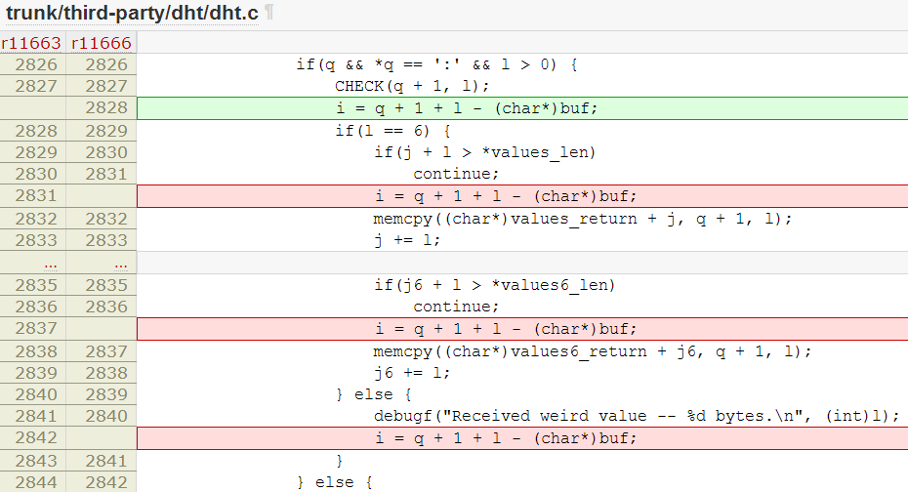
Case Study: A Deadlock in Transmission’s DHT Implemenation

Slide 49
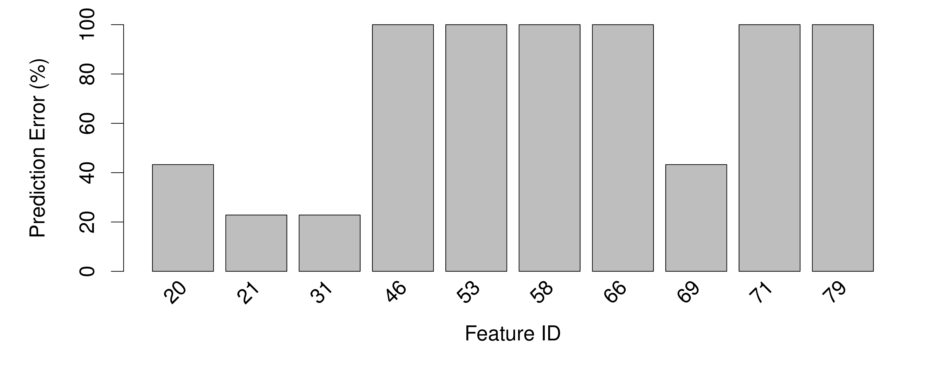
Case Study: A Deadlock in Transmission’s DHT Implemenation

Slide 50
Case Study: A Deadlock in Transmission’s DHT Implemenation
Feature 53, 66

Slide 51
Roadmap
Scale-dependent bugs: intro
Pitfalls in applying machine learning
Solution approach
  Error detection (HPDC 11)
  Fault localization (HotDep 12, HPDC 13)
Evaluation: Fault injection and case study
Metric-based fault localization: intro
Case study
Take-away lessons

Slide 52
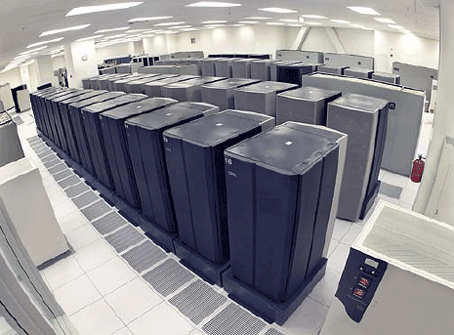
Commercial Applications Generate Many Metrics
Application
Requests rate, transactions, DB reads/writes, etc..
Middleware
Virtual machines and containers statistics
Operating System
CPU, memory, I/O, network statistics
Hardware
CPU performance counters
Tivoli
Operations Manager
How can we use these metrics to localize the root cause of problems?

Slide 53
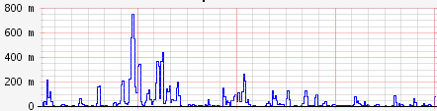
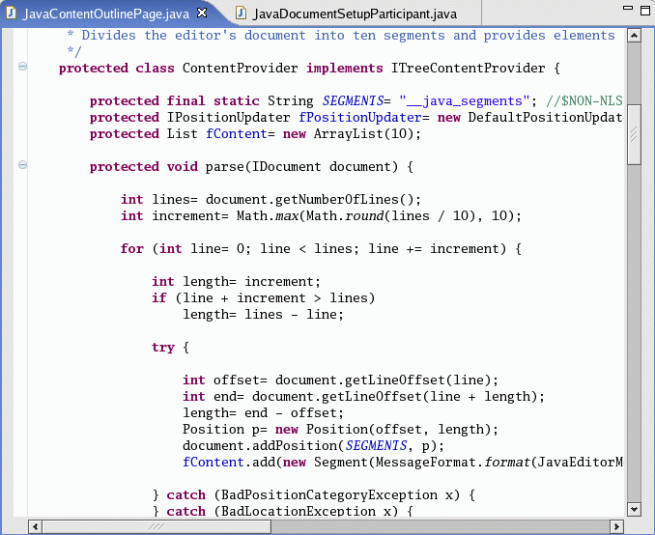
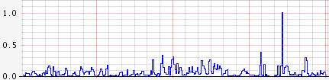
Research Objectives
Look for abnormal patterns in time and space
Pinpoint code regions that are correlated to these abnormal patterns
Program
Metric 1
Abnormal code blocks
Metric 2
Code Region
Metric 3
…
Code Region
Metric 100

Slide 54
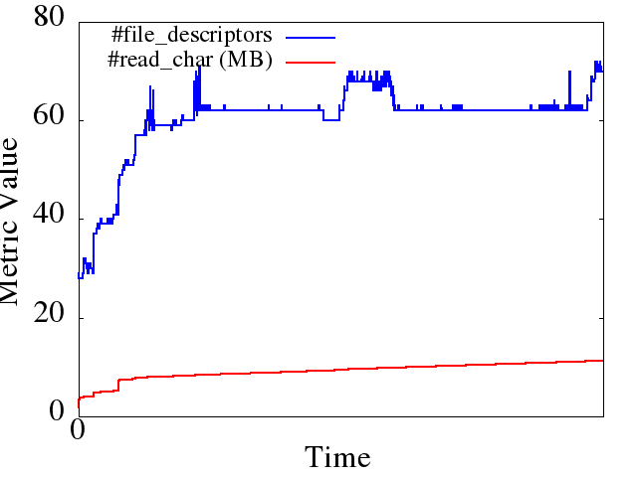
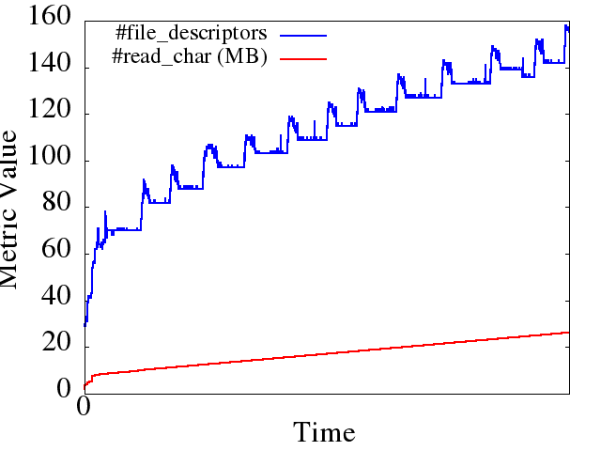
Observation: Bugs Change Metric Behavior
Healthy Run
Unhealthy Run
Patch
} catch (IOException e) {
ioe = e;
LOG.warn("Failed to connect to " +
targetAddr + "...");
+ } finally {
+ IOUtils.closeStream(reader);
+ IOUtils.closeSocket(dn);
+ dn = null;
+ }
Behavior is different
Hadoop DFS file-descriptor leak in version 0.17
Correlations differ on bug manifestation
Notes:
Correlation coefficient computed for abnormal run is 0.97 over the entire time window for the above two metrics.
Correlation coefficient computed for normal run is 0.85 over the entire time window for the above two metrics.
Metrics: open file descriptors, characters read from disk

Slide 55
ORION: Workflow for Localization
Normal Run
Failed Run
When correlation model of metrics broke
Find Abnormal Windows
Those that contributed most to the model breaking
Find Abnormal Metrics
Instrumentation in code used to map metric values to code regions
Find Abnormal Code Regions

Slide 56
Roadmap
Scale-dependent bugs: intro
Pitfalls in applying machine learning
Solution approach
  Error detection (HPDC 11)
  Fault localization (HotDep 12, HPDC 13)
Evaluation: Fault injection and case study
Metric-based fault localization: intro
Case study
Take-away lessons

Slide 57
Case Study: IBM Mambo Health Monitor (MHM)
Example of typical infrastructure-related failures:
  Problem with the simulated architecture
  NFS connection fails intermittently
  Failed LDAP server authentications
  /tmp filling up
Notes:
- MHM executes tests to figure out whether new bugs have been introduced due to new development

Slide 58
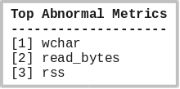
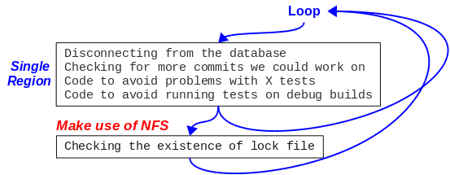
Case Study: MHM Results
Abnormal code-region is selected almost correctly
Abnormal metrics are correlated with the failure origin: NFS connection
Abnormal code regions given by the tool
Where the problem occurs

Slide 59
Roadmap
Scale-dependent bugs: intro
Pitfalls in applying machine learning
Solution approach
  Error detection (HPDC 11)
  Fault localization (HotDep 12, HPDC 13)
Evaluation: Fault injection and case study
Metric-based fault localization: intro
Case study
Take-away lessons

Slide 60
Take-Away Lessons
Supervised machine learning is more accurate for diagnosing problems
  We should have some samples of buggy runs, and preferably some samples of correct runs
  Unsupervised learning can work but we need accurate view of how many kinds of behavior there are among the application processes
Selecting features to throw into the model is the single most critical decision
  Too many features will mean the signal (fault manifestation) will be drowned out in the noise (correct behavior of most features) and too high instrumentation overhead
  Too few features will mean we will miss the bug case
It is important to apply the model to the correct execution context (i.e., “correct” scale, “correct” data set)
  And stay away from over-generalizing it

Slide 61
Ongoing Work
Scale-dependent bugs
  How to handle data as the scale parameter?
  How to build a testing framework that will speed up finding such scale-dependent bugs?
  How to model environment-dependent features?
Metric-based localization
  Pair-wise correlation is not the only model for bug manifestations
  How to avoid the curse of dimensionality?
  Technique works well for resource-leak kinds of bugs. How to make it more broadly applicable?

Slide 62
Presentation available at:
Dependable Computing Systems Lab (DCSL) web site engineering.purdue.edu/dcsl

