Slide 1

ECE 60400: Electromagnetic Field Theory
Fall 2025
L27 Quantum Theory of EM Wave
Instructor: Dr. Shengwang Du
Tuesday & Thursday 4:30pm-5:45pm
Hampton Hall of Civil Engineering 2117

Slide 2
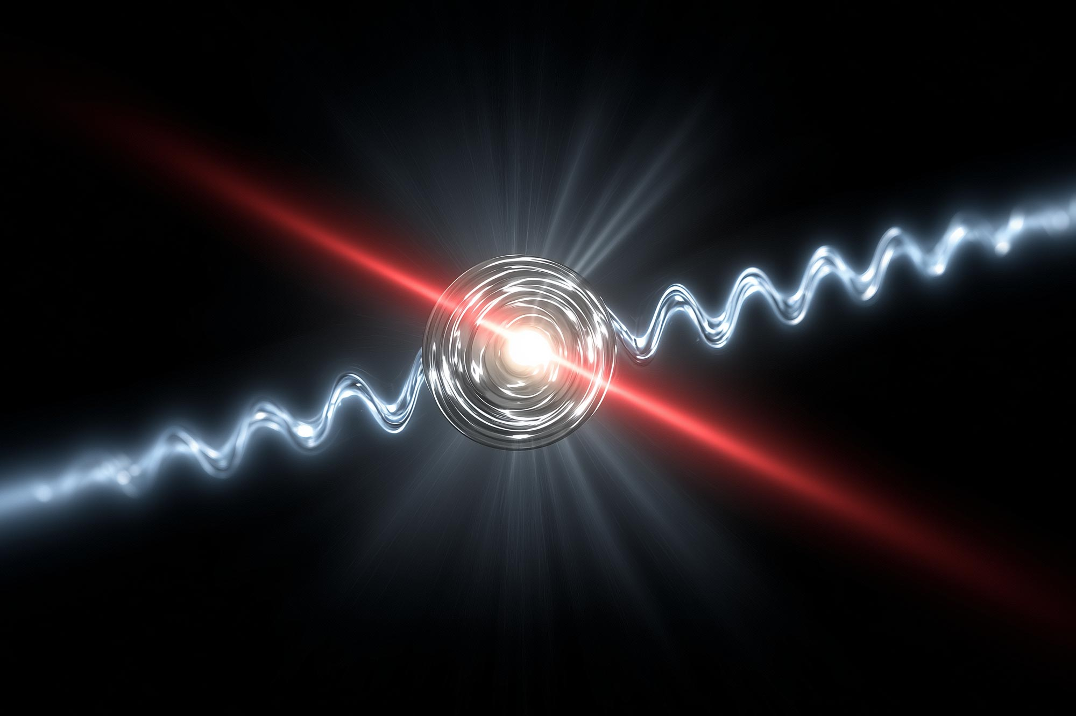
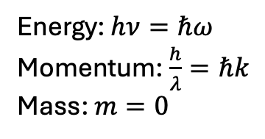
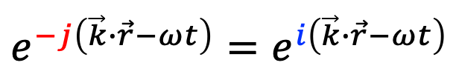



Photon of EM Wave: Wave-Particle Duality
Energy: $hν=ℏω$
Momentum: $\frac{h}{λ}=ℏk$
Mass: $m=0$
Energy-momentum 4-vector
$$\left(ℏω, ℏ\vec{k}\right)$$
Energy-momentum relation
$$E=Pc$$
$$ℏω=ℏkc⟺k=\frac{ω}{c}$$
$${e^{−j\left(\vec{k}∙\vec{r}−ωt\right)}=e}^{i\left(\vec{k}∙\vec{r}−ωt\right)}$$

Slide 3
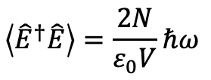
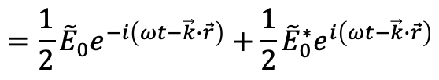
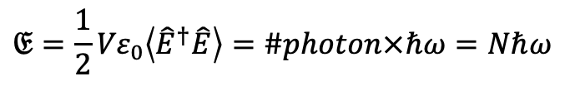

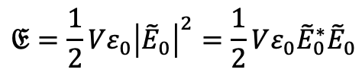
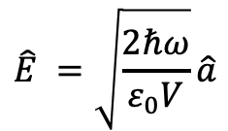
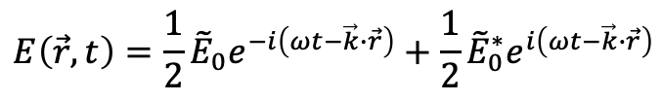

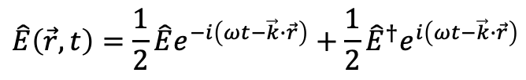
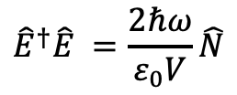
Single-Mode EM Field vs Photon in a Box V
$$E\left(\vec{r},t\right)=E_{0}\cos\left(ωt−\vec{k}∙\vec{r}+φ\right)=Re\left\{E_{0}e^{−i\left(ωt−\vec{k}∙\vec{r}+φ\right)}\right\}=\frac{1}{2}E_{0}e^{−i\left(ωt−\vec{k}∙\vec{r}+φ\right)}+\frac{1}{2}E_{0}e^{i\left(ωt−\vec{k}∙\vec{r}+φ\right)}$$
$$=\frac{1}{2}{\tilde{E}}_{0}e^{−i\left(ωt−\vec{k}∙\vec{r}\right)}+\frac{1}{2}{\tilde{E}}_{0}^{∗}e^{i\left(ωt−\vec{k}∙\vec{r}\right)}$$
$$E\left(\vec{r},t\right)=\frac{1}{2}{\tilde{E}}_{0}e^{−i\left(ωt−\vec{k}∙\vec{r}\right)}+\frac{1}{2}{\tilde{E}}_{0}^{∗}e^{i\left(ωt−\vec{k}∙\vec{r}\right)}$$
$$𝔈=\frac{1}{2}Vε_{0}{\left|{\tilde{E}}_{0}\right|}^{2}=\frac{1}{2}Vε_{0}{\tilde{E}}_{0}^{∗}{\tilde{E}}_{0}$$
$$\hat{E}\left(\vec{r},t\right)=\frac{1}{2}\hat{E}e^{−i\left(ωt−\vec{k}∙\vec{r}\right)}+\frac{1}{2}{\hat{E}}^{†}e^{i\left(ωt−\vec{k}∙\vec{r}\right)}$$
$$𝔈={\frac{1}{2}Vε}_{0}\left\langle {\hat{E}}^{†}\hat{E}\right\rangle =\#photon×ℏω=Nℏω$$
$$\hat{E} =\sqrt{\frac{2ℏω}{ε_{0}V}}\hat{a}$$
$$\left\langle {\hat{E}}^{†}\hat{E}\right\rangle =\frac{2N}{ε_{0}V}ℏω$$
$${\hat{E}}^{†}\hat{E} =\frac{2ℏω}{ε_{0}V}\hat{N}$$
$\hat{N}={\hat{a}}^{†}\hat{a}∝$ ${\hat{E}}^{†}\hat{E}$
$${\hat{E}}^{†}=\sqrt{\frac{2ℏω}{ε_{0}V}}{\hat{a}}^{†}$$
Photon rate

Slide 4
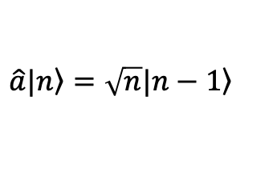

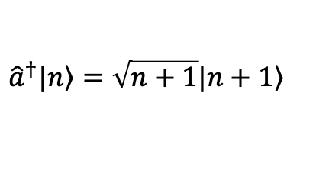
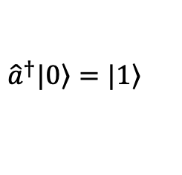



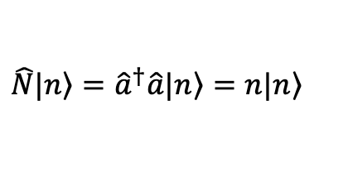
Quantization of a Single-Mode EM Field
$$\hat{E}\left(\vec{r},t\right)=\frac{1}{2}\hat{E}e^{−i\left(ωt−\vec{k}∙\vec{r}\right)}+\frac{1}{2}{\hat{E}}^{†}e^{i\left(ωt−\vec{k}∙\vec{r}\right)}=\sqrt{\frac{2ℏω}{ε_{0}V}}\left[\frac{1}{2}\hat{a}e^{−i\left(ωt−\vec{k}∙\vec{r}\right)}+\frac{1}{2}{\hat{a}}^{†}e^{i\left(ωt−\vec{k}∙\vec{r}\right)}\right]$$
Photon Number
$$\hat{N}={\hat{a}}^{†}\hat{a}$$
$$\hat{a}\left(\vec{r},t\right)=\hat{a}e^{−i\left(ωt−\vec{k}∙\vec{r}\right)}$$
${\hat{a}}^{†}\left(\vec{r},t\right)=$ ${\hat{a}}^{†}e^{i\left(ωt−\vec{k}∙\vec{r}\right)}$
Annihilation operator
Creation operator
$${\hat{a}}^{†}|\left.0\right\rangle =|\left.1\right\rangle$$
$${\hat{a}}^{†}|\left.n\right\rangle =\sqrt{n+1}|\left.n+1\right\rangle$$
$$\left[\hat{a},{\hat{a}}^{†}\right]=\hat{a}{\hat{a}}^{†}−{\hat{a}}^{†}\hat{a}=1$$
$$\hat{a}|\left.n\right\rangle =\sqrt{n}|\left.n−1\right\rangle$$
$$\hat{N}|\left.n\right\rangle ={\hat{a}}^{†}\hat{a}|\left.n\right\rangle =n|\left.n\right\rangle$$

Slide 5

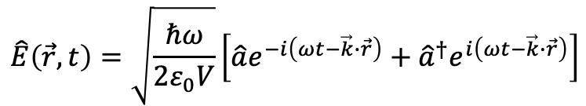
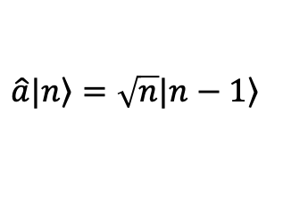

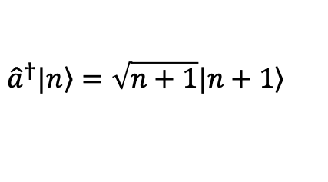
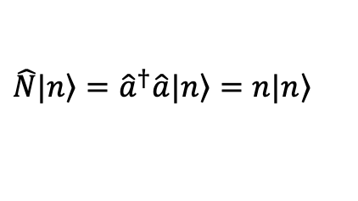
Fock State: fixed photon number $|\left.n\right\rangle$
$$\hat{E}\left(\vec{r},t\right)=\sqrt{\frac{ℏω}{2ε_{0}V}}\left[\hat{a}e^{−i\left(ωt−\vec{k}∙\vec{r}\right)}+{\hat{a}}^{†}e^{i\left(ωt−\vec{k}∙\vec{r}\right)}\right]$$
Photon Number
$$\hat{N}={\hat{a}}^{†}\hat{a}$$
$$\hat{N}|\left.n\right\rangle ={\hat{a}}^{†}\hat{a}|\left.n\right\rangle =n|\left.n\right\rangle$$
$${\hat{a}}^{†}|\left.n\right\rangle =\sqrt{n+1}|\left.n+1\right\rangle$$
$$\hat{a}|\left.n\right\rangle =\sqrt{n}|\left.n−1\right\rangle$$
$$\left\langle m | n\right\rangle =δ_{ij}$$
$$\left\langle \hat{N}\right\rangle =\left\langle n | \hat{N} | n\right\rangle =\left\langle n | {\hat{a}}^{†}\hat{a} | n\right\rangle =\left\langle n | n | n\right\rangle =n\left\langle n | n\right\rangle =n$$
$$\left\langle {∆n}^{2}\right\rangle =\left\langle {\left(\hat{N}−n\right)}^{2}\right\rangle =\left\langle {\hat{N}}^{2}−2n\hat{N}+n^{2}\right\rangle =\left\langle n | {\hat{N}}^{2}−2n\hat{N}+n^{2} | n\right\rangle =\left\langle n | n^{2}−2nn+n^{2} | n\right\rangle =0$$

Slide 6
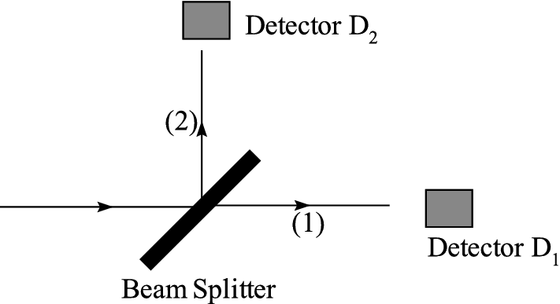
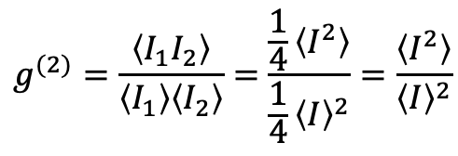



Photon on a Beam Splitter
Classical Optics
$$I_{1}=I_{2}=\frac{1}{2}I$$
$$g^{(2)}=\frac{\left\langle I_{1}I_{2}\right\rangle }{\left\langle I_{1}\right\rangle \left\langle I_{2}\right\rangle }=\frac{\frac{1}{4}\left\langle I^{2}\right\rangle }{{\frac{1}{4}\left\langle I\right\rangle }^{2}}=\frac{\left\langle I^{2}\right\rangle }{{\left\langle I\right\rangle }^{2}}$$
Quantum Optics
$$g^{(2)}=\frac{\left\langle {\hat{a}}^{†}{\hat{a}}^{†}\hat{a}\hat{a}\right\rangle }{{\left\langle {\hat{a}}^{†}\hat{a}\right\rangle }^{2}}=\frac{\left\langle n | {\hat{a}}^{†}{\hat{a}}^{†}\hat{a}\hat{a} | n\right\rangle }{{\left\langle n | {\hat{a}}^{†}\hat{a} | n\right\rangle }^{2}}=\frac{\left\langle n | n(n−1) | n\right\rangle }{{\left\langle n | n | n\right\rangle }^{2}}=\frac{n(n−1)}{n^{2}}=\frac{n−1}{n}=1−\frac{1}{n}$$
$$g^{(2)}=0$$
for
$$n=1$$

Slide 7
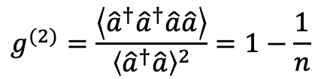


A Single Photon on a Beam Splitter
$$g^{(2)}=\frac{\left\langle {\hat{a}}^{†}{\hat{a}}^{†}\hat{a}\hat{a}\right\rangle }{{\left\langle {\hat{a}}^{†}\hat{a}\right\rangle }^{2}}=1−\frac{1}{n}$$
$$g^{(2)}=0$$
for
$$n=1$$

Slide 8


Two Photons on a Beam Splitter
$$g^{(2)}=\frac{\left\langle {\hat{a}}^{†}{\hat{a}}^{†}\hat{a}\hat{a}\right\rangle }{{\left\langle {\hat{a}}^{†}\hat{a}\right\rangle }^{2}}=1−\frac{1}{n}$$
$$g^{(2)}=0.5$$
for
$$n=2$$

Slide 9
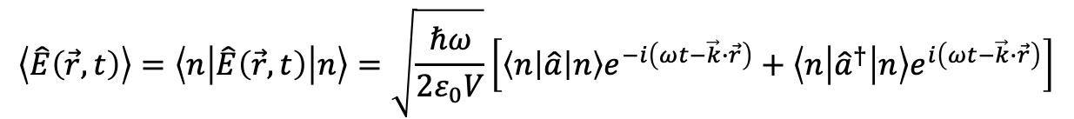

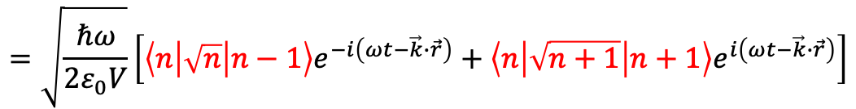
Fock State: fixed photon number $|\left.n\right\rangle$
$$\hat{E}\left(\vec{r},t\right)=\sqrt{\frac{ℏω}{2ε_{0}V}}\left[\hat{a}e^{−i\left(ωt−\vec{k}∙\vec{r}\right)}+{\hat{a}}^{†}e^{i\left(ωt−\vec{k}∙\vec{r}\right)}\right]$$
Photon Number
$$\hat{N}={\hat{a}}^{†}\hat{a}$$
$$\hat{N}|\left.n\right\rangle ={\hat{a}}^{†}\hat{a}|\left.n\right\rangle =n|\left.n\right\rangle$$
$${\hat{a}}^{†}|\left.n\right\rangle =\sqrt{n+1}|\left.n+1\right\rangle$$
$$\hat{a}|\left.n\right\rangle =\sqrt{n}|\left.n−1\right\rangle$$
$$\left\langle m | n\right\rangle =δ_{ij}$$
$$\left\langle \hat{E}\left(\vec{r},t\right)\right\rangle =\left\langle n | \hat{E}\left(\vec{r},t\right) | n\right\rangle =\sqrt{\frac{ℏω}{2ε_{0}V}}\left[\left\langle n | \hat{a} | n\right\rangle e^{−i\left(ωt−\vec{k}∙\vec{r}\right)}+\left\langle n | {\hat{a}}^{†} | n\right\rangle e^{i\left(ωt−\vec{k}∙\vec{r}\right)}\right]$$
$$=\sqrt{\frac{ℏω}{2ε_{0}V}}\left[\left\langle n | \sqrt{n} | n−1\right\rangle e^{−i\left(ωt−\vec{k}∙\vec{r}\right)}+\left\langle n | \sqrt{n+1} | n+1\right\rangle e^{i\left(ωt−\vec{k}∙\vec{r}\right)}\right]$$
$$=0$$

Slide 10
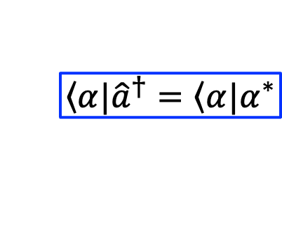
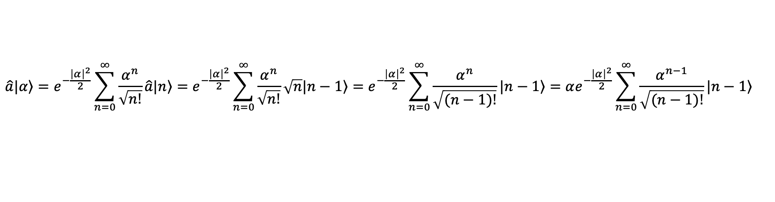
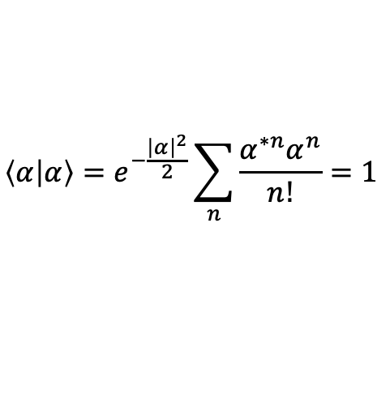
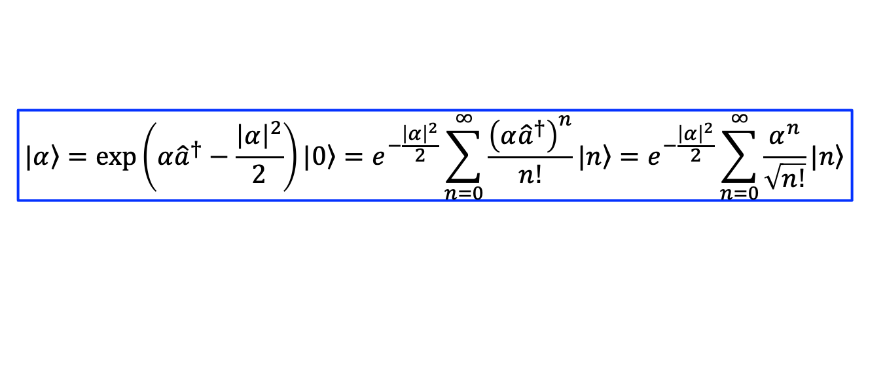
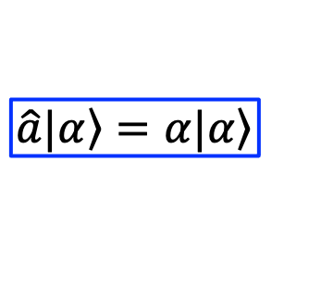

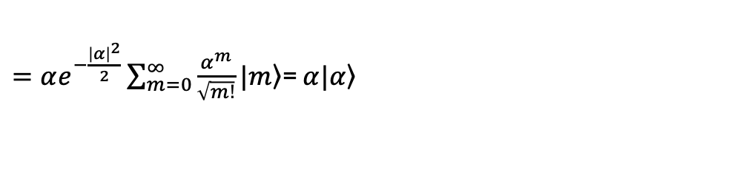
Coherent States as Classical EM Wave
$$|\left.α\right\rangle =\exp\left(α{\hat{a}}^{†}−\frac{{\left|α\right|}^{2}}{2}\right)|\left.0\right\rangle =e^{−\frac{{\left|α\right|}^{2}}{2}}\sum_{n=0}^{∞}{\frac{{\left(α{\hat{a}}^{†}\right)}^{n}}{n!}|\left.n\right\rangle }=e^{−\frac{{\left|α\right|}^{2}}{2}}\sum_{n=0}^{∞}{\frac{α^{n}}{\sqrt{n!}}|\left.n\right\rangle }$$
$$\hat{a}|\left.α\right\rangle =e^{−\frac{{\left|α\right|}^{2}}{2}}\sum_{n=0}^{∞}{\frac{α^{n}}{\sqrt{n!}}\hat{a}|\left.n\right\rangle }=e^{−\frac{{\left|α\right|}^{2}}{2}}\sum_{n=0}^{∞}{\frac{α^{n}}{\sqrt{n!}}\sqrt{n}|\left.n−1\right\rangle }=e^{−\frac{{\left|α\right|}^{2}}{2}}\sum_{n=0}^{∞}{\frac{α^{n}}{\sqrt{(n−1)!}}|\left.n−1\right\rangle }=αe^{−\frac{{\left|α\right|}^{2}}{2}}\sum_{n=0}^{∞}{\frac{α^{n−1}}{\sqrt{(n−1)!}}|\left.n−1\right\rangle }$$
$$m=n−1$$
$$\hat{a}|\left.α\right\rangle =α|\left.α\right\rangle$$
$$\left\langle α|\right.{\hat{a}}^{†}=\left\langle α|\right.α^{∗}$$
$=αe^{−\frac{{\left|α\right|}^{2}}{2}}\sum_{m=0}^{∞}{\frac{α^{m}}{\sqrt{m!}}|\left.m\right\rangle }$= $α|\left.α\right\rangle$
$$\left\langle α | α\right\rangle =e^{−\frac{{\left|α\right|}^{2}}{2}}\sum_{n}{\frac{α^{∗n}α^{n}}{n!}}=1$$

Slide 11
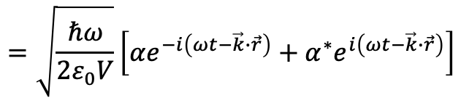
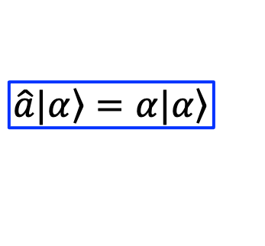
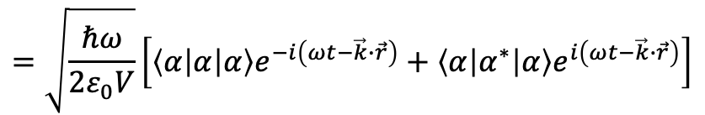
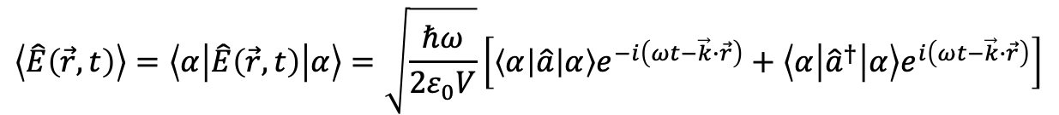
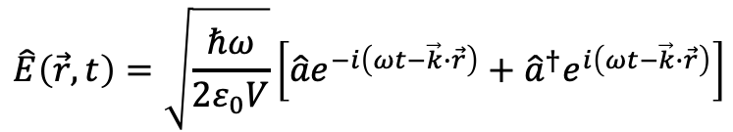
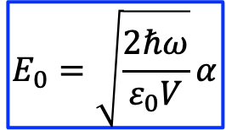
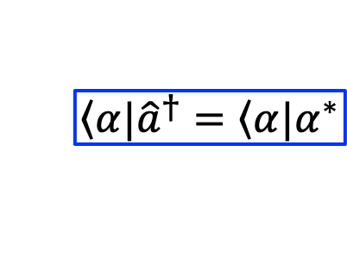
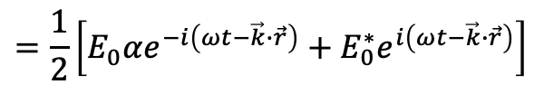
Coherent States as Classical EM Wave
$$\hat{a}|\left.α\right\rangle =α|\left.α\right\rangle$$
$$|\left.α\right\rangle =\exp\left(α{\hat{a}}^{†}−\frac{{\left|α\right|}^{2}}{2}\right)|\left.0\right\rangle =e^{−\frac{{\left|α\right|}^{2}}{2}}\sum_{n=0}^{∞}{\frac{{\left(α{\hat{a}}^{†}\right)}^{n}}{n!}|\left.n\right\rangle }=e^{−\frac{{\left|α\right|}^{2}}{2}}\sum_{n=0}^{∞}{\frac{α^{n}}{\sqrt{n!}}|\left.n\right\rangle }$$
$$\left\langle α|\right.{\hat{a}}^{†}=\left\langle α|\right.α^{∗}$$
$$\hat{E}\left(\vec{r},t\right)=\sqrt{\frac{ℏω}{2ε_{0}V}}\left[\hat{a}e^{−i\left(ωt−\vec{k}∙\vec{r}\right)}+{\hat{a}}^{†}e^{i\left(ωt−\vec{k}∙\vec{r}\right)}\right]$$
$$\left\langle \hat{E}\left(\vec{r},t\right)\right\rangle =\left\langle α | \hat{E}\left(\vec{r},t\right) | α\right\rangle =\sqrt{\frac{ℏω}{2ε_{0}V}}\left[\left\langle α | \hat{a} | α\right\rangle e^{−i\left(ωt−\vec{k}∙\vec{r}\right)}+\left\langle α | {\hat{a}}^{†} | α\right\rangle e^{i\left(ωt−\vec{k}∙\vec{r}\right)}\right]$$
$$=\sqrt{\frac{ℏω}{2ε_{0}V}}\left[\left\langle α | α | α\right\rangle e^{−i\left(ωt−\vec{k}∙\vec{r}\right)}+\left\langle α | α^{∗} | α\right\rangle e^{i\left(ωt−\vec{k}∙\vec{r}\right)}\right]$$
$$=\sqrt{\frac{ℏω}{2ε_{0}V}}\left[αe^{−i\left(ωt−\vec{k}∙\vec{r}\right)}+α^{∗}e^{i\left(ωt−\vec{k}∙\vec{r}\right)}\right]$$
$$E_{0}=\sqrt{\frac{2ℏω}{ε_{0}V}}α$$
$$=\frac{1}{2}\left[E_{0}αe^{−i\left(ωt−\vec{k}∙\vec{r}\right)}+E_{0}^{∗}e^{i\left(ωt−\vec{k}∙\vec{r}\right)}\right]$$

Slide 12

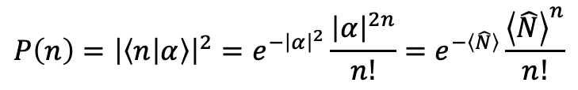
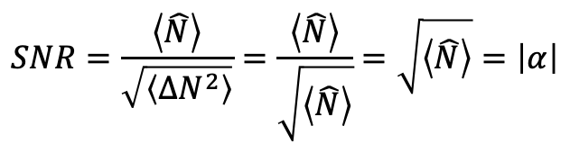

Coherent States: Statistics
$$\hat{a}|\left.α\right\rangle =α|\left.α\right\rangle$$
$$|\left.α\right\rangle =\exp\left(α{\hat{a}}^{†}−\frac{{\left|α\right|}^{2}}{2}\right)|\left.0\right\rangle =e^{−\frac{{\left|α\right|}^{2}}{2}}\sum_{n=0}^{∞}{\frac{{\left(α{\hat{a}}^{†}\right)}^{n}}{n!}|\left.n\right\rangle }=e^{−\frac{{\left|α\right|}^{2}}{2}}\sum_{n=0}^{∞}{\frac{α^{n}}{\sqrt{n!}}|\left.n\right\rangle }$$
$$\left\langle α|\right.{\hat{a}}^{†}=\left\langle α|\right.α^{∗}$$
$$\left\langle \hat{N}\right\rangle =\left\langle α | \hat{N} | α\right\rangle =\left\langle α | {\hat{a}}^{†}\hat{a} | α\right\rangle =\left\langle α | α^{∗}α | α\right\rangle ={\left|α\right|}^{2}\left\langle n | n\right\rangle ={\left|α\right|}^{2}$$
$$\left\langle {∆N}^{2}\right\rangle =\left\langle {\left(\hat{N}−{\left|α\right|}^{2}\right)}^{2}\right\rangle =\left\langle {\hat{N}}^{2}−2{\left|α\right|}^{2}\hat{N}+{\left|α\right|}^{4}\right\rangle =\left\langle {\hat{N}}^{2}−{\left|α\right|}^{4}\right\rangle =\left\langle {\hat{N}}^{2}\right\rangle −{\left|α\right|}^{4}$$
$$\left[\hat{a},{\hat{a}}^{†}\right]=\hat{a}{\hat{a}}^{†}−{\hat{a}}^{†}\hat{a}=1$$
$$\left\langle {\hat{N}}^{2}\right\rangle =\left\langle α | {\hat{a}}^{†}\hat{a}{\hat{a}}^{†}\hat{a} | α\right\rangle =\left\langle α | α^{∗}\hat{a}{\hat{a}}^{†}α | α\right\rangle ={\left|α\right|}^{2}\left\langle α | \hat{a}{\hat{a}}^{†} | α\right\rangle ={\left|α\right|}^{2}\left\langle α | 1+{\hat{a}}^{†}\hat{a} | α\right\rangle ={\left|α\right|}^{2}\left(1+{\left|α\right|}^{2}\right)={\left|α\right|}^{2}+{\left|α\right|}^{4}$$
$\left\langle {∆N}^{2}\right\rangle =\left\langle {\hat{N}}^{2}\right\rangle −{\left|α\right|}^{4}={\left|α\right|}^{2}=$ $\left\langle \hat{N}\right\rangle$
Shot noise
Probability of find n photons
$$SNR=\frac{\left\langle \hat{N}\right\rangle }{\sqrt{\left\langle {∆N}^{2}\right\rangle }}=\frac{\left\langle \hat{N}\right\rangle }{\sqrt{\left\langle \hat{N}\right\rangle }}=\sqrt{\left\langle \hat{N}\right\rangle }=\left|α\right|$$
$$P\left(n\right)={\left|\left\langle n | α\right\rangle \right|}^{2}=e^{−{\left|α\right|}^{2}}\frac{{\left|α\right|}^{2n}}{n!}=e^{−\left\langle \hat{N}\right\rangle }\frac{{\left\langle \hat{N}\right\rangle }^{n}}{n!}$$

Slide 13
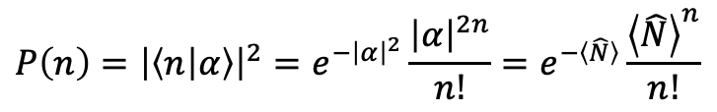
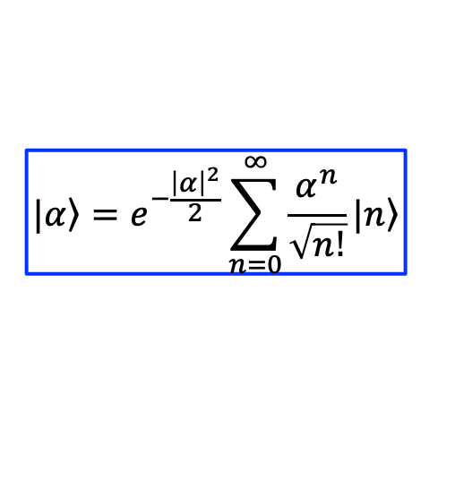


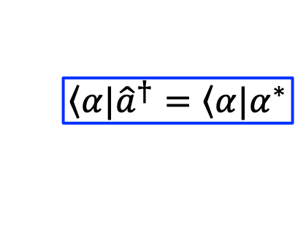
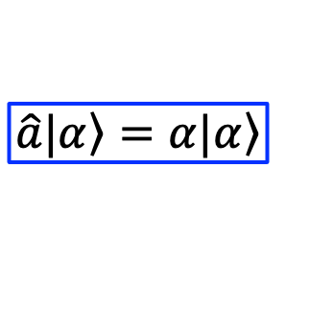
Coherent States: Statistics
$$|\left.α\right\rangle =e^{−\frac{{\left|α\right|}^{2}}{2}}\sum_{n=0}^{∞}{\frac{α^{n}}{\sqrt{n!}}|\left.n\right\rangle }$$
$$\hat{a}|\left.α\right\rangle =α|\left.α\right\rangle$$
$$\left\langle α|\right.{\hat{a}}^{†}=\left\langle α|\right.α^{∗}$$
$$\left\langle \hat{N}\right\rangle ={\left|α\right|}^{2}$$
$$\left\langle {∆N}^{2}\right\rangle =\left\langle \hat{N}\right\rangle$$
Probability of find n photons
$$P\left(n\right)={\left|\left\langle n | α\right\rangle \right|}^{2}=e^{−{\left|α\right|}^{2}}\frac{{\left|α\right|}^{2n}}{n!}=e^{−\left\langle \hat{N}\right\rangle }\frac{{\left\langle \hat{N}\right\rangle }^{n}}{n!}$$

Slide 14
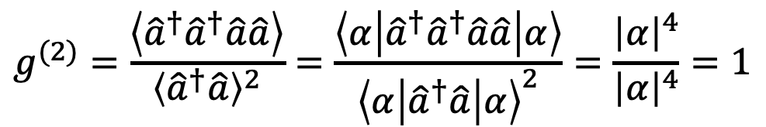
Coherent States on a Beam Splitter
$$|\left.α\right\rangle =e^{−\frac{{\left|α\right|}^{2}}{2}}\sum_{n=0}^{∞}{\frac{α^{n}}{\sqrt{n!}}|\left.n\right\rangle }$$
$$\hat{a}|\left.α\right\rangle =α|\left.α\right\rangle$$
$$\left\langle α|\right.{\hat{a}}^{†}=\left\langle α|\right.α^{∗}$$
$$g^{(2)}=\frac{\left\langle {\hat{a}}^{†}{\hat{a}}^{†}\hat{a}\hat{a}\right\rangle }{{\left\langle {\hat{a}}^{†}\hat{a}\right\rangle }^{2}}=\frac{\left\langle α | {\hat{a}}^{†}{\hat{a}}^{†}\hat{a}\hat{a} | α\right\rangle }{{\left\langle α | {\hat{a}}^{†}\hat{a} | α\right\rangle }^{2}}=\frac{{\left|α\right|}^{4}}{{\left|α\right|}^{4}}=1$$

Slide 15
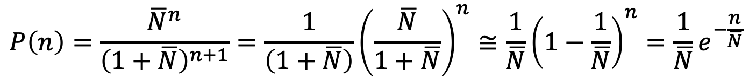
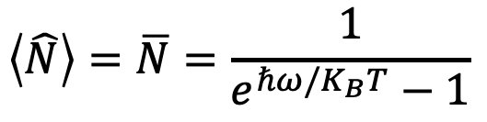


Thermal Light:
$$\left\langle \hat{N}\right\rangle =\overline{N}=\frac{1}{e^{ℏω/K_{B}T}−1}$$
$$\left\langle {∆N}^{2}\right\rangle ={\overline{N}}^{2}+\overline{N}$$
$$P\left(n\right)=\frac{{\overline{N}}^{n}}{{\left(1+\overline{N}\right)}^{n+1}}=\frac{1}{\left(1+\overline{N}\right)}{\left(\frac{\overline{N}}{1+\overline{N}}\right)}^{n}≅\frac{1}{\overline{N}}{\left(1−\frac{1}{\overline{N}}\right)}^{n}=\frac{1}{\overline{N}}e^{−\frac{n}{\overline{N}}}$$
$$g^{(2)}=2$$

Slide 16
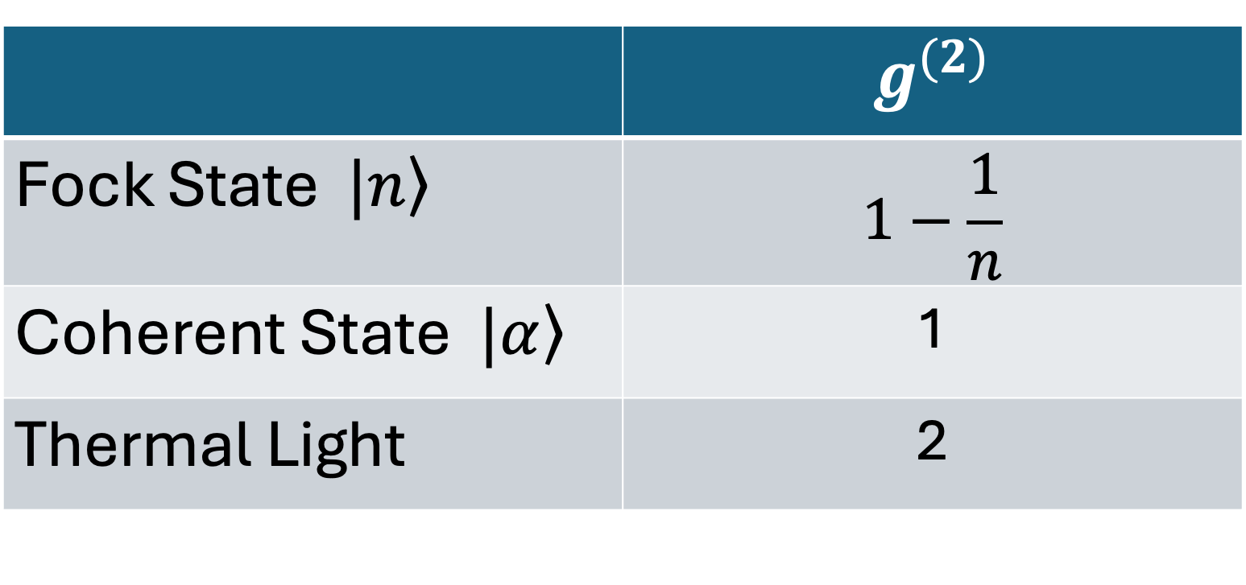
Summary
 | $$g^{(2)}$$
Fock State $|\left.n\right\rangle$ | $$1−\frac{1}{n}$$
Coherent State $|\left.α\right\rangle$ | 1
Thermal Light | 2

