Slide 1

ECE 60400: Electromagnetic Field Theory Fall 2025 L26 Fourier Optics
Instructor: Dr. Shengwang Du
Tuesday & Thursday 4:30pm-5:45pm
Hampton Hall of Civil Engineering 2117

Slide 2
Study 3 cases using Fourier Optics
Gaussian Beam Propagation
Non-Diffractive Bessel Beam
Fraunhofer Diffraction

Slide 3
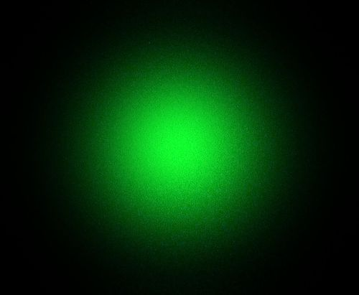
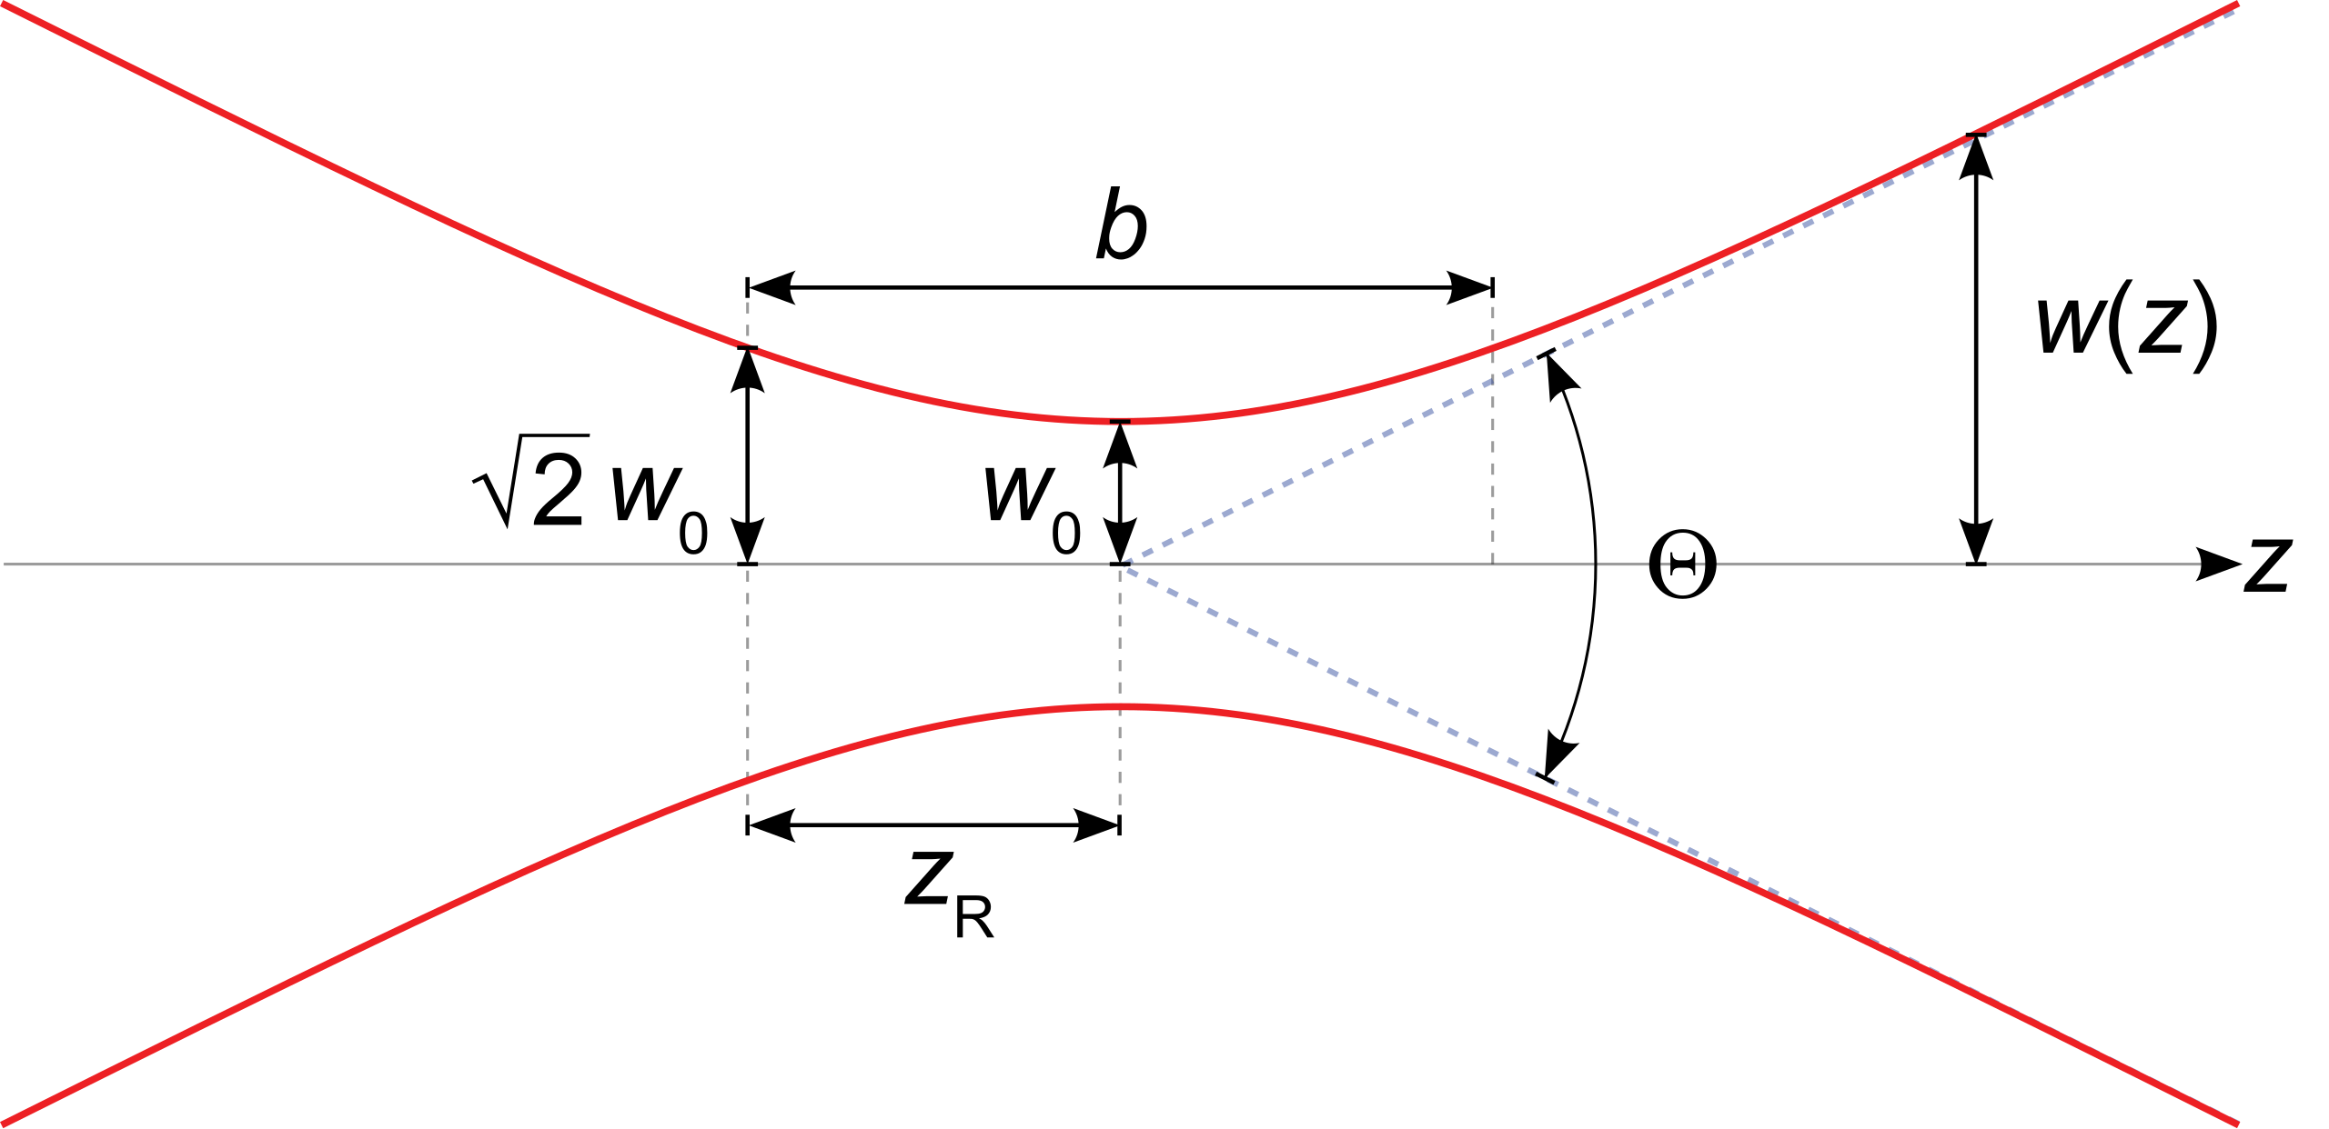
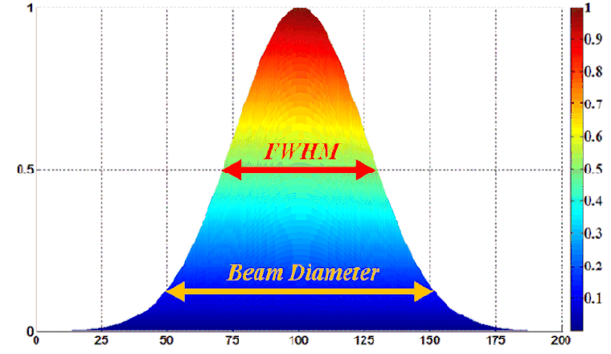
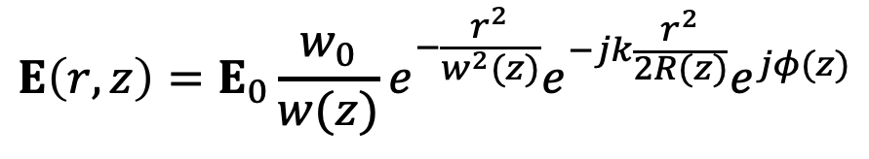
Gaussian Beam Propagation
L11
$$r^{2}=x^{2}+y^{2}$$
$$E\left(r,z\right)=E_{0}\frac{w_{0}}{w(z)}e^{−\frac{r^{2}}{w^{2}(z)}}e^{−jk\frac{r^{2}}{2R(z)}}e^{jφ(z)}$$
$$w^{2}\left(z\right)=w_{0}^{2}\left[1+{\left(\frac{z}{z_{0}}\right)}^{2}\right]$$
$$I\left(r,z\right)=\frac{{\left|E\right|}^{2}}{2η}=I_{0}{\left(\frac{w_{0}}{w(z)}\right)}^{2}e^{−\frac{{2r}^{2}}{w^{2}(z)}}$$
$$R\left(z\right)=z+\frac{z_{0}^{2}}{z}$$
$$z_{0}=\frac{kw_{0}^{2}}{2}=\frac{πw_{0}^{2}n}{λ}$$
$$θ=\lim_{z→∞}{\arctan\left(\frac{w(z)}{z}\right)≅\frac{λ}{πnw_{0}}}$$
$$\tan{φ(z)}=\frac{2z}{kw_{0}^{2}}=\frac{z}{z_{0}}$$
$$θ$$
$$z_{0}$$
w: Beam radius at $e^{−2}$ intensity

Slide 4
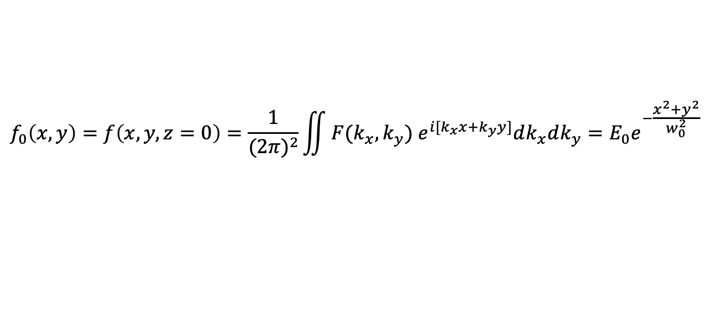

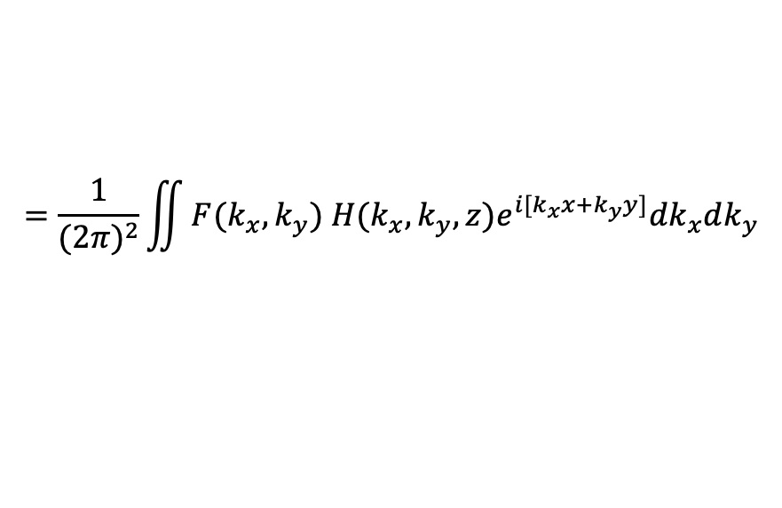
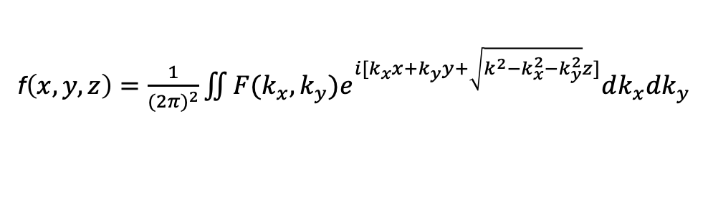
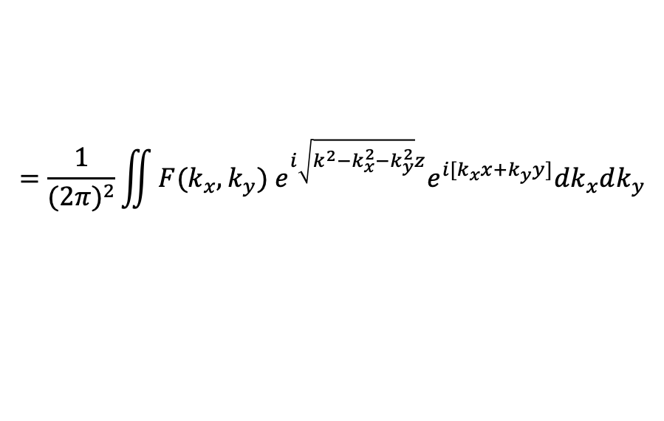



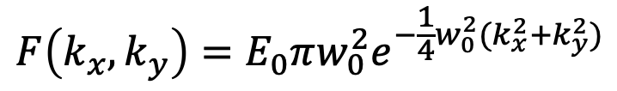
Gaussian Beam Propagation
$$j→−i$$
$E\left(x,y,z,t\right)$=$f\left(x,y,z\right)e^{−iωt}$
$$k=\frac{ω}{c}=\sqrt{k_{x}^{2}+k_{y}^{2}+k_{z}^{2}}$$
$$k_{z}=\sqrt{{k^{2}−k}_{x}^{2}−k_{y}^{2}}$$
f$\left(x,y,z\right)=\frac{1}{{(2π)}^{2}}\iint{F(k_{x},k_{y})e^{i[k_{x}x+k_{y}y+\sqrt{{k^{2}−k}_{x}^{2}−k_{y}^{2}}z]}dk_{x}dk_{y}}$
$$=\frac{1}{{(2π)}^{2}}\iint{F(k_{x},k_{y}) e^{i\sqrt{{k^{2}−k}_{x}^{2}−k_{y}^{2}}z}e^{i[k_{x}x+k_{y}y]}dk_{x}dk_{y}}$$
$$=\frac{1}{{(2π)}^{2}}\iint{F(k_{x},k_{y}) H(k_{x},k_{y},z)e^{i[k_{x}x+k_{y}y]}dk_{x}dk_{y}}$$
$$f_{0}\left(x,y\right)=f\left(x,y,z=0\right)=\frac{1}{{(2π)}^{2}}\iint{F(k_{x},k_{y}) e^{i[k_{x}x+k_{y}y]}dk_{x}dk_{y}}=E_{0}e^{−\frac{x^{2}+y^{2}}{w_{0}^{2}}}$$
$$F\left(k_{x},k_{y}\right)=E_{0}πw_{0}^{2}e^{−\frac{1}{4}w_{0}^{2}(k_{x}^{2}+k_{y}^{2})}$$

Slide 5
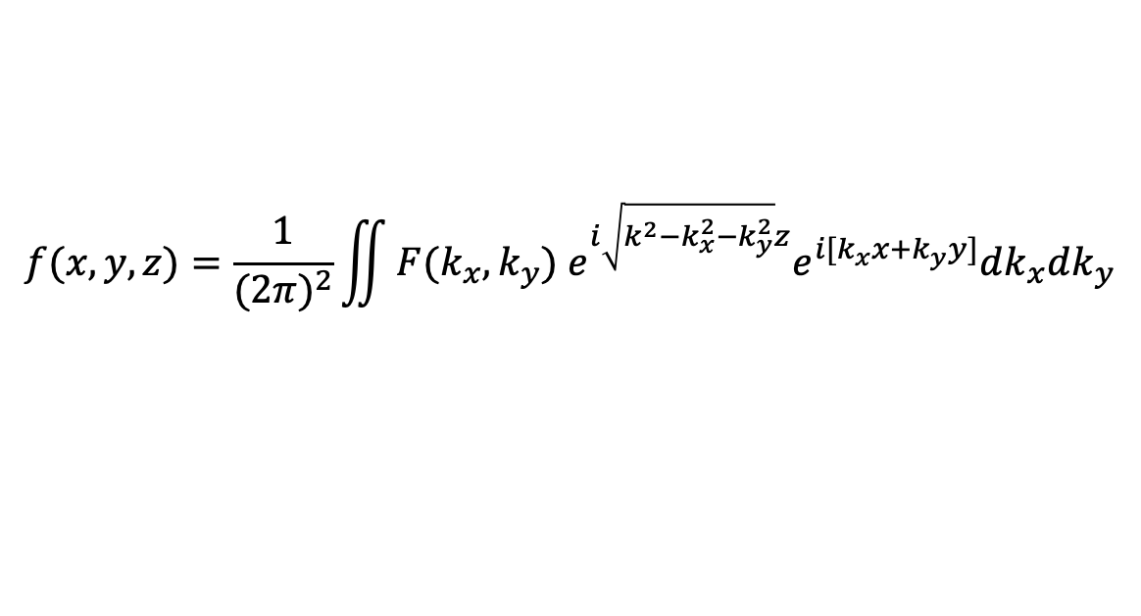
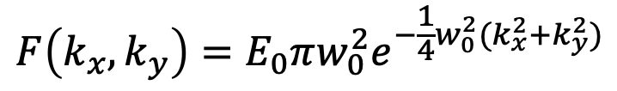
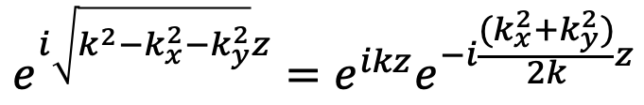
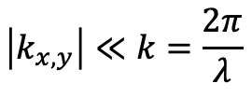
Gaussian Beam Propagation
$$F\left(k_{x},k_{y}\right)=E_{0}πw_{0}^{2}e^{−\frac{1}{4}w_{0}^{2}(k_{x}^{2}+k_{y}^{2})}$$
$$f(x,y,z)=\frac{1}{{(2π)}^{2}}\iint{F(k_{x},k_{y}) e^{i\sqrt{{k^{2}−k}_{x}^{2}−k_{y}^{2}}z}e^{i[k_{x}x+k_{y}y]}dk_{x}dk_{y}}$$
Assume: the wave field envelope varies slowly as compared with its wavelength:
$$\left|k_{x,y}\right|≪k=\frac{2π}{λ}$$
$$\sqrt{k^{2}−k_{x}^{2}−k_{y}^{2}}=k\sqrt{1−{\left(\frac{k_{x}}{k}\right)}^{2}−{\left(\frac{k_{y}}{k}\right)}^{2}}≈k\left[1−\frac{1}{2}{\left(\frac{k_{x}}{k}\right)}^{2}−\frac{1}{2}{\left(\frac{k_{y}}{k}\right)}^{2}\right]=k−\frac{(k_{x}^{2}+k_{y}^{2})}{2k}$$
$$e^{i\sqrt{{k^{2}−k}_{x}^{2}−k_{y}^{2}}z}=e^{ikz}e^{−i\frac{(k_{x}^{2}+k_{y}^{2})}{2k}z}$$

Slide 6
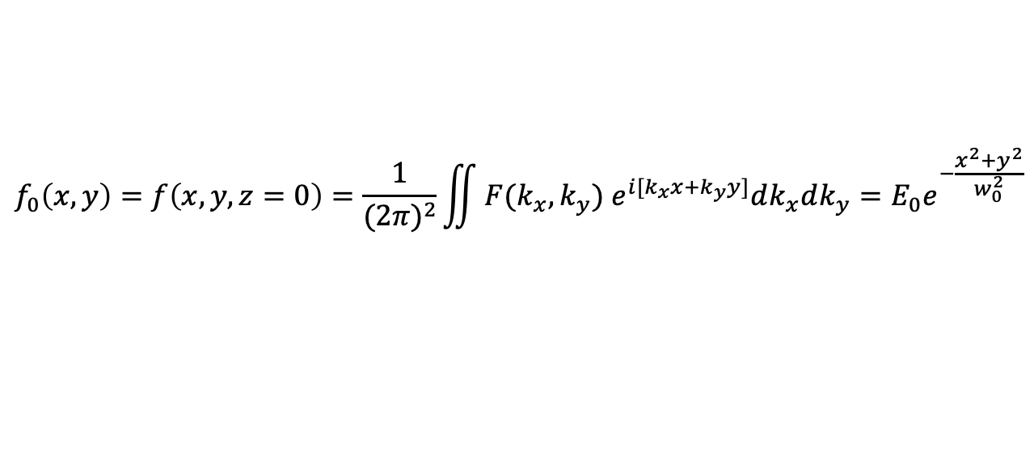
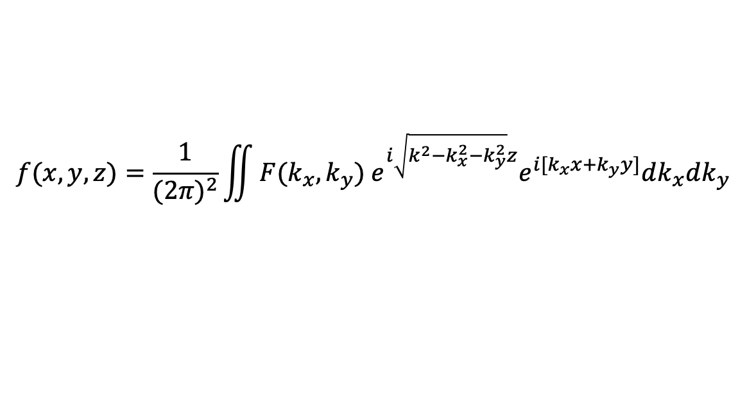
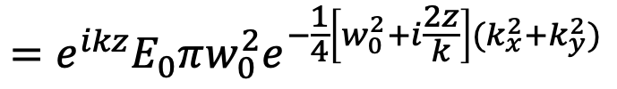
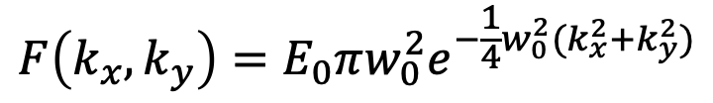
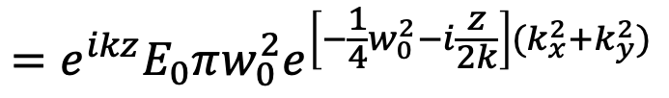
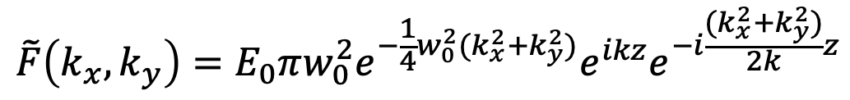
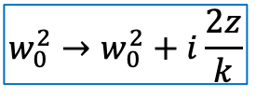
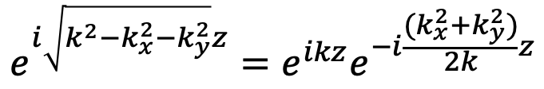
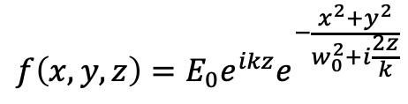
Gaussian Beam Propagation
$$F\left(k_{x},k_{y}\right)=E_{0}πw_{0}^{2}e^{−\frac{1}{4}w_{0}^{2}(k_{x}^{2}+k_{y}^{2})}$$
$$e^{i\sqrt{{k^{2}−k}_{x}^{2}−k_{y}^{2}}z}=e^{ikz}e^{−i\frac{(k_{x}^{2}+k_{y}^{2})}{2k}z}$$
$$f(x,y,z)=\frac{1}{{(2π)}^{2}}\iint{F(k_{x},k_{y}) e^{i\sqrt{{k^{2}−k}_{x}^{2}−k_{y}^{2}}z}e^{i[k_{x}x+k_{y}y]}dk_{x}dk_{y}}$$
$$\tilde{F}\left(k_{x},k_{y}\right)=E_{0}πw_{0}^{2}e^{−\frac{1}{4}w_{0}^{2}(k_{x}^{2}+k_{y}^{2})}e^{ikz}e^{−i\frac{(k_{x}^{2}+k_{y}^{2})}{2k}z}$$
$$=e^{ikz}E_{0}πw_{0}^{2}e^{−\frac{1}{4}\left[w_{0}^{2}+i\frac{2z}{k}\right](k_{x}^{2}+k_{y}^{2})}$$
$$=e^{ikz}E_{0}πw_{0}^{2}e^{\left[−\frac{1}{4}w_{0}^{2}−i\frac{z}{2k}\right](k_{x}^{2}+k_{y}^{2})}$$
$$f_{0}\left(x,y\right)=f\left(x,y,z=0\right)=\frac{1}{{(2π)}^{2}}\iint{F(k_{x},k_{y}) e^{i[k_{x}x+k_{y}y]}dk_{x}dk_{y}}=E_{0}e^{−\frac{x^{2}+y^{2}}{w_{0}^{2}}}$$
$$w_{0}^{2}→w_{0}^{2}+i\frac{2z}{k}$$
$$f\left(x,y,z\right)=E_{0}e^{ikz}e^{−\frac{x^{2}+y^{2}}{w_{0}^{2}+i\frac{2z}{k}}}$$

Slide 7
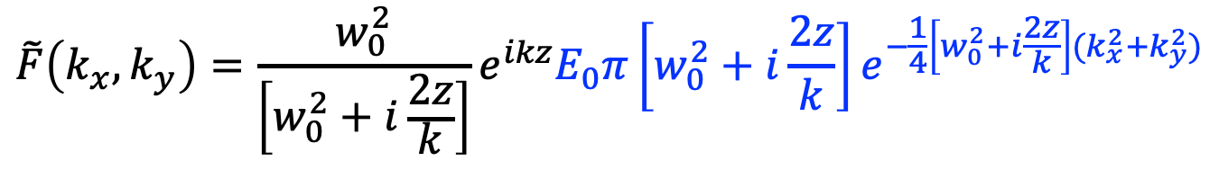
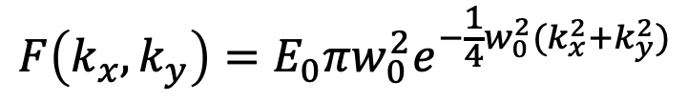
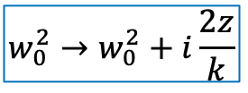
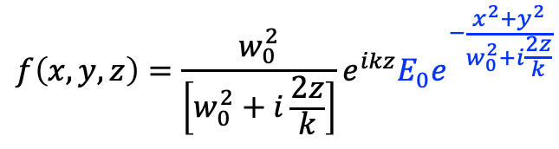
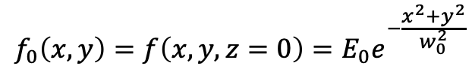
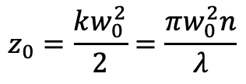
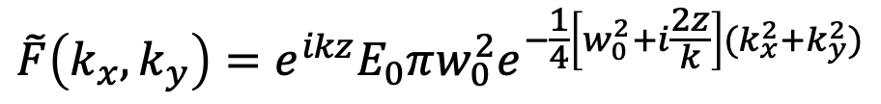
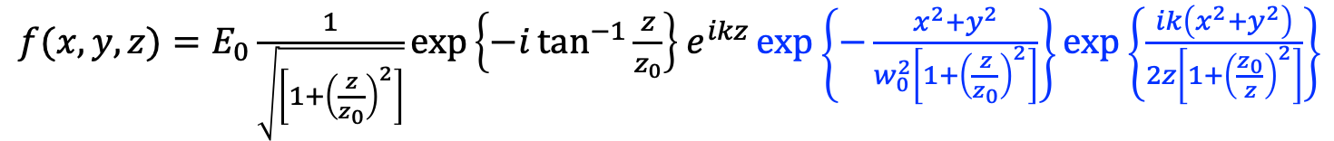
Gaussian Beam Propagation
$$f_{0}\left(x,y\right)=f\left(x,y,z=0\right)=E_{0}e^{−\frac{x^{2}+y^{2}}{w_{0}^{2}}}$$
$$F\left(k_{x},k_{y}\right)=E_{0}πw_{0}^{2}e^{−\frac{1}{4}w_{0}^{2}(k_{x}^{2}+k_{y}^{2})}$$
$$\tilde{F}\left(k_{x},k_{y}\right)=e^{ikz}E_{0}πw_{0}^{2}e^{−\frac{1}{4}\left[w_{0}^{2}+i\frac{2z}{k}\right](k_{x}^{2}+k_{y}^{2})}$$
$$w_{0}^{2}→w_{0}^{2}+i\frac{2z}{k}$$
$$\tilde{F}\left(k_{x},k_{y}\right)=\frac{w_{0}^{2}}{\left[w_{0}^{2}+i\frac{2z}{k}\right]}e^{ikz}E_{0}π\left[w_{0}^{2}+i\frac{2z}{k}\right]e^{−\frac{1}{4}\left[w_{0}^{2}+i\frac{2z}{k}\right](k_{x}^{2}+k_{y}^{2})}$$
$$f\left(x,y,z\right)=\frac{w_{0}^{2}}{\left[w_{0}^{2}+i\frac{2z}{k}\right]}e^{ikz}E_{0}e^{−\frac{x^{2}+y^{2}}{w_{0}^{2}+i\frac{2z}{k}}}$$
$f(x,y,z)=E_{0}\frac{1}{\sqrt{\left[1+{\left(\frac{z}{z_{0}}\right)}^{2}\right]}}exp\left\{−i\tan^{−1}{\frac{z}{z_{0}}}\right\}$ $e^{ikz}\exp\left\{−\frac{x^{2}+y^{2}}{w_{0}^{2}\left[1+{\left(\frac{z}{z_{0}}\right)}^{2}\right]}\right\}\exp\left\{\frac{ik\left(x^{2}+y^{2}\right)}{2z\left[1+{\left(\frac{z_{0}}{z}\right)}^{2}\right]}\right\}$
$$z_{0}=\frac{kw_{0}^{2}}{2}=\frac{πw_{0}^{2}n}{λ}$$

Slide 8
Gaussian Beam Propagation
L11
$$r^{2}=x^{2}+y^{2}$$
$$E\left(r,z\right)=E_{0}\frac{w_{0}}{w(z)}e^{−\frac{r^{2}}{w^{2}(z)}}e^{−jk\frac{r^{2}}{2R(z)}}e^{jφ(z)}$$
$$w^{2}\left(z\right)=w_{0}^{2}\left[1+{\left(\frac{z}{z_{0}}\right)}^{2}\right]$$
$$I\left(r,z\right)=\frac{{\left|E\right|}^{2}}{2η}=I_{0}{\left(\frac{w_{0}}{w(z)}\right)}^{2}e^{−\frac{{2r}^{2}}{w^{2}(z)}}$$
$$R\left(z\right)=z+\frac{z_{0}^{2}}{z}$$
$$z_{0}=\frac{kw_{0}^{2}}{2}=\frac{πw_{0}^{2}n}{λ}$$
$$θ=\lim_{z→∞}{\arctan\left(\frac{w(z)}{z}\right)≅\frac{λ}{πnw_{0}}}$$
$$\tan{φ(z)}=\frac{2z}{kw_{0}^{2}}=\frac{z}{z_{0}}$$
$$θ$$
$$z_{0}$$
w: Beam radius at $e^{−2}$ intensity

Slide 9
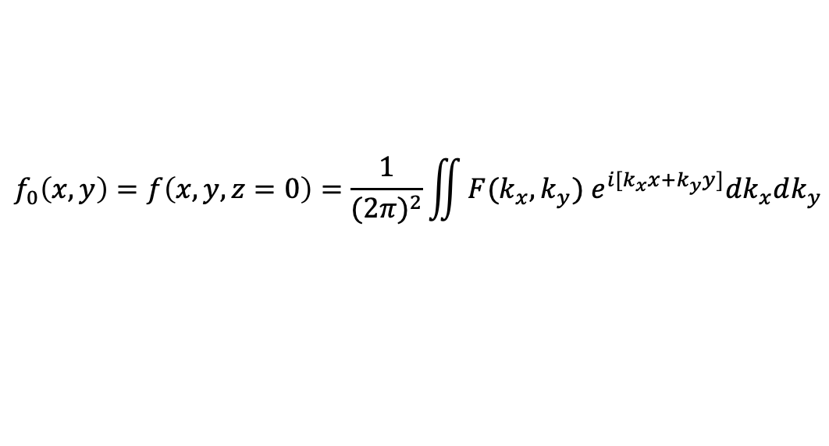

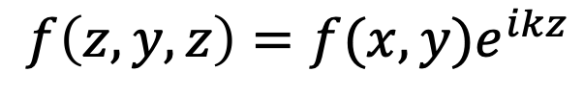
Beam Diffraction during Propagation
$E\left(x,y,z,t\right)$=$f\left(x,y,z\right)e^{−iωt}$
$$k=\frac{ω}{c}=\sqrt{k_{x}^{2}+k_{y}^{2}+k_{z}^{2}}$$
$$k_{z}=\sqrt{{k^{2}−k}_{x}^{2}−k_{y}^{2}}$$
f$\left(x,y,z\right)=\frac{1}{{(2π)}^{2}}\iint{F(k_{x},k_{y})e^{i[k_{x}x+k_{y}y+\sqrt{{k^{2}−k}_{x}^{2}−k_{y}^{2}}z]}dk_{x}dk_{y}}$
$$=\frac{1}{{(2π)}^{2}}\iint{F(k_{x},k_{y}) e^{i\sqrt{{k^{2}−k}_{x}^{2}−k_{y}^{2}}z}e^{i[k_{x}x+k_{y}y]}dk_{x}dk_{y}}$$
$$=\frac{1}{{(2π)}^{2}}\iint{F(k_{x},k_{y}) H(k_{x},k_{y},z)e^{i[k_{x}x+k_{y}y]}dk_{x}dk_{y}}$$
$$f_{0}\left(x,y\right)=f\left(x,y,z=0\right)=\frac{1}{{(2π)}^{2}}\iint{F(k_{x},k_{y}) e^{i[k_{x}x+k_{y}y]}dk_{x}dk_{y}}$$
$$f\left(z,y,z\right)=f(x,y)e^{ikz}$$
Nondiffractive in free space without waveguide?
$$?$$

Slide 10









Bessel Beam: Nondiffractive
$$\frac{2π}{λ}=k=\sqrt{k_{x}^{2}+k_{y}^{2}+k_{z}^{2}}$$
$$k_{z}=\sqrt{k^{2}−k_{x}^{2}+k_{y}^{2}}$$
$$k_{y}$$
$$E\left(x,y,z,t\right)=\iint{A\left(k_{x},k_{y}\right)e^{i\left(k_{x}x+k_{y}y+k_{z}z\right)}e^{−iωt}dk_{x}dk_{y}}$$
$$k_{x}$$
$k_{z}=\sqrt{k^{2}−k_{x}^{2}+k_{y}^{2}}$=constant
For
or
$$k_{x}^{2}+k_{y}^{2}=k^{2}−k_{z}^{2}=constant$$
$$E\left(x,y,z,t\right)=e^{i(k_{z}z−ωt)}\iint{A\left(k_{x},k_{y}\right)e^{i\left(k_{x}x+k_{y}y\right)}dk_{x}dk_{y}}$$
=$e^{i(k_{z}z−ωt)}E\left(x,y\right)$
Non-diffracting

Slide 11
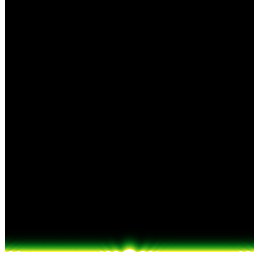
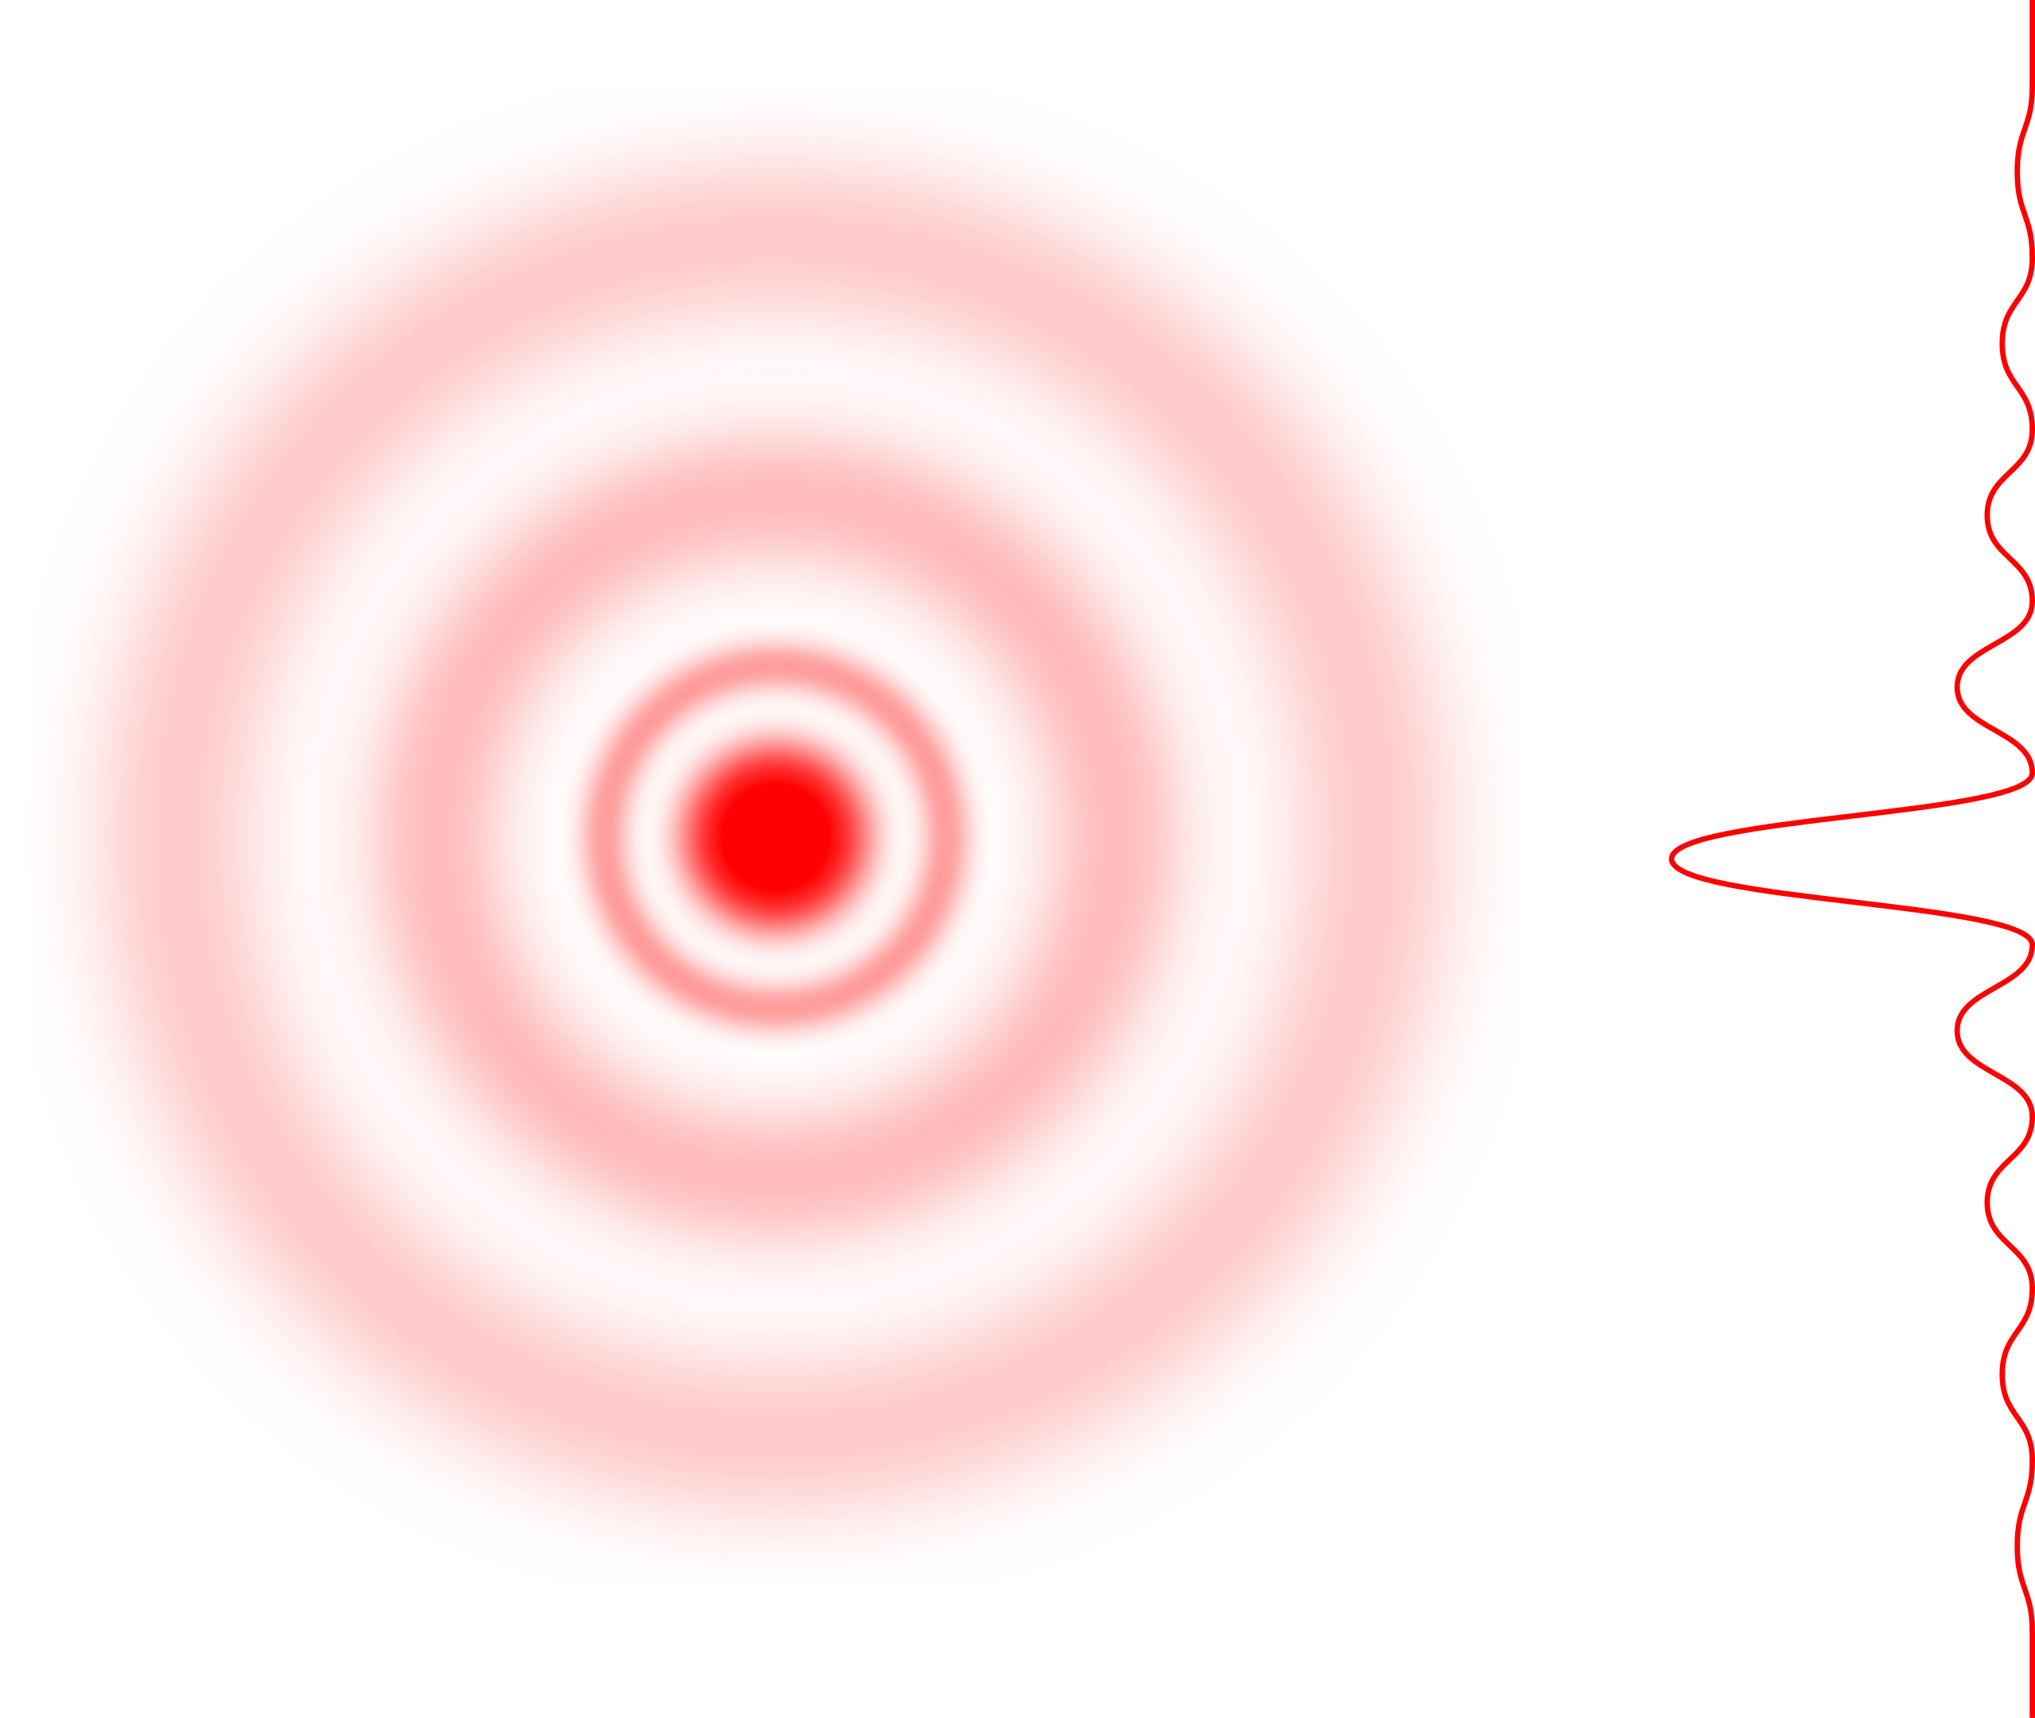
Bessel Beam

Slide 12
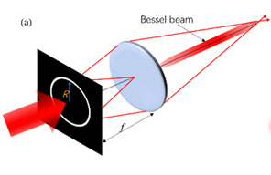
Make a Bessel Beam: I, Fourier Lens

Slide 13
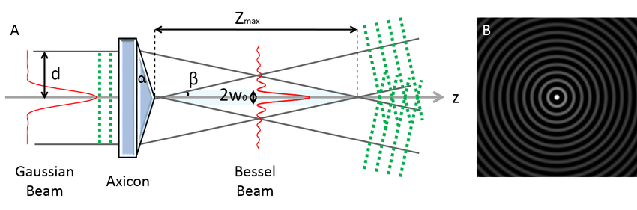
Make a Bessel Beam: II, with an Axicon

Slide 14
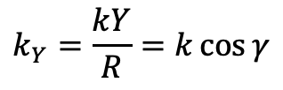
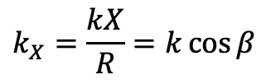
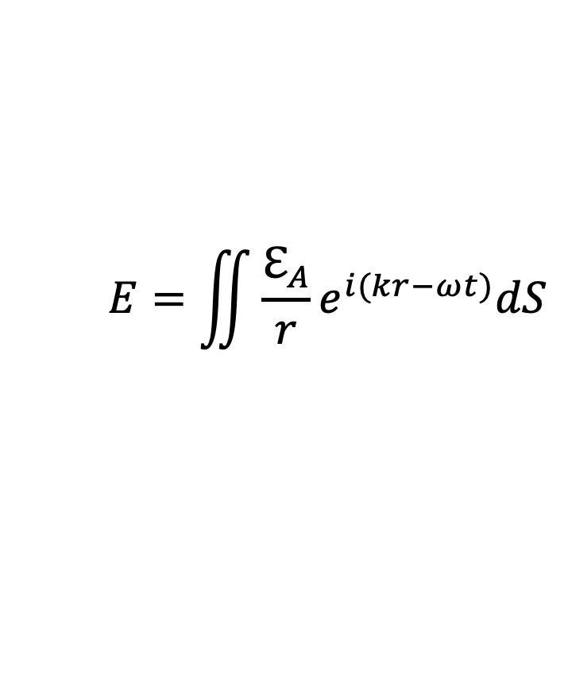
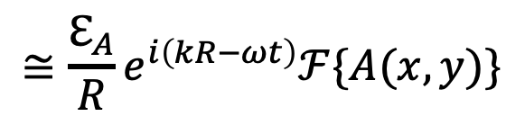
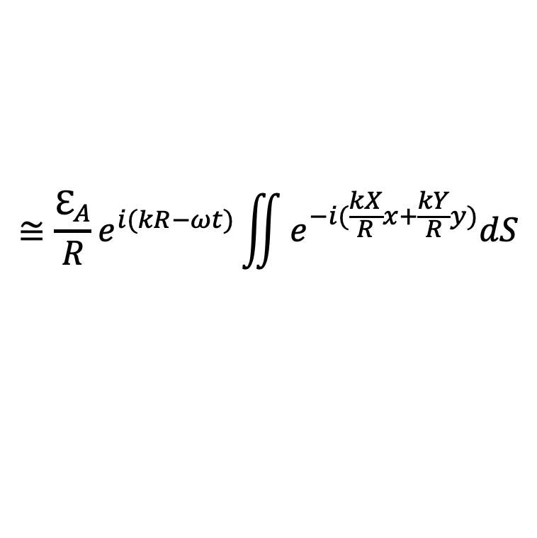
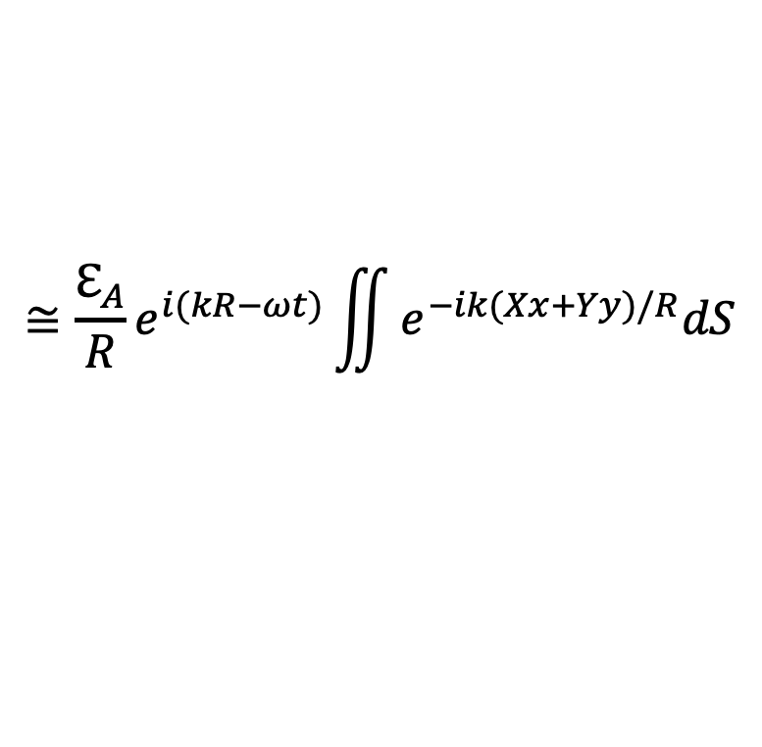
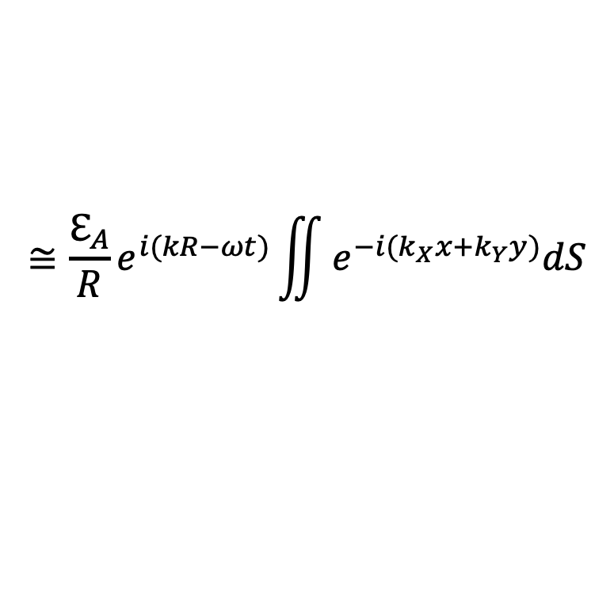
2D Aperture
Fraunhofer Diffraction
$$E=\iint{\frac{ℇ_{A}}{r}e^{i(kr−ωt)}dS}$$
$$≅\frac{ℇ_{A}}{R}e^{i(kR−ωt)}\iint{e^{−ik(Xx+Yy)/R}dS}$$
$$≅\frac{ℇ_{A}}{R}e^{i(kR−ωt)}\iint{e^{−i(\frac{kX}{R}x+\frac{kY}{R}y)}dS}$$
$$≅\frac{ℇ_{A}}{R}e^{i(kR−ωt)}\iint{e^{−i(k_{X}x+k_{Y}y)}dS}$$
x
$$≅\frac{ℇ_{A}}{R}e^{i\left(kR−ωt\right)}ℱ\{A(x,y)\}$$
z
$$k_{X}=\frac{kX}{R}=k\cos{β}$$
$$k_{Y}=\frac{kY}{R}=k\cos{γ}$$

Slide 15
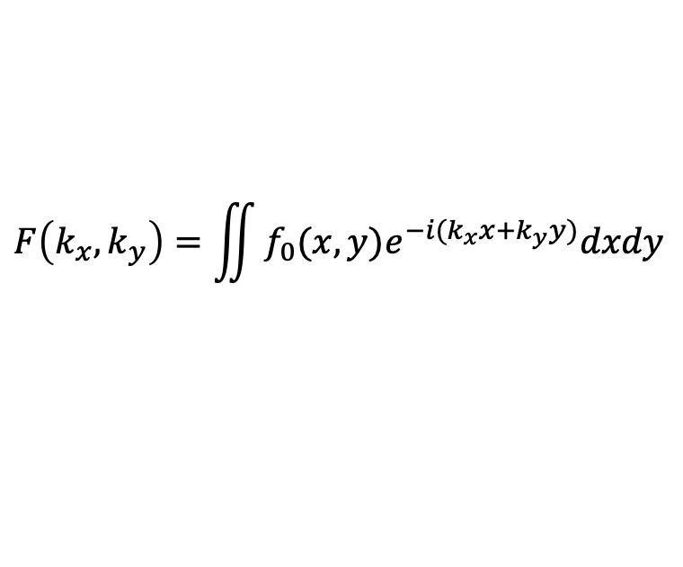
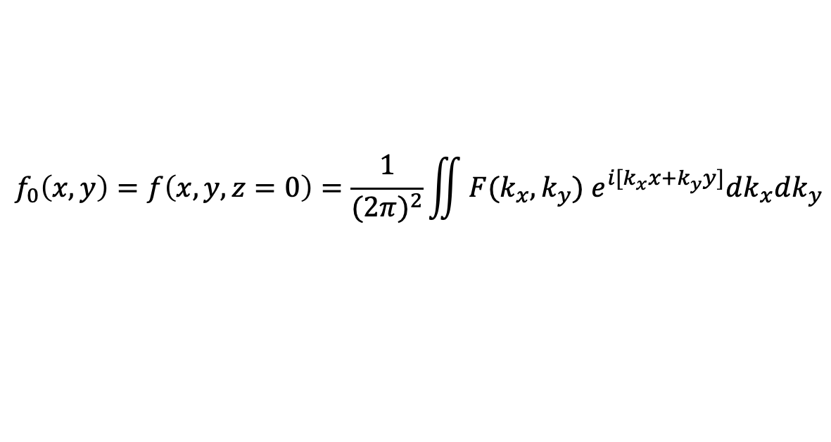
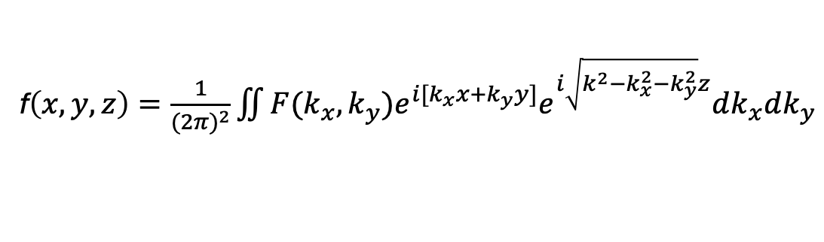
Fraunhofer Diffraction: Fourier Optics Approach
$$f_{0}\left(x,y\right)=f\left(x,y,z=0\right)=\frac{1}{{(2π)}^{2}}\iint{F(k_{x},k_{y}) e^{i[k_{x}x+k_{y}y]}dk_{x}dk_{y}}$$
$$F\left(k_{x},k_{y}\right)=\iint{f_{0}(x,y)e^{−i(k_{x}x+k_{y}y)}dxdy}$$
f$\left(x,y,z\right)=\frac{1}{{(2π)}^{2}}\iint{F(k_{x},k_{y})e^{i[k_{x}x+k_{y}y]}e^{i\sqrt{{k^{2}−k}_{x}^{2}−k_{y}^{2}}z}dk_{x}dk_{y}}$
Assume: the wave field envelope varies slowly as compared with its wavelength:
$$\sqrt{k^{2}−k_{x}^{2}−k_{y}^{2}}=k\sqrt{1−{\left(\frac{k_{x}}{k}\right)}^{2}−{\left(\frac{k_{y}}{k}\right)}^{2}}≈k\left[1−\frac{1}{2}{\left(\frac{k_{x}}{k}\right)}^{2}−\frac{1}{2}{\left(\frac{k_{y}}{k}\right)}^{2}\right]=k−\frac{(k_{x}^{2}+k_{y}^{2})}{2k}$$
$$e^{i\sqrt{{k^{2}−k}_{x}^{2}−k_{y}^{2}}z}=e^{ikz}e^{−i\frac{(k_{x}^{2}+k_{y}^{2})}{2k}z}$$

Slide 16
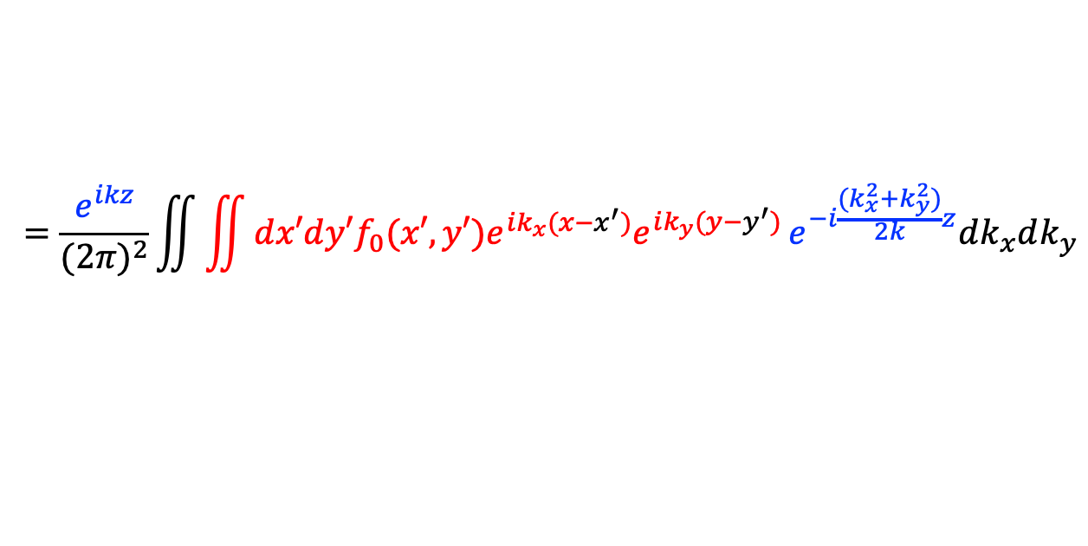
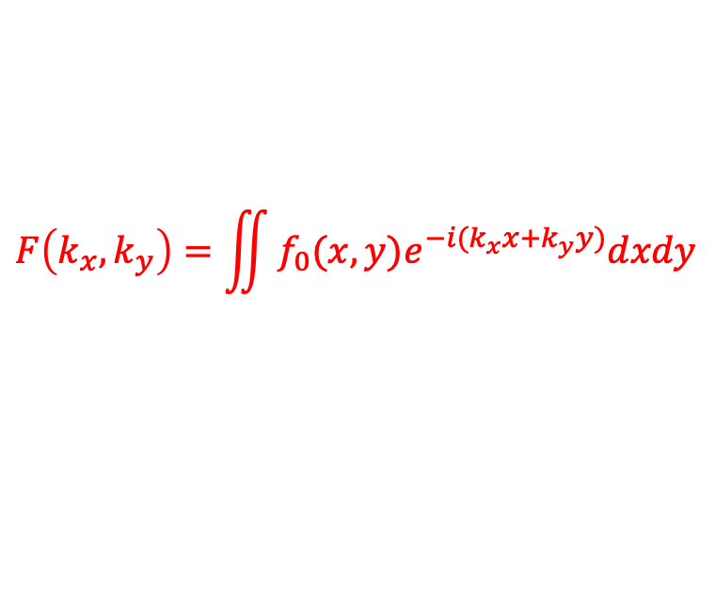
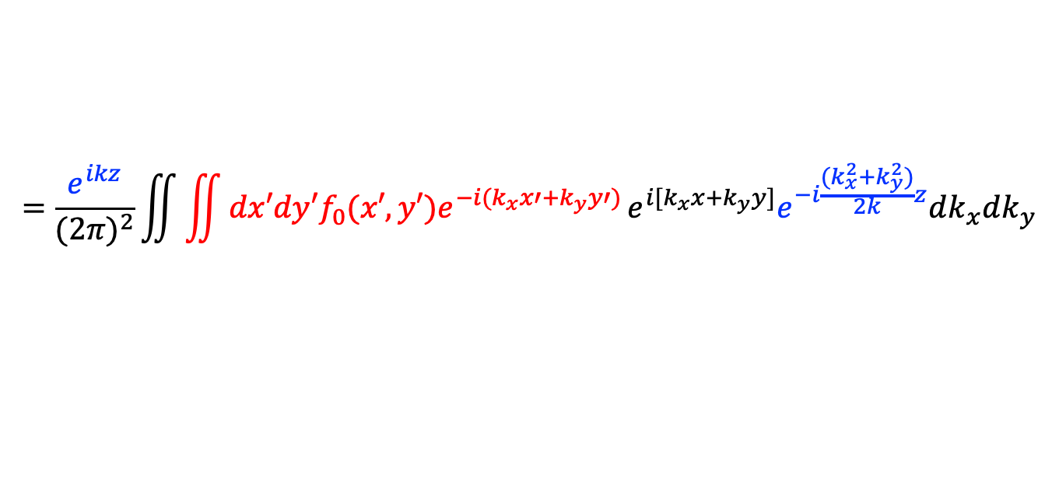
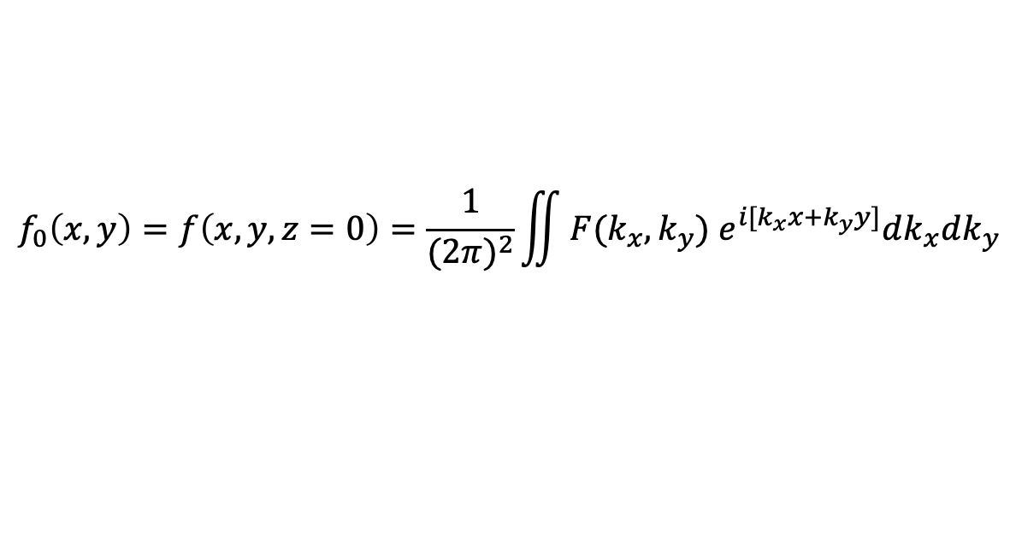



Fraunhofer Diffraction: Fourier Optics Approach
$$f_{0}\left(x,y\right)=f\left(x,y,z=0\right)=\frac{1}{{(2π)}^{2}}\iint{F(k_{x},k_{y}) e^{i[k_{x}x+k_{y}y]}dk_{x}dk_{y}}$$
$$F\left(k_{x},k_{y}\right)=\iint{f_{0}(x,y)e^{−i(k_{x}x+k_{y}y)}dxdy}$$
f$\left(x,y,z\right)=\frac{1}{{(2π)}^{2}}\iint{F(k_{x},k_{y})e^{i[k_{x}x+k_{y}y]}e^{i\sqrt{{k^{2}−k}_{x}^{2}−k_{y}^{2}}z}dk_{x}dk_{y}}$
$$=\frac{1}{{(2π)}^{2}}\iint{F(k_{x},k_{y})e^{i[k_{x}x+k_{y}y]}e^{ikz}e^{−i\frac{(k_{x}^{2}+k_{y}^{2})}{2k}z}dk_{x}dk_{y}}$$
$$=\frac{e^{ikz}}{{(2π)}^{2}}\iint{F(k_{x},k_{y})e^{i[k_{x}x+k_{y}y]}e^{−i\frac{(k_{x}^{2}+k_{y}^{2})}{2k}z}dk_{x}dk_{y}}$$
$$=\frac{e^{ikz}}{{(2π)}^{2}}\iint{\iint{dx′dy′f_{0}(x′,y′)e^{−i(k_{x}x′+k_{y}y′)}}e^{i[k_{x}x+k_{y}y]}e^{−i\frac{(k_{x}^{2}+k_{y}^{2})}{2k}z}dk_{x}dk_{y}}$$
$$=\frac{e^{ikz}}{{(2π)}^{2}}\iint{\iint{dx′dy′f_{0}(x′,y′)e^{ik_{x}(x−x^{′})}e^{ik_{y}(y−y^{′})}}e^{−i\frac{(k_{x}^{2}+k_{y}^{2})}{2k}z}dk_{x}dk_{y}}$$

Slide 17







Fraunhofer Diffraction: Fourier Optics Approach
$$f_{0}\left(x,y\right)=f\left(x,y,z=0\right)=\frac{1}{{(2π)}^{2}}\iint{F(k_{x},k_{y}) e^{i[k_{x}x+k_{y}y]}dk_{x}dk_{y}}$$
$$F\left(k_{x},k_{y}\right)=\iint{f_{0}(x,y)e^{−i(k_{x}x+k_{y}y)}dxdy}$$
$$f(x,y,z)=\frac{e^{ikz}}{{(2π)}^{2}}\iint{\iint{dx′dy′f_{0}(x′,y′)e^{ik_{x}(x−x^{′})}e^{ik_{y}(y−y^{′})}}e^{−i\frac{(k_{x}^{2}+k_{y}^{2})}{2k}z}dk_{x}dk_{y}}$$
$$z≫x′$$
$$e^{ik_{x}(x−x^{′})}e^{−i\frac{k_{x}^{2}}{2k}z}=e^{−i\frac{z}{2k}\left[k_{x}^{2}−2kk_{x}\frac{\left(x−x^{′}\right)}{z}\right]=}e^{−i\frac{z}{2k}{\left[k_{x}−k\frac{\left(x−x^{′}\right)}{z}\right]}^{2}e^{ik\frac{{\left(x−x^{′}\right)}^{2}}{2z}}}=e^{−i\frac{z}{2k}{\left[k_{x}−k\frac{\left(x−x^{′}\right)}{z}\right]}^{2}}e^{ik\frac{{x′}^{2}}{2z}}e^{−ik\frac{xx′}{z}}$$
$$\int{e^{−i\frac{z}{2k}{\left[k_{x}−k\frac{\left(x−x^{′}\right)}{z}\right]}^{2}}dk_{x}}=\sqrt{\frac{2kπ}{z}}e^{i\frac{π}{4}}$$
Making use of
$$f\left(x,y,z\right)=2kπie^{ikz}\frac{1}{{\left(2π\right)}^{2}}\iint{dx^{′}dy^{′}}f_{0}\left(x^{′},y^{′}\right)e^{−i\left[k\frac{xx^{′}}{z}+k\frac{yy^{′}}{z}\right]}=2kπie^{ikz}\frac{1}{{\left(2π\right)}^{2}}\iint{dx^{′}dy^{′}}f_{0}\left(x^{′},y^{′}\right)e^{−i\left[K_{x}x′+K_{y}y′\right]}$$
$$K_{x}=\frac{kx}{z}$$
$$K_{Y}=\frac{ky}{z}$$

