Slide 1

ECE 60400: Electromagnetic Field Theory
Fall 2025
L21 Special Relativity
Reading:
Instructor: Dr. Shengwang Du
Tuesday & Thursday 4:30pm-5:45pm
Hampton Hall of Civil Engineering 2117

Slide 2
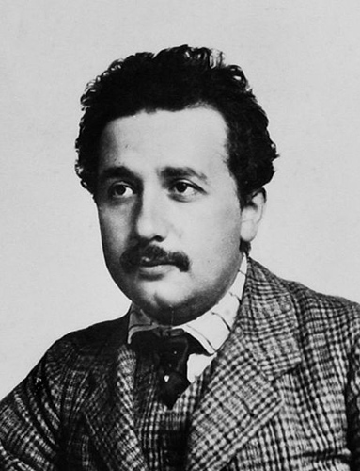
Albert Einstein
In 1905, Einstein was 26
In one year, he published 3 papers that shocked the world
  Photoelectric effect (quantum nature of light)
  Explanation of Brownian motion
  Special Relativity
The Nobel Prize in Physics 1921 was awarded to Albert Einstein "for his services to Theoretical Physics, and especially for his discovery of the law of the photoelectric effect".

Slide 3
Relativity
Albert Einstein
Special Theory of Relativity (1905):
  Space, time, relative motion at constant speed...
General Theory of Relativity (1915):
  Geometric theory of gravity, accelerated motions...

Slide 4
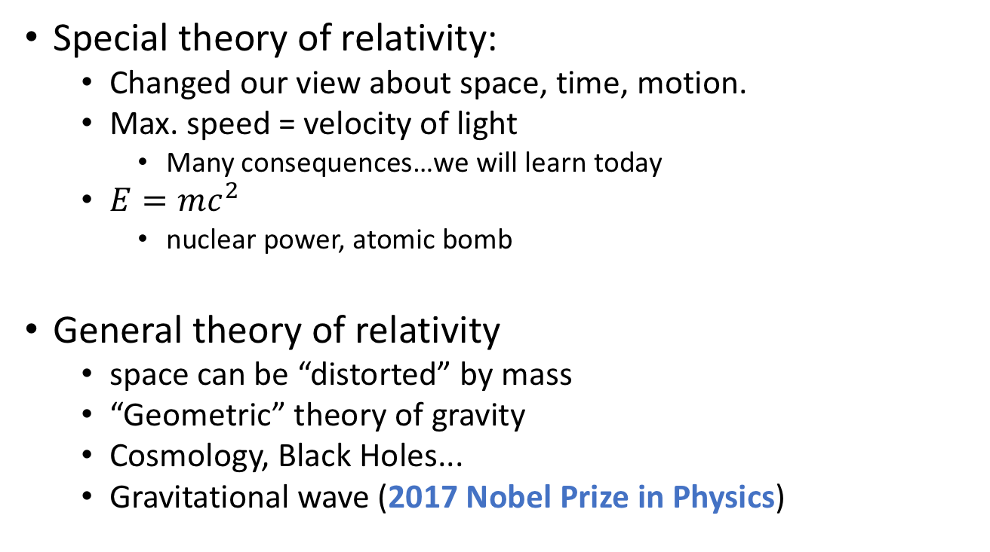
Some impact of the theory of relativity
Special theory of relativity:
  Changed our view about space, time, motion.
  Max. speed = velocity of light
    Many consequences…we will learn today
  $E=mc^{2}$
    nuclear power, atomic bomb
General theory of relativity
  space can be “distorted” by mass
  “Geometric” theory of gravity
  Cosmology, Black Holes...
  Gravitational wave (2017 Nobel Prize in Physics)

Slide 5
Review of Basic Kinematics
Speed = distance/time
momentum = mv = mass * velocity
Motion is relative
  speed of an object is always RELATIVE to some reference frame.
  It is known well before Einstein that no mechanical experiment of any kind can reveal the motion of constant speed of an observer.

Slide 6






On the Electrodynamics of Moving Bodies
Special Relativity
u
$$\vec{E}(\vec{r},t)$$
$$\vec{B}(\vec{r},t)$$
$$\vec{E}′(\vec{r}′,t)$$
$\vec{B}′(\vec{r}′,t)$=0
S
S'
S: Lab reference frame
S’: Co-moving reference frame
$$\vec{E}(\vec{r},t)≠\vec{E}′(\vec{r}′,t)$$
$$\vec{B}(\vec{r},t)≠\vec{B}′(\vec{r}′,t)$$

Slide 7
Maxwell’s Equations in vacuum
Can you feel vacuum moves?
Independent of reference frame: for all inertial reference frames!
Incompatible with the classical velocity addition

Slide 8

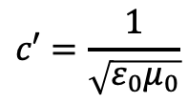


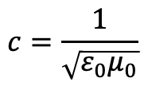


Speed of Light in Vacuum
Maxwell’s Equations ➔
$$c=\frac{1}{\sqrt{ε_{0}μ_{0}}}$$
In S’: Use Maxwell Equaitons,
$$c′=\frac{1}{\sqrt{ε_{0}μ_{0}}}$$
Classical velocity addition:
u
In S: c=$c′$+u=
$\frac{1}{\sqrt{ε_{0}μ_{0}}}$+u
Vacuum
S'
S
In S: Use Maxwell Equaitons,
$$c=\frac{1}{\sqrt{ε_{0}μ_{0}}}$$
Classical velocity addition:
In S’: c’=$c−$u=
$\frac{1}{\sqrt{ε_{0}μ_{0}}}−$u

Slide 9
Is there a frame of absolute rest?
Many 19th century scientists believe that a frame of absolute rest really exists.
Waves: ordinary waves need a medium to propagate.
  For example: Water waves are disturbances in the surface of water.
What is the medium for sound?
What is the medium for light (electromagnetic wave)?
where Maxwell Equations apply
Not vacuum!
Ether: massless, structure-less, no viscosity but very stiff, permeate all space

Slide 10
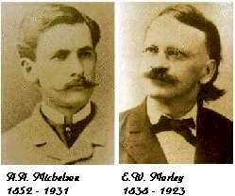
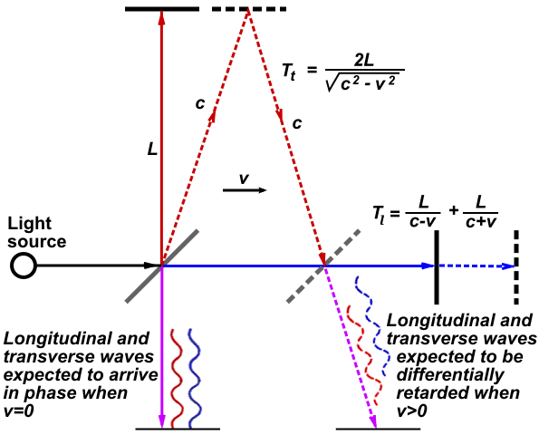
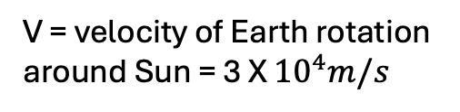
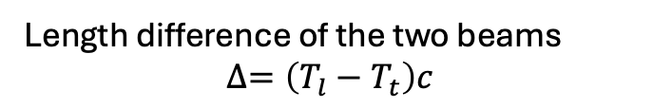
The Michelson-Morley experiment (1887)
With “ether” at rest in lab frame, we expect
Length difference of the two beams
$$∆=\left(T_{l}−T_{t}\right)c$$
V = velocity of Earth rotation around Sun = 3 X ${10}^{4}m/s$

Slide 11
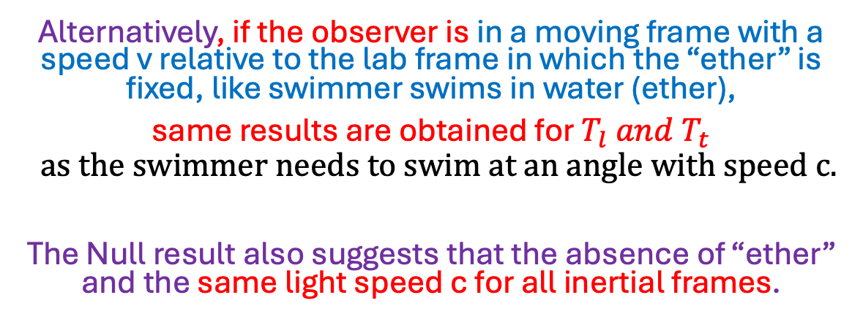
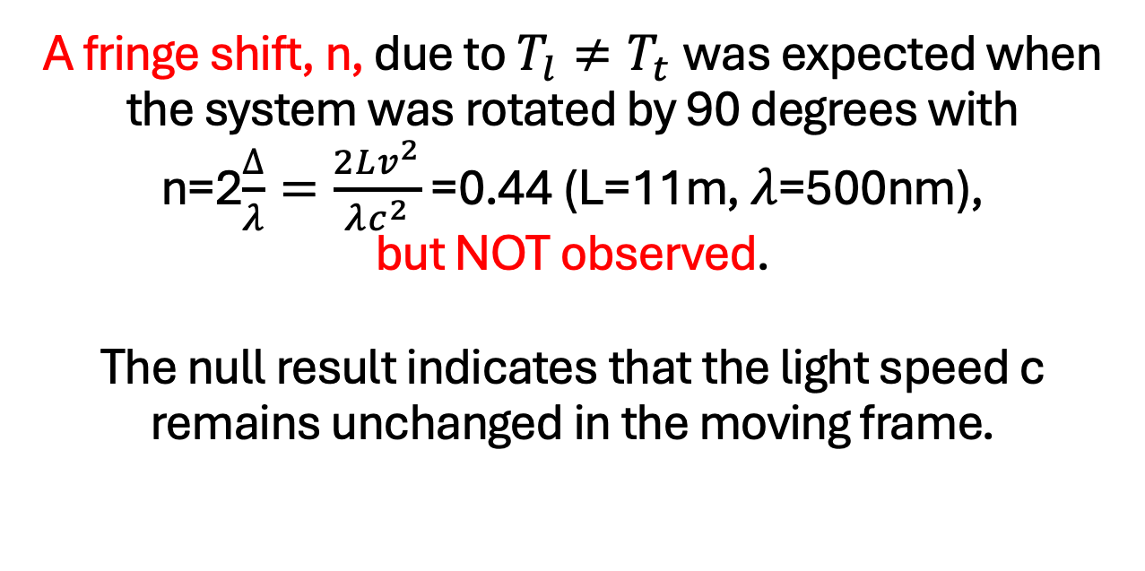
A fringe shift, n, due to $T_{l}≠T_{t}$was expected when the system was rotated by 90 degrees with n=2$\frac{∆}{λ}=\frac{2Lv^{2}}{λc^{2}}$ =0.44 (L=11m, $λ$=500nm), but NOT observed.
The null result indicates that the light speed c remains unchanged in the moving frame.
Alternatively, if the observer is in a moving frame with a speed v relative to the lab frame in which the “ether” is fixed, like swimmer swims in water (ether),
same results are obtained for $T_{l} and T_{t}$
$$as the swimmer needs to swim at an angle with speed c.$$
The Null result also suggests that the absence of “ether” and the same light speed c for all inertial frames.

Slide 12
Einstein’s postulates of the special theory of relativity
1. All laws of physics are the same in all uniformly moving (inertial) frames of reference.(the same Maxwell Equations.)
2. The speed of light in free space has the same measured value regardless of the motion of the source or the motion of the observer; that is, the speed of light is invariant.

Slide 13
If we accept Einstein’s postulates, we have to re-examine our understanding of time.
Time is “definite”: independent of observer
The sequence of events that have cause-effect relationships (causality): some events must happen before others.
  For example, you mother must be born before you.
Einstein’s theory: Time is “entangled” with space…

Slide 14
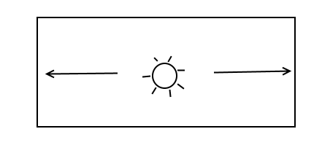
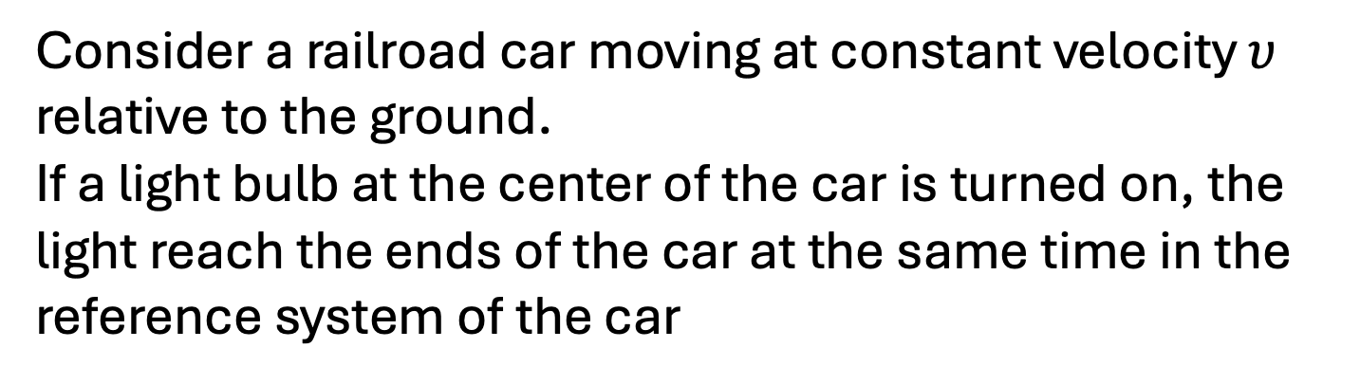
Simultaneity
Consider a railroad car moving at constant velocity $υ$ relative to the ground.
If a light bulb at the center of the car is turned on, the light reach the ends of the car at the same time in the reference system of the car
Events (a) and (b) are simultaneous in the reference frame of the train.

Slide 15
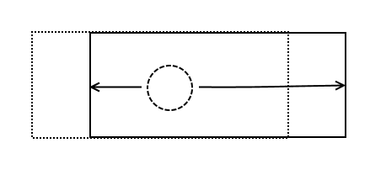
But to an observer on the ground , the light travels a shorter distance to reach (b) than it does to reach (a):
Therefore, in this reference frame , event (b) happens before event (a)!
Conclusion : Two events that are simultaneous in one inertial system are not (in general) simultaneous in another.

Slide 16
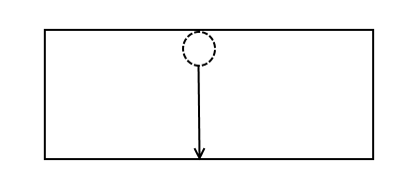
Time dilation
How long does it take light from the bulb to strike the floor a distance h directly below it?
In the reference frame of the train , this is
We use a bar to denote the time and space coordinates in this reference system.

Slide 17
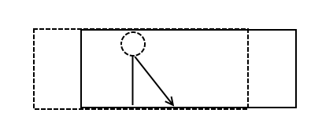
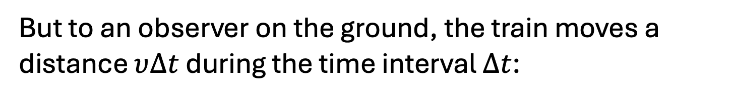
But to an observer on the ground, the train moves a distance $υ∆t$ during the time interval $∆t$:
or
where

Slide 18
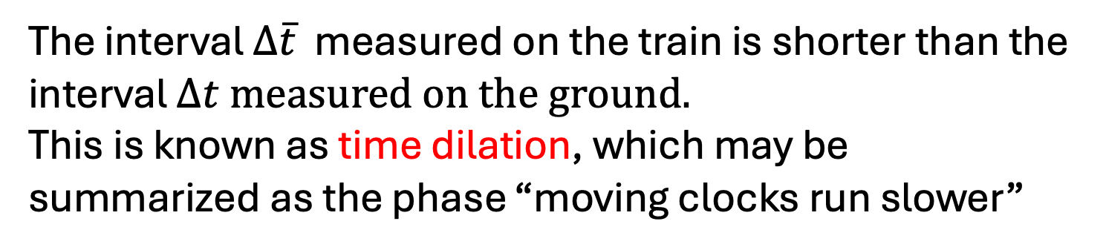
The interval $∆\overline{t}$ measured on the train is shorter than the interval $∆t measured on the ground.$
This is known as time dilation, which may be summarized as the phase “moving clocks run slower”
where

Slide 19
Einstein’s Relativity: Time Dilation
https://www.youtube.com/watch?v=HHRK6ojWdtU
https://www.youtube.com/watch?v=02tchltLm3c

Slide 21

Lorentz contraction
How long does it take light to move from one end of the train to the other and back again after reflecting off of a mirror?
$$Δ\overline{x}$$
In the reference frame of the train, this is just

Slide 22
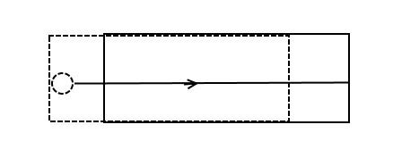
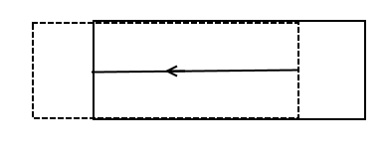
but to a ground observer the interval is
where
and

Slide 23
Thus
But since $∆\overline{t}=\frac{1}{γ}∆t$ ,we have

Slide 24
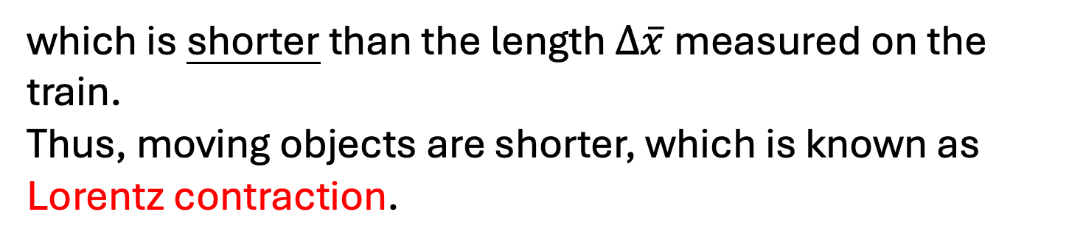
This shows that the observer on the ground measures the length of the car to be
which is shorter than the length $∆\overline{x}$measured on the train.
Thus, moving objects are shorter, which is known as Lorentz contraction.
The contraction occurs only in the direction of motion
Dimensions perpendicular to the velocity are not contracted.

Slide 25
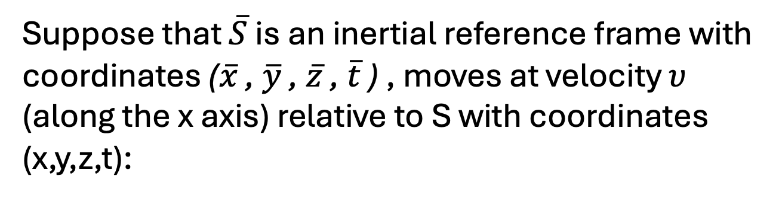
Lorentz transformations
We can combine all of these conclusions into what is called a Lorentz transformation of the time and space coordinates.
Suppose that $\overline{S}$ is an inertial reference frame with coordinates ($\overline{x}$ , $\overline{y}$ , $\overline{z}$ , $\overline{t}$ ) , moves at velocity $υ$ (along the x axis) relative to S with coordinates (x,y,z,t):

Slide 26
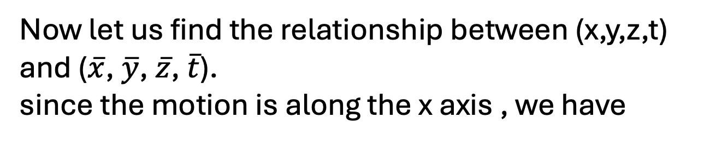
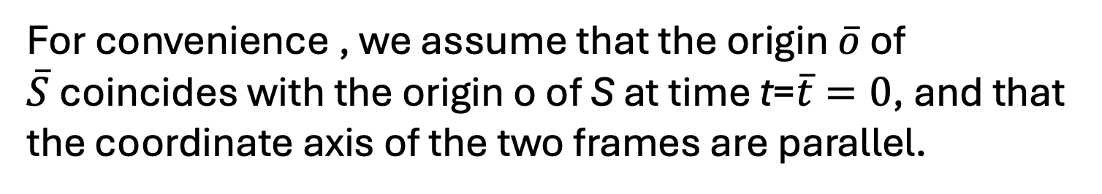
For convenience , we assume that the origin $\overline{o}$ of $\overline{S}$coincides with the origin o of S at time t=$\overline{t}=0$, and that the coordinate axis of the two frames are parallel.
Now let us find the relationship between (x,y,z,t) and ($\overline{x}$, $\overline{y}$, $\overline{z}$, $\overline{t}$).
since the motion is along the x axis , we have
Under Galilean relativity we would also have
NOT true in special relativity !
Derivations of Lorentz transformation see next slides

Slide 27


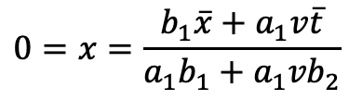

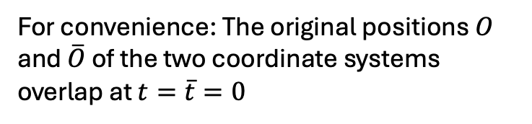
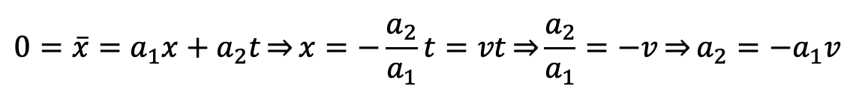

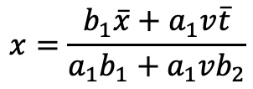









Lorentz Transform
$$\overline{S}$$
For convenience: The original positions $O$ and $\overline{O}$ of the two coordinate systems overlap at $t=\overline{t}=0$
$$S$$
$$\overline{x}=a_{1}x+a_{2}t$$
$$\overline{y}=y$$
$$\overline{t}=b_{1}t+b_{2}x$$
$$\overline{z}=z$$
Let’s look at $\overline{O}$ which moves with a velocity v along x axis in Reference $S$:
$\overline{O}$:
$$0=\overline{x}=a_{1}x+a_{2}t\underset{⇒}{}x=−\frac{a_{2}}{a_{1}}t=vt\underset{⇒}{}\frac{a_{2}}{a_{1}}=−v\underset{⇒}{}a_{2}=−a_{1}v$$
$$\overline{x}=a_{1}x−a_{1}vt$$
$$x=\frac{b_{1}\overline{x}+a_{1}v\overline{t}}{a_{1}b_{1}+{a_{1}vb}_{2}}$$
$$\overline{t}=b_{2}x+b_{1}t$$
Let’s look at O which moves with a velocity -v along $\overline{x}$ axis in Reference $\overline{S}$:
$$0=x=\frac{b_{1}\overline{x}+a_{1}v\overline{t}}{a_{1}b_{1}+{a_{1}vb}_{2}}$$
$$\overline{x}=a_{1}x−a_{1}vt$$
O :
$\overline{x}=−\frac{a_{1}v}{b_{1}}\overline{t}=−v$ $\overline{t}$
$$b_{1}=a_{1}$$
$$\overline{t}=b_{2}x+a_{1}t$$

Slide 28






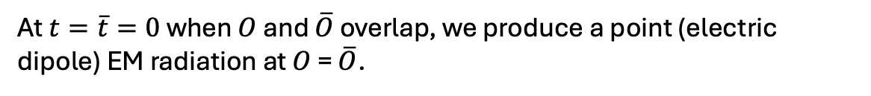

Lorentz Transform
$$\overline{S}$$
For convenience: The original positions $O$ and $\overline{O}$ of the two coordinate systems overlap at $t=\overline{t}=0$
$$S$$
$$\overline{x}=a_{1}x−a_{1}vt$$
$$\overline{y}=y$$
$$\overline{t}=b_{2}x+a_{1}t$$
$$\overline{z}=z$$
At $t=\overline{t}=0$ when $O$ and $\overline{O}$ overlap, we produce a point (electric dipole) EM radiation at $O$ = $\overline{O}$.
Reference $S:$ speed of light is constant in all directions ➔ spherical EM wave
$$x^{2}+y^{2}+z^{2}=c^{2}t^{2}$$
$$y^{2}+z^{2}=c^{2}t^{2}−x^{2}$$
Reference $\overline{S}:$ speed of light is constant in all directions ➔ spherical EM wave
$${\overline{x}}^{2}+{\overline{y}}^{2}+{\overline{z}}^{2}=c^{2}{\overline{t}}^{2}$$
$${\overline{y}}^{2}+{\overline{z}}^{2}=c^{2}{\overline{t}}^{2}−{\overline{x}}^{2}$$
$${c^{2}t}^{2}−x^{2}=c^{2}{\overline{t}}^{2}−{\overline{x}}^{2}$$

Slide 29
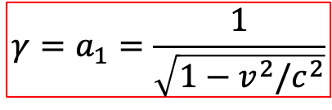
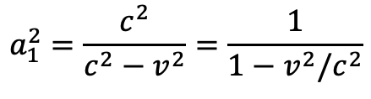




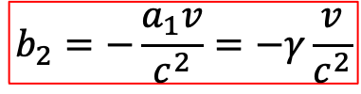
Lorentz Transform
$$\overline{S}$$
For convenience: The original positions $O$ and $\overline{O}$ of the two coordinate systems overlap at $t=\overline{t}=0$
$$S$$
$$\overline{x}=a_{1}x−a_{1}vt$$
$$\overline{y}=y$$
$$\overline{t}=b_{2}x+a_{1}t$$
$$\overline{z}=z$$
$${c^{2}t}^{2}−x^{2}=c^{2}{\overline{t}}^{2}−{\overline{x}}^{2}$$
$${c^{2}t}^{2}−x^{2}=c^{2}{\overline{t}}^{2}−{\overline{x}}^{2}=c^{2}{\left(b_{2}x+a_{1}t\right)}^{2}−{(a_{1}x−a_{1}vt)}^{2}$$
$=c^{2}a_{1}^{2}t^{2}+2c^{2}a_{1}b_{2}xt+c^{2}b_{2}^{2}x^{2}−v^{2}a_{1}^{2}t^{2}+2a_{1}^{2}vxt−a_{1}^{2}$ $x^{2}$
$$a_{1}^{2}=\frac{c^{2}}{c^{2}−v^{2}}=\frac{1}{1−v^{2}/c^{2}}$$
$$γ=a_{1}=\frac{1}{\sqrt{1−v^{2}/c^{2}}}$$
$$c^{2}=c^{2}a_{1}^{2}−v^{2}a_{1}^{2}$$
$$−1=c^{2}b_{2}^{2}−a_{1}^{2}$$
$0=2c^{2}a_{1}b_{2}$+ $2a_{1}^{2}v$
$$b_{2}=−\frac{a_{1}v}{c^{2}}=−γ\frac{v}{c^{2}}$$

Slide 30
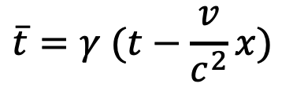




Lorentz Transform
$$\overline{S}$$
For convenience: The original positions $O$ and $\overline{O}$ of the two coordinate systems overlap at $t=\overline{t}=0$
$$S$$
$$\overline{x}=γ (x−vt)$$
$$\overline{t}=γ (t−\frac{v}{c^{2}}x)$$
$$\overline{y}=y$$
$$\overline{z}=z$$
$${c^{2}t}^{2}−x^{2}=c^{2}{\overline{t}}^{2}−{\overline{x}}^{2}$$
$${c^{2}t}^{2}−x^{2}−y^{2}−z^{2}=c^{2}{\overline{t}}^{2}−{\overline{x}}^{2}−{\overline{y}}^{2}−{\overline{z}}^{2}$$

Slide 31

Lorentz transformation: Events in the two inertial reference frames S and $\overline{S}$ are related by
Note that all of our previous concepts(simultaneity, time dilation , and Lorentz contraction) are contained in the Lorentz transformation formulae.

Slide 32

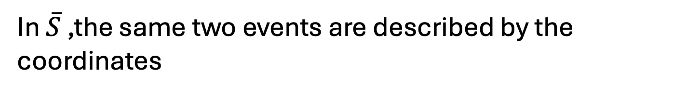
For example , suppose two events (A and B) are simultaneous in S:
In $\overline{S}$ ,the same two events are described by the coordinates
Hence these events are not simultaneous in $\overline{S}$ , since B happens before A.

Slide 33


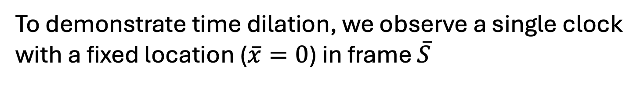
To demonstrate time dilation, we observe a single clock with a fixed location ($\overline{x}=0$) in frame $\overline{S}$
Two events at this location are
$$x=γ\left(\overline{x}+v\overline{t}\right)$$
$$t=γ\left(\overline{t}+\frac{v}{c^{2}}\overline{x}\right)$$
The same two events in frame S are
Hence in frame S, the two events are separated by a time interval
moving clocks run slow (since $γ≥1$)

Slide 34
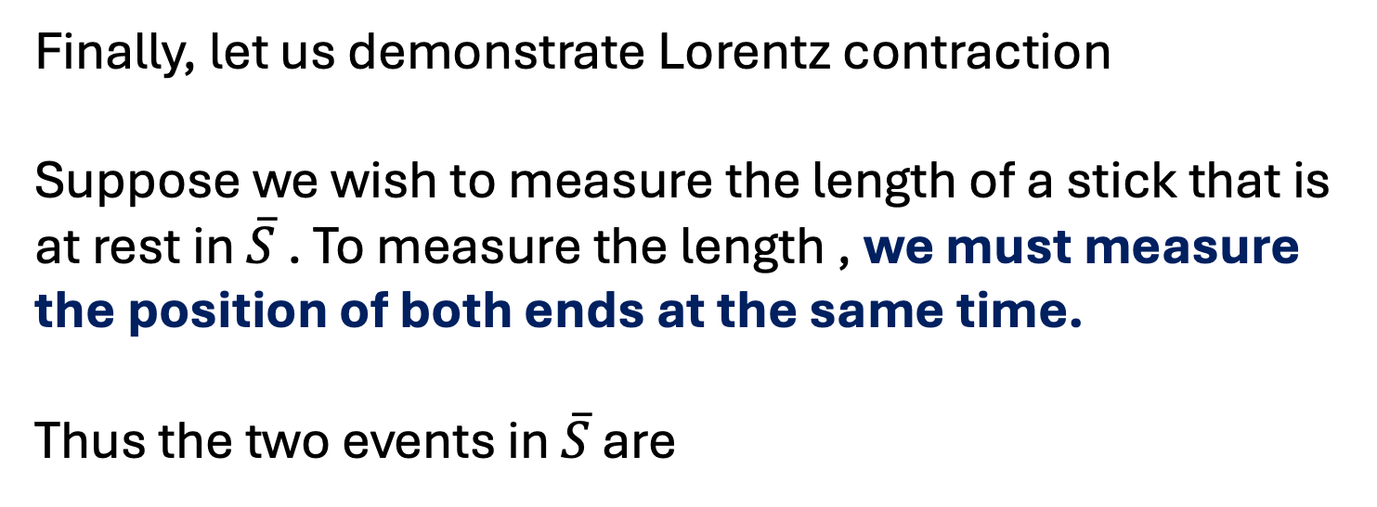
Finally, let us demonstrate Lorentz contraction
Suppose we wish to measure the length of a stick that is at rest in $\overline{S}$ . To measure the length , we must measure the position of both ends at the same time.
Thus the two events in $\overline{S}$ are
Measure means: we must measure the two ends at the same time t in frame.

Slide 35
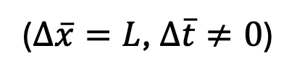
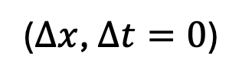
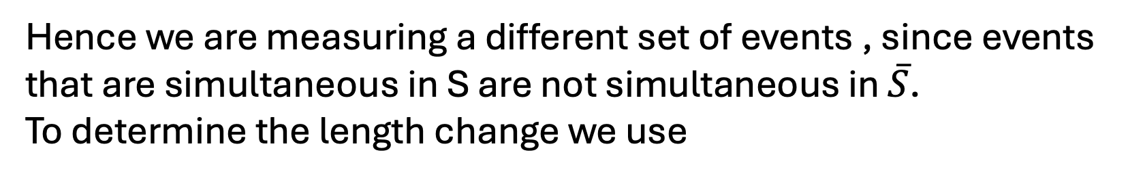
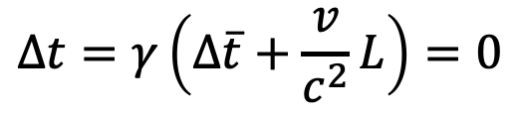
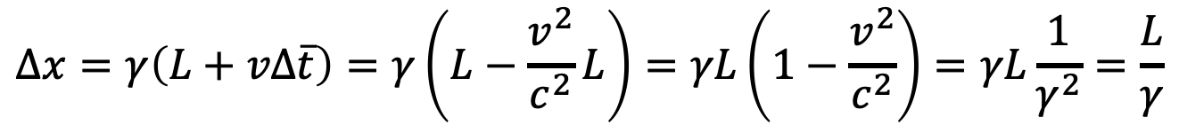

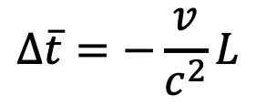
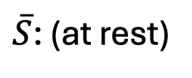
Hence we are measuring a different set of events , since events that are simultaneous in S are not simultaneous in $\overline{S}$.
To determine the length change we use
S:
($Δx$, $∆t=0$)
$\overline{S}$: (at rest)
($Δ\overline{x}=L$, $∆\overline{t}≠0$)
$$∆x=γ\left(L+vΔ\overline{t}\right)$$
$$Δt=γ\left(Δ\overline{t}+\frac{v}{c^{2}}L\right)=0$$
$$Δ\overline{t}=−\frac{v}{c^{2}}L$$
$$∆x=γ\left(L+vΔ\overline{t}\right)=γ\left(L−\frac{v^{2}}{c^{2}}L\right)=γL\left(1−\frac{v^{2}}{c^{2}}\right)=γL\frac{1}{γ^{2}}=\frac{L}{γ}$$
moving objects are shorter

Slide 36













Tips for Lorentz Transform
S
$$\overline{S}$$
Event:
$$(x,y,z,t)$$
$$(\overline{x},y,z,\overline{t})$$
$$x=γ\left(\overline{x}+v\overline{t}\right)$$
$$\overline{x}=γ\left(x−vt\right)$$
$$t=γ\left(\overline{t}+\frac{v}{c^{2}}\overline{x}\right)$$
$$\overline{t}=γ\left(t−\frac{v}{c^{2}}x\right)$$
Event interval:
$$(∆x,∆y,∆z,∆t)$$
$$(∆\overline{x},∆y,∆z,∆\overline{t})$$
$$Δx=γ\left(Δ\overline{x}+vΔ\overline{t}\right)$$
$$Δ \overline{x}=γ\left(Δx−vΔt\right)$$
$$Δt=γ\left(Δ\overline{t}+\frac{v}{c^{2}}Δ\overline{x}\right)$$
$$Δ\overline{t}=γ\left(Δt−\frac{v}{c^{2}}Δx\right)$$

Slide 37
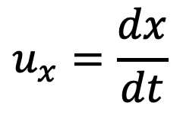

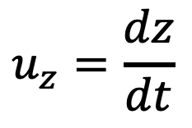
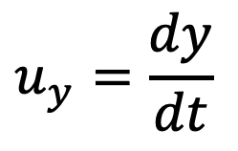
what is the relation between velocities in the two inertial frames?
Suppose a particle in S moves a distance dx in a time interval dt , so that it has velocity
$$u_{x}=\frac{dx}{dt}$$
$$u_{y}=\frac{dy}{dt}$$
$$u_{z}=\frac{dz}{dt}$$
what is its velocity in $\overline{S}$ is thus

Slide 38
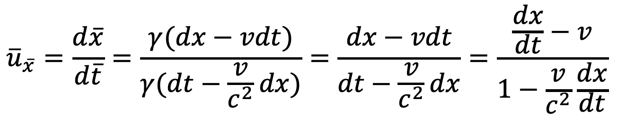
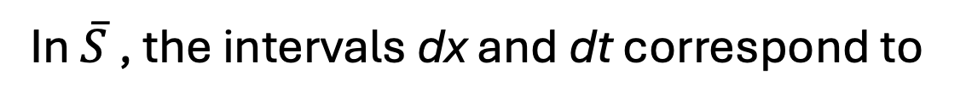

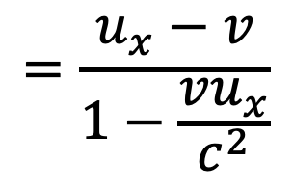
In $\overline{S}$ , the intervals dx and dt correspond to
The velocity in $\overline{S}$ is thus
$${\overline{u}}_{\overline{x}}=\frac{d\overline{x}}{d\overline{t}}=\frac{γ(dx−vdt)}{γ(dt−\frac{v}{c^{2}}dx)}=\frac{dx−vdt}{dt−\frac{v}{c^{2}}dx}=\frac{\frac{dx}{dt}−v}{1−\frac{v}{c^{2}}\frac{dx}{dt}}$$
$$=\frac{u_{x}−v}{1−\frac{vu_{x}}{c^{2}}}$$

Slide 39
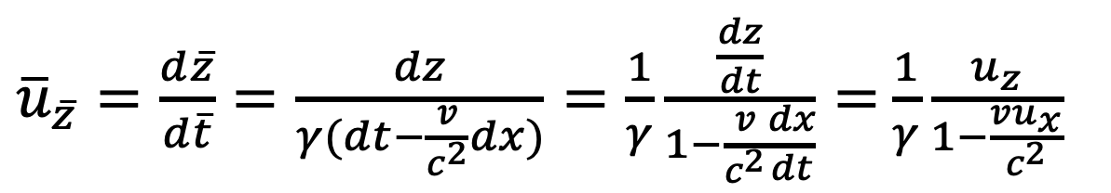



$$S⟹\overline{S}$$
$${\overline{u}}_{\overline{x}}=\frac{u_{x}−v}{1−\frac{vu_{x}}{c^{2}}}$$
${\overline{u}}_{\overline{y}}=\frac{d\overline{y}}{d\overline{t}}=\frac{dy}{γ(dt−\frac{v}{c^{2}}dx)}=\frac{1}{γ}\frac{\frac{dy}{dt}}{1−\frac{v}{c^{2}}\frac{dx}{dt}}=$ $\frac{1}{γ}\frac{u_{y}}{1−\frac{vu_{x}}{c^{2}}}$
${\overline{u}}_{\overline{z}}=\frac{d\overline{z}}{d\overline{t}}=\frac{dz}{γ(dt−\frac{v}{c^{2}}dx)}=\frac{1}{γ}\frac{\frac{dz}{dt}}{1−\frac{v}{c^{2}}\frac{dx}{dt}}=$ $\frac{1}{γ}\frac{u_{z}}{1−\frac{vu_{x}}{c^{2}}}$

Slide 40




$\overline{S}⟹S$: $v→−v$
$$u_{x}=\frac{{\overline{u}}_{\overline{x}}+v}{1+\frac{v{\overline{u}}_{\overline{x}}}{c^{2}}}$$
$$u_{y}=\frac{1}{γ}\frac{{\overline{u}}_{\overline{y}}}{1+\frac{v{\overline{u}}_{\overline{x}}}{c^{2}}}$$
$$u_{z}=\frac{1}{γ}\frac{{\overline{u}}_{\overline{z}}}{1+\frac{v{\overline{u}}_{\overline{x}}}{c^{2}}}$$

Slide 41
Lorentz Transform
S
$$\overline{S}$$
Event:
$$(x,y,z,t)$$
$$(\overline{x},y,z,\overline{t})$$
$$x=γ\left(\overline{x}+v\overline{t}\right)$$
$$\overline{x}=γ\left(x−vt\right)$$
$$t=γ\left(\overline{t}+\frac{v}{c^{2}}\overline{x}\right)$$
$$\overline{t}=γ\left(t−\frac{v}{c^{2}}x\right)$$
Event interval:
$$(∆x,∆y,∆z,∆t)$$
$$(∆\overline{x},∆y,∆z,∆\overline{t})$$
$$Δx=γ\left(Δ\overline{x}+vΔ\overline{t}\right)$$
$$Δ \overline{x}=γ\left(Δx−vΔt\right)$$
$$Δt=γ\left(Δ\overline{t}+\frac{v}{c^{2}}Δ\overline{x}\right)$$
$$Δ\overline{t}=γ\left(Δt−\frac{v}{c^{2}}Δx\right)$$
41

Slide 42








Lorentz Transform
S
$$\overline{S}$$
$$\vec{u}=\frac{d\vec{r}}{dt}$$
$$\vec{\overline{u}}=\frac{d\vec{\overline{r}}}{dt}$$
$$u_{x}=\frac{{\overline{u}}_{\overline{x}}+v}{1+\frac{v{\overline{u}}_{\overline{x}}}{c^{2}}}$$
$${\overline{u}}_{\overline{x}}=\frac{u_{x}−v}{1−\frac{vu_{x}}{c^{2}}}$$
$$u_{y}=\frac{1}{γ}\frac{{\overline{u}}_{\overline{y}}}{1+\frac{v{\overline{u}}_{\overline{x}}}{c^{2}}}$$
$${\overline{u}}_{\overline{y}}=\frac{1}{γ}\frac{u_{y}}{1−\frac{vu_{x}}{c^{2}}}$$
$$u_{z}=\frac{1}{γ}\frac{{\overline{u}}_{\overline{z}}}{1+\frac{v{\overline{u}}_{\overline{x}}}{c^{2}}}$$
$${\overline{u}}_{\overline{z}}=\frac{1}{γ}\frac{u_{z}}{1−\frac{vu_{x}}{c^{2}}}$$
42

Slide 43










Example: $u≪c$, (Classical Mechanics)
S
$$\overline{S}$$
Event:
$$(x,y,z,t)$$
$$(\overline{x},y,z,\overline{t})$$
$$u_{x}=\frac{{\overline{u}}_{\overline{x}}+v}{1+\frac{v{\overline{u}}_{\overline{x}}}{c^{2}}}→{\overline{u}}_{\overline{x}}−v$$
$${\overline{u}}_{\overline{x}}=\frac{u_{x}−v}{1−\frac{vu_{x}}{c^{2}}}→u_{x}−v$$
$u_{y}=\frac{1}{γ}\frac{{\overline{u}}_{\overline{y}}}{1+\frac{v{\overline{u}}_{\overline{x}}}{c^{2}}}→$ ${\overline{u}}_{\overline{y}}$
${\overline{u}}_{\overline{y}}=\frac{1}{γ}\frac{u_{y}}{1−\frac{vu_{x}}{c^{2}}}→$ $u_{y}$
$u_{z}=\frac{1}{γ}\frac{{\overline{u}}_{\overline{z}}}{1+\frac{v{\overline{u}}_{\overline{x}}}{c^{2}}}→$ ${\overline{u}}_{\overline{z}}$
$${\overline{u}}_{\overline{z}}=\frac{1}{γ}\frac{u_{z}}{1−\frac{vu_{x}}{c^{2}}}→u_{z}$$

Slide 44




Example: $\left(u_{x}=c,u_{y}=0,u_{z}=0\right)$
${\overline{u}=\overline{u}}_{\overline{x}}=\frac{c−v}{1−\frac{vc}{c^{2}}}=$ $\frac{c−v}{1−\frac{v}{c}}=c\frac{c−v}{c−v}=c$
$${\overline{u}}_{\overline{y}}=0$$
$${\overline{u}}_{\overline{z}}=0$$
c is invariant in any inertial reference!

