Slide 1

Applied Quantum Computing II ECE 50651 Spring 2025 Recitation Module 0: Photonic Qubits
Instructor: Dr. Shengwang Du
Recitation: Monday 2:30pm-3:20pm
Knoy Hall of Technology B033

Slide 2

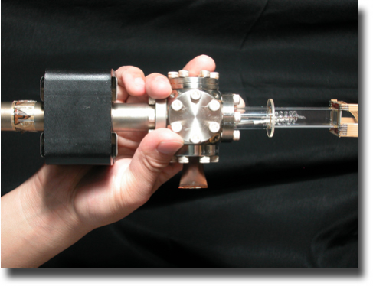
Infleqtion: Neutral Atom
Founded in 2007 by Prof. Dana Z. Anderson (ColdQuanta)
Became public on 02/17/2026
The first publicly listed neutral-atom quantum technology company and will begin trading on the NYSE under ticker symbol “INFQ” on February 17, 2026
https://www.stocktitan.net/news/CCCX/infleqtion-and-churchill-capital-corp-x-complete-business-osdfz8kbb19o.html
S. Du, M. B. Squires, Y. Imai, L. Czaia, R.A. Saravanan, V. Bright, J. Reichel, T. W. Hansch, and D. Z. Anderson, “Atom-chip Bose-Einstein condensation in a portable vacuum cell,” Phys. Rev. A 70 , 053606 (2004).

Slide 3
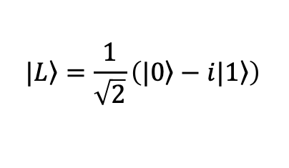

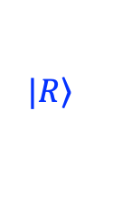
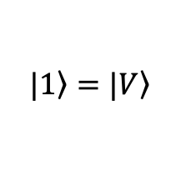
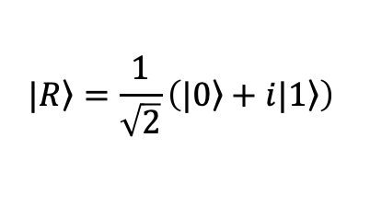

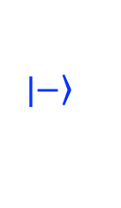
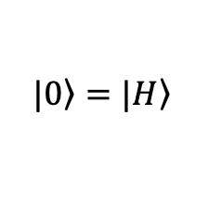
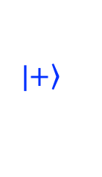
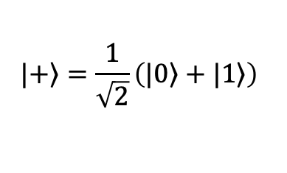
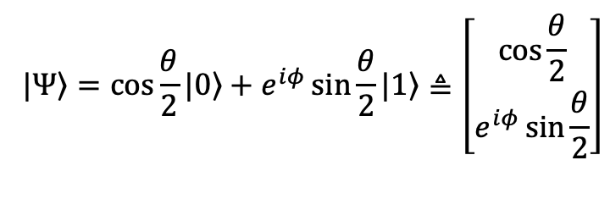
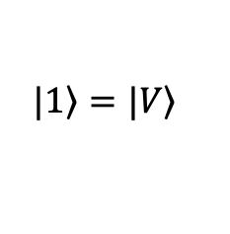
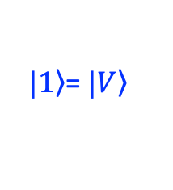

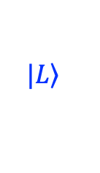
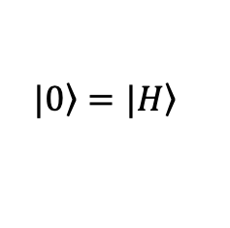
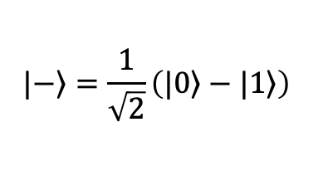
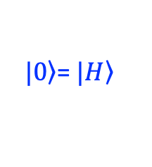
Photonic Polarization Qubit
$$|\left.1\right\rangle =|\left.V\right\rangle$$
$$|\left.0\right\rangle =|\left.H\right\rangle$$
$$|\left.0\right\rangle =|\left.H\right\rangle$$
$$|\left.1\right\rangle =|\left.V\right\rangle$$
Horizental/Vertical linear polarizations
$$|\left.+\right\rangle =\frac{1}{\sqrt{2}}\left(|\left.0\right\rangle +|\left.1\right\rangle \right)$$
$$|\left.−\right\rangle =\frac{1}{\sqrt{2}}\left(|\left.0\right\rangle −|\left.1\right\rangle \right)$$
+/- 45 degree linear polarizations
$$|\left.R\right\rangle =\frac{1}{\sqrt{2}}\left(|\left.0\right\rangle +i|\left.1\right\rangle \right)$$
$$|\left.L\right\rangle =\frac{1}{\sqrt{2}}\left(|\left.0\right\rangle −i|\left.1\right\rangle \right)$$
Circular polarizations
z
$|\left.0\right\rangle$= $|\left.H\right\rangle$
$$e^{−i(ωt−kz)}$$
Plane wave propagating along +z direction
$$θ$$
$$|\left.−\right\rangle$$
Qubit state: Jones vector
$$|\left.L\right\rangle$$
y
$$|\left.R\right\rangle$$
x
$$φ$$
$$|\left.Ψ\right\rangle =\cos{\frac{θ}{2}}|\left.0\right\rangle +e^{iφ}\sin{\frac{θ}{2}}|\left.1\right\rangle ≜\left[\begin{matrix}\cos{\frac{θ}{2}} \\ e^{iφ}\sin{\frac{θ}{2}}\end{matrix}\right]$$
$$|\left.+\right\rangle$$
$|\left.1\right\rangle$= $|\left.V\right\rangle$

Slide 4
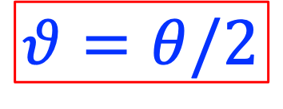
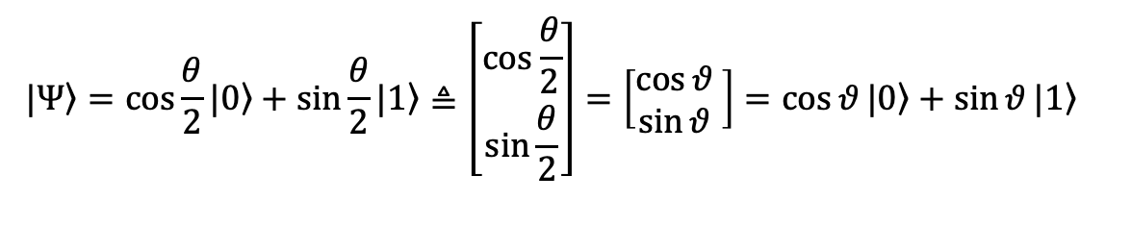

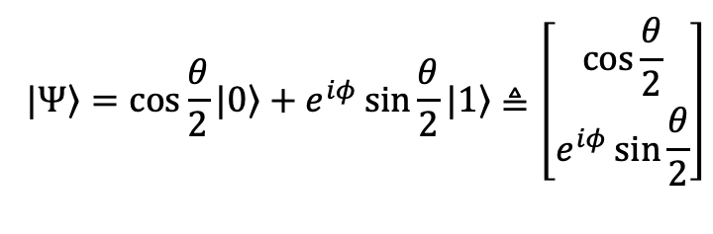
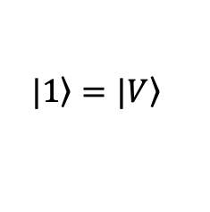
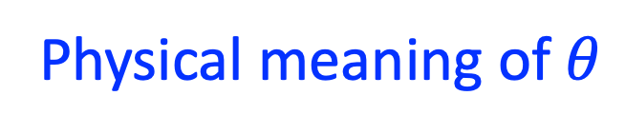
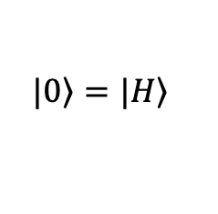
Photonic Polarization Qubit
Physical meaning of $θ$
$$|\left.0\right\rangle =|\left.H\right\rangle$$
$$|\left.1\right\rangle =|\left.V\right\rangle$$
$$|\left.Ψ\right\rangle =\cos{\frac{θ}{2}}|\left.0\right\rangle +e^{iφ}\sin{\frac{θ}{2}}|\left.1\right\rangle ≜\left[\begin{matrix}\cos{\frac{θ}{2}} \\ e^{iφ}\sin{\frac{θ}{2}}\end{matrix}\right]$$
z
$|\left.0\right\rangle$= $|\left.H\right\rangle$
$$θ$$
$$|\left.1\right\rangle =|\left.V\right\rangle$$
$$θ=θ/2$$
$$|\left.−\right\rangle$$
$$|\left.L\right\rangle$$
y
$$|\left.R\right\rangle$$
x
$$φ$$
$$θ$$
$$|\left.+\right\rangle$$
$$|\left.0\right\rangle =|\left.H\right\rangle$$
$$|\left.Ψ\right\rangle =\cos{\frac{θ}{2}}|\left.0\right\rangle +\sin{\frac{θ}{2}}|\left.1\right\rangle ≜\left[\begin{matrix}\cos{\frac{θ}{2}} \\ \sin{\frac{θ}{2}}\end{matrix}\right]=\left[\begin{matrix}\cos{θ } \\ \sin{θ }\end{matrix}\right]=\cos{θ}|\left.0\right\rangle +\sin{θ}|\left.1\right\rangle$$
$|\left.1\right\rangle$= $|\left.V\right\rangle$

Slide 5
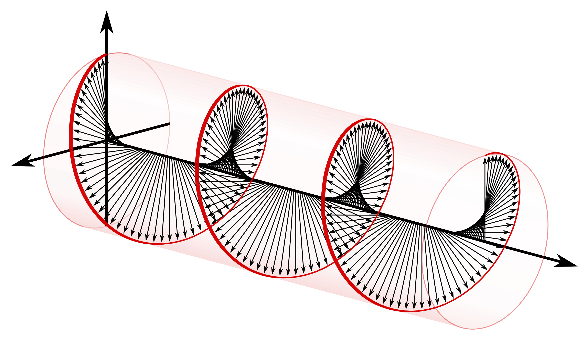
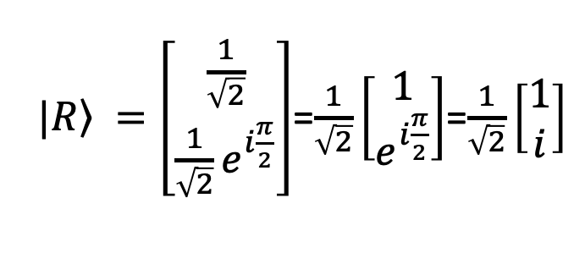
Right(-handed) Circular Polarization
$|\left.R\right\rangle =\left[\begin{matrix}\frac{1}{\sqrt{2}} \\ \frac{1}{\sqrt{2}}e^{i\frac{π}{2}}\end{matrix}\right]$=$\frac{1}{\sqrt{2}}\left[\begin{matrix}1 \\ e^{i\frac{π}{2}}\end{matrix}\right]$=$\frac{1}{\sqrt{2}}\left[\begin{matrix}1 \\ i\end{matrix}\right]$
$${\vec{E}}_{x}=\hat{x}E_{0}Re\left\{e^{−i\left(ωt−kz\right)}\right\}=\hat{x}E_{0}\cos{(ωt−kz)}\underset{→}{t=0}\hat{x}E_{0}\cos{kz}$$
$${\vec{E}}_{y}=\hat{y}E_{0}Re\left\{e^{−i\left(ωt−kz\right)}e^{i\frac{π}{2}}\right\}=\hat{y}E_{0}\cos{(ωt−kz−\frac{π}{2})}=\hat{y}E_{0}\sin{(ωt−kz)}\underset{→}{t=0}−\hat{y}E_{0}\sin{kz}$$
V (y)
H (x)
Right-handed: rotation is the same as the propagation direction.

Slide 6
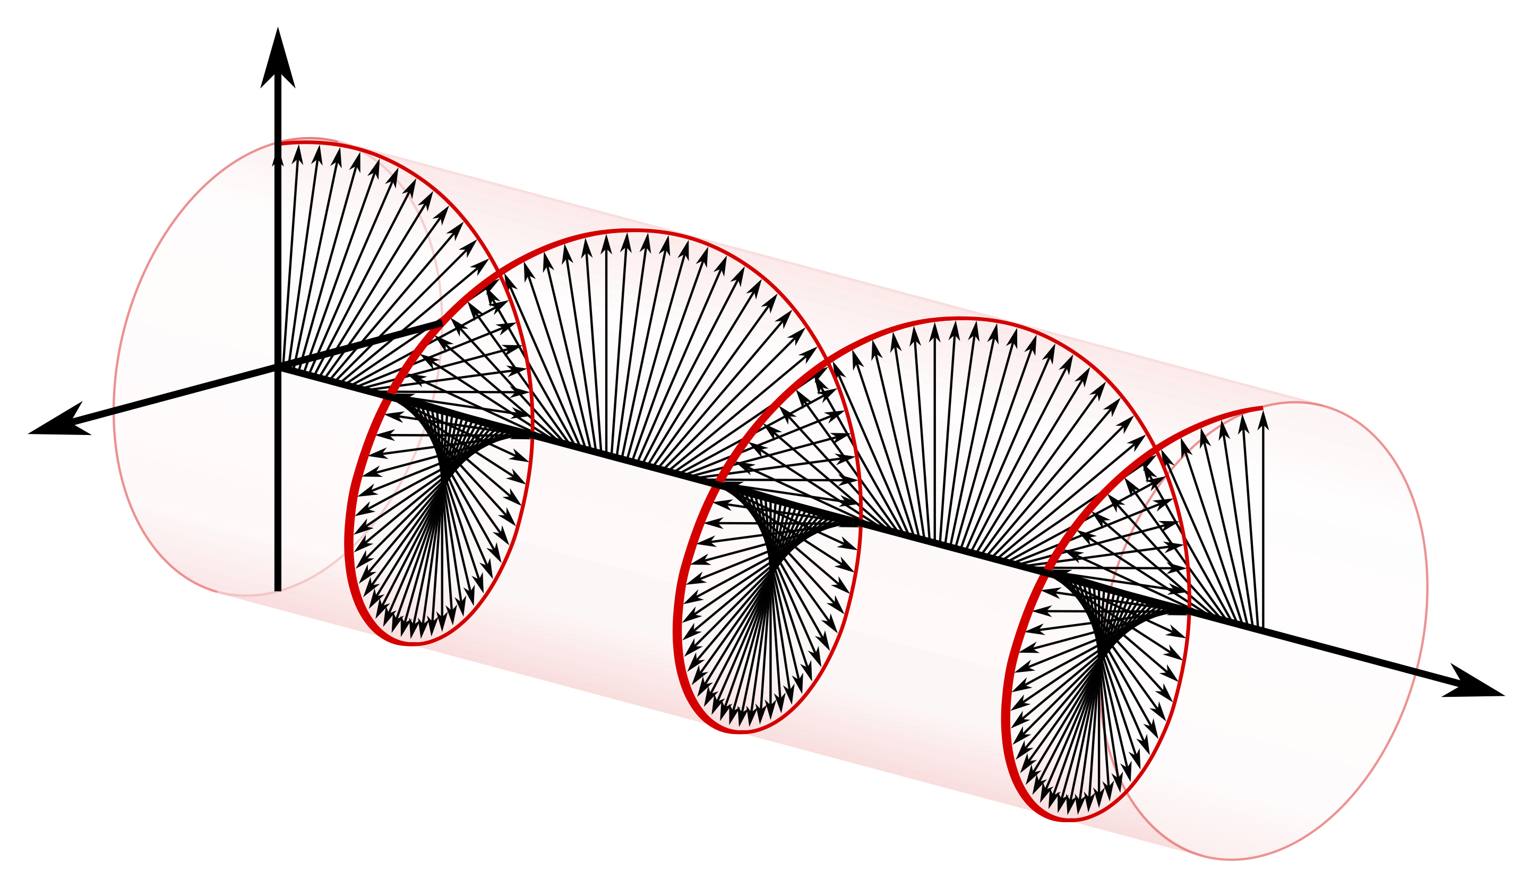
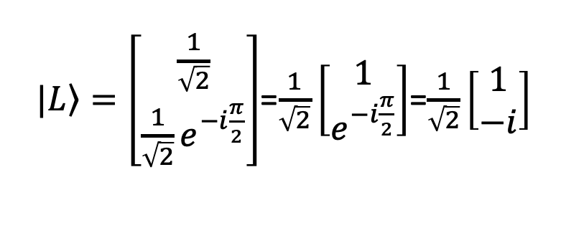
Left(-handed) Circular Polarization
$|\left.L\right\rangle =\left[\begin{matrix}\frac{1}{\sqrt{2}} \\ \frac{1}{\sqrt{2}}e^{−i\frac{π}{2}}\end{matrix}\right]$=$\frac{1}{\sqrt{2}}\left[\begin{matrix}1 \\ e^{−i\frac{π}{2}}\end{matrix}\right]$=$\frac{1}{\sqrt{2}}\left[\begin{matrix}1 \\ −i\end{matrix}\right]$
$${\vec{E}}_{x}=\hat{x}E_{0}Re\left\{e^{−i\left(ωt−kz\right)}\right\}=\hat{x}E_{0}\cos{(ωt−kz)}\underset{→}{t=0}\hat{x}E_{0}\cos{kz}$$
$${\vec{E}}_{y}=\hat{y}E_{0}Re\left\{e^{−i\left(ωt−kz\right)}e^{−i\frac{π}{2}}\right\}=\hat{y}E_{0}\cos{(ωt−kz+\frac{π}{2})}=−\hat{y}E_{0}\sin{(ωt−kz)}\underset{→}{t=0}\hat{y}E_{0}\sin{kz}$$
V (y)
H (x)
Left-handed: rotation is opposite to the propagation direction.

Slide 7



Retarders (Wave Plates)
Now, phase velocity depends on the polarization
$${\vec{E}}_{x}=\hat{x}E_{0x}e^{−i(ωt−k_{x}z)}⇒\hat{x}E_{0x}e^{−iωt}$$
$${\vec{E}}_{y}=\hat{y}E_{0y}e^{−i\left(ωt−k_{y}z\right)+iφ}⇒\hat{y}E_{0y}e^{−i[ωt−{(k}_{y}−k_{x})z]+iφ}$$
$$∆φ={φ+(k}_{y}−k_{x})z=φ+∆φ_{xy}$$
$$∆φ_{xy}={(k}_{y}−k_{x})z$$

Slide 8
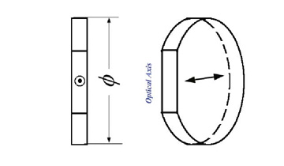
Retarders (Wave Plates)
$$v_{s}=\frac{c}{n_{s}}$$
slow axis
$$k_{0}=\frac{ω}{c}=\frac{2π}{λ_{0}}$$
Fast axis
$$v_{f}=\frac{c}{n_{f}}$$
$$n_{s}>n_{f}$$
$$k_{s}=n_{s}k_{0}>k_{f}=n_{f}k_{0}$$
$${∆φ}_{fs}={(k}_{s}−k_{f})d=\frac{2π}{λ_{0}}d(n_{s}−n_{f})$$
$${∆φ}_{fs}=\frac{1}{\#}×2π+2mπ$$
1/# Wave plate

Slide 9
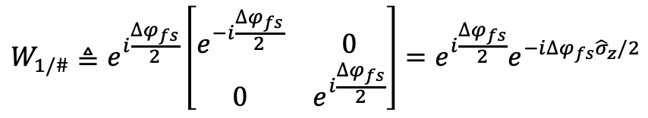
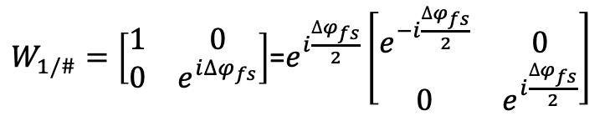
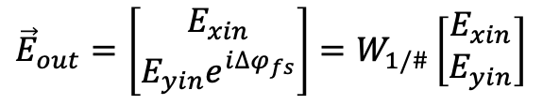
Retarders (Wave Plates)
$$v_{s}=\frac{c}{n_{s}}$$
slow axis (V)
$$k_{0}=\frac{ω}{c}=\frac{2π}{λ_{0}}$$
Fast axis (H)
$$v_{f}=\frac{c}{n_{f}}$$
$${\vec{E}}_{in}=\left[\begin{matrix}E_{xin} \\ E_{yin}\end{matrix}\right]$$
$${\vec{E}}_{out}=\left[\begin{matrix}E_{xin} \\ E_{yin}e^{i{∆φ}_{fs}}\end{matrix}\right]=W_{1/\#}\left[\begin{matrix}E_{xin} \\ E_{yin}\end{matrix}\right]$$
$$n_{s}>n_{f}$$
$$k_{s}=n_{s}k_{0}>k_{f}=n_{f}k_{0}$$
$W_{1/\#}=\left[\begin{matrix}1 & 0 \\ 0 & e^{i∆φ_{fs}}\end{matrix}\right]$=$e^{i\frac{∆φ_{fs}}{2}}\left[\begin{matrix}e^{−i\frac{∆φ_{fs}}{2}} & 0 \\ 0 & e^{i\frac{∆φ_{fs}}{2}}\end{matrix}\right]$
$${∆φ}_{fs}={(k}_{s}−k_{f})d=\frac{2π}{λ_{0}}d(n_{s}−n_{f})$$
$$W_{1/\#}≜e^{i\frac{∆φ_{fs}}{2}}\left[\begin{matrix}e^{−i\frac{∆φ_{fs}}{2}} & 0 \\ 0 & e^{i\frac{∆φ_{fs}}{2}}\end{matrix}\right]=e^{i\frac{∆φ_{fs}}{2}}e^{−i∆φ_{fs}{\hat{σ}}_{z}/2}$$
$${∆φ}_{fs}=\frac{1}{\#}×2π+2mπ$$
1/# Wave plate

Slide 10
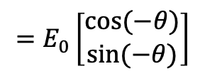

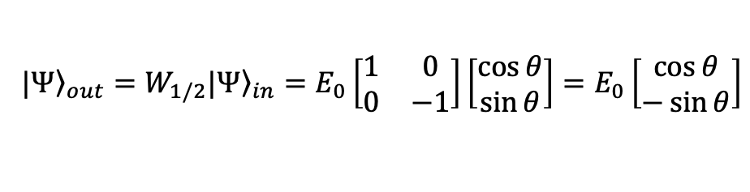
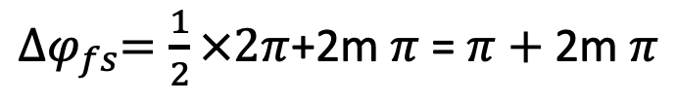
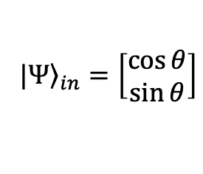



Half-Wave Plate
z
$|\left.0\right\rangle$= $|\left.H\right\rangle$
${∆φ}_{fs}=\frac{1}{2}×2π$+2m $π$= $π+\text{2}\text{m} π$
$$θ$$
$$|\left.−\right\rangle$$
$$|\left.L\right\rangle$$
y
$$|\left.R\right\rangle$$
$$W_{1/2}=i\left[\begin{matrix}−i & 0 \\ 0 & i\end{matrix}\right]=\left[\begin{matrix}1 & 0 \\ 0 & −1\end{matrix}\right]=Z={\hat{σ}}_{z}$$
x
$$|\left.+\right\rangle$$
Input (linear)
$${\left.|Ψ\right\rangle }_{in}=\left[\begin{matrix}\cos{θ} \\ \sin{θ}\end{matrix}\right]$$
V, slow axis
$|\left.1\right\rangle$= $|\left.V\right\rangle$
Output
$${\left.|Ψ\right\rangle }_{out}=W_{1/2}{\left.|Ψ\right\rangle }_{in}=E_{0}\left[\begin{matrix}1 & 0 \\ 0 & −1\end{matrix}\right]\left[\begin{matrix}\cos{θ} \\ \sin{θ}\end{matrix}\right]=E_{0}\left[\begin{matrix}\cos{θ} \\ −\sin{θ}\end{matrix}\right]$$
$$θ$$
$$−θ$$
$$=E_{0}\left[\begin{matrix}\cos{(−θ}) \\ \sin{(−θ)}\end{matrix}\right]$$
H, fast axis
“Reflection” according to the fast axis

Slide 11
Half-Wave Plate

Slide 12

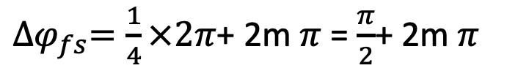
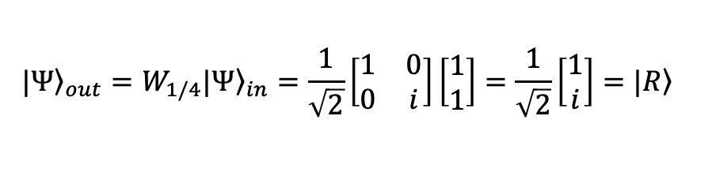
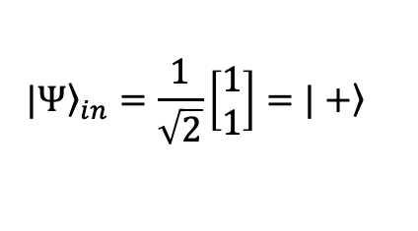
Quarter-Wave Plate
z
$|\left.0\right\rangle$= $|\left.H\right\rangle$
$$θ$$
${∆φ}_{fs}=\frac{1}{4}×2π$+ 2m $π$= $\frac{π}{2}$+ 2m $π$
m-order
$$|\left.−\right\rangle$$
$$|\left.L\right\rangle$$
y
$$|\left.R\right\rangle$$
x
$W_{1/4}=\left[\begin{matrix}1 & 0 \\ 0 & e^{iπ/2}\end{matrix}\right]=\left[\begin{matrix}1 & 0 \\ 0 & i\end{matrix}\right]=e^{iπ/4}\left[\begin{matrix}e^{−iπ/4} & 0 \\ 0 & e^{iπ/4}\end{matrix}\right]$=$e^{iπ/4}e^{−i(π/2){\hat{σ}}_{z}/2}$
$$|\left.+\right\rangle$$
Linearly polarized
$${\left.|Ψ\right\rangle }_{in}=\frac{1}{\sqrt{2}}\left[\begin{matrix}1 \\ 1\end{matrix}\right]=\left.|+\right\rangle$$
Y, slow axis
Input
Output
$|\left.1\right\rangle$= $|\left.V\right\rangle$
$${\left.|Ψ\right\rangle }_{out}=W_{1/4}{\left.|Ψ\right\rangle }_{in}=\frac{1}{\sqrt{2}}\left[\begin{matrix}1 & 0 \\ 0 & i\end{matrix}\right]\left[\begin{matrix}1 \\ 1\end{matrix}\right]=\frac{1}{\sqrt{2}}\left[\begin{matrix}1 \\ i\end{matrix}\right]=\left.|R\right\rangle$$
$${45}^{o}$$
X, fast axis
Right circularly polarized
Linear polarization ➔ Circular polarization

Slide 13
Quarter-Wave Plate

Slide 14
Rotation Operator in real-position space
V (y)
$$R\left(β\right)=\left[\begin{matrix}\cos{β} & −sin{β} \\ \sin{β} & \cos{β}\end{matrix}\right]$$
$$β$$
H (x)
$$R^{−1}\left(β\right)=R\left(−β\right)=\left[\begin{matrix}\cos{β} & \sin{β} \\ −sin{β} & \cos{β}\end{matrix}\right]$$

Slide 15
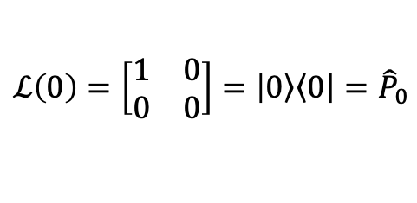
Linear Polarizer: Projection operator
$$ℒ(θ)=\left[\begin{matrix}\cos^{2}θ & \sin{θ\cos{θ}} \\ \sin{θ\cos{θ}} & \sin^{2}θ\end{matrix}\right]$$
$$ℒ\left(0\right)=\left[\begin{matrix}1 & 0 \\ 0 & 0\end{matrix}\right]=\left|\left.0\right\rangle \left\langle 0\right.\right|={\hat{P}}_{0}$$
$$ℒ(θ)=R\left(θ\right)ℒ(0)R\left(−θ\right)$$
y
$$=\left[\begin{matrix}\cos{θ} & −sin{θ} \\ \sin{θ} & \cos{θ}\end{matrix}\right]\left[\begin{matrix}1 & 0 \\ 0 & 0\end{matrix}\right]\left[\begin{matrix}\cos{θ} & \sin{θ} \\ −\sin{θ} & \cos{θ}\end{matrix}\right]$$
Polarizer
$$=\left[\begin{matrix}\cos{θ} & 0 \\ \sin{θ} & 0\end{matrix}\right]\left[\begin{matrix}\cos{θ} & \sin{θ} \\ −\sin{θ} & \cos{θ}\end{matrix}\right]$$
$$θ$$
x
$$=\left[\begin{matrix}\cos{θ}\cos{θ} & \cos{θ\sin{θ}} \\ \cos{θ\sin{θ}} & \sin{θ}\sin{θ}\end{matrix}\right]$$

Slide 16

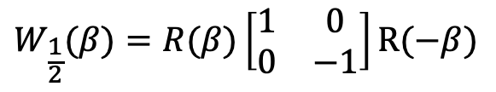


Half-Wave Plate
${∆φ}_{fs}=\frac{1}{2}×2π$+2m $π$= $π+\text{2}\text{m} π$
$$W_{1/2}=\left[\begin{matrix}1 & 0 \\ 0 & −1\end{matrix}\right]$$
$$W_{\frac{1}{2}}(β)=R(β)\left[\begin{matrix}1 & 0 \\ 0 & −1\end{matrix}\right]R(−β)$$
Y
slow axis
Example: $β$=$π/2$
fast axis
$$R\left(π/2\right)=\left[\begin{matrix}0 & −1 \\ 1 & 0\end{matrix}\right]$$
$$β$$
X
$$W_{\frac{1}{2}}(π/2)=\left[\begin{matrix}0 & −1 \\ 1 & 0\end{matrix}\right]\left[\begin{matrix}1 & 0 \\ 0 & −1\end{matrix}\right]\left[\begin{matrix}0 & 1 \\ −1 & 0\end{matrix}\right]$$
=$\left[\begin{matrix}−1 & 0 \\ 0 & 1\end{matrix}\right]$

Slide 17

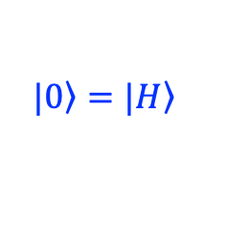

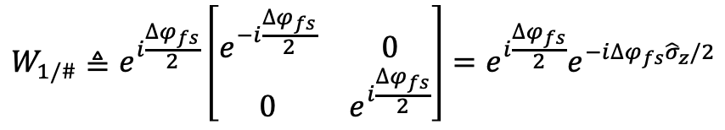




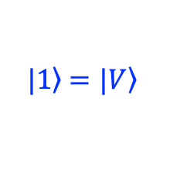

Retarders : Spin ½ Rotation
With their fast axis aligned along $|\left.0\right\rangle =|\left.H\right\rangle$ polarization
z
$$|\left.0\right\rangle =|\left.H\right\rangle$$
$$W_{1/\#}≜e^{i\frac{∆φ_{fs}}{2}}\left[\begin{matrix}e^{−i\frac{∆φ_{fs}}{2}} & 0 \\ 0 & e^{i\frac{∆φ_{fs}}{2}}\end{matrix}\right]=e^{i\frac{∆φ_{fs}}{2}}e^{−i∆φ_{fs}{\hat{σ}}_{z}/2}$$
$$\hat{n}$$
$$∆φ_{fs}$$
$$|\left.−\right\rangle$$
$$|\left.L\right\rangle$$
y
$$|\left.R\right\rangle$$
x
Half-wave plate: Rotate by 180 degree along its fast axis
$$|\left.+\right\rangle$$
Quarter-wave plate: Rotate by 90 degree along its fast axis
$|\left.1\right\rangle$ $=|\left.V\right\rangle$

Slide 18

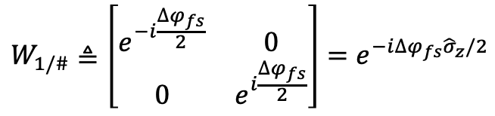



Retarders : Spin ½ Rotation
With their fast axis aligned with $θ$ respect to $|\left.0\right\rangle =|\left.H\right\rangle$ polarization
z
$$|\left.0\right\rangle =|\left.H\right\rangle$$
$$W_{1/\#}≜\left[\begin{matrix}e^{−i\frac{∆φ_{fs}}{2}} & 0 \\ 0 & e^{i\frac{∆φ_{fs}}{2}}\end{matrix}\right]=e^{−i∆φ_{fs}{\hat{σ}}_{z}/2}$$
$$\hat{n}$$
fast axis
$$2θ$$
$$|\left.−\right\rangle$$
$W_{1/\#}(θ)=R(θ)e^{−i∆φ_{fs}{\hat{σ}}_{z}/2}$ $R\left(−θ\right)=e^{−i\frac{1}{2}∆φ_{fs}{(\hat{σ}}_{z}\cos{2θ}+{\hat{σ}}_{x}\sin{2θ})}$
$$∆φ_{fs}$$
$$|\left.L\right\rangle$$
y
$$|\left.R\right\rangle$$
x
Half-wave plate: Rotate by 180 degree along its fast axis
$$|\left.+\right\rangle$$
Quarter-wave plate: Rotate by 90 degree along its fast axis
$|\left.1\right\rangle$ $=|\left.V\right\rangle$

Slide 19
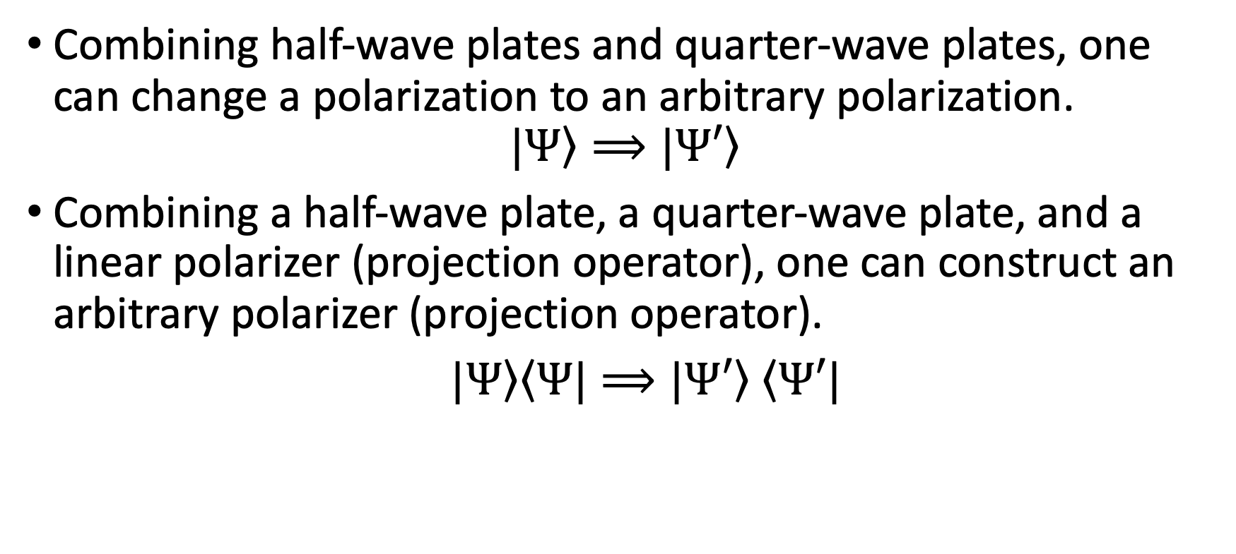
Manipulating Polarization
Combining half-wave plates and quarter-wave plates, one can change a polarization to an arbitrary polarization.
$$|\left.Ψ\right\rangle ⟹|\left.Ψ′\right\rangle$$
Combining a half-wave plate, a quarter-wave plate, and a linear polarizer (projection operator), one can construct an arbitrary polarizer (projection operator).
$|\left.Ψ\right\rangle \left\langle Ψ\right.|⟹|\left.Ψ′\right\rangle$ $\left\langle Ψ′\right.|$

Slide 20

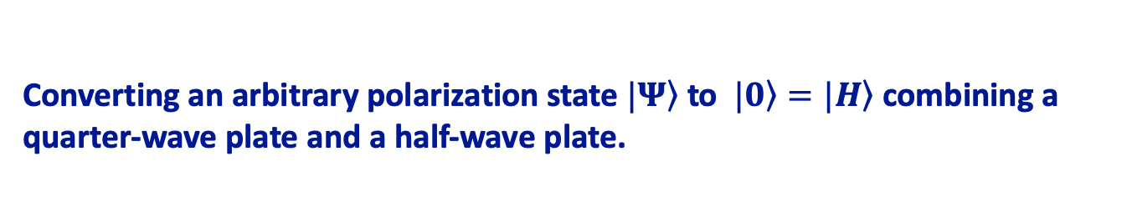
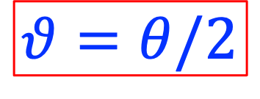



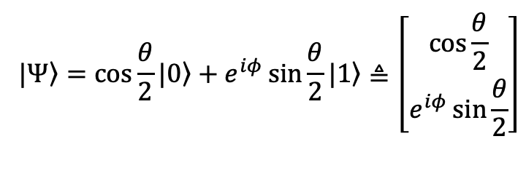

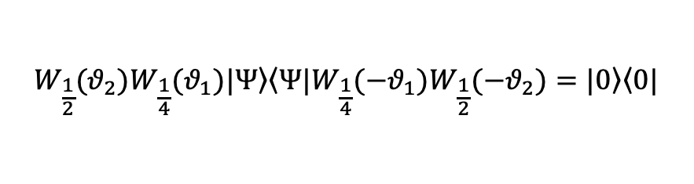

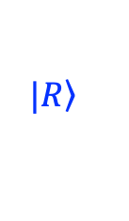
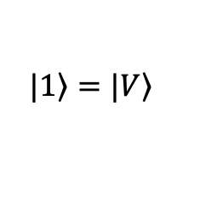





Manipulating Polarization States
$$|\left.1\right\rangle =|\left.V\right\rangle$$
Converting an arbitrary polarization state $|\left.Ψ\right\rangle$ to $|\left.0\right\rangle =|\left.H\right\rangle$ combining a quarter-wave plate and a half-wave plate.
$$θ$$
$$|\left.Ψ\right\rangle =\cos{\frac{θ}{2}}|\left.0\right\rangle +e^{iφ}\sin{\frac{θ}{2}}|\left.1\right\rangle ≜\left[\begin{matrix}\cos{\frac{θ}{2}} \\ e^{iφ}\sin{\frac{θ}{2}}\end{matrix}\right]$$
$$|\left.0\right\rangle =|\left.H\right\rangle$$
$$θ=θ/2$$
Operation of a wave plates: a right-hand rotation of ${∆φ}_{fs}$ along its fast axis
z
$$|\left.0\right\rangle =|\left.H\right\rangle$$
Half-wave plate: Rotate by 180 degree along its fast axis
½ WP
Quarter-wave plate: Rotate by 90 degree along its fast axis
¼ WP
$$W_{1/\#}=e^{−i∆φ_{fs}{\hat{σ}}_{z}/2}$$
$$|\left.−\right\rangle$$
$W_{1/\#}(θ)=R(θ)e^{−i∆φ_{fs}{\hat{σ}}_{z}/2}$ $R\left(−θ\right)=e^{−i\frac{1}{2}∆φ_{fs}{(\hat{σ}}_{z}\cos{2θ}+{\hat{σ}}_{x}\sin{2θ})}$
$$|\left.L\right\rangle$$
y
$$|\left.R\right\rangle$$
x
$$W_{1/2}(θ)=e^{−i\frac{π}{2}{(\hat{σ}}_{z}\cos{2θ}+{\hat{σ}}_{x}\sin{2θ})}$$
$$|\left.+\right\rangle$$
$$W_{1/4}(θ)=e^{−i\frac{π}{4}{(\hat{σ}}_{z}\cos{2θ}+{\hat{σ}}_{x}\sin{2θ})}$$
$$W_{\frac{1}{2}}(θ_{2})W_{\frac{1}{4}}(θ_{1})|\left.Ψ\right\rangle =|\left.0\right\rangle$$
$|\left.1\right\rangle$ $=|\left.V\right\rangle$
$$W_{\frac{1}{2}}(θ_{2})W_{\frac{1}{4}}(θ_{1})|\left.Ψ\right\rangle \left\langle Ψ|\right.W_{\frac{1}{4}}({−θ}_{1})W_{\frac{1}{2}}(−θ_{2})=|\left.0\right\rangle \left\langle 0\right.|$$

Slide 21




Transform between any two arbitrary polarization qubit states: I
$$W_{\frac{1}{2}}(θ_{2})W_{\frac{1}{4}}(θ_{1})|\left.Ψ\right\rangle =|\left.0\right\rangle$$
$$W_{\frac{1}{2}}({θ′}_{2})W_{\frac{1}{4}}({θ′}_{1})|\left.Ψ′\right\rangle =|\left.0\right\rangle$$
$$|\left.Ψ^{′}\right\rangle =W_{\frac{1}{4}}(−{θ′}_{1})W_{\frac{1}{2}}(−{θ′}_{2})|\left.0\right\rangle$$
$$|\left.Ψ^{′}\right\rangle =W_{\frac{1}{4}}(−{θ′}_{1})W_{\frac{1}{2}}(−{θ′}_{2})W_{\frac{1}{2}}(θ_{2})W_{\frac{1}{4}}(θ_{1})|\left.Ψ\right\rangle$$

Slide 22





Transform between any two arbitrary polarization qubit states: II
$$W_{\frac{1}{4}}\left(θ_{1}\right)\left|\left.Ψ\right\rangle =\cos{{(θ}_{1}/2)}\right|\left.0\right\rangle +\cos{{(θ}_{1}/2)} |\left.1\right\rangle$$
$$W_{\frac{1}{4}}\left({θ′}_{1}\right)\left|\left.Ψ′\right\rangle =\cos{{(θ′}_{1}/2)}\right|\left.0\right\rangle +\cos{{(θ′}_{1}/2)} |\left.1\right\rangle$$
Choose $θ_{2}=(θ_{1}+{θ′}_{1})/2$
$$W_{\frac{1}{2}}(θ_{2})W_{\frac{1}{4}}\left(θ_{1}\right)\left|\left.Ψ\right\rangle =\cos{{(θ′}_{1}/2)}\right|\left.0\right\rangle +\cos{{(θ′}_{1}/2)} |\left.1\right\rangle$$
$$|\left.Ψ^{′}\right\rangle =W_{\frac{1}{4}}(−{θ′}_{1}) W_{\frac{1}{2}}(θ_{2})W_{\frac{1}{4}}(θ_{1})|\left.Ψ\right\rangle$$

Slide 23



Summary: Single Photonic Qubit Gates
$$W_{\frac{1}{2}}(θ=0)=i\left[\begin{matrix}−i & 0 \\ 0 & i\end{matrix}\right]=\left[\begin{matrix}1 & 0 \\ 0 & −1\end{matrix}\right]=Z={\hat{σ}}_{z}$$
$$W_{\frac{1}{2}}\left(θ=\frac{π}{4}\right)=R\left(\frac{π}{4}\right)ℒ\left(0\right)R\left(−\frac{π}{4}\right)=\frac{1}{2}\left[\begin{matrix}1 & −1 \\ 1 & 1\end{matrix}\right]\left[\begin{matrix}1 & 0 \\ 0 & −1\end{matrix}\right]\left[\begin{matrix}1 & 1 \\ −1 & 1\end{matrix}\right]=\left[\begin{matrix}0 & 1 \\ 1 & 0\end{matrix}\right]=X={\hat{σ}}_{x}$$
$$Y={\hat{σ}}_{y}=−iZX$$
$$W_{\frac{1}{4}}\left(θ=0\right)=\left[\begin{matrix}1 & 0 \\ 0 & e^{\frac{iπ}{2}}\end{matrix}\right]=\sqrt{Z}=S$$
Phase gate

