Slide 1

Applied Quantum Computing II ECE 50651 Spring 2025 Recitation Module 2a: Superconducting Qubit Platform
Instructor: Dr. Shengwang Du
Recitation: Monday 2:30pm-3:20pm
Knoy Hall of Technology B033

Slide 2
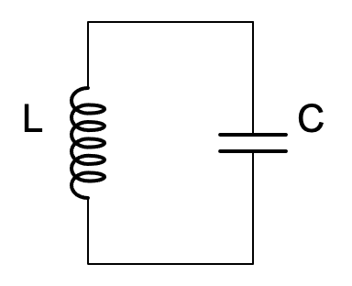
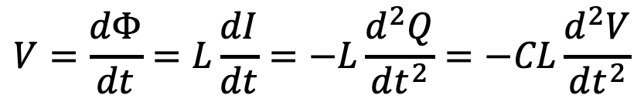


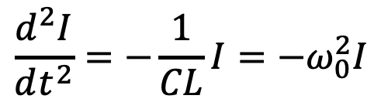
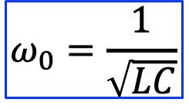



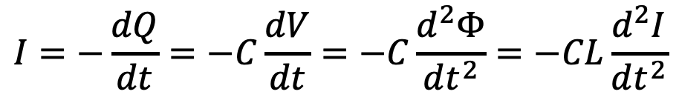
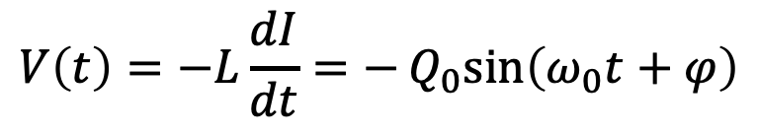
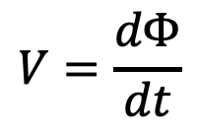


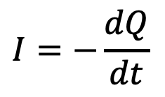
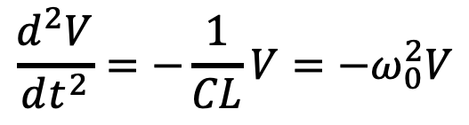
LC Oscillation Circuit
$$I$$
Magnetic flux
$$V=\frac{dΦ}{dt}$$
$$Φ$$
$$Φ=LI$$
Charge
$$Q=CV$$
$$I=−\frac{dQ}{dt}$$
+
+
$$V$$
$$Q$$
-
-
$$I=−\frac{dQ}{dt}=−C\frac{dV}{dt}=−C\frac{d^{2}Φ}{dt^{2}}=−CL\frac{d^{2}I}{dt^{2}}$$
$$\frac{d^{2}I}{dt^{2}}=−\frac{1}{CL}I=−ω_{0}^{2}I$$
$$ω_{0}=\frac{1}{\sqrt{LC}}$$
$$V=\frac{dΦ}{dt}=L\frac{dI}{dt}=−L\frac{d^{2}Q}{dt^{2}}=−CL\frac{d^{2}V}{dt^{2}}$$
$$I(t)=I_{0}\cos\left(ω_{0}t+φ\right)$$
$$\frac{d^{2}V}{dt^{2}}=−\frac{1}{CL}V=−ω_{0}^{2}V$$
$$V\left(t\right)=−L\frac{dI}{dt}=−Q_{0}sin\left(ω_{0}t+φ\right)$$

Slide 3


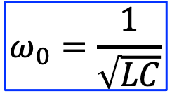
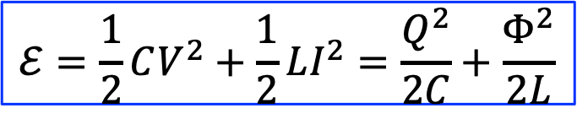
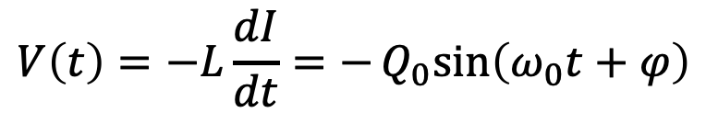

LC Oscillation Circuit
$$ω_{0}=\frac{1}{\sqrt{LC}}$$
$$I$$
Magnetic flux
$$V=\frac{dΦ}{dt}$$
$$Φ$$
$$Φ=LI$$
Charge
$$Q=CV$$
$$I=−\frac{dQ}{dt}$$
+
+
$$V$$
$$Q$$
-
-
$$I(t)=I_{0}\cos\left(ω_{0}t+φ\right)$$
$$V\left(t\right)=−L\frac{dI}{dt}=−Q_{0}sin\left(ω_{0}t+φ\right)$$
$$Φ(t)=LI(t)=Φ_{0}\cos\left(ω_{0}t+φ\right)$$
$$Q\left(t\right)=CV\left(t\right)=−Q_{0}sin\left(ω_{0}t+φ\right)$$
Energy
$$ℰ=\frac{1}{2}CV^{2}+\frac{1}{2}LI^{2}=\frac{Q^{2}}{2C}+\frac{Φ^{2}}{2L}$$

Slide 4
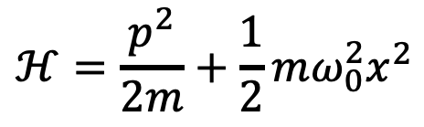


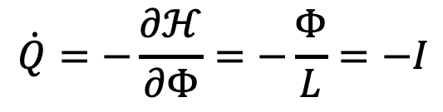
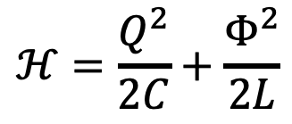
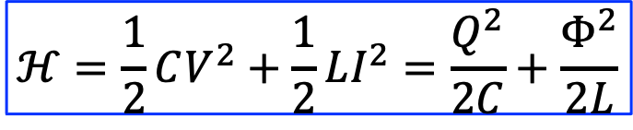


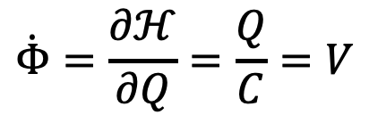



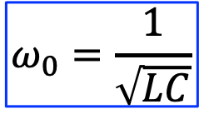

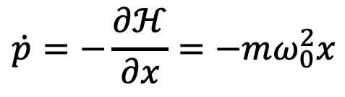

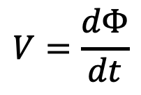

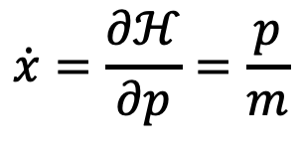



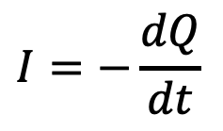


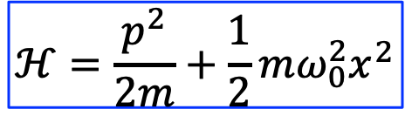

LC Oscillation Circuit vs Harmonic Oscillator
$$I$$
Magnetic flux
$$V=\frac{dΦ}{dt}$$
$$ω_{0}=\frac{1}{\sqrt{LC}}$$
$$Φ=LI$$
$$Φ$$
Charge
$$Q=CV$$
$$I=−\frac{dQ}{dt}$$
+
+
Energy
$$ℋ=\frac{1}{2}CV^{2}+\frac{1}{2}LI^{2}=\frac{Q^{2}}{2C}+\frac{Φ^{2}}{2L}$$
$$Q$$
$$V$$
-
-
$$ℋ=\frac{p^{2}}{2m}+\frac{1}{2}{mω_{0}^{2}x}^{2}$$
Harmonic oscillator
$$p$$
$$Q$$
$$ℋ=\frac{p^{2}}{2m}+\frac{1}{2}{mω_{0}^{2}x}^{2}$$
$$ℋ=\frac{Q^{2}}{2C}+\frac{Φ^{2}}{2L}$$
$$m$$
$$C$$
$$x$$
$$Φ$$
$$\dot{x}=\frac{∂ℋ}{∂p}=\frac{p}{m}$$
$$\dot{Φ}=\frac{∂ℋ}{∂Q}=\frac{Q}{C}=V$$
$$mω_{0}^{2}$$
$$1/L$$
$$ω_{0}^{2}$$
$$1/(LC)$$
$$\dot{Q}=−\frac{∂ℋ}{∂Φ}=−\frac{Φ}{L}=−I$$
$$\dot{p}=−\frac{∂ℋ}{∂x}=−mω_{0}^{2}x$$
$$p=m\dot{x}$$
$$Q=C\dot{Φ}=CV$$

Slide 5


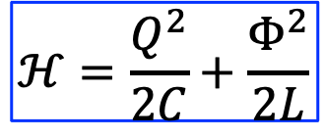

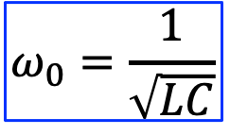
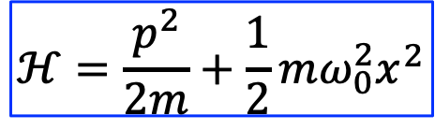




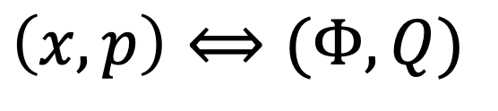



LC Oscillation Circuit vs Harmonic Oscillator
$$I$$
Energy
$$ℋ=\frac{Q^{2}}{2C}+\frac{Φ^{2}}{2L}$$
$$Φ$$
$$ℋ=\frac{p^{2}}{2m}+\frac{1}{2}{mω_{0}^{2}x}^{2}$$
Harmonic oscillator
+
+
$$V$$
$$Q$$
-
-
Canonically conjugate variables
$$p$$
$$Q$$
$$ω_{0}=\frac{1}{\sqrt{LC}}$$
$$m$$
$$C$$
$$x$$
$$Φ$$
$$mω_{0}^{2}$$
$$1/L$$
$$\left(x,p\right)⟺(Φ,Q)$$
$$ω_{0}^{2}$$
$$1/(LC)$$
$$p=m\dot{x}$$
$$Q=C\dot{Φ}=CV$$

Slide 6
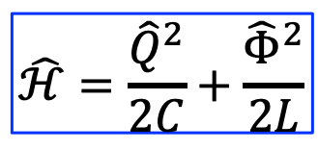
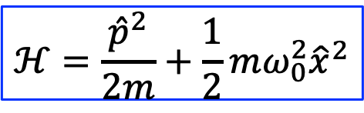
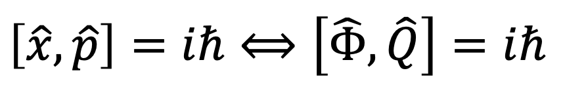
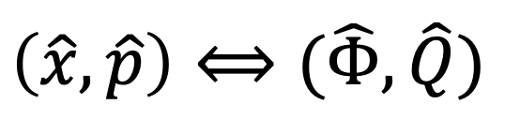
Quantum LC Oscillation Circuit vs Quantum Harmonic Oscillator
$$I$$
$$\hat{ℋ}=\frac{{\hat{Q}}^{2}}{2C}+\frac{{\hat{Φ}}^{2}}{2L}$$
$$Φ$$
Harmonic oscillator
$$ℋ=\frac{{\hat{p}}^{2}}{2m}+\frac{1}{2}{mω_{0}^{2}\hat{x}}^{2}$$
+
+
$$V$$
$$Q$$
-
-
Canonically conjugate variables
$$p$$
$$Q$$
$$ω_{0}=\frac{1}{\sqrt{LC}}$$
$$m$$
$$C$$
$$x$$
$$Φ$$
$$\left(\hat{x},\hat{p}\right)⟺(\hat{Φ},\hat{Q})$$
$$mω_{0}^{2}$$
$$1/L$$
$$ω_{0}^{2}$$
$$1/(LC)$$
$$\left[\hat{x},\hat{p}\right]=iℏ⟺\left[\hat{Φ},\hat{Q}\right]=iℏ$$
$$p=m\dot{x}$$
$$Q=C\dot{Φ}=CV$$

Slide 7
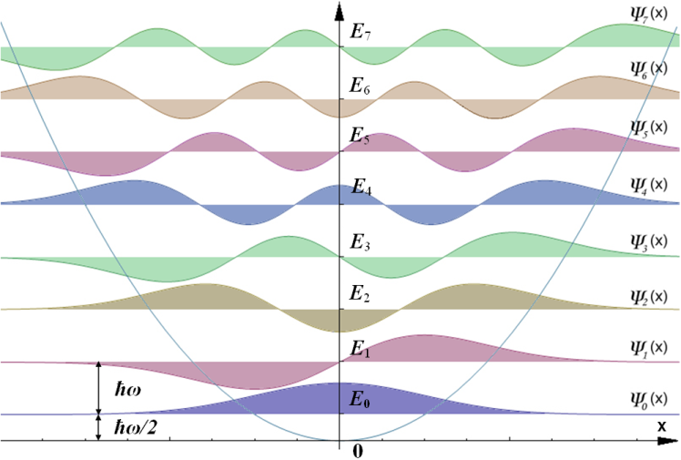



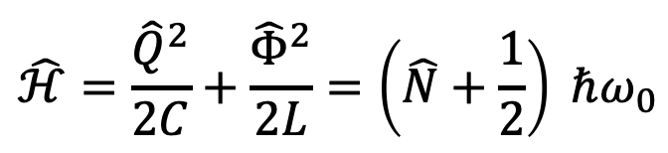


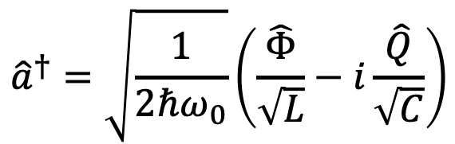
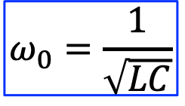


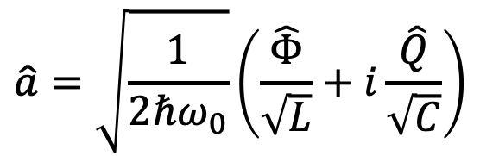


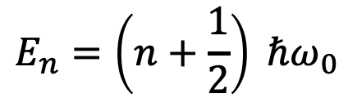





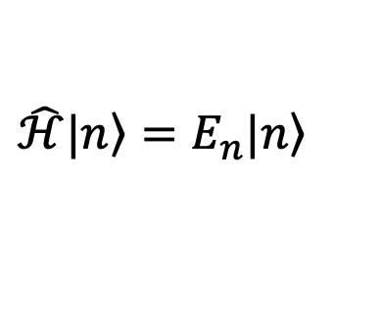

Quantum LC Oscillation Circuit
$$I$$
$$\hat{ℋ}=\frac{{\hat{Q}}^{2}}{2C}+\frac{{\hat{Φ}}^{2}}{2L}=\left(\hat{N}+\frac{1}{2}\right) ℏω_{0}$$
$$Φ$$
$$\hat{N}={\hat{a}}^{†}\hat{a}$$
$$p$$
$$Q$$
+
+
$$\hat{a}=\sqrt{\frac{1}{2ℏω_{0}}}\left(\frac{\hat{Φ}}{\sqrt{L}}+i\frac{\hat{Q}}{\sqrt{C}}\right)$$
$$V$$
$$Q$$
$$m$$
$$C$$
-
-
$$x$$
$$Φ$$
$$mω_{0}^{2}$$
$$1/L$$
$${\hat{a}}^{†}=\sqrt{\frac{1}{2ℏω_{0}}}\left(\frac{\hat{Φ}}{\sqrt{L}}−i\frac{\hat{Q}}{\sqrt{C}}\right)$$
$$ω_{0}^{2}$$
$$1/(LC)$$
$$p=m\dot{x}$$
$$Q=C\dot{Φ}=CV$$
$$ω_{0}=\frac{1}{\sqrt{LC}}$$
$$\left[\hat{a},{\hat{a}}^{†}\right]=1$$
$$\hat{ℋ}\left.|n\right\rangle =E_{n}\left.|n\right\rangle$$
$$\left[\hat{Φ},\hat{Q}\right]=iℏ$$
$$E_{n}=\left(n+\frac{1}{2}\right) ℏω_{0}$$
$$Φ$$

Slide 8
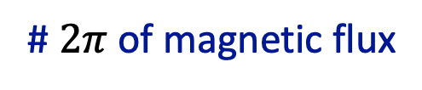

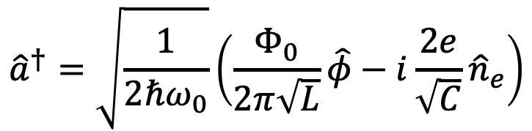

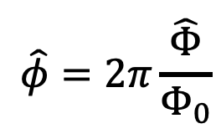
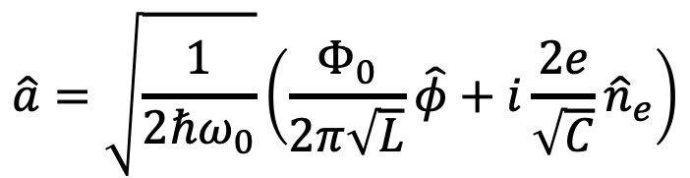
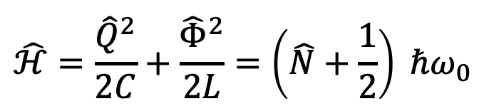
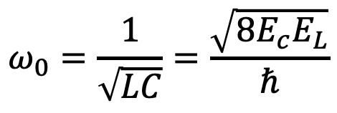
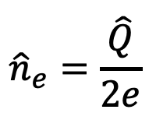
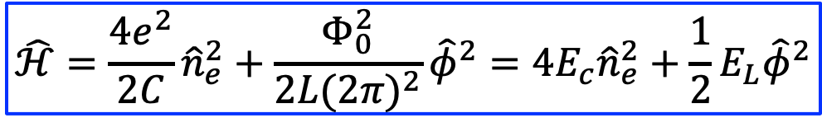

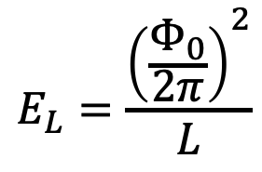
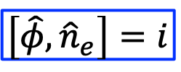
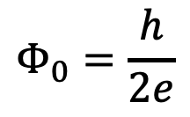
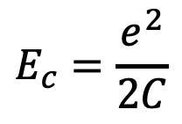

Superconducting LC Circuit
$$I$$
$$n_{e}$$
$$φ$$
$$\hat{ℋ}=\frac{{\hat{Q}}^{2}}{2C}+\frac{{\hat{Φ}}^{2}}{2L}=\left(\hat{N}+\frac{1}{2}\right) ℏω_{0}$$
$$\left[\hat{φ},{\hat{n}}_{e}\right]=i$$
$${\hat{n}}_{e}=\frac{\hat{Q}}{2e}$$
Cooper pair charge
$$2e$$
# of Copper pair
$$Φ_{0}=\frac{h}{2e}$$
$$\hat{φ}=2π\frac{\hat{Φ}}{Φ_{0}}$$
Magnetic flux quanta
# $2π$ of magnetic flux
$$\hat{ℋ}=\frac{4e^{2}}{2C}{\hat{n}}_{e}^{2}+\frac{Φ_{0}^{2}}{2L{(2π)}^{2}}{\hat{φ}}^{2}=4E_{c}{\hat{n}}_{e}^{2}+\frac{1}{2}E_{L}{\hat{φ}}^{2}$$
$$\hat{a}=\sqrt{\frac{1}{2ℏω_{0}}}\left(\frac{Φ_{0}}{2π\sqrt{L}}\hat{φ}+i\frac{2e}{\sqrt{C}}{\hat{n}}_{e}\right)$$
$$E_{L}=\frac{{\left(\frac{Φ_{0}}{2π}\right)}^{2}}{L}$$
$$E_{c}=\frac{e^{2}}{2C}$$
$${\hat{a}}^{†}=\sqrt{\frac{1}{2ℏω_{0}}}\left(\frac{Φ_{0}}{2π\sqrt{L}}\hat{φ}−i\frac{2e}{\sqrt{C}}{\hat{n}}_{e}\right)$$
$$ω_{0}=\frac{1}{\sqrt{LC}}=\frac{\sqrt{8E_{c}E_{L}}}{ℏ}$$

Slide 9












Zero Point Energy and Flucturations
$$I$$
$$n_{e}$$
$$φ$$
$$\hat{ℋ}=4E_{c}{\hat{n}}_{e}^{2}+\frac{1}{2}E_{L}{\hat{φ}}^{2}=\left(\hat{N}+\frac{1}{2}\right) ℏω_{0}$$
$$\hat{N}={\hat{a}}^{†}\hat{a}$$
$$E_{c}=\frac{e^{2}}{2C}$$
$$E_{L}=\frac{{\left(\frac{Φ_{0}}{2π}\right)}^{2}}{L}$$
$$ω_{0}=\frac{1}{\sqrt{LC}}=\frac{\sqrt{8E_{c}E_{L}}}{ℏ}$$
Zero point energy
$$E_{0}=\frac{1}{2}ℏω_{0}=\sqrt{2E_{c}E_{L}}$$
The zero point energy is equally distributed to kinetic and potential energy
$$\hat{a}=\frac{1}{2}\left(\frac{\hat{φ}}{φ_{zpf}}+i\frac{{\hat{n}}_{e}}{n_{zpf}}\right)$$
$$\frac{1}{2}E_{0}=4E_{c}n_{zpf}^{2}$$
$$n_{zpf}={\left(\frac{E_{L}}{32E_{c}}\right)}^{1/4}$$
$$\frac{1}{2}E_{0}=\frac{1}{2}E_{L}φ_{zpf}^{2}$$
$$φ_{zpf}={\left(\frac{2E_{C}}{E_{L}}\right)}^{1/4}$$
$${\hat{a}}^{†}=\frac{1}{2}\left(\frac{\hat{φ}}{φ_{zpf}}−i\frac{{\hat{n}}_{e}}{n_{zpf}}\right)$$

Slide 14








Josephson Junction: Density & Current
Cooper pair
$$ψ\left(r\right)=\sqrt{ρ(r)}e^{iφ(r)}$$
Schrödinger equation
$$iℏ\frac{∂ψ}{∂t}=\hat{ℋ}ψ=\frac{{\left(−iℏ∇\right)}^{2}}{2m}ψ+Vψ$$
$$\hat{\vec{p}}=−iℏ∇$$
$$\frac{∂\left(ψ^{∗}ψ\right)}{∂t}=−∇∙\frac{1}{2}\left\{ψ^{∗}\frac{\hat{\vec{p}}}{m}ψ+{\left[ψ^{∗}\frac{\hat{\vec{p}}}{m}ψ\right]}^{∗}\right\}=−∇∙\frac{1}{2m}\left\{ψ^{∗}\left(−iℏ∇\right)ψ+ψ\left(iℏ∇\right)ψ^{∗}\right\}$$
$$\vec{J}$$
$$\vec{J}$$
$$\frac{∂ρ}{∂t}=−∇∙\vec{J}$$
$$\vec{J}=\frac{1}{2m}\left\{ψ^{∗}\left(−iℏ∇\right)ψ+ψ\left(iℏ∇\right)ψ^{∗}\right\}$$

Slide 15






Superconducting Cooper Pair: Density & Current
Cooper pair
$$ψ\left(r\right)=\sqrt{ρ(r)}e^{iφ(r)}$$
$$\frac{∂ρ}{∂t}=−∇∙\vec{J}$$
$$\vec{J}=\frac{1}{2m}\left\{ψ^{∗}\left(−iℏ∇\right)ψ+ψ\left(iℏ∇\right)ψ^{∗}\right\}=\frac{1}{2m}\left\{\sqrt{ρ}e^{−iφ}\left(−iℏ∇\right)\sqrt{ρ}e^{iφ}+c.c.\right\}=\frac{1}{2m}\left\{\sqrt{ρ}e^{−iφ}\left[e^{iφ}\left(−iℏ∇\right)\sqrt{ρ}+\sqrt{ρ}\left(−iℏ∇\right)e^{iφ}\right]+c.c.\right\}=\frac{1}{2m}\left\{\sqrt{ρ}e^{−iφ}\left[e^{iφ}\left(−iℏ∇\right)\sqrt{ρ}+\sqrt{ρ}e^{iφ}i\left(−iℏ∇φ\right)\right]+c.c.\right\}=\frac{1}{2m}\left\{\sqrt{ρ}\left[\left(−iℏ∇\right)\sqrt{ρ}+\sqrt{ρ}i\left(−iℏ∇φ\right)\right]+c.c.\right\}=\frac{1}{2m}\left\{\left[\sqrt{ρ}\left(−iℏ∇\right)\sqrt{ρ}+ρℏ∇φ\right]+c.c.\right\}=\frac{1}{2m}2ρℏ∇φ=ρ\frac{ℏ∇φ}{m}$$
Imaginary
$$\overset{⃑}{J}=ρ\frac{ℏ∇φ}{m}=ρ\vec{v}$$
$\vec{v}=$ $\frac{ℏ∇φ}{m}$
$$m\vec{v}=ℏ∇φ$$

Slide 16












$Josephson Junction$(JJ)
$$ψ_{1}=\sqrt{ρ_{1}}e^{iφ_{1}}$$
$$ψ_{2}=\sqrt{ρ_{2}}e^{iφ_{2}}$$
$$iℏ\frac{d}{dt}\left[\begin{matrix}ψ_{1} \\ ψ_{2}\end{matrix}\right]=\left[\begin{matrix}U_{1} & κ \\ κ & U_{2}\end{matrix}\right]\left[\begin{matrix}ψ_{1} \\ ψ_{2}\end{matrix}\right]$$
Potential energy
$$qV=U_{1}−U_{2}$$
$$q=e$$
+
-
V
Tunneling energy
$$κ$$
$${\dot{ρ}}_{2}=−{\dot{ρ}}_{1}=\frac{2}{ℏ}κ\sqrt{ρ_{1}ρ_{2}}\sin{φ}$$
$$iℏ\frac{d}{dt}\left[\begin{matrix}ψ_{1} \\ ψ_{2}\end{matrix}\right]=\left[\begin{matrix}qV/2 & κ \\ κ & −qV/2\end{matrix}\right]\left[\begin{matrix}ψ_{1} \\ ψ_{2}\end{matrix}\right]$$
$$φ=φ_{2}−φ_{1}$$
$$\dot{φ}=qV/ℏ$$
$$I=\frac{dQ_{2}}{dt}=I_{0}\sin{φ}$$
Critical current

Slide 17







$Josephson Junction$(JJ)
$$φ=φ_{2}−φ_{1}$$
$$ψ_{1}=\sqrt{ρ_{1}}e^{iφ_{1}}$$
$$ψ_{2}=\sqrt{ρ_{2}}e^{iφ_{2}}$$
$$φ\left(t\right)=φ_{0}+\frac{qV}{ℏ}t$$
$$\dot{φ}=qV/ℏ$$
$$I\left(t\right)=I_{0}\sin{φ}=I_{0}\sin\left(φ_{0}+\frac{qV}{ℏ}t\right)$$
$$q=e$$
+
-
V
Energy stored in the JJ
$$\int_{0}^{φ}{dW}=\int_{0}^{φ}{VdQ}=\int_{0}^{φ}{\frac{ℏ\dot{φ}}{q}dQ}=\int_{0}^{φ}{\frac{ℏ}{q}\frac{dφ}{dt}dQ}=\int_{0}^{φ}{\frac{ℏ}{q}\frac{dQ}{dt}dφ}=\int_{0}^{φ}{\frac{ℏ}{q}I_{0}\sin{φ}dφ}=−\frac{ℏ}{q}I_{0}\cos{φ}$$
$$E_{J}=\frac{ℏ}{q}I_{0}$$
$$U=−E_{J}\cos{φ}$$

Slide 18









$Josephson Junction$(JJ)
$$I\left(t\right)=I_{0}\sin{φ}=I_{0}\sin\left(φ_{0}+\frac{qV}{ℏ}t\right)$$
Current induces $φ$ (something like magnetic flux)
C_{J}
$$ψ_{1}=\sqrt{ρ_{1}}e^{iφ_{1}}$$
$$ψ_{2}=\sqrt{ρ_{2}}e^{iφ_{2}}$$
$$φ$$
Junction capacitance
JJ Circuit Symbol
$$E=ℋ=4E_{c}n_{e}^{2}−E_{J}\cos{φ}$$
$$\dot{φ}\sim \frac{∂ℋ}{∂n_{e}}=8E_{c}n_{e}=8\frac{e^{2}}{2C}n_{e}\sim V$$
$${\dot{n}}_{e}\sim −\frac{∂ℋ}{∂φ}=E_{J}\sin{φ}\sim I$$
Quantization
$$\hat{ℋ}=4E_{c}{\hat{n}}_{e}^{2}−E_{J}\cos{\hat{φ}}$$
$$\left[\hat{φ},{\hat{n}}_{e}\right]=i$$

Slide 19









JJ Q-bit: Transmon
Q-anharmonic oscillator
$$C=C_{S}+C_{J}$$
C_{S}
JJ
Adding an external parallel capacitor
$$\left[\hat{φ},{\hat{n}}_{e}\right]=i$$
$$\hat{ℋ}=4E_{c}{\hat{n}}_{e}^{2}−E_{J}\cos{\hat{φ}}≅4E_{c}{\hat{n}}_{e}^{2}−E_{J}+\frac{1}{2}E_{J}{\hat{φ}}^{2}−\frac{1}{24}E_{J}{\hat{φ}}^{4}$$
$$E_{c}=\frac{e^{2}}{2C}$$
$$E_{J}=\frac{ℏ}{q}I_{0}$$
$$ω_{0}=\frac{\sqrt{8E_{c}E_{L}}}{ℏ}$$
$$\hat{a}=\frac{1}{2}\left(\frac{\hat{φ}}{φ_{zpf}}+i\frac{{\hat{n}}_{e}}{n_{zpf}}\right)$$
$${\hat{a}}^{†}=\frac{1}{2}\left(\frac{\hat{φ}}{φ_{zpf}}−i\frac{{\hat{n}}_{e}}{n_{zpf}}\right)$$
$$\frac{E_{J}}{E_{C}}\left\{\begin{matrix}<1→Charge q−bits, large anharmonicity but more sensitive to Q noise \\ 50−100→Transmons, reasonable anharmonicity immune from Q noise \\ >{10}^{4}→Phase−qubits, need additnonal curent bias for anharmonicity\end{matrix}\right.$$

Slide 20






JJ Q-bit: Transmon
Q-anharmonic oscillator
$$C=C_{S}+C_{J}$$
C_{S}
JJ
Adding an external parallel capacitor
$$\left[\hat{φ},{\hat{n}}_{e}\right]=i$$
$$\hat{a}=\frac{1}{2}\left(\frac{\hat{φ}}{φ_{zpf}}+i\frac{{\hat{n}}_{e}}{n_{zpf}}\right)$$
$${\hat{a}}^{†}=\frac{1}{2}\left(\frac{\hat{φ}}{φ_{zpf}}−i\frac{{\hat{n}}_{e}}{n_{zpf}}\right)$$
$$ω_{0}=\frac{\sqrt{8E_{c}E_{L}}}{ℏ}$$
$$\hat{ℋ}=4E_{c}{\hat{n}}_{e}^{2}−E_{J}\cos{\hat{φ}}≅4E_{c}{\hat{n}}_{e}^{2}−E_{J}+\frac{1}{2}E_{J}{\hat{φ}}^{2}−\frac{1}{24}E_{J}{\hat{φ}}^{4}$$
$$=ℏω_{0}\left({\hat{a}}^{†}\hat{a}+\frac{1}{2}\right)−\frac{E_{c}}{12}{\left(\hat{a}+{\hat{a}}^{†}\right)}^{4}$$
$$=ℏω_{0}\left(\hat{N}+\frac{1}{2}\right)−\frac{E_{c}}{2}\hat{N}\left(\hat{N}−1\right)−E_{c}\hat{N}$$

Slide 22









Transmon: from Anharmonic Oscillator to Qubit
$$\hat{ℋ}=\left(ℏω_{0}−E_{c}\right)\hat{N}−\frac{E_{c}}{2}\hat{N}\left(\hat{N}−1\right)$$
Use $\left.|0\right\rangle$ and $\left.|1\right\rangle$ as qubit basis
$$\hat{a}=\left[\begin{matrix}0 & 1 \\ 0 & 0\end{matrix}\right]$$
$${\hat{a}}^{†}=\left[\begin{matrix}0 & 0 \\ 1 & 0\end{matrix}\right]$$
$$\hat{N}=\left[\begin{matrix}0 & 0 \\ 0 & 1\end{matrix}\right]$$
$$\hat{a}−{\hat{a}}^{†}=i{\hat{σ}}_{y}$$
$$\hat{N}=\frac{1}{2}\hat{I}−\frac{1}{2}{\hat{σ}}_{z}$$
$$\hat{a}+{\hat{a}}^{†}={\hat{σ}}_{x}$$
$$\hat{ℋ}=−\frac{1}{2}ℏω_{q}{\hat{σ}}_{z}$$

