Slide 1
CountryMark Workplace Excellence
Management System
Presented by: Thomas Noah and Leslie Day

Slide 2

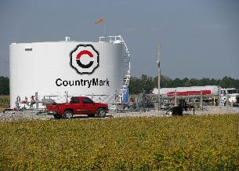
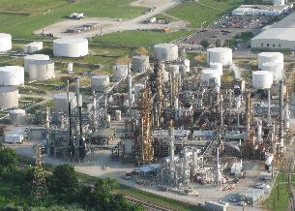
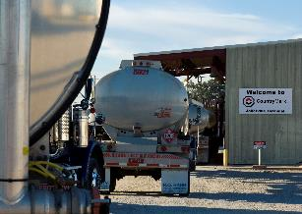
CountryMark at a glance

Slide 3

CountryMark Management System
“We will become the industry benchmark for how we work”

Slide 4

Workplace Excellence Pathway
Current Process
Target Process
Step Definitions, Quick Reference Guides, RACI Chart, Audit Card
Process Approval
Employee Training
Quarterly Process Audits

Slide 5
Striving to meet our Values
Reliability Engineering
Refining Operations
Supply Chain
Work Management
Regulatory Compliance
Safety
Safety
Human Resources
Quality
Marketing
Finance & Accounting
Project Management
Yield Accounting
Strategy & Optimization
Management Systems
Supply
Information Technology
Product Distribution
Division Order
Equipment & Lubes
Crude Gathering
Production
Turnaround Management
Excellence, Quality, Improvement, Innovation, Integrity, & Reliability

Slide 6
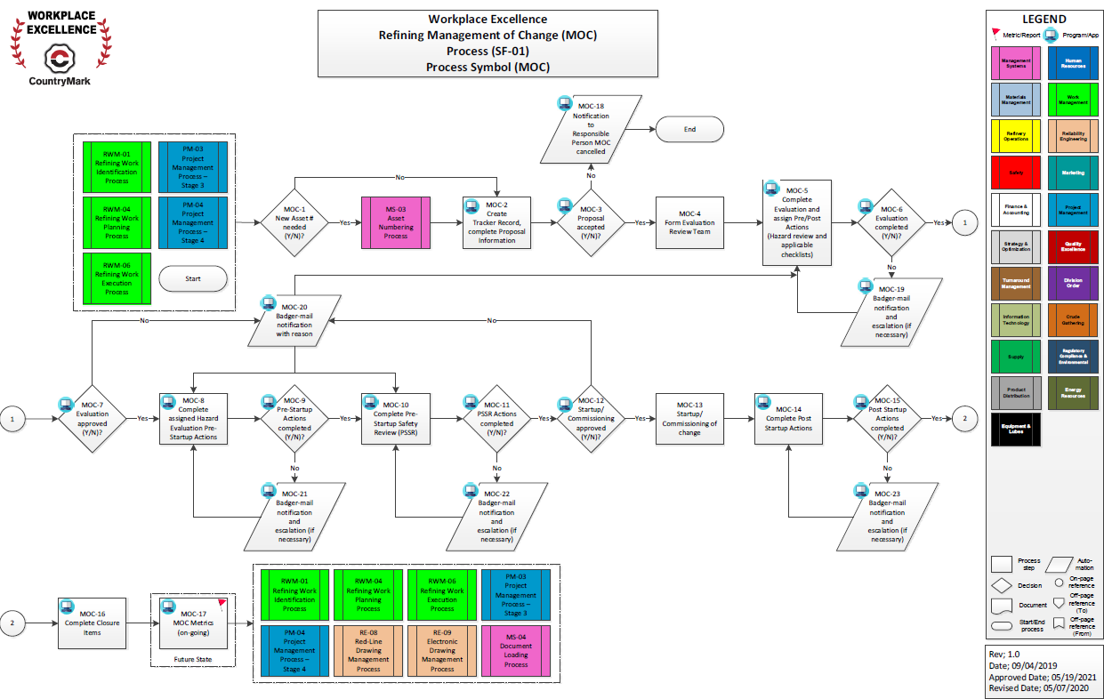
Refining PSM Management of Change

Slide 7
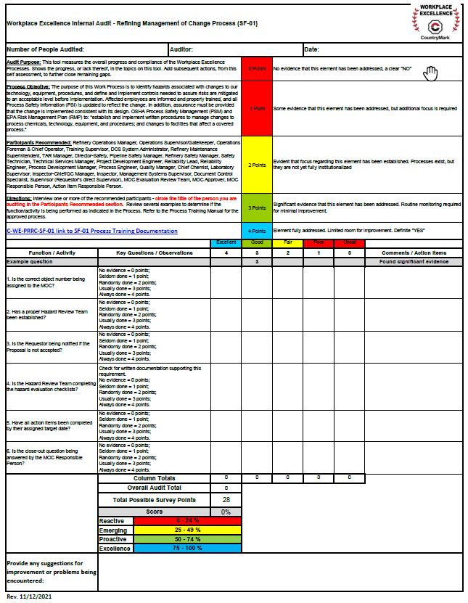
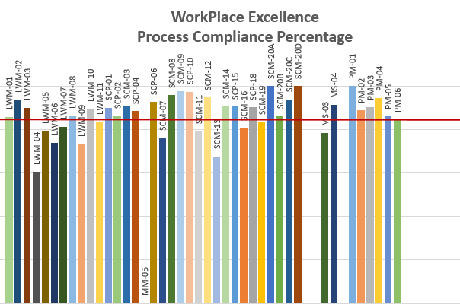
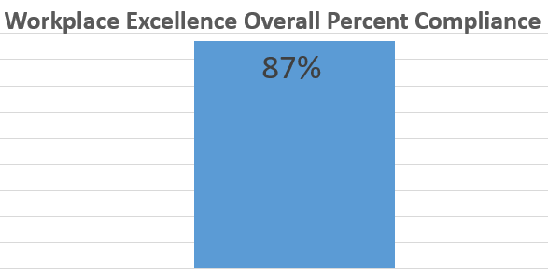
Process Compliance

Slide 8
Workplace Excellence Library
Workplace Excellence Home

