Slide 1
Sustainability Metrics for Small Molecule Development
Abe Schuitman, Process Development Engineering Team Leader
Purdue Process Safety & Assurance Center (P2SAC)
December 2021

Slide 2
Sustainability in Small Molecule Development
Corteva 2030 Sustainability Goals
Tools used in Process Development
Sustainability Scorecard – Why is this important?
“If you can’t measure it, you can’t fix it” (i.e. know if we’re winning or losing)
Data driven decision making – compare/contrast/select
Partnership & Opportunities

Slide 3
https://youtu.be/m2Z8lFp2rCQ
Notes:
TALKING POINTS:
Our 2030 sustainability goals create a sustainable future.
Building trust is critical to agriculture’s long-term success. Trust with consumers, external stakeholders, and customers.​
​
Farming is full of uncertainty. Making long-term sustainability investments today reduce risk and help anticipate and react to economic, social, environmental, and regulatory changes.​
​
Sustainability grows demand by increasing business growth, and opening up new markets for our customers and for us. It drives innovations to increase yield, optimize inputs, and expand the solutions we offer to farmers.​
​

Slide 5
R&D Sustainable Innovation
Every newly developed Corteva Agriscience innovation from our pipeline will meet our sustainability criteria by 2025
Sustainability assessed and tracked at every stage and applies to all pipeline projects.

Slide 6
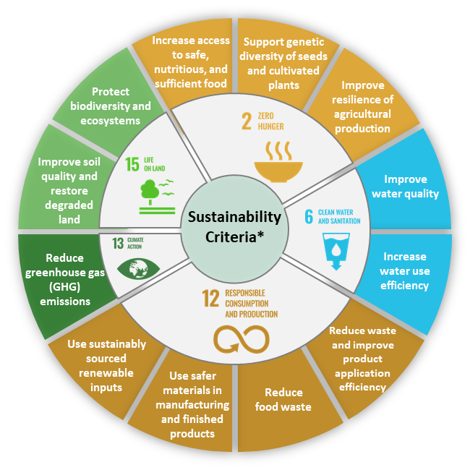
Sustainable Innovation Criteria
* Meets baseline requirements, delivers at least one notable sustainability advantage, so that our portfolio maintains the level of performance for all other sustainability criteria across the life cycle (product and packaging) compared to a current Corteva product it would replace (or equivalent).

Slide 7
Corteva Tools/Process During Discovery & Development Phases
Sustainability Scorecard
Route Selection
Continuous Improvement.
Guide Research
Make Decisions
Drive Holistic Process Improvements
Leading Indicators

Slide 8
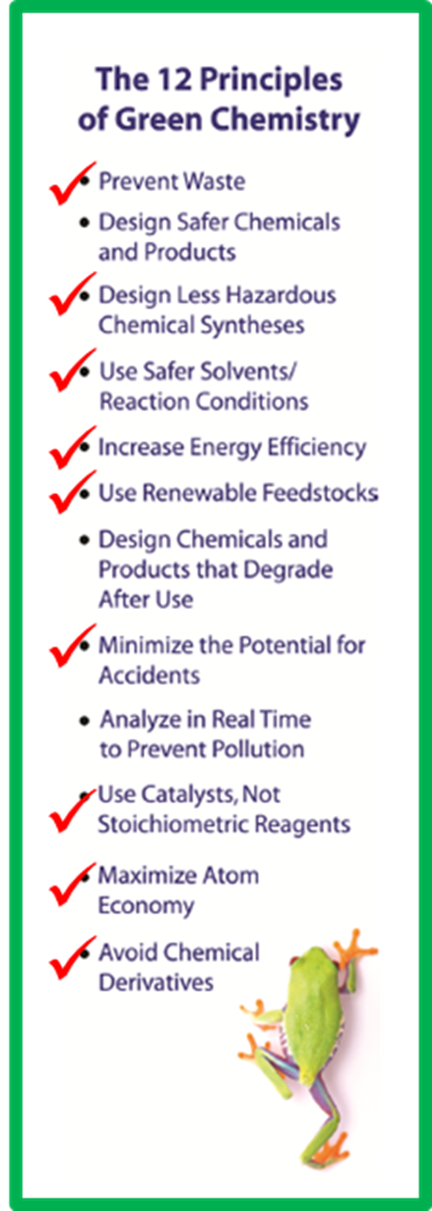
Scorecard: Sustainable Active Ingredient Manufacture
Metrics align to American Chemical Society Green Chemistry principles
Seven categories prioritize and guide research:
Process Mass Intensity:
minimize waste and maximize atom efficiency
Solvents:
use benign “green” solvents
Toxicity:
avoid highly toxic chemicals
Energy Release Potential:
avoid highly energetic chemistries
Temperature Range:
minimize energy input during processing
Metals:
minimize use of heavy metals & transition metals
Renewable Content:
use renewable (non-petroleum) feedstocks
Notes:
For the teams that develop the technology for AI manufacture, sustainability objectives are built upon the 12 Principles of Green Chemistry as defined by the American Chemical Society.
Teams track seven criteria to guide and prioritize research. Those criteria are summarized on this slide along with one example of a radar plot that helps illustrate areas of opportunity as compromises are made in designing robust and cost-effective manufacturing technology.

Slide 9
Sustainability Scorecard Example (Stage 0-1): Higher Score is Better
**Industrial standard
**Relevancy in R&D and manufacturing
Sustainability Category |  | Score
Process Mass Intensity |  | 15
Solvent Selection |  | 9
Toxicity of worst substance |  | 15
Reactive Chem |  | -10
Temperature range |  | 7
Precious metals |  | 16
Total Score |  | 43
☑
Route A
Higher PMI
Eliminated Precious Metals
Sustainability Category |  | Score
Process Mass Intensity |  | 30
Solvent Selection |  | 9
Toxicity of worst substance |  | 15
Reactive Chem |  | -10
Temperature range |  | 7
Precious metals |  | -10
Total Score |  | 41
Route B
Lower PMI
Usage of Precious Metals

Slide 10
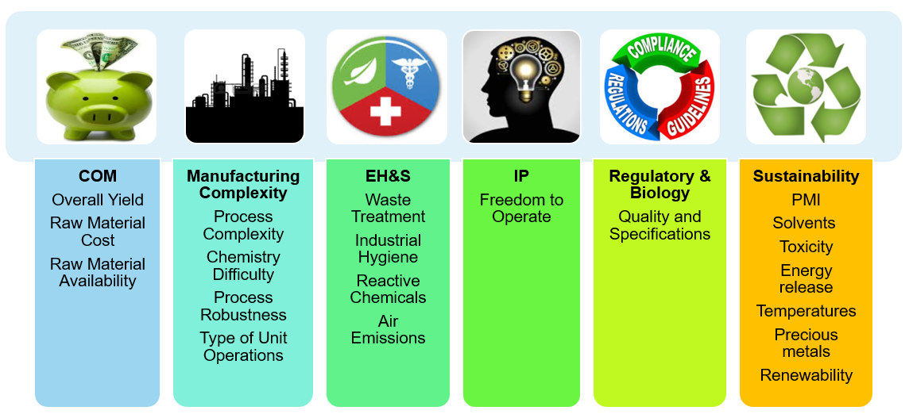
Route Selection Criteria
Route Selection

Slide 11
Route Selection Criteria and Correlation
Route Selection
Can the project team achieve the business objective with the routes under consideration?
COM (Cost of Manufacturing) trends with Sustainability indicators:
PMI
Reductions
~
Lower
COM
Safer
Rx Chem
~
Lower
COM
Eliminate
Precious
Metals
Improved
Tox
~
Lower
COM
~
Lower
COM

Slide 12
Route Selection Criteria – Manufacturing Complexity
Challenging questions centered on the ability for the selected chemistry to translate into process
Specialty equipment requirements that could limit where production can take place
High level ‘fit’ into envisioned manufacturing assets

Slide 13
Route Selection Criteria – EH&S
All waste is not created equally (go beyond a singular PMI #)
More details process information allows for a more thorough comparison (organic/aqueous/solid)
“Show-stopping” issues regarding waste are identified
Detailed discussion conducted with our manufacturing teams and Subject Matter Experts (SME)
Reactive chem analysis complete with key hazards identified
Again, a key focus on “show-stopping” issues has typically been completed
Areas of significant engineering controls also identified

Slide 14
Route Selection Criteria – Sustainability
Green Chemistry #5 - Increase Energy Efficiency
Cryogenic conditions can significantly add to energy consumption
Leng, et al. Org. Proc. Res. Dev. 2012, 16, 415

Slide 15
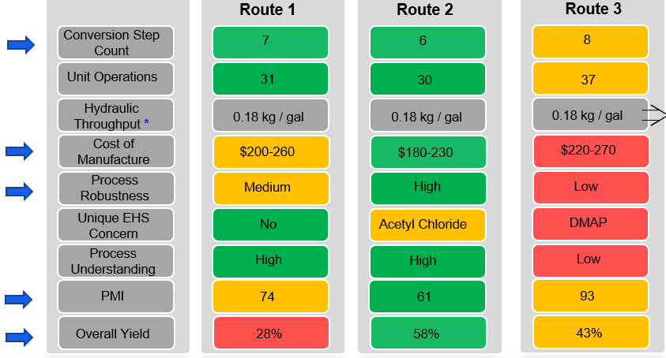
Route Selection (example Stage 3)
☑

Slide 16
Partnerships & Opportunities
Keep/Maintain
P2SAC Partnership (Advisory Board – Expansion into Sustainability)
Academia & Industry partnerships focused on Continuous Improvement & Sustainability
Opportunities (NSF Funding – Industry/Academia)
Catalysis improvements (rational catalyst design)
Process intensification opportunities (Flow/Modular/etc)

Slide 17
Summary
Corteva is actively developing and tracking measurable sustainability parameters
Guide Research
Make Decisions
Drive Holistic Process Improvements
Relevancy in R&D and manufacturing
We look forward to expanding P2SAC further into the sustainability space through collaboration and active participation

