Slide 1


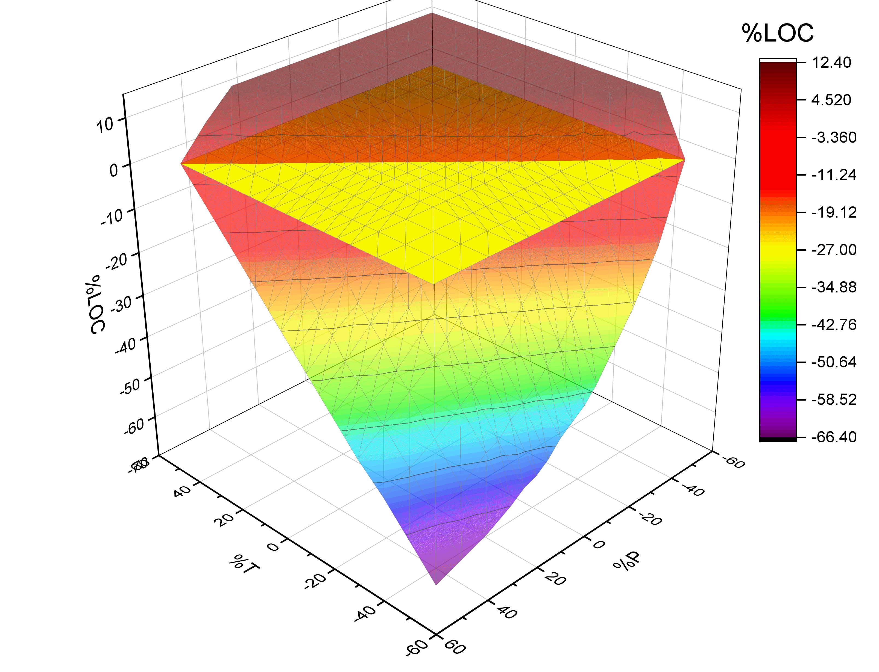
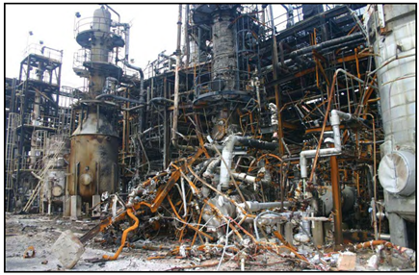
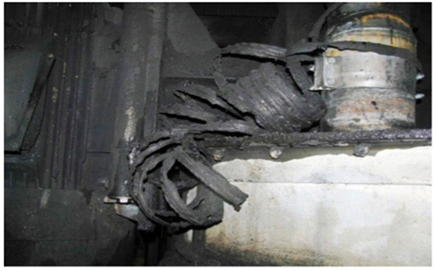
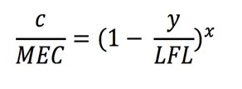

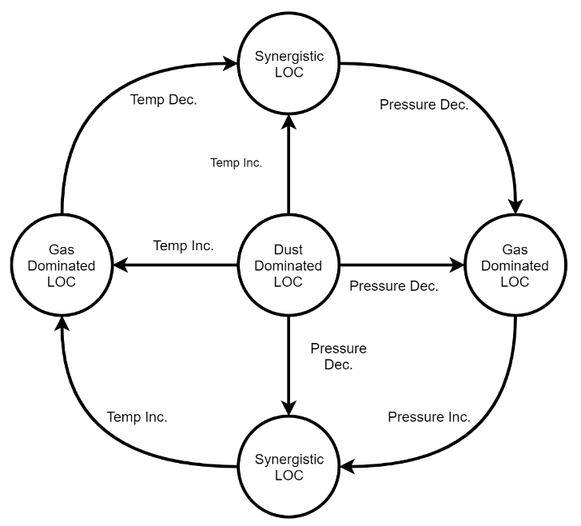
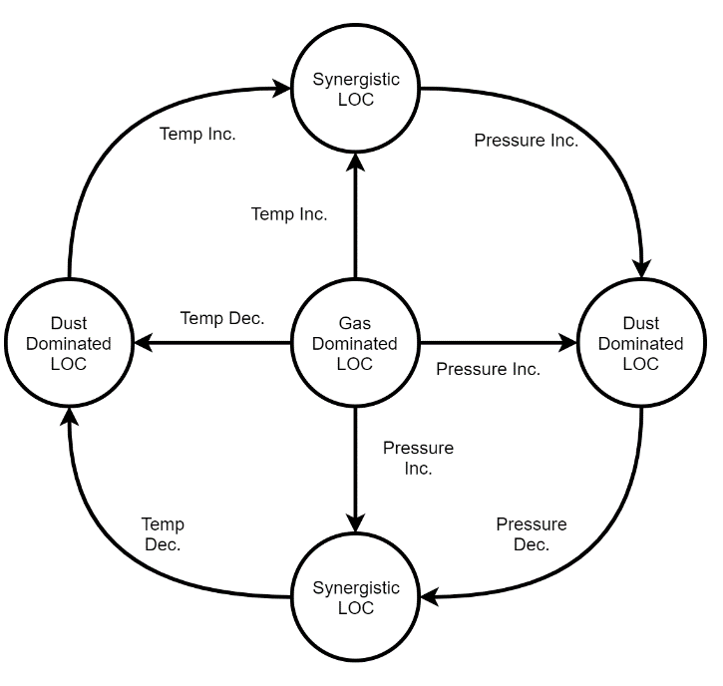

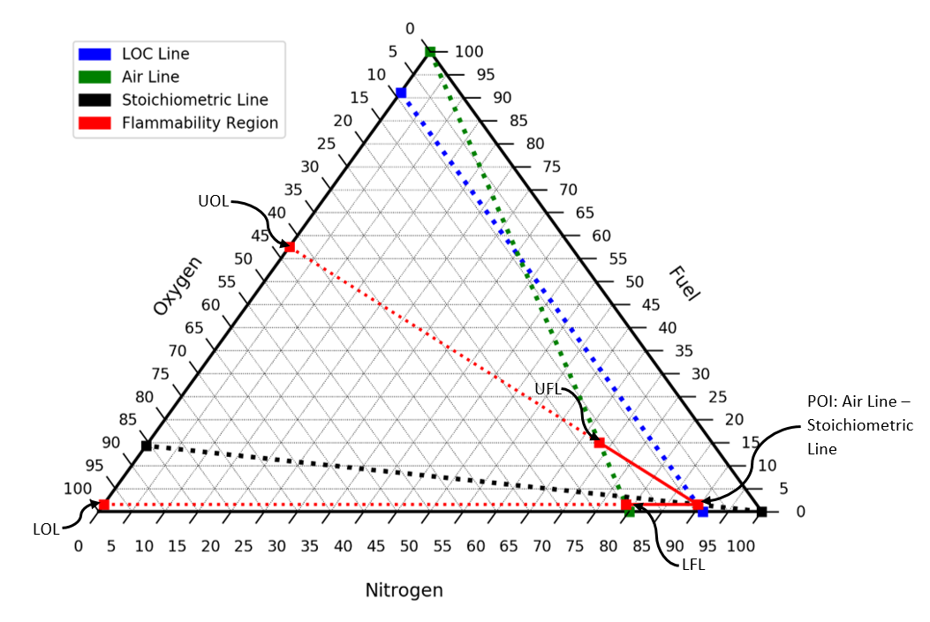


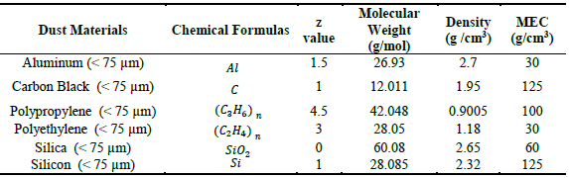
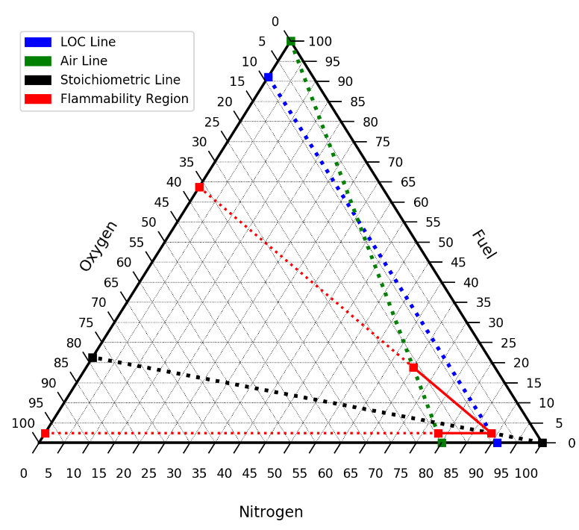
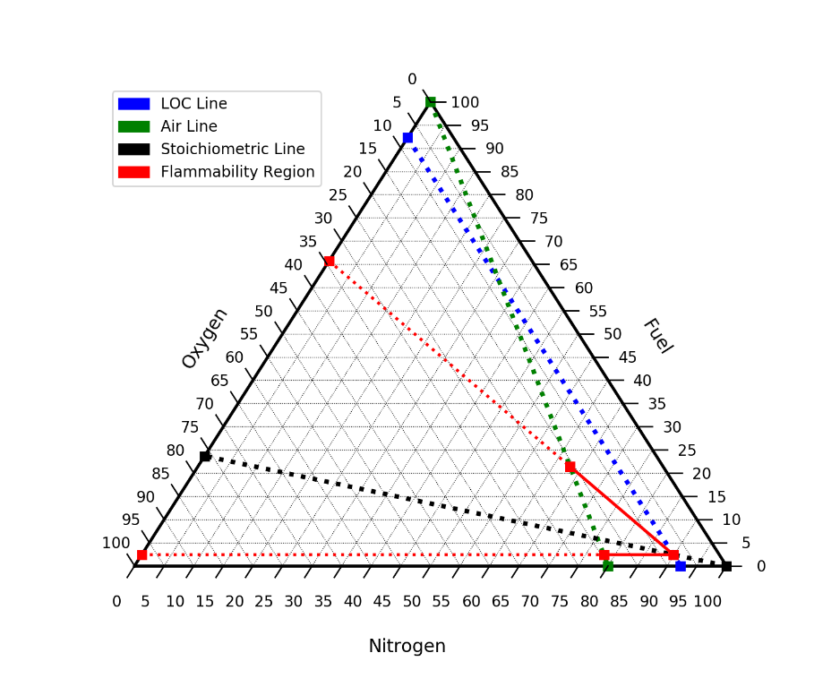
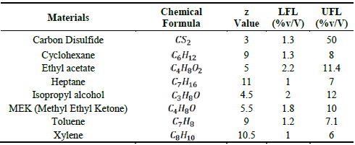

Explosion Analysis for Hybrid Mixtures Containing Dusts
Professional Masters Capstone Project
Zach Batts & Yang Lyu in collaboration with 3M
Motivation
Methodology
Results and Findings
In the chemical industry hybrid mixtures containing flammable gases and combustible dust are common. These mixtures are hazardous and put process and personal safety at risk.
Hybrid Mixture Explosion Examples:
Hybrid mixtures are not understood well because of their synergistic behaviors. By modeling hybrid mixtures engineers can predict potential behavior and design safer processes and operating conditions.
1.) Apply an empirically modified version of Le Chatlier’s Law to determine lower flammability limit of the hybrid mixture
The exponent value is a fitting parameter that has not been derived theoretically
For most accurate result, the exponent value must be found experimentally
Performed sensitivity analysis to understand parameters that affect LOC as a $f(T,P)$
Normalized at 273 K and 1 atm
Analyzed exponential parameter
Plotted flammability diagrams of all 48 hybrid mixture component combinations
Diagrams illustrate Methane-Coal LOC behavior
2.) Perform a stoichiometric balance on a per atom basis of the fuel
Bayer Crop Science, LP.
West Virginia; Aug. 28, 2008
US Ink/ Sun Chemical Corporation
East Rutherford, NJ; Oct. 9, 2012
3.) Visualize Prediction via Flammability Diagram
Using the following correlations
Background Information
Hybrid Flammable Mixtures include flammable dust and gas​
Synergistic phenomenon often occur with hybrid mixtures​
Limiting Oxygen Concentration (LOC): minimum concentration of oxygen necessary for combustion to occur​
Inerting < LOC of gas is the industry standard​
  Is this safe? ​
  Is there a potential for optimization?
Three LOC Trends
Dust Dominated → Ex. C₈H₁₈- Al
Gas Dominated → Ex. C₇H₈-(C₃H₆)_{n}
Synergistic → Ex. C₆H₁₂- C
Empirical Exponent Value
x ≤ 1 → dust or gas dominated
x > 1 → synergistic
MEC α Dust Particle Size → LOC
$$LOL=extrapolation of LFL line$$
Conclusions
$$UOL=extrapolation of UFL line$$
Is it safe to inert to the gaseous LOC? No, not for all hybrid mixture scenarios
Is there the possibility for optimization? Yes, in some hybrid mixture scenarios
Objective/Assignment
Model Validation
Future Work
The goal for this study is understanding the behavior of hybrid mixtures and to determine the threshold limit factor to prevent a hybrid mixture explosion to ensure process safety
Methane- Coal
Predicted LOC of Hybrid Mixture : 7.8% - 11.1%
Experimental LOC of Hybrid Mixture: 7% - 12%
Methane- Cornstarch
Predicted LOC of Hybrid Mixture: 8.9% - 10.8%
Experimental LOC of Hybrid Mixture: 9% - 11%
More experimental data to determine characteristics of materials
- LFL, UFL, UOL, and LOL of gas
- MEC of dust (affected by particle size)
Empirical exponent value
- Run experiments
- Develop a theoretical framework to predict exponent
Future iterations of the model should extend to systems outside of STP
We strongly encourage all engineers to corroborate the model predicted LOC & flammable regions before any process changes or implementation​
Dust Components and their Properties:
Gas Components and their Properties:
References
Crowl, D.; Louvar, J. Chemical Process Safety: Fundamentals with Applications, Third Edition, Third.; Pearson Inc.: Westford, Massachusetts, 2011.
Jiang, J. Study of Dust - Gas Hybrid Mixture Explosions, Texas A&M University, 2015.
Krause, U.; Addai, E. K.; Gabel, D. Determination of the Limiting Oxygen Concentration of Dust/Air and Hybrid Mixtures Based on Thermochemical Properties; 2016. https://doi.org/10.13140/rg.2.1.4293.9127.
Methane- Cornstarch Model Data
Methane- Coal Model Data

