Slide 1
Analysis of Cybersecurity Risks for Proposed Remote CISTAR Facilities
Abhijit Talpade¹, Suddhadeep Sarkar¹, H. M. Leith², Alexis de Alvarez², Colin Armstrong², David Moore², Fabio H. Ribeiro¹ and Ray A. Mentzer^{1,3}
¹Charles D. Davidson School of Chemical Engineering, Purdue University
²AcuTech Consulting Group
³Purdue Process Safety Assurance Center (P2SAC), Purdue University
May 14, 2021

Slide 2
Presentation Outline
Purpose of this study
Overall cyber-threat analysis for CISTAR process
Overview of CISTAR process (with assumed controls)
Cyber-enhanced HAZOP study
Critical component analysis
Overall threat statement
Summary, Impacts and Future work

Slide 3
Purpose of this Study – ICS vulnerability
Goal of CISTAR: Design local, modular and highly networked light hydrocarbon processing facilities, operating remotely
Remote operations involve the use of Industrial Control Systems (ICS) to enable control over the operations
ICS components could be subject to attack by a variety of threat vectors: Cyber, Sabotage, Disgruntled Employee, Terrorism, Vandalism, Theft¹
¹Moreno et al., Process Saf. Environ. Prot. 2018, 116, 621-631

Slide 4
Purpose of this Study – Increase in Cyber Threat
Recent data on industrial cyberattacks indicate an increase in targeted attacks on the energy sector
Kaspersky Lab ICS CERT report suggests 38% of computers cyberattacked in 2019 were in the Oil & Gas sector¹
A March 2018 survey by Siemens and the Ponemon Institute noted that 50% of all cyber attacks in the Middle East target the oil and gas sector²
Research from Hornet Security, a German cloud security provider, identifies energy as the number one target for cyberattacks in 2019, 16% of all attacks worldwide³
The number of known attack groups targeting the energy sector increased from 87 in 2015 to 155 in 2019⁴
CERT – Cyber Emergency Response Team
¹Threat Landscape for Industrial Automation Systems in H1 2020 Kaspersky Lab ICS CERT 2019
²https://www.siemens.com/mea/en/home/company/topic-areas/digitalization/cybersecurity.html
³https://energymonitor.ai/technology/digitalisation/cybersecurity-threats-escalate-in-the-energy-sector
⁴ISTR 2019: Targeted Attack Groups Increase Despite Growing Risk of Exposure, Symantec 2019

Slide 5
Purpose of this Study – Learning from Past Incidents
Colonial Pipeline Attack (2021)¹
On May 7, 2021, hackers attacked the Colonial pipeline holding them at ransomware. This forced the pipeline operators to close down operations and freeze the IT systems. Colonial pipeline provides roughly 45% of the fuel supplies (gasoline, diesel, jet fuel, etc.) for the East Coast. Expected rise in the gasoline prices because of this incident.
¹Osborne, C., https://www.zdnet.com/article/colonial-pipeline-ransomware-attack-everything-you-need-to-know/

Slide 6
Purpose of this Study – Learning from Past Incidents
Colonial Pipeline Attack (2021)¹
On May 7, 2021, hackers attacked the Colonial pipeline holding them at ransomware. This forced the pipeline operators to close down operations and freeze the IT systems. Colonial pipeline provides roughly 45% of the fuel supplies (gasoline, diesel, jet fuel, etc.) for the East Coast. Expected rise in the gasoline prices because of this incident.
Electronic customer communications attack (2018) ²
In April 2018, a cyber attack targeted the electronic customer communications systems at four natural gas pipeline companies, leading to service disruptions and possible economic and data losses¹
Turkish Pipeline Incident (2008)³
In 2008, hackers blew up a section of a Turkish oil pipeline. The control room console indicated normal operation, before a phone call from the field caused the console operator to trigger the alarm. The attackers manipulated not just the DCS parameters but also the CCTV feed to the control room, covering up the actual situation at the site.
Triton (2017)³
Triton was a malware used against a petrochemical plant in Saudi Arabia. It allowed the hackers to take over the plant's safety systems remotely, though a flaw in the code allowed the plant to respond before any damage occurred.
DCS – Distributed Control System
SIS – Safety Instrumented System
Such incidents demonstrate the importance of designing cyber safe CISTAR facilities
¹Osborne, C., https://www.zdnet.com/article/colonial-pipeline-ransomware-attack-everything-you-need-to-know/
²Malik et al., https://www.bloomberg.com/news/articles/2018-04-03/day-after-cyber-attack-a-third-gas-pipeline-data-system-shuts
³Hemsley, K. E.; Fisher, R. E. History of Industrial Control System Cyber Incidents; 2018

Slide 7
Cyberattack Threat Statement - Methodology
Steps for development of an overall cyberattack threat statement:
Conduct a cyber-enhanced HAZOP analysis for all equipment associated with the CISTAR process
Identify the critical components in the process (high potential cyber risk rating with catastrophic consequences employing safeguards with 1-way/2-way communication for control)
Study previous incidents on these critical components (to guide the future process designers on the cyber threats associated with these components)
Generate an overall cyberattack threat statement for the CISTAR process (study of the threat history, current cyberattack capabilities, possible motivation/intent behind the attacks and the potential actions from these attacks to decide on a cyber threat rating)

Slide 8
Cyberattack Threat Statement - Methodology
Steps for development of an overall cyberattack threat statement:
Conduct a cyber-enhanced HAZOP analysis for all equipment associated with the CISTAR process
Identify the critical components in the process (high potential cyber risk rating with catastrophic consequences employing safeguards with 1-way/2-way communication for control)
Study previous incidents on these critical components (to guide the future process designers on the cyber threats associated with these components)
Generate an overall cyberattack threat statement for the CISTAR process (study of the threat history, current cyberattack capabilities, possible motivation/intent behind the attacks and the potential actions from these attacks to decide on a cyber threat rating)

Slide 9
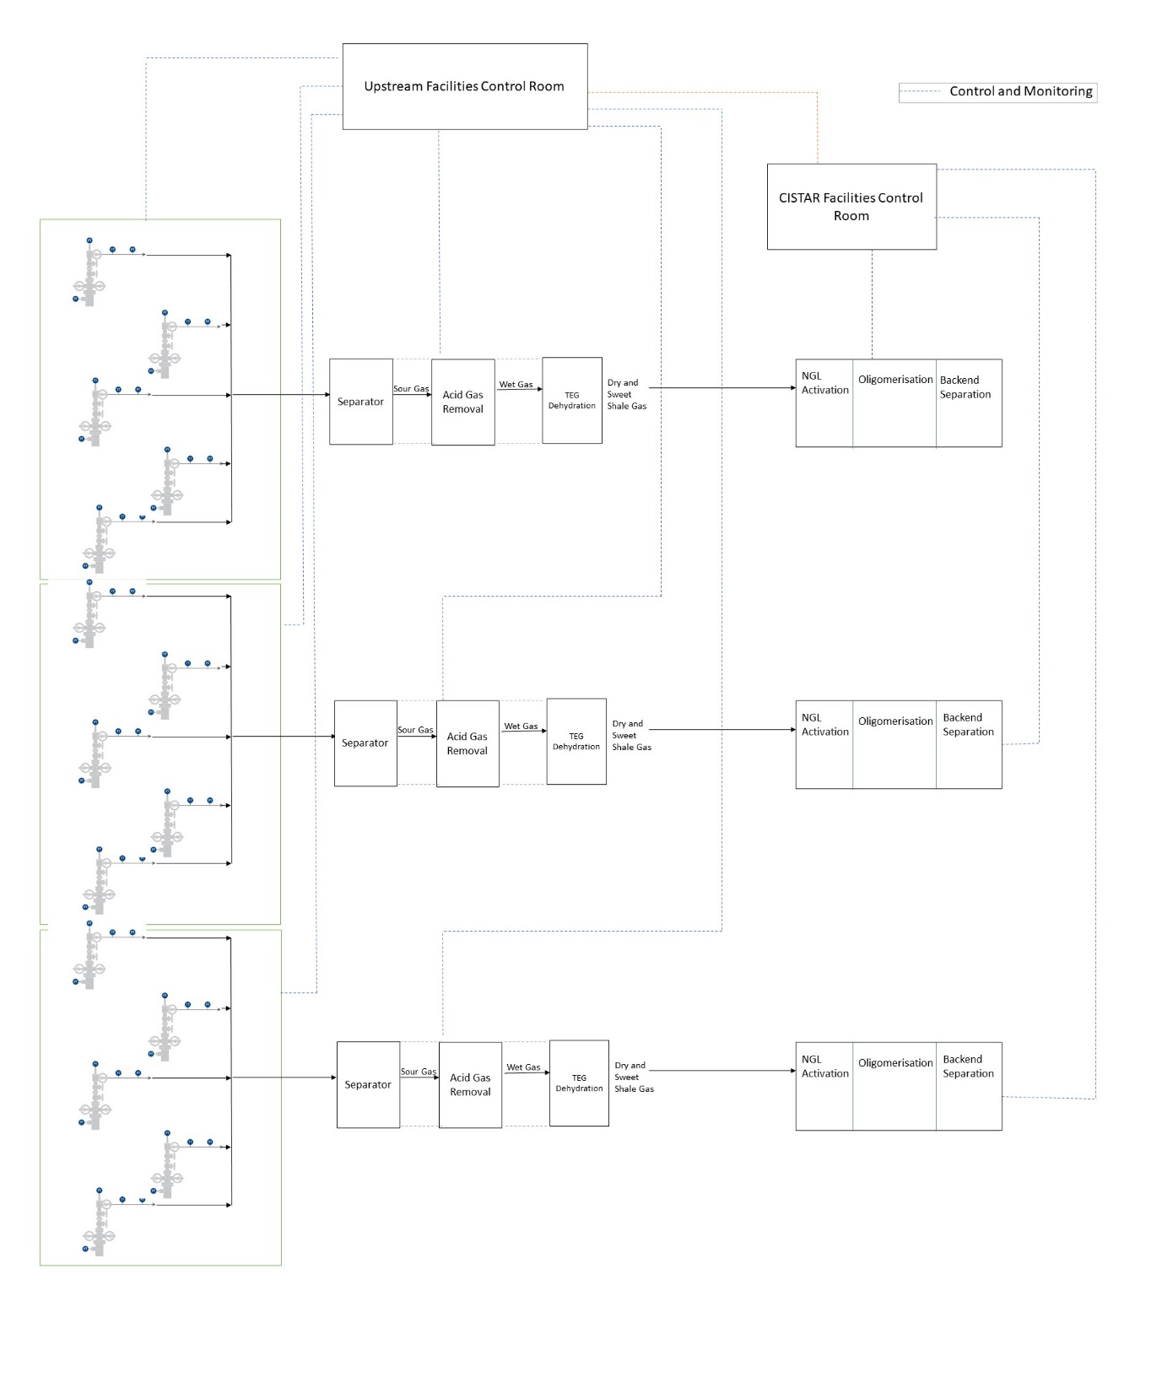
HAZOP Analysis of CISTAR Process – Process Schematic
Shale gas withdrawn from the wellheads undergoes a series of separation, acid gas removal and dehydration steps
Dry and sweet shale gas proceeds to the CISTAR complex starting with NGL activation
Wellheads and the upstream facilities are assumed to be controlled independently

Slide 10
HAZOP Analysis of CISTAR Process – Process Schematic
The CISTAR facilities are assumed to be controlled by a separate control room
The focus of this study will be on the CISTAR facilities and its associated control room

Slide 11
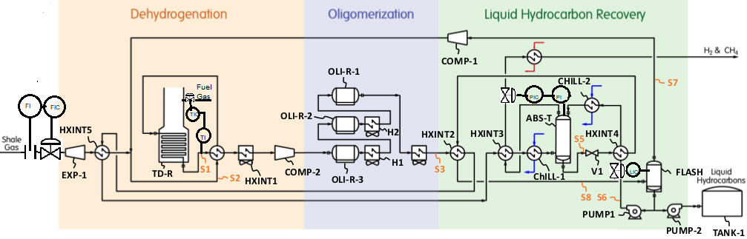
HAZOP Analysis on CISTAR Process - Assumed Controls
CISTAR Process:
Dehydrogenation – Oligomerization – Liquid Hydrocarbon Recovery
Assumed controls/control strategy:
Shale gas flow control only at the inlet to the process (inlet to EXP-1)
Fuel gas flow control to the fired heater connected to the thermal dehydrogenation reactor (TD-R) to control the temperature of the reactor
The exit temperature of the oligomerization reactors (OLI-Rs) controlled by the heat exchanger upstream of the reactor (HXINT-1, H1, H2)
Liquid level control for the day tank (TANK-1) by controlling the inlet flow to the tank
DOL Process with assumed controls
Zewei, C.; Li, Y.; Rodriguez Gil, E. A.; Sawyer, G.; Agrawal, R. Paradigm Shift of Process Hierarchy: A Transformative Intensification Strategy for Small Scale Natural Gas Liquid to Liquid Fuel Process; 2021.

Slide 12
Cyber-enhanced HAZOP Analysis - Terms and Definitions
Term | Description
Potential Cyber Interface | Operational parameters/interface (at the control room) for the equipment vulnerable to cyber attacks
Operational Deviations (Parameter Deviations) | Process parameters that have deviated from the set point (temperature, pressure, etc.)
Possible Cause | The possible equipment or instrumentation cause for the deviation (Assumed that all equipment has inlet / outlet block valves to isolate for maintenance, and these are manually operated)
Failure Scenarios | Scenario description causing the deviation or incident to occur
Possible Incident | Major incidents caused by the deviation (for example, rupture, loss of containment, fire, explosion)
Consequence | Consequences (damages/operational issues) caused by the incident
Potential Cyber Risk Rating (Unmitigated) | Potential risk level to the safe operation if cyber attack occurs (without any safeguards in place)
Potential Safeguards | Suggested instrumented/mechanical/procedural safeguards to protect the equipment/system from the described scenario. To be effective, safeguards must not be cyber vulnerable. (Note: Instrumented safeguards implementing two-way remote communications could pose additional threats)

Slide 13
Cyber-enhanced HAZOP Analysis – Example 1
Analysis on Expander EXP-1
Potential Cyber Interface | Shale Gas Inlet Flow
Operational Deviations | High Pressure
Possible Causes | Upstream flow variation or Expander Impeller Failure
Failure Scenarios | Higher pressure downstream of the expander
Possible Incident | No
Consequence | Operational Issues in the TD-R
Potential Cyber Risk Rating (Unmitigated) | Low
Potential Safeguards | High pressure shutdown interlock (Instrumented) (Two-way communication)

Slide 14
Cyber-enhanced HAZOP Analysis – Example 2
Analysis on Oligomerization Reactors, OLI-R-1, OLI-R-2, OLI-R-3
Potential Cyber Interface | Reactor furnace control
Operational Deviations | High temperature
Possible Causes | Irregular reactor furnace operation
Failure Scenarios | High temperature within the reactor leading to potential runaway conditions
Possible Incident | Loss of containment, fire, explosion in the reactor
Consequence | Potential runaway conditions
Potential Cyber Risk Rating (Unmitigated) | High
Potential Safeguards | High temperature alarm and shutdown interlock (Instrumented) (Two-way communication)

Slide 15
Cyberattack Threat Statement - Methodology
Steps for development of an overall cyberattack threat statement:
Conduct a cyber-enhanced HAZOP analysis for all equipment associated with the CISTAR process
Identify the critical components in the process (high potential cyber risk rating with catastrophic consequences employing safeguards with 1-way/2-way communication for control)
Study previous incidents on these critical components (to guide the future process designers on the cyber threats associated with these components)
Generate an overall cyberattack threat statement for the CISTAR process (study of the threat history, current cyberattack capabilities, possible motivation/intent behind the attacks and the potential actions from these attacks to decide on a cyber threat rating)

Slide 16
Identification of Critical Components
Three components identified to be critical for the CISTAR process
Equipment | Potential Cyber Interface | 2-way Instrumented Safeguards | Consequences
Thermal Dehydrogenation Reactor (TD-R) | Pressure Indicator at TD-R, temperature indicator at TD-R, fuel gas inlet flow control valve | High pressure alarm with heater shutdown, High temperature alarm with heater shutdown | Explosion, fire due to loss of firebox
Oligomerization Reactors (OLI-R-1, OLI-R-2, OLI-R-3) | Temperature sensor at OLI-R outlet, fan RPM control | High temperature indicator with alarm and interlock | Loss of containment, fire, explosion due to potential reaction runaway
Product Storage Tank (TANK – 1) | Liquid level sensor, flow control valve | Liquid level indicator with alarm and flow control | Explosion, loss of containment, fire due to tank overfill and release of light hydrocarbon liquid
Critical components: high potential cyber risk rating with catastrophic consequences employing safeguards with 1-way/2-way communication for control

Slide 17
Cyberattack Threat Statement - Methodology
Steps for development of an overall cyberattack threat statement:
Conduct a cyber-enhanced HAZOP analysis for all equipment associated with the CISTAR process
Identify the critical components in the process (high potential cyber risk rating with catastrophic consequences employing safeguards with 1-way/2-way communication for control)
Study previous incidents on these critical components (to guide the future process designers on the cyber threats associated with these components)
Generate an overall cyberattack threat statement for the CISTAR process (study of the threat history, current cyberattack capabilities, possible motivation/intent behind the attacks and the potential actions from these attacks to decide on a cyber threat rating)

Slide 18
Critical Component Incident History
Studying previous cyber incidents for the three critical components
Incident | Short Description
Flow controller
Florida water treatment facility¹ | The computer system was compromised and used to send instructions to the ICS, changing NaOH levels.
Maroochy water services breach² | Disgruntled employee used proprietary equipment to mimic a field controller and send malicious commands to other controllers over radio and compromising the system.
Temperature controller
Industrial heating system attack³ | Heating and fire detection system was compromised as the control box was directly connected to the internet.
German Steel Mill Attack² | Heating and fire detection system was compromised as the control box was connected to the business network. Safe shutdown was also hampered leading to massive damage.
Pressure controller
Triton attack (malware targeted for Triconex safety controller)⁴ | Triton, which was named for the Triconex safety controller model that it targeted, malware attack against a petrochemical plant in Saudi Arabia. The malware allowed the hackers to take over the plant's safety systems remotely, though a flaw in the code allowed the plant to respond before any damage occurred.
Turkish oil pipeline⁵ | Hackers manipulated the operating parameters, as well as prevented the pressure alarm from going off.
¹Henriquez, M. https://www.securitymagazine.com/articles/94552-hacker-breaks-into-florida-water-treatment-facility-changes-chemical-levels
²Hemsley and Fisher, History of Industrial Control System Cyber Incidents 2018
³Goodin, D. https://arstechnica.com/information-technology/2012/12/intruders-hack-industrial-control-system-using-backdoor-exploit/
⁴Giles, M. https://www.technologyreview.com/2019/03/05/103328/cybersecurity-critical-infrastructure-triton-malware
⁵Bogle, A. https://slate.com/technology/2014/12/bloomberg-reports-a-cyber-attack-may-have-made-a-turkish-oil-pipeline-catch-fire.html#:~:text=In 2008%2C two years before,Baku-Tbilisi-Ceyhan pipeline

Slide 19
Cyberattack Threat Statement - Methodology
Steps for development of an overall cyberattack threat statement:
Conduct a cyber-enhanced HAZOP analysis for all equipment associated with the CISTAR process
Identify the critical components in the process (high potential cyber risk rating with catastrophic consequences employing safeguards with 1-way/2-way communication for control)
Study previous incidents on these critical components (to guide the future process designers on the cyber threats associated with these components)
Generate an overall cyberattack threat statement for the CISTAR process (study of the threat history, current cyberattack capabilities, possible motivation/intent behind the attacks and the potential actions from these attacks to decide on a cyber threat rating)

Slide 20
Cyber Threat Statement
Threat | Cyberattack
General Threat History | Previous cyberattacks like Triton, Turkish Oil Pipeline incident, Maroochy water services breach, etc. have focused on targeting ICS components to cause significant physical and economic damage.
Specific Threat History | No history at proposed CISTAR facility
Capability | Severe physical damage can be inflicted by cyber-attacks on the pressure controller (across TD-R), temperature controller (across TD-R and OLI-reactors) and the flow controller (TANK-1)).
Motivation/ Intent | Sophistication of cyber criminals is out stripping the ability to effectively counter the attacks, resulting in increased malicious events, loss of data and physical damage.
Potential Actions | Malicious intent, personal enrichment, political or religious motivation.
Overall Assessment | The exposure to these proposed small remotely operated gas processing plants assets by cyberattack was evaluated by the team and determined within the next 10 years that the cyber-attack potential on these facilities is a ‘Medium’ threat
Threat Ranking | Medium
Similar assessment can be repeated for other threat vectors (Theft, Vandalism, Terrorism, etc.)

Slide 21
Summary
Cyber-enhanced HAZOP analysis was conducted on the CISTAR Process
Performed on all equipment associated with the process
All safeguards were classified based on the communication type (Local SIS, 1-way or 2-way)
Three potential cyber interfaces were identified to be critical
The temperature and pressure controllers on the alkane dehydrogenation reactor (TD-R)
The temperature controller on the oligomerization reactors (OLI-R-1/2/3)
The level controller of the product tank (TANK-1)

Slide 22
Summary
Past cyber incidents related to these controllers were studied to understand their cyber-vulnerability and guide design of additional safeguards
Temperature control: Triton malware attack, German steel mill attack^{1,2}
Pressure control: Triton malware attack, Turkish oil pipeline breach^{1,3}
Flow control: Maroochy water services breach²
Overall cyberattack threat statement generated
CISTAR process threat ranking: Medium
¹Giles, M. https://www.technologyreview.com/2019/03/05/103328/cybersecurity-critical-infrastructure-triton-malware
²Hemsley and Fisher, History of Industrial Control System Cyber Incidents 2018
³Bogle, A. https://slate.com/technology/2014/12/bloomberg-reports-a-cyber-attack-may-have-made-a-turkish-oil-pipeline-catch-fire.html#:~:text=In 2008%2C two years before,Baku-Tbilisi-Ceyhan pipeline

Slide 23
Impacts and Future Work
Impacts
Cyber-enhanced HAZOP study can identify critical components associated with the process (high cyber risk components with catastrophic consequences)
Procedure/methodology outlined for studying the overall threat assessment can help future CISTAR engineers to identify cyber threats following final design of the process or control strategy employed
Guide the CISTAR design engineers on the choice of high-risk components (decision on make & type of controllers based on incident history)

Slide 24
Impacts and Future Work
Future
Study of individual threat vectors to understand their risk potential
Study of communication modes (wired/wireless) and communication protocols (Modbus, DNP3, IEC 61850) to identify additional cyber threats and safeguard design
Study of different control strategies and how they impact the overall risk

Slide 25
Thank You!
Questions?

