Slide 1
Process Safety Deliverables for Projects
December 6, 2023
Tim Hoff
EMTEC Process Safety Engineering - Projects SME

Slide 2
Tim Hoff Bio
ExxonMobil Process Safety SME for Global Projects
B.S. in ChemE from Purdue University (2001)
Variety of roles within EM
Project Development, Process Design, and Execution/Start-up
Senior Operations Engineer for Alkylation and Light Ends Fractionation
Site Process Safety Engineer
Technical Process Safety Lead for Northeastern Operating Sites

Slide 3
Why Do We Even Do Projects?
Projects are critical to enable continued safe and profitable operations
Meet new or updated regulations
Reduce residual risk
Maintain facilities to retain profitability
Build for new ventures/opportunities
Projects vary greatly in cost and scope and hazards
Installation of a new fume hood in a lab (6 months)
Development and construction of a $4B chemical production facility (5-7 years)
External pressures abound to complete projects in the most cost-effective and efficient means available

Slide 4
General Project Management System

Slide 5
2022 ExxonMobil Project Arrow – Gates & Check Points
Objectives of Gates and Check Points
Gate 1 – Determine where a business opportunity or need should be pursued and alternatives developed in Stage 2
Gate 2 – Decide if optimum concept has been selected and delineated from a business and project management perspective (“go / no-go” decision)
CP1 – Confirm that the optimization of the scope of the project has been completed and that FEED is ready to be commenced
Gate 3 – Support readiness for Appropriation and advancement to Execution. Decide if the project is acceptable from a business and project management perspective.
CP2 – Confirm that the construction of the project is ready to be commenced
CP3 – Confirm that the project is ready to proceed to Startup and turnover to Operations

Slide 6
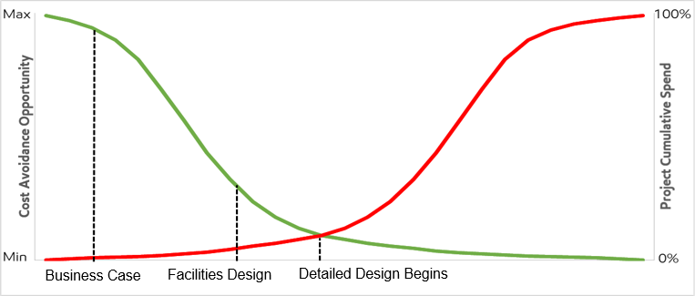
Late Scope Change Can Be Painful
Hazards or major risks identified later in a project’s life cycle can be costly to mitigate
Late scope change can lead to major execution delays or redesign of equipment in production stage
When is the right time to complete process safety reviews?
Too early, not enough definition
Too late, major cost/execution concerns

Slide 7
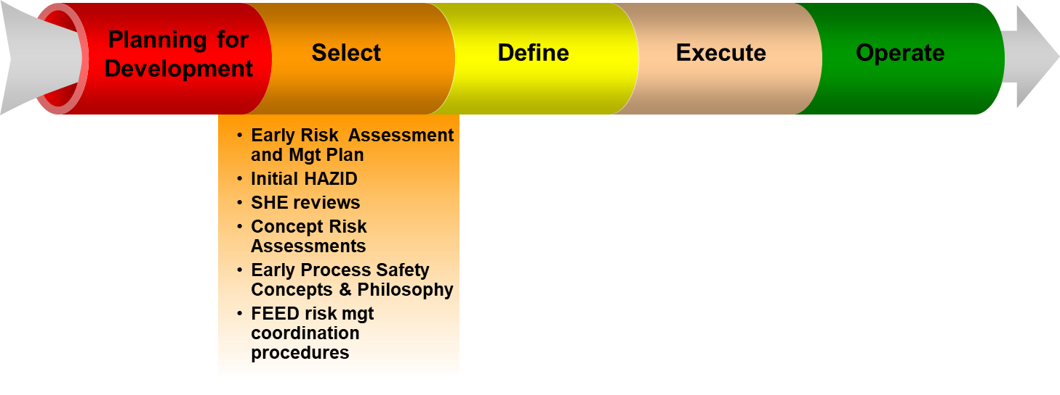
Process Safety Deliverables – Selection Stage
Assignment of process safety engineer to project teams
Development of risk management plan
Outlines processes and studies to identify, analyze, manage, and accept discovered risk in a project
Key Selection Stage Process Safety Reviews:
HAZID/ISHER/SHE Review
Preliminary Safety Relief Reviews
Early Facility Layout and Building Siting Reviews

Slide 8
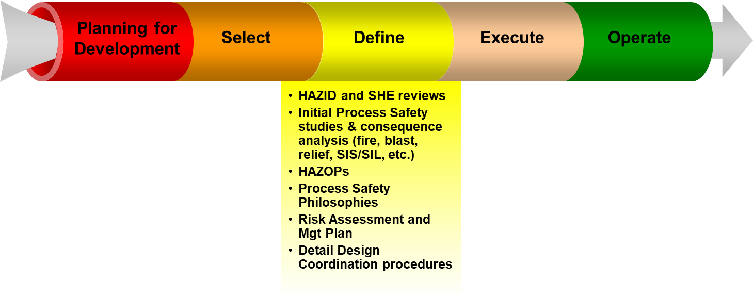
Process Safety Deliverables – Definition Stage
Update risk management plan
Facility Layout and Building Siting study
Consequence/Dispersion/Fire and Explosion Hazard analyses
FEED PHA
Preliminary SIL assignment and verification
FEED Safety Relief review and verification
Design and preliminary construction risk assessments

Slide 9
Process Safety Deliverables – Execution Stage
Finalize risk management plan
EPC PHA
Final SIL assignment and verification
Evacuation, Escape, and Rescue validation
EPC Relief, Flare, and Blow Down System Design report and verification
Update Facility Layout and Building Siting study
Model Reviews (30/60/90)
Pre-Startup Safety Reviews (PSSR)
Formal handover of Risk Assessments/Register and Process Safety Studies to Operations

Slide 10
Questions?

